Slide 2
Learning Objectives
Apply JavaScript rules for functions, declarations, return values, function calls, scope of reference, and local/global variable reference
Write JavaScript functions with the proper structure
Build a GUI that contains functions, analogous to the Memory Bank Web page
Explain how computers generate random numbers

Slide 3
Anatomy of a Function
Functions are packages for algorithms
They have three parts:
Name
Parameters
Definition
These three arts form the function declaration

Slide 4
Pick a Name
name is the identifier for the function
It is common to use it to describe what the function does
Try to pick a name that is meaningful
function <name> ( <parameter list> ) { < statement list> }

Slide 5
Pick a Name
In JavaScript function names follow the rules for identifiers:
They begin with a letter, use any mix of letters, numbers, and underscores (_), avoid reserved words
Programming languages have a standard form for writing function declarations
function <name> ( <parameter list> ) { < statement list> }

Slide 6
Pick a Name
Look at the punctuation:
Parentheses always follow a function name
Curly braces should be positioned should be placed where they are obvious
Programmers place them as shown so that everyone knows where to find them
function <name> ( <parameter list> ) { < statement list> }

Slide 7
Parameters
The parameters are the values that the function will compute on
They are the input to the function
In order for the statements of the algorithm to refer to the input values, the inputs are given names
The <parameter list> is simply a list of names for the inputs separated by commas

Slide 8
Parameters
Parameter names follow the usual rules for identifiers in all programming languages
When writing our algorithm statements, the parameters are like normal variables
Unlike normal variables, parameters begin with a defined value and they don’t have to be declared

Slide 9
Function Definition
The function definition is the algorithm written in a programming language.
A function definition follows the language’s general rules for program statements
In the function definition there must be a way to say what the result is
JavaScript uses the statement return <expression>

Slide 10
Function Definition
How do you get an answer from the function?
It must be called
Calling a function is asking the computer to run or execute the statements of the function to produce the answers
Simply write the function’s name and put the input values in parentheses after it

Slide 11
Function Definition
To test the function, a little Web page needs to be created to host the JavaScript
The Web page:
Begins with the standard HTML
Gives the definition of the function (aka declaring the function)
Computes the result using an alert( ) call

Slide 12
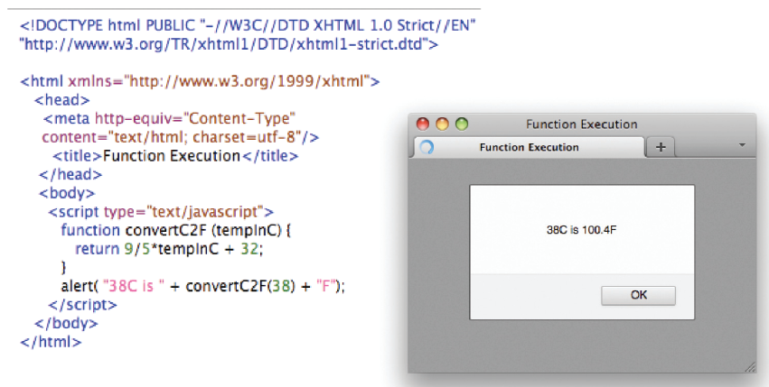

Slide 13
Declaration Versus Call
A function’s declaration is different from its call
Functions are declared only once
It is unnecessary to tell the computer more than once how the function works
For built-in functions we don’t even have to do that much
Some programmer declared alert( ) while writing the JavaScript interpreter

Slide 14
Declaration Versus Call
Functions are typically called many times
The answers they give are needed many times
One declaration, many calls

Slide 15
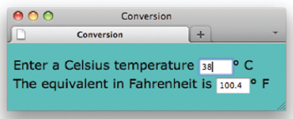
Forms and Functions
Let’s create a Web page for testing our Java Script
Use forms to test the script

Slide 16
Forms and Functions
Recall the following from Chapter 18:
Forms must be enclosed in <form> tags
Text boxes are specified by an <input type="text" . . . /> tag
Text boxes have a name, size, and other attributes
To refer to the value or contents of a text box named tb in the first form of a page, write document.form[0].tb.value
The main event handler of interest is onchange

Slide 17
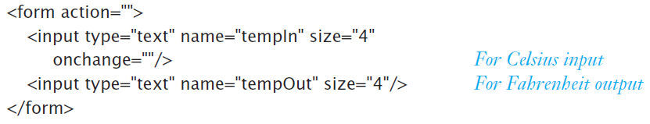
Forms and Functions
The onchange event handler recognizes when a value is entered into the Celsius window (the cursor moved out of the window) and handles it as we direct.

Slide 18
Forms and Functions
The tempIn window is where the Celsius temperature is entered
The tempOut window shows the result
Remember that JavaScript uses the <input . . . /> tag for both input and output

Slide 19

Forms and Functions
handle the onchange event with this function call:
This line says that when the input window (tempIn) is changed, use the value in that window document.forms[0].tempIn.value as an argument to convertC2F() and assign the result to display as the value document.forms[0]

Slide 20
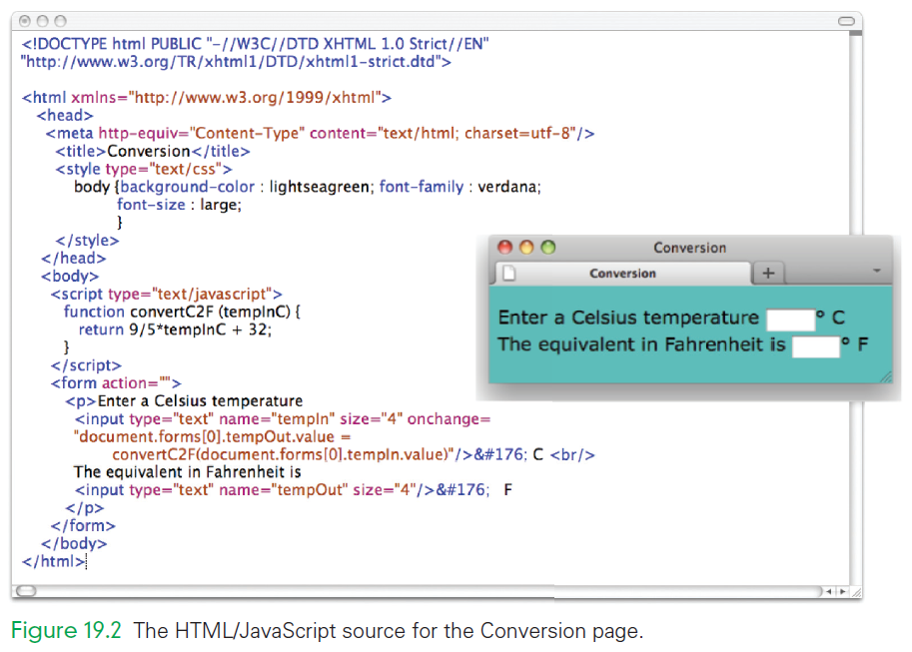

Slide 21
Calling to Customize a Page
There are three ways to get the result of a function call to print on the monitor:
Before the page is created
Interactively after the page is displayed
While the page is being created
Calling functions while the browser is creating the page means pages can be customized on the fly

Slide 22
How a Browser Builds a Page…
The browser begins by reading through the HTML file, figuring out all of the tags and preparing to build the page.
It finds our JavaScript tags
The browser removes those tags and all of the text between them (aka JavaScript)
Then it does what the JavaScript tells it to do

Slide 23
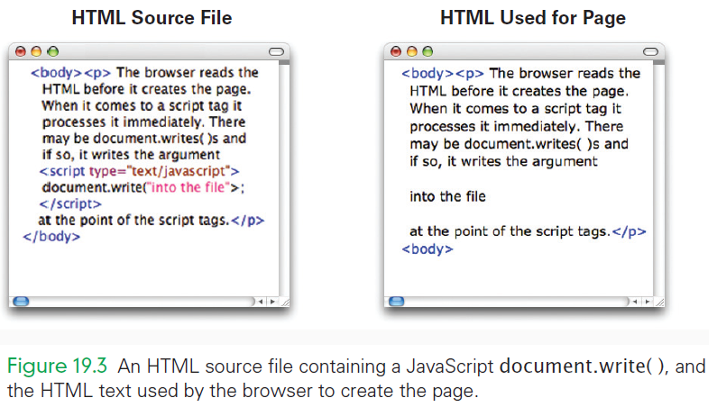

Slide 24
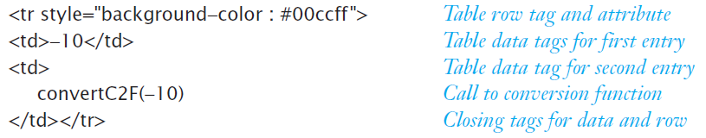
Build the Page on the Fly
In the HTML file, place <script> tags where the table rows go
Using document.write( ) within the JavaScript tags, create the rows of the table
A row will be composed of several components joined or concatenated together

Slide 25
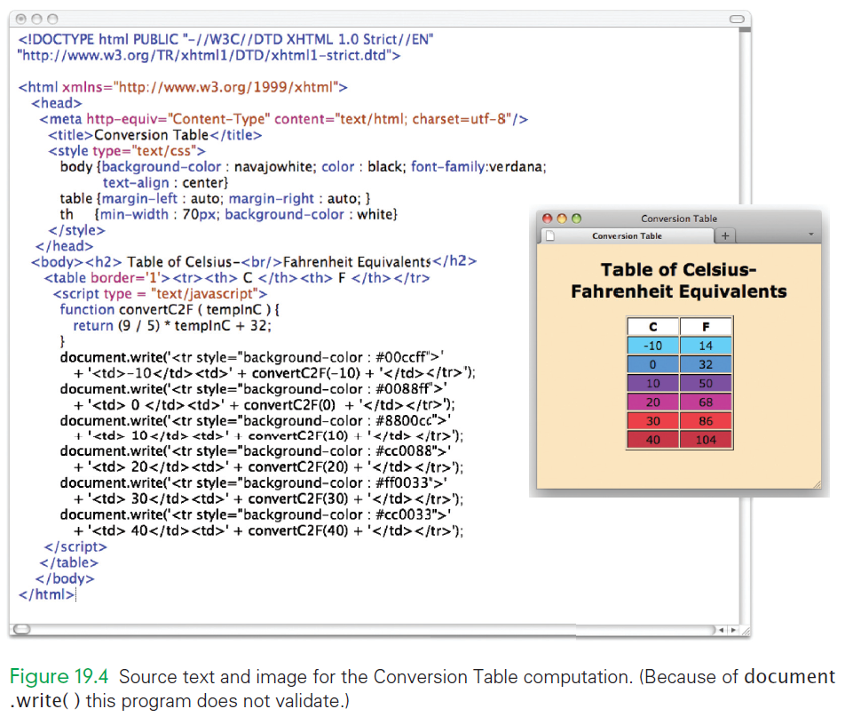

Slide 26
Build the Page on the Fly
Combine the components into a document.write( ) call with the proper quotes and concatenations
document.write('<tr style="background-color : #00ccff ">‘ + '<td>–10</td><td>' + convertC2F(–10) + '</td></tr>' );
All of the rows have a similar structure

Slide 27
Build the Page on the Fly
As the browser is setting up the page, it encounters the script tags
It does what the JavaScript says and calls the document.write( ) functions
The browser must construct its argument using concatenation.
When the browser builds the page, the table is formed from on-the-fly rows

Slide 28
Writing Functions, Using Functions
Flipping Electronic Coins
A coin flip is an unpredictable event whose two outcomes are “equally probable”
A computer could generate a random number between 0 and 1, and round to the nearest whole number
0 could represent tails
1 could represent heads
About half the time the outcome would be tails and the rest of the time it would be heads

Slide 29
Writing Functions, Using Functions
Flipping Electronic Coins
But aren’t computers completely deterministic?
Given a program and its input, isn’t the outcome is perfectly predictable?
They are not random in any way
Computers generate pseudo-random numbers

Slide 30
Pseudo-random numbers
Pseudo-random numbers are an invention of computer science
An algorithm produces a sequence of numbers that passes the statistical tests for randomness.
A sequence of pseudo-random numbers between 0 and 1 has the property that about half are closer to 0 and the others are closer to 1

Slide 31
Pseudo-random numbers
The sequence of items, when rounded to the nearest whole number, behave like a coin flip
You know the algorithm and the starting point, you could predict the sequence
Pseudorandom numbers are believable
In JavaScript the random number generator is called Math.random( )

Slide 32
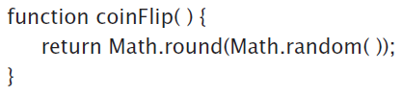
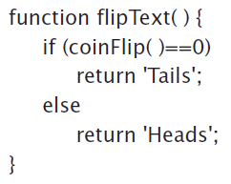
Pseudo-random numbers
When coinFlip( ) is called, it returns with equal probability a 0 or a 1
An obvious improvement would be to return “Heads” and “Tails” rather than numbers

Slide 33
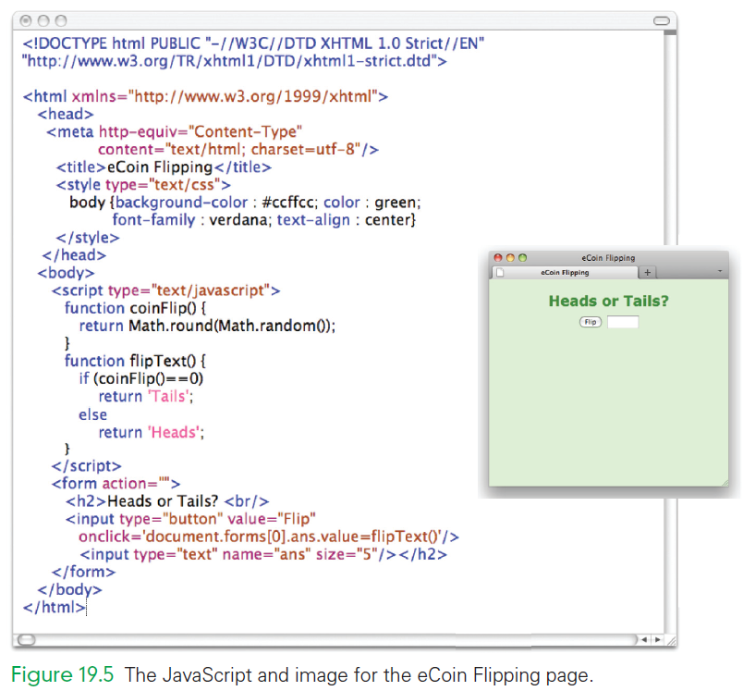

Slide 34
Body Mass Index Computation
Building the BMI will feel similar to creating the Celsius/Fahrenheit program
BMI uses radio buttons to select the English or metric units
Recall that radio buttons are specified with <input . . . /> tags and must be placed within <form> tags

Slide 35
Body Mass Index Computation
The following are additional features of radio buttons:
All related radio buttons share the same name
if when clicking one the other should click off, then they must have the same name.
Radio buttons can be preset by writing checked='checked'.

Slide 36
Body Mass Index Computation
onclick event handlers must also be written for the radio buttons
What should happen when the user clicks the radio button?
Remember the type of units chosen…English or metric?
When the Metric button is clicked, we want scale = "M"; as the response to the click-event

Slide 37
Scoping: When to Use Names
Name scoping
The scope of a name defines how “far” from its declaration it can be used
Every programming language has its own scoping constraints
The general rules for scoping are fairly simple:
Variable names declared in a function can be used only within that function (local variables)
Variable names declared outside any function can be used throughout the program (global)

Slide 38
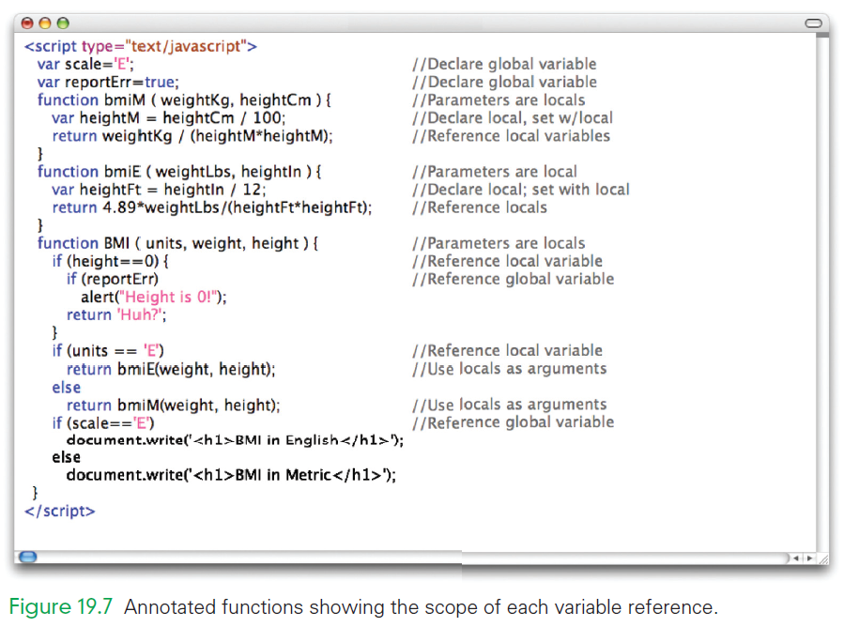

Slide 39
Scoping: When to Use Names
Two global variables, scale and reportErr, are declared at the start of the JavaScript, outside any function
scale and reportErr are referenced inside BMI( ), illustrating that globals can be referenced from inside functions
The only way to figure out the scoping information shown is to notice where the variables are declared and where they are used

Slide 40
Scoping: When to Use Names
Local and global variables behave differently.
Locals come into existence when a function begins, and when it ends, they vanish.
Global variables are around all the time.
If information must be saved from one function call to the next, it must be a global variable

Slide 41
Global/Local Scope Interaction
What if a global variable and a local variable have the same name?
In the example, y is globally declared and can be referenced anywhere.
The same name is declared as a local in the tricky( ) function.
var y=0;
. . .
function tricky (x) {
var y;
y = x;
. . .
}

Slide 42
Global/Local Scope Interaction
They are two different variables
Which y is being assigned the parameter x?
It’s the local y because it is declared in the function’s scope, making it the “closest” declaration
var y=0;
. . .
function tricky (x) {
var y;
y = x;
. . .
}

Slide 43
Math.random( )
Math.random( ) produces a result in the interval [0,1)
Any number (except 1) is possible within those limits (and the limits of the computer)
Multiply Math.random( ) by 2 and the interval over which the random numbers spread to [0,2)

Slide 44
Math.random( )
Generally, multiplying by n expands to the interval [0,n)
The numbers are whole numbers with a decimal fraction
The end point is not possible
If we throw away the decimal fraction, we get whole numbers

Slide 45
Two Reasons to Write Functions
Most functions are general
They are written for a specific application
We hope that we will have a chance to use them again
They are building blocks for future programs
Some function are not building blocks
They must run within a document with a form, and that form must have within it input controls with specific names

Slide 46
Two Reasons to Write Functions
Managing complexity is the other reason to write functions.
The two reasons for packaging algorithms into functions:
Reuse: the building blocks of future programming
Complexity management: keeps our sanity while solving problems

Slide 47
Add a JavaScript Date
JavaScript has a built-in Date( ) function
To add the single line to insert it, place in document.write( ) operation between <script> and </script>
<script type = 'text/javascript'> document.write('<p>' + (Date( ).toString( )) + '</p>');
</script>

Slide 48
Add a JavaScript Date
The date object contains the current date and time in numeric form
The numeric form can be converted to a printable form using toString( )
<script type = 'text/javascript'> document.write('<p>' + (Date( ).toString( )) + '</p>');
</script>

Slide 49
Summary
The following were the main topics of Chapter 19:
The three parts of a function—name, parameter list, and definition—are specified in a function declaration using a standard form.
The function declaration specifies to the computer how the function works, so we give it only once. To use the function requires that we give the function name and its input values, known as arguments.

Slide 50
Summary
The following were the main topics of Chapter 19:
Writing functions packages algorithms, but to get their benefit in JavaScript and HTML requires that we develop Web pages with which we give the inputs to the functions and get their answers displayed.

Slide 51
Summary
The following were the main topics of Chapter 19:
We showed three different ways to display the results of a function
in HTML: using alert( )
interacting with a page that has text boxes
using document.write( ) to include the results of a function while the page is being constructed

