Slide 2
Learning Objectives
Trace the execution of a given for loop
Write a World-Famous Iteration for loop
Discuss the structure of nested loops
Explain the use of indexes
List the rules for arrays; describe the syntax of an array reference
Explain the main programming tasks for online animations

Slide 3
Terminology
Repeat
5 repeats, means you may have done it once followed by 5 more times (the repeats!)
Iterate
5 iterations means that you do it 5 times
Iteration means looping through a series of statements to repeat them
In JavaScript, the main iteration statement is the for loop

Slide 4
for Loop Syntax
for ( <initialization>; <continuation>; <next iteration> ) {
< statement list>
}
Text that is not in <meta-brackets> must be given literally
The statement sequence to be repeated is in the <statement list>

Slide 5
for Loop Syntax
for ( <initialization>; <continuation>; <next iteration> ) {
< statement list>
}
Whole statement sequence is performed for each iteration
Computer completes the whole statement sequence of the <statement list> before beginning the next iteration

Slide 6
for Loop Syntax
for ( <initialization>; <continuation>; <next iteration> ) {
< statement list>
}
Three operations in the parentheses of the for loop control the number of times the loop iterates
Called the control specification

Slide 7
for Loop Syntax
for (j = 1; j < = 3; j = j + 1 ) {
< statement list>
}
Use an iteration variable
Iteration variables are normal variables and must be declared
This example uses j as the iteration variable

Slide 8
for Loop Syntax
for ( <initialization>; <continuation>; <next iteration> ) {
< statement list>
}
<initialization> sets the iteration variable’s value for the first (if any) iteration of the loop

Slide 9
for Loop Syntax
for ( <initialization>; <continuation>; <next iteration> ) {
< statement list>
}
<continuation> has the same form as the predicate in a conditional statement
If the <continuation> test is false outcome, the loop terminates and <statement list> is skipped

Slide 10
for Loop Syntax
for ( <initialization>; <continuation>; <next iteration> ) {
< statement list>
}
If <continuation> has a true outcome, the < statement list> is performed
When the statements are completed, the <next iteration> operation is performed
<next iteration> changes iteration variable

Slide 11
for Loop Syntax
for ( <initialization>; <continuation>; <next iteration> ) {
< statement list>
}
Next iteration starts with the <continuation> test, performing the same sequence of operations
Iterations proceed until the <continuation> test has a false outcome, terminating the loop

Slide 12
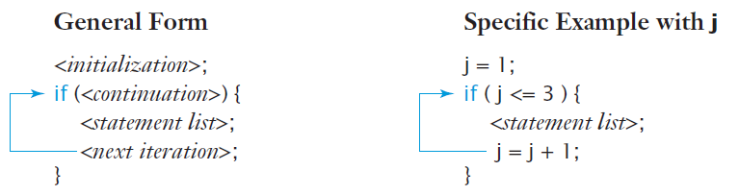
for Loop

Slide 13
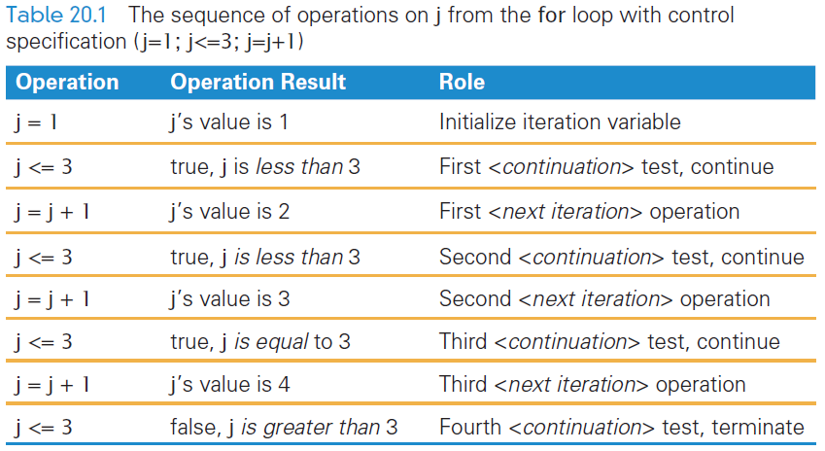
for Sequence

Slide 14
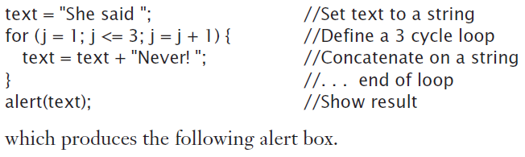
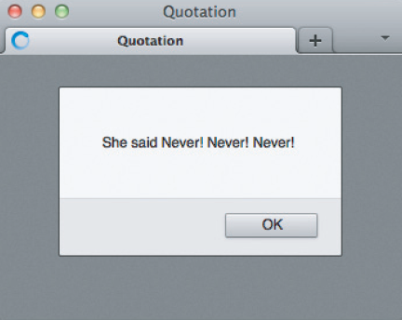
for Example

Slide 15
Iteration Variables
Iteration variables are normal variables, but just used in iteration
They must be declared using the same rules for identifiers
Programmers tend to choose short or even single-letter identifiers for iteration
i, j, and k are the most common

Slide 16
Starting Point
Iterations can begin anywhere
Including with negative numbers: for ( j = −10; j <= 10; j = j + 1) { . . . }
Including fractional numbers: for ( j = 2.5; j <= 6; j = j + 1) { . . . }
j assumes the values 2.5, 3.5, 4.5, and 5.5

Slide 17
Continuation/Termination Test
If you can begin an iteration anywhere, you can end it anywhere
The <continuation> test follows the rules for predicates—the tests in if statements.
The test is any expression resulting in a Boolean value
It must involve the iteration variable

Slide 18
Step-by-Step
<next iteration> also allows considerable freedom
It allows you to specify how big or small the change in the iteration variable
The amount of change is known as the step or step size: j=j+1 j=j+10

Slide 19
Iteration Variable does Math!
iteration variable is often used in computations in the <statement list>
Important that you focus on the values of the iteration variable during the loops
For example: fact = 1; for ( j = 1; j <= 5; j = j + 1) { fact = fact * j; {

Slide 20
WFI!
World-Famous Iteration (WFI)
JavaScript uses the same for loop statement structure as other popular programming languages like Java, C++, and C
Using the form just described for ( j=0; j<n; j++) { . . . }

Slide 21
Infinite Loops ad infinitum
for loops are relatively error free
Still possible to create infinite loops
Think what could go wrong…
Every loop in a program must have a continuation test or it never terminates!
The fifth property of algorithms is that they must be finite or stop and report that no answer is possible

Slide 22
Infinite Loops ad infinitum
for ( j = 1 ; j <= 3; i = i + 1) {
. . .
}
If the test is based on values that don’t change in the loop, the outcome of the test will never change
The loop, then, will never end (note i and j above)

Slide 23
for Loop Practice: Heads/Tails
Let’s use randNum(2) from Chapter 19
It will return 0 (tails) or 1 (heads)
And flip the “coin” 100 times
Use WFI

Slide 24
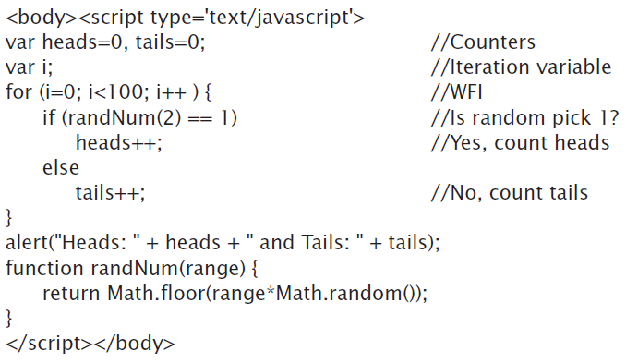

Slide 25
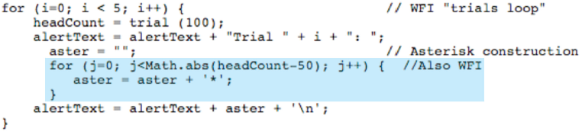
Nested Loops…Loop in a Loop
All programming languages allow loops to nest
Inner and outer loops must use different iteration variables or else they will interfere with each other

Slide 26
Indexing
Indexing is the process of creating a sequence of names by associating a base name with a number
Each indexed item is called an element of the base-named sequence
An index is enclosed in [square brackets] in JavaScript

Slide 27
Arrays [1]
In programming, an indexed base name is called an array
Arrays must be declared
In JavaScript, arrays are declared: var <variable> = new Array(<number of elements>)
Notice that Array starts with an uppercase “A”

Slide 28
Arrays [2]
Variables either are or are not arrays var week = new Array(7);
week is the identifier being declared,
new Array(7) specifies that the identifier will be an array variable.
number in parentheses gives the number of array elements
To refer to an array’s length, we use <variable>.length

Slide 29
Arrays [3]
Rules for arrays in JavaScript:
Arrays are normal variables initialized by new Array(<number of elements>)
<number of elements> in the declaration is just that—the number of array elements
Array indexing begins at 0
Number of elements in an array is its length
Greatest index of an array is <number of elements> − 1 (because the origin is 0)

Slide 30
Arrays [4]
The number in the bracket is called the subscript
Array reference consists of array name with an index [enclosed in brackets]
Value to which the index evaluates must be less than the array’s length
Example:
var dwarf = new Array(7);
dwarf[0] = "Happy";
dwarf[1] = "Sleepy";

Slide 31

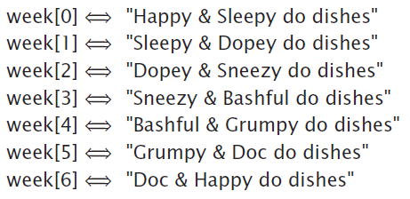
WFI and Arrays
0-origin of the WFI is perfect for 0-origin indexing
Easily allows for iterating through all the values of an array

Slide 32
Animation
Movies, cartoons, etc. animate by the rapid display of many still pictures known as frames
Human visual perception is relatively slow so it’s fooled into observing smooth motion when the display rate is about 30 fps or 30 Hz
Iteration, arrays, and indexing can be used for animation

Slide 33
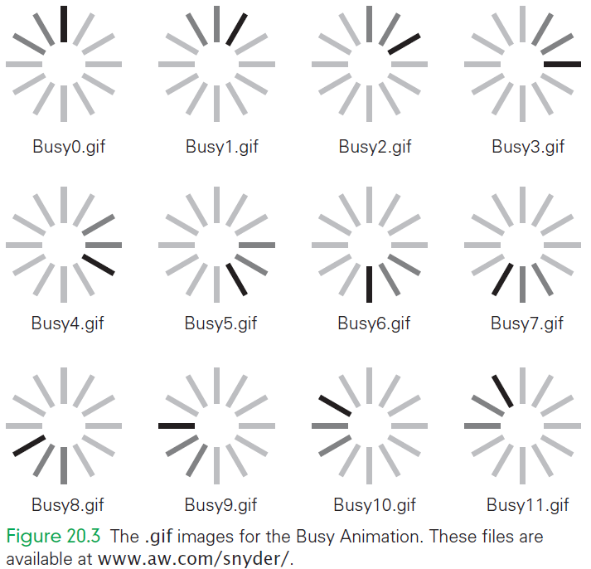

Slide 34
JavaScript Animation
Animation in JavaScript requires three things:
Using a timer to initiate animation events
Prefetching the frames of the animation
Redrawing a Web page image

Slide 35
1. Using a Timer
JavaScript animation will be shown in a Web browser.
Web browsers are event driven:
They sit idle until an event occurs, then they act, and then idly wait for next event…repeat
Doesn’t animation require constant action? (action every 30 milliseconds)
Then, turn the activity of drawing the next frame into an event!

Slide 36
1. Using a Timer
Programmers’ timers typically “tick” once per millisecond
Timers, in JavaScript, are intuitive
The command to set a timer is setTimeout("<event handler >", <duration>)

Slide 37
1. Using a Timer
<event handler > is a “string” giving the JavaScript computation that runs when the timer goes off
<duration> is positive number in milliseconds saying when the timer should go off
the last step for the function must be to set the timer so that it “wakes up” again or the animation will stop

Slide 38
1. Using a Timer
Example:
To display a frame in 30 ms using the function animate( ): setTimeout("animate( )", 30)
30 ms later the computer runs the animate( ) function and displays the frame

Slide 39
1. Using a Timer
Using a Handle to Refer to a Timer
Computer timers can keep track of many different times at once
Computers use special code called handle to identify which timer is being used
timerID is the variable name to handle our timer
timerID = setTimeout( "animate()", 30 );
To cancel our timer: clearTimeout( timerID );

Slide 40
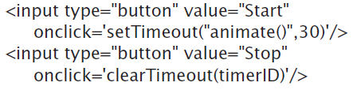
1. Using a Timer
Using Buttons to Start/Stop the Animation
Buttons can be used to start (setTimeout()) and stop (clearTimeout()) animation
Start button sets the timer for the first time
Animation keeps going on its own
Stop button clears the timer/stops the animation

Slide 41
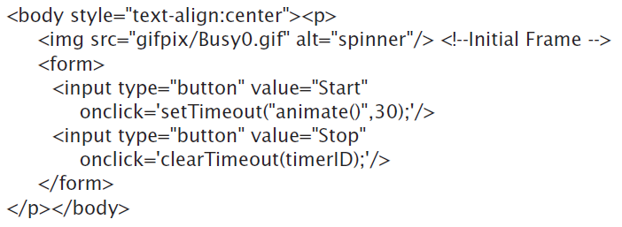
2. Prefetching
Graphics files are usually stored in separate directory
Display first image at first (doesn’t need to be animated yet)

Slide 42

2. Prefetching
To animate (overwrite image with next sequenced image):
Loading an image one-at-a-time is too slow
Get all images first, store them locally, then display them
Images are already numbered (to keep track of where they are in the sequence)
Indexed already? use an array!

Slide 43

2. Prefetching
Initializing to an Image Object:
Elements of the array must be initialized to an image object
Image object is a blank instance of an image
Initialize the 12 array elements to image objects requires an iteration and the new Image() operation:

Slide 44

2. Prefetching
Using the src Component
Field called src where the image’s source is stored
<img src=". . . "/> tag in HTML
Browser saves the name, gets the file, stores it in memory:
NOTE how the file name is build using iteration and concatenation: gifpix/Busyi.gif

Slide 45
2. Prefetching
Important difference between the prefetching and using <img src=". . . "/>
Prefetching: is not visible on the screen
<img src>: is visible on the screen
Advantage to use both: there is an initial image to be seen, then the animation occurs

Slide 46
3. Redrawing an Image
To animate we need to overwrite it with the images that were prefetched
Browsers keep an array of the images used on the page in the DOM
When <img src=". . . "/> is encountered, browser fills its images
To change initial frame, write:

Slide 47
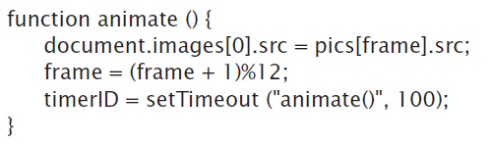
3. Redrawing an Image
Defining the animate( ) event Handler
To animate the Busy icon must sweep through all of the i values, cyclically, one every 30 ms
animate( ) event handler overwrites the image, sets up for the next frame, and sets the timer to call itself again:

Slide 48
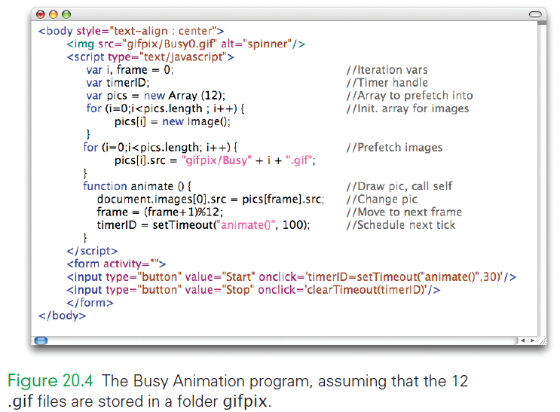
Complete Busy Animation

Slide 49
Summary
The basics of for loop iteration. The control part of a for statement is written in parentheses and the < statement list> is enclosed in curly braces. With each iteration, the entire statement list is performed. The number of iterations is determined by assignments to, and tests of, the iteration variable as specified in the control part.

Slide 50
Summary
In the JavaScript for statement, the <initialization> component is executed first. Then, prior to each iteration, including the first, the <continuation> predicate is tested. If it is true, the < statement list> is performed; otherwise, it is skipped, and the for statement terminates. After each iteration, the <next iteration> operation is performed.

Slide 51
Summary
The principles of iteration ensure that every iteration contains a test and that the test is dependent on variables that change in the loop.
The for statement is very flexible. The <initialization> can begin with any number, the <continuation> test can stop the loop at any number, and the <next iteration> operation can increment by various amounts upward or downward.

Slide 52
Summary
In indexing, we create a series of names by associating a number with a base name. If we need more names, we count more numbers. Indexed variables are known as arrays in programming. Like ordinary variables, arrays must be declared, but they use the new Array(<length>) syntax, in which <length> is the number of elements of the array.

Slide 53
Summary
Array elements—referenced by giving the name and a non-negative index in brackets—can be used like ordinary variables. Arrays and iterations can be effectively used together.
Basic concepts of online animation. All animations achieve the appearance of motion by rapidly displaying a series of still frames.

Slide 54
Summary
When animating information displayed by a Web browser, we should prefetch the images so that they are readily accessible for rapid display. The key idea is to use a timer to create events, and then use the timer event handler to redraw an image that has been placed on the Web page by the <img src=". . . "/> tag. These are referenced as the elements of the document’s images array.

