Slide 2
Learning Objectives
State and apply the Decomposition Principle
Explain the problem-solving strategy used in creating the Smooth Motion application
Explain the use of the JavaScript operations for iteration, indexing, arrays, functions, animation controls, and event handlers in Smooth Motion
Explain how mouse events are handled in Smooth Motion

Slide 3
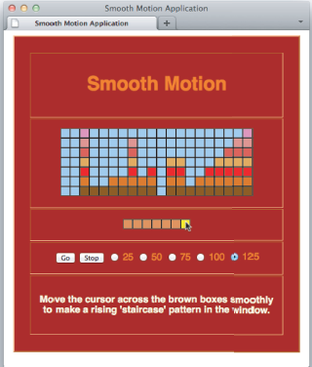
The Smooth Motion Application
Step 0 in solving any problem is to understand what must be accomplished.
What needs to be accomplished with “Smooth Motion”?
Heading
Grid
Keys
Controls
Instructions

Slide 4
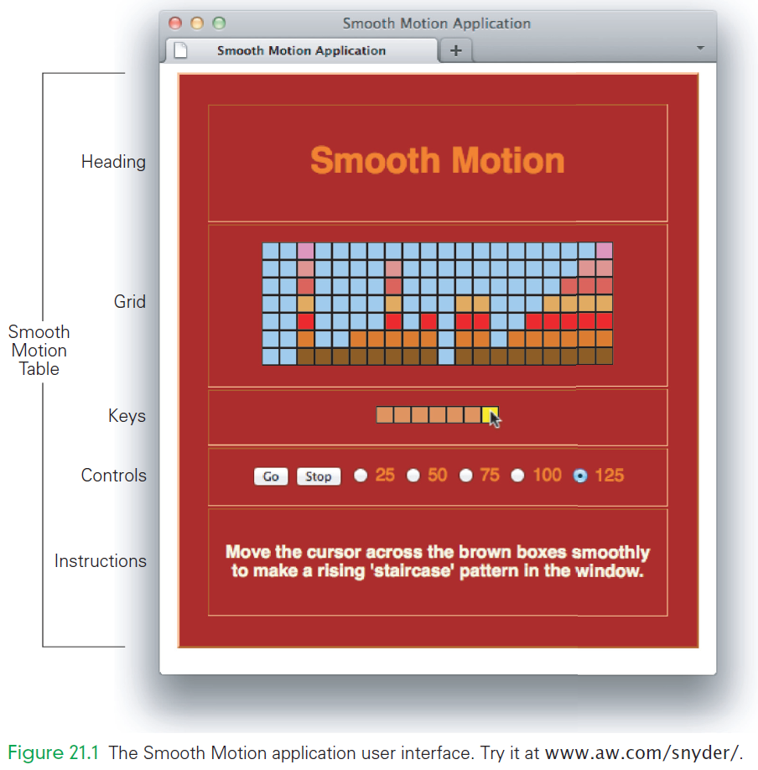

Slide 5
How the Smooth Motion Application Should Work
The application starts up automatically 5 seconds after it is loaded
It begins filling the grid from the right with stacks of blocks of random height
The blocks move steadily to the left at a rate determined by the controls
The random stack generation continues until the user places the mouse cursor over one of the brown keys
When the mouse hovers over key n, a stack of n blocks appears in the grid
The goal is to move the mouse across the brown keys as smoothly as possible
When the user has moved the mouse smoothly enough to create a perfect staircase rising to the right in the grid, the action stops
The process can be started or stopped at any point using the Go and Stop buttons.
The speed selections are given in milliseconds and describe the rate at which the blocks move left
The test requires a smooth mouse motion across the keys from left to right at a rate corresponding to the frame rate of the grid animation

Slide 6
Planning Smooth Motion
There are timer events for both the animation and mouse events for the controls that happen simultaneously
We approach it in a methodical step-by-step way, applying a standard divide-and-conquer technique to simplify our work
Breaking the project into convenient, manageable pieces ensures success

Slide 7
The Decomposition Principle
Decomposition Principle:
Divide a large task into smaller subtasks that can be solved separately
Combine their solutions to produce the overall solution
The Decomposition Principle can be applied to each of the subtasks, producing even smaller subtasks
The components become small enough they become solvable

Slide 8
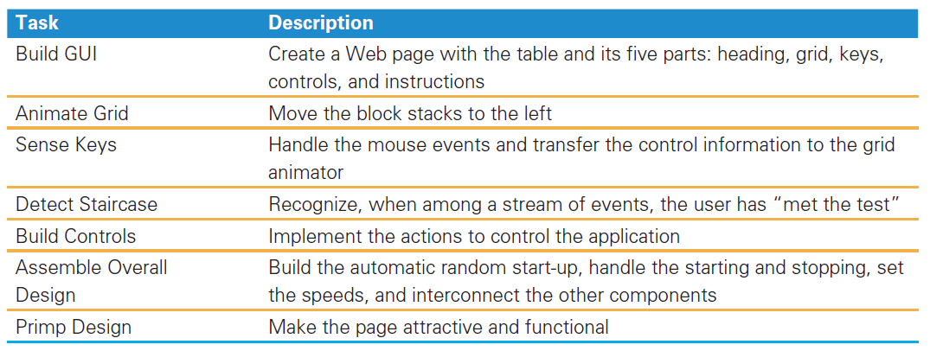
List the Tasks
An obvious beginning point for applying the Decomposition Principle:

Slide 9
Decide on Problem-Solving Strategy
Step 1: Decomposing the problem into solvable tasks
Step 2: Strategize how to solve each of the parts
The strategy is in what order will we’ll solve the parts?

Slide 10
Step 2.a: Build a Basic Web Page
The “Build GUI task”
Provides a place to test and save the solutions to the other tasks
The page is an organizing structure, where we can add JavaScript code to it
Build only the basic primitive page
The GUI construction is split into two:
Working prototype first
Embellishment second

Slide 11
Step 2.b: Solve Independent Tasks
Consider the task dependencies:
Some tasks rely on or depend on the solution of other tasks
Tasks that do not rely on the solution of any other tasks are independent, and should be done first.
Tasks that depend on the independent tasks are done next
Tasks that depend on them follow
and so on

Slide 12
Step 2.b: Solve Independent Tasks
Consider the task dependencies:
Plan to schedule the tasks based on the rule:
Perform any task when all of the tasks it depends on are solved!
If all of the tasks are mutually dependent:
Begin the dependent tasks
Do them as far as possible until they need the results of another task
Work on the other task

Slide 13
Step 2.c: PERT Chart
Keeping track of many dependencies can be confusing
Engineers and managers draw a task dependency graph, or PERT chart
There are several ways to draw them:
circles and use arrows to show dependencies
Task at the head of the arrow depends on the task at the tail of the arrow

Slide 14
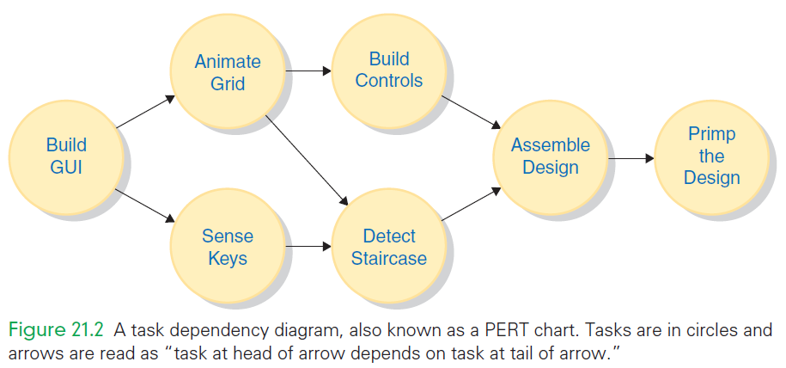

Slide 15
Step 2.c: PERT Chart
Strategy here:
Build GUI for a basic Web page
Animate Grid (dependent on Build GUI task)
Sense Keys (dependent on Build GUI task)
Detect Staircase (dependent on Animate Grid and Sense Keys)
Build Controls (dependent on Animate Grid)
Assemble Overall Design (working with parts not completed)
Primp Design (embellishment)

Slide 16
Build Basic Web Page GUI
The full GUI for Smooth Motion, a table:
heading, grid, keys, controls, and instructions.
The basic structure the structural page include:
Table, heading, and instructions
Background color
Font style and color
Center application on the page

Slide 17
The Structural Page
Easiest to build tables “inside out” using Copy/Paste
Construct generic table cell, <td> tags
Replicate it to make a row, enclose in <tr> tags
Replicate the row to make the table, enclose in <table> tags
Fill it in

Slide 18
The Structural Page Heading
For the heading text, use an <h1> tag
For the instructions, use a <p> tag
Because the instructions text has a different text color than the other text on the page, set the font color
Note the middle three rows are empty because they are white space
They are still defined in HTML

Slide 19
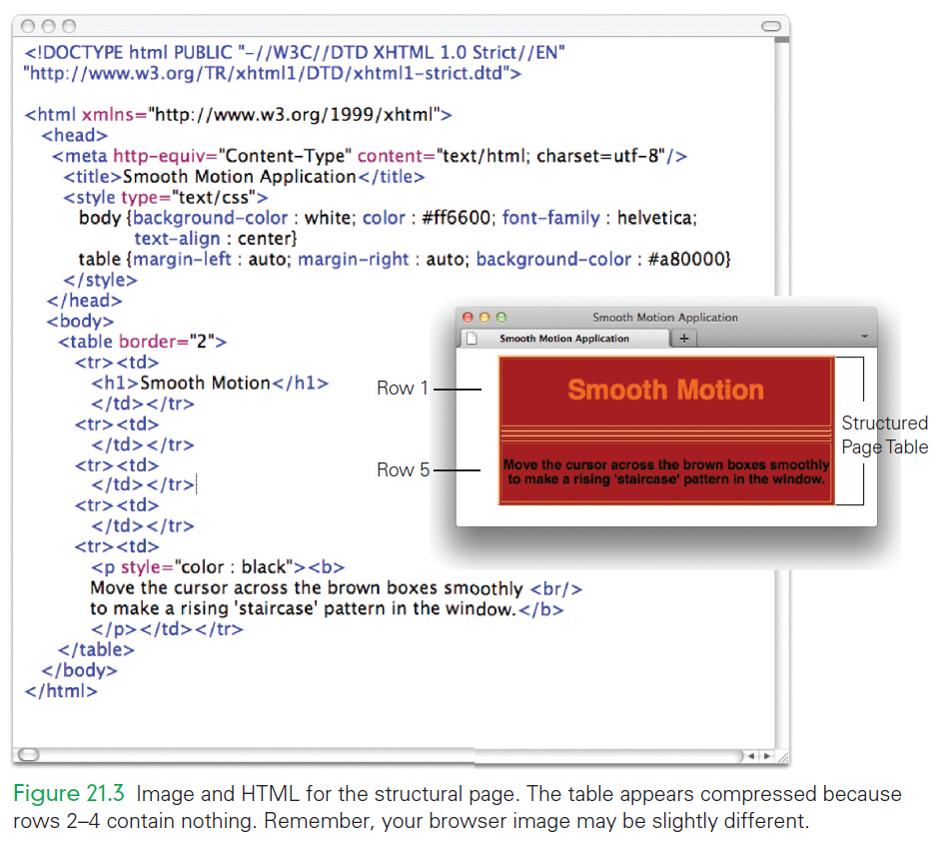

Slide 20
Animate the Grid
The Animate Grid task animates the 7 × 20 = 140 grid of blocks moving from right to left
This task is complicated to solve directly
Apply the Decomposition Principle
again

Slide 21
First Analysis
The Busy Animation from Chapter 20 illustrated the basic steps of animation:
Define and place the initial image
Prefetch the frames for updating the image
Set a timer and build a timer event handler, to update the image

Slide 22
First Analysis
Observations regarding Frames for the Columns of Blocks:
Reviewing how the application is supposed to work, we first notice that it only discusses “stacks” of blocks
This implies that there is no “motion” of images vertically, only horizontally
The horizontal motion is limited to moving from right to left

Slide 23
First Analysis
Observations regarding Frames for the Columns of Blocks:
We don’t have to animate individual squares
The images can be whole columns
That simplification reduces the total number of images in the grid to 20 (or the number of columns)
A new subtask is to define and organize the column frames

Slide 24
Indexing Columns Left to Right
Consider now the “motion of an image”
On each time step, any column is replaced by the column to its right
If the 20 columns are indexed left to right:
The image in column i of the grid is replaced on the next time step by the image in column i+1
The columns will be indexed from 0, left to right

Slide 25
Indexing Columns Left to Right
When browsers place images on a page, they are recorded in the array document.images in the order encountered
The leftmost column of the grid is document.images[0]
The action replaces the contents of document.images[i] with the contents of document.images[i+1]

Slide 26
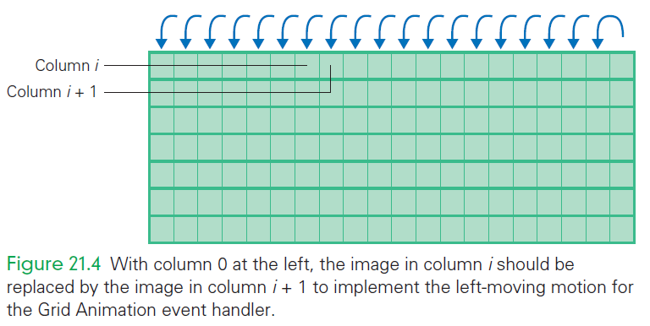

Slide 27
Indexing Columns Left to Right
Shifting each column to the left is easy
Only the last column is handled differently
Handling the last column 19 is also easy because we only need to assign a new image
Which frame is assigned:
If in the random start-up phase, it should be a random frame
If we are in the user-controlled phase, it should be whichever frame the user has specified by the mouse position

Slide 28
Second Analysis
Do we need to add subtasks for defining the image-shifting process?
It’s not necessary
Both activities are part of the timer event handler
The Animate Grid task subtask list has increased by one item:
Define/organize the 8 columnar frames
Define and place the initial images
Prefetch the 8 frames for updating image
Set a timer with an event handler

Slide 29
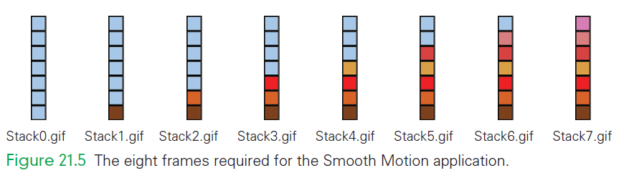
Subtask: Define/Organize the Frames
Notice that the files have names indexed in accordance with the block height
The images have the necessary colors and lines that will be placed side-by-side to construct the grid

Slide 30
Subtask: Define/Organize the Frames
There are two guidelines to follow when creating frame images for JavaScript animations:
Ensure that all images overwriting one another have the same dimensions in pixels
Ensure that all files are saved using either the .gif or .jpg formats, and that they are used consistently

Slide 31
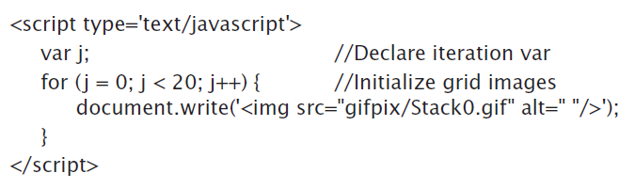
Subtask: Define/Place Initial Images
This subtask constructs the grid in the second row of the structural page
The initial state of the grid is created from 20 copies of Stack0.gif

Slide 32
Subtask: Define/Place Initial Images
To use JavaScript’s for statement, we place the <script> tags inside the second row’s <td> tags
To have the images appear we must place them using the document.write() function

Slide 33
Subtask: Prefetch the Frame Images
Prefetching is necessary
Prefetching can be performed at any time prior to the start of the animation
Place the prefetching with the code from the initialization subtask just completed

Slide 34
Subtask: Prefetch the Frame Images
The three steps of prefetching are as follows:
Declare the array into which the images will be fetched.
Initialize the array elements to be image objects
Define the image structure for each array element using the new Image( ) specification.
Assign the names of the files to the src fields of the image objects

Slide 35
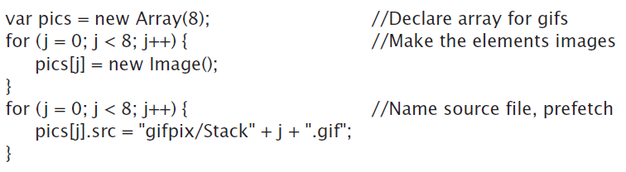
Subtask: Prefetch the Frame Images
Call the array pics
Use a separate iteration for the second and third tasks
Inserted the code within the <script> tags after the declaration
Note the file names are constructed on the fly

Slide 36
Subtask: Set Timer and Build Timer Event Handler
This subtask is concerned with writing the event handler to move each grid image one position left
Begin constructing that event handler by calling it animate( )
The event handler has three operations:
Move all images but the first, one position left
Assign a new frame to image 19
Schedule itself for some time in the future

Slide 37
Subtask: Set Timer and Build Timer Event Handler
Assemble Overall Design task will take care of creating the mechanism for choosing the new frame
Assigning a random frame is an easy way to have something different happen on each tick
Assigning random frames is the way the application begins anyway!

Slide 38
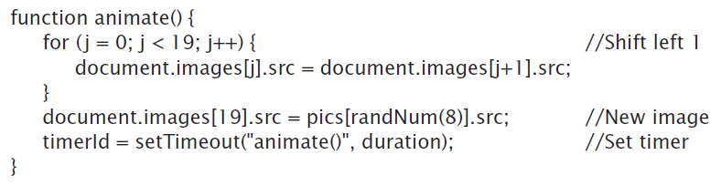
Subtask: Set Timer and Build Timer Event Handler
Recall that browsers store the details of the images they display in an array called images
The array is referenced as document.images
The source field, src, is the relevant one to change to display a new image

Slide 39

Subtask: Set Timer and Build Timer Event Handler
The randNum() function must be declared in order to use it
Add a variable duration to the list of declarations
Include the timerId statement to get the process started automatically

Slide 40
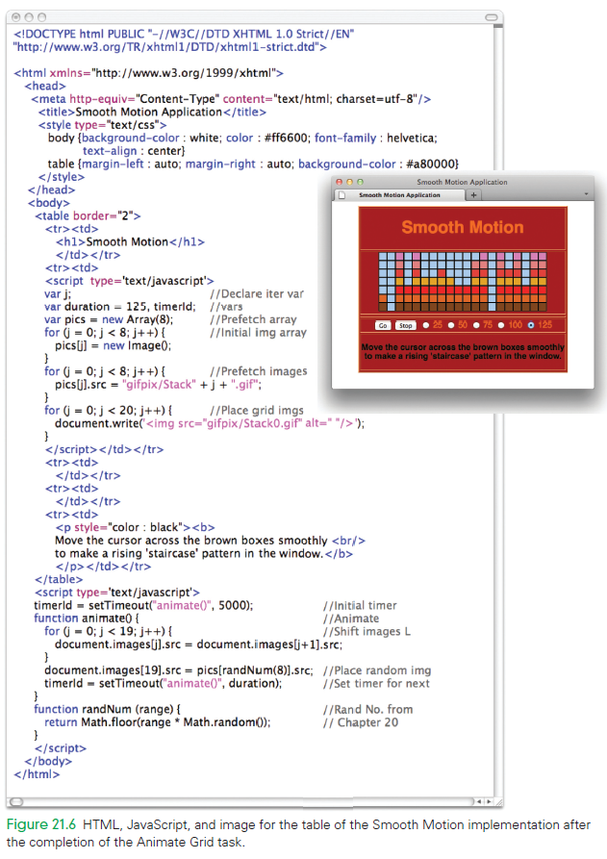

Slide 41
Build Controls
The controls entry of the table contains seven input controls
The fourth row of the table contains the <form> tags
There are three things that could happen when the control is clicked
Go button click-event. Start the animation with setTimeout()
Stop button click-event End the animation by clearing the timer
Radio button click-event Set the timer interval by assigning to duration

Slide 42
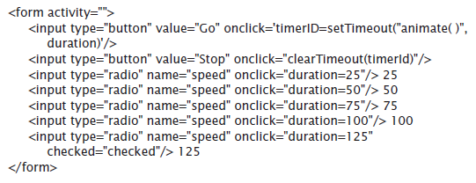

Slide 43
Sense the Keys
The Sense Keys task implements the ability to recognize when the mouse hovers over a given key
Browsers recognize events caused by controls
If an image is clicked, a click-event is caused
The event is processed with an event handler
The event handler is specified by using the onclick attribute of the image tag

Slide 44
Sense the Keys
With the help of the operating system, the browser keeps track of where the mouse is
When the mouse moves over an image, a mouseover event is recognized
When the mouse moves off the object, a mouseout event is recognized
Two events are needed to follow the mouse cursor across the Smooth Motion keys

Slide 45
Sense the Keys
Decompose the Sense Keys task:
Define and organize the necessary frames
Place the initial images and create the keys
Prefetch the frames
Build the event handlers

Slide 46


Subtask: Define and Organize the Frames
The first subtask involves two images
They are stored in the gifpix directory with the Stack images
Moving the files to that directory completes the first subtask.

Slide 47

Subtask: Place the Initial Images
When the images are placed, the keys are created
Seven orange images are placed in the center of the third row of the structural page’s table
The JavaScript loop to iterates through the document.write of the <img src=". . ."/> tags
The resulting code is temporarily incomplete

Slide 48


Subtask: Prefetch the Frames
There are two frames to prefetch, a small array is declared
These lines complete the prefetch subtask

Slide 49
Subtask: Build the Event Handlers
We need to build two event handlers:
here() for mouseover
gone() for mouseout
What happens when the mouse moves over a key?
The key must change color to give feedback to the user that the mouse is on or off the key
This involves simply updating the key’s image with YellowBox.gif or OrangeBox.gif

Slide 50
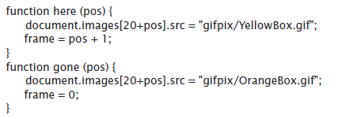
Subtask: Build the Event Handlers
The mouse-sensing event handlers must tell the Grid Animation event handler which new Stack image to draw
The event handler needs the key’s position
Assign the position to a global variable (frame)

Slide 51
Subtask: Build the Event Handlers
This makes the key’s position a parameter
here() solves the problem of mismatched indices
For gone( ) we don’t know where the mouse is moving to
The mouse could be moving to another key or moving off the keys entirely
If the mouse moves to another key, its mouseover event handler will be called immediately

Slide 52

Combine the Subtasks
The two mouse event handler functions have their position parameters specified by the for loop’s iteration variable j
Test the Sense Keys task solution, by making a tiny change in the Grid Animation event handler, animate( )

Slide 53
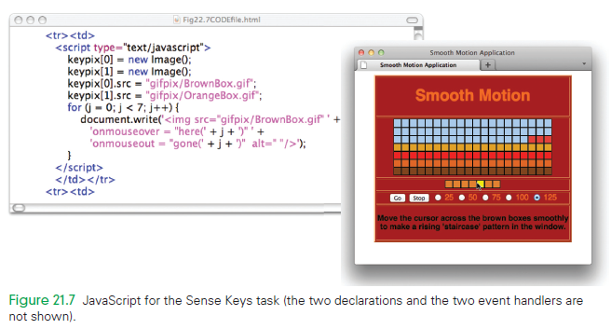

Slide 54
Staircase Detection
Animation stops when the user has manipulated the mouse to create a rising “staircase”
A staircase occurs when the frame values for seven consecutive animate( ) calls are 1, 2, 3, 4, 5, 6, 7
The value of frame tells the animate( ) event handler which Stack frame to display
If it displays the seven frames in order on seven consecutive ticks, there is a staircase

Slide 55
Subtask: Recognizing the Staircase
How are the seven consecutive frame values recognized?
There are many techniques:
Keep an array of the seven most recent frame values and checking each time to see if the desired sequence occurs
Look at the src fields in the last seven images of the grid to see if they have the right sequence of file names
Predict the next frame value

Slide 56
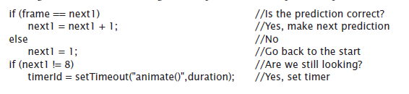
Subtask: Recognizing Continuity
Modify the animate( ) function at the point where it is about to set the timer for the next tick
If the staircase is found, there will be no next tick

Slide 57
Assemble Overall Design
The Build Controls task is performed out of order
Parts of the Assemble Overall Design task are performed ahead of time
The display of randomly selected stacks of blocks isn’t currently working
It’s time to put the Animate Grid task back in

Slide 58
Assemble Overall Design
Set image 19 to frame or randNum(8), depending on whether the user has ever passed the mouse over a key
The mouseover event handlers recognize the situation
Start out with frame initialized to an erroneous number and test it in the animate( ) event handler
If the erroneous number is there, the mouse has not yet passed over the keys the first time;
Anything else means the mouse has passed over the keys the first time

Slide 59

Assemble Overall Design

Slide 60
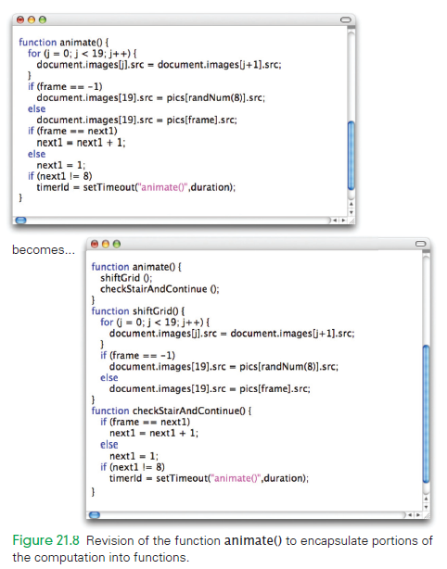

Slide 61
Primp the Design
The following improvements need to be added:
Cell padding
Revised instruction colors
The two enhancements are programmed in both the table and td element properties

Slide 62
Assessment and Retrospective
Loops
Loops save us from writing the same statement multiple times
Loops simplify programming
There may be times when a loop will work, but you choose not to use one
The computer does the same work either way
You decide which method is more convenient

Slide 63

Assessment and Retrospective
Parameterizing Functions for Reuse
The here() and gone() functions use a single parameter that is the position of the key in sequence
Separate functions could have been written in which the key’s position is used explicitly
This would create many almost-identical functions

Slide 64
Assessment and Retrospective
Managing Complexity with Functions
Functions manage complexity
Functions clarify how the animation function works
People will see the function names and interpret them as describing what the function does
Programming both teaches viewers of the program about how the problem was solved AND how the computer was instructed to solve it

Slide 65
Summary
To solve a problem we did the following:
Defined the tasks and strategized about the order in which to solve them. Because there were dependencies among the tasks, we defined a feasible plan to solve them.
Used a dependency diagram to show which tasks depended on others and to assist us in strategizing. We planned an order consistent with the diagram and produced a workable plan.

Slide 66
Summary
To solve a problem we did the following:
Considered other features, such as ease of testing, and adjusted the schedule to address these aspects.
Developed the actual solution of the Smooth Motion program directly. We decomposed each task into several subtasks. There was similarity among these subtasks.

Slide 67
Summary
To solve a problem we did the following:
Decided to solve the tasks out of order from our original schedule, to give ourselves the ability to start and stop the animation. Convenience motivated us to depart from our original schedule.
Learned about mouse events. This was not a difficult concept to grasp, but it illustrated that it is often necessary to learn new information to solve a complex problem.

Slide 68
Summary
To solve a problem we did the following:
Used the programming facilities covered in earlier chapters—loops, functions, parameters, and so on—as tools to instruct both the computer and humans looking at the program.
Developed an IT application with techniques that have wide application.
Learned powerful problem-solving techniques.

