Slide 2
Learning Objectives
Explain what the Turing test was designed to show
Discuss the issue of a computer being intelligent and able to think; refer to Deep Blue and Watson
Discuss the issue of computer creativity; refer to computer generated music and art
State the meaning of the Universality Principle
State the way in which the amount of work in a program is related to the speed of the program

Slide 3
I Think, You Think, Can Computers Think?
What is thinking?
Is it what People do?
Alan M. Turing tried to answer this question
One of the pioneers of computing
Decided to forget defining thinking
Proposed an IQ test for the computer in 1950

Slide 4
The Turing Test
The Turing Test
Two identical rooms (A and B) are connected to a judge who can type questions directed to either room.
A human occupies one room and a computer the other
The judge’s goal is to decide based answers received, which room contains the computer.
If the judge cannot decide for certain, the computer can be said to be intelligent

Slide 5
Advances in Computing
Initially, computers could not understand “natural language”
Now, computers parse language and respond to it (the iPhone’s Siri for example!)
Computers can translate from one language to another (translate.google.com)

Slide 6
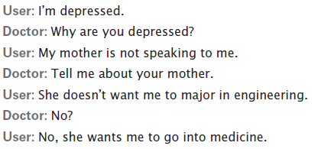
Acting Intelligently?
Spell and grammar checks are based on rules (syntax) … the computer doesn’t understand the context
But, what about Eliza (Doctor)?
Developed by MIT researcher Joseph Weizenbaum
She carried on a conversation as though she were a psychotherapist

Slide 7
Acting Intelligently?
Eliza was programmed to keep the dialog going by asking questions and requesting more information
She took cues from words like “mother” and negative words (don’t, hate, not, etc.)
Eliza was NOT intelligent…her response was just pre-programmed

Slide 8
AI (Artificial Intelligence)
To be intelligent, a computer has to understand a situation and reason to act on that understanding
Actions could not be scripted (pre-programmed) or predetermined
Systems would have to understand natural language and/or have real-world knowledge

Slide 9
Games
Games usually have clear, well-defined rules with an obvious outcome – someone wins!
Chess is a good example!
In 1952, it was predicted that a computer would beat the grand master
In 1996, IBM’s Deep Blue played the World Chess Champion, Garry Kasparov (Kasparov won)
In 1997, Deep Blue won!

Slide 10
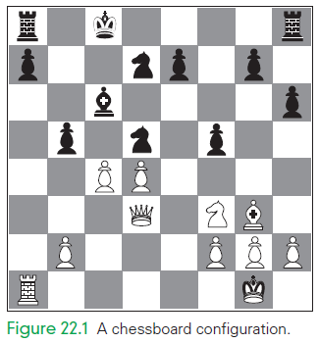
Chess: a Game of Logic
Think back to Chapter 8…a checkered board is fairly easy to represent digitally
Chess uses 32 pieces of only two colors. There are only 6 different types of pieces.

Slide 11
Moving the Chess Piece
To move, the computer appears to think by determining which position a piece will move to that makes it better off in the game
Humans use experience and intuition to decide
Computers use an evaluation function that compares position and captures to get a score to move

Slide 12
Game Tree
The Evaluation Function gives a score for each move
If the score is positive, it’s a good move
If the score is negative, it’s a bad one
The higher the score, the better the move
The computer must also “evaluate” or “look ahead” at the opponent’s move and see how that will affect it’s move

Slide 13
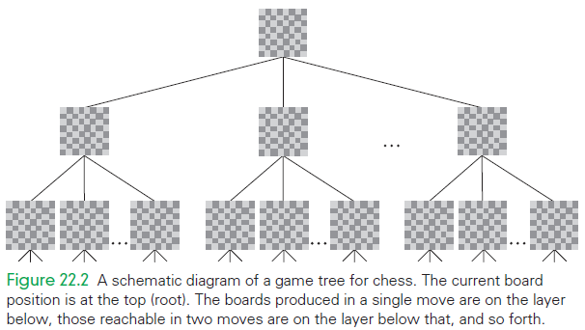
Example of a Game Tree
If there are 28 moves possible from the current position, and an average of 28 from each of those, and each of their descendants, and so on, then six moves deep (i.e., three for each side) generates
28 + 282 + 283 + 284 + 285 + 286 = 499,738,092
which is a half billion boards that the computer must try to evaluate!

Slide 14
Using Database Knowledge
The computer needs some more to play the game
It uses a database of openings and endgames
Chess has been studied for so long that there is ample information about how to start and end a game
Using a database is like giving the computer chess experience

Slide 15
Beating the Master
Required a large database of prior knowledge on openings and endgames
Required special-purpose hardware that allowed rapid evaluation of board positions
Deep Blue won by speed
Blue simply looked deeper into possible moves
. It did so intelligently, of

Slide 16

What is Watson?
February 2011, IBM semantic analysis system competed and won a special edition of Jeopardy!
Game winnings were:
$77,147 for Watson,
$24,000 for Jennings
$21,000 for Rutter
Watson is a program with specialized functions and a huge database!

Slide 17
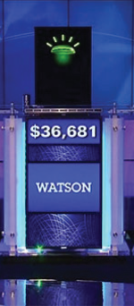
What does Watson do?
The program is:
self-contained (not on the Internet)
parses English,
formulates queries to its database
filters the results it receives
evaluates the relevance to the question
selects an answer
and gives its answer in the form of spoken English

Slide 18
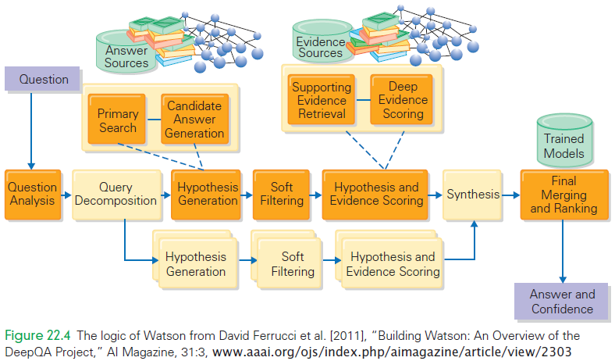
Watson

Slide 19
Watson’s Database
The database is built from 200 million pages of unstructured input:
encyclopedias, dictionaries, blogs, magazines, and so forth
If your standard desktop computer ran the Watson program, it would take two hours to answer a Jeopardy! Question
Watson had to answer in 2–6 seconds, requiring 2,800 computers with terabytes of memory!

Slide 20
Watson’s Learning
Researchers analyzed 20,000 previous Jeopardy! Questions for its “lexical answer type” or LAT
There were more than 2,500 different explicit LATs, and more than 10% didn’t have an explicit LAT
Even if Watson were perfect at figuring out the LAT, one time in 10 it wouldn’t even know what kind of answer to give

Slide 21
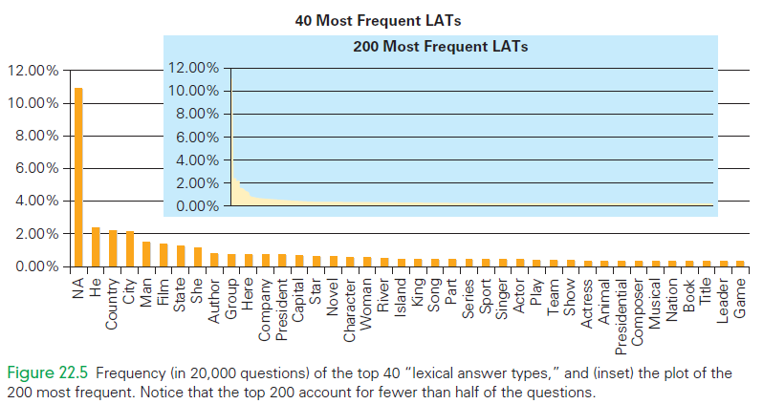
LAT’s

Slide 22
Acting Creatively
Can a computer create art?
Can it make music?
What are the “rules” to be creative?
Is creativity defined as: a process of breaking the rules?
But, computers only follow rules…maybe there are rules on how to break rules

Slide 23
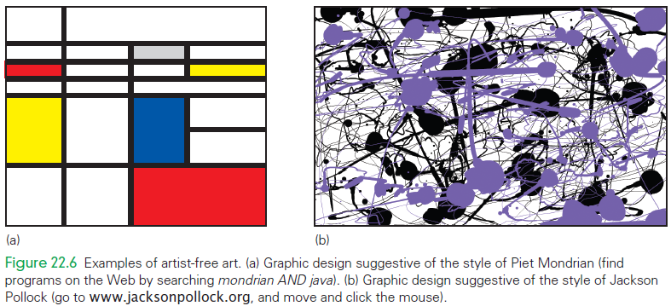
Is it Live? Or is it Computer?

Slide 24
Creativity as a Spectrum
Creativity that comes from inspiration—“a flash out of the blue”—and the form that comes from hard work—“incremental revision.” (Bruce Jacob)
In Jacob’s view the hard work is algorithmic.
To be inspired, the computer would have to step outside of the “established order” and invent its own rules

Slide 25
The Universality Principle
What makes one computer more powerful than another?
Any computer using only very simple instructions could simulate any other computer.
Known as the Universality Principle means that all computers have the same power!
The six instructions Add (remember Chapter 9), Subtract, Set_To_One, Load, Store, and Branch_On_Zero are sufficient to program any computation

Slide 26
Practical Consequences
Universality Principle says that all computers compute the same way, and speed is the only difference
The claim that any computer can simulate any other computer has the disadvantage that simulation does the work more slowly
Although both computers can realize the same computations, they perform them at different rates

Slide 27
Exactly the Same, But Different
If all computers are the same, why need different copies of software to run on different platforms?
All computers have equal power in that they can DO the same computations, but they don’t USE the same instructions
The processors have different instructions, different encodings, and a lot of other important difference

Slide 28
Outmoded Computers
New software with new features runs slowly on old machines
Two reasons in support that older computers are “outmoded:”
Hardware and/or software products are often incompatible with older machines
Software vendors simply don’t support old machines.

Slide 29
More Work, Slower Speed
There are very difficult computations with no known fast algorithm
Many problems of interest don’t have any known “practical” algorithmic solutions
For example, look at the many websites dedicated to finding the cheapest air tickets. The prices are different!!!
These are called NP-complete problems

Slide 30
NP-complete problems
These problems are called intractable
This means that the best way to solve them is so difficult that large data sets cannot be solved with a realistic amount of computer time on any computer
In principle, the problems are solvable, in practice, they are not

Slide 31
Unsolvable Problems
There are problems computers cannot solve at all
There are no algorithms to solve the problem!
These problems have a clear quantifiable objective

Slide 32
Summary
Identified a tendency for people to decide that an intellectual activity isn’t considered thinking if it is algorithmic. Thinking is probably best defined as what humans do, and therefore something computers can’t do.
Discussed the Turing test, an experimental setting in which we can compare the capabilities of humans with those of computers.

Slide 33
Summary
Studied the question of computer chess and learned that computers use a game tree formulation, an evaluation function to assess board positions, and a database of openings and endgames.
Studied the problem of semantic analysis as implemented in the Watson program.

Slide 34
Summary
Studied creativity, deciding it occurs on a spectrum: from algorithmic variation (Mondrian and Pollock graphics-in-a-click) through incremental revision to a flash of inspiration.
Presumed that there will be further advancement, but we do not know where the “algorithmic frontier” will be drawn.
Considered the Universality Principle, which implies that computers are equal in terms of what they can compute.

Slide 35
Summary
Discussed that software companies can write a single application program and translate it into the machine language of any computer, making it available to everyone regardless of the kind of computer they own.
Learned the amazing fact that some computations—for example, general-purpose debugging—cannot be solved by computers, even in principle.

