Slide 2
Learning Objectives
The “big idea” of computing inventions
Explain why it’s important to know the right word
Define basic hardware and software terms
Define and give examples of “idea” terms

Slide 3
Computation’s Big Ideas
Digitizing information
Stored-program computers
Transistors
Integrated circuits
“Personal” computers
The Internet
World Wide Web
Layered Software

Slide 4
Computation’s Greatest Hits
Digitizing information
  data represented as numbers
    the breakthrough! machines reading digital info
  census data digitized (1890)
    1880 it took 8 years to process the data by hand
    punch cards digitized the process (not a computer, a card reader)

Slide 5
Computation’s Greatest Hits
Stored-Program Computers
  central processing unit: instructions stored in memory (software)
  programs can be changed quickly, more complex, and autonomous
  ENIAC: started in 1943 finished in 1946
  the problem: vacuum tubes

Slide 6
Computation’s Greatest Hits
Transistors
  low power, less heat
  extremely reliable
  small in size and weight
  the problem: lots of assembly required

Slide 7
Computation’s Greatest Hits
Integrated Circuits
  transistors and connective parts (e.g., wires) are fabricated together in a multistep process
  photolithography makes it all possible by “printing” the wires onto the circuits

Slide 8
Computation’s Greatest Hits
Personal Computers
  1973: first personal machine, Xerox’s Alto
  “There is no reason for any individual to have a computer in their home.”
  how many computers do you have with you today?

Slide 9
Computation’s Greatest Hits
The Internet
  a network of networks
  ARPANet sent its first packet in 1969
    used for email and file fransfer
HTTP and the World Wide Web
  universal protocol
  Mosaic: first widely used Web browser

Slide 10
Computation’s Greatest Hits
Layered Software Development
  until 1980 programs had little structure, and were hard to understand
  programs at one level apply code for lower levels, and provide more advanced facilities for higher levels

Slide 11
Hardware and Software
Computing in its most general form concerns data, hardware, and software

Slide 12
Hardware and Software
Hardware:
  Computers are the physical embodiment of computation
  They represent one of the greatest technological achievements
  Few inventions are more important

Slide 13
Hardware and Software
Software:
  Instruct computers with the steps needed to implement applications
  Software, unrestricted by the physical world, can direct a computer to do almost anything

Slide 14
Computers Are Everywhere
They are in laptops, tablets, smart phones, music players, wireless mics, anti-lock brakes, TV remotes, credit card readers, etc.
  Through 2010, 24.1 billion ARM processor chips have been shipped
  It means that every consumer in the developed world owns more than a dozen

Slide 15
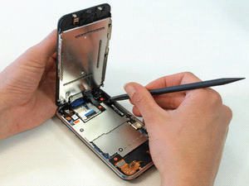
Computers Are Everywhere
Looking Inside:
  Computers don’t always have keyboard and printer attached
Notice there are metal plates covering the internal parts
  They shield the surrounding environment from electromagnetic radiation
Figure 1.1 An iPhone 3GS when first opened

Slide 16
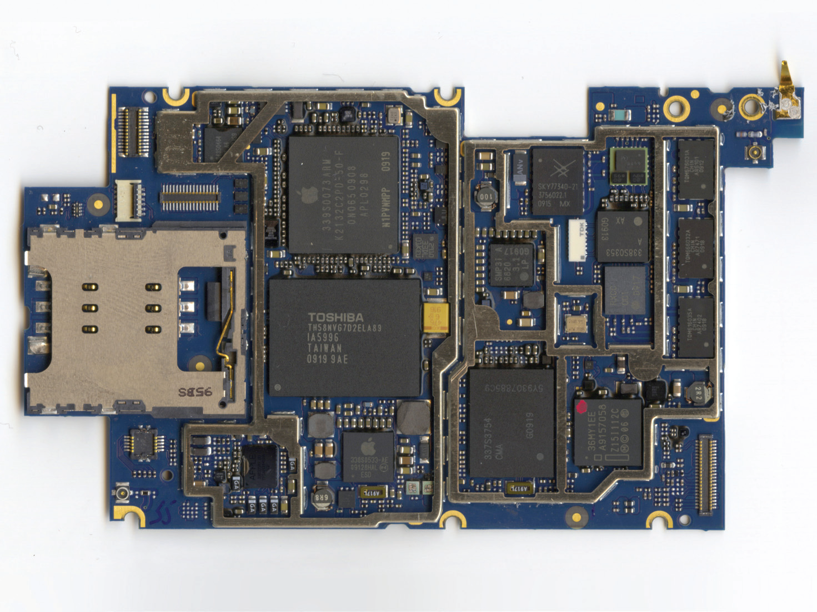
Computers Are Everywhere
Figure 1.2 Top side of the main printed circuit board in the iPhone 3GS; for orientation, the USB port is at left, and processor and memory IC packages are identified. *32-bit describes the size of a typical operation; GB is short for gigabyte (1 billion bytes).

Slide 17
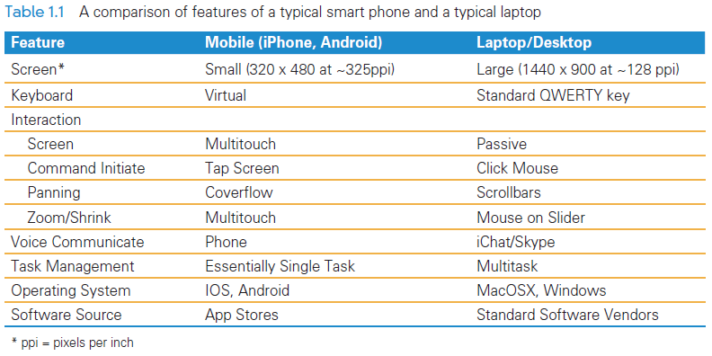
Computers Are Everywhere
Head-to-Head Comparisons

Slide 18
Software
Software is a collective term for programs
Programs are the instructions computers perform to implement applications
Software “instructs” the computer (hardware), by providing the steps needed to perform a task
The computer follows the program and carries out the instructions

Slide 19
Software
The Software Stack
  Concept used to structure and organize the software in contemporary computer systems
  Series of layers of programs that implement user applications.
  Each software layer implements operations used to build the layers above

Slide 20
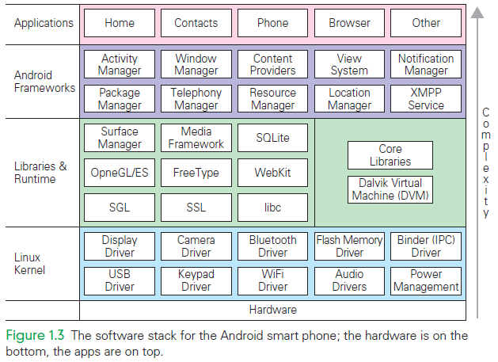
Software

Slide 21
Software
Referring to the figure on the previous slide:
  To check out a video on YouTube using a smart phone, you would:
    use the browser application to get to YouTube
    the browser app uses the window manager, and several other frameworks
    the window manager uses media manager, and several other libraries
    the media manager uses the display
    drivers, and several other kernel operations

Slide 22
Software
Writing software is a difficult and challenging
Instructs an agent to perform some function or action by giving a step-by-step process
The agent is anything that can follow the instructions
For software professionals, the agent is a computer

Slide 23
The Data
Data vs. Information are interchangeable works in computing
Physical Form
  Information is literally everywhere in the physical world
  Much of it can be captured and converted to digital form
  It is always represented as bits
  (0’s and 1’s)

Slide 24
The Information You Use
Most of the information used daily is delivered by the World Wide Web
Newspapers, TV, magazines, and libraries also deliver information but in a diminishing role
Some digital data (like GPS or ATM transactions) is not delivered at all by the Web

Slide 25
Terms of Endearment
Not only should you learn the right computing terms, but you should also understand how to use them to benefit from the technology.
There are two practical reasons for this:
  Tech Support: everyone needs and uses it
  To learn a new subject, we must learn its terminology

Slide 26
Tech Support
Usually, you must look up the answer yourself using the Help feature, or you must contact tech support
  The technician might not know what you talking about
  Without the right word, the search algorithm of the Help facility won’t work for you

Slide 27
Algorithms
What’s an algorithm?
  An algorithm is a precise, systematic method for producing a specified result
We use and invent algorithms all the time to solve our problems
Often the agent that “runs” the algorithm is a person, NOT a computer

Slide 28
Algorithms
Computers are clueless. They need to be told what to do
For a method to be precise enough for a computer to follow, everything needs to be spelled out
Programmers make algorithms perfectly precise for computers by writing them in a programming language

Slide 29
Algorithms
People do have a clue, so many things can be left out of an explanation when people have to follow directions
Example:
  After finding a letter, a computer has to be told to go back to the beginning of the letter sequence to start looking for the next letter
  People figure that out by themselves!

Slide 30
Algorithm Versus Program
Algorithms are a precise, systematic method for producing a specified result
Programs are algorithms that have been specialized to a specific set of conditions and assumptions, and (usually) written in a specific programming language
In most cases however, we use the terms interchangeably

Slide 31
The Words for Ideas
“Abstract”
  The word has several meanings:
    In natural language: to remove can mean to steal
    In computing: to abstract also means to remove, but this time, it’s an idea or a process, and it is extracted from some form of information
Abstractions
  Parables and fables require us to abstract the essential point of the story so that we
  can learn from it

Slide 32
Abstractions
Notice two key points:
  Many, but not all the details, of the story are irrelevant to the concept
  The abstraction has meaning beyond the story
In computing, separating the relevant from the irrelevant, and applying the abstraction to other cases are essential

Slide 33
The Words for Ideas
“Generalize”
  Process to recognize the common idea in two or more situations
  To generalize is to express an idea, concept, or process that applies to many situations
  The statement that sums up that idea is called a generalization
  If it is true most of the time, we can generalize an idea

Slide 34
The Words for Ideas
“Operationally Attuned”
  The ability to apply what we know about how a device or system works to simplify its use
  Example:
    We loosen lids by turning it left and tighten by turning it right
    We know this intuitively, but knowing it explicitly makes us operationally attuned
With computing, thinking about how computation works makes it simpler to use

Slide 35
The Words for Ideas
“Mnemonic”
  A mnemonic is an aid for remembering something
  Example: HOMES (the Great Lakes: Huron, Ontario, Michigan, Erie, and Superior)
  Mary’s Violet Eyes Make John Stay Up Nights (Mercury, Venus, Earth, Mars, Jupiter, Saturn, Uranus, Neptune)

Slide 36
Summary
We learned how to do the following:
  Understand the major computing inventions from the past
  Know and use the right word
  Give informed definitions for common computer terms
  Consider a brief list of “idea” words, such as abstract and generalize.

