Slide 2
Learning Objectives
Know the meaning of and use hypertext terms
Use HTML tags to structure a document
Use HTML tag attributes
Use Cascading Style Sheets to style a Web page
Use HTML tags to link to other files
Explain the differences between absolute and relative pathnames
Use HTML to encode lists and tables to structure a Web page

Slide 3
Web Pages
Web pages are created, stored, and sent in encoded form
A browser converts them to what we see on the screen
Hypertext Markup Language (HTML) is the main language used to define how a Web page should look
We use HTML version 5

Slide 4
Formatting with Tags
Formatting instructions are given by tags, which the browser obeys.
Tags are words or abbreviations enclosed in angle brackets, < and >
Many tags come in pairs
The second of the pair comes with a slash:<title> Fluency </title>
The tag pair surrounds the text to be formatted like parentheses

Slide 5
Formatting with Tags
<title>Serena Williams</title>
These tags can be read as “this is where the title starts” and “this is where the title ends”
<title> is referred to as the start or open tag
</title> is the end or close tag
The title appears on the title bar of the browser

Slide 6
Tags for Bold and Italic
HTML has tags:
  for bold text, <b> and </b>
  for italic text, <i> and </i>
  for paragraphs, <p> and </p>
More than one kind of formatting can be used at a time:
<p><b><i>Veni, Vidi, Vici!</i></b></p>
produces Veni, Vidi, Vici!

Slide 7
Tags for Bold and Italic
It doesn’t matter in which order you start the tags: italic follows bold, or bold follows italic
You get the same result
The rule is to make sure the tags “nest” correctly…they should mirror each other
All the tags between a starting tag and its ending tag should be matched

Slide 8
Singleton Tags
A few tags are not paired
They do not have a matching ending tag
For those tags, the closing angle bracket > of the singleton tag is replaced by />
Examples:<hr /> produces a horizontal line<br />
continues the text on the next line

Slide 9
More Formatting Tags
Documents can be formatted in many ways
Each formatting feature requires its own tag
Programmers and Web designers need to remember a few common tags
Uncommon tags can be looked up:
www.w3schools.com/tags/default.asp

Slide 10
Required Tags
HTML tags that are required for every Web page:
    <!doctype html>
    <html>
      <head>
      </head>
      <body>
      </body>
    </html>

Slide 11
Required Tags
<head>
<meta charset=″UTF-8″ />
<title>Title</title>
additional material discussed later
</head>
The head section contains the beginning material like the title and other information that applies to the whole page

Slide 12
Required Tags
<body>
the main content of the page goes here
</body>
The body section contains the content of the page.
This <html> <head> <body> form must always be followed
All of these tags are required

Slide 13
Configure Your Computer for Writing HTML
Check that two programs are installed:
  A browser (check for Firefox)
  A text editor (Notepad++ for Windows or Text Wrangler for Macs)
Both programs are free
These programs are preferred for technical and educational reasons

Slide 14
Firefox
Firefox is a free open source browser
Open source means that the program code is publicly available, and any programmer can contribute improvements to it
Firefox is the browser referenced throughout this book
It is available at:
  www.mozilla.com/en-US/firefox/all.html

Slide 15
Text Editor
A text editor is a basic way to process text
Our word processors are called
“what-you-see-is-what-you-get” or (WYSIWYG)
Word processors include many application-specific information in their files
This information confuses browsers

Slide 16
Text Editor
You must use a text editor to write HTML
Text editors do not include this extra information
Browsers want Web pages written in ASCII characters only
Think of ASCII as the normal keyboard characters with “nothing strange”

Slide 17
Text Editor
Text editors figure out what language you are writing in and add color to your code to make it easier to read
Operating systems come with simple text editors installed.
  TextEdit can be found on the Mac
  Notepad comes with Windows
TextWrangler and Notepad++ are better choices

Slide 18
Hello, World!
To produce your first HTML page, follow these instructions:
  In your text editor, open a New document instance
  Carefully type in your text (see next slide)
  Save the file as starterPage.html
  Open the file with the Firefox browser

Slide 19
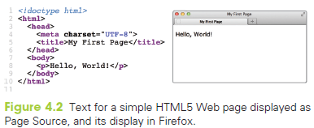

Slide 20
Open with Double-Click
As HTML is written, files must be opened in two applications:
  the text editor, to make changes
  the browser, to see the changes made
Double-click on the file to open it with the default application (your browser)

Slide 21
Save This Page
All HTML files have the same structure as the starterPage.html file you just created
Use it as a template for future HTML coding
Set up a new folder to keep your HTML files in
Using your new page as a template ensures that all pages will have the
correct form

Slide 22
Headings in HTML
Documents can have headings and subheadings
HTML provides several levels of heading tags:
  <h1> and </h1> level one
  <h2> and </h2> level two
  …
  <h6> and </h6> level six
  Headings display content on a new line
headings are bold and get less “strong” (smaller and perhaps not so bold) as the level number increases.

Slide 23
HTML Format Versus
Display Format
HTML source code tells the browser how to produce the formatted page based on the meanings of the tags
HTML is written in a structured format to make it easier for people to understand
Indenting is frequently used to emphasize the tags’ meanings

Slide 24
White Space
Spaces that have been inserted for readability are called white space
White space is created with spaces, tabs, and new lines (return or enter)
HTML ignores white space
The browser turns a sequence of white space characters into a single space

Slide 25
White Space
preformatted information contained within <pre> and </pre> is displayed exactly as it appears (white space and all)
The width of a line of text is determined by the width of the browser window
  A narrower or wider browser window makes the lines break in different places

Slide 26
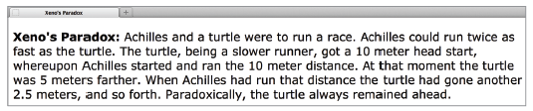
White Space
<p> <b>Xeno’s Paradox: </b>
Achilles and a turtle were to run a race. Achilles could
run twice as fast as the turtle. The turtle,
being a slower runner,
got a 10 meter head start, whereupon
Achilles started and ran the 10 meter distance. At that
moment the turtle was 5 meters farther. When Achilles had run
that distance the turtle had gone another 2.5 meters,
and so forth. Paradoxically, the turtle always remained
ahead. </p>

Slide 27
Attributes
Some tags have attributes
Given as name=value pairs inside the opening tag
The meta tag takes a charset attribute:
<meta charset=″UTF-8″ />
Different tags take different attributes
Some are optional and some are required

Slide 28
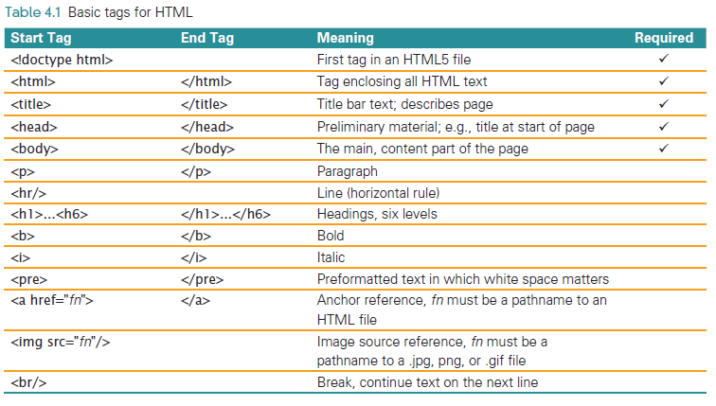

Slide 29
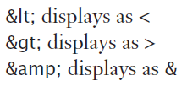
The Escape Symbol
What if the Web page had to show a math relationship: 0<p>r
The browser might misinterpret <p> as a paragraph tag
Using angle brackets as
text is prohibited
To show angle brackets, use an escape symbol (&), followed by an abbreviation, followed by a semicolon

Slide 30
Accent Marks in HTML
Letters with accent marks also use the escape symbol
General form is:
  ampersand, followed by the letter,
  followed by the name of the accent mark, followed by a semicolon
The case of the letter is important!
  &eacute; displays as é
  &Egrave; displays as È

Slide 31
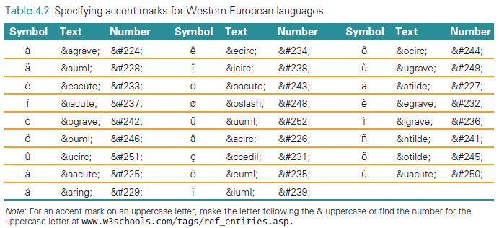
Notes:
Note: This figure is from 5th ed. The 6th is the same but for the color scheme.

Slide 32
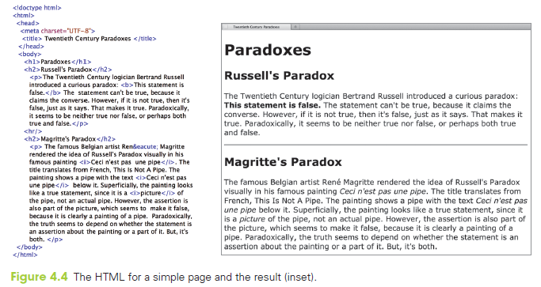

Slide 33
HTML
Notice these features in the previous slide:
Title appears on the browser’s frame
The h1 and h2 text is shown in bold
The separating line extends the full browser window width
An acute accent appears in Margritte’s first name
Text in italics as directed by the <i> tag.

Slide 34
Compose and Check
A productive way to work is to keep two windows open:
  your text editor
  your browser
After writing a few HTML formatting tags, save the file
Check the result in the browser by a Reload or Refresh of the source
Repeat

Slide 35
Markup Validation Service
Another way to limit the mistakes you make is to have it automatically validated
This service checks to make sure your HTML is correct
If it is wrong, the service tells you where the mistakes are and what’s not proper

Slide 36
Check My Work
Normally, validation doesn’t happen until the HTML page is finished and stable
During “compose and check,” the validation occurs at a “stopping place”
To validate go to the W3C Markup Validation Service at:validator.w3.org/#validate_by_upload

Slide 37
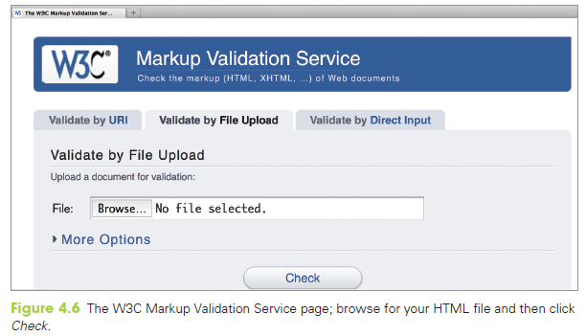

Slide 38
Check My Work
If a green banner comes back:
the HTML checks out
If a red banner comes back, it will have a list of errors with it and an explanation of what’s wrong.
It’s common to have a lot of errors at the start

Slide 39
Cascading Style Sheets (CSS)
Cascading Style Sheets (CSS) can be used to control the layout and styling of Web pages

Slide 40
Setting Global Style
Style specifications can be placed in a global location inside the <head>
They then apply to the whole page
Place the style information inside a pair of <style> and </style> tags

Slide 41
Styling Background and Paragraph
for each tag, you can give properties
  <style>
  body {background-color: black; color: white;}
  </style>
this results in the background being black, and all text on the page being white

Slide 42
Global Styling
Give the name of the tag you want to control
But do not use the brackets around the name
After the element name and inside curly braces ({}) is the list of property-value pairs separated by semicolons

Slide 43
Inline Styling
to make a styling specification that applies to a tag in only one place, use the style attribute inside that one tag
  <b style=″color: red;″>text</b>
this will result in text turning red
the value of the style attribute is a list of property-pairs with the same format as the contents of { } in the <style> section.

Slide 44
Styling The Paradox
Inside the <head>:
<style>
body {background-color: darkslategray}
p {color: lightyellow}
h1 {color: gold; text-align: center}
h2 {color: darkorange}
</style>

Slide 45
Styling the Paradox
The tag which makes “The statement is false” bold will also make it red:
<b style=″color: red″>

Slide 46
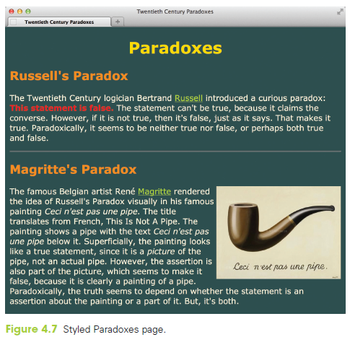

Slide 47
Making Links
two parts to a hyperlink
  the highlighted text in the current document, which is called the anchor text
  the address of the other Web page,
  called the hyperlink reference
the address is specified in the anchor tag using the href attribute
the highlighted text is contained between the opening and closing anchor tag

Slide 48
Marking Links with Anchor Tags
Both parts of the hyperlink are specified using the anchor tag:
  Begin with <a and make sure there’s a space after the a but not before it. a is for anchor
  Give the hyperlink reference using the href attribute href=″insert URL here″, making sure to include the double quotes
  Close the anchor tag with the > symbol
  Give the anchor text, which will be highlighted when it is displayed by the browser
  End the hyperlink with the </a> tag

Slide 49

Bertrand Russell

Slide 50
Structure of the Image Tag
An image tag specifies a file that contains an image:
<img src="filename" alt="description"/>
src is the abbreviation for “source”
filename is the URL of the image file
alt value specifies an alternative form for the image, usually a textual description

Slide 51
Structure of the Image Tag
The alt tag was introduced to assist persons who are visually impaired
Screen readers don’t know what the image is, but they can read the description of the alt tag
HTML requires alt tags
When an image is unavailable or loads slowly, browsers show the alt information

Slide 52
Image File Types
The file name needs to use the correct file extension
.gif, .png, and .jpg are frequently used extensions

Slide 53
Attributes for Image Tags
The img tag has attributes width and height which take values in pixels
Use one or the other to resize the image
Using both can stretch the image
<img src=″pipe.jpg″
alt=″Magritte’s pipe art″ width=″250″ />

Slide 54
Styling Position for Images
Images are inserted in the page at the point in the text where the tag is
specified in the HTML, and the text lines up with the bottom of the image
Messy? Hard to read?
A better way to place images in
text is to flow the text around them

Slide 55
Styling Position for Images
You can either by position the image on the left with the text to its right, or vice versa
To make the text flow around the image, use the style attribute in the image tag with the value
"float:left" or "float:right"
To display an image without any text around it, enclose it in paragraph tags

Slide 56
Making an Image Link
We do not have to use text as the anchor
Images can be used as well
Combine an anchor tag with an image tag:<a href="history_red_square.html">
<img src="red.gif" alt="Red Box"></a>
When the page displays, the usual highlighting that links receive will be used to mark the .gif as a link

Slide 57
Referring to Pages and Images
The value of the href or src attribute is a URL
Sometimes a full URL is used.
<a href = "http://www.example.com/page.html">
Shorter forms are used to refer to files which are closer

Slide 58
Absolute References (URLs)
In these anchor tags, the hyperlink reference is an entire URL
  The Web browser needs to know how/where to find the page
A complete URL is made from:
  a protocol specification, http://
  a domain or IP address, www.biyo.com
  a path to the file, /bios/sci/russell.html

Slide 59
Relative References
Often links refer to other Web pages on the same site
These pages will be stored in the same or nearby folders
These anchor tags use relative references
A relative reference describes how to find the referenced file relative to the file in which the anchor or img tag appears

Slide 60
Going “Deeper” in a Folder
When the file containing the anchor and the referenced file are in the same folder—we just give the file name
When the referenced file is “deeper” in the directory, we simply give the path from the current folder down to the file

Slide 61
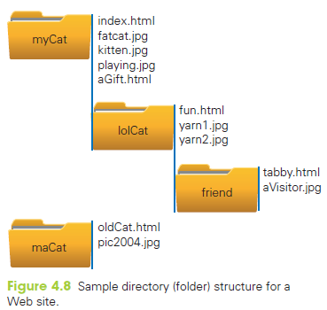

Slide 62
Going Down
From index.html to
aGift.html, use
href="aGift.html"
fun.html, use
href="lolCat/fun.html"
tabby.html, use
href="lolCat/friend/tabby.html"

Slide 63
Going “Higher” in a Hierarchy
To go up to a folder, add ../ to the beginning of the relative URL
Each ../ moves up one level higher in the hierarchy
This convention originated in the Unix operating system

Slide 64
Going Up
From tabby.html to fun.html, use
href="../fun.html"
From tabby.html to pic2004.jpg
src="../../../maCat/pic2004.jpg"

Slide 65
Span
What if there is no tag to add a style attribute?
Use the <span> tag
<span>’s only job is to surround text, and provide a place for style and other attribute information

Slide 66
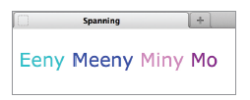
Span
<span style="color:darkturquoise">Eeny</span>
<span style="color:blue">Meeny</span>
<span style="color:violet">Miny</span>
<span style="color:darkmagenta">Mo</span>

Slide 67
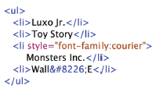
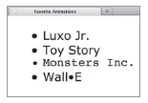
Lists Tags
The easiest type of list is the unordered list
Unordered list tags <ul> and </ul> surround the items of the list
The items are enclosed in list item tags, <li> and </li>
Notes:
This slide and some following have small figures from 5th ed. The same example appears in the 6th, with some differences in the border. You might want to swap in the new figures for appearance, but it’s not a correctness issue.

Slide 68


Lists Tags
Another list is the ordered list
It uses the tags <ol> and </ol>
Bullets are replaced with numbers
The ordered list behaves just like the unnumbered list

Slide 69
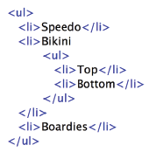
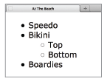
Lists Tags
You can also have a list within a list
Make a sublist within the main list
Notice that sublists use a different bullet symbol

Slide 70
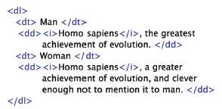
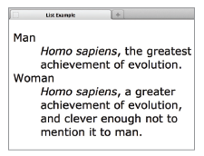
Lists Tags
The definitional list
Indicated by the <dl> and </dl> tags
Definitional lists are made of:
  Definitional terms surrounded by <dt> and </dt>
  Definitional data surrounded by <dd> and </dd>

Slide 71

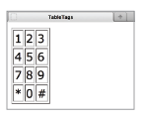
Handling Tables
A table is a good way to present information.
It’s like defining a list of lists
  The main list items, called rows, has one or more items, called cells
The browser aligns cells to form columns

Slide 72
Handling Tables
The table is enclosed in <table> and </table>
The table can have a border, if you use the border attribute
Each row is enclosed in <tr> and </tr>
Cells are surrounded by table data tags, <td> and </td>

Slide 73
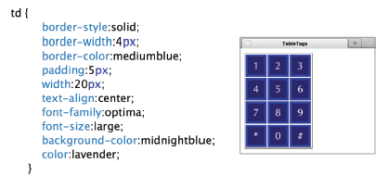
Handling Tables
The td element has a number of style attributes.
Place a td specification in the <style> section, and it will control every cell.

Slide 74
Embellishing Tables
You can give tables captions and column headings:
Place caption tags within the table tags around the table’s caption
  caption tags are <caption> and </caption>
Captions are centered at the top of the table

Slide 75
Embellishing Tables
Column headings are the first row of the table
In the “heading” row, replace the table data tags with table heading tags<th> and </th>
Column headings display in bold
The colspan attribute allows a cell to expand into multiple columns

Slide 76
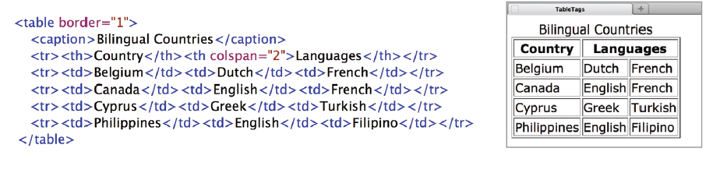
Embellishing Tables

Slide 77
Box Model of CSS
CSS considers every HTML5 element to be enclosed in a “box”
  the boxes will not be visible, unless you make them visible
can clearly visualize content, padding, border, and margin

Slide 78
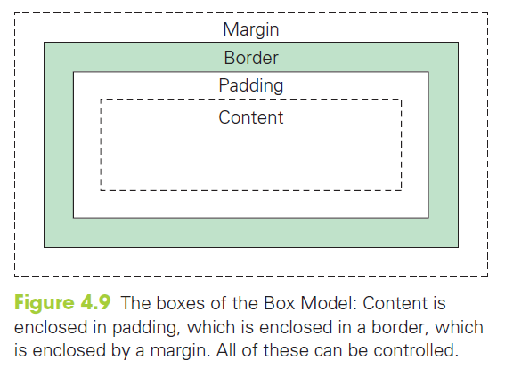

Slide 79
Controlling The Box
The margin and padding are blank space
Content and border areas may contain visible material
CSS can be used to set the sizes and widths
Different sides can be set separately

Slide 80
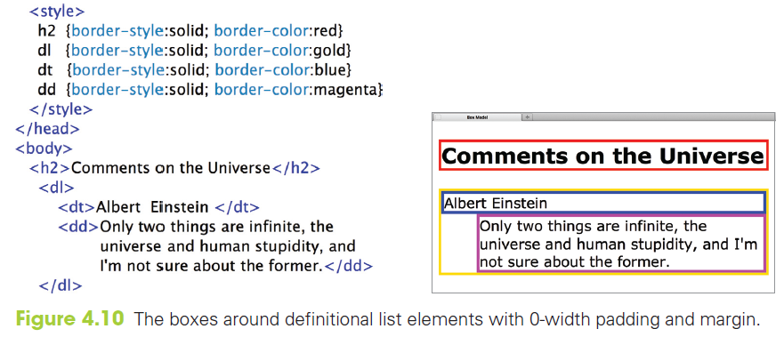

Slide 81
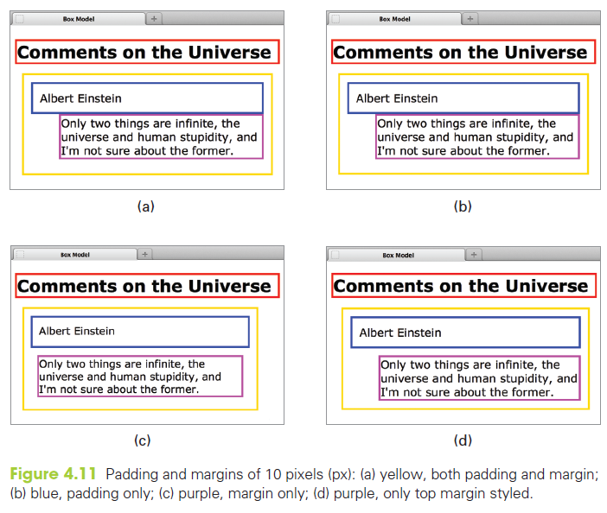

Slide 82
Globally Speaking
So far, we have placed our style information either in the head or directly in the tag
If we want to easily have the same style information on multiple pages, to have a consistent “look and feel,” we should instead use a Style File

Slide 83
Style Files
Transfer your style section of the page into a new text file
  do not include the style tags, just the style elements
Save the file with a .css extension, perhaps myFaveStyle.css

Slide 84
Style Files
Go back to the original .html page and add a link to your .css page inside the head
    <link rel=“stylesheet” type=“text/css” href=“myFaveStyle.css” />
It is okay to use both a separate file, and internal style tags

Slide 85
The Cascade
Style Information sources
  default: comes with the browser
  external: styling in a file
  style section: defined inside of <style> tags
  inherited: properties set by enclosing tag
  tagged: defined with the style attribute
The list is in increasing precedence order; that is, tagged will be used over inherited, style section over external, etc

Slide 86
Adding Class to Style
A class is a family of styling specifications with a common name
The class is given in two places:
  In the style definition inside the style tags in the <head> or in the style file
  At the site in the HTML code when the
  class styling is used

Slide 87
Adding Class to Style
<h2 class="scientist"> . . . </h2>
For the style definition, we append the class name (scientist) to the tag with a dot: h2.scientist
Plain <h2> tags are styled with those features that apply to all <h2> tags
Each separate class gives additional styling specifications

Slide 88
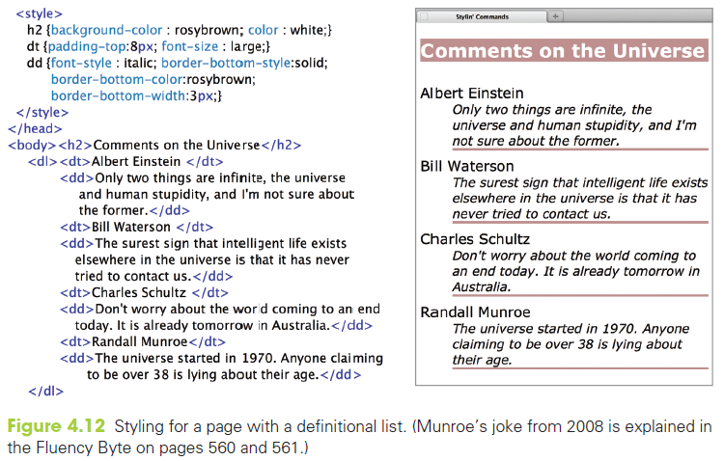

Slide 89
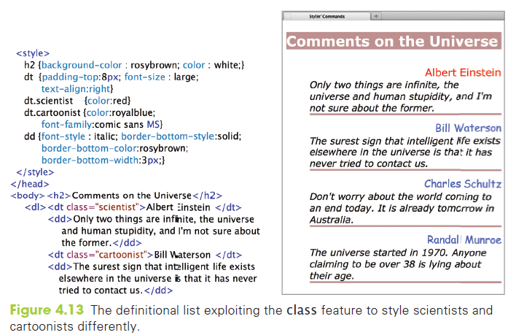

Slide 90
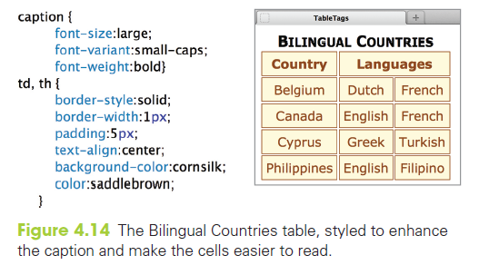

Slide 91
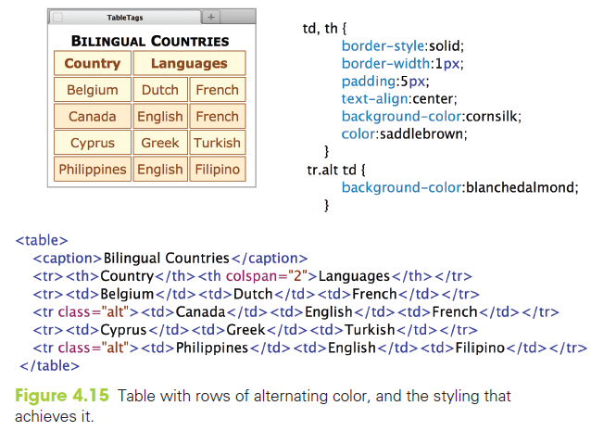

Slide 92
Pseudo Classes
Links styles change under different conditions.
  Initial style
  After you have visited the link
  While you are pointing at it
These states can be styled separately:
a:link {color : darkviolet; text-decoration : none}
a.me:link {color : gray; text-decoration : none}
a:hover {color:red}

Slide 93
Pseudo Classes
These styles are slightly different from the other tags
The different conditions (or states) can be styled separately
These different states are referred to as pseudo classes
The three main ones are link, hover, and visited

Slide 94
Pseudo Classes
link: the style for an unvisited link
hover: the style for when the cursor hovers over an element
visited: the style for links that have been visited
Note: The link and visit classes apply just to the a tag, but most tags can use hover

Slide 95
Navigation Bars
Common on the tops of many web pages
Can be horizontal or vertical
Built using an unordered list of links
  Turns off the bullets:
    list-style-type: none

Slide 96
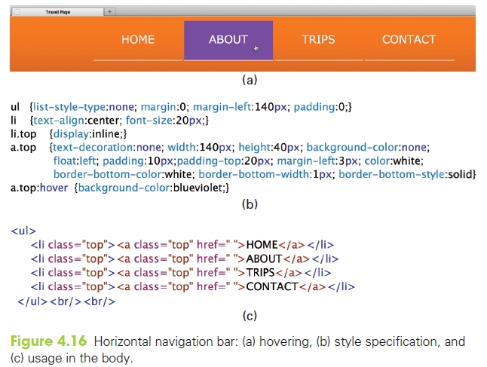

Slide 97
Gradient Background
First, create a gradient image and save it as a .jpg
  narrow, but tall to cover a long page
Then use the image as the background, allowing it to be repeated in the x-direction
    body{background-image: url(‘background.jpg’);
  background-repeat: repeat-x; }

Slide 98
Summary
Recall the idea of using tags for formatting:
  A working set of HTML tags, giving you the ability to create a Web page
  An explanation of how links are marked with anchor tags
  Absolute and relative pathnames. Relative pathnames refer to files deeper or higher in the directory hierarchy
  The most popular image formatting schemes and how to place them in a page
  Cascading Style Sheets, a general system for styling Web documents
  Lists and tables
  The precision achievable by using style classes

