Slide 2
Learning Objectives
Explain the link between patterns, symbols, and information
Determine possible PandA encodings using a physical phenomenon
Encode and decode ASCII
Represent numbers in binary form
Compare two different encoding methods
Explain how structure tags (metadata) encode the Oxford English Dictionary

Slide 3
Digitizing Discrete Information
The dictionary definition of digitize is to represent information with digits
Digit means the ten Arabic numerals
0 through 9

Slide 4
Limitation of Digits
A limitation of the dictionary definition of digitize is that it calls for the use of the ten digits, which produces a whole number
  Digitizing in computing can use almost any symbol
Having a bigger telephone number does not make you a better person

Slide 5
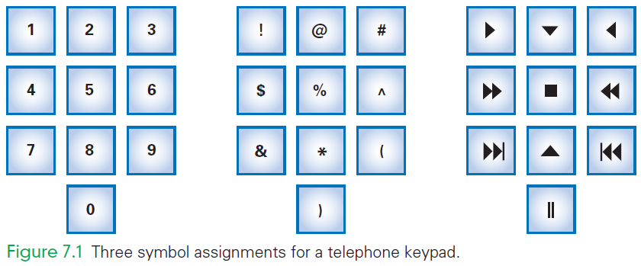

Slide 6
Symbols, Briefly
One practical advantage of digits is that digits have short names (one, two, etc)
Imagine speaking your phone number the multiple syllable names:
  “asterisk, exclamation, closing parenthesis”
IT uses these symbols, but have given them shorter names:
  exclamation point . . . is bang
  asterisk . . . is star

Slide 7
Ordering Symbols
Another advantage of digits is that the items can be listed in numerical order
Sometimes ordering items is useful
collating sequence: placing information in order by using non-digit symbols
  need to agree on an ordering for the basic symbols
Today, digitizing means representing information by symbols

Slide 8
Fundamental Information Representation
The fundamental patterns used in computing come into play when the physical world meets the logical world
In the physical world, the most fundamental form of information is the presence or absence of a physical phenomenon

Slide 9
Fundamental Information Representation
From a digital information point of view, the amount of a phenomenon is not important as long as it is reliably detected
  Whether there is some information or none;
  Whether it is present or absent
In the logical world, concepts of true and false are important

Slide 10
Fundamental Information Representation
Logic is the foundation of reasoning
It is also the foundation of computing
The physical world can implement the logical world by associating “true” with the presence of a phenomenon and “false” with its absence

Slide 11
The PandA Representation
PandA is the name used for two fundamental patterns of digital information:
  Presence
  Absence
PandA is the mnemonic for “Presence and Absence”
A key property of PandA is that the phenomenon is either present or not

Slide 12
The PandA Representation
The presence or absence can be viewed as “true” or “false”
Such a formulation is said to be discrete
Discrete means “distinct” or “separable”
  It is not possible to transform one value into another by tiny gradations
  There are no “shades of gray”

Slide 13
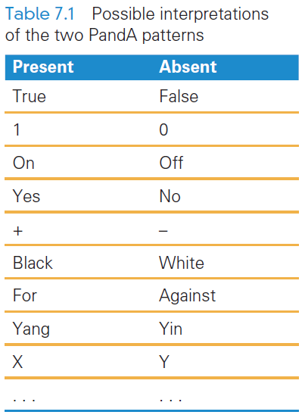
A Binary System
The PandA encoding has two patterns: present and absent
Two patterns make it a binary system
There is no law that says on means “present” or off means “absent”

Slide 14
Bits Form Symbols
In the PandA representation, the unit is a specific place (in space and time), where the presence or absence of the phenomenon can be set and detected.
The PandA unit is known as a bit
Bit is a contraction for “binary digit”
Bit sequences can be interpreted as binary numbers
Groups of bits form symbols

Slide 15
Bits in Computer Memory
Memory is arranged inside a computer in a very long sequence of bits
  the physical phenomenon can be encoded, the information can be set and detected to present or absent

Slide 16
Alternative PandA Encodings
There is no limit to the ways to encode two physical states
  stones on all squares, but with white (absent) and black (present) stones for the two states
  multiple stones of two colors per square, more white stones than black means 1 and more black stones than white means 0
  And so forth

Slide 17
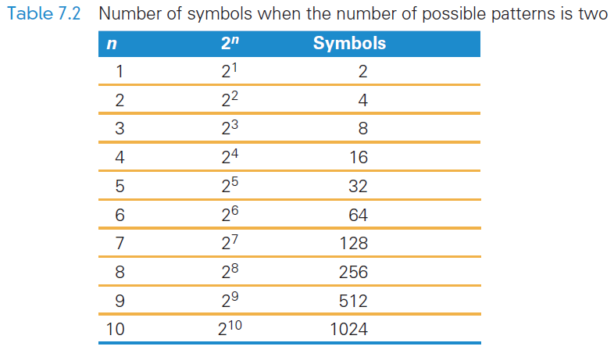
Combining Bit Patterns
The two-bit patterns gives limited resources for digitizing information
Only two values can
be represented
The two patterns must
be combined into
sequences to create
enough symbols to encode the intended information

Slide 18
Binary Explained
computers use base-2 to represent numbers, also know as the binary number system
when counting in binary you are limited to only use 0 and 1
  0, 1, 10, 11, 100, 101, 110, 111, 1000, …

Slide 19
Hex Explained
Hex digits, short for hexadecimal digits, are base-16 numbers
Uses decimal numbers, and then the first six Latin letters
  0, 1, 2, 3, 4, 5, 6, 7, 8, 9, A, B, C, D, E, F
There needed to be a better way to write bit sequences…hexadecimal digits

Slide 20
Changing Hex to Binary
The 32 bits below represent a computer instruction
    1000 1110 1101 1000 1010 0011 1010 0000
Writing so many 0’s and 1’s is tedious and error prone
We can convert each group of bits (8) above to hex
8E D8 A3 A0

Slide 21
Digitizing Numbers in Binary
The two earliest uses of PandA were to:
  Encode numbers
  Encode keyboard characters
Representations for sound, images, video, and other types of information are also important

Slide 22
Place Value in a Decimal Number
Recall that To find the quantity expressed by a decimal number:
  The digit in a place is multiplied by the place value and the results are added
Example, 1010 (base 10) is:
  Digit in the 1’s place is multiplied by its place
  Digit in the 10’s place is multiplied by its place
  and so on:
  (0 × 1) + (1 × 10) + (0 × 100) + (1 × 1000)

Slide 23
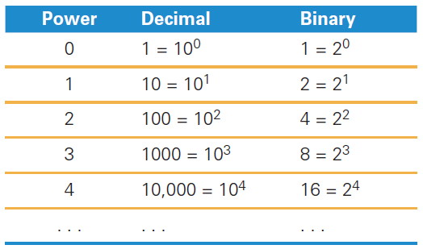
Place Value in a Binary Number
Binary works the same way
The base is 2 instead of 10
Instead of the decimal place values:
1, 10, 100, 1000, . . . ,
the binary place values are:
1, 2, 4, 8, 16, . . . ,

Slide 24
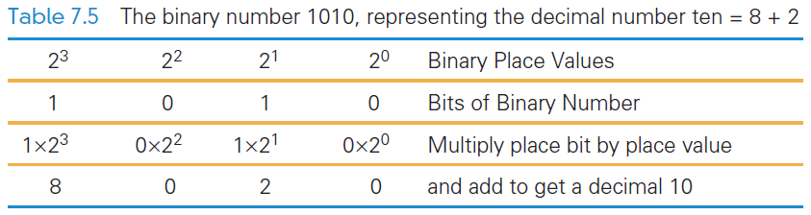
Place Value in a Binary Number
1010 in binary:
  (1 × 8) + (0 × 4) + (1 × 2) + (0 × 1)

Slide 25
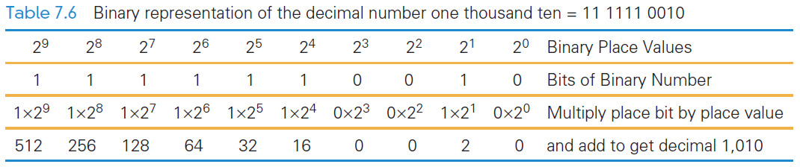

Slide 26
Digitizing Text
The number of bits determines the number of symbols available for representing values:
  n bits in sequence yield 2n symbols
The more characters you want encoded, the more symbols you need

Slide 27
Digitizing Text
Roman letters, Arabic numerals, and about a dozen punctuation characters are the minimum needed to digitize English text
What about:
  Basic arithmetic symbols like +, −, *, /, =?
  Characters not required for English ö, é, ñ, ø?
  Punctuation? « », ¿, π, ∀)? What about business symbols: ¢, £, ¥, ©, and ®?

Slide 28
Assigning Symbols
We need to represent:
  26 uppercase,
  26 lowercase letters,
  10 numerals,
  20 punctuation characters,
  10 useful arithmetic characters,
  3 other characters (new line, tab, and backspace)
  95 symbols…enough for English

Slide 29
Assigning Symbols
To represent 95 distinct symbols, we need 7 bits
  6 bits gives only 2⁶ = 64 symbols
  7 bits give 2⁷ = 128 symbols
128 symbols is ample for the 95 different characters needed for English characters
Some additional characters must also be represented

Slide 30
Assigning Symbols
ASCII stands for American Standard Code for Information Interchange
ASCII is a widely used 7-bit (2⁷) code
Advantages of a “standard”:
  Computer parts built by different manufacturers can be connected
  Programs can create data and store it so that other programs can process it later, and so forth

Slide 31
Extended ASCII: An 8-Bit Code
7-bit ASCII is not enough, it cannot represent text from other languages
IBM decided to use the next larger set of symbols, the 8-bit symbols (2⁸)
Eight bits produce 2⁸ = 256 symbols
  The 7-bit ASCII is the 8-bit ASCII representation with the leftmost bit set to 0
  Handles many languages that derived from the Latin alphabet

Slide 32
Extended ASCII: An 8-Bit Code
Handling other languages is solved in two ways:
  recoding the second half of Extended ASCII for the language
  using the multibyte Unicode representation
IBM gave 8-bit sequences a special name, byte
It is a standard unit for computer memory

Slide 33
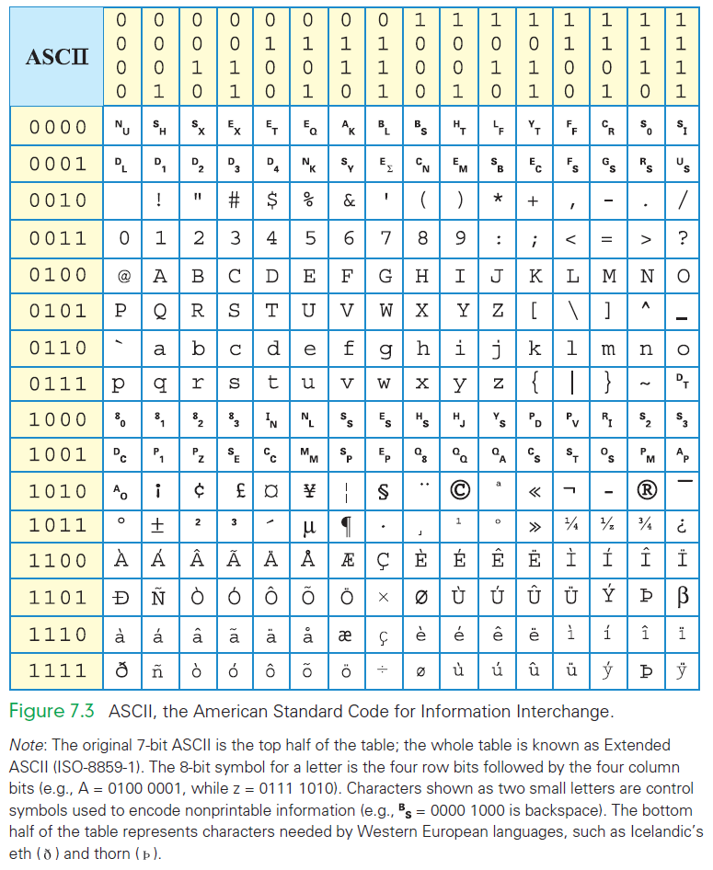

Slide 34
Advantages of Long Encodings
With computing, we usually try to be efficient by using the shortest symbol sequence to minimize the amount of memory
Examples of the opposite:
  NATO Broadcast Alphabet
  Bar Codes

Slide 35
NATO Broadcast Alphabet
The code for the letters used in radio communication is purposely inefficient
The code is distinctive when spoken amid noise
The alphabet encodes letters as words
  Words are the symbols
  “Mike” and “November” replace “em” and “en”
The longer encoding improves the chance that letters will be recognized
Digits keep their usual names, except nine, which is known as niner

Slide 36
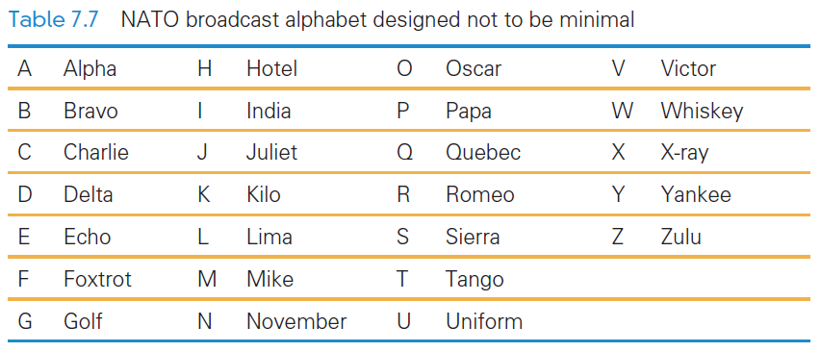
NATO Broadcast Alphabet

Slide 37
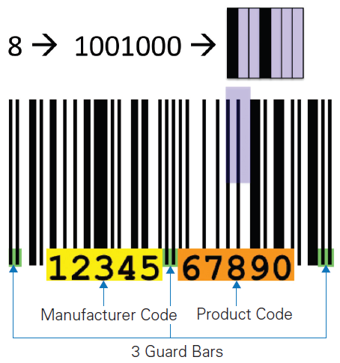
Bar Codes
Universal Product Codes (UPC) also use more than the minimum number of bits to encode information
In the UPC-A encoding, 7 bits are used to encode the digits 0 – 9

Slide 38
Bar Codes
UPC encodes the manufacturer (left side) and the product (right side)
Different bit combinations are used for each side
One side is the complement of the other side
The bit patterns were chosen to appear as different as possible from each other

Slide 39
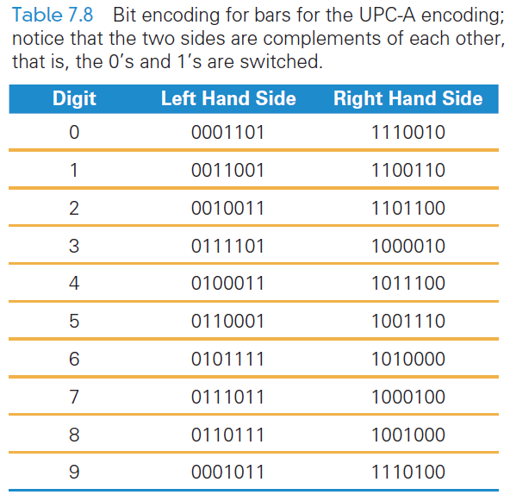
Bar Codes
Different encodings for each side make it possible to recognize whether the code is right side up or upside down

Slide 40
Metadata and the OED
Converting the content into binary is half of the problem of representing information
The other half of the problem? Describing the information’s properties
Characteristics of the content also needs to be encoded:
  How is the content structured?
  What other content is it related to?
  Where was it collected?
  What units is it given in?
  How should it be displayed?
  When was it created or captured?
  And so on…

Slide 41
Metadata and the OED
Metadata: information describing information
Metadata is the third basic form of data
It does not require its own binary encoding
The most common way to give metadata is with tags (think back to Chapter 4 when we wrote HTML)

Slide 42
Properties of Data
Metadata is separate from the information that it describes
For example:
  The ASCII representation of letters has been discussed
  How do those letters look in Comic Sans font?
  How they are displayed is metadata

Slide 43
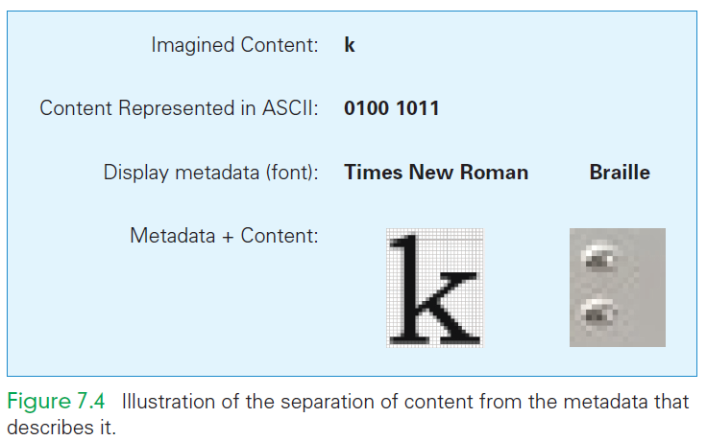
Properties of Data
Rather than fill a file with the Times New Roman font, the file is filled with the letters and tags that describe how it should be displayed
Metadata can be presented at several levels

Slide 44
Using Tags for Metadata
The Oxford English Dictionary (OED) is the definitive reference for every English word’s meaning, etymology, and usage
The printed version of the OED is truly monumental is 20 volumes, weighs 150 pounds, and fills 4 feet of shelf space

Slide 45
Using Tags for Metadata
In 1984, the conversion of the OED to digital form began
Imagine, with what you know about searching on the computer, finding the definition for the verb set:
  “set” is part of many words
  You would find closet, horsetail, settle, and more
Software can help sort out the words

Slide 46
Structure Tags
Special tags can be developed to handle structure:
  <hw> is the OED’s tag for a headword (word being defined)
  <pr> handles pronunciation
  <ph> does the phonetic notations
  <ps> parts of speech
  <hm> homonym numbers
  <e> surrounds the entire entry
  <hg> surrounds the head group or all of the information at the start of a definition

Slide 47
Structure Tags
With structure tags, software can use a simple algorithm to find what is needed
Tags do not print
They are included only to specify the structure, so the computer knows what part of the dictionary to use
Structure tags are also useful for formatting…for example, boldface used for headwords
Knowing the structure makes it possible to generate the formatting information

Slide 48
Why “Byte”?
Computer memory is subject to errors
An extra bit is added to the memory to help detect errors
  A ninth bit per byte can detect errors using parity
Parity refers to whether a number is even or odd
  Count the number of 1’s in the byte. If there is an even number of 1’s we set the ninth bit to 0

Slide 49
Why “Byte”?
All 9-bit groups have even parity:
  Any single bit error in a group causes its parity to become odd
  This allows hardware to detect that an error has occurred
  It cannot detect which bit is wrong, however

Slide 50
Why “Byte”?
IBM was building a supercomputer, called Stretch
They needed a word for a quantity of memory between a bit and a word
  A word of computer memory is typically the amount required to represent computer instructions (currently a word is 32 bits)

Slide 51
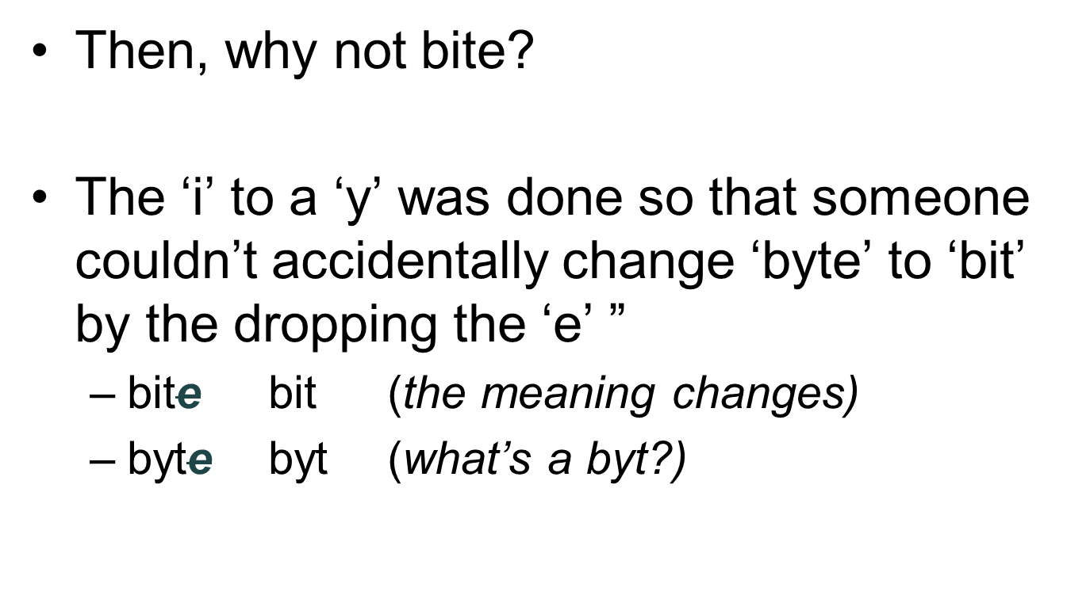
Why “Byte”?

Slide 52
Summary
We began the chapter by learning that digitizing doesn’t require digits—any symbols will do
We explored the following:
  PandA encoding, which is based on the presence and absence of a physical phenomenon
  Their patterns are discrete; they form the basic unit of a bit. Their names (most often 1 and 0) can be any pair of opposite terms

Slide 53
Summary
We explored the following:
  A bit’s 0 and 1 states naturally encourage the representation of numbers in base 2, that is, binary
  7-bit ASCII, an early assignment of bit sequences (symbols) to keyboard characters. Extended or 8-bit ASCII is the standard
  The need to use more than the minimum number of bits to encode information

Slide 54
Summary
We explored the following:
  How documents like the Oxford English Dictionary are digitized
    We learned that tags associate metadata with every part of the OED
    Using that data, a computer can easily help us find words and other information.
  The mystery of the y in byte

