Slide 2
Learning Objectives
Explain what a software stack represents and how it is used
Describe how the Fetch/Execute Cycle works, listing the five steps
Understand the function of the memory, control unit, arithmetic/logic unit (ALU), input unit and output unit, and a program counter
Discuss the purpose of an operating system
Explain the purpose of a compiler
Describe how large tasks are performed with simple instructions
Explain why integration and photolithography are important in integrated circuits

Slide 3
Computer Overview
Computers are used throughout your day
  we are continually using computation
They are laptops, cameras, tablets, iPods, desktops, GPS navigators, TV’s and all the other electronic devices that we use
9-*

Slide 4
Cast of Characters
Processor: follows the program’s instructions
Operating System: program that performs common operations, and makes your computer a useful device
Software: programs
Instructions: tell the processor what to do
Fetch/Execute Cycle: executes the instructions
Memory: stores the data
Hardware: the physical parts of the computer
9-*

Slide 5
Software
When you get a new app it is really a long sequence of bits
  a team of programmers created the bits but did not type them one by one
Software characteristics (C#)
  each line only has a few symbols on it
  the English words are blue
  some words run together, like SetAndStartTimer()
Make one small type, and the program will have a bug
9-*

Slide 6
Software Layers
software available in the operating system
reusing code that has already been developed has lots of advantages
  reduce effort
  leverage other programmer’s knowledge
  updating a single instance is easier than changing it in lots of places
9-*

Slide 7
The Fetch/Execute Cycle
“Instruction Execution Engine”
a machine that cycles through a series of operations
Series is called: Fetch/Execute Cycle
  Get the next instruction
  Figure out what to do
  Gathering the data needed to do it
  Do it
  Save the result, and
  Repeat (billions of times/second)!

Slide 8
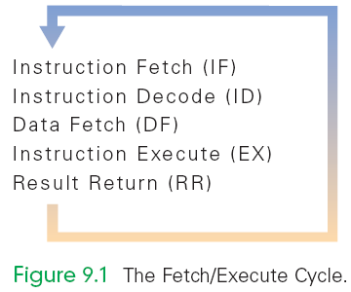
A Five-Step Cycle
These operations are repeated in a never-ending sequence
The step names suggest the operations described in the previous paragraph

Slide 9
Anatomy of a Computer
All computers, regardless of their implementing technology, have five basic parts or subsystems:
  Memory,
  Control unit,
  Arithmetic/logic unit (ALU),
  Input unit, and
  Output unit

Slide 10
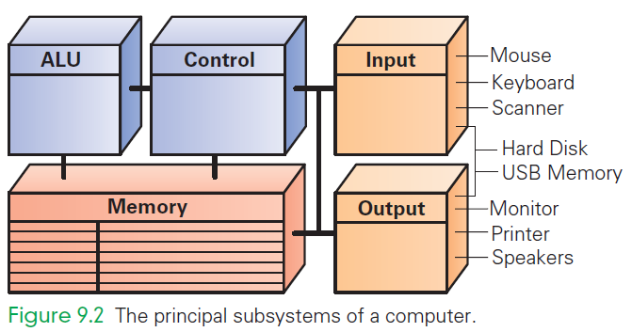
Principal Subsystems of a Computer

Slide 11
1. Memory
Memory stores both the program while it is running and the data on which the program operates
Properties of memory:
  Discrete locations
    Memory is organized as a sequence of discrete locations
    In modern memory, each location is composed of 1 byte (8 bits)

Slide 12
1. Memory
Addresses
  Every memory location has an address, whole numbers starting at 0
Values
  Memory locations record or store values
Finite capacity
  Memory locations have a finite capacity (limited size),
  Data may not “fit” in the memory location

Slide 13
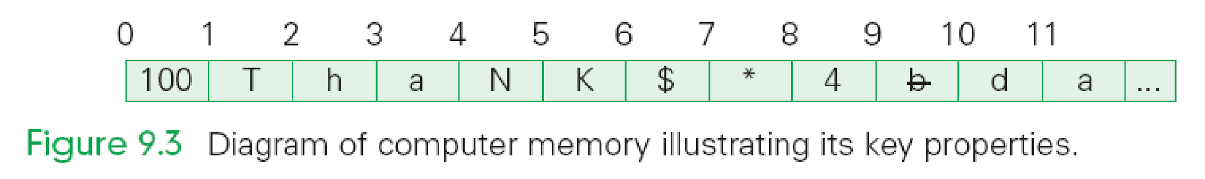
Byte-Size Memory Location
Common visualization of computer memory
Discrete locations are shown as boxes holding 1-byte each
Address of location is displayed above the box and the contents of location is shown in the box

Slide 14
Byte-Size Memory Location
That 1-byte memory location can store one ASCII character or a number less than 256
Blocks of four bytes are used as a unit so often that they are called memory words

Slide 15
Random Access Memory
Computer memory is called random access memory (RAM)
  “Random access” is out-of-date and simply means that the computer can refer to the memory locations in any order
RAM is measured in megabytes (MB) or gigabytes (GB)
Lots of memory is need to handle the space required of programs and data

Slide 16
2. Control Unit
The control unit of a computer is where the Fetch/Execute Cycle occurs
Its circuitry fetches an instruction from memory and performs the other operations of the Fetch/Execute Cycle on it
A typical machine instruction has the form
ADD 4000, 2000, 2080

Slide 17
2. Control Unit
ADD 4000, 2000, 2080
  Looks like those three numbers should be added together
  What it really means is that whatever numbers are stored in memory locations 2000 and 2080 be added together, and the result be stored in location 4000

Slide 18
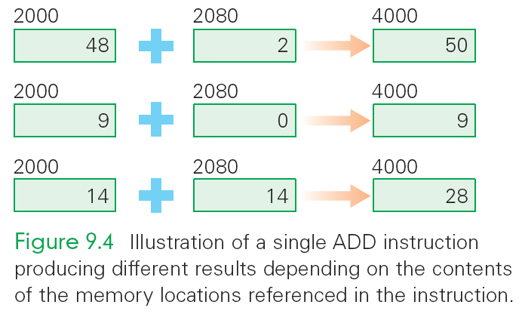
Illustration of a single instruction

Slide 19
3. Arithmetic/Logic Unit (ALU)
“Does the math”
A circuit in the ALU can add two numbers
The circuit uses logic gates or simpler circuits that implement operations like AND and OR
There are also circuits for multiplying, for comparing two numbers, etc.
The ALU carries out each machine instruction with a separate circuit

Slide 20
4. And 5. Input and Output Units
These two components are the wires and circuits through which information moves into and out of a computer
A computer without input or output is useless

Slide 21
The Peripherals
Peripherals connect to the computer input/output (I/O) ports
They provide input or receiving its output
They are not considered part of the computer:
  They are only specialized gadgets that encode or decode information between the computer and the physical world

Slide 22
The Peripherals
The keyboard encodes our keystrokes into binary form for the computer
The monitor decodes information from the computer’s memory and displays it on a screen
The peripherals handle the physical part of the operation

Slide 23
Portable Memory & Hard Drives
Some peripherals are used by computers for both input and output:
  USB memory
  Hard disks/drives
They are storage devices
The hard disk is the alpha-peripheral, being the most tightly linked device to the computer

Slide 24
A Device Driver for Every Peripheral
Most peripheral devices are “dumb”
  They provide only basic physical translation to or from binary signals.
Additional information from the computer is needed to make it operate “intelligently”
Added processing by software called a device driver gives the peripheral its standard meaning and behavior
Every device needs a device driver

Slide 25
Machine Instructions
Machine instructions are more primitive than what programmers type
  ADD 4000, 2000, 2080
  Commands the computer to add the numbers stored in memory locations 2000 and 2080 and then store that in the memory location 4000
  Computer instructions encode the memory addresses, not the numbers themselves
  Indirect reference: referring to a value by referring to the address in memory

Slide 26
The Program Counter:
The PC's PC
How does the computer determine which instruction it should execute next?
Address of the Next Instruction
  The instruction is stored in memory and the computer has its address
  Computers use the address (known as the program counter or PC) to keep track of the next instruction

Slide 27
The Program Counter:
The PC's PC
The computer gets ready to process the next instruction
It assumes that the next instruction is the next instruction in sequence
Because instructions use 4 bytes of memory, the next instruction must be at the memory address PC + 4 or 4 bytes further along the sequence

Slide 28
Branch and Jump Instructions
Not all instructions are in a strict sequence
The instruction may include a memory location (address) to go to next
This changes the PC, so instead of going to PC+4 automatically, the computer "jumps" or "branches" to the specified location to continue execution

Slide 29
The Fetch/Execute Cycle
A five-step cycle:
  Instruction Fetch (IF)
  Instruction Decode (ID)
  Data Fetch (DF) / Operand Fetch (OF)
  Instruction Execution (EX)
  Result Return (RR) / Store (ST)

Slide 30
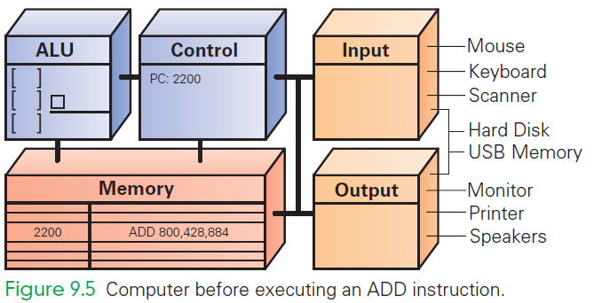
ADD 800, 428, 884
ADD the values found in memory locations 428 and 884 and store the result in location 800

Slide 31
Instruction Fetch (IF)
Execution begins by moving the instruction at the address given by the PC (PC 2200) from memory to the control unit
Bits of instruction are placed into the decoder circuit of the CU
Once instruction is fetched, the PC can be readied for fetching the next instruction

Slide 32
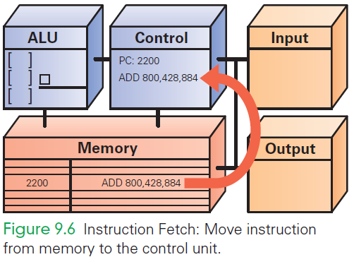
IF
ADD 800, 428, 884

Slide 33
Instruction Decode (ID)
ALU is set up for the operation
Decoder finds the memory address of the instruction's data (source operands)
  Most instructions operate on two data values stored in memory (like ADD), so most instructions have addresses for two source operands
  These addresses are passed to the circuit that fetches them from memory during the next step

Slide 34
Instruction Decode (ID)
Decoder finds the destination address for the Result Return step and places the address in the RR circuit
Decoder determines what operation the ALU will perform (ADD), and sets up the ALU

Slide 35
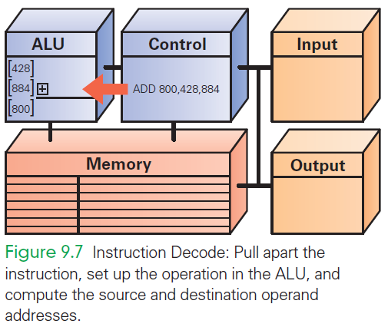
ID
+
ADD
800
428
884

Slide 36
Data Fetch (DF)
The data values to be operated on are retrieved from memory
Bits at specified memory locations are copied into locations in the ALU circuitry
Data values remain in memory (they are not destroyed)

Slide 37
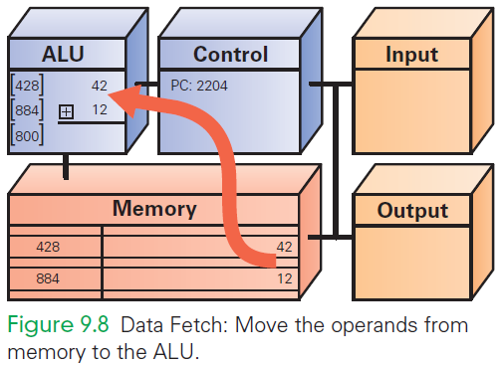
DF
42
12

Slide 38
Instruction Execution (EX)
For this ADD instruction, the addition circuit adds the two source operands together to produce their sum
Sum is held in the ALU circuitry
This is the actual computation

Slide 39
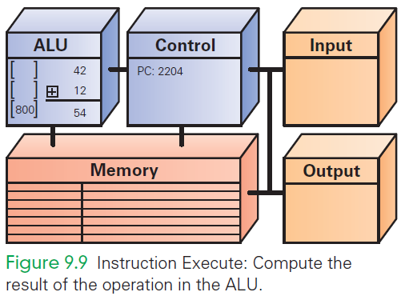
EX
54

Slide 40
Return Result (RR)
RR returns the result of EX to the memory location specified by the destination address.
Once the result is stored, the cycle begins again

Slide 41
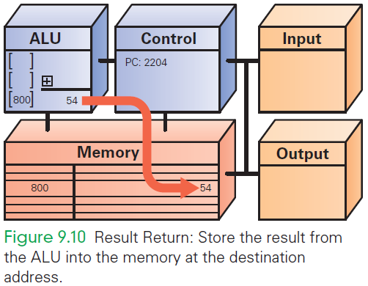
RR
54

Slide 42
Many, Many Simple Operations
Computers “know” very few instructions
The decoder hardware in the controller recognizes, and the ALU performs, only about 100 different instructions (with a lot of duplication)
There are only about 20 different kinds of operations.
Everything that computers do must be reduced to some combination of these primitive, hardwired instructions

Slide 43
Cycling the Fetch/Execute Cycle
ADD is representative of the complexity of computer instructions…some are slightly simpler, some slightly more complex
Computers achieve success at what they can do with speed.
They show their impressive capabilities by executing many simple instructions per second

Slide 44
The Computer Clock
Computers are instruction execution engines.
Since the computer does one instruction per cycle in principle, the speed of a computer depends on the number of Fetch/Execute Cycles it completes per second.

Slide 45
The Computer Clock
The rate of the Fetch/Execute Cycle is determined by the computer’s clock, and it is measured in megahertz, or millions (mega) of cycles per second (hertz).
A 1,000 MHz clock ticks a billion (in American English) times per second, which is one gigahertz (1 GHz)

Slide 46
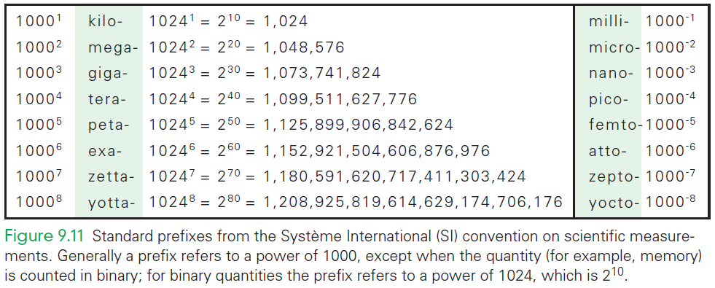
Standard Prefixes

Slide 47
One Cycle per Clock Tick
A computer with a 1 GHz clock has one billionth of a second—one nanosecond—between clock ticks to run the Fetch/Execute Cycle.
In that amount of time, light travels about one foot (~30 cm).
Modern computers try to start an instruction on each clock tick.

Slide 48
One Cycle per Clock Tick
They pass off completing the instruction to other circuitry
This process is called pipelining and frees the fetch unit to start the next instruction before the last one is done
It is not quite true that 1,000 instructions are executed in 1,000 ticks

Slide 49
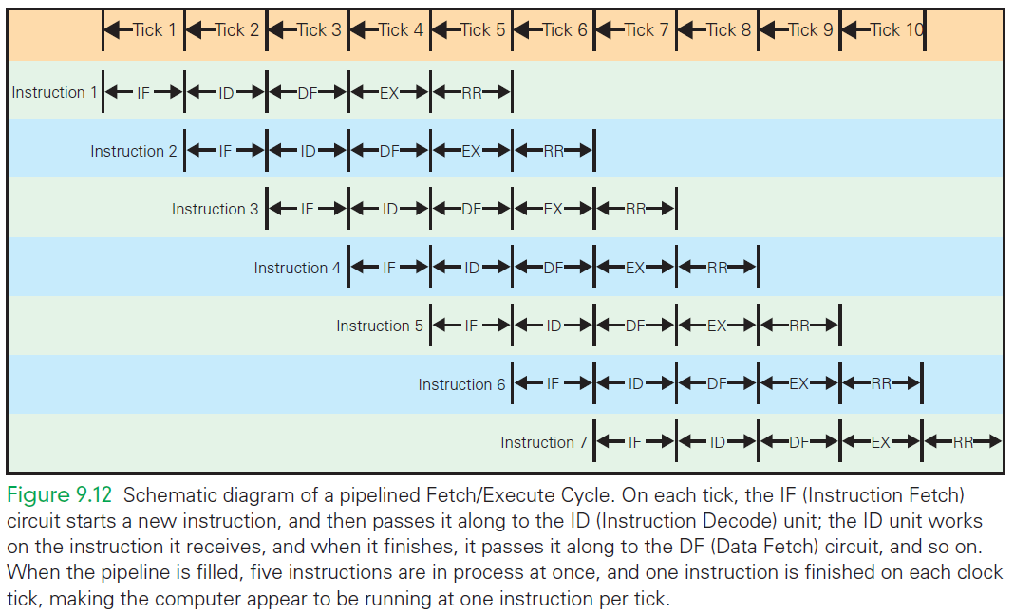
Schematic Fetch/Execute Cycle

Slide 50
Assembly language
this.Opacity += 0.02 is source code
The bits the processor needs are known as object code, binary code, or just binary
Before source code becomes object code, it needs to first become assembly code

Slide 51
Assembly language
Primitive programming language
  Uses words instead of 0s and 1s
ADD Opacity, TwoCths, Opacity
To convert source code into assembly code, the source code needs to be compiled
Every programming lanaguage has its own compiler

Slide 52
Integrated Circuits (ICs)
Miniaturization
  Computer clocks run at GHz rates because their processor chips are so tiny
  Electrical signals can travel one foot (30 cm) in a nanosecond
  Early computers (the size of whole rooms) could never have run as fast because their components were farther apart than one foot
  Making everything smaller has made computers faster

Slide 53
Integration
Early computers were made from separate parts (discrete components) wired together by hand
There were three wires coming out of each transistor, the two wires from each resistor, the two wires from each capacitor, and so on
Each had to be connected to the wires of another transistor, resistor, or capacitor

Slide 54
Integration
Active components and the wires that connect them are manufactured from similar materials by a single (multistep) process
IC technology places two transistors side by side in the silicon, and a wire connecting the two is placed in position

Slide 55
Photolithography
ICs are made with a printing process called photolithography:
  Begin by depositing a layer of material (like aluminum) on the silicon
  Cover that layer with a light-sensitive material called photoresist, and place a mask over it
  The mask has a pattern corresponding to the features being constructed
  Exposure to uv light causes open areas to harden
  Unexposed areas do not and can be washed away leaving the pattern
  Hot gases etch the original layer
  When the remaining photoresist is removed, the pattern from the remains

Slide 56
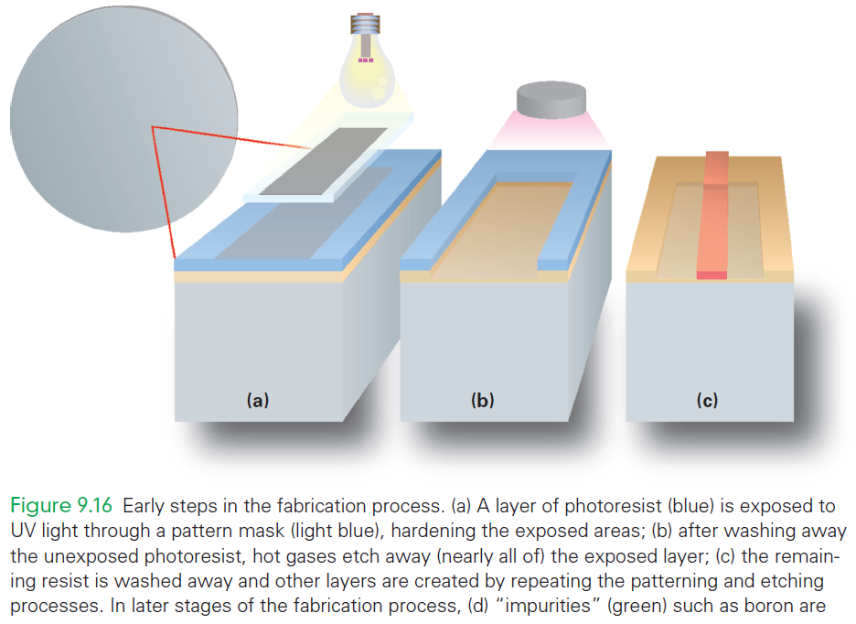

Slide 57
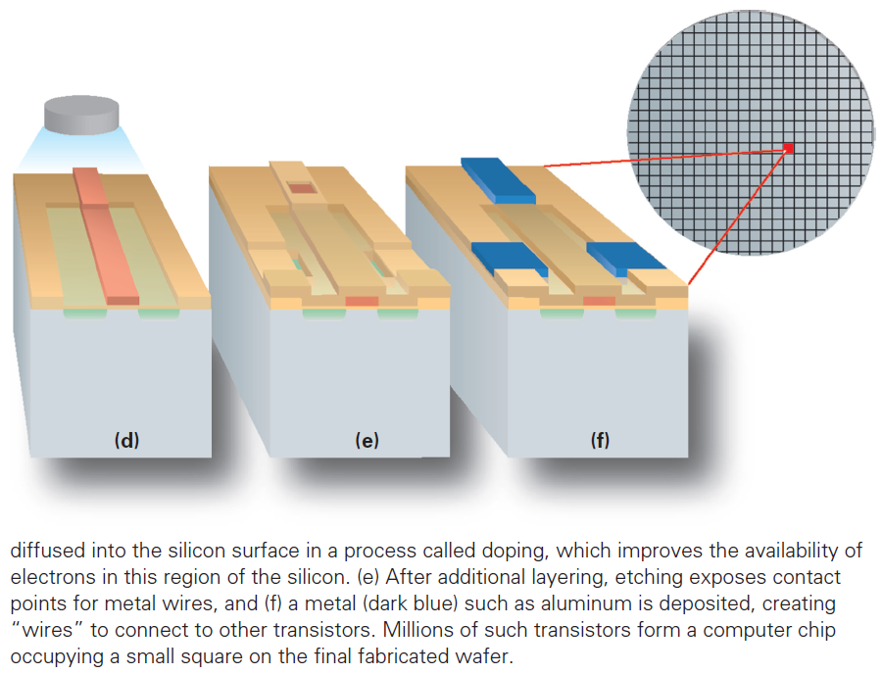

Slide 58
How Semiconductor Technology Works
Silicon is a semiconductor sometimes it conducts electricity and sometimes it does not
The ability to control when semiconductors do and don’t conduct electricity is the main process used in computer construction

Slide 59
On-Again, Off-Again
A simple principle of setting up a situation in which the conductivity of a wire is controlled to create a logical conclusion is needed
It is the basis of all the instructions and operations of a computer
In the ALU hardware, the circuit computes x AND y for any logical values x and y
Such a circuit is part of the ALU, performing the Instruction Execute step of all the AND instructions

Slide 60
The Field Effect
Conductivity of a semiconductor is controlled using the field effect
Objects can be charged positively or negatively
The effect that charged objects have on each other without actually touching is called the field effect
The field effect controls a semiconductor

Slide 61
The Field Effect
The ends of the two wires are specially treated (doped) to improve their conducting/nonconducting properties
The part between the ends is called a channel, because it creates a path for electricity to travel on
An insulator covers the channel
Passing over the insulator is a third wire called the gate

Slide 62
The Field Effect
The silicon in the channel can conduct electricity when it is in a charged field
Charging the gate positively creates a field over the channel
Electrons are then attracted from the silicon into the channel, causing it to conduct
If the field is removed, the electrons disperse into the silicon, the channel doesn’t conduct

Slide 63
Transistors
A transistor is a connector between two wires that can be controlled to allow a charge to flow between the wires (conduct) or not
The transistor is a MOS (Metal Oxide Semiconductor) transistor
Modern computers are developed with CMOS technology (“complementary MOS”)

Slide 64
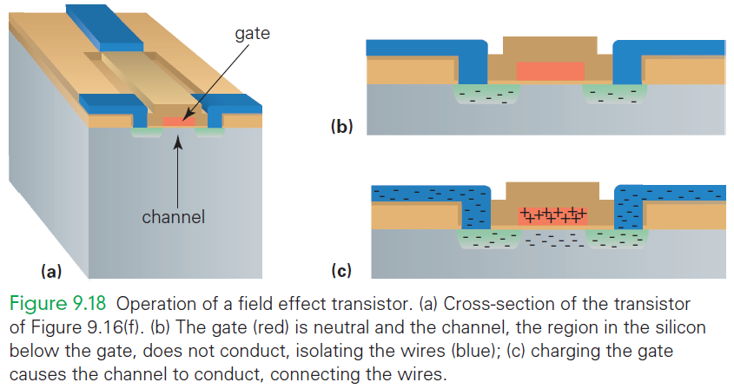

Slide 65
Combining the Ideas
Start with an information-processing task.
Task is performed by an application implemented as a large
The program performs the specific operations of the application
The program’s commands are compiled into many simple assembly language instructions
The assembly instructions are then translated into a more primitive binary form
Fetch/Execute Cycle executes the instructions

Slide 66
Summary
You learned the following:
  Modern software is written in a language using familiar terms and operations, though they are expressed very briefly; the code relies heavily on the software stack
  The repeating process fetches each instruction (indicated by the PC), decodes the operation, retrieves the data, performs the operation, and stores the result back into the memory

Slide 67
Summary
You learned the following:
  This process is hardwired into the control subsystem, one of the five components of a processor
  The memory, a very long sequence of bytes, each with an address, stores the program and data while the program is running
  The ALU does the actual computing

Slide 68
Summary
You learned the following:
  The input and output units are the interfaces for the peripheral devices connected to the computer
  Machine instructions do not refer to the data (operands) directly, but rather indirectly. Thus, different computations can be done with an instruction, just by changing the data in the referenced memory locations each time the instruction is executed

Slide 69
Summary
You learned the following:
  Programmers use sophisticated programming languages to create operating systems as well as complex applications software
  The basic ideas of integrated circuits are integrating active and connective components, fabrication by photolithography, and controlling conductivity through the field effect

