Slide 2
Learning Objectives
Explain the meaning of privacy; discuss the issues surrounding privacy of information
List and explain the meaning of the OECD Fair Information Practices
Discuss the issues concerning U.S. privacy: Opt-in/Opt-out, compliance/enforcement, coverage
List the ways a computer can be compromised
Explain the security methods used in public key cryptosystems (PKCs)
Perform simple encryption from cleartext to cipher
text and perform the reverse decryption

Slide 3
Privacy: Whose Information Is It?
Buying a product at a store generates a transaction, which produces information.
  Paying with cash generally ensures anonymity
  Paying by check, credit card, or debit card
  Purchasing through mail order or on the Internet
  Providing a “preferred customer” number
  Buying a product that must be registered for a service agreement or warranty

Slide 4
How Can the Information Be Used?
Transaction information is a normal part of conducting business (keeping a record until our check clears)
  The information belongs, then, to the store
If the store decides, based on your previous purchases, to send you ads for other items, the store is using the information for the standard business practice of generating more business

Slide 5
How Can the Information Be Used?
If the store sells your name to others has the information been misused?
  Those other businesses are only trying to generate more business.
  Is it misused if the information gets to the newspaper and is published?
  Has the store broken the law?

Slide 6
Modern Devices and Privacy
In the past, it was hard for people’s privacy to be violated without their knowledge
With modern technological devices, people’s privacy can be violated without their knowing it
Your image and your information deserves “sufficient safeguards against improper circulation”

Slide 7
Controlling the Use of Information
Who controls the use, if any, of the transaction information?
There are four main possibilities:
  No Uses. The information ought to be deleted when the store is finished with it.
  Approval or Opt-in. The store can use it for other purposes, but only if you approve.
  Objection or Opt-out. The store can use it for other purposes, but not if you object.
  No Limits. The information can be used any
  way the store chooses.

Slide 8
Controlling the Use of Information
There is also a fifth possibility, Internal Use:
  The store can use the information to conduct business with you (keeping your address, for example), but for no other use
  It would not include giving or selling your information to another person or business, but it may not require your approval either

Slide 9
Controlling the Use of Information
If the transaction took place outside the US, the law and standards would place it between (1) and (2) on the spectrum, but very close to (1).
If the transaction occurred in the US, the law and standards would place it between (3) and (4) on the spectrum, but very close to (4)

Slide 10
Controlling the Use of Information
Many Americans assume that there is a privacy law that is close to the fifth case, internal use

Slide 11
A Privacy Definition
Privacy: The right of people to choose freely under what circumstances and to what extent they will reveal themselves, their attitude, and their behavior to others.
Privacy is difficult to define
Generally, privacy concerns four aspects of our lives: our bodies, territory, personal information, and communication

Slide 12
A Privacy Definition
This definition emphasizes first that it is the person who decides the circumstances and the extent to which information is revealed, not anyone else
Second, it emphasizes that the range of features over which the person controls the information embodies every aspect of the person—themselves, their attitudes, and their behaviors

Slide 13
Enjoying the Benefits of Privacy
Sometimes we want publicity, sometimes we don’t
Strong privacy laws insure that we control the dissemination of our information

Slide 14
Threats to Privacy
What are the threats to privacy?
There are only two basic threats:
  Government
  Business
  (Snooping or gossiping private parties, will be handled by security)

Slide 15
Threats to Privacy
Historically, the governmental threat of spying on its citizens, worries people the most
The business threat is a more recent worry
There are two types of business threats:
  Surveillance of employees
  The use of business-related information for other purposes

Slide 16
Voluntary Disclosure
In principle, a person can enjoy perfect privacy by simply deciding not to reveal anything to anyone
It may be in our interest to reveal private information, freely in exchange for real benefits

Slide 17
Benefits of Voluntary Disclosure
Doctors receive our personal information so they can help us stay healthy
Credit card companies get our personal information to check our credit record in exchange for the convenience of paying with a card
Employers read our email at work, because we are using the employer’s computer for a job

Slide 18
Benefits of Voluntary Disclosure
The government may have information on us regarding our parents’ names and birthplaces, our race and ethnicity, etc. for the purpose of enjoying the rights of citizenship
How private can we be when we reveal so much about ourselves, our attitudes, and our behavior?

Slide 19
Fair Information Practices
If people or organizations are free to give or sell the information to anyone else, they are also revealing information about us.
Our privacy is compromised
There must be clear guidelines adopted for handling private information:
  The Fair Information Practices principles.

Slide 20
OECD Fair Information Practices
In 1980 the Organization for Economic Cooperation and Development (OECD) developed an eight-point list of privacy principles that became known as the Fair Information Practices
They have become a widely accepted standard

Slide 21
OECD Fair Information Practices
The public has an interest in these principles becoming law
The principles also give a standard that businesses and governments can meet as a “due diligence test” for protecting citizens’ rights of privacy, thereby protecting themselves from criticism or legal action

Slide 22
OECD Fair Information Practices
An important aspect of the OECD principles is the concept that the data controller (the person or office setting the policies) must interact with individuals about their information, if any, and must be accountable for those policies and actions!

Slide 23
OECD’s Fair Information Practices
The standard eight-point list of privacy principles.
  Limited Collection Principle
  Quality Principle
  Purpose Principle
  Use Limitation Principle
  Security Principle
  Openness Principle
  Participation Principle
  Accountability Principle
17-<number>

Slide 24
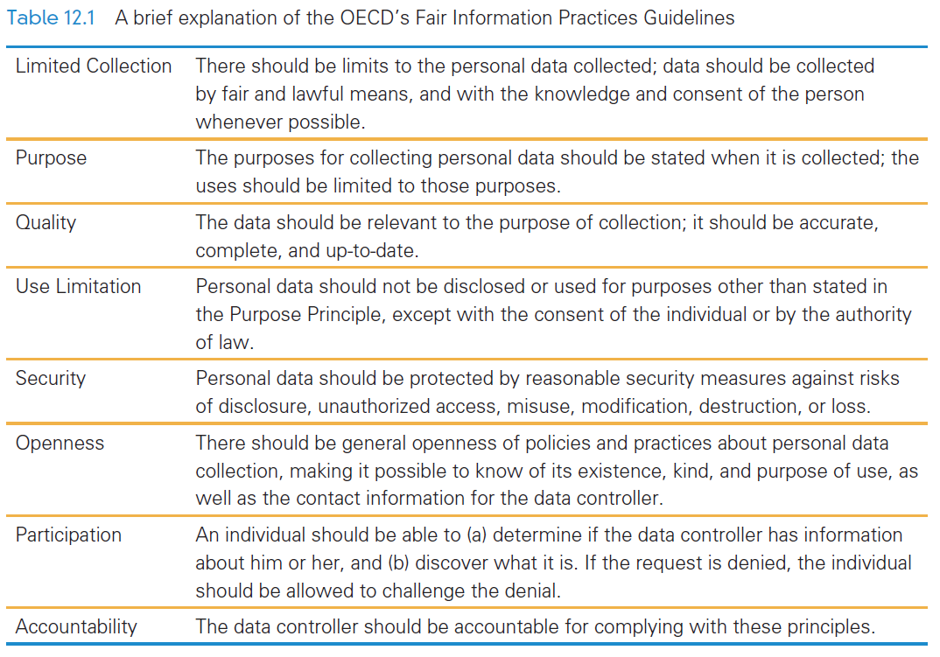

Slide 25
Privacy Worldwide
Privacy is not enjoyed in much of the world
Privacy often comes in conflict with the goals of businesses and governments:
  Example, the United States has not adopted the OECD principles, possible because many U.S. companies profit by buying and using information in ways that are inconsistent with the OECD principles

Slide 26
Privacy Worldwide
The European Union (EU) issued a benchmark law incorporating the OECD principles
  EU Directive requires that data about EU citizens be protected by the standards of the law even when it leaves their country
Other countries adopted it as well including Australia, Canada, Hong Kong, and New Zealand

Slide 27
Business as Usual
US businesses and government gathers data contrary to the OECD rules
Patriot Act makes it a crime to say that data gathering is taking place

Slide 28
Business as Usual
Almost every store and company you do business with has information about you
  if you want to know what they are doing with that information you must read their privacy policies
  often it says, “We use the information however we like.”

Slide 29
Targeted by Target
“Big Data” is the statistical analysis of huge information archives
the retailer Target can figure out if a woman is pregnant from her buying habits
  was able to develop a ‘pregnancy predication’ score by analyzing all of the data

Slide 30
Government, as Usual
In June 2013, Edward Snowden revealed that the U.S. government was collecting complete metadata records from telephone carriers
  it is still unknown if these allegations are true
The government was also collecting online activity from Facebook, Microsoft, Google, etc.
Included data to calls to other countries with OECD laws in place

Slide 31
Tracking
in electronic privacy, tracking is used in two different ways
  online tracking: Web site automatically sending details about your visit to other content providers (to show you adds and other products)
  cell phone tracking: positioning information, used to map your physical location

Slide 32
Online Tracking
we assume it is used to target advertising and marketing organizations
but anyone could arrange to follow your “click streams”
HTTP has a “Do Not Track” flag that tells Web servers your tracking preferences
  it is up to the Web server to honor your request

Slide 33
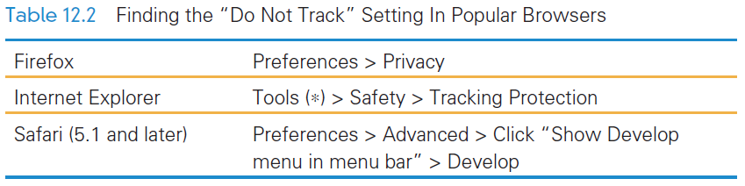
Do Not Track
Notice that Google’s Chrome browser does not support user requests not to track.

Slide 34
Even More Private
“Do Not Track” is controversial because consumer behavior is very valuable, but people don’t want anyone following them around (even online)
Two additional protections
  National Advertising Initiative opt-out program
    http://www.networkadvertising.org/choices/
  DoNotTrackMe offers a free blocker
    https://www.abine.com/index.php

Slide 35
Private Browsing
“client side” facility
  only concerns the information stored locally on your machine, not what's stored on servers
all cookies, cached files, and history are deleted at the end of the session
useful when using a public computer

Slide 36
Cell Phones
it is possible to determine where a cell phone is, even if “location services” (GPS) is off
  based on proximity to cell phone towers
Freedom of Information Act (FOIA) request was launched in 2010
  companies keep it for a while, and the NSA keeps it permanently

Slide 37
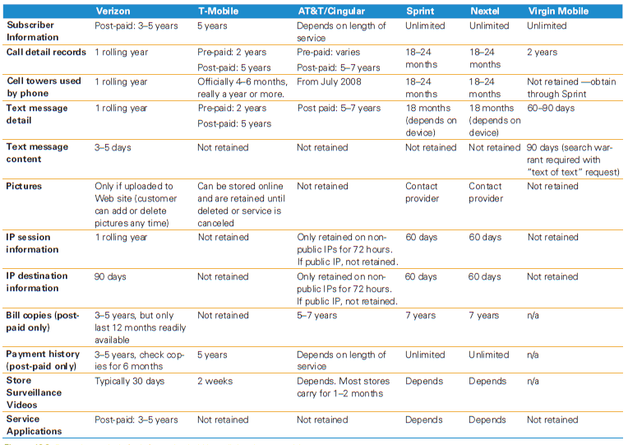

Slide 38
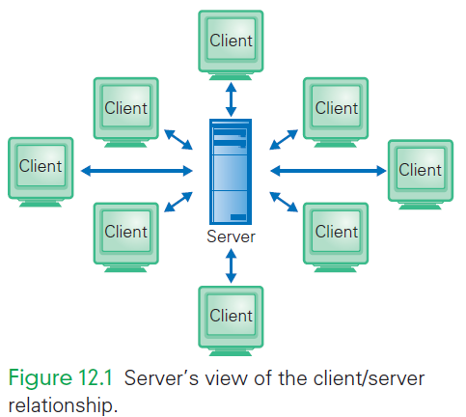
Cookies
Cookies are a standard computer science concept originally used by Netscape engineers to connect the identity of a client across a series of independent client/server events

Slide 39
Cookies
Imagine this is your bank’s server, and you are a client
The server is helping many clients at once, and to know who’s who, the server stores a cookie of information that uniquely identifies you

Slide 40
Cookies
Cookies are exchanged between the client and the server on each transmission of information, allowing the server to know which of the many clients is sending information

Slide 41
Cookies
Many sites use cookies, even when the interaction is not intended to be as secure as a bank transaction (National Air and Space Museum sent the above)
The meaning of the fields is unimportant
The first is the server and the last is
the unique information identifying the session

Slide 42
Cookie Abuse
There is a loophole called a third-party cookie
A cookie is exchanged between the client and server making the interaction private
But, if the Web site includes ads on its page, the server may direct it to link to the ad company to deliver the ad
This new client/server relationship
places a cookie on your computer

Slide 43
Cookie Abuse
All browsers allow users to control how cookies are processed
You could turn them off, forcing the browser to ask you every time whether you will accept a cookie or not
Turning off cookies prevents you from being able to bank online
Simply set your browser’s cookie
policy to your own comfort level

Slide 44
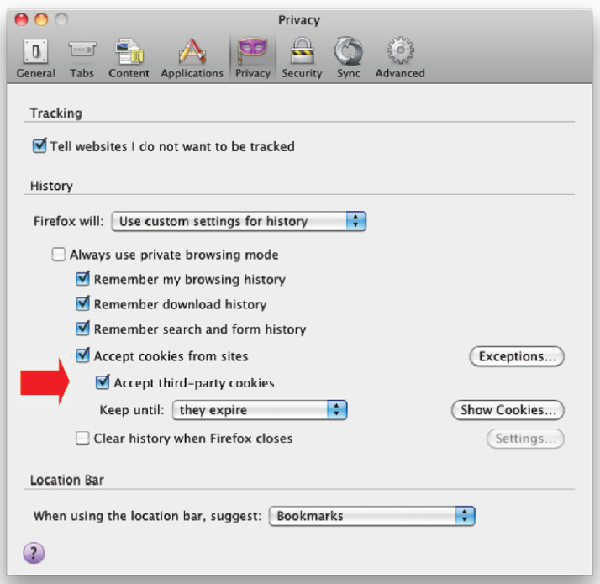

Slide 45
Identity Theft
The Security Principle of the Fair Information Practices is also important
  The Security Principle states that those who hold private information are obligated to maintain its privacy against unauthorized access and other hazards
Americans do not enjoy protection from this principle either

Slide 46
Identity Theft
How can this private information be used?
One possibility is identity theft the crime of posing as someone else for fraudulent purposes
Over 800 identity thefts have been reported from the one instance of private information “viewed” by unauthorized persons!

Slide 47
Digital Security
Computer security is a topic that is in the news almost daily
Remember the long list of “dos and don’ts” for online behavior?
  Do check with the sender before opening an attachment you’re unsure about
  Don’t fall for phishing emails
  And the other’s from Chapter 11?

Slide 48
The Risks: What can happen?
Mischief: infecting a computer, causing a nuisance, erasing files, trashing files, etc
Information theft: stealing personal information
Spying: surreptitiously recording videos of the user, logging keystrokes, compromising secure online activities
Resource theft: taking over a computer

Slide 49
Terms and Jargon
Malware: software that harms computers
Virus: shared program the contains code to reproduce itself
Worm: program that is often embedded in an email attachment, reproduces itself and sends a copy to everyone on your contact list
Exploit: when software takes advantage of bugs in commercial software
Trojan: malicious program that performs unauthorized activities

Slide 50
What Does Malware Do?
Backdoors: software that creates an access path allowing attackers to run any program on your computer
Trojans: may record every key you type (trying to find passwords), extort money, watch for banking and credit card information
Rootkits: infects your computer and then fights back against security systems

Slide 51
Plan of Action
Turn off Bluetooth when not in use
Keep your phone and other computers locked
Do not automatically click on email attachments
Never enter sensitive information in a pop-up

Slide 52
Plan of Action
Thinking of getting something for nothing
  Think again
Know where you’re going
Be somewhat skeptical
Use extreme care when visiting notorious sites

Slide 53
If Something Really Bad Happens
Turn off your computer immediately
Use a different computer to do a web search about what happened
Use an external source for the OS to reboot

Slide 54
Plan of Action
Run “modern” software
Install updates often
Install anti-virus software
Set your Wi-Fi router to security level of at least WPA2
Password-protect your phones and computers with appropriate passwords (chapter 11)
Use your knowledge, be wise

Slide 55
Encryption
Information that is recoded to hide its true meaning uses encryption
A major component of encryption is the key
They come in two forms:
  Private
  Public

Slide 56
Encryption
The key is a “magic number” used to transform text into gibberish (cipher text)
Both the sender and receiver must agree on the key
The process of sending an encrypted message is a five-step algorithm

Slide 57
Encryption
5-Step Encryption algorithm:
  The sender breaks the message into groups of letters
  “Multiply” each group of letters times the key
  Send the “products”/results from the “multiplications” to the receiver
  The receiver “divides” the “products” by the key to recreate the groups
  Assemble the groups into the message

Slide 58
Encryption
This works because the math works
The “reversibility” of encryption makes them 2-way ciphers
  Only the sender and receiver know the key, making the products useless numbers
This is a secure communication
The technique just explained is called private key encryption, or symmetric-
key cryptography

Slide 59
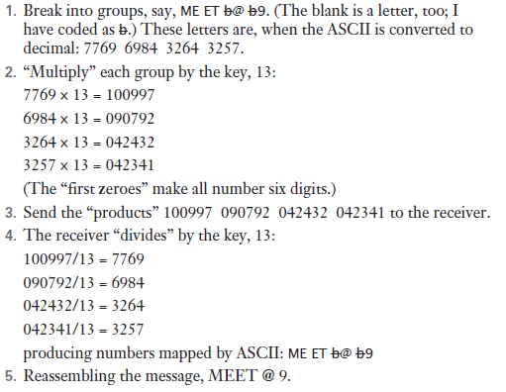
Encryption Example

Slide 60
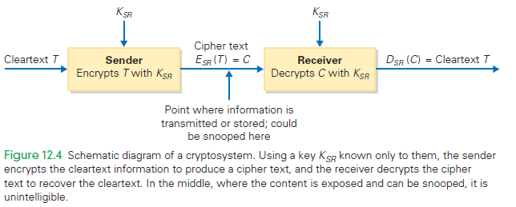
Cryptosystem Schematic Diagram

Slide 61
Private Key Encryption
Real encryption systems use much longer blocks (hundreds of letters) and larger keys
Multiplication, division are not the only operations that can be used for encryption
All that is needed is for an operation to have an inverse (divide is the inverse of multiply)

Slide 62
Private Key Encryption
Private key encryption works very well
Only one small problem: The sender and receiver have to agree on the key, which means they need to communicate somehow
Usually, they meet face-to-face (they can’t email, they don’t have a key yet!)

Slide 63
Public Key Encryption
To avoid that face-to-face meeting, publish the key!
Use public key encryption
  Two special prime numbers multiplied together

Slide 64
Public Key Encryption Steps
After, the receiver publishes the special key, K, the following happens:
  The sender breaks up the message into blocks as before
  The sender cubes each block, and divides by K, keeping only the remainders
  The remainders are transmitted

Slide 65
Public Key Encryption Steps
After, the receiver publishes the special key, K, the following happens:
  The receiver raises each remainder to a high power determined by the prime numbers and known only to him
  The receiver divides by K, too, and saves only the remainders, which are the original blocks.
  The receiver assembles the message

Slide 66
How Do We Know It Works?
K, the magic public key, is just two prime numbers, p and q, multiplied together
It is possible to figure out those two numbers from the published key in theory.
This process, called factoring, is tough if the numbers p and q are large (60 digits apiece)
It is impractical to factor them no matter how powerful the computer!

Slide 67
Redundancy Is Very, Very, Very Good
Take precautions with your technology!
Businesses archive files daily and store these backups off-site
They have a system recovery team to clean up after a disaster strikes
They also have system redundancy—multiple computers performing the same work, so that when one fails, another is up and running

Slide 68
Fault Recovery Program
Full backup
  A complete copy of everything written on the system as of a date and time
Partial backup
  Changes since the last full (or partial) backup are saved
  “Changes” means to keep a copy of any files or folders that have been created or modified

Slide 69
Fault Recovery Program
After a disaster, recover by installing the last full backup copy
Then make the changes saved in the partial backups in order
Continue with each partial backup until the most recent
That’s as close to “full recovery” as possible

Slide 70
Backing Up a Personal Computer
First, you need a place to keep the copy, and you need software to make the copy
The two easiest “places” to keep the copy are on an external hard disk or “in the cloud”
The “cloud” company’s computers store the information for you and they take responsibility of keeping it available
to you

Slide 71
Backups
You don’t have to back up the following:
  Information that can be recreated from some permanent source
  Information that was saved but that has not changed
  Information that you don’t care about

Slide 72
Recovering Deleted Information
If you accidentally delete important files, file restoration (that backup copy!) is great!
Backups can save evidence of crimes or inappropriate behavior (digital copies of files are easy to create and store)
Two copies of email are produced immediately when the Send button is clicked—one in the sent mail directory, and one somewhere else

Slide 73
Summary
Revealing personal information can be beneficial, so the people and organizations that receive the information must keep it private
  The guidelines for keeping data private have been created by several organizations, including the Organization for Economic Cooperation and Development (OECD)

Slide 74
Summary
Guidelines often conflict with the interests of business and government, so some countries like the United States have not adopted them
  Because the United States takes a sectorial approach to privacy, adopting laws only for specific business sectors or practices, much of the information collected on its citizens is not protected by OECD standards

Slide 75
Summary
The Do Not Track flag should be set, and DoNotTrackMe should be installed to avoid third parties building a profile of your Web surfing behavior
The best way to manage privacy in the Information Age is to have OECD-grade privacy laws
There are two key features to encryption: private key and public key techniques

Slide 76
Summary
Public key cryptography (PKC) is a straightforward idea built on familiar concepts
Computer scientists have not yet proved the invincibility of the RSA scheme, but it can be “made more secure” simply by increasing the size of the key.

Slide 77
Summary
Viruses and worms cause damage
  We can reduce the chance of infection by installing and running anti-virus software
  We must be aware of hoaxes and phishing scams
We can implement a plan of action to ensure that our personal computers remain private and secure

Slide 78
Summary
Backing up computer files is an essential safeguard
  It ensures that your files will survive for a long time, even if you don’t want them to

