Slide 2
Learning Objectives
Explain the differences between everyday tables and database tables
Use XML to describe the metadata for a table of information, and classify the uses of the tags as identification, affinity, or collection
Understand how the concepts of entities and attributes are used to design a database table
Use the six database operations: Select, Project, Union, Difference, Product, and Join
Express a query using Query By Example
Describe the differences between physical and logical databases

Slide 3
Differences Between Tables and Databases
When we think of databases, we think of tables of information:
  iTunes show the title, artist, running time on a row
  Your car’s information is one line in the state’s database of automobile registrations
  The U.S. is a row in the demography table for the World’s listing of country name, population, etc.

Slide 4
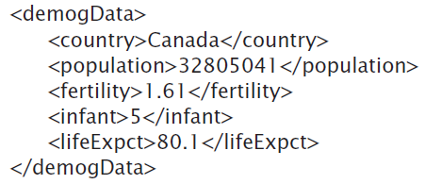
Comparing Tables
These images show how the row of data is described using tags

Slide 5
The Database’s Advantage
Metadata is the key advantage of databases over other approaches to recording data as tables
  enables content search
Two most important roles in defining metadata
  Identify the type of data: each different type of value is given a unique tag
  Define the affinity of the data: Tags enclose all data that is logically related

Slide 6
XML:
A Language for Metadata Tags
XML stands for the Extensible Markup Language
It is a tagging scheme
What makes XML easy and intuitive is that there are no standard tags to learn
Tags are created as needed
  This trait makes XML a self-describing language

Slide 7
XML:
A Language for Metadata Tags
There are a couple of rules:
  Always match tags
  Basically anything goes
XML works well with browsers and Web-based applications
XML must be written with a text editor to avoid unintentionally including the word processor’s tags (see Chapter 4)

Slide 8
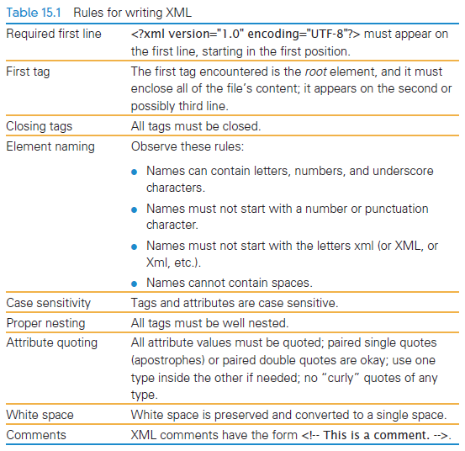
Rules for Writing XML

Slide 9
XML
As with HTML, the tag and its companion closing tag surround the data
XML tag names cannot contain spaces
Both UPPERCASE and lowercase are allowed
XML is case sensitive
Like XHTML, XML doesn’t care about white space between tags

Slide 10
XML Example
Scenario:
  Create a database for the Windward Islands archipelago in the South Pacific
  Plan what information will be stored
  Develop those tags:
    <archipelago>
    <island>
    <iName> Tahiti </iName>
    <area>1048</area>
    </island>
    ⁞
    </archipelago>
Affinity role

Slide 11
XML
<?xml version = "1.0" encoding="UTF-8" ?>
This required line is added at the beginning of the file
Note the question marks.
This line identifies the file as containing XML data representations
The file also has standard UTF-8 encoded characters

Slide 12
Expanding the Use of XML
To create a database of the two similar items (in this chapter, archipelagos), put both sets of information in the file
As long as the two sets use the same tags for the common information, they can be combined
Extra data is allowed and additional tags can be created (<a_name> to indentify which archipelago is being used)

Slide 13
Expanding the Use of XML
Group sets of information by surrounding them with tags
These tags are the root elements of the XML database
A root element is the tag that encloses all content of the XML file
  In Figure 15.1 the <archipelago> tag was the root element

Slide 14
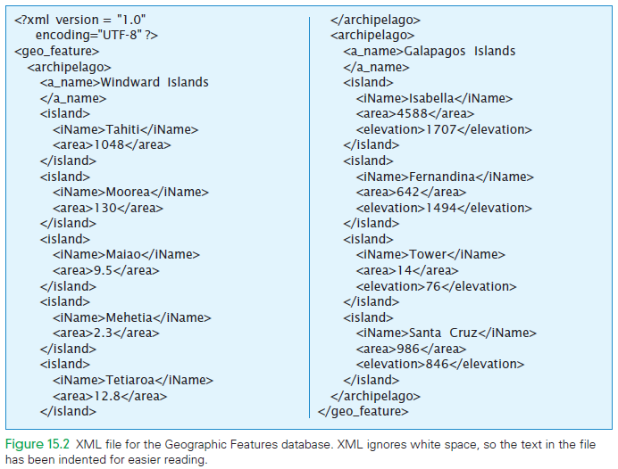
New root element

Slide 15
Attributes in XML
XHTML tags can have attributes to give additional information
Tags of XML also have attributes
  They have a similar form
  Must always be set inside simple quotation marks
  Tag attribute values can be enclosed either in paired single or paired double quotes

Slide 16
Attributes in XML
Writing tag attributes is easy enough
The rules for using quotes are straightforward
Use attributes is to use them for additional metadata, not for actual content

Slide 17
Effective Design with XML Tags
XML is a flexible way to encode metadata
Identification Rule: Label Data with Tags Consistently
  You choose the tags, but once you’ve decided you must always surround that kind of data with that tag
  Keeps data together

Slide 18
Effective Design with XML Tags
Affinity Rule: Group Data Referencing an Entity
  Enclose in a pair of tags all tagged data referring to the same thing
  Grouping it keeps it all together, but it also makes an association of the tagged data items as being related to each other

Slide 19
Effective Design with XML Tags
Collection Rule: Group Instances
  When you have several instances of the same kind of data, enclose them in tags
  Keeps them together and implies that they are instances of the same type

Slide 20
The XML Tree
The rules for producing XML encodings of information produce hierarchical descriptions
  Can be thought of as trees
  The hierarchy is a consequence of how the tags enclose one another and the data

Slide 21
Tables and Entities
lets set aside the tagging and XML and focus on database tables
the XML tree on the next slide shows the root element to the left and the leaves (content) to the right

Slide 22
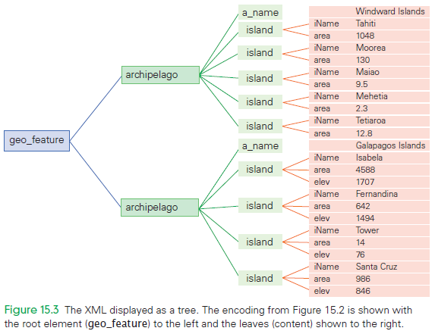

Slide 23
Database Tables
Any group of things with common characteristic that specifically identify each one can be formed into a database table
contains a set of things with common attributes

Slide 24
Database Vocabulary
Entities: rows of the database table
Attribute Name: column heading
Entity Instance: value in a row
Table Instance: whole table

Slide 25
What to Notice
Rows are all different
  Two rows can have the same value for some attributes, but not all
Even when we don’t know the data for an attribute value it is still a characteristic
The rows can be in any order
The columns can be in any order

Slide 26
What to Notice
Rearranging the rows or columns will result in the same table
If we add (or remove) rows, or change a value we create a new table instance

Slide 27
Properties of Entities
A database table can be empty
  It is a table with no rows
An entity is anything defined by a specific set of attributes
A table exists with a name and column headings
Once entity instances have been specified, there will be rows
Among the instances of any table is the “empty instance”

Slide 28
Every One is Different
Amoebas are not entities, because they have no characteristics that allow us to tell them apart
One-celled animals are entities
In cases where it is difficult to process the information specifically identifying an entity, we might select an alternate encoding
Entities are the data of databases

Slide 29
Relational Database Tables
Tables are technically called relations, but we’ll continue to call them database tables
The rows must always be different, even after adding rows
  Be sure the table has all of the attributes (columns) needed to tell the entities apart
  You can always add a sequence number to guarantee that every row is different

Slide 30
Keys
By itself, repeated data in a column is not a problem
We are interest in columns in which all of the entries are always different, because they can be used to look up data
  such a column is called a candidate key
  doesn't’t have to be just one column (it can be multiple columns together)

Slide 31
Keys
Primary Key: candidate key that the computer and user agree will be used to locate entries during database operations

Slide 32
A Database Table’s Metadata
It is possible to succinctly describe a database table with a database scheme or database schema
  Attributes are listed, one per row
  For each attribute, the user specifies its data type and whether or not it is the primary key
  It is also customary to include a brief description
The database scheme is the database table’s metadata

Slide 33
Computing with Tables
To get information from database tables, we write a query describing what we want
Query: command that tells the database system how to manipulate its tables to computer the answer
  the answer will be in the form of a database table
We need to know 6 operations

Slide 34
Project Operation
Project (pronounced prōJECT) picks out and arranges columns from one database table to create a new, possibly “narrower”, table

Slide 35
Select Operation
The Select operation picks out rows according to specified criterion

Slide 36
Cross-Product Operation
Combines two tables in a process like multiplication
  For reach row in the first table, we make a new row by appending a row form the second table
  All combinations are in the result
The order in which the two operations are applied doesn’t matter

Slide 37
Cross-Product Operation
Because we pair all rows, a table with m rows crossed with a table with n rows will produce a table with m*n rows
Using cross-product with other table operations is powerful

Slide 38
Union Operation
Combines two tables with compatible attributes (columns)
The result has rows from both tables
For any rows that are in both tables, only one copy is included in the result

Slide 39
Difference Operation
The opposite of the Union operation
D1 – D2 contains the rows of the D1 table that are not also in the D2 table

Slide 40
Join Operation
Join is a combination of a Cross-Product, followed by a Select operation
Takes two database tables, and an attribute from each one (D1.a1 and D2.a2)

Slide 41
Join Operation
Join crosses the two tables and then uses Select to find those rows of the cross in which the two attributes match
  D1.a1 = D2.a2
Puts tables together while matching up related data

Slide 42
Ask Any Question
“How many men from Africa have won an Olympic gold medal in the marathon?”
A computer can answer this question Imagine that the database contains two tables
  one with a list of all men who have won Olympic medals over the years
  the other is a list of African countries with country codes

Slide 43
Ask Any Question
Select only those rows from OlympicMen referring to the marathon
    The portion of OlympicMen
Select only those rows from OMMarathon referring to gold medalists
    A table with all marathon runners who were gold medal winners

Slide 44
Ask Any Question
Cross OMMGold with the AfricanCountries table and keep only the matches (using a Join)
    Table of marathon gold medalists from Africa (we will call it Olympians)
Project Olympians to get the final result

Slide 45
Summarizing the Science
Joining is optional
  It is always possible to express what Join does using only Cross-Product and Select
Five operations do the work
  Given a set of database tables for entities, the operations of Project, Select, Cross-Product, Union and Difference are sufficient to create any database table derivable from them

Slide 46
Summarizing the Science
The Relationship Metadata
  Notice that we used operations in queries
  We have exploited the fact that data in one table was related to data in another table
  To maximize the help the database system gives us, we need to tell the software about these relationship
  a relationship is a property of two attributes saying that there is a connection between their data values

Slide 47
SQL: The Language of Databases
The most widely used database language is SQL (Structured Query Language)
The operations we call Project and Select are combined into one command called Select
  uses WHERE to specify the formula
Users INNER JOIN rather than just JOIN

Slide 48
Query By Example
The Access UI presents users with the opportunity to select the tables to be input to the query
Next, the attributes in the final result are listed from a drop-down menu in each column

Slide 49
Query By Example
Once the attributes are selected, constraint formulas can be entered into the criteria row
We must tell the database system that the attributes refer to the same information
  saying that a relationship exists between the two fields

Slide 50
Query By Example
On releasing the mouse, a line is drawn indicating the relationship
  Ready to run the query and build the table

Slide 51
Structure of a Database
There are two forms of tables:
  The physical database is stored on the disk drives of the computer system and is a permanent repository of the database
  The logical database is known as the view of the database, created for users on-the-fly, customized for their needs

Slide 52
Physical Database
The physical database is designed by database administrators
Data must be accessed fast
The physical database is set up to avoid redundancy (duplicate information)
  There is a good chance that data stored in various places will not be updated

Slide 53
Logical Database
The logical database shows users the view of the information they need and want
It doesn’t exist permanently, but is created every time they need it
The logical database is retrieved from the one copy stored in the physical database, and provided to the users as needed

Slide 54
Logical Database
Creating a new copy each time is essential
  If it were to be created once and then stored on the user’s computer, then there would be two copies of the information
The other advantage of creating specialized versions of the database for each user is that different users want to see different information

Slide 55
Queries
A query is a specification using the five operations and Join that define a table from other tables
Queries are written in the standard database language SQL (Structured Query Language)
SQL allows a new query to be run each time it is selected or opened

Slide 56
Summary
In this chapter we followed a path from XML tagging through to the construction of logical views using QBE
You learned a lot, including the following:
  XML tags are an effective way to record metadata in a file
  Metadata is used to identify values; it can capture the affinity among values of the same entity, and can collect a group of entity instances

Slide 57
Summary
  Database tables have names and fields that describe the attributes of the entity contained in the table
  The data that quantitatively records each property has a specific data type and is atomic

Slide 58
Summary
  The five primitive operations on tables are Select, Project, Union, Difference, and Product
    These operations are the only ones you need to create new tables from other database tables
  Join is an especially useful operation that associates information from separate tables in new ways, based on matching fields

Slide 59
Summary
  Relationships are the key to associating fields of the physical database
  The physical database resides on the disk drive; it avoids storing data redundantly and is optimized for speed
  There is a direct connection between the theoretical ideas of database tables and the software of database systems

