Slide 2
Learning Objectives
Tell the difference between name, value, and variable
List three basic data types and the rules for specifying them in a program
Explain the way in which the assignment statement changes a variable’s value
Write expressions using arithmetic, relational, and logical operators
Write conditional and compound statements

Slide 3
Programming Concepts
Programming is the act of formulating an algorithm or program
A systematic means of solving a problem
  Someone (and a computer) can follow the instructions and produce the intended result for every input, every time

Slide 4
Programming Concepts
The program must be able to perform or be executed without the programmer
All steps must be spelled out precisely and effectively
All contingencies must be planned for

Slide 5
Programming Concepts
Programming requires thinking
Basic programming concepts provide tools needed to formulate any computation
Trying to program an algorithm precisely using English is hopeless
Natural languages are too ambiguous for directing anything as clueless as a computer

Slide 6
Programming Concepts
This chapter introduces the following programming concepts:
  Names, values, and variables
  Declarations
  Data types, numbers, string literals, and Booleans
  Assignment
  Expressions
  Conditionals

Slide 7
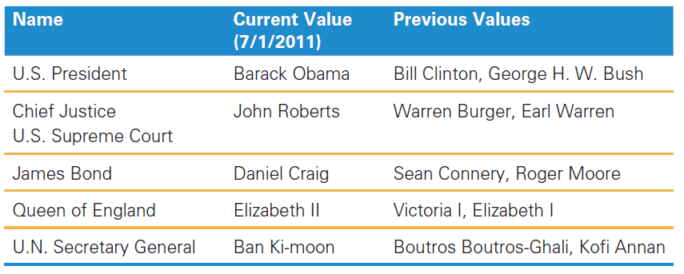
Names, Values, and Variables
Names Have Changing Values
  Names and values are separable in programming
  Names have changing values

Slide 8
Names, Values, and Variables
Names change values
A program is a fixed specification of a process
As the process evolves, the names must refer to these new values
In computing, the name is always separable from the value, and the value can be changed

Slide 9
Names in a Program are
Called Variables
In programming terminology, the names are called variables
Variables mean that values vary
The most commonly used programming language operation is the command to change the value of a variable:
  Called assignment

Slide 10
Identifiers and Their Rules
The letter sequence that makes up a variable’s name is called the identifier
Identifiers have a particular form
Identifiers must begin with a letter, followed by any sequence of letters, numerals, or the underscore symbol
Identifiers are not allowed to contain spaces

Slide 11
Identifiers and Their Rules
Note two features of identifiers:
  The underscore symbol can be used as a word separator
    It makes identifiers more readable
    “No spaces” rule
  Identifiers are case sensitive
    UPPERCASE and lowercase letters are different

Slide 12
Variable Declaration Statement
Programs are usually written “starting from scratch”
The first thing to do when writing any program is to state or declare the variables that will be used
Declaring variables is done using a command called a declaration
In JavaScript, the declaration command is the word var, followed by a list of the identifiers for the variables to be declared, separated by commas

Slide 13
Variable Declaration Statement
var area, radius;
This command declares that two identifiers (area, radius) will be used as variables

Slide 14
The Statement Terminator
A program is simply a list of statements;
Each statement must be terminated by some punctuation symbol;
The statement terminator in JavaScript is the semicolon;
The computer needs the semicolon to know when a statement is complete;
Terminate every statement with a semicolon;

Slide 15
Rules for Declaring Variables
Every variable used must be declared
JavaScript allows declaration statements anywhere in the list of statements
Variable declarations announce what variables will be used in the program
Declare variables first

Slide 16
Undefined Values
The declaration states that the identifier is the name of a variable
The name has no value at first, it is not defined
It is a name that doesn’t name anything
The name is declared but there is no value assigned yet
  The value is undefined

Slide 17
Initializing a Declaration
Sometimes there is an initial value for identifiers
  JavaScript allows setting the initial value as part of the declaration
  This is called initializing the variable
Declaring variables with initial values is written as:
  var taxRate = .088;
  var balanceDue = 0;

Slide 18
Initializing a Declaration
Variables can be declared and initialized by separating them with commas:
  var taxRate = .088, balanceDue = 0;
Usually several variables are declared in a single declaration statement when the variables are logically related
If the variables are not related, they are usually specified in separate statements

Slide 19
Three Basic Data Types of JavaScript
There are three types of data in the JavaScript programs used in this book:
  numbers,
  strings, and
  Booleans

Slide 20
Rules for Writing Numbers
There are rules for writing numbers
One “unusual” aspect of numbers in programming is that there are no “units”
  Numbers must be written in decimal form (0.33, not 33%; 10.89, not $10.89)
Standard computer numbers
  Have about 10 significant digits
  Range from as small as 10⁻³²⁴ to as large as 10³⁰⁸

Slide 21
Rules for Writing Numbers
Numbers and computer arithmetic are unexpectedly subtle
As a general rule, the “safe zone” for numbers is the range from 2 billion to 2 billion plus or minus

Slide 22
Strings
Strings are a common kind of data
Strings are “sequences of keyboard characters”
Notice that a string is always surrounded by single (') or double (") quotes
Strings can initialize a declaration
Strings are needed when manipulating text

Slide 23

Rules for Writing Strings in JavaScript
There are rules for writing strings in JavaScript:
  Strings must be surrounded by quotes, either single (') or double ("), which are not curly
  Most characters are allowed within quotes except:
    the return character ( ), backspace character, tab character, \, and two little used others
  Double quoted strings can contain single quotes, and vice versa

Slide 24
Rules for Writing Strings in JavaScript
There are rules for writing strings in JavaScript:
  The apostrophe (') is the same as the single quote
  Any number of characters is allowed in a string.
  The minimum number of characters in a string is zero (""), which is called the empty string

Slide 25
Strings
To use double quotes in a string, enclose the string in single quotes:
var answer = 'He said, "No!“ ‘
If our string contains single quotes, enclose it in double quotes:
var book = "Guide to B&B's"
Since the apostrophe is commonly used in possessives and contractions, use double quotes as the default

Slide 26
String constants or string literals
The term literal means that the characters are typed literally in the program
There are rules about how to write literals:
  The surrounding quotes are removed when the literal is stored in the computer
  Any character can be stored in the computer’s memory
  Prohibited characters can be the value of a string in the computer by using the “escape” mechanism

Slide 27
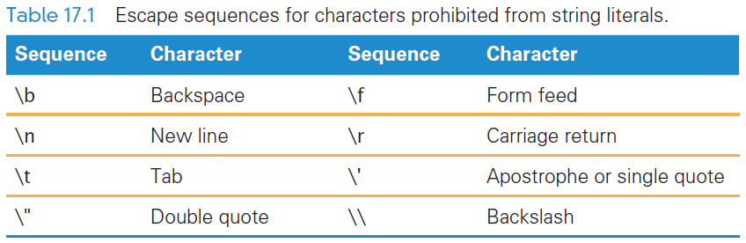
Escape Mechanisms
For JavaScript, the escape symbol is the backslash (\)
The escape sequences are converted to the single characters they represent when stored in the computer’s memory

Slide 28
Boolean Values
Another kind of value is the Boolean value (Booleans)
There are only two Boolean values:
true and false
Boolean values are written as letter sequences, they are values, not identifiers or strings
Booleans are used implicitly throughout the programming process

Slide 29
Values in Programming
The different kinds of values of a programming language are called its data types
There are three types used here for JavaScript: numbers, strings, and Booleans
There are several other types

Slide 30
The Assignment Statement
If variables are to change values in an algorithm or program, there should be a command to do so
The assignment statement changes a variable’s value
An assignment statement has three parts that always occur in this order:
  <variable> <assignment symbol> <expression>;

Slide 31
The Assignment Statement
The assignment statement is terminated by a semicolon
JavaScript’s <assignment symbol> is the equal sign (=)

Slide 32

Assignment Symbol
Different programming languages use different symbols for indicating assignment
The three most widely used symbols are:
  The equal sign (=)
  The colon/equal sign pair (:=)
  The left pointing arrow (←)
  An example of an assignment is:

Slide 33
Interpreting an Assignment Statement
To understand how assignment works, you must think of a value flowing from the right side (expression side) to the left side (variable side)
The assignment symbol should be read as “is assigned ” or “becomes” or “gets”
These terms emphasize the role that the assignment symbol plays in changing the value of the variable named

Slide 34
Interpreting an Assignment Statement
In an assignment statement everything to the right of the assignment symbol is computed/evaluated first
If there are any variables used, their current values are used
The evaluation produces a value that then becomes the new value of the variable named on the left side

Slide 35
Interpreting an Assignment Statement
Executing the sample assignment statement: weeks = days/7;
The current value of days is retrieved from memory
That value is divided by 7
The answer becomes the new value of the variable weeks

Slide 36
Three Key Points About Assignment
There are three key points to remember about assignment statements:
  All three of the components must be given
  The flow of the value to the name is always right to left.
  The values of any variables used in the expression are their values before the start of execution of the assignment
This last point is the most important

Slide 37
Lab Practice
From now on in our JavaScript study, everything we learn, we can try in the Firefox browsers
  learning programming is active!
We will use Firefox Scratchpad
Then transfer the JavaScript to other Web pages

Slide 38
Lab Practice
Tools > Web Developer > Scratchpad
Comments in JavaScript
  multiline begin with /* and end with */
  end of line use //
Type in the code below
  var days = 77;
  var weeks;
  weeks = days / 7;

Slide 39
Lab Practice
To see the result, use the Display command (^L)
Change days to be initalized to some other number, instead of 77 and display the new result

Slide 40
Lab Practice
Initialize two more variables (totalScore, and shotClock) to 10
Then write two assignment statements, one that adds 3 to totalScore and the other that subtracts 1 from shotClock
To Save your work type ^S, then save the file with a .js extension

Slide 41
An Expression and Its Syntax
Programming is not mathematics but it has its roots there
One programming concepts is an algebra-like formula called an expression
Expressions describe the means of performing an actual computation
Expressions are built of variables and operators:
  addition (+) and subtraction(–)
  multiplication (*) and division (/ )
These are called the arithmetic operators

Slide 42
Arithmetic Operators
Expressions usually follow rules similar to algebraic formulas
Multiplication must be given explicitly with the asterisk (*) multiply operator: a * b
Multiplication and division are performed before addition and subtraction
  They have a higher precedence than addition and subtraction
  Parentheses can bypass that order

Slide 43
Arithmetic Operators
Superscripts (x²) are prohibited
Some languages have an operator for exponents or powers, but not JavaScript
If we want to square the value of x, then you must multiply it times itself:
x * x

Slide 44
Arithmetic Operators
Operators like + and * are called binary operators
  They operate on two values
  The values are called operands
There are also unary operators
  Negate (−) has only one operand
  This is NOT subtract

Slide 45
Arithmetic Operators
Another useful operator is mod
The modulus (mod) operation (%) divides two integers and returns the remainder
  The result of a % b for integers a and b is the remainder of the division a/b
  Examples:
  4%2 is 0 because 2 evenly divides 4
  5%2 is 1 because 2 into 5 leaves a remainder of 1

Slide 46
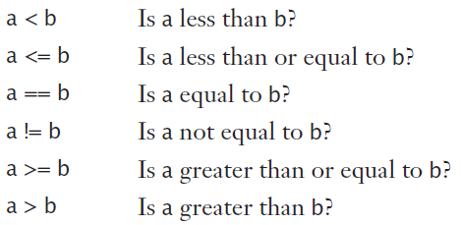
Relational Operators
Relational operators make comparisons between numerical values
The relationship between
two numbers is tested
The outcome of the
comparison is a Boolean
value of true or false
The “equal to” relational operator (==) is a double equal sign
The “not equal to” operator uses the !

Slide 47
Logical Operators
The relational test results in a true or false outcome
Either the two operands are related to each other, or they are not
It is common to test two or more relationships together
  This requires that relational expression results be combined

Slide 48
Logical Operators
Logical and
  The && is the logical and operator
  It plays the same role AND plays in query expressions
  The outcome of a && b is true if both a and b are true; otherwise, it is false
  The operands a and b can be variables, or expressions, or a mix

Slide 49
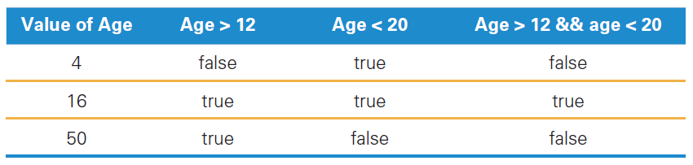
Logical and

Slide 50
Logical Operators
Logical or
  The outcome of a || b is true if:
    either a is true or b is true
    if they are both true
  It is false only if both are false
&& and || have lower precedence than the relational operators
  Relationals are always tested first
  It doesn’t matter how the operands of || are produced; it only matters that they are true or false values.

Slide 51
Logical not
logical not (!)
  It is a unary operator, taking only a single operand
  Its outcome is the opposite of the value of its operand
  By placing the logical not operator in front of the parenthesized expression, we have a new expression with the opposite outcome

Slide 52
Operator Overload
Operator overload is a technical term meaning the “use of an operator with different data types”
  Strings to numbers or to Booleans
Operators usually apply to a single data type
  4 + 5 produces the numerical result of 9
If operands are strings, what does the
+ mean?

Slide 53
Concatenation
When we use + with strings, it joins the strings by the operation of concatenation
It just means that the two strings are placed together if we want them joined
The meaning of + is overloaded:
  + to mean addition when operands are numeric
  + means concatenation when the operands are strings

Slide 54
Conditional Statements
A conditional statement or a conditional makes testing numbers and strings simple
The conditional has the form:
if (<Boolean expression>)
<then-statement>;
The <Boolean expression> is an expression evaluating to true or false
The <then-statement> is any JavaScript statement

Slide 55
if Statements and Their Flow of Control
if (waterTemp < 32)
waterState = "Frozen";
The <Boolean expression> is called a predicate
It is evaluated, resulting in a true or false outcome
If the outcome is true, the <then-statement> is performed
If the outcome is false, the <then-statement> is skipped

Slide 56
if Statements and Their Flow of Control
if (waterTemp < 32)
waterState = "Frozen";
Writing the <then-statement> indented on the following line is common practice
Programmers write the <then-statement> indented on the following line to set it off
The indent emphasizes its conditional nature

Slide 57
Compound Statements
Programming languages allow for a sequence of statements in the <then-statement>
Group multiple statements by surrounding them with “curly braces” { }
{ } collects single statements together to become a compound statement

Slide 58
Compound Statements
The opening { is placed immediately after the predicate to signal that a compound statement is next
The closing } is placed conspicuously on its own line after the last statement within the compound
The closing } should not be followed by a semicolon

Slide 59
if/else Statements
The if/else statement contain statements that will be executed when the condition’s outcome is false
  if (<Boolean expression>)
  <then-statement>;
  else
  <else-statement>;

Slide 60
if/else Statements
The <Boolean expression> is evaluated first
  If the <Boolean expression>’s outcome is true:
    The <then-statement> is executed
    The <else-statement> is skipped
  If the <Boolean expression>’s outcome is false:
    The <then-statement> is skipped
    The <else-statement> is executed

Slide 61
Nested if/else Statements
Both the <then-statement> and the <else-statement> can contain an if/else
The rule in JavaScript and most other programming languages is that the else associates with the (immediately) preceding if
This can be confusing to read
The best policy is to enclose the <then-statement> or <else-statement> in compound curly braces whenever they contain an if/else

Slide 62
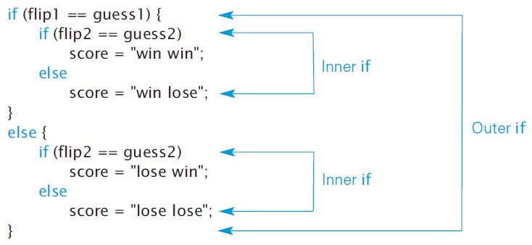

Slide 63
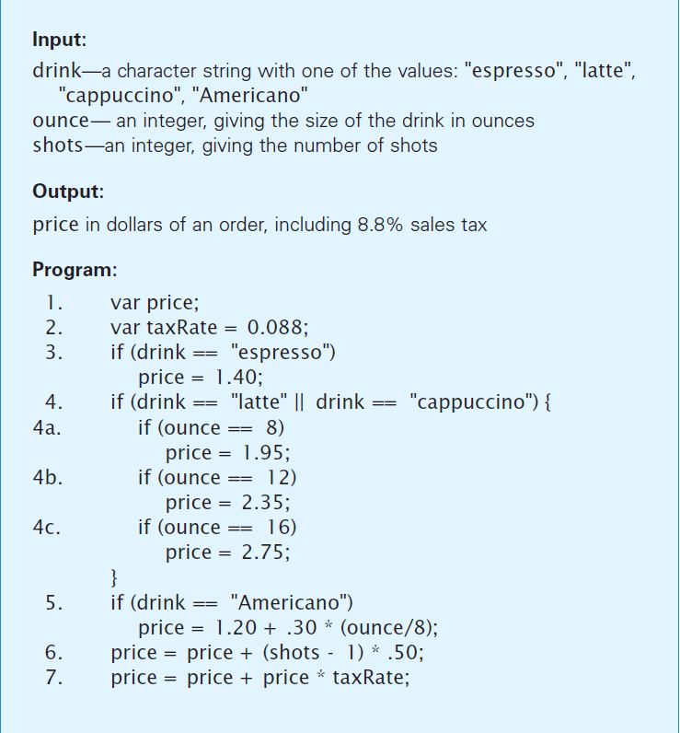
The Espresso Program
The program computes the price of four kinds of espresso drinks based on:
  The type of drink
  The size of drink
  The number of additional shots
  Plus tax

Slide 64
The Espresso Program
The input variables are listed at the start of the program, as is the output
The input variables are assumed to be given
The program will create the output

Slide 65
The Espresso Program
The output is declared to be a variable in the first statement of the program.
Statements 3 through 5 determine the kind of drink and establish the base price

Slide 66
The Espresso Program
The following lines are executed with the purchase of a double tall latte:
  Line 3 is executed:
  The test drink == "espresso" fails, because the variable drink has the value "latte“
  The then statement is skipped

Slide 67
The Espresso Program
The purchase of a double tall latte:
  Line 4 is executed:
  The test drink == "latte" || drink == "cappuccino“ has a true outcome

Slide 68
The Espresso Program
The purchase of a double tall latte:
  Line 4a is executed:
  The test ounce == 8 has a false outcome, so its then statement is skipped
  Line 4b is executed:
  The ounce == 12 test is true, so the then statement is
  executed

Slide 69
The Espresso Program
The purchase of a double tall latte:
  Line 4c is executed:
  The ounce == 16 test fails, so its then statement is skipped
  Line 5 is executed:
  The drink == "Americano" test fails, so its then statement is skipped

Slide 70
The Espresso Program
The purchase of a double tall latte:
  Line 6 is executed:
  This causes the value of shots minus 1 to be multiplied by .50, resulting in the value .50, which is added to price, yielding price ⇐⇒ 2.85

Slide 71
The Espresso Program
The purchase of a double tall latte:
  Line 7 is executed: Current value of price is multiplied by taxRate, resulting in 0.25, which is added to price to compute the final value of 3.10, which is assigned to price

Slide 72
Summary
In basic programming, you now understand the following:
  Name–value separation is an important concept. It’s one of the ways that programming differs from algebra
  Letter sequences that make up a variable’s name (identifiers) must be declared
    Variables can be initialized when they are declared
    Changing the value of a variable is possible by using assignment

Slide 73
Summary
  An assignment statement has a variable on the left side of the symbol and an expression on the right side
    The operation is to compute the value of the expression and make the result the new value of the variable
    This makes information flow from right to left in an assignment statement
    Statements like x = x + 1; make sense in programming, but not in algebra

Slide 74
Summary
  There are three JavaScript data types of interest to us—numbers, strings, and Booleans—and we can build expressions to compute values of these types
  Standard arithmetic operators and relationals compute on numbers, and logical operations on Booleans
    In defining concatenation, you learned about “operator overload”
    Expressions “do the computing” in programs and are generally a familiar idea

Slide 75
Summary
  As a rule, all programming statements are executed one after another, starting at the beginning
    The conditional statements are the exception. JavaScript’s two conditional forms are if and if/else
    These allow statements to be executed depending on the outcome of a Boolean expression called a predicate

Slide 76
Summary
  We must be careful to group statements within a compound statement to make it clear which statements are skipped or executed
    We also must be careful when using if/else in a conditional so that the if and else associate correctly

Slide 77
Summary
  The espresso program illustrates most of the ideas in this chapter
    The program uses both numeric and string data types, as well as the declaration, assignment, and conditional statement forms
  All that keeps us from running the program and demonstrating our knowledge is setting up the input to acquire the values for drink, ounce, and shots, and outputting the price. This requires a UI written in HTML (the topic of Chapter 18)

