Slide 2
Learning Objectives
Apply JavaScript rules for functions, declarations, return values, function calls, scope of reference, and local/global variable reference
Apply your knowledge of functions in the context of publicly available software
Design Web applications for mobile use
Write JavaScript functions with the proper structure
Build a UI that contains functions
Explain what a computer-generated random number is

Slide 3
Anatomy of a Function
Functions are packages for algorithms
They have three parts:
  Name
  Parameters
  Definition
These three parts form the function declaration

Slide 4
Converting Some Temperatures
First, let’s write the Celsius to Fahrenheit conversion function in JavaScript using Scratchpad
  Tools > Web Developer > Scratchpad

Slide 5
Standard Form
JavaScript requires a standard form for writing function declarations
function <name>( <parameter list> ){
<statement list>
}

Slide 6
Standard Form
In the example, the name is convertC2F, the only parameter in the list is tempInC, and the only statement is a return statement
All of the punctuation is important
  parentheses always follow a function name
  curly braces always come in pairs

Slide 7
Picking a Name
name is the identifier
for the function
It is common to use it
to describe what the
function does
Try to pick a name
that is meaningful
function <name>
( <parameter list> )
{
< statement list>
}

Slide 8
Picking a Name
function <name>
( <parameter list> ) {
< statement list>
}
In JavaScript function
names follow the
rules for identifiers:
  They begin with a
  letter, use any mix of
  letters, numbers, and
  underscores (_), avoid
  reserved words
Programming languages have a standard form for writing function declarations

Slide 9
Picking a Name
function <name>
( <parameter list> ) {
< statement list>
}
Look at the
punctuation:
  Parentheses always
  follow a function name
  Curly braces should
  be positioned should
  be placed where they are obvious
Programmers place them as shown so that everyone knows where to find them

Slide 10
Parameters
The parameters are the values that the function will compute on
They are the input to the function
In order for the statements of the algorithm to refer to the input values, the inputs are given names
The <parameter list> is simply a list of names for the inputs separated by commas

Slide 11
Parameters
Parameter names follow the usual rules for identifiers in all programming languages
When writing our algorithm statements, the parameters are like normal variables
Unlike normal variables, parameters begin with a defined value and they don’t have to be declared

Slide 12
Function Definition
The function definition is the algorithm written in a programming language.
A function definition follows the language’s general rules for program statements
In the function definition there must be a way to say what the result is
JavaScript uses the statement
return <expression>

Slide 13
Function Definition
How do you get an answer from the function?
It must be called
Calling a function is asking the computer to run or execute the statements of the function to produce the answers
Simply write the function’s name and put the input values in parentheses after it

Slide 14
Function Definition
To test the function, a little Web page needs to be created to host the JavaScript
The Web page:
  Begins with the standard HTML
  Gives the definition of the function (aka declaring the function)
  Computes the result using an alert( ) call

Slide 15
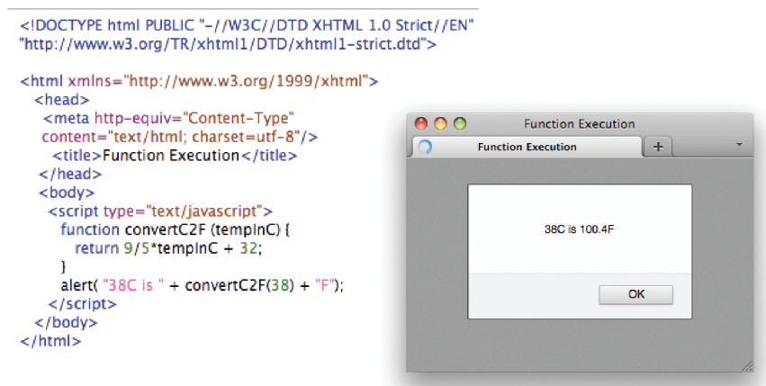

Slide 16
Making the Call
Lines 1 – 3 define the algorithm, which says how it works
To make it actually happen, we must call the function
To call a function is to ask the computer to run or execute the statements of the function to produce the answer

Slide 17
Making the Call
We write the function name and give the input values, also known as arguments in parentheses
The computer follows the definition of the function and returns the answer

Slide 18
Definition Versus Call
A function’s declaration is different from its call
Functions are declared only once
It is unnecessary to tell the computer more than once how the function works
For built-in functions we don’t even have to do that much
Some programmer declared alert( ) while writing the JavaScript interpreter

Slide 19
Declaration Versus Call
Functions are typically called many times
The answers they give are needed many times
One declaration, many calls

Slide 20
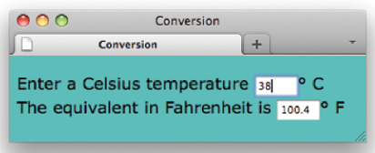
Forms and Functions
Let’s create a Web page for testing our Java Script
Use forms to test the script

Slide 21
Forms and Functions
Recall the following from Chapter 18:
  Forms must be enclosed in <form> tags
  Text boxes are specified by an
  <input type="text" . . . /> tag
  Text boxes have a name, size, and other attributes
  To refer to the value or contents of a text box named tb in the first form of a page, write document.form[0].tb.value
  The main event handler of interest is
  onchange

Slide 22
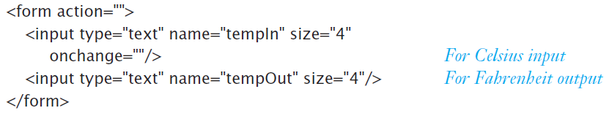
Forms and Functions
The onchange event handler recognizes when a value is entered into the Celsius window (the cursor moved out of the window) and handles it as we direct.

Slide 23
Forms and Functions
The tempIn window is where the Celsius temperature is entered
The tempOut window shows the result
Remember that JavaScript uses the <input . . . /> tag for both input and output

Slide 24

Forms and Functions
handle the onchange
event with this
function call:
This line says that when the input window (tempIn) is changed, use the value in that window document.forms[0].tempIn.value as an argument to convertC2F() and assign the result to display as the value document.forms[0]

Slide 25
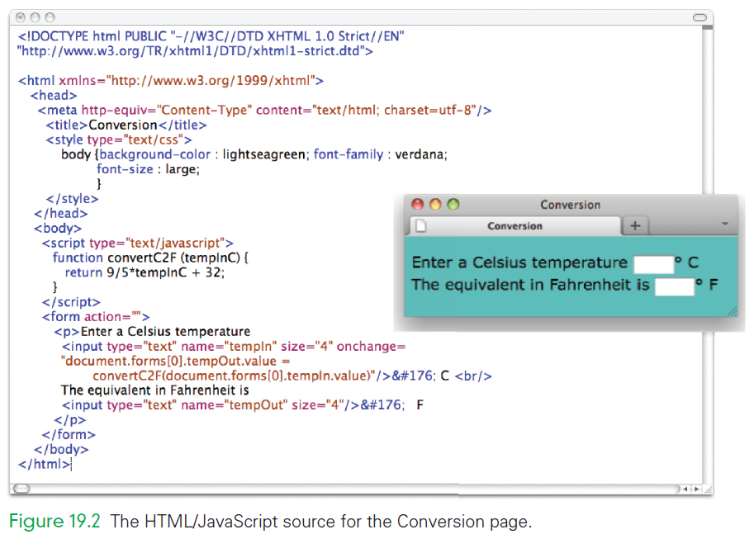

Slide 26
Writing Functions, Using Functions
Flipping Electronic Coins
  A coin flip is an unpredictable event whose two outcomes are “equally probable”
  A computer could generate a random number between 0 and 1, and round to the nearest whole number
    0 could represent tails
    1 could represent heads
  About half the time the outcome would be tails and the rest of the time it would be heads

Slide 27
Writing Functions, Using Functions
Flipping Electronic Coins
  But aren’t computers completely deterministic?
  Given a program and its input, isn’t the outcome is perfectly predictable?
  They are not random in any way
  Computers generate pseudo-random numbers

Slide 28
Pseudo-random numbers
Pseudo-random numbers are an invention of computer science
An algorithm produces a sequence of numbers that passes the statistical tests for randomness.
  A sequence of pseudo-random numbers between 0 and 1 has the property that about half are closer to 0 and the others are closer to 1

Slide 29
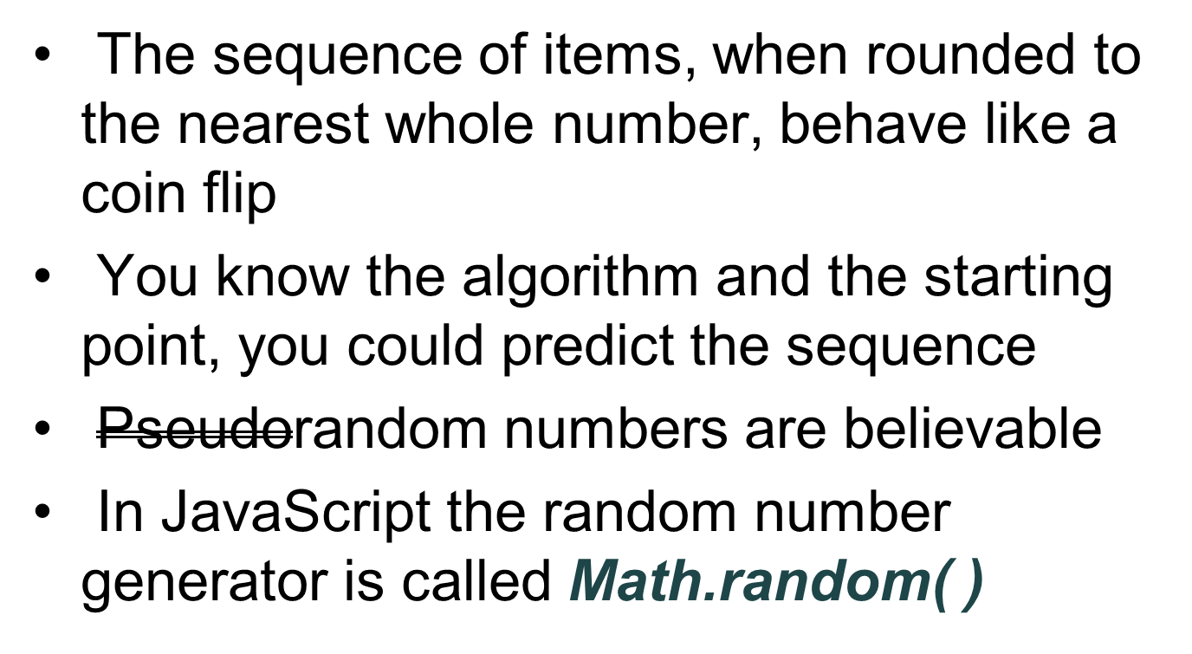
Pseudo-random numbers

Slide 30
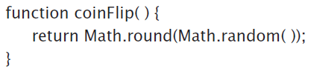
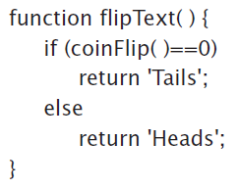
Pseudo-random numbers
When coinFlip( ) is called, it returns with equal probability a 0 or a 1
An obvious improvement would be to return “Heads” and “Tails” rather than numbers

Slide 31
Math.random( )
Math.random( ) produces a result in the interval [0,1)
Any number (except 1) is possible within those limits (and the limits of the computer)
Multiply Math.random( ) by 2 and the interval over which the random numbers spread to [0,2)

Slide 32
Math.random( )
Generally, multiplying by n expands to the interval [0,n)
The numbers are whole numbers with a decimal fraction
The end point is not possible
If we throw away the decimal fraction, we get whole numbers

Slide 33
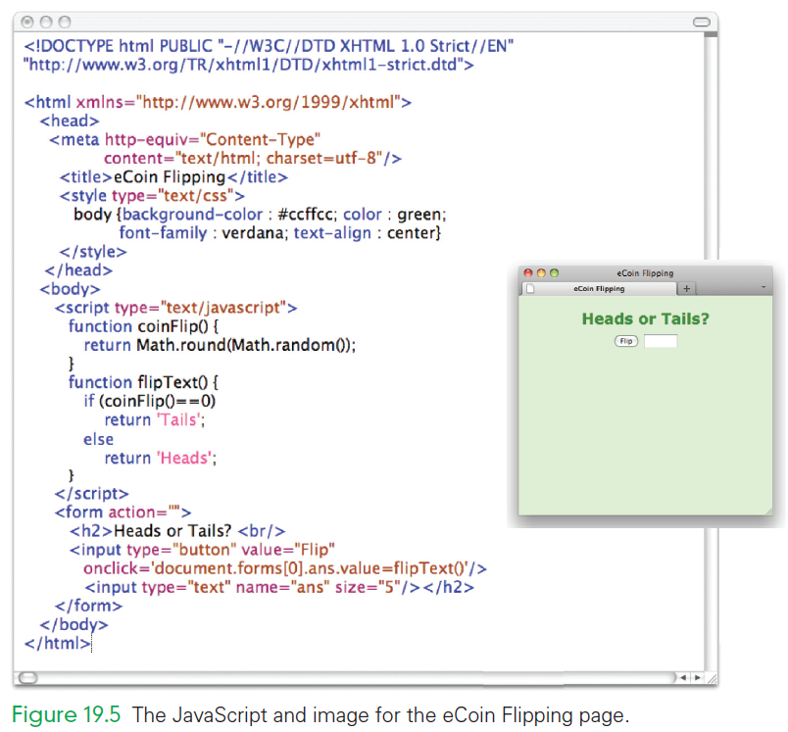

Slide 34
Body Mass Index Computation
Building the BMI will feel similar to creating the Celsius/Fahrenheit program
BMI uses radio buttons to select the English or metric units
Recall that radio buttons are specified with
<input . . . /> tags and must be placed within <form> tags

Slide 35
Body Mass Index Computation
The following are additional features of radio buttons:
  All related radio buttons share the same name
    if when clicking one the other should click off, then they must have the same name.
  Radio buttons can be preset by writing checked='checked'.

Slide 36
Body Mass Index Computation
onclick event handlers must also be written for the radio buttons
What should happen when the user clicks the radio button?
  Remember the type of units chosen…English or metric?
  When the Metric button is clicked, we want
  scale = "M";
  as the response to the click-event

Slide 37
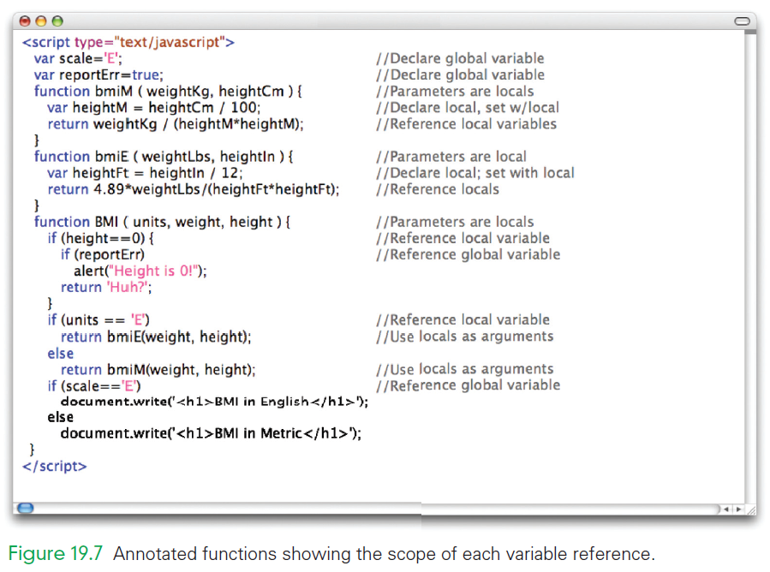

Slide 38
Customizing Pages
Creating Page Content
  A browser begins to create a page by reading through the HTML file
  As it comes across JavaScript tags it removes them and the text between the tags
  Then it does whatever the JavaScript tells it to do
  document.write() inserts the text of its arguments into the Web page

Slide 39
Customizing Pages
Customizing the Coin Flip
  Lets use document.write() to display on-the-fly the proper heads or tails image
  Locate two images to use
  Change the flipOut() function from giving Heads or Tails output to instead giving a text string with the name of the image file we want to display

Slide 40
Customizing Pages
Table of Equivalents
  Suppose we want a table of temperature conversions for a Web Page with a column for Celsius and a column for Fahrenheit
  Use document.write() to create the table on-the-fly
  <tr>
  <td>-10</td>
  <td>convertC2F(-10)</td>
  <tr>

Slide 41
Customizing Pages
Automatically Created Rows
  When the browser encounters script tags it does what the JavaScript tells it to do and calls document.write()
  The browser must construct the function’s arguments using concatenation
  When the browser builds the page, the table is formed from our created on-the-fly rows that use our conversion function

Slide 42
Making a Web-Based Phone App
We will write and then load our app using a browser on our smartphone or tablet
Our app will work just fine on a laptop or desktop, but will be designed for something smaller
Design for Mobility
  Our Bean Counter app would be hard to use on a phone display because of the small buttons and drop-down metaphor

Slide 43
Making a Web-Based Phone App
Design for Mobility
  The touch metaphor benefits from larger blocks and a more “open” organization
  We will use a two-dimensional grid (table) of blocks that the user will tap

Slide 44
Referencing Functions
Every Little bit Counts
  We will create a Counter Assistant page
  Clicking the Count button increments the Total field, the Meaning field can be filled in with any text, and the C button clears the fields

Slide 45
The Counter Assistant’s Structure
We write a function to create a row of the table, placing the entire HTML text in the function
Requires us to use a sequence of document.write() function calls
It relies on four global variables to keep track of the counts

Slide 46
The Counter Assistant’s Structure
It sets up the structure of the table and then calls a row() function, which constructs the rows and their input controls
The row() function has a single parameter that is the number of the row being specified

Slide 47
Two Reasons to Write Functions
Most functions are general
  They are written for a specific application
  We hope that we will have a chance to use them again
  They are building blocks for future programs
Some function are not building blocks
  They must run within a document with a form, and that form must have within it input controls with specific names

Slide 48
Two Reasons to Write Functions
Managing complexity is the other reason to write functions.
The two reasons for packaging algorithms into functions:
  Reuse: the building blocks of future programming
  Complexity management: keeps our sanity while solving problems

Slide 49
Social Functions
“Boldly go” after software that you may not fully understand, but which you can still make work for your goal by trying it out and noticing what happens
Using Other People’s Code
  There is a strong tradition in computing to share code
  From the Open Source movement, to all browsers displaying the Page Source

Slide 50
Social Functions
Making a Comment
  Let’s create a page that has an image and a cord balloon on it
    Include text in the word balloon
    Move the balloon and text around
    Place an image on the page
    Make the final page by positioning the comment in the right place

Slide 51
Social Functions
Using Other People’s Code
  Suppose you come across a page that uses the <canvas> tag from HTML5
  in the draw() function, there are familiar statement forms
  You notice the use of rgb(200, 0, 0)
  With almost no understanding of <canvas> you’ve already tried it out

Slide 52
Making a Comment
Place an Image
  The easiest way to cover the window with an image is to make it the background
Position the balloon
  We estimate that the balloon should be about 700 pixels from the left side, and 10 pixels down from the top
  We need to fill in the background of the word balloon with white

Slide 53
Making a Comment
Let’s create a page that has an image and a word balloon on it
    Include text in the word balloon
    Move the balloon and text around
    Place an image on the page
    Make the final page by positioning the comment in the right place

Slide 54
Making a Comment
Add Text to a Balloon
  if we add a <p> tag after the <canvas> text it writes the text below the balloon
  We apply absolute position to the paragraph element, to move it to the correct position
Move the Balloon Around
  To have a word balloon anywhere on the screen we need to expand the canvas

Slide 55
Making a Comment
Move the Balloon Around
  We will use window.innerWidth and window.innerHeight
  Making this change did not actually move the balloon
  We revise the draw() function to have x and y as parameters
  We also use the same parameters for the text

Slide 56
Summary
The following were the main topics of Chapter 19:
  The three parts of a function—name, parameter list, and definition—are specified in a function declaration using a standard form
  The function declaration specifies to the computer how the function works, so we give it only once
    To use the function requires that we give the function name and its input values, known as arguments

Slide 57
Summary
  Writing functions packages algorithms, but to get their benefit in JavaScript and HTML requires that we develop Web pages with which we give the inputs to the functions and get their answers displayed
  There are three different ways to display the results of a function in HTML:
    using alrert()
    interacting with a page that has text boxes
    using document.write() to include the results of a function while the page is being constructed

Slide 58
Summary
  We put all of our knowledge about functions into a small Web Apps page; the source code is shown in Appendix F
    It gave us the ability to apply functions directly using our smartphones
    The next thing is to think up and implement some apps of personal interest
  Finally, we “boldly went” online to find tutorial examples that we could put to use simply by trying them out and noticing what happened
    We quickly figured them out and put them to use

