Slide 2
Learning Objectives
Explain what the Turing test was designed to show
Discuss the issue of a computer being intelligent and able to think; refer to Deep Blue and Watson
Discuss the issue of computer creativity; refer to computer generated music and art
State the meaning of the Universality Principle
State the way in which the amount of work in a program is related to the speed of the program

Slide 3
Can Computers Think?
What is thinking?
  Is it what People do?
Alan M. Turing tried to answer this question
  One of the pioneers of computing
  Decided to forget defining thinking
  Proposed an IQ test for the computer in 1950

Slide 4
The Turing Test
The Turing Test
  Two identical rooms (A and B) are connected to a judge who can type questions directed to either room
  A human occupies one room and a computer the other
  The judge’s goal is to decide based answers received, which room contains the computer
  If the judge cannot decide for certain, the computer can be said to be intelligent

Slide 5
Passing the Test
Turing’s experiment sidestepped the problem of defining thinking, and also got away from focusing on any specific ability such as performing arithmetic
When Turing conceived the test, no algorithmic process was known for analyzing English, as word processor’s grammar checkers do today

Slide 6
Passing the Test
Computers are still a long way from being perfect
Good enough at language tasks that we can imagine a day when computers are better than most humans

Slide 7
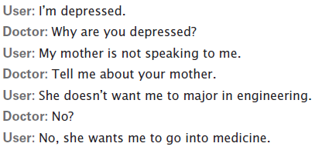
Acting Intelligently?
Spelling and grammar checks are based on rules (syntax)
  the computer doesn’t understand the context
About Eliza (Doctor)?
  Developed by MIT
  researcher Joseph
  Weizenbaum
  She carried on a
  conversation as
  though she were a psychotherapist

Slide 8
Acting Intelligently?
Eliza was programmed to keep the dialog going by asking questions and requesting more information
She took cues from words like “mother” and negative words (don’t, hate, not, etc.)
Eliza was NOT intelligent…her response was just pre-programmed

Slide 9
AI (Artificial Intelligence)
To be intelligent, a computer has to understand a situation and reason to act on that understanding
Actions could not be scripted (pre-programmed) or predetermined
Systems would have to understand natural language and/or have real-world knowledge

Slide 10
Playing Chess
Does not require natural language
Offered a challenging task that humans were both good at and interested in
It was predicted as early as 1952 that a computer would beat a grand master
  It took more than a decade before computers could do much more than know the legal chess moves
  Well established as a litmus test for AI

Slide 11
A Game Tree
The Evaluation Function gives a score for each move
  If the score is positive, it’s a good move
  If the score is negative, it’s a bad one
  The higher the score, the better the move
The computer must also “evaluate” or “look ahead” at the opponent’s move and see how that will affect it’s move

Slide 12
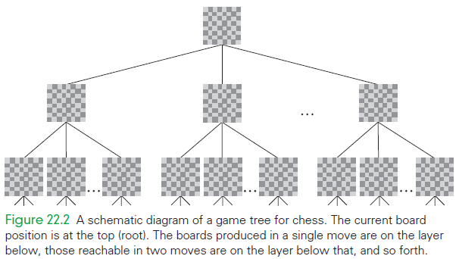
Example of a Game Tree
If there are 28 moves possible from the current position, and an
average of 28 from each of those, and each of their descendants,
and so on, then six moves deep (i.e., three for each side) generates
28 + 282 + 283 + 284 + 285 + 286 = 499,738,092
which is a half billion boards that the computer must try to evaluate!

Slide 13
Using the Game Tree Tactically
Before picking a move, the computer must consider what the opponent might do
The computer considers every possible next move and evaluates them

Slide 14
Using the Game Tree Tactically
The best move for the opponent is presumably the worst move for the computer
  computer assumes the opponent will choose the move with the most negative score in the evaluation function
  process is known as “look ahead”
Checking the whole game tree is generally impossible

Slide 15
Using the Game Tree Tactically
If there are 28 moves possible from the current position, and an average of 28 from each of those, that generates a half billion boards
Picking the best move at the first level is not necessarily the best strategy
  think about advantages
  strategize, sacrifice, force behaviors

Slide 16
Using Database Knowledge
The computer needs more knowledge to play the game
It uses a database of openings and endgames
Chess has been studied for so long that there is ample information about how to start and end a game
Using a database is like giving the computer “chess experience”

Slide 17
Using Parallel Computation
Slowly chess programs got better and better
Eventually they started beating masters
Progress came with faster computers, complete databases, and better evaluation
  Parallel computation: the application of several computers to one task

Slide 18
The Deep Blue Matches
Required a large database of prior knowledge on openings and endgames
Required special-purpose hardware that allowed rapid evaluation of board positions
Deep Blue won by speed
  Blue simply looked deeper into possible moves

Slide 19
Interpreting the Outcome of the Matches
The problem was basically solved by speed
  Deep Blue simply looked deeper
May have demonstrated that computers can be intelligent or that IBM’s team is intelligent
Deep Blue is completely specialized to chess

Slide 20

What is Watson?
February 2011, IBM semantic
analysis system competed and
won a special edition of Jeopardy!
Game winnings were:
  $77,147 for Watson,
  $24,000 for Jennings
  $21,000 for Rutter
Watson is a program with specialized functions and a huge database!

Slide 21
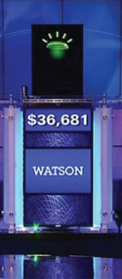
What does Watson do?
The program is:
  self-contained (not on the Internet)
  parses English
  formulates queries to its database
  filters the results it receives
  evaluates the relevance to the
  question
  selects an answer
  and gives its answer in the form of spoken English

Slide 22
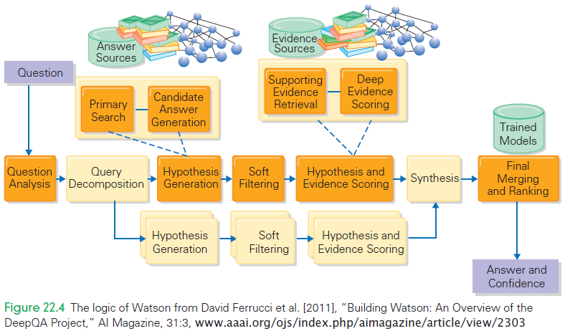
Watson

Slide 23
Watson’s Database
The database is built from 200 million pages of unstructured input:
  encyclopedias, dictionaries, blogs, magazines, and so forth
If your standard desktop computer ran the Watson program, it would take two hours to answer a Jeopardy! Question
Watson had to answer in 2–6 seconds, requiring 2,800 computers with terabytes of memory!

Slide 24
Watson’s Learning
Researchers analyzed 20,000 previous Jeopardy! Questions for its “lexical answer type” or LAT
There were more than 2,500 different explicit LATs, and more than 10% didn’t have an explicit LAT
Even if Watson were perfect at figuring out the LAT, one time in 10 it wouldn’t even know what kind of answer to give

Slide 25
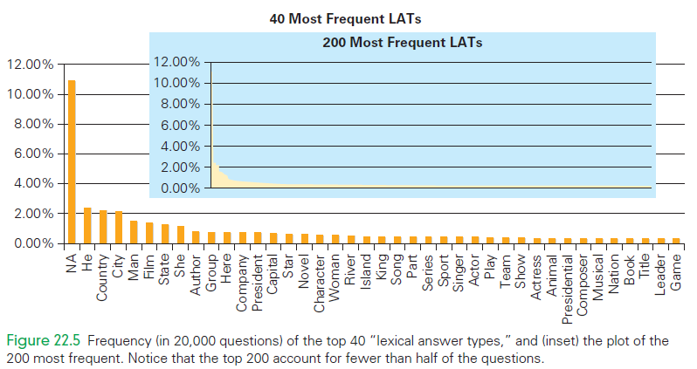
LAT’s

Slide 26
Acting Creatively
Can a computer create art?
Can it make music?
What are the “rules” to be creative?
Is creativity defined as:
a process of breaking the rules?
But, computers only follow rules…maybe there are rules on how to break rules

Slide 27
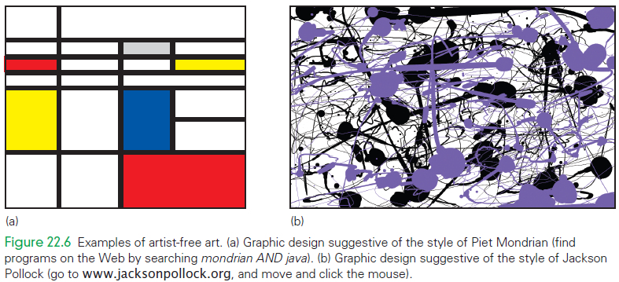
Is it Live? Or is it Computer?

Slide 28
Creativity as a Spectrum
Creativity that comes from inspiration—“a flash out of the blue”—and the form that comes from hard work—“incremental revision.” (Bruce Jacob)
In Jacob’s view the hard work is algorithmic
To be inspired, the computer would have to step outside of the “established order” and invent its own rules

Slide 29
What Part of Creativity is Algorithmic?
Consider whether a computer can be creative not as a yes/no question, but instead as an expedition
The more deeply we understand creativity, the more we find ways in which it is algorithmic
Aspects of creativity are algorithmic

Slide 30
The Universality Principle
What makes one computer more powerful than another?
  Any computer using only very simple instructions could simulate any other computer.
  Known as the Universality Principle means that all computers have the same power!
    The six instructions Add (remember Chapter 9), Subtract, Set_To_One, Load, Store, and Branch_On_Zero are sufficient to program
    any computation

Slide 31
Practical Consequences
Universality Principle says that all computers compute the same way, and speed is the only difference
The claim that any computer can simulate any other computer has the disadvantage that simulation does the work more slowly
Although both computers can realize the same computations, they perform them at different rates

Slide 32
Exactly the Same, But Different
If all computers are the same, why need different copies of software to run on different platforms?
All computers have equal power in that they can DO the same computations, but they don’t USE the same instructions
The processors have different instructions, different encodings, and a lot of other important difference

Slide 33
Outmoded Computers
New software with new features runs slowly on old machines
Two reasons in support that older computers are “outmoded:”
  Hardware and/or software products are often incompatible with older machines
  Software vendors simply don’t support old machines.

Slide 34
More Work, Slower Speed
There are very difficult computations with no known fast algorithm
Many problems of interest don’t have any known “practical” algorithmic solutions
  For example, look at the many websites dedicated to finding the cheapest air tickets. The prices are different!!!
These are called NP-complete problems

Slide 35
NP-complete problems
These problems are called intractable
This means that the best way to solve them is so difficult that large data sets cannot be solved with a realistic amount of computer time on any computer
In principle, the problems are solvable,
in practice, they are not

Slide 36
Unsolvable Problems
There are problems computers cannot solve at all
There are no algorithms to solve the problem!
These problems have a clear quantifiable objective

Slide 37
Summary
Identified a tendency for people to decide that an intellectual activity isn’t considered thinking if it is algorithmic
  Thinking is probably best defined as what humans do, and therefore something computers can’t do
Discussed the Turing test, an experimental setting in which we can compare the capabilities of humans with those of computers.

Slide 38
Summary
Studied the question of computer chess and learned that computers use a game tree formulation, an evaluation function to assess board positions, and a database of openings and endgames
Studied the problem of semantic analysis as implemented in the Watson program

Slide 39
Summary
Studied creativity, deciding it occurs on a spectrum: from algorithmic variation (Mondrian and Pollock graphics-in-a-click) through incremental revision to a flash of inspiration
Presumed that there will be further advancement, but we do not know where the “algorithmic frontier” will be drawn
Considered the Universality Principle, which implies that computers are equal in terms of what they can compute

Slide 40
Summary
Learned that important problems, the so-called NP-complete problems, require much more computational work than the computations we do daily
  Many of the problems we would like to solve are NP-complete problems, but unfortunately the NP-complete problems are intractable, large instances are solvable by computer only in principle, not in practice

Slide 41
Summary
Learned the amazing fact that some computations—for example, general-purpose debugging—cannot be solved by computers, even in principle

