Slide 1
A Balanced Introduction to Computer Science, 2/E
David Reed, Creighton University
©2008 Pearson Prentice Hall
ISBN 978-0-13-601722-6
Chapter 10
Computer Science as a Discipline

Slide 2
Computer “Science”
some people argue that computer science is not a science in the same sense that biology and chemistry are
  the interdisciplinary nature of computer science has made it hard to classify
computer science is the study of computation (more than just machinery)
  it involves all aspects of problem solving, including
    the design and analysis of algorithms
    the formalization of algorithms as programs
    the development of computational devices for executing programs
    the theoretical study of the power and limitations of computing
whether this constitutes a "science" is a matter of interpretation
  certainly, computer science represents a rigorous approach to understanding complex phenomena and problem solving

Slide 3
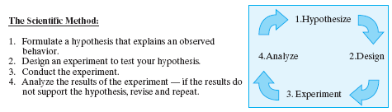
Scientific Method
the process developed by the scientific community for examining
observations and events is known as the scientific method
many activities carried out by computer scientists follow the scientific method
  e.g., designing and implementing a large database system requires hypothesizing about its behavior under various conditioning, experimenting to test those hypotheses, analyzing the results, and possibly redesigning
  e.g., debugging a complex program requires forming hypotheses about where an error might be occurring, experimenting to test those hypotheses, analyzing the results, and fixing the bugs

Slide 4
Artificial Science
the distinction between computer science and natural sciences like biology, chemistry, and physics is the type of systems being studied
  natural sciences study naturally occurring phenomena and attempt to extract underlying laws of nature
  computer science study human-made constructs: programs, computers, and computational modes
Herbert Simon coined the phrase "artificial science" to distinguish computer science from the natural sciences
in Europe, computer science is commonly called "Informatics"
  emphasizes the role of information processing as opposed to machinery
the term "Algorithmics" has also been proposed
  emphasizes the role of algorithms and problem solving
other related fields study computation from different perspectives
  computer engineering focuses on the design and construction of computers
  information systems management focuses on business applications

Slide 5
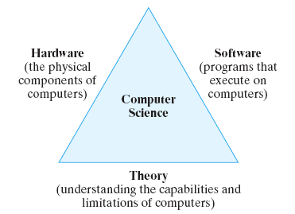
Computer Science Themes
since computation encompasses many different types of activities, computer science research is often difficult to classify
  three recurring themes define the discipline

Slide 6
Hardware
hardware refers to the physical components of a computer and its supporting devices
most modern computers implement the von Neumann architecture
  CPU + memory + input/output devices
ongoing research seeks to improve hardware design and organization
  circuit designers create smaller, faster, more energy-efficient chips
  microchip manufacturers seek to miniaturize and streamline production
  systems architects research methods to increase throughput (the amount of work done in a given time period)
    e.g., parallel processing – splitting the computation across multiple CPUs
    e.g., networking – connecting computers to share information and work

Slide 7
Software
software refers to the programs that execute on computers
3 basic software categories
  systems software: programs that directly control the execution of hardware components (e.g., operating systems)
  development software: programs that are used as tools in the development of other programs (e.g. Microsoft.NET, Java SDK)
  applications software: all other programs, which perform a wide variety of tasks (e.g., web browsers, word processors, games)
many careers in computer science are related to the design, development, testing, and maintenance of software
  language designers develop and extend programming languages for easier and more efficient solutions
  programmers design and code algorithms for execution on a computer
  systems analysts analyze program designs and manage development

Slide 8
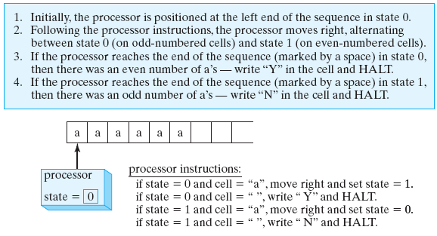
Theory
theoretical computer scientists strive to understand the capabilities of algorithms and computers (deeply rooted in math and formal logic)
example: the Turing machine is an abstract computational machine invented by computer pioneer Alan Turing
  consists of: a potentially infinite tape on which characters can be written
    a processing unit that can read and write on the tape, move in either direction, and distinguish between a finite number of states
  significance of the Turing machine
    it is programmable (example below is programmed to distinguish between an even or odd number of a's on the tape)
    provably as powerful as any modern computer, but simpler so provides a manageable tool for studying computation
Turing used this simpler model to prove there are problems that cannot be solved by any computer!

Slide 9
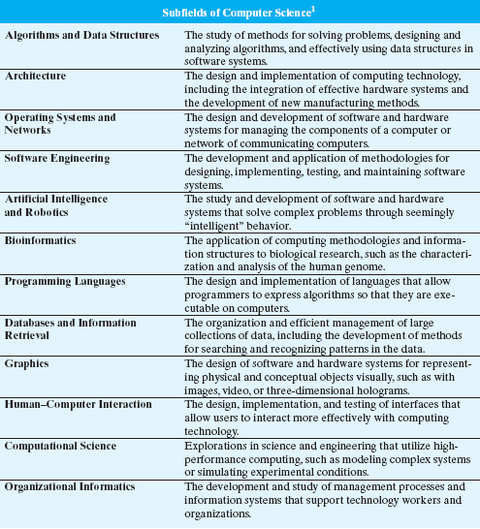
Subfields of Computer Science
computer science can be divided into subfields
  each subfield takes a unique approach to computation
  however the common themes of computer science (hardware, software, and theory) influence every subfield
(Denning, Peter. “Computer Science: The Discipline.” In Encyclopedia of Computer Science, 4th ed., 2000.)

Slide 10
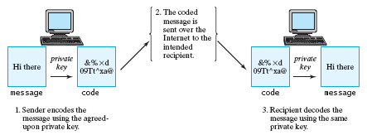
Algorithms and Data Structures
subfield that involves developing, analyzing, and implementing algorithms for solving problems
application: encryption
  encryption is the process of encoding a message so that it is decipherable only by its intended recipient
    Caesar cipher: shift each letter three down in the alphabet
      e.g., ET TU BRUTE → HW WX EUXWH
  Caesar cipher is an example of private-key encryption
    relies on the sender and the recipient sharing a secret key
  some modern encryption algorithms rely on private keys
    e.g., Digital Encryption Standard (DES) utilizes 56-bit keys

Slide 11
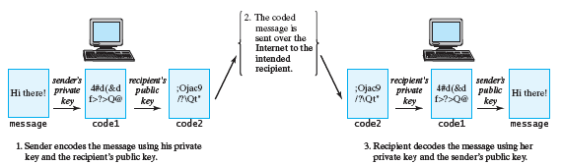
Public-Key Encryption
private-key encryption assumes that the sender and the recipient have agreed upon some key ahead of time (which introduces other security risks)
Whitfield Diffie and Martin Hellman proposed public-key encryption
  assign each party a pair of associated keys, one is public and the other is private
  a message encoded with a public key requires the corresponding private key for decoding, and vice versa
  almost all secure communications on the Internet use public key encryption
  allows for double encryption to also verify the identity of the sender
    you can encode messages with your own private key and the recipient’s public key, and decode the message in reverse

Slide 12
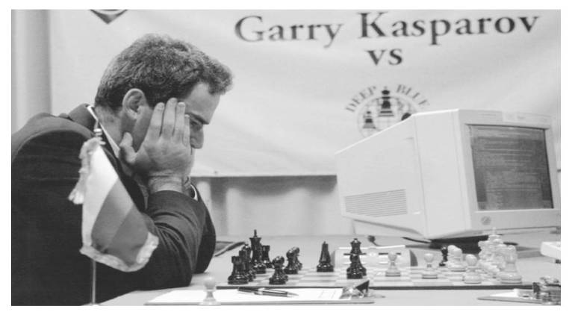
Architecture
subfield concerned with methods of organizing hardware components into efficient, reliable systems
application: parallel processing
  multiple processors can sometimes be utilized to share the computational load
  there are costs associated with coordinating the processors and dividing the work, so not well suited for all tasks
  understanding when parallel processing can be used effectively is a common task for computer architects
  e.g., Core 2 Duo processor integrates the circuitry for 2 processors
    can execute two different instructions simultaneously, potentially double execution speed
  e.g., high-end Web Servers utilize multiple processors
    can service multiple requests simultaneously by distributing the load among the processors
  Deep Blue, IBM's chess playing computer, contained 32 general purpose processors and 512 special-purpose chess processors
    the processors worked in parallel to evaluate chess moves (could generate and evaluate 200 million chess moves per second)
    in 1997, Deep Blue became the first computer to beat a world champion in a chess tournament

Slide 13
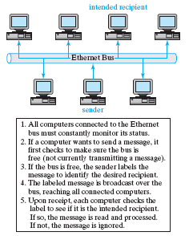
Operating Systems and Networks
subfield concerned with mechanisms to control the hardware and software components of computer systems
application: operating systems mediate between hardware and software
  time-sharing - allowed for multiple users to work on the same computer
    each user is allocated a portion of the processor, and the processor rotates among tasks so rapidly that it appears to be executing tasks simultaneously
  multitasking – a single user can run multiple programs simultaneously
    each application is allocated a portion of the memory
application: networks allow computers to communicate and share resources
  wide area network (WAN) – connects
  computers over long distances (e.g., Internet)
  local area network (LAN) – connects
  computers over short distances (e.g., same
  room or building)
  Ethernet is a family of technologies for building LANs
    simplest form uses broadcasting approach

Slide 14
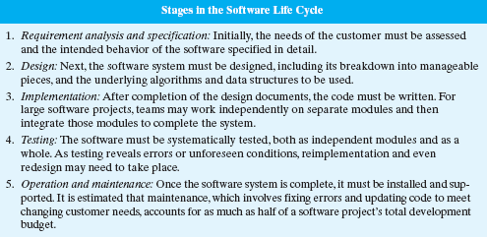
Software Engineering
subfield concerned with creating effective software systems
  large projects can encompass millions of lines of code
  teams of programmers work together to make an integrated whole
    coordination and testing are key to successful projects
  software demand continues to grow, placing pressure on programmers to produce at faster rates
    clearly, there is a limit to personal productivity
    simply adding more programmers does not solve the problem: increasing numbers means increased complexity, and coordination becomes an even bigger challenge
  in recent years, the adoption of the object-oriented programming methodology has made it easier to reuse code

Slide 15
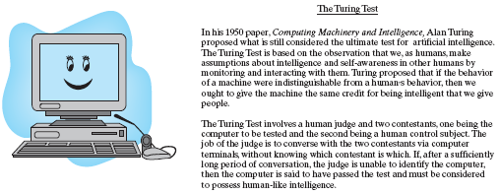
Artificial Intelligence
subfield that attempts to make computers exhibit human-like characteristics (e.g., the ability to reason and think)
  in 1950, Turing predicted intelligent computers by 2000 (still not even close)
  but, progress has been made in many A.I. realms
    robots in manufacturing
    expert systems – programs that encapsulate expert knowledge in a specific domain (e.g., for medical diagnosis)
    neural computing – design of architectures that mimic the brain

Slide 16
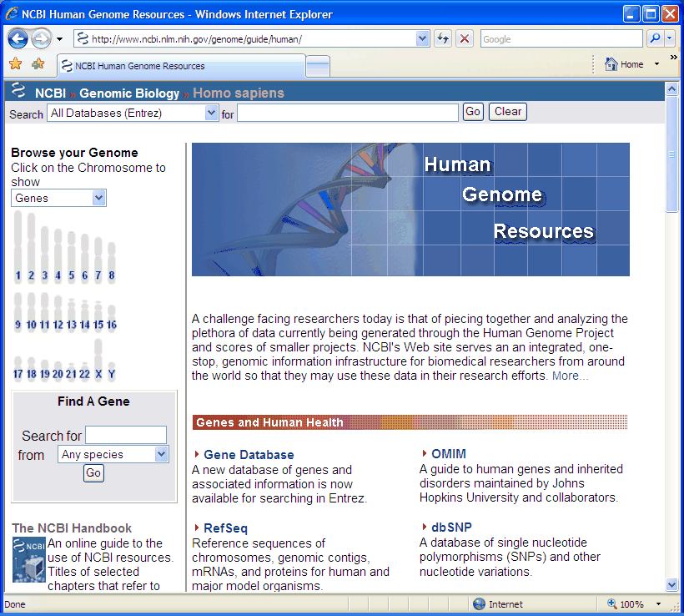
Bioinformatics
subfield that bridges the gap between biology and computer science
  focuses on using computers and computer science techniques to solve biological problems
  computers are integrated with various scientific tools
    e.g., microscopes connected to computers and digital cameras
  computer are used to model biological systems
    e.g., pharmaceutical companies model drug interactions to save time and money
  computers are used to store and process large amounts of biological data
    e.g., Human Genome Project stores and provides tools for studying DNA

Slide 17
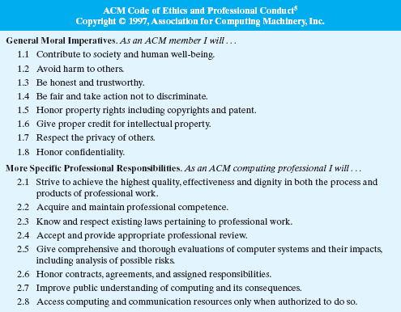
The Ethics of Computing
as technology becomes more prevalent in society, computing professionals must ensure that hardware and software are used safely, fairly, and effectively

