Slide 1
A Balanced Introduction to Computer Science, 2/E
David Reed, Creighton University
©2008 Pearson Prentice Hall
ISBN 978-0-13-601722-6
Chapter 14
Inside the Computer - the
von Neumann Architecture

Slide 2
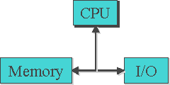
CPU Subunits and Datapath
recall the von Neumann architecture
  Central Processing Unit (CPU)
  Input/Output devices
  Memory
the CPU acts as the brain of the computer
  it obtains data and instructions from memory
  it carries out instructions
  it stores results back to memory
the program instructions that are executed by the CPU are in the machine language of that CPU
  users can write programs in a high-level language, but those high-level instructions must be translated into machine language before executing
    even programs that exhibit complex behavior are specified to the CPU as sequences of simple machine-language commands
    the CPU can execute these instructions at such a high speed that complex programmatic behavior is achieved

Slide 3
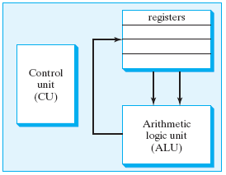
CPU Subunits
the CPU is comprised of several subunits, each playing a specific role in processor functioning
  Arithmetic Logic Unit (ALU): circuitry that performs the actual operations on data (addition, subtraction, bit manipulations)
  Registers: memory locations built into the CPU (to provide fast access)
    the transfer of data between registers and main memory occurs across a collection of wires called a bus
  Control Unit (CU): circuitry in charge of fetching data and instructions from main memory, as well as controlling the flow of data between registers and the ALU

Slide 4
CPU Datapath Cycles
the path that data follows within the CPU, traveling along buses from registers to the ALU and then back to registers, is known as the CPU datapath
  a single rotation around the CPU datapath is referred to as a CPU datapath cycle
recall earlier that we defined CPU speed as measuring the number of instructions that a CPU can carry out per second
  CPU speed = the number of CPU cycles per second
    e.g., a 2.5GHz CPU can perform 2.5 billion cycles per second
  CPUs cannot be compared solely on the basis of their speeds
    since CPUs have different instruction sets, one CPU may be able to complete more complex tasks in a single cycle
    so, a slower CPU with a richer instruction set may complete some tasks faster

Slide 5
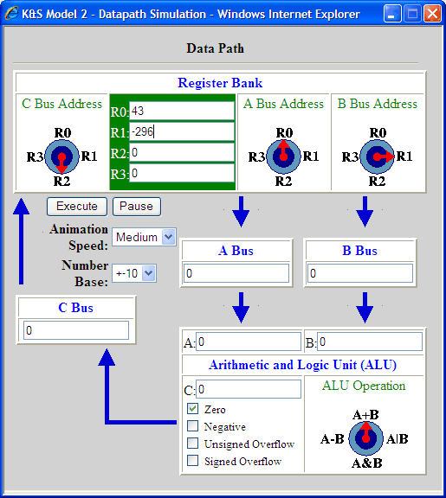
Datapath Simulator
accompanying the text is a datapath simulator
  a.k.a. the Knob & Switch Computer
  developed by Grant Braught at Dickinson College
  allows the user to enter data directly into the register boxes and configure the CPU hardware by clicking on knobs and switches
by clicking on the knobs labeled A Bus Address and B Bus Address, the user can select which registers will be accessed
  here, registers R0 and R1 are selected
by clicking on the knob labeled ALU Operation, the user can select which operation will be performed on the specified register data
  here, the addition operation (A+B) is selected
by clicking on the knob labeled C Bus Address, the user can select which register the result will be written to
  here, register R2 is selected

Slide 6
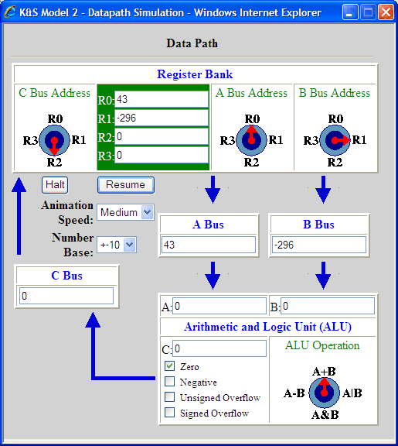
Datapath Simulator (cont.)
when the user clicks on the Execute button, a CPU datapath cycle is executed with the given settings
  data can be observed as it moves around the datapath
  in the 1st step, data values are retrieved from the specified registers (R0 and R1) and passed along the A and B buses, respectively

Slide 7

Datapath Simulator (cont.)
  data can be observed as it moves around the datapath
  in the 2nd step, the data values from the A and B buses are operated on by the ALU, with the result passed along the C bus

Slide 8

Datapath Simulator (cont.)
  data can be observed as it moves around the datapath
  in the 3rd step, the data on the C bus is written to the specified register (R2)
the end result of the datapath cycle is that the contents of two registers are added and the result is stored in a different register

Slide 9
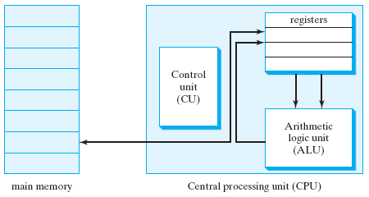
CPU and Main Memory
the CPU datapath describes the way in which a computer manipulates data stored in registers
  but, it does not explain how data gets into registers in the first place
  or, how the results of ALU operations are accessed outside the CPU
both of these tasks involve connections between the CPU and main memory
  all active programs and data are stored in the main memory of a computer
  main memory is comprised of a large number of memory locations, with each location accessible via an address
  a bus connects main memory to the CPU, enabling the computer to copy data and instructions to registers, and then copy the results of computations back to main memory

Slide 10
Main Memory Data Transfer
as a program is executed, the control unit processes the program instructions and identifies which data values are needed to carry out the specified tasks
  the required values are then fetched from main memory along the main memory bus, loaded into registers, and used in ALU operations
note: data must be copied from main memory into registers BEFORE it can be operated on
  in practice, the data transfer takes much longer than a single datapath cycle (due mainly to the distance that must be covered)
  modern CPUs compensate by fetching multiple instructions at once – ideally, the CPU will predict which instructions will be needed next and prefetch them

Slide 11
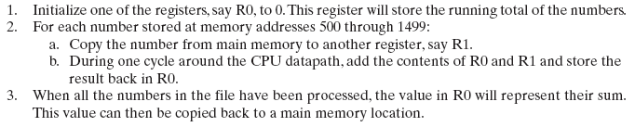
Data Transfer Example
example: suppose you had a file containing 1,000 numbers and wanted to compute the sum of those numbers
  first, need to load the data from the file into main memory — for example, at memory locations 500 through 1499
  then, the control unit would carry out the following steps to add the numbers and store the resulting sum back in main memory

Slide 12
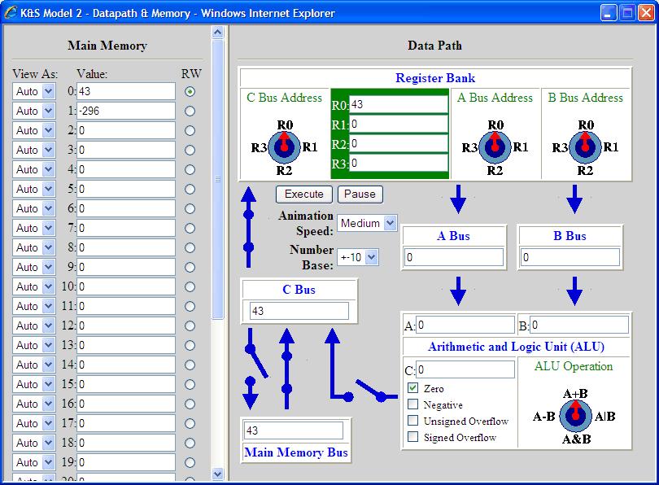
Datapath w/ Memory Simulator
we can extend the datapath simulator to integrate main memory
  main memory is displayed as a series of boxes, labeled with addresses 0-31
  a Main Memory Bus is added to transfer data to and from main memory
  buses have switches that open and close when the user clicks on them
by selecting the radio button labeled R/W in the Main Memory partition, the user can select a memory address
  here, address 0 is selected
by clicking on the Main Memory Bus and C Bus, they can be opened/closed
  here, the buses are configured to allow data to flow from main memory to the register
the other components of the datapath are configured as before

Slide 13
Memory Simulator (cont.)
for example, suppose we wanted to add the contents of address 0 and address 1, and store the result in address 2
  in the 1st step, copy the data from address 0 into a register, say R0
  note: the A Bus, B Bus, and ALU settings are irrelevant since the C Bus is disconnected

Slide 14

Memory Simulator (cont.)
  in the 2nd step, similarly copy the data from address 1 into a register, say R1
  note: when the simulator executes, there is a noticeable (and intentional) delay as data moves on the Main Memory Bus

Slide 15

Memory Simulator (cont.)
  in the 3rd step, the contents of R0 and R1 are added and the result is sent directly to address 2
  in some CPUs, this would require 2 steps: send the result to a register, then copy the register to main memory

Slide 16

Stored-Program Computer
the last component of the CPU is a fully functioning, automatic control unit
  recall that in the simulations, tasks were defined by selecting registers and ALU operations via knobs, switches, and buses
  the idea behind a stored-program computer is that tasks can be represented as instructions stored in main memory along with data
  the control unit must fetch, decode, and execute those instructions
recall: each type of CPU has its own machine language for representing instructions
  for example, we could define an instruction for our simulator by specifying the knob and switch settings for the datapath
  since real world CPUs contain an extremely large number of physical components, a more compact representation is required
  machine language instructions are represented as binary strings, where the bits correspond to hardware settings

Slide 17
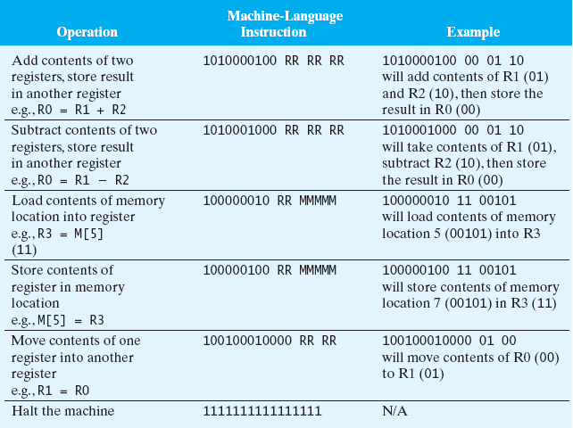
Simulator Machine Language
1st two instructions – select ALU operation and registers to operate on
next 3 instructions – control flow of data between main memory and datapath
last instruction – mark the end of instruction sequence

Slide 18
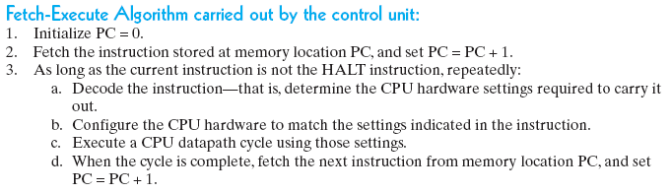
Control Unit
the control unit fetches each machine language instruction from memory, interprets its meaning, carries out the specified CPU cycle, and then moves on to the next instruction
  since instructions and data are both stored in memory, the control unit must recognize where a sequence of instructions begins and ends
  for our simulator, we will assume that programs start at address 0 and end with a HALT instruction
    in real computers, the operating system must keep track of program locations

Slide 19
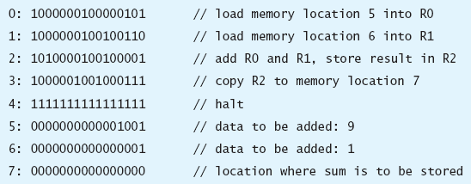
Program Execution
example: machine language program for adding two numbers in memory
program execution:
  program counter is initialized: PC = 0
  instruction at memory location 0 is fetched, PC is incremented to 1
  instruction is decoded and CPU cycle is executed: load contents of memory location 5 into RO
  next instruction is fetched at location 1, PC is incremented to 2
  instruction is decoded and CPU cycle is executed: load contents of memory location 6 into R1
  next instruction at memory location 2 is fetched, PC is incremented to 3
  instruction is decoded and CPU cycle is executed: add contents of R0 and R1, store result in R2
  next instruction at location 3 is fetched, PC is incremented to 4
  instruction is decoded and CPU cycle is executed: copy contents of R2 into memory location 7
  next instruction at location 4 is fetched, PC is incremented to 5
  instruction is decoded and CPU cycle is executed: halt instruction → program ends

Slide 20
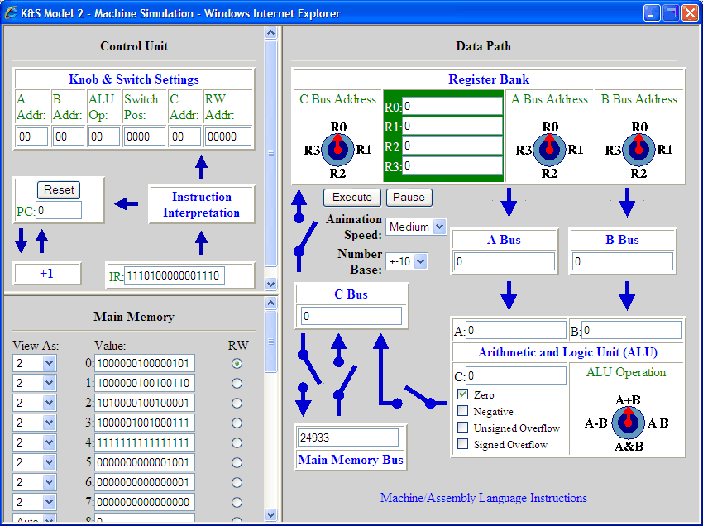
Complete Computer Simulator
we can extend the simulator to integrate a control unit, containing
  Program Counter (PC) for keeping track of the next statement
  Instruction Register (IR): for storing fetched instructions
the user can enter a sequence of instructions directly into memory, starting at address 0 and ending with a Halt instruction
any data to be acted upon is stored in additional memory locations
when the user clicks execute, the program instructions are executed in sequence

Slide 21
Computer Simulator Example
  here, the program consists of 5 instructions, stored in addresses 0 – 4
  data values are stored in addresses 5 & 6
  before execution, the PC = 0

Slide 22
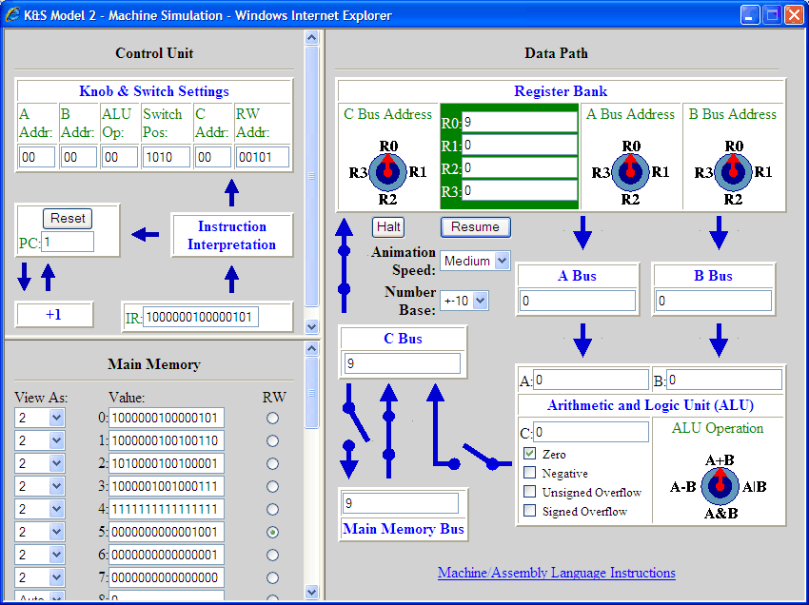
Simulator Example (cont.)
  when execution begins, the instruction at address 0 is fetched and decoded
  the CPU hardware is configured as specified (here, to copy data from address 5 to R0)
  PC is incremented
  a datapath cycle is executed

Slide 23

Simulator Example (cont.)
  next, the instruction at address 1 is fetched and decoded
  the CPU hardware is configured as specified (here, to copy data from address 6 to R1)
  PC is incremented
  a datapath cycle is executed

Slide 24
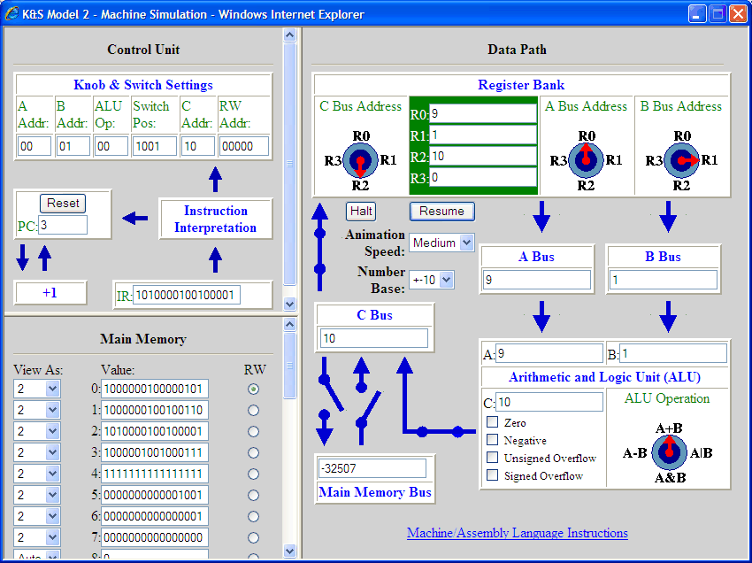
Simulator Example (cont.)
  next, the instruction at address 2 is fetched and decoded
  the CPU hardware is configured as specified (here, to add R0 and R1 and store the sum in R2)
  PC is incremented
  a datapath cycle is executed

Slide 25

Simulator Example (cont.)
  next, the instruction at address 3 is fetched and decoded
  the CPU hardware is configured as specified (here, the value in R2 is copied to address 7)
  PC is incremented
  a datapath cycle is executed

Slide 26

Simulator Example (cont.)
  next, the instruction at address 4 is fetched and decoded
  the CPU hardware is configured as specified (here, Halt)
  PC is incremented
  execution halts

Slide 27
The Role of I/O Devices
recall: input/output devices enable the user to interact with the computer
  input devices – keyboards, mice, scanners, …
  output devices – display screens, speakers, printers, …
the first programmable computers (1950s) and personal computers (1970s) were designed to execute one program at a time
  the user entered program instructions and data directly into main memory via input devices
  the user instructed the CPU to fetch program instructions and execute them in sequential order
  the user viewed results by sending the contents of the memory to an output device
most modern computers allow for multitasking (multiple programs can be active simultaneously)
  instructions and data associated with each program must be loaded into separate portions of main memory
  when control switches from one program to another, the CPU must save the state of the current program and locate the portion of memory for the new program
  memory partitioning and control switches are managed by the operating system

Slide 28
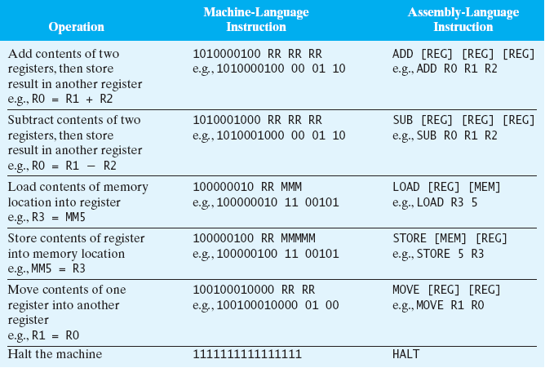
Machine vs. Assembly Language
programming in machine languages is difficult and tedious
  machine code is nearly impossible to understand and debug
assembly languages were developed in the early 1950s to simplify programming
  assembly languages allow for words to substitute for bit patterns
  also, allow for variable names instead of numerical addresses

Slide 29
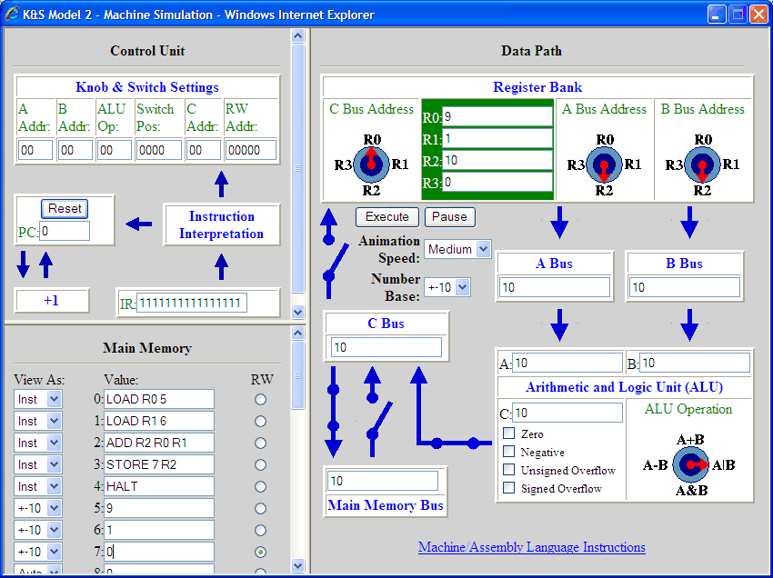
Assembly Language Example
the stored-program computer simulator allows the user to enter instructions in assembly language
  can even toggle the view from assembly language to machine language using the "View As:" pull-down menu to the left of each memory location

