Slide 1
A Balanced Introduction to Computer Science, 2/E
David Reed, Creighton University
©2008 Pearson Prentice Hall
ISBN 978-0-13-601722-6
Chapter 16
Inside the Computer –
Transistors and Integrated Circuits

Slide 2
Electricity and Switches
modern computers are powered by electricity, using electrical signals to store and manipulate information
the components of a computer require electrical power to carry out their assigned task
  electricity generates the light that shines through a computer screen, illuminating the individual pixels that make up images and letters
  electricity runs the motor that spins the hard-drive disk, allowing information to be accessed
  main memory and CPU employ electrical signals to store and manipulate data
  bit patterns are represented by the presence or absence of electrical current along a wire

Slide 3
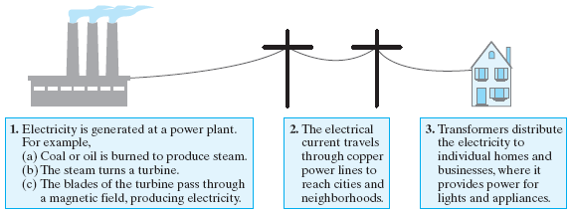
Electricity Basics
electricity is a flow of electrons, the negatively charged particles in atoms, through a medium
  good conductors of electricity allow for the flow of electrons with little resistance (e.g., copper, silver, gold)
  other elements, especially nonmetals, are poor conductors (e.g., carbon, oxygen)
electricity can be quantified in amperes or voltage
  amperes gauge electron flow: 1 amp is equal to 6.24 quintillion electrons flowing past a given point each second
  voltage measures the physical force produced by the flow of electrons: standard household in United States has 110 to 120 volt outlets

Slide 4
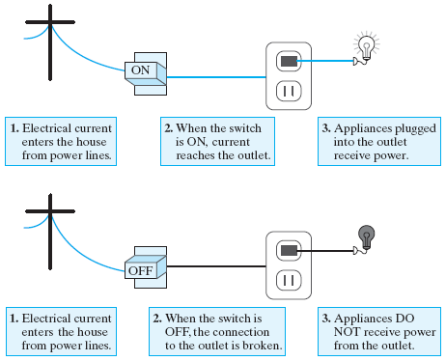
Switches
the most basic tool for controlling the flow of electricity is a switch
  a switch can be flipped to connect or disconnect two wires, thus regulating the flow of electricity between them
example: a light switch on a wall serves as an intermediary between the power line entering your home and the outlet that operates a lighting fixture
  if the switch is turned on, then the wires that link the outlet to the power line are connected, and the lighting fixture receives electricity
  if the switch is turned off, then the connection is interrupted, and no power reaches the outlet

Slide 5
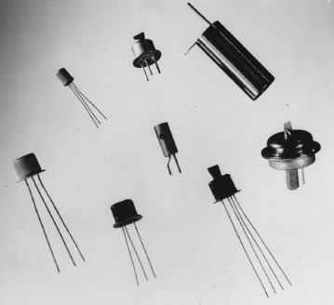
Transistors
as we saw in Chapter 6, advances in switching technology have defined the generations of computers
  1930’s – electromagnetic relays served as physical switches, whose on/off positions were controlled by the voltage to a magnet
  1940’s – vacuum tubes replaced relays, which were faster (since no moving parts) but tended to overheat and burn out frequently
  1948 – the transistor was developed by Bardeen, Brattain, and Shockley
    a transistor is a solid piece of metal attached to a wire that serves as a switch by alternatively conducting or resisting electricity
    transistors allowed for the development of smaller, faster machines at a lower cost
semiconductors are metals that can be manipulated to be either good or bad conductors of electricity
  the first transistors were made of germanium and gold, but modern transistors are constructed from silicon
  through a process known as doping, impurities are added to a slab of silicon, causing the metal to act as an electrical switch

Slide 6
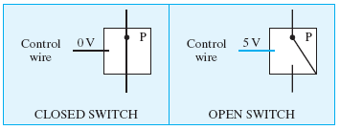
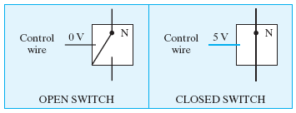
Transistors as Switches
a PMOS transistor is positively doped, so that the switch is "closed" when there is no current on the control wire, but "opens" when current is applied
an NMOS transistor is negatively doped, so that the switch is "open" when there is no current, but "closes" when there is current

Slide 7
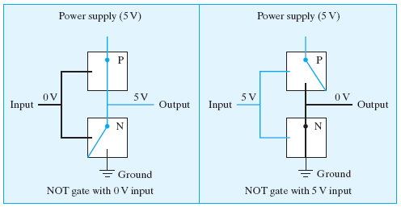
From Transistors to Gates
transistors can be combined to form a circuit, which controls the flow of electricity in order to produce a particular behavior
example: consider the following circuit combining two transistors
  if no current (0 volts) is applied to the input wire, the PMOS transistor will close to allow current to travel on the output wire, and the NMOS transistor will open to disconnect the ground
  if current (5 volts) is applied to the input wire, the PMOS transistor will open to disconnect the output wire, and the NMOS transistor will close to ground the input
  the end result is that the output is the opposite of the input
  this circuit known as a NOT gate

Slide 8

Gates and Binary Logic
the term “gate” suggests a simple circuit that controls the flow of electricity
  in the case of a NOT gate, the flow of electricity is manipulated so that the output signal is always opposite of the input signal
  we can think of a gate as computing a function of binary values
    0 represents no current; 1 represents current
    the symbol to the left (triangle w/ circle) is often used to denote a NOT gate
    the truth table to the right describes the mapping of input to output
  note: NOT gates invert voltages in the same way that the JavaScript NOT operator (!) inverts Boolean values
    0 corresponds to false; 1 corresponds to true

Slide 9
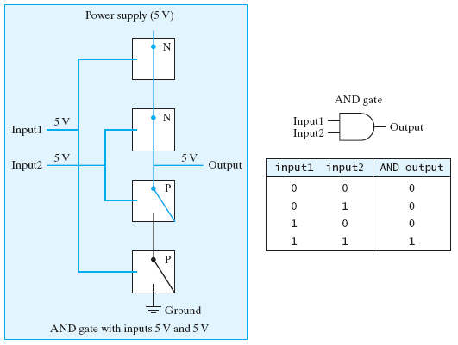
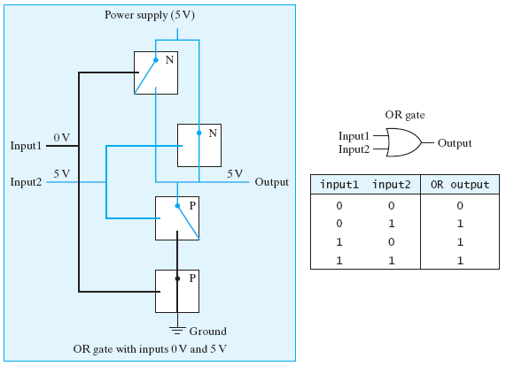
Gates and Binary Logic
many other simple circuits can be defined to perform useful tasks
  AND gate – produces voltage on its output wire if both input wires carry voltage
  OR gate – produces voltage on its output wire if either input wire carries voltage
  AND, OR, and NOT gates can be combined to construct all the circuitry required to store and manipulate information within a computer

Slide 10
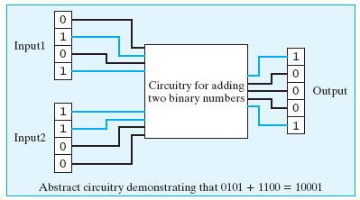
From Gates to Circuits
transistors are connected to form basic logic gates, which are then combined to build more advanced circuitry
example: adding two binary numbers
  we can represent a 4-bit binary number using 4 wires
  current on a wire signifies a 1 bit for that place; no current signifies 0

Slide 11

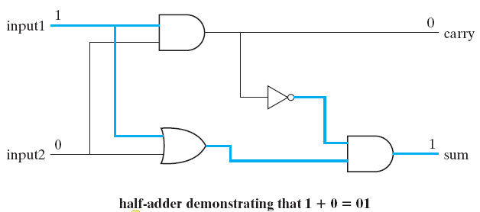
Half-adder Circuit
recall the rules of binary addition:
although binary addition is relatively straightforward, designing a circuit for adding binary numbers is quite complex
  instead of starting at the transistor level, we can use AND, OR, and NOT gates
  focus first on the addition of 2 bits
    requires two input lines, two output lines (sum of inputs and possible carry)
    the circuit consist of four gates (known as a half-adder)

Slide 12
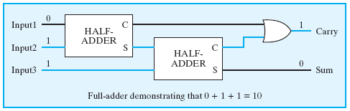
Full-adder Circuit
the term “half-adder” refers to the fact that when you add binary numbers containing more than one bit, summing the corresponding bit pairs by column is only half the job
  you must also consider that a bit might be carried over from the previous addition
  using half-adders and logical gates as building blocks, we can design a circuit that takes this into account (known as a full-adder)

Slide 13
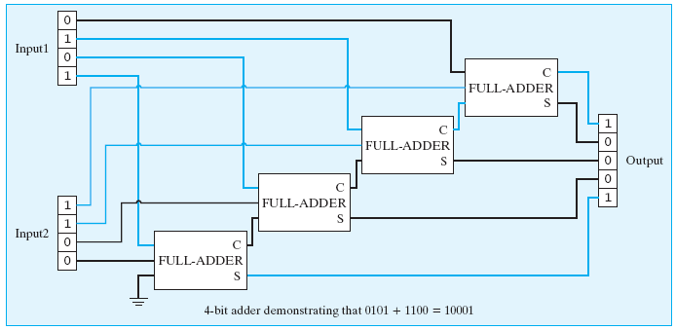
4-bit Adder Circuit
using full-adders as building blocks, we can design a more complex circuit that sums two 4-bit numbers
  since a full-adder is required to add each corresponding bit pair together (along with possible carry), the circuit will need four full-adders wired together

Slide 14

Designing Memory Circuitry
main memory and registers within the CPU are composed of circuitry
  whereas adders manipulate inputs to produce outputs, memory circuits must maintain values over time
  the simplest circuit for storing a value is known as a flip-flop
    it can be set to store a 1 by applying current on an input wire
    it can be reset to store a 0 by applying current on another input wire

Slide 15
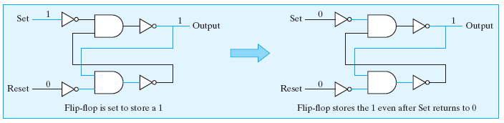
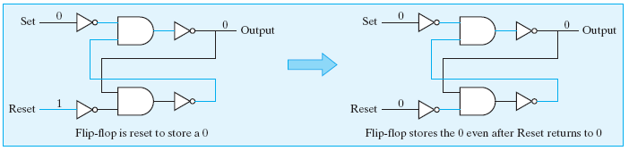
Flip-flop Circuit
a flip-flop stores a value by feeding the output currents back into the circuit
  the value is maintained by current flowing around and around the circuit
  a current on the Set wire produces current on the output, which then cycles
  a current on the Reset wire produces no current on the output

Slide 16
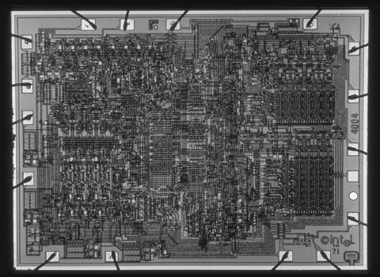
From Circuits to Microchips
initially, circuits were built by wiring together individual transistors
  this did not lend itself to mass production
  it also meant that even simple circuits consisting of tens or hundreds of transistors were quite large (to allow space for human hands)
in 1958, two researchers (Jack Kilby and Robert Noyce) independently developed techniques that allowed for the mass-production of circuitry
  circuitry (transistors + connections) is layered onto a single wafer of silicon, known as a microchip
  since every component is integrated onto the same microchip, these circuits became known as integrated circuits

Slide 17
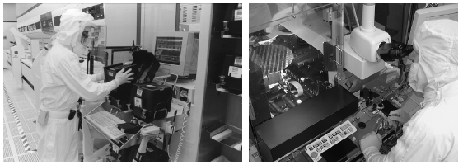
Manufacturing ICs
the production of integrated circuits is one of the most complex engineering processes in the world
  transistors on chips can be as small as .065 microns (roughly 1/1,500th the width of human hair)
  since a hair or dust particle can damage circuitry during manufacture, chips are created in climate-controlled "clean rooms"

Slide 18
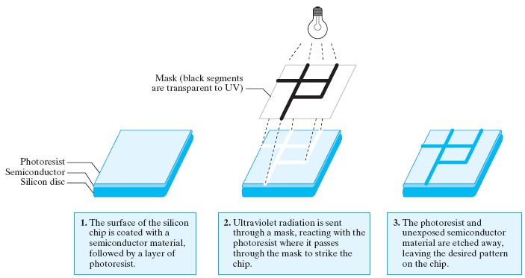
Manufacturing ICs
to produce the incredibly small and precise circuitry on microchips, manufacturers use light-sensitive chemicals
  initially, the silicon chip is covered with a semiconductor material, then coated with a layer of photoresist (a chemical sensitive to UV light)
  transistors are then printed onto a mask (transparent surface on which an opaque coating has been applied to form patterns)
  UV light is filtered through the mask, passing through the transparent portions and striking the surface of the chip in the specified pattern
  the photoresist that is exposed to the UV light reacts, hardening the layer of the semiconductor below it
  the photoresist that was not exposed and the soft layer of semiconductor below are etched away, leaving only the desired pattern of semiconductor material on the surface of the chip
  the process can be repeated 20-30 times depositing multiple layers

Slide 19
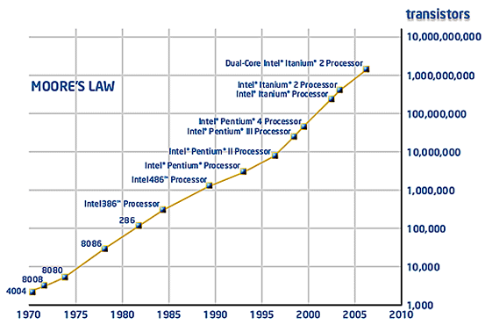
Packaging Microchips
since a silicon chip is fragile, the chip is encased in plastic for protection
  metal pins are inserted on both sides of the packaging, facilitating easy connections to other microchips
impact of the microchip
  lower cost due to mass production
  faster operation speed due to the close proximity of circuits on chips
  simpler design/construction of computers using prepackaged components
Moore’s Law describes the remarkable evolution of manufacturing technology
  Moore noted that the number of transistors that can fit on a microchip doubles every 12 to 18 months
  this pattern has held true for the past 30 years
  industry analysts predict that it will continue to hold for the near future

