Slide 1
A Balanced Introduction to Computer Science, 2/E
David Reed, Creighton University
©2008 Pearson Prentice Hall
ISBN 978-0-13-601722-6
Chapter 3
The Internet and the Web

Slide 2
History of Internet
recall: the Internet is a vast, international network of computers
the Internet traces its roots back to the early 1960s
  MIT professor J.C.R. Licklider published a series of articles describing a “Galactic Network” of communicating computers
  in 1962, Licklider became head of computer research at the U.S. Department of Defense’s Advanced Research Project Agency (ARPA)
  in 1967, Licklider hired Larry Roberts to design and implement his vision of a Galactic Network
the ARPANet (precursor to the Internet) became a reality in 1969
  it connected computers at four universities: UCLA, UCSB, SRI, and Utah
  it employed dedicated cables, buried underground
    the data transfer rate was 56K bits/sec, roughly the same as dial-up services today
  the ARPANet demonstrated that researchers at different sites could communicate, share data, and run software remotely

Slide 3
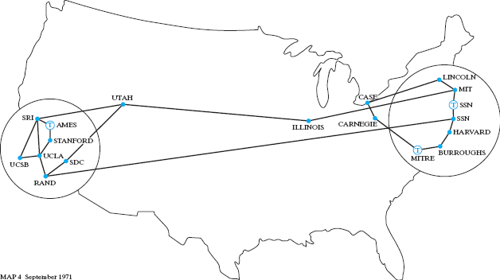
ARPANet
the ARPANet was intended to connect only military installations and universities participating in government projects
  by 1971, 18 sites were connected; most used Interface Message Processors (IMPs) which allowed up to 4 terminal connections at the site
  sites labeled with a T utilized Terminal Interface Processors (TIPs), which allowed up to 64 terminal connections at the site

Slide 4
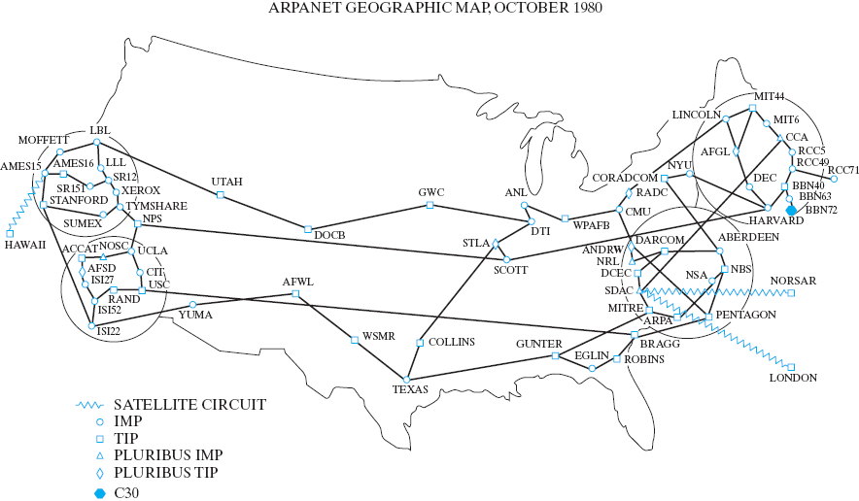
ARPANet Growth
by 1980, close to 100 sites were connected to the ARPANet
  satellite connections provided links to select cities outside the continental U.S.

Slide 5
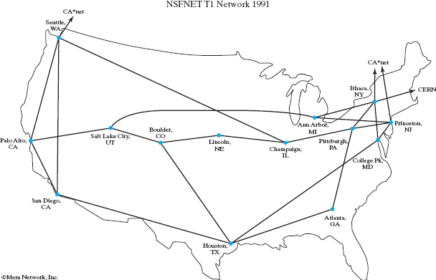
NSFNet
in the early 1980s, the ARPANet experienced an astounding growth spurt
  applications such as email, newsgroups, and remote logins were attractive to all colleges and universities
  by 1984, the ARPANet encompassed more than 1,000 sites
to accommodate further growth, the National Science Foundation (NSF) became involved with the ARPANet in 1984
  NSF funded the construction of high-speed transmission lines that would form the backbone of the expanding network

Slide 6
"Internet"
the term “Internet” was coined in recognition of the similarities between the NSFNet and the interstate highway system
  backbone connections provided fast communications between principal destinations, analogous to interstate highways
  connected to the backbone were slower transmission lines that linked secondary destinations, analogous to state highways
  local connections were required to reach individual computers, analogous to city and neighborhood roads
note: Al Gore did not INVENT the Internet, nor did he ever claim to
  he sponsored legislation in the late 1980s to support growth and expand access
recognizing that continued growth would require significant funding and research, the government decided in the mid 90s to privatize the Internet
  control of the network’s hardware was turned over to telecommunications companies and research organizations (e.g., AT&T, Verizon, Qwest, Sprint)
  research and design are administered by the Internet Society

Slide 7
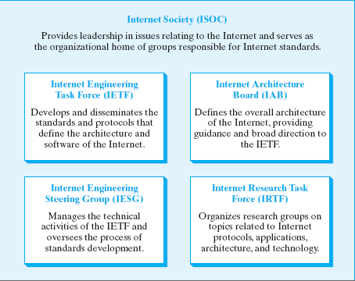
Internet Society
Internet Society is an international nonprofit organization (founded in 1992)
  it maintains and enforces standards, ensuring that all computers on the Internet are able to communicate with each other
  it also organizes committees that propose and approve new Internet-related technologies and software

Slide 8
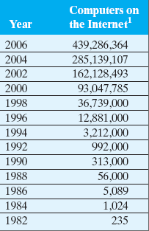
Internet Growth
until recently, the Internet more than doubled in size every 1 or 2 years
  why has this trend slowed? will it continue?
(“Internet Domain Survey.” Internet Software Consortium, July 2006.)

Slide 9
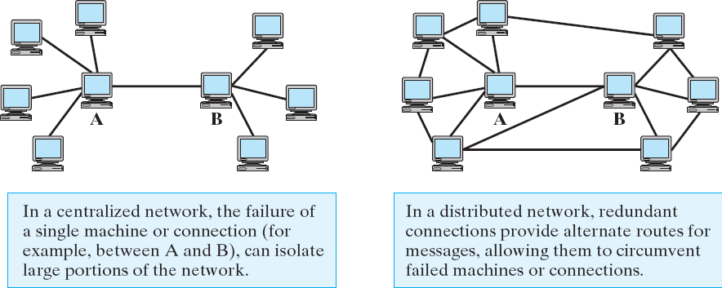
Distributed Networks
the design of the ARPANet was influenced by the ideas of Paul Baran, a researcher at the RAND Institute
  Baran proposed 2 key ideas: distributed network and packet-switching
recall: the ARPANet was funded by the Dept of Defense for communications
  as such, it needed to be resistant to attack or mechanical failure

Slide 10
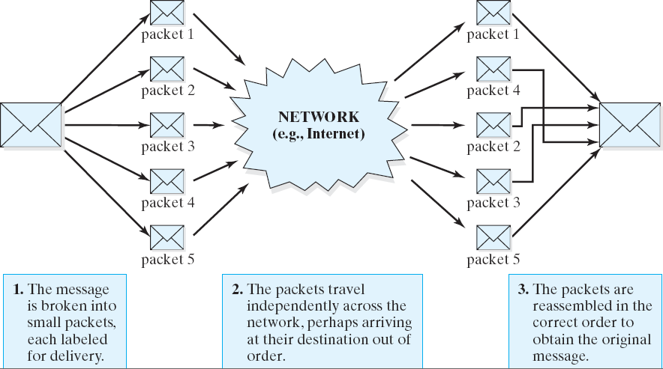
Packet Switching
in a packet-switching network, messages to be sent over the network are first broken into small pieces known as packets
  these packets are sent independently to their final destination

Slide 11
Advantages of Packets
sending information in smaller units increases the efficient use of connections
  large messages can't monopolize the connection
  analogy: limiting call lengths at a pay phone to limit waiting
transmitting packets independently allows the network to react to failures or network congestion
  routers (special-purpose computers that direct the flow of messages) can recognize failures or congestion and reroute the packet around trouble areas
breaking the message into packets can improve reliability
  since the packets are transmitted independently, it is likely that at least part of the message will arrive (even if some failures occur within the network)
  software at the destination can recognize which packets are missing and request retransmission

Slide 12
Protocols and Addresses
the Internet allows different types of computers from around the world to communicate
  this is possible because the computing community agreed upon common protocols (sets of rules that describe how communication takes place)
  the two central protocols that control Internet communication are:
    Transmission Control Protocol (TCP)
    Internet Protocol (IP)
these protocols rely on each computer having a unique identifier (known as an IP address)
  analogy: street address + zip code provide unique address for your house/dorm
      using this address, anyone in the world can send you a letter
  an IP address is a number, written as a dotted sequence such as 147.134.2.84
  each computer is assigned an IP address by its Internet Service Provider (ISP)
  some ISPs (e.g., AOL, most colleges) maintain a pool of IP addresses and assign them dynamically to computers each time they connect

Slide 13
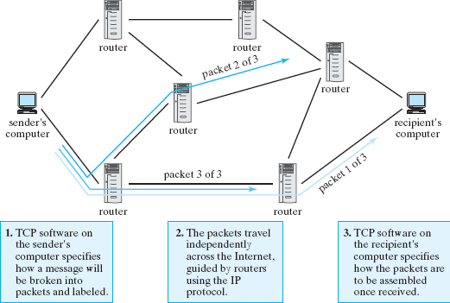
TCP/IP
Transmission Control Protocol (TCP)
  controls the method by which messages are broken down into packets and then reassembled when they reach their final destination
Internet Protocol (IP)
  concerned with labeling the packets for delivery and controlling the packets’ paths from sender to recipient

Slide 14
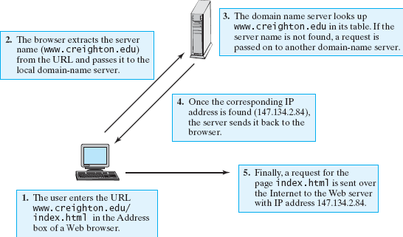
Routers and DNS
the Internet relies on special purpose computers in the network
  routers are computers that receive packets, access the routing information, and pass the packets on toward their destination
  domain name servers are computers that store mappings between domain names and IP addresses
    domain names are hierarchical names for computers (e.g., bluejay.creighton.edu)
      they are much easier to remember and type than IP addresses
    domain name servers translate the names into their corresponding IP addresses

Slide 15
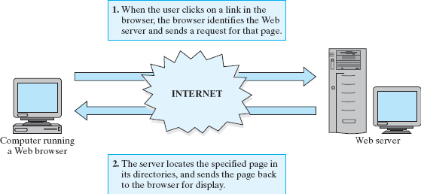
History of the Web
the World Wide Web is a multimedia environment in which documents can be
seamlessly linked over the Internet
  proposed by Tim Berners-Lee at the European Laboratory for Particle Physics (CERN) in 1989
  designed to facilitate sharing information among researchers located all over Europe and using different types of computers and software
Berners-Lee's design of the Web integrated two key ideas
  hypertext (documents with interlinked text and media)
    Web pages can contain images and links to other pages
  the distributed nature of the Internet
    pages can be stored on machines all across the Internet, known as Web servers
    logical connections between pages are independent of physical locations

Slide 16
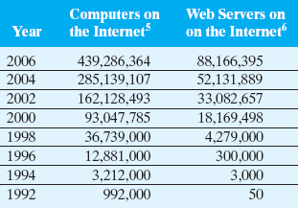
Web Timeline
1990: Berners-Lee produced working prototypes of a Web server and browser
1991: Berners-Lee made his software available for free over the Internet
1993: Marc Andreesen and Eric Bina of the University of Illinois’ National Center for Supercomputing Association (NCSA), wrote the first graphical browser: Mosaic
  Mosaic integrated text, image & links, made browsing more intuitive
1994: Andreesen founded Netscape, which marketed the Netscape Navigator
1995: Microsoft released Internet Explorer → the browser wars begin!
1999: Internet Explorer becomes the most popular browser (~90% of market in 2002)
2006: Mozilla Firefox (Netscape descendent) grows in popularity, IE share drops to 80%
in 2005, Google indexed more than 8 billion Web pages
other sources estimated more than 25 billion Web pages
(“Internet Domain Survey.” Internet Software Consortium, July 2006.
“Netcraft Web Server Survey.” Netcraft, July 2006.)

Slide 17
How the Web Works
like Internet communications, the Web relies on protocols to ensure that pages are accessible to any computer
  HyperText Markup Language (HTML) defines the form of Web page content
  HyperText Transfer Protocol (HTTP) defines how messages exchanged between browsers and servers are formatted
    the prefix http:// in a URL specifies that the HTTP protocol is to be used in communicating with the server
    the prefix is NOT used for local file access since no server communication is necessary
for efficiency reasons, browsers will sometimes cache pages/images
  to avoid redundant downloads, the browser will store a copy of a page/image on the hard drive (along with a time stamp)
  the next time the page/image is requested, it will first check the cache
    if a copy is found, it sends a conditional request to the server
      essentially: "send this page/image only if it has been changed since the timestamp"
      if the server copy has not changed, the server sends back a brief message and the browser simply uses the cached copy

