Slide 1
A Balanced Introduction to Computer Science, 2/E
David Reed, Creighton University
©2008 Pearson Prentice Hall
ISBN 978-0-13-601722-6
Chapter 4
JavaScript and Dynamic Web Pages

Slide 2
Static vs. Dynamic Pages
recall: a Web page uses HTML tags to identify page content and formatting information
HTML can produce only static pages
  static pages look the same and behave in the same manner each time they are loaded into a browser
in 1995, researchers at Netscape developed JavaScript, a language for creating dynamic pages
  Web pages with JavaScript can change their appearance:
    over time (e.g., a different image each time that a page is loaded), or
    in response to a user’s actions (e.g., typing, mouse clicks, and other input methods)

Slide 3
Programming Languages
JavaScript is a programming language
  a programming language is a language for specifying instructions that a computer can execute
  each statement in a programming language specifies a particular action that the computer is to carry out
    (e.g., changing an image or opening a window when a button is clicked)
some programming languages are general-purpose
  popular languages include C++, Java, J#
JavaScript was defined for a specific purpose: adding dynamic content to Web pages
  can add JavaScript statements to a Web page using the HTML tags
    <script type="text/javascript"> . . . </script>
  when the browser displays the page, any statements inside the SCRIPT tags are executed and the result is displayed

Slide 4
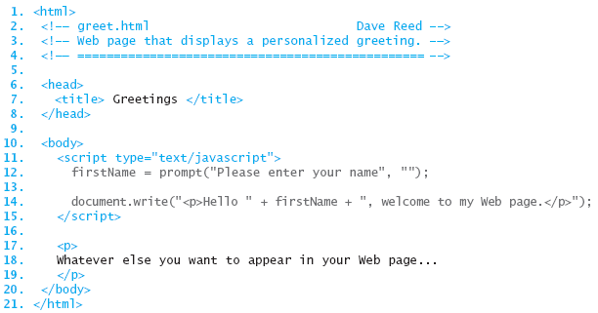
Simple Dynamic Page
below is a simple Web page with dynamic content
  note: dynamic content can be mixed with static HTML content
it demonstrates two types of JavaScript statements
  an assignment statement that asks the user for input and stores that input
  a write statement that writes text into the HTML page

Slide 5
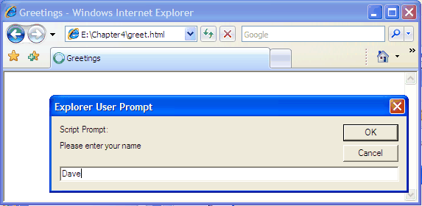
Assignment Statement
when an assignment statement involving prompt is executed by the browser
  a separate window is opened with a text box for the user to enter text
  when the user is done typing, he/she can click on the OK button
  firstName = prompt("Please enter your name", "");
  when OK is clicked, the text entered is assigned to a variable
    a variable is a name used to symbolize a dynamic value
    here, the variable firstname is used to store the text entered by the user

Slide 6
Assignment Statement (cont.)
the general form of an assignment statement using a prompt is
  VARIABLE = prompt("PROMPT MESSAGE", "");
  the variable name can vary depending on the task at hand
    here, the variable is used to store the user's first name, so firstName is a meaningful name
  the prompt message that appears in the window can likewise change
    here, the message "Please enter your name" tells the user what is expected

Slide 7
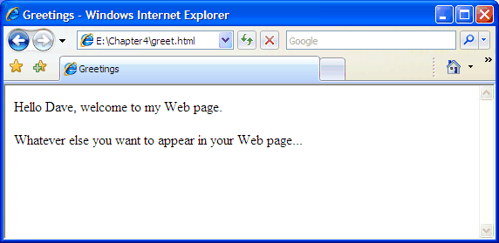
Write Statement
when a write statement is executed by the browser
  the message specified in the statement is written into the HTML page
  a message can include
    a string literal – text enclosed in quotes
    a variable
    a combination of strings and variables, connected via '+'
  document.write("<p>Hello " + firstName +
  ", welcome to my Web page.</p>");
  when a variable is encountered, the browser substitutes the value currently assigned to that variable

Slide 8
Write Statement (cont.)
the general form of a write statement is
  document.write("MESSAGE TO BE DISPLAYED " + VARIABLE +
  " MORE MESSAGE" + ...);
  note that the statement can be broken across lines, as long as no string literal is split (i.e., the beginning and ending quotes of a string must be on same line)
  the pieces of the message are displayed in sequence, with no spaces in between
    if you want spaces, you have to enter them in the text

Slide 9
Formatted Output
the output produced by a write statement is embedded in the page
  the browser displays this output just as it does any other text
  if the text contains HTML tags, the browser will interpret the tags and format the text accordingly
  document.write("<p>Hello <i>" + firstName +
  "</i>, welcome to my Web page.</p>");
  assuming the variable firstName has been assigned "Dave", the browser would execute the statement to produce
    <p>Hello <i>Dave</i>, welcome to my Web page.</p>
  which would be displayed by the browser as
    Hello Dave, welcome to my Web page.

Slide 10
Syntax Errors
an error in the format of an HTML or JavaScript statements is known as a syntax error
  some syntax errors are ignored by the browser
    e.g., misspelling an HTML tag name
  most JavaScript syntax errors will generate an error message
  document.write("This example is illegal since the
  string is broken across lines");
    yields: Error: unterminated string literal
    document.write("The value of x is " x);
  yields: Error: missing ) after argument list

Slide 11
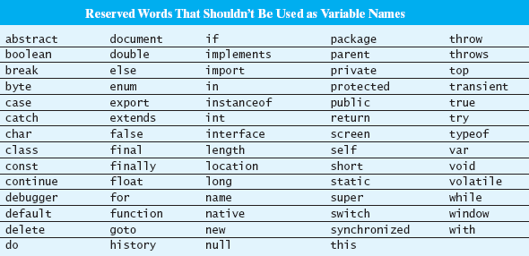
JavaScript Variables
a variable name can be any sequence of letters, digits, and underscores (but must start with a letter)
  valid: tempInFahr SUM current_age Sum2Date x
  invalid: 2hotforU salary$ two words "sum_to_date"
variable names are case sensitive, so Sum and SUM are treated as different variables

Slide 12

Variables & Memory Cells
computers keep track of the values that variables represent by associating each variable with a specific piece of memory, known as a memory cell
  when a JavaScript assignment is executed,
    firstName = prompt("Please enter your name", "");
  the value entered by the user (e.g., "Dave") is stored in a memory cell associated with the variable firstName
  any future reference to the variable name evaluates to the value stored in its associated memory cell

Slide 13
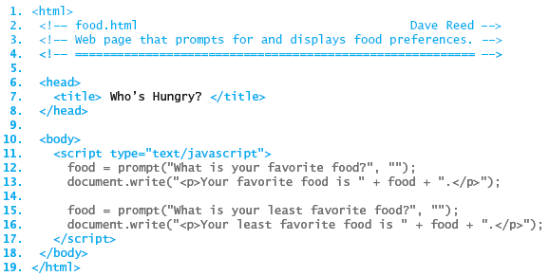
Another Example
once you create a variable, you can repeatedly assign values to it
  only the most recent value is retained in memory
EXAMPLE: suppose we want to prompt the user for two different foods
  if only one food is needed at a time, we can reuse the same variable

Slide 14
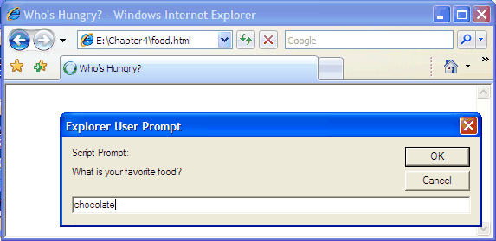
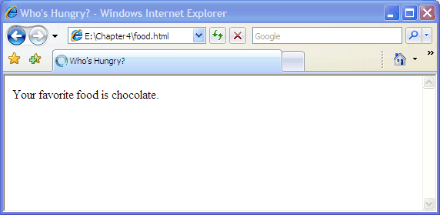
Reusing Variables
food = prompt("What is your favorite food?", "");
document.write("<p>Your favorite food is " + food + "</p>");
the first pair of statements
  stores the user's favorite food
  displays that food in the page

Slide 15
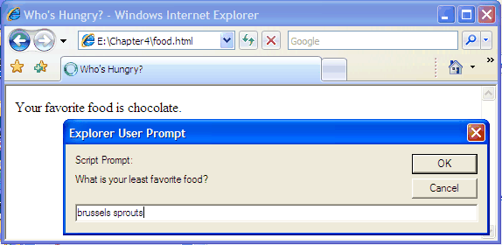
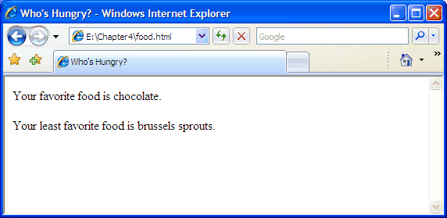
Reusing Variables (cont.)
food = prompt("What is your least favorite food?", "");
document.write("<p>Your least favorite food is " + food + "</p>");
the second pair of statements
  stores the user's least favorite food (overwriting the old value)
  displays that food in the page

Slide 16
Prompts with Defaults
so far, all prompts have been of the form
  VARIABLE = prompt("PROMPT MESSAGE", "");
sometimes it makes sense to provide default values for prompts
  can specify a string literal instead of ""
  this string will appear in the prompt box when it appears
    if the user wants to accept the default value, can just click OK
EXAMPLE: suppose we wanted to create a page that displays a verse of the children's song, Old MacDonald had a Farm
  the page should be able to display any verse
  can accomplish this by prompting the user for the animal and sound
  can specify default values so that it is easy to display a common verse
    animal = prompt("Enter a kind of animal:", "cow");
    sound = prompt("What kind of sound does it make?", "moo");

Slide 17
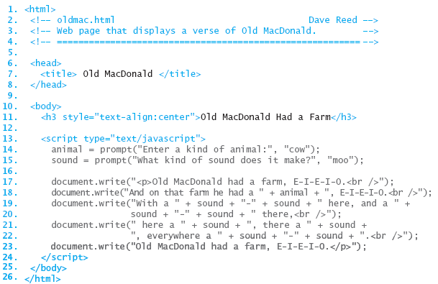
Old MacDonald
this page prompts the user for the animal and sound ("cow" and "moo", by default), then displays a verse using those values
  <br /> tags are embedded to break the output onto separate lines

Slide 18
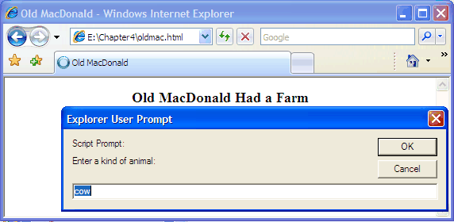
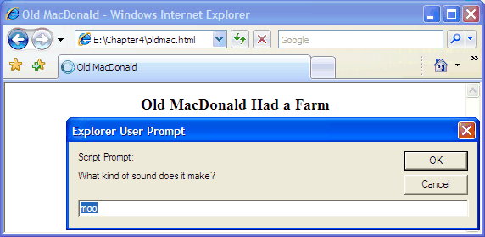
Old MacDonald (cont.)
the default values automatically appear in the prompt boxes
  the user can click OK to accept the defaults
  OR
  type new values into the prompt box

Slide 19
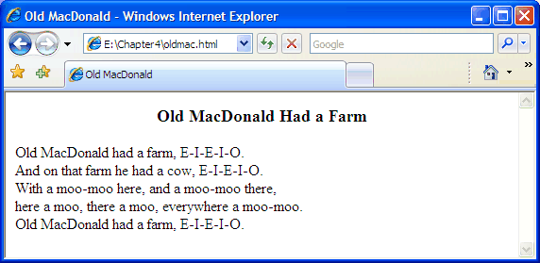
Old MacDonald (cont.)

Slide 20
Localizing Changes
so far, we have used variables to store values read in via prompts
another common use is to store values used repeatedly in a page
  suppose we wanted to change the spelling of the refrain in Old MacDonald
    ("E-I-E-I-O" → "Eeyigh-Eeyigh-Oh")
  as is, would need to find and update all occurrences in the verse
  instead, could use a variable to store the refrain
    refrain = "E-I-E-I-O";
    document.write("<p>Old MacDonald had a farm, " + refrain + ".<br />");
    document.write("And on that farm he had a " + animal + ", " +
    refrain + ".<br />");
  . . .
  now, to update the value in the entire verse, simply must change the assignment
    refrain = "Eeyigh-Eeyigh-Oh";
document.write("<p>Old MacDonald had a farm, " + refrain + ".<br />");
    document.write("And on that farm he had a " + animal + ", " +
    refrain + ".<br />");
  . . .

