Slide 1
A Balanced Introduction to Computer Science, 2/E
David Reed, Creighton University
©2008 Pearson Prentice Hall
ISBN 978-0-13-601722-6
Chapter 5
JavaScript Numbers and Expressions

Slide 2
Data Types
each unit of information processed by a computer belongs to a general category or data type
  e.g., string, number, Boolean (either true or false)
each data type is associated with a specific set of predefined operators that may be used by programmers to manipulate values of that type
  e.g., we have seen string concatenation via +
  similarly, standard operators are predefined for numbers
    addition (+), subtraction (-), multiplication (*), division (/)
variables can be assigned various kinds of numerical values, including mathematical expressions formed by applying operators to numbers
  when an expression appears on the right-hand side, the expression is evaluated and the resulting value is assigned to the variable on the left-hand side
    word = "howdy" + " doo"; "howdy doo"
    word
    x = 50/4; 12.5
    x

Slide 3
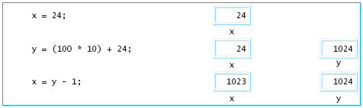
Variables and Expressions
similarly, expressions can appear in write statements
  note: parentheses can be used to make sub-expression grouping explicit
  document.write(3 + 7); ➔ writes 10
  document.write("The sum of is " + (3 + 7)); ➔ writes The sum is 10
if a variable appears in an expression, the value currently assigned to that variable is substituted

Slide 4
Number Representation
useful facts about JavaScript numbers
  to improve readability, very large or very small number are displayed in scientific notation: XeY represents the value X  10^{Y}
    e.g., 1e24 → 1  10²⁴ → 1000000000000000000000000
  JavaScript stores all numbers in memory cells of a fixed size (64 bits)
    as a result, only a finite number of values can be represented
    e.g., 1e308 can be represented, but 1e309 is treated as Infinity
      1e-323 can be represented, but 1e-324 is treated as 0
  even within the range 1e-323 . . . 1e309, not all numbers can be represented
    note that between any two numbers lie infinitely more numbers!
    JavaScript can represent approximately 17 significant digits
    e.g.., 0.9999999999999999 can be represented exactly
    0.99999999999999999 is rounded up to 1

Slide 5

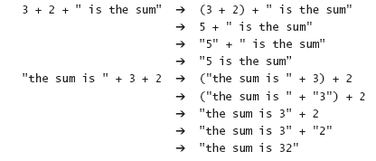
Mixed Expressions
in JavaScript, the + operator serves two purposes
  when applied to numbers, + means addition
  when applied to strings, + means concatenation
  what about a mixed expression?
when applied to a string and a number,
  the number is converted to a string (effectively, by placing quotes around it),
  then string concatenation is performed
note: expressions involving + are evaluated left-to-right
  this can have consequences in the way mixed expressions are evaluated
  ADVICE: always use parentheses to group nested sub-expressions

Slide 6
Prompting for Numbers
special care must be taken when prompting the user for number values
  recall that prompt always returns a string, even if the user enters only digits
  e.g., if the user enters 500 at a prompt, then the value "500" is returned
    myNumber = prompt("Enter a number", "");
    document.write("One more is " + (myNumber + 1));
  if the user entered 12 at the prompt, what would be displayed?
  the message displayed would be One more is 121 WHY?
    the prompt returns "12" which is stored in myNumber
    the parenthesized sub-expression (myNumber + 1) is evaluated first
    since this is a mixed expression, the number 1 is converted to "1" then concatenated
    the result, "121", is then concatenated to the end of "One more is "
what is needed is a mechanism for converting strings of digits into numbers
  e.g., "500" → 500, "1.314" → 1.314, …
  this is accomplished in JavaScript using the parseFloat function

Slide 7
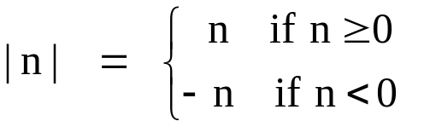
Functions
in mathematics, a function is a mapping from inputs to a single output
  e.g., the absolute value function maps one number to another
    -5 → 5, -2.4 → 2.4, 17 → 17, …
  similarly, the parseFloat function maps strings of digits to numbers
    "500" → 500, "1.314" → 1.314, "0" → 0, …
from a programmer's view, a function is a "unit of computational abstraction"
  there is some computation required to calculate the output given the input(s)
  a JavaScript function encapsulates that computation and hides the details
  the user does not need to know how the function works, only how to apply it
    applying a function to inputs is known as calling the function
    the output of a function call is known as the return value

Slide 8
parseFloat
a function call can appear anywhere in a JavaScript expression
  when the expression is evaluated, the return value for that call is substituted
    myNumber = prompt("Enter a number", "");
    myNumber = parseFloat(myNumber);
    document.write("One more is " + (myNumber + 1));
    the 1st statement prompts the user and stores their input (say "12")in myNumber
    the 2nd statement calls parseFloat to convert the string to a number (12) and then reassigns that number back to myNumber
    the 3rd statement uses the number value 12 to display One more is 13
note, the following is not an error (but probably not what was intended)
    myNumber = prompt("Enter a number", "");
    parseFloat(myNumber);
    document.write("One more is " + (myNumber + 1));
    the call to parseFloat returns a number, but nothing is done with that number
    NOTE: the only way to change the value of a variable is via an assignment statement

Slide 9
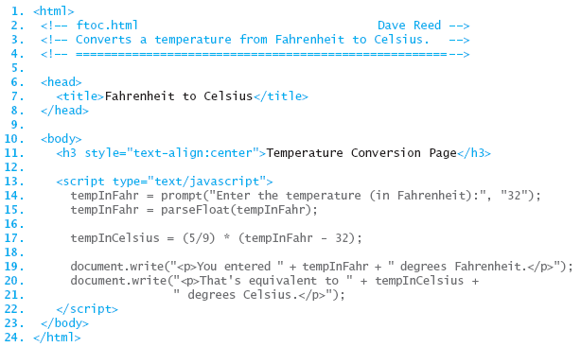
Temperature Conversion
the following page prompts the user for a temperature (in Fahrenheit), stores the input as a number, then converts that temperature to Celsius

Slide 10
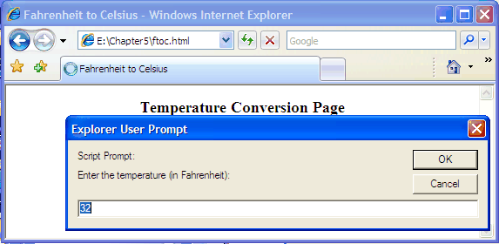
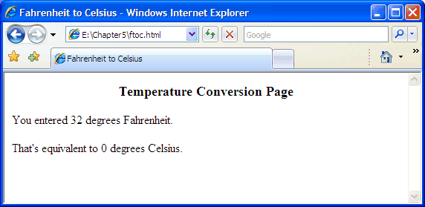
Conversion Page
note that the prompt has a default value of 32

Slide 11
Common Pattern
many tasks that we will consider have the same basic form
  prompt the user for numbers
  store them in variables
  perform some calculation(s) using those numbers
  display the results
not surprisingly, there is a pattern to the code
    <script type="text/javascript">
    number1 = prompt("PROMPT MESSAGE", "");
    number1 = parseFloat(number1);
    number2 = prompt("PROMPT MESSAGE", "");
    number2 = parseFloat(number2);
    . . .
    numberN = prompt("PROMPT MESSAGE", "");
    numberN = parseFloat(numberN);
    answer = SOME EXPRESSION INVOLVING number1, …, numberN;
    document.write("MESSAGE INVOLVING answer");
    </script>

Slide 12
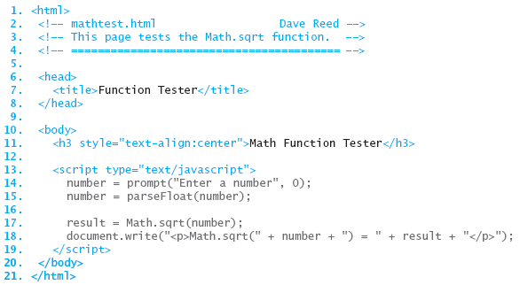
Predefined Functions
JavaScript provides an extensive library of predefined mathematical functions
  Math.sqrt returns the square root of a number
  e.g., Math.sqrt(9) → 3
  Math.max returns the maximum of two numbers
  e.g., Math.max(3.2, 1.8) → 3.2

Slide 13
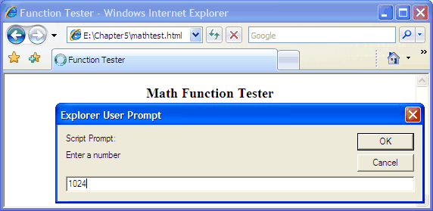
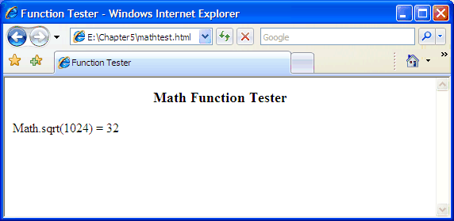
Tester Page
this page could be modified to test a variety of functions
  change the function call in the page
  enter various inputs and observe the corresponding outputs

Slide 14
Other Useful Functions
Math.pow raises a number to a power
  Math.pow(2, 10) → 2¹⁰ = 1024
  Math.pow(2, -1) → 2⁻¹ = 0.5
  Math.pow(9, 0.5) → 9^{0.5} = 3
Math.random generates a random number in the range [0…1)
  note: this function has no inputs; it returns a different number each call
  Math.random() → 0.33008525626748814
  Math.random() → 0.213335955823927
  Math.random() → 0.8975001737758223
  .
  .
  .

Slide 15
Errors and Debugging
in computer jargon, the term bug refers to an error in a program
  the process of systematically locating and fixing errors is debugging
three types of errors can occur
  syntax errors: typographic errors
    e.g., omitting a quote or misspelling a function name
    since the browser catches these, they are usually "easy" to identify and fix
  run-time errors: occur when operations are applied to illegal values
    e.g., attempting to multiply a string or divide by zero
    also caught by the browser, which either produces an error message or else returns a special value (string multiplication produces NaN, for "Not a Number"; division by zero produces Infinity)
  logic errors: flaws in the design or implementation of a program
    whenever your program produces the wrong result
    since they are not caught by the browser (the program is legal, just not what you wanted), logic errors are hardest to identify
useful technique for identifying bugs: diagnostic write statements
  at various intervals in the code, write out the values of key variables
  you can then isolate at what point the program is going wrong

