Slide 1
A Balanced Introduction to Computer Science, 2/E
David Reed, Creighton University
©2008 Pearson Prentice Hall
ISBN 978-0-13-601722-6
Chapter 7
Event-Driven Pages

Slide 2

Event-driven Pages
one popular feature of the Web is its interactive nature
  e.g., you click on buttons to make windows appear
  e.g., you enter credit card information in a form and submit it
pages that respond to user actions such as mouse clicks or form entries are known as event-driven pages
  JavaScript code can be combined with HTML elements such as buttons, text fields, and text areas to produce event-driven pages
an event handler is an HTML element that can be programmed to respond to a user’s actions
  the simplest event handler is a button
  a button can be associated with JavaScript code that will execute when the button is clicked

Slide 3
Buttons and Forms
general form of a button element:
<input type="button" value="BUTTON_LABEL" onclick="JAVASCRIPT_CODE" />
  the TYPE attribute of the INPUT element identifies the element to be a button
  the VALUE attribute specifies the text label that appears on the button
  the ONCLICK attribute specifies the action to take place
    any JavaScript statement(s) can be assigned to the ONCLICK attribute
    this can be (and frequently is) a call to a JavaScript function
for example,
<input type="button" value="Click for Free Money"
onclick="alert('Yeah, right.');" />
  the predefined alert function displays a message in a new window
    here, the message 'Yeah, right.' is displayed at the click of the button
  a string can be denoted using either double("…") or single ('…') quotes
    here, single quotes must be used to avoid confusion with the ONCLICK quotes

Slide 4
Random Number Example
recall the task of generating random numbers
  earlier, we did this by embedding JavaScript code in SCRIPT tags
  each time the page was loaded in the browser, the code was executed and the random number was written into the HTML text using document.write
DRAWBACK: the user had to reload for each random number
ALTERNATIVE: place a button in the page with associated code for generating and displaying the random number
  each time the user clicks the button, the code for generating and displaying the number is executed

Slide 5
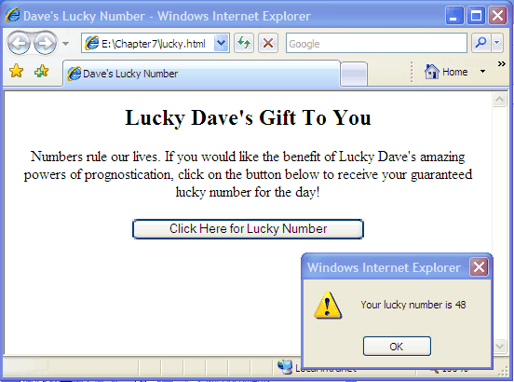
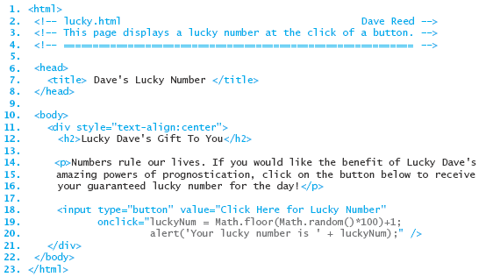
LuckyForm Example
when the button is clicked, two JavaScript statements are executed
  a number in the range 1..100 is randomly selected
  that number is displayed in an alert window

Slide 6
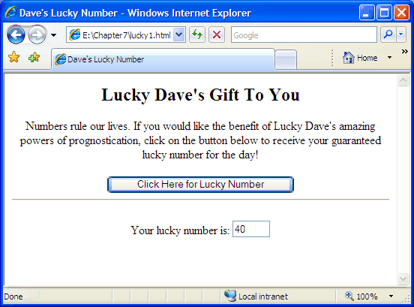
Output via Text Boxes
a button provides a simple mechanism for user interaction in a Web page
  by clicking the button, the user initiates some action
a text box is an event-handler that can display text (a word or phrase)
  unlike an alert window, the text box appears as a box embedded in the page
  text can be written to the box by JavaScript code (i.e., the box displays output)
for example, we could reimplement the lucky number page using a text box
the text box containing the random number is embedded in the page
doesn't require the user to close the alert window after each number

Slide 7
Output via Text Boxes
general form of a text box element:
<input type="text" id="BOX_NAME" size="NUM_CHARS" value="INITIAL_TEXT" />
  the TYPE attribute of the INPUT element identifies the element to be a text box
  the ID attribute gives the element an identifier so that it can be referenced
  the SIZE attribute specifies the size of the box (number of characters that fit)
  the VALUE attribute specifies text that initially appears in the box
to display text in a text box, a JavaScript assignment is used to assign to its value attribute
  as part of the assignment, must specify the absolute name of the box
  the general form is:
document.getElementById('BOX_NAME').value = VALUE_TO_BE_DISPLAYED;

Slide 8
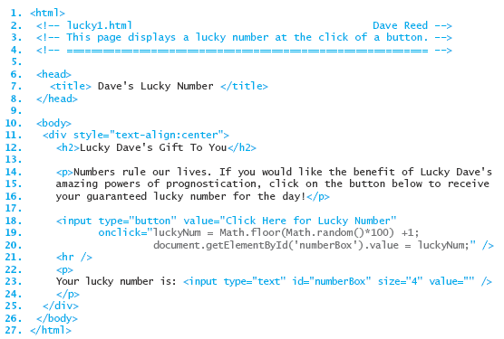
Text Box for Displaying Output
when the button is clicked, the function call
DisplayNumber(); is executed
the function generates the random number and assigns it to the text box
as a result, each button click yields a new number in the box

Slide 9
Input via Text Boxes
text boxes can also be used for receiving user input
  the user can enter text directly into the box
  that text can then be accessed by JavaScript code via the absolute name of the box
    document.geElementById('BOX_NAME').value
  note that the value retrieved from a text box is always a string
    if the user enters a number, say 93, then the absolute name will access "93"
    similar to prompt, you must use parseFloat to convert the string to its numeric value
example: we can revisit our temperature conversion page
  the user enters the Fahrenheit temperature in a text box
  at the click of a button, the input is accessed and converted to Celsius
  another text box is used to display the converted temperature

Slide 10
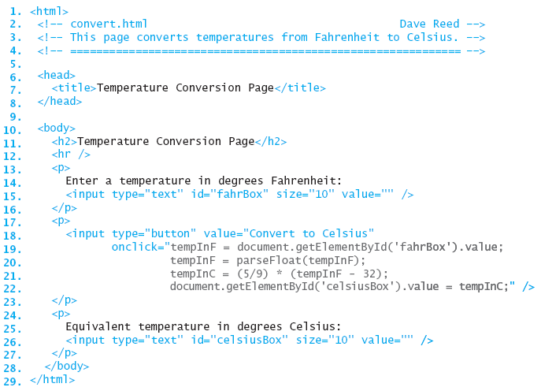
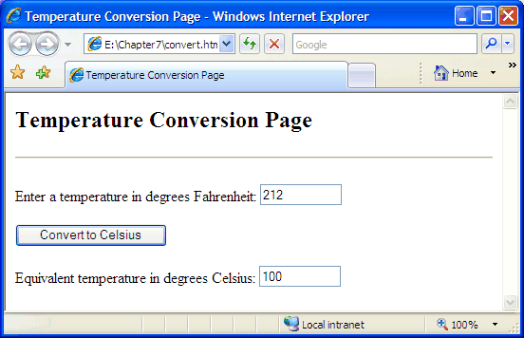
Text Boxes for Input
fahrBox is used for input
the button's ONCLICK attribute specifies the code for converting the temperature
celsiusBox is used for output

Slide 11
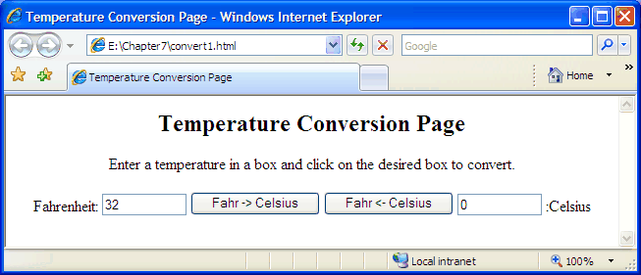
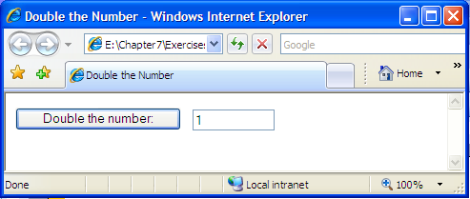
Input and Output
note: the same text box can be used for both input and output
  can modify the conversion page to allow for entering a temperature in either box, then convert to the other
  can write a simple page in which the user can enter a number, then double it by clicking a button

Slide 12
Text Areas
a text area is similar to a text box but it can contain any number of text lines
general form of a text area element:
<textarea name="TEXTAREA_NAME" rows=NUM_ROWS cols=NUM_COLS wrap="virtual">
INITIAL_TEXT
</textarea>
  the NAME attribute gives the element a name so that it can be referenced
  the ROWS attribute specifies the height (number of text lines) of the area
  the COLS attribute specifies the width (number of characters) of the area
  the WRAP attribute ensures that the text will wrap from one line to the next
  instead of running off the edge of the text area
unlike a text box, opening and closing tags are used to define a text area
  any text appearing between the tags will be the initial text in the text area
  otherwise, the contents of a text area are accessed/assigned in the same way

Slide 13
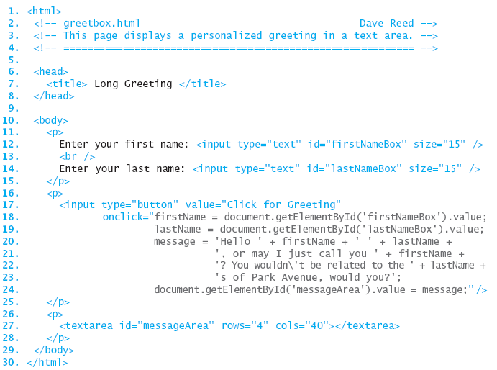
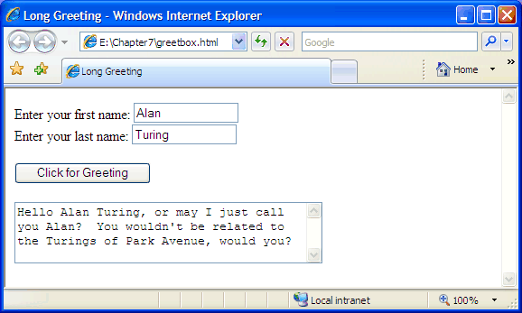
Input/Output via Text Areas
the user enters first and last names into text boxes
a long greeting is constructed using the names and assigned to the text area

Slide 14
Dynamic Images
just as you can use user-initiated events to change the contents of
text areas and text boxes, you can also dynamically modify images
<img id="faceImg" src="happy.gif" alt="Happy Face" />
  causes the image stored in the file happy.gif to appear in the page
you can change the image by reassigning its SRC attribute
  similar to the way that text boxes/areas have their VALUE attribute reassigned
document.getElementById('faceImg').src = "sad.gif";
  replaces happy.gif with sad.gif

Slide 15
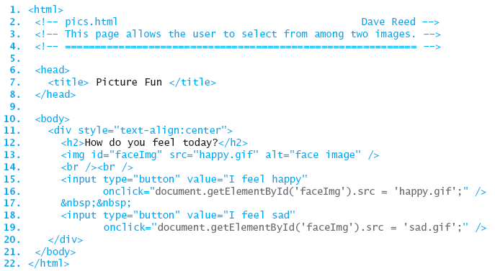
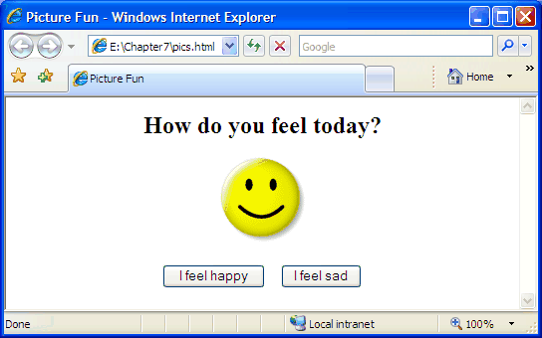
Dynamic Image Example
initially the image is set to happy.gif
when a button is clicked, images is assigned a new SRC file

Slide 16
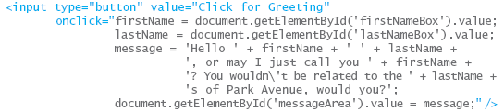
Simplifying buttons
consider the button from greetbox.html:
  the size of ONCLICK attribute makes the button complex and difficult to read
  plus, must be careful with nested quotes ("…" vs. '…')
functions provide a mechanism for simplifying complex buttons such as this
recall from Chapter 5:
  functions minimize the amount of detail that has to be considered
    e.g., can use Math.sqrt without worrying about how it works
  functions reduce the length and complexity of code
    e.g., a single call to Math.sqrt replaces the underlying complex algorithm

Slide 17
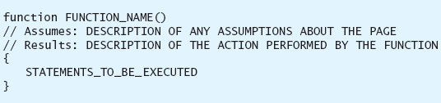
Simple user-defined functions
in addition to JavaScript's predefined functions, the user can define new functions in the HEAD section and call them within the page
we will explore user-defined functions fully in Chapter 9
  for now, the following simple form suffices for simplifying buttons
  a function definition begins with the word function followed by its name and ()
    a function name should be descriptive of the task being performed
  lines beginning with // are comments that describe the function's behavior
    comments are ignored by the interpreter, but make code more user-readable
  the statements to be executed when the function is called are placed between the curly braces

Slide 18
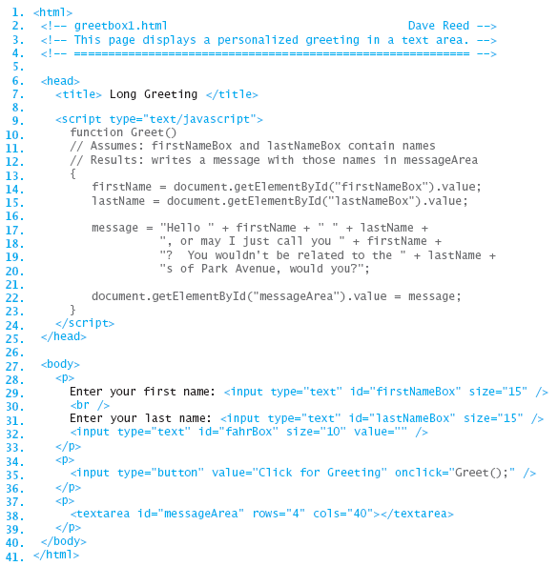
Greeting revisited
the code from the button is moved to the user-defined Greet function
as a result, the button is greatly simplified
GENERAL RULE: if more than one statement is to be associated with a button, define a separate function

