Slide 1
A Balanced Introduction to Computer Science, 2/E
David Reed, Creighton University
©2008 Pearson Prentice Hall
ISBN 978-0-13-601722-6
Chapter 8
Algorithms and Programming Languages

Slide 2
Algorithms
the central concept underlying all computation is that of the algorithm
  an algorithm is a step-by-step sequence of instructions for carrying out some task
programming can be viewed as the process of designing and implementing algorithms that a computer can carry out
  a programmer’s job is to:
    create an algorithm for accomplishing a given objective, then
    translate the individual steps of the algorithm into a programming language that the computer can understand
example: programming in JavaScript
  we have written programs that instruct the browser to carry out a particular task
  given the proper instructions, the browser is able to understand and produce the desired results

Slide 3
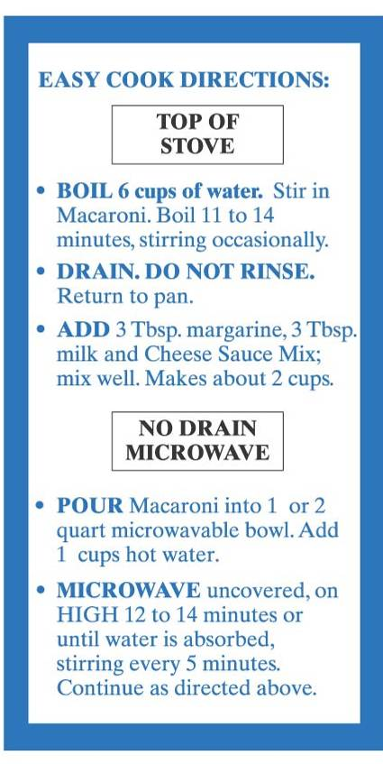
Algorithms in the Real World
the use of algorithms is not limited to the domain of computing
  e.g., recipes for baking cookies
  e.g., directions to your house
there are many unfamiliar tasks in life that we could not complete without the aid of instructions
  in order for an algorithm to be effective, it must be stated in a manner that its intended executor can understand
    a recipe written for a master chef will look different than a recipe written for a college student
  as you have already experienced, computers are more demanding with regard to algorithm specifics than any human could be

Slide 4
Designing & Analyzing Algorithms
4 steps to solving problems (George Polya)
  understand the problem
  devise a plan
  carry out your plan
  examine the solution
EXAMPLE: finding the oldest person in a room full of people
  understanding the problem
    initial condition – room full of people
    goal – identify the oldest person
    assumptions
      a person will give their real birthday
      if two people are born on the same day, they are the same age
      if there is more than one oldest person, finding any one of them is okay
  we will consider 2 different designs for solving this problem

Slide 5
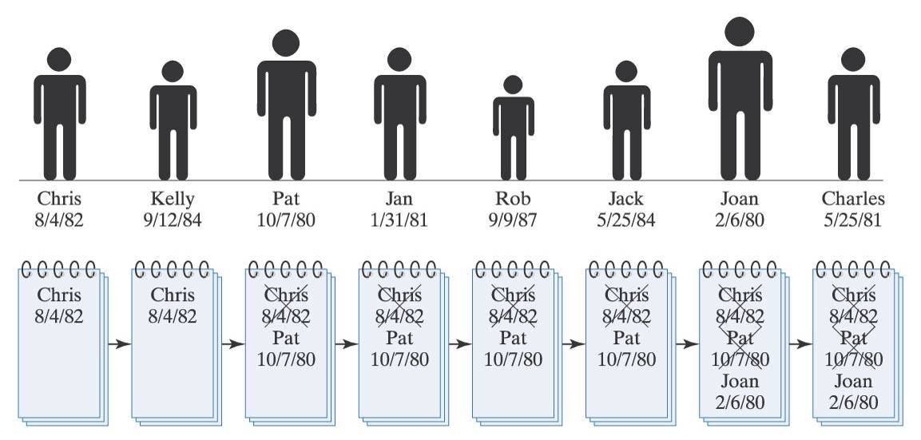
Algorithm 1
Finding the oldest person (algorithm 1)
  line up all the people along one wall
  ask the first person to state his or her name and birthday, then write this information down on a piece of paper
  for each successive person in line:
    ask the person for his or her name and birthday
    if the stated birthday is earlier than the birthday on the paper, cross out old information and write down the name and birthday of this person
  when you reach the end of the line, the name and birthday of the oldest person will be written on the paper

Slide 6
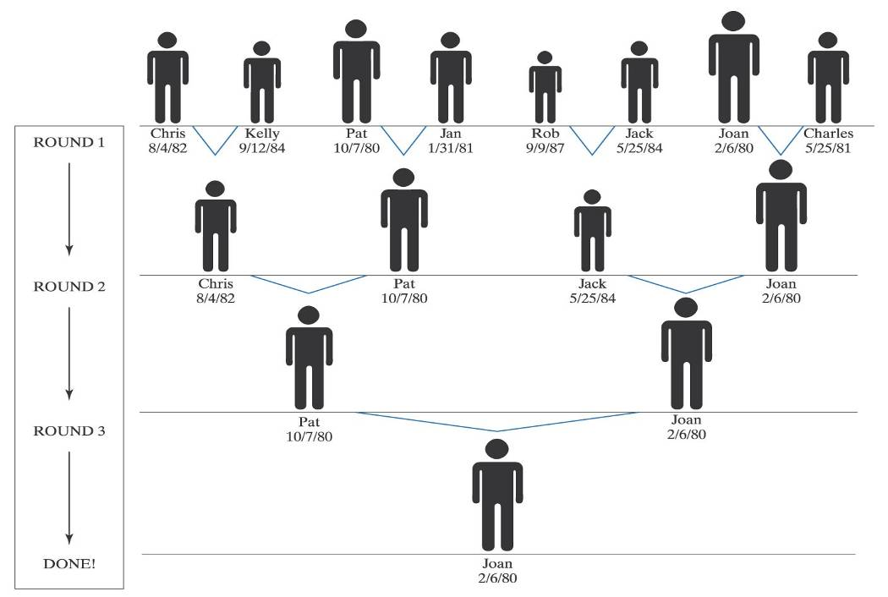
Algorithm 2
Finding the oldest person (algorithm 2)
  line up all the people along one wall
  as long as there is more than one person in the line, repeatedly
    have the people pair up (1st with 2nd, 3rd with 4th, etc) – if there is an odd number of people, the last person will be without a partner
    ask each pair of people to compare their birthdays
    request that the younger of the two leave the line
  when there is only one person left in line, that person is the oldest

Slide 7
Algorithm Analysis
determining which algorithm is "better" is not always clear cut
  it depends upon what features are most important to you
    if you want to be sure it works, choose the clearer algorithm
    if you care about the time or effort required, need to analyze performance
algorithm 1 involves asking each person’s birthday and then comparing it to the birthday written on the page
  the amount of time to find the oldest person is proportional to the number of people
  if you double the amount of people, the time needed to find the oldest person will also double
algorithm 2 allows you to perform multiple comparisons simultaneously
  the time needed to find the oldest person is proportional to the number of rounds it takes to shrink the line down to one person
    which turns out to be the logarithm (base 2) of the number of people
  if you double the amount of people, the time needed to find the oldest person increases by the cost of one more comparison
the words algorithm and logarithm are similar – do not be confused by this
  algorithm: a step-by-step sequence of instructions for carrying out a task logarithm: the exponent to which a base is raised to produce a number
  e.g., 2¹⁰ = 1024, so log₂(1024) = 10

Slide 8
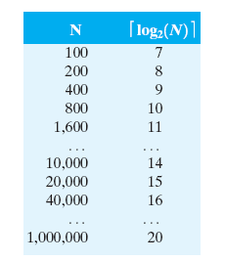
Algorithm Analysis (cont.)
when the problem size is large, performance differences
can be dramatic
for example, assume it takes 5 seconds to compare birthdays
  for algorithm 1:
    100 people → 5*100 = 500 seconds
    200 people → 5*200 = 1000 seconds
    400 people → 5*400 = 2000 seconds
    . . .
    1,000,000 people → 5*1,000,000 = 5,000,000 seconds
  for algorithm 2:
    100 people → 5*⎡ log₂ 100 ⎤ = 35 seconds
    200 people → 5*⎡ log₂ 200 ⎤ = 40 seconds
    400 people → 5*⎡ log₂ 400 ⎤ = 45 seconds
    . . .
    1,000,000 people → 5*⎡ log₂ 1,000,000 ⎤ = 100 seconds

Slide 9
Big-Oh Notation
to represent an algorithm’s performance in relation to the size of the
problem, computer scientists use what is known as Big-Oh notation
  executing an O(N) algorithm requires time proportional to the size of problem
    given an O(N) algorithm, doubling the problem size doubles the work
  executing an O(log N) algorithm requires time proportional to the logarithm of the problem size
    given an O(log N) algorithm, doubling the problem size adds a constant amount of work
based on our previous analysis:
  algorithm 1 is classified as O(N)
  algorithm 2 is O(log N)

Slide 10
Another Algorithm Example
SEARCHING: a common problem in computer science involves storing and
maintaining large amounts of data, and then searching the data for
particular values
  data storage and retrieval are key to many industry applications
  search algorithms are necessary to storing and retrieving data efficiently
  e.g., consider searching a large payroll database for a particular record
    if the computer selected entries at random, there is no assurance that the particular record will be found
    even if the record is found, it is likely to take a large amount of time
    a systematic approach assures that a given record will be found, and that it will be found more efficiently
there are two commonly used algorithms for searching a list of items
  sequential search – general purpose, but relatively slow
  binary search – restricted use, but fast

Slide 11
Sequential Search
sequential search is an algorithm that involves examining each list item in sequential order until the desired item is found
sequential search for finding an item in a list
  start at the beginning of the list
  for each item in the list
    examine the item - if that item is the one you are seeking, then you are done
    if it is not the item you are seeking, then go on to the next item in the list
  if you reach the end of the list and have not found the item, then it was not in the list
sequential search guarantees that you will find the item if it is in the list
  but it is not very practical for very large databases
  worst case: you may have to look at every entry in the list

Slide 12
Binary Search
binary search involves continually cutting the desired search list in half until the item is found
  the algorithm is only applicable if the list is ordered
    e.g., a list of numbers in increasing order
    e.g., a list of words in alphabetical order
binary search for finding an item in an ordered list
  initially, the potential range in which the item could occur is the entire list
  as long as items remain in the potential range and the desired item has not been found, repeatedly
    examine at the middle entry in the potential range
    if the middle entry is the item you are looking for, then you are done
    if the middle entry is greater than the desired item, then reduce the potential range to those entries left of the middle
    if the middle entry is less than the desired item, then reduce the potential range to those entries right of the middle
by repeatedly cutting the potential range in half, binary search can hone in on the value very quickly

Slide 13
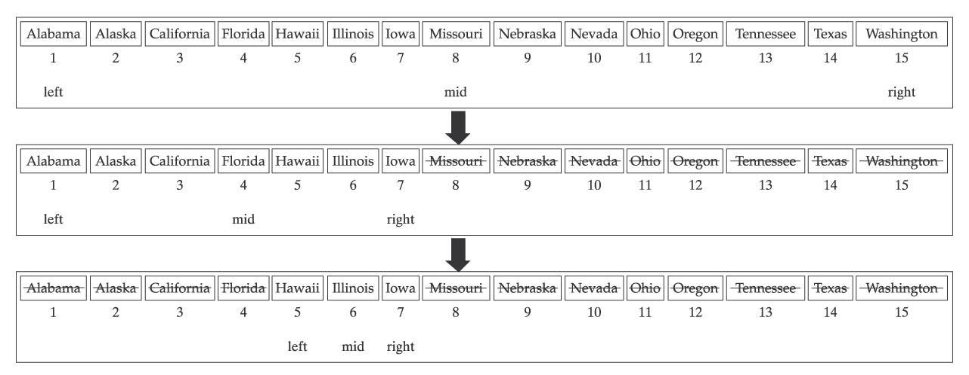
Binary Search Example
suppose you have a sorted list of state names, and want to find Illinois
  start by examining the middle entry (Missouri)
    since Missouri comes after Illinois alphabetically, can eliminate it and all entries that appear to the right
  next, examine the middle of the remaining entries (Florida)
    since Florida comes before Illinois alphabetically, can eliminate it and all entries that appear to the left
  next, examine the middle of the remaining entries (Illinois)
    the desired entry is found

Slide 14
Search Analysis
sequential search
  in the worst case, the item you are looking for is in the last spot in the list (or not in the list at all)
    as a result, you will have to inspect and compare every entry in the list
  the amount of work required is proportional to the list size
    → sequential search is an O(N) algorithm
binary search
  in the worst case, you will have to keep halving the list until it gets down to a single entry
    each time you inspect/compare an entry, you rule out roughly half the remaining entries
  the amount of work required is proportional to the logarithm of the list size
    → binary search is an O(log N) algorithm
imagine searching a phone book of the United States (300 million people)
  sequential search requires at most 300 million inspections/comparisons
  binary search requires at most ⎡log₂(300,000,000)⎤ = 29 inspections/comparisons

Slide 15
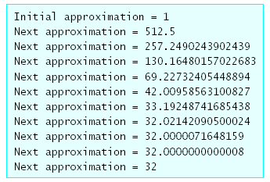
Another Algorithm Example
Newton’s Algorithm for finding the square root of N
  start with an initial approximation of 1
  as long as the approximation isn’t close enough, repeatedly
    refine the approximation using the formula:
    newApproximation = (oldApproximation + N/oldApproximation)/2
  example: finding the square root of 1024
algorithm analysis:
  Newton's Algorithm does converge on the square root because each successive approximation is closer than the previous one
    however, since the square root might be a non-terminating fraction it is difficult to define the exact number of steps for convergence
  in general, the difference between the given approximation and the actual square root is roughly cut in half by each successive refinement
    → demonstrates O(log N) behavior

Slide 16
Algorithms and Programming
programming is all about designing and coding algorithms for solving problems
  the intended executor is the computer or a program executing on that computer
  instructions are written in programming languages which are more constrained and exact than human languages
the level of precision necessary to write programs can be frustrating to beginners
  but it is much easier than it was 50 years ago
  early computers (ENIAC) needed to be wired to perform computations
  with the advent of the von Neumann architecture, computers could be programmed instead of rewired
    an algorithm could be coded as instructions, loaded into the memory of the computer, and executed

Slide 17
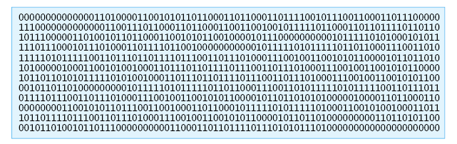
Machine Languages
the first programming languages were known as machine languages
  a machine language consists of instructions that correspond directly to the hardware operations of a particular machine
    i.e., instructions deal directly with the computer’s physical components including main memory, registers, memory cells in CPU
    very low level of abstraction
  machine language instructions are written in binary
    programming in machine language is tedious and error prone
    code is nearly impossible to understand and debug
excerpt from a machine language program:

Slide 18
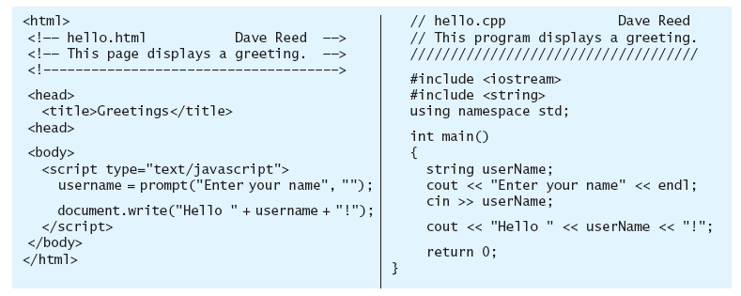
High-Level Languages
in the early 1950’s, assembly languages evolved from machine languages
  an assembly language substitutes words for binary codes
  much easier to remember and use words, but still a low level of abstraction (instructions correspond to hardware operations)
in the late 1950's, high-level languages were introduced
  high-level languages allow the programmer to write code closer to the way humans think (as opposed to mimicking hardware operations)
  a much more natural way to solve problems
  plus, programs are machine independent
  two high level languages that perform the same task (in JavaScript and C++)

Slide 19
Program Translation
using a high-level language, the programmer is able to reason at a high-level of abstraction
  but programs must still be translated into machine language that the computer hardware can understand/execute
there are two standard approaches to program translation
  interpretation
  compilation
real-world analogy: translating a speech from one language to another
  an interpreter can be used provide a real-time translation
    the interpreter hears a phrase, translates, and immediately speaks the translation
    ADVANTAGE: the translation is immediate
    DISADVANTAGE: if you want to hear the speech again, must interpret all over again
  a translator (or compiler) translates the entire speech offline
    the translator takes a copy of the speech, returns when the entire speech is translated
    ADVANTAGE: once translated, it can be read over and over very quickly
    DISADVANTAGE: must wait for the entire speech to be translated

Slide 20
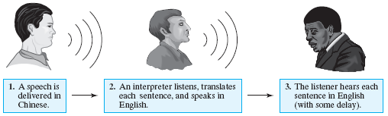
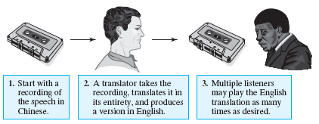
Speech Translation
Interpreter:
Translator (compiler):

Slide 21
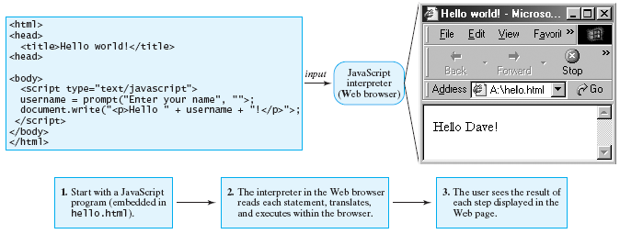
Interpreters
for program translation, the interpretation approach relies on a program known as an interpreter to translate and execute high-level statements
  the interpreter reads one high-level statement at a time, immediately translating and executing the statement before processing the next one
  JavaScript is an interpreted language

Slide 22
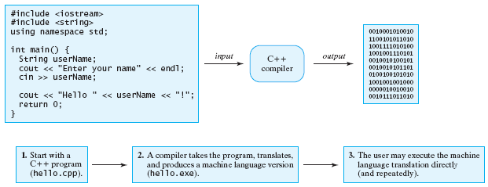
Compilers
the compilation approach relies on a program known as a compiler to translate the entire high-level language program into its equivalent machine-language instructions
  the resulting machine-language program can be executed directly on the computer
  most languages used for the development of commercial software employ the compilation technique (C, C++)

Slide 23
Interpreters and Compilers
tradeoffs between interpretation and compilation
interpreter
  produces results almost immediately
  particularly useful for dynamic, interactive features of web pages
  program executes more slowly (slight delay between the execution of statements)
compiler
  produces machine-language program that can run directly on the underlying hardware
  program runs very fast after compilation
  must compile the entire program before execution
  used in large software applications when speed is of the utmost importance

