Slide 1
A Balanced Introduction to Computer Science, 2/E
David Reed, Creighton University
©2008 Pearson Prentice Hall
ISBN 978-0-13-601722-6
Chapter 9
Abstraction and User-Defined Functions

Slide 2
Abstraction
abstraction is the process of ignoring minutiae and focusing on the big picture
  in modern life, we are constantly confronted with complexity
  we don't necessarily know how it works, but we know how to use it
  e.g., how does a TV work? a car? a computer?
we survive in the face of complexity by abstracting away details
  to use a TV/car/computer, it's not important to understand the inner workings
  we ignore unimportant details and focus on those features relevant to using it
  e.g., TV has power switch, volume control, channel changer, …
JavaScript functions (like Math.sqrt) provide computational abstraction
  a function encapsulates some computation & hides the details from the user
  the user only needs to know how to call the function, not how it works
  Chapter 7 introduced simple user-defined functions
    could encapsulate the statements associated with a button, call the function as needed

Slide 3
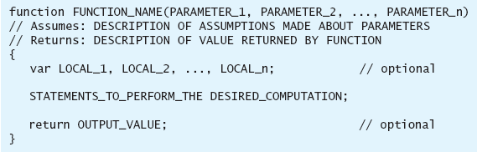
General Function Form
to write general-purpose functions, we can extend definitions to include:
1) parameters, 2) local variables, and 3) return statements
  parameters are variables that correspond to the function’s inputs (if any)
    parameters appear in the parentheses, separated by commas
  local variables are temporary variables that are limited to that function only
    if require some temporary storage in performing calculations, then declare local variables using the keyword var, separated by commas
    a local variable exists only while the function executes, so no potential conflicts with other functions
  a return statement is a statement that specifies an output value
    consists of the keyword return followed by a variable or expression

Slide 4
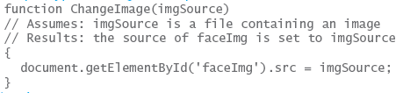
Functions with Inputs
most of the predefined function we have considered expect at least on input
  e.g., Math.sqrt takes a number as input, and returns its square root as output
      Math.sqrt(9) → 3
  e.g., Math.max takes two numbers as inputs, and returns the maximum as output
      Math.max(7, 3) → 7
in English, the word parameter refers to some aspect of a system that can be varied in order to control its behavior
  in JavaScript, a parameter is a variable (declared inside the function's parentheses) whose value is automatically initialized to the corresponding input value when the function is called
  parameters allow the same function to perform different (but related) tasks when called with different input values
the call ChangeImage("happy.gif") will assign the input "happy.gif" to the parameter imgSource, resulting in the image being assigned to that file
__________________________________________________
the call ChangeImage("sad.gif") will assign the input "sad.gif" to the parameter imgSource, resulting in the image being assigned to that file

Slide 5
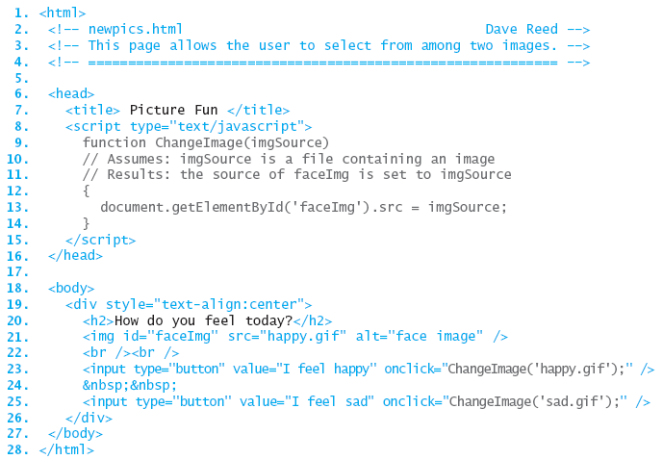
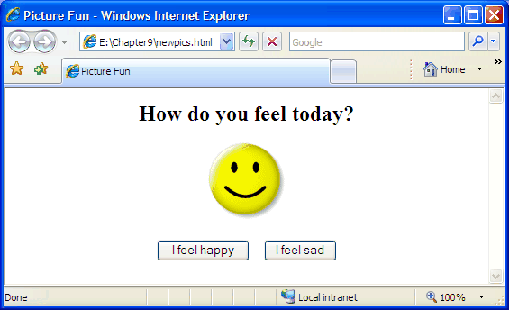
Newpics Page
in newpics.html, each button performs a similar task - changing the image file
  the single ChangeImage function suffices for each (using different inputs)

Slide 6
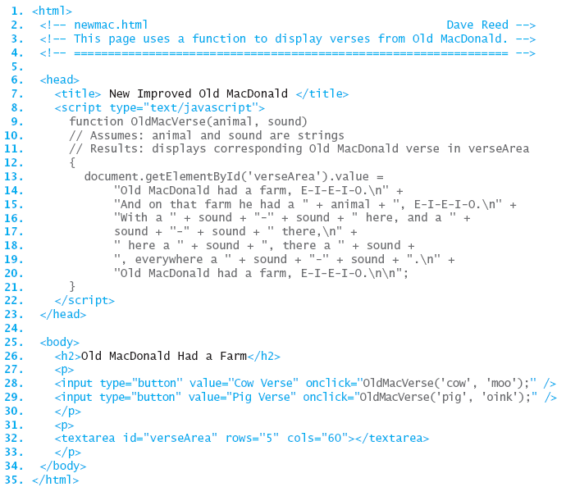
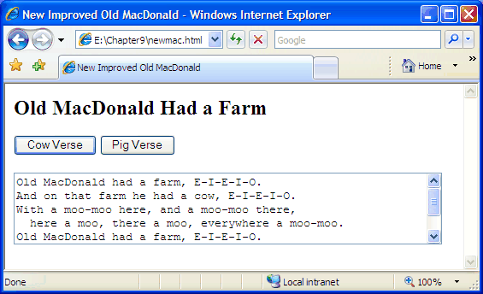
Newmac Page
similarly, we could redefine oldmac.html from Chapter 5
  OldMacVerse has 2 inputs: the animal and sound for that verse
this function can be used to display any verse, given the animal and sound

Slide 7
Multiple Inputs
if a function has more than one input,
  parameters in the function definition are separated by commas
  input values in the function call are separated by commas
  values are matched to parameters by order
    1st input value in the function call is assigned to the 1st parameter in the function
    2nd input value in the function call is assigned to the 2nd parameter in the function
    . . .
function OldMacVerse(animal, sound)
// Assumes: animal and sound are strings
// Results: displays corresponding Old MacDonald verse
{
. . .
}
----------------------------------------------------------
OldMacVerse("cow", "moo");
OldMacVerse("moo", "cow");

Slide 8
Parameters and Locals
parameters play an important role in functions
  they facilitate the creation of generalized computations
  i.e., the function defines a formula, but certain values within the formula can differ each time the function is called
technically, a parameter is a local variable, meaning it exists only inside its particular function
  when the function is called, memory cells are allocated for the parameters and each input from the call is assigned to its corresponding parameter
  once a parameter has been assigned a value, you can refer to that parameter within the function just as you would any other variable
  when the function terminates, the parameters “go away,” and their associated memory cells are freed
by default, variables other than parameters are considered global, meaning they exist and can be accessed by JavaScript code anywhere in the page
  note: it is possible to use the same name to refer to a local variable and a global variable
    within the function, the local variable is accessible
    outside that function, the global variable is accessible

Slide 9
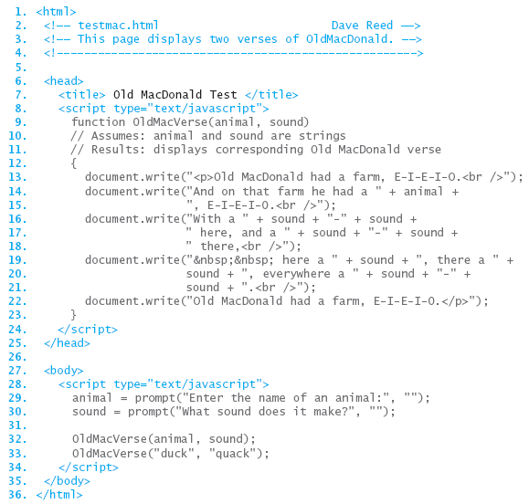
Local vs. Global
here, the variable names animal and sound are
  used for parameters in the function definition
  (local variables)
  used for variables in the BODY
  (global variables)
we can think of these as completely separate variables, identifiable via a subscript
  animal_{OldMacVerse} and sound_{OldMacVerse} are used in the function
  animal_{BODY} and sound_{BODY} are used in the BODY

Slide 10
Declaring Local Variables
we have seen that variables are useful for storing intermediate steps in a complex computation
  within a user-defined function, the programmer is free to create new variables and use them in specifying the function’s computation
  however, by default, new variables used in a function are global
    but what if the same variable name is already used elsewhere?
to avoid name conflicts, the programmer should declare temporary variables to be local
  a variable declaration is a statement that lists all local variables to be used in a function (usually the first statement in a function)
  general form: var LOCAL_1, LOCAL_2, . . ., LOCAL_n;
function IncomeTax(income, itemized)
// Assumes: income >= 0, itemized >= 0
// Results: displays flat tax (13%) due after deductions
{
var deduction, taxableIncome, totalTax;
deduction = Math.max(itemized, 4150);
taxableIncome = Math.max(income - deduction, 0);
totalTax = 0.13*taxableIncome
alert("You owe $" + totalTax);
}
since these variables are declared as local, they will not affect (or be affected by) any variables with the same names elsewhere in the page

Slide 11
Functions with Return
displaying results using document.write or alert is OK for some functions
  for full generality, we need to be able to return an output value, which can then be used in other computations
    e.g., number = Math.sqrt(9);
    amountOwed = IncomeTax(38000, 6500);
a return statement can be added to a function to specify its output value
  when the return statement is reached, the variable or expression is evaluated and its value is returned as the function's output
  general form: return OUTPUT_VALUE;
function IncomeTax(income, itemized)
// Assumes: income >= 0, itemized >= 0
// Returns: flat tax (13%) due after deductions
{
var deduction, taxableIncome, totalTax;
deduction = Math.max(itemized, 4150);
taxableIncome = Math.max(income - deduction, 0);
totalTax = 0.13*taxableIncome
return totalTax;
}
since this function returns the value, it can be used in other computations, e.g., calculate amount owed in 4 payments:
payment =
IncomeTax(38000, 6500)/4;

Slide 12
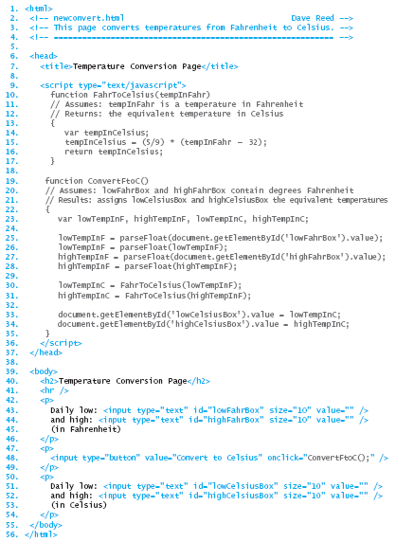
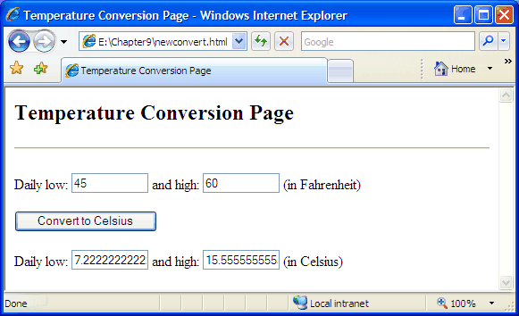
Newconvert Page
if the same computation must be done repeatedly, a function can greatly simplify the page
  here, FahrToCelsius is called twice to convert two different temperatures

Slide 13
Designing Functions
functions do not add any computational power to the language
  a function definition simply encapsulates other statements
still, the capacity to define and use functions is key to solving complex problems, as well as to developing reusable code
  encapsulating repetitive tasks can shorten and simplify code
  functions provide units of computational abstraction – user can ignore details
  functions are self-contained, so can easily be reused in different applications
when is it worthwhile to define a function?
  if a particular computation is complex—meaning that it requires extra variables and/or multiple lines to define
  if you have to perform a particular computation repeatedly within a page
when defining a function, you must identify
  the inputs
  the computation to be performed using those inputs
  the output

Slide 14
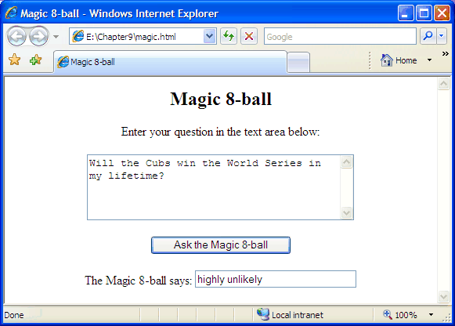
Design Example
consider the task of designing an online Magic 8-ball® (Mattell, Inc.)
  must be able to ask a yes/no type question
  receive an answer (presumably, at random)
could use:
  a text area for entering the question (which could be several lines long)
  a text box for displaying the answer (which should be short)
  a button for initiating the action – which involves calling a function to process the question, select an answer, and display it in the text box

Slide 15
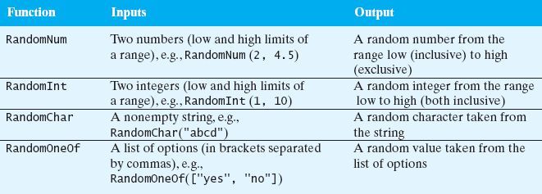
random.js
general-purpose functions can be grouped together in a library
  a library is a text file that contains one or more function definitions
  once the functions are defined in the library, that library can be loaded into pages as needed
e.g., the random.js library contains useful functions for generating random values
to load a library of functions in a page, use a special pair of SCRIPT tags
<script type="text/javascript" src="URL_OR_LOCAL_FILENAME">
</script>

Slide 16
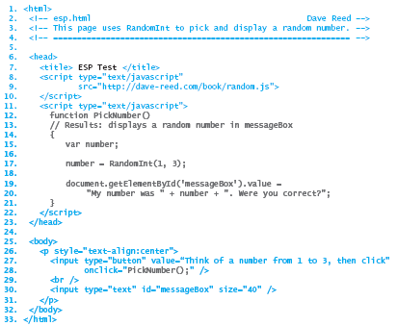
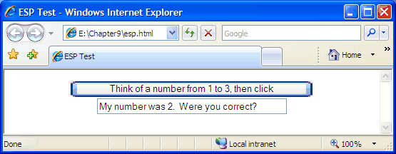
Using random.js
in the page below, the random.js library is accessed via the Web
  you can download the file and store it on your own machine
  then, simply specify the file name in the SRC attribute (the default is that the file is in the same folder as the Web page that includes it)
note: the RandomOneOf function from random.js would similarly be useful for the Magic 8-ball page (in selecting possible answers at random)

Slide 17
Errors to Avoid
When beginning programmers attempt to load a JavaScript code library, errors of two types commonly occur:
if the SCRIPT tags are malformed or the name/address of the library is incorrect, the library will fail to load
  this will not cause an error in itself, but any subsequent attempt to call a function from the library will produce
    “Error: Object Expected” (using Internet Explorer)
    or
    “Error: XXX is not a function” (using Firefox), where XXX is the entered name
when you use the SRC attribute in a pair of SCRIPT tags to load a code library, you cannot place additional JavaScript code between the tags
  think of the SRC attribute as causing the contents of the library to be inserted between the tags, overwriting any other code that was erroneously placed there
  <script type="text/javascript" src="FILENAME">
  ANYTHING PLACED IN HERE WILL BE IGNORED
  </script>
  if you want additional JavaScript code or another library, you must use another pair of SCRIPT tags

