Slide 1
A Balanced Introduction to Computer Science, 2/E
David Reed, Creighton University
©2008 Pearson Prentice Hall
ISBN 978-0-13-601722-6
Chapter 1
Computer Basics

Slide 2
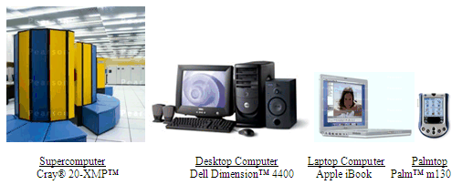
What is a Computer?
a computer is a device that receives, stores, and processes information
different types of computers have different characteristics
  supercomputers: powerful but expensive; used for complex computations (e.g., weather forecasting, engineering design and modeling)
  desktop computers: less powerful but affordable; used for a variety of user applications (e.g., email, Web browsing, document processing)
  laptop computers: similar functionality to desktops, but mobile
  palmtop computers: portable, but limited applications and screen size

Slide 3
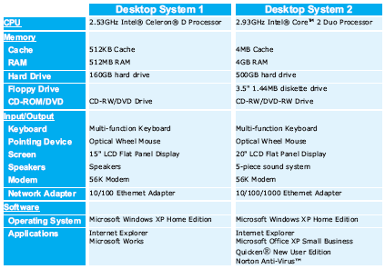
Desktop Specifications
purchasing a computer can be confusing
  sales materials contain highly technical information and computer jargon
the following specs describe two computer systems for sale in January, 2007
  Desktop 1 is a low-end system, inexpensive but with limited features
  Desktop 2 is a high-end system, uses the latest technology so expensive

Slide 4
Hardware vs. Software
the term hardware refers to the physical components of a computer system
  e.g., monitor, keyboard, mouse, hard drive
the term software refers to the programs that execute on the computer
  e.g., word processing program, Web browser
hardware components
software components

Slide 5
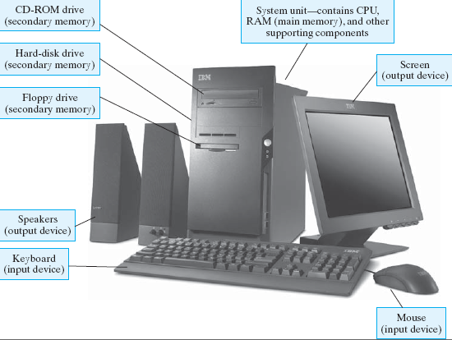
Common Desktop Hardware

Slide 6
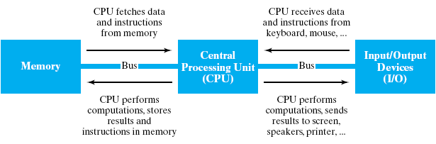
von Neumann Architecture
although specific components may vary, virtually all modern computers have the same underlying structure
  known as the von Neumann architecture
  named after computer pioneer, John von Neumann, who popularized the design in the early 1950's
the von Neumann architecture identifies 3 essential components
  Input/Output Devices (I/O) allow the user to interact with the computer
  Memory stores information to be processed as well as programs (instructions specifying the steps necessary to complete specific tasks)
  Central Processing Unit (CPU) carries out the instructions to process information

Slide 7
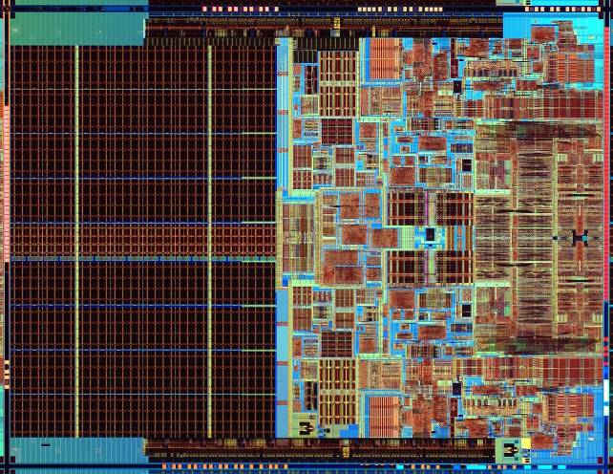
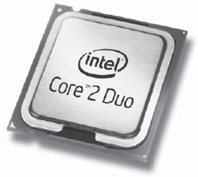
Central Processing Unit (CPU)
the CPU is the "brains" of the computer, responsible for controlling its inner workings
  made of circuitry – electronic components wired together to control the flow of electrical signals
  the circuitry is embedded in a small silicon chip, 1-2 inches square
  despite its small size, the CPU is the most complex part of a computer
    (CPU circuitry can have 100's of millions of individual components)
  commercial examples: Intel Core 2 Duo, AMD Athlon, Motorola PowerPC G4

Slide 8
CPU (cont.)
the CPU works by repeatedly fetching a program instruction from memory and executing that instruction
  individual instructions are very simple (e.g., add two numbers, or copy this data)
  complex behavior results from incredible speed
    a 2.53 GHz Celeron D processor can execute 2.53 billion instructions per second
    a 2.93 GHz Core 2 Duo processor can execute 2.93 billion instructions per second

Slide 9
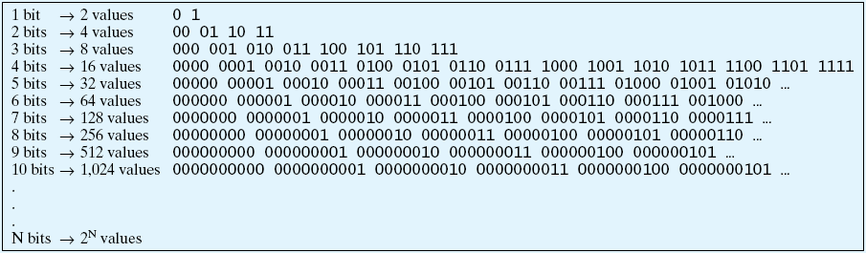
Memory
memory is the part of the computer that stores data and programs
modern computers are digital devices, meaning they store and process information as binary digits (bits)
  bits are commonly represented as either 0 or 1
  bits are the building block of digital memory
    by grouping bits together, large ranges of values can be represented

Slide 10
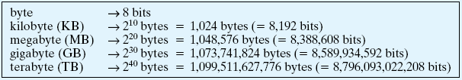
Memory (cont.)
memory capacity is usually specified in bytes
  a byte is a collection of 8 bits – so can represent a range of 2⁸ = 256 values
  large collections of bytes can be specified using prefixes
since a byte is sufficient to represent a single character, can think of memory in terms of text
  a kilobyte can store a few paragraphs (roughly 1 thousand characters)
  a megabyte can store a book (roughly 1 million characters)
  a gigabyte can store a small library (roughly 1 billion characters)
  a terabyte can store a book repository (roughly 1 trillion characters)

Slide 11
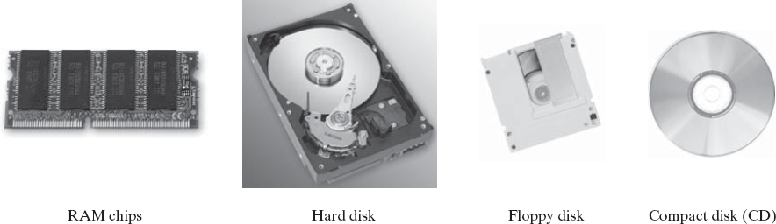
Memory (cont.)
modern computers use a combination of memory types, each with its own performance and cost characteristics
main memory (or primary memory) is fast and expensive
  data is stored as electric signals in circuitry, used to store active data
  memory is volatile – data is lost when the computer is turned off
  examples: Random Access Memory (RAM), cache
secondary memory is slower but cheaper
  use different technologies (magnetic signals on hard disk, reflective spots on CD)
  memory is permanent – useful for storing long-term data
  examples: hard disk, floppy disk, compact disk (CD), flash drive

Slide 12
Memory (cont.)
higher-end computers tend to have
  more main memory to allow for quick access to more data and programs
  more secondary memory to allow for storing more long-term data

Slide 13
Input/Output (I/O)
input devices allow the computer to receive data and instructions from external sources
  examples: keyboard, mouse, track pad, microphone, scanner
output devices allow the computer to display or broadcast its results
  examples: monitor, speaker, printer

Slide 14
Software
recall: hardware refers to the physical components of computers
software refers to the programs that execute on the hardware
a software program is a sequence of instructions for the computer (more specifically, for the CPU) to carry out in order to complete some task
  e.g., word processing (Microsoft Word, Corel WordPerfect)
  e.g., image processing (Adobe Photoshop, Macromedia Flash)
  e.g., Web browsing (Internet Explorer, Mozilla Firefox)

Slide 15
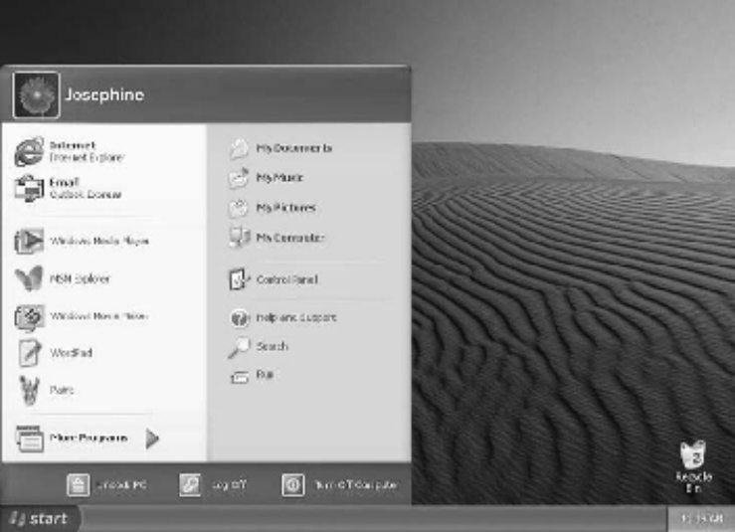
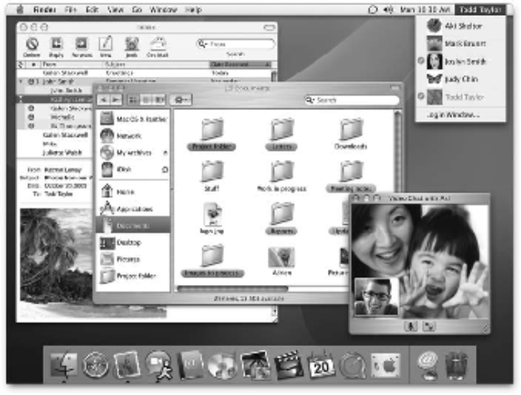
Operating Systems
the Operating System (OS) is a collection of programs that controls how the CPU, memory, and I/O devices work together
  it controls how data and instructions are loaded and executed by the CPU
  it organizes and manages files and directories
  it coordinates the CPU, memory, and I/O devices
    most modern OS's utilize a Graphical User Interface (GUI) to make interacting with the computer easy
    GUI's utilize windows, icons, menus, and pointers

Slide 16
Quick Net & Web Overview
the Internet is a vast, international network of computers
  the physical connections between computers vary, but the overall effect is that computers around the world can communicate and share resources
  the Internet traces its roots back to 1969, when the U.S. government sponsored the first long-distance computer network
  starting with only 4 computers, the network would eventually evolve into today's Internet
the World Wide Web is a collection of software that spans the Internet and enables the interlinking of documents and resources
  the basic idea for the Web was proposed by Tim Berners-Lee in 1989
  his system interlinked documents (including multimedia elements such as images and sound clips) over the Internet
  through the use of well-defined rules, or protocols, that define how they are formatted, documents could be shared across networks on various types of computers

Slide 17
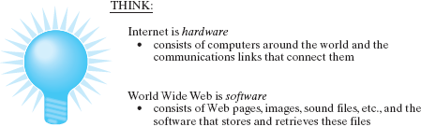
Internet ≠ World Wide Web
the Internet could exist without the Web
  and did, in fact, for many years (applications included email and news groups)
the Web couldn't exist without the Internet
  the Internet is the hardware that stores and executes the Web software

Slide 18
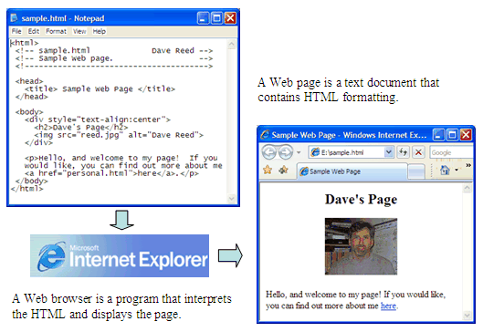
Viewing a Web Page
a Web page is a text document that contains additional formatting information in a language called HTML (HyperText Markup Language)
a Web browser is a program that accesses a Web page, interprets its content, and displays the page

Slide 19
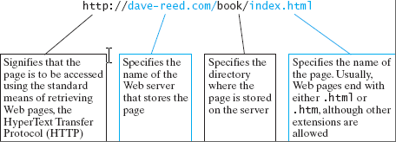
Web Addresses
a Web server is an Internet-enabled computer that stores Web pages and executes software for providing access to the pages
  when you request a Web page, the browser sends a request over the Internet to the appropriate server
  the server locates the specified page and sends it back to your computer
Web pages require uniform names to locate and identify them uniquely
  each page is assigned a Uniform Resource Locator (URL)
  URL's are commonly referred to as Web addresses
  the different parts of the Web address provide information for locating the page

Slide 20
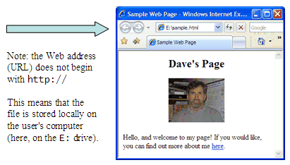
Viewing Local Web Pages
a Web browser can be used to view pages stored on the same computer
  can go through the File menu to select the local page, or
  can enter the File location in the address box (without the http prefix)
this feature is handy when developing Web pages
  can create a Web page and view it in the browser before uploading to a server

