Slide 1
A Balanced Introduction to Computer Science
David Reed, Creighton University
©2005 Pearson Prentice Hall
ISBN 0-13-046709-X
Chapter 7
Abstraction and User-Defined Functions

Slide 2
Abstraction
abstraction is the process of ignoring minutiae and focusing on the big picture
  in modern life, we are constantly confronted with complexity
  we don't necessarily know how it works, but we know how to use it
  e.g., how does a TV work? a car? a computer?
we survive in the face of complexity by abstracting away details
  to use a TV/car/computer, it's not important to understand the inner workings
  we ignore unimportant details and focus on those features relevant to using it
  e.g., TV has power switch, volume control, channel changer, …
JavaScript functions (like Math.sqrt) provide computational abstraction
  a function encapsulates some computation & hides the details from the user
  the user only needs to know how to call the function, not how it works
  in order to create our own abstractions, we must learn how functions work

Slide 3
User-defined Functions
JavaScript’s predefined functions represent a collection of useful, general-purpose abstractions
  the programmer can add additional abstractions via user-defined functions
  once defined, a user-defined function can be used the same way as a predefined function
  e.g., consider converting a temperature from Fahrenheit to Celsius
    tempInCelsius = (5/9) * (tempInFahr - 32);
this expression & assignment could be used whenever we want to convert
  requires remembering the formula every time
instead, we could define a function to encapsulate the calculation
function FahrToCelsius(tempInFahr)
// Assumes: tempInFahr is a temperature in Fahrenheit
// Returns: the equivalent temperature in Celsius
{
return (5/9) * (tempInFahr - 32);
}
could then call that function whenever a conversion was needed
freezing = FahrToCelsius(32); current = FahrToCelsius(78);

Slide 4
Dissecting the Function
function FahrToCelsius(tempInFahr)
// Assumes: tempInFahr is a temperature in Fahrenheit
// Returns: the equivalent temperature in Celsius
{
return (5/9) * (tempInFahr - 32);
}
the 1st line specifies that we are defining a function named FahrToCelsius that takes one input
  the variable name in parentheses is known as a parameter
  when the function is called, the provided input is assigned to the parameter
    e.g., for the call FahrToCelsius(32), the value 32 would be assigned to tempInFahr for the calculation
the 2nd and 3rd lines are comments that describe the behavior of the function
  anything to the right of // is ignored by the browser (so not strictly required)
  but, you should ALWAYS have comments in any user-defined function to make the code easier to read and understand
the actual code that carries out the function's computation is enclosed in { }
  here, the function definition contains only one statement, but could be more
  a return statement specifies the value that should be returned by the function (i.e., it's output)

Slide 5
General Function Form
in general, the form of a user-defined function is as follows:
  function names follow the same rules as variables: consist of letters, digits, and underscores and must start with a letter
  note that there may be:
    more than one parameter, separated by commas
    no parameters at all, in which case the function name is followed by ()
    more than one statement inside the curly braces (more later)
function FUNCTION_NAME(PARAMETER_1, PARAMETER_2,..., PARAMETER_n)
// Assumes: DESCRIPTION OF ASSUMPTIONS MADE ABOUT PARAMETERS
// Returns: DESCRIPTION OF VALUE RETURNED BY FUNCTION
{
STATEMENTS_TO_PERFORM_(AND_RETURN)_THE DESIRED_COMPUTATION;
}
function difference(num1, num2)
// Assumes: num1 and num2 are numbers
// Returns: the absolute difference between num1 and num2
{
return Math.abs(num1 – num2);
}

Slide 6
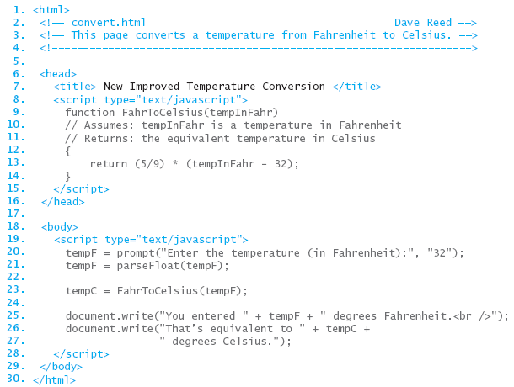
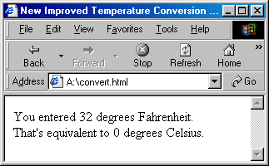
Temperature Conversion Page
to include a user-defined function in a page, the simplest way is to include its definition in SCRIPT tags in the HEAD
  once the function is defined in the HEAD, it can be called just like any other function
note: if a page requires more than one user-defined function, they can all be enclosed in the same pair of SCRIPT tags

Slide 7
Functions without Return
mathematically speaking, a function is a mapping from some number of inputs to an output
  we saw that it is possible to have JavaScript functions with no inputs
    e.g., Math.random()
  does it make sense to talk about a function with no output?
in JavaScript, a function is not required to have a return statement
  if no return, the function automatically returns the special value: undefined
  thus, a JavaScript function has an output whether you specify it or not
why would you ever write a function without a return?
return-less functions are useful for displaying long or repetetive messages
  if you want to print a long message multiple times, you can define a single function that writes the message then call it wherever needed

Slide 8
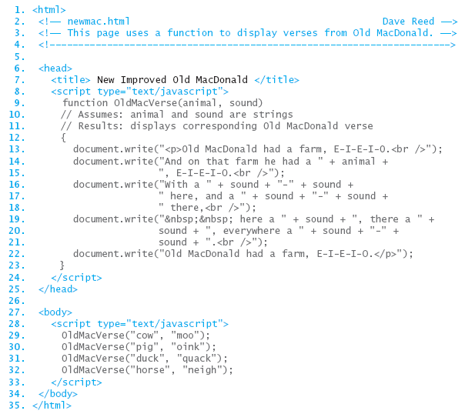
Functions without Return
here is a function that displays a verse of the song "Old MacDonald had a Farm"
  the function has two parameters for the animal name and sound
  by calling the function with different inputs, you can display different verses
how much work is it to rearrange the verses?
how much work is it to add a new verse?

Slide 9
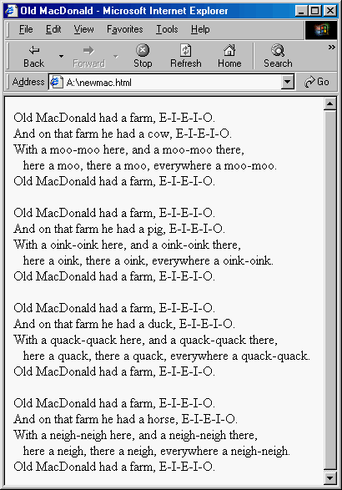
Old MacDonald
each call to the OldMacVerse function displays the verse with the specified animal & sound
  to rearrange the verses, simply rearrange the calls in the BODY
  to add a new verse, simply add a new call in the BODY
  to make a change to all verses, e.g., change indentation, simply make the change once in the function definition

Slide 10
Multiple Inputs
if a function has more than one input,
  parameters in the function definition are separated by commas
  input values in the function call are separated by commas
  values are matched to parameters by order
    1st input value in the function call is assigned to the 1st parameter in the function
    2nd input value in the function call is assigned to the 2nd parameter in the function
    . . .
function OldMacVerse(animal, sound)
// Assumes: animal and sound are strings
// Results: displays corresponding Old MacDonald verse
{
. . .
}
----------------------------------------------------------
OldMacVerse("cow", "moo");
OldMacVerse("moo", "cow");

Slide 11
Designing Functions
functions do not add any computational power to the language
  a function definition simply encapsulates other statements
still, the capacity to define and use functions is key to solving complex problems, as well as to developing reusable code
  encapsulating repetitive tasks can shorten and simplify code
  functions provide units of computational abstraction – user can ignore details
  functions are self-contained, so can easily be reused in different applications
when is it worthwhile to define a function?
  if a particular computation is complex—meaning that it requires extra variables and/or multiple lines to define
  if you have to perform a particular computation repeatedly within a page
when defining a function, you must identify
  the inputs
  the computation to be performed using those inputs
  the output

Slide 12
Parameters and Locals
parameters play an important role in functions
  they facilitate the creation of generalized computations
  i.e., the function defines a formula, but certain values within the formula can differ each time the function is called
Technically, a parameter is a local variable, meaning it exists only inside its particular function
  when the function is called, memory cells are allocated for the parameters and each input from the call is assigned to its corresponding parameter
  once a parameter has been assigned a value, you can refer to that parameter within the function just as you would any other variable
  when the function terminates, the parameters “go away,” and their associated memory cells are freed
variables that appear in the BODY of the page are global variables, meaning they exist and can be accessed by JavaScript code anywhere in the page
  note: it is possible to use the same name to refer to a local variable and a global variable
    within the function, the local variable is accessible
    outside that function, the global variable is accessible

Slide 13
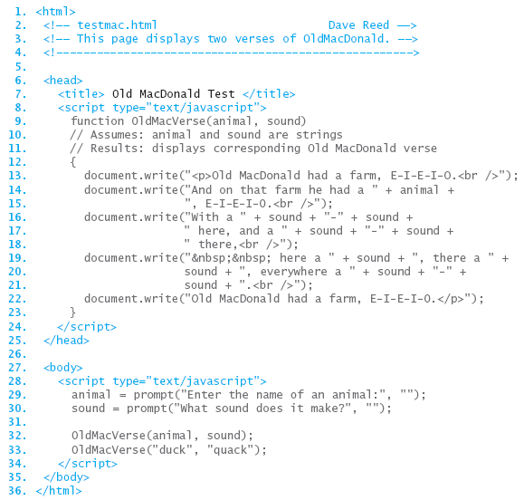
Local vs. Global
here, the variable names animal and sound are
  used for parameters in the function definition
  (local variables)
  used for variables in the BODY
  (global variables)
we can think of these as completely separate variables, identifiable via a subscript
  animal_{OldMacVerse} and sound_{OldMacVerse} are used in the function
  animal_{BODY} and sound_{BODY} are used in the BODY

Slide 14
Declaring Local Variables
we have seen that variables are useful for storing intermediate steps in a complex computation
  within a user-defined function, the programmer is free to create new variables and use them in specifying the function’s computation
  however, by default, new variables used in a function are global
    but what if the same variable name is already used elsewhere?
to avoid name conflicts, the programmer can declare variables to be local
  a variable declaration is a statement that lists all local variables to be used in a function (usually the first statement in a function)
  general form:
      var LOCAL_1, LOCAL_2, . . ., LOCAL_n;
function IncomeTax(income, itemized)
// Assumes: income >= 0, itemized >= 0
// Returns: flat tax (13%) due after deductions
{
var deduction, taxableIncome, totalTax;
deduction = Math.max(itemized, 4150);
taxableIncome = Math.max(income - deduction, 0);
totalTax = 0.13*taxableIncome
return totalTax;
}

Slide 15
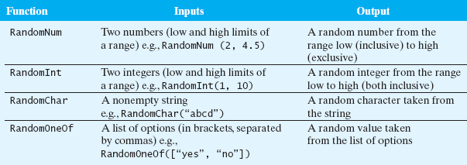
random.js
general-purpose functions can be grouped together in a library
  a library is a text file that contains one or more function definitions
  once the functions are defined in the library, that library can be loaded into pages as needed
e.g., the random.js library contains useful functions for generating random values
to load a library of functions in a page, use a special pair of SCRIPT tags
<script type="text/javascript"
src="URL_OR_LOCAL_FILENAME">
</script>

Slide 16
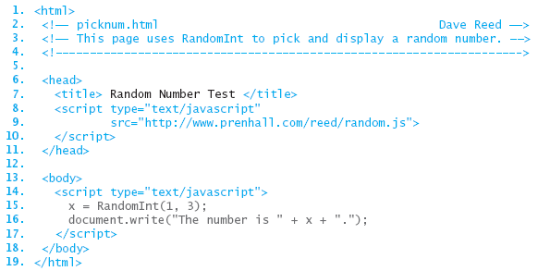
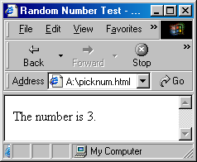
Using random.js
in the page below, the random.js library is accessed via the Web
  you can download the file and store it on your own machine
  then, simply specify the file name in the SRC attribute (the default is that the file is in the same folder as the Web page that includes it)

Slide 17
Errors to Avoid
When beginning programmers attempt to load a JavaScript code library, errors of two types commonly occur:
if the SCRIPT tags are malformed or the name/address of the library is incorrect, the library will fail to load
  this will not cause an error in itself, but any subsequent attempt to call a function from the library will produce
    “Error: Object Expected” (using Internet Explorer)
    or
    “Error: XXX is not a function” (using Navigator), where XXX represents the typed function name
when you use the SRC attribute in a pair of SCRIPT tags to load a code library, you cannot place additional JavaScript code between the tags
  think of the SRC attribute as causing the contents of the library to be inserted between the tags, overwriting any other code that was erroneously placed there
  <script type="text/javascript" src="FILENAME">
  ANYTHING PLACED IN HERE WILL BE IGNORED
  </script>
  if you want additional JavaScript code or another library, you must use another pair of SCRIPT tags

