Slide 1
A Balanced Introduction to Computer Science
David Reed, Creighton University
©2005 Pearson Prentice Hall
ISBN 0-13-046709-X
Chapter 18
Computers and Society

Slide 2
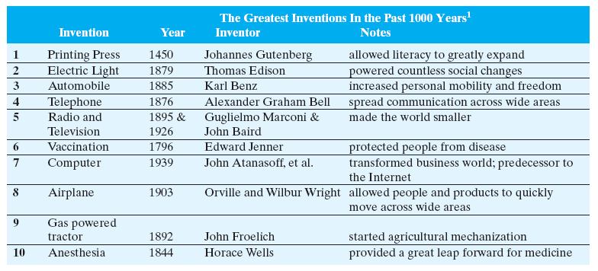
Positive Impact of Technology
historian Larry Gormley ranked technological developments according to their impact on modern life
  do you agree with his list?

Slide 3
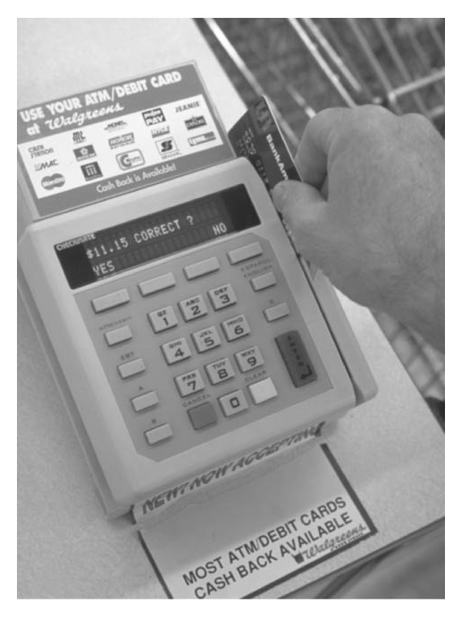
Positive Impact of Technology
more than any other invention, computer technology is still evolving, which means that it continues to impact society in new ways
  the first electronic computers made significant contributions in the 1940’s
    COLOSSUS – used for code breaking in World War II
    ENIAC – performed calculations and simulations that led to the development of nuclear technology and Cold War science
  currently, we live in an "information economy", with computers central to business and innovation
technology has become so pervasive in daily life, it is difficult to imagine life without it
e.g., monetary transactions
  cash is frequently being replaced with credit or debit cards
  computerized banking networks enable the immediate electronic transfer of funds
  ATM machines allow people to access their money around the clock from any location
  all this has discouraged traditional theft, but has inspired new forms of illegal activity

Slide 4
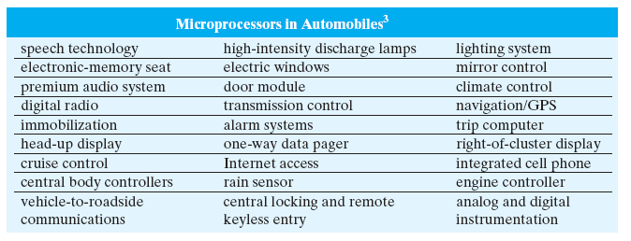
Computers in Everyday Tasks
modern life also depends on thousands of less obvious, hidden computer applications
embedded processors are computer chips that are built into appliances and machinery to control their workings
  they account for more than 90% of all computer processors
  the average U.S. home contains 50 to 100 embedded processors
    in ovens, television remote controls, cordless phones, automatic thermostats, …
  automobiles employ embedded processors to control a wide variety of components

Slide 5
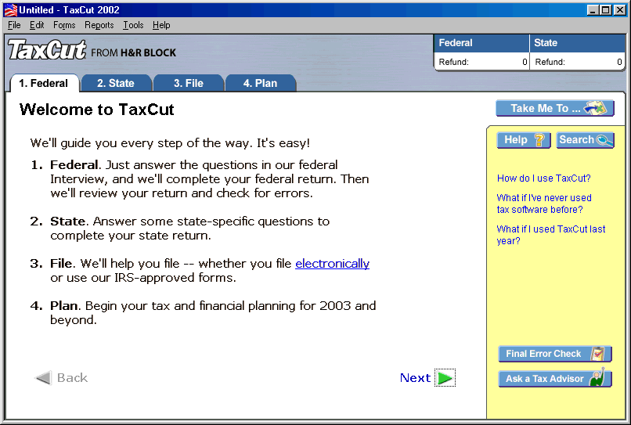
Computers in Everyday Tasks
society has also been affected by the availability of personal computers and easy-to-use software
  software can enable people to accomplish tasks previously reserved for highly trained professionals, e.g.,
    word processing and desktop publishing software
    video editing software
    tax preparation software

Slide 6
Internet/Web for Information
many users utilize the Internet/Web as an information source
online resources are quickly replacing (or complementing) traditional sources of information
  Web sites can be updated 24 hours a day allowing publishers to report stories as soon as they break
  text can be integrated with other types of media
  the immediacy of online delivery system is especially appealing
in order to compete, many newspapers and magazines have expanded their offerings to include online versions
  e.g., www.nytimes.com, www.washingtonpost.com, www.time.com

Slide 7
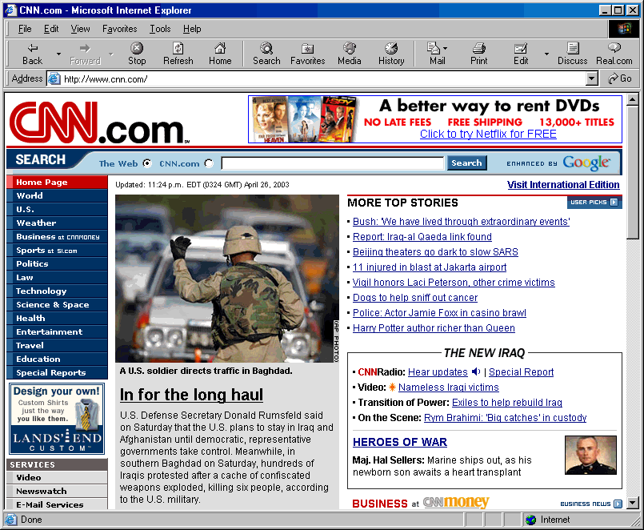
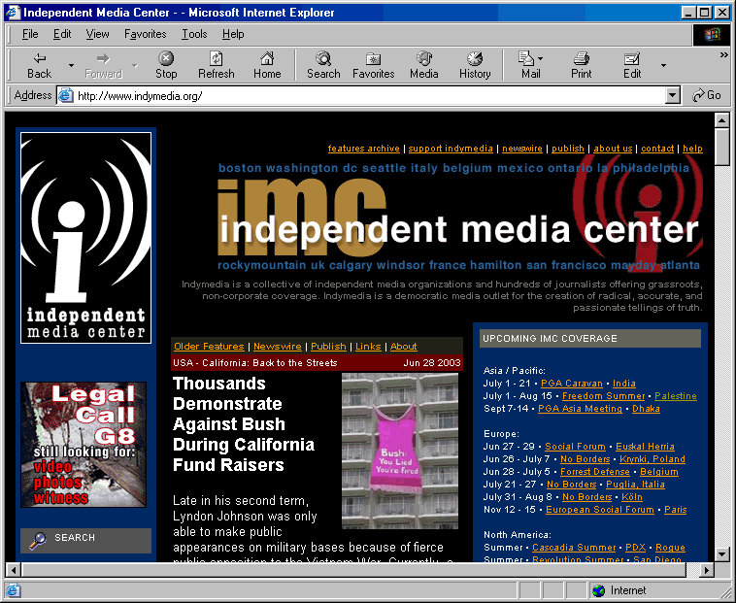
Internet/Web for Information
traditional media have approached the Internet in a variety of ways
  some provide limited services online for free
    e.g., cnn.com, weather.com
  others provide full services with a fee
    e.g., Encyclopedia Britannica sells access over the Web
independent media organizations have utilized the Web to present stories and opinions that might not otherwise reach a mainstream audience

Slide 8
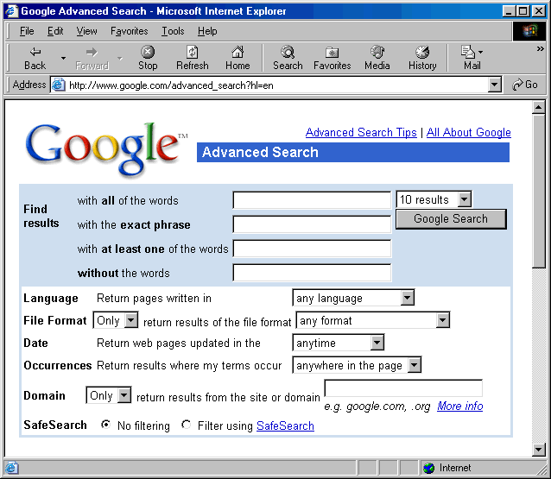
Internet/Web for Information
the majority of Web pages are unique resources created by individuals and private organizations
  you can find Web content on virtually any topic
  to help navigate the vast sea of information, search engines automatically catalog Web pages and allow users to search for data by topic or keywords

Slide 9
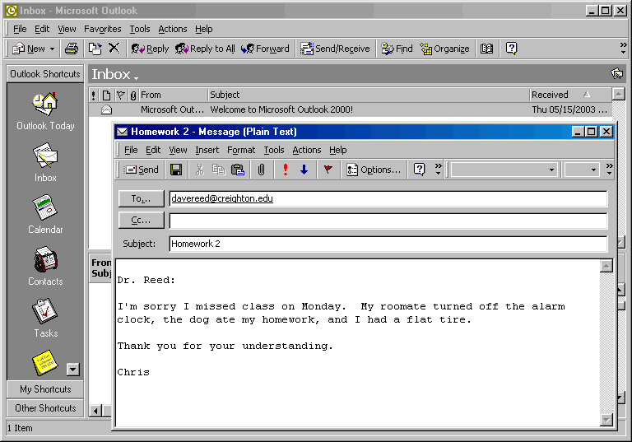
Internet/Web for Communication
many users were originally drawn to the Internet by the availability of electronic mail and newsgroups
  in 2002, 93% of all Internet users communicated via email
  31 billion email messages were sent and received each day
  the number of emails is expected to reach 60 billion by 2006
Internet Service Providers (ISPs) manage email accounts with other services
  e.g., AOL, msn, Microsoft Hotmail, Yahoo! Mail
  programs such as Microsoft Outlook provide an intuitive user interface for sending and receiving email messages

Slide 10
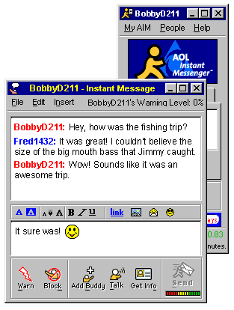
Internet/Web for Communication
more recently, the Internet has popularized the use of instant messaging
  enables users to type text messages and view responses immediately in the same window
  in effect, they can conduct personal conversations online
  41 million home users sent instant messages during May 2002

Slide 11
Internet/Web for Commerce
another popular function of the Web is to facilitate electronic commerce, or e-commerce
  businesses have recognized the Web’s potential as an advertising medium, and as a tool for reaching new customers
  some business sites are information-based (providing background on the company or product descriptions)
  other business sites are transaction-based (allowing customers to purchase products or services directly)
online shopping has numerous advantages for the consumer
  you can make purchases from your home at any time
  it is easy to comparison shop
  many online retailers, such as Amazon.com, allow consumers to research products as well as purchase them

Slide 12
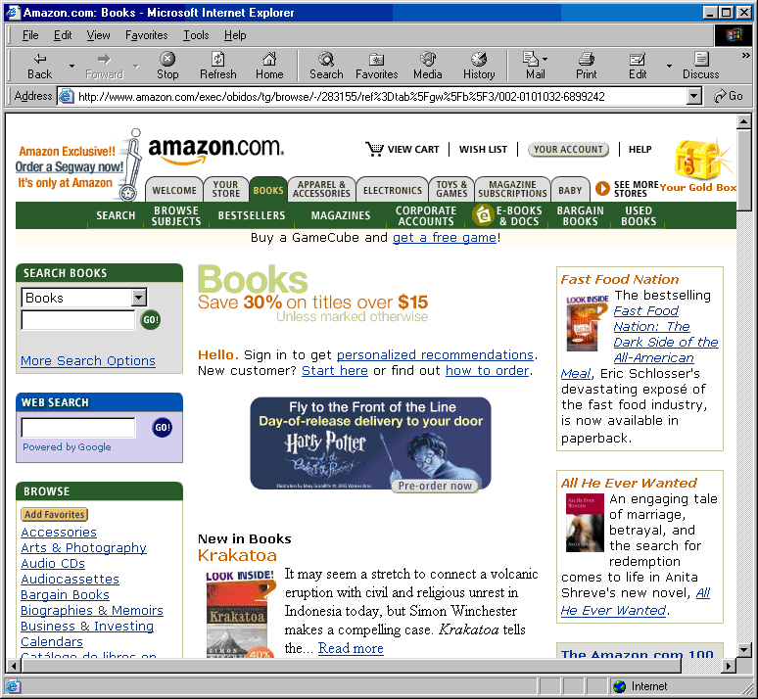
Internet/Web for Commerce
many of the most successful sites are online offshoots of traditional retailers
  Barnes & Noble, Sears, Circuit City
companies that are strictly Internet ventures have added risks due to their lack of other revenue streams for startup and development
  many of these companies fail early on, however, some are very successful
  Amazon.com: $3.93 billion in sales in 2002

Slide 13
Internet/Web for Commerce
the Web has provided a new advertising channel for businesses and organizations
  e-commerce sites charge fees for hosting advertising banners on web pages
    banner ads are clickable images that promote a particular company’s product or service
    users who click on a banner ad are typically directed to the company’s Web site, where they can make purchases or review product-related information
  the Web’s structure allows for a direct connection between ads and related purchasing interfaces
in addition, the Internet is extensively used for communication and information exchanges within and among businesses
  business-to-business (B2B) transactions allow companies to manage inventory more dynamically
  can improve efficiency by linking various data channels (e.g., sales & marketing)
  businesses may form partnerships based on sharing resources and information

Slide 14
Potential Dangers
in conjunction with the benefits we have mentioned, the widespread adoption of technology also introduces the potential for abuses and undesirable consequences
potential dangers to individuals, businesses, and society at large include
  an over-reliance on complex, perhaps poorly-understood, systems
  information overload
  privacy and security violations
  the Digital Divide

Slide 15
Reliance on Complex Systems
as society becomes dependent on complex, computer-based products and services, the effects of errors or system failures become far-reaching
computer-system bugs can produce dire consequences
  between 1985 and 1987, six cancer patients received massive radiation overdoses due to equipment malfunction, resulting in four deaths (the malfunction was traced to a single coding error)
  in 1990, AT&T’s long-distance telephone network was down for nine hours due to a misplaced statement in the electronic switching software (60,000 customers were without service, resulting in $60 million of lost revenue)
  in 1991, 28 soldiers were killed by a Scud missile because a software error caused the Patriot missile to miss its target
  in 1999, NASA’s Mars Climate Orbiter went off course and was destroyed in the Martian atmosphere (the problem was due to software inconsistencies which used different measurement conversions, e.g., English vs. Metric)
to avoid errors, various software design and testing methodologies are used
  however, as the size and complexity of the software grows, design and testing become exponentially more difficult
  Windows 2000 – 35 million lines of code, 63,000 known bugs

Slide 16
Information Overload
the impressive range of information available online can be viewed as a strength, but it is also one of the greatest weaknesses
  often, data is not well organized
  finding a single piece of specific information can be very difficult
  as of April 2003, Google claimed to have cataloged more than 3 billion pages
search engines are helpful in narrowing down Internet searches, but users must be careful in selecting search criteria
  a Google search for “JavaScript” produced 11,100,000 matches
  a more refined search for “JavaScript prompt function” produced 50,100 matches
even after a user locates a Web page related to the desired topic, judging reliability is not always easy
  the Web is neither monitored or censored
  authors may provide incomplete, uninformed, or biased answers

Slide 17
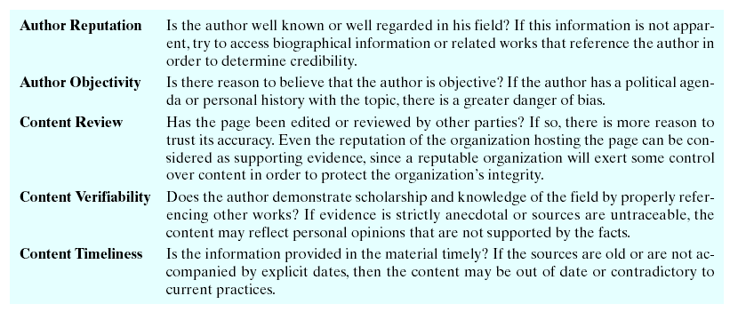
Information Overload
since most Internet/Web content lacks editorial review, it is up to the user to evaluate its credibility
  common criteria for evaluating credibility include:

Slide 18
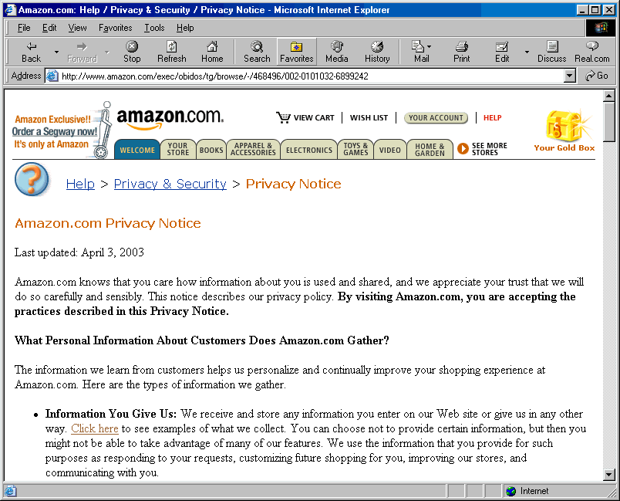
Privacy and Security
when using credit cards or shopping online, consumers sacrifice privacy for the sake of convenience
  companies maintain records of consumer purchases
  private details can be inferred from shopping patterns
  companies often sell customer profiles to marketing firms
Web users can limit exploitation by interacting only with reputable online businesses with privacy policies
  such policies will explain what information is collected by the business and how that information is to be used (and shared)

Slide 19
Privacy and Security
email also raises privacy concerns
  when a message is received it is commonly stored in a file on the recipient’s computer
  there is a danger that unauthorized users might get access to that file
  few laws apply directly to electronic privacy
    courts overwhelmingly favor employers over employees in privacy suits
    unless explicitly stated, it is generally accepted that employers may access any content on company-owned machines
privacy is closely linked with security
  email messages travel through numerous routers, and each router represents a security risk, because someone could gain access to a router and eavesdrop on a relayed message
  with online transactions, credit card numbers or other personal information can be intercepted and subsequently result in identity theft
  encryption methods are commonly used to secure information transmissions, but online fraud is still a continuing problem

Slide 20
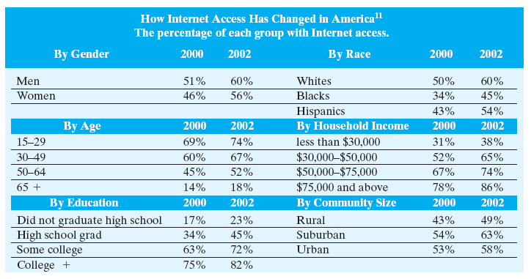
The Digital Divide
an especially troubling aspect of recent technological developments is that the benefits associated with computers are not shared by all
  Americans with minority ancestry, lower incomes, and less education are far less likely to be online

Slide 21
The Digital Divide
addressing the digital divide
  during the Clinton administration, public schools received government funding for computer technology and Internet service
    by the fall of 2000, 98% of all public schools were connected to the Internet, as compared to 35% in 1994
    most public libraries and community centers provide Internet-enabled computers
  organizations such as CompuMentor supply Internet access and technical assistance to minority groups and low income individuals
  the digital divide is still a problem for Americans, but there is no doubt that conditions have improved
the digital divide also exists on a global scale
  America, Western Europe, and certain Asian countries have much greater Internet connectivity than other parts of the world
  lack of Internet access places less developed nations at a significant disadvantage, and compounds other economic problems
  the United Nations, World Economic Forum, and other organizations are working to address the global digital divide

