Slide 1
Chapter 2
Introduction
to the
C++ Language

Slide 2
OBJECTIVES
After studying this chapter you will be able to:
 Identify the basic components of a C++ function.
 Identify and use the standard C++ data types.
 Identify and use the four kinds of C++ constants.
 Differentiate between literal, as defined, and memory constants.
 Define and use variables.
 Read data from the keyboard and output data to the console.
 Add comments to a program as a form of inline documentation.
 Create “intelligent” names to make programs easier to read and
understand.

Slide 3

2.1
Background

Slide 4
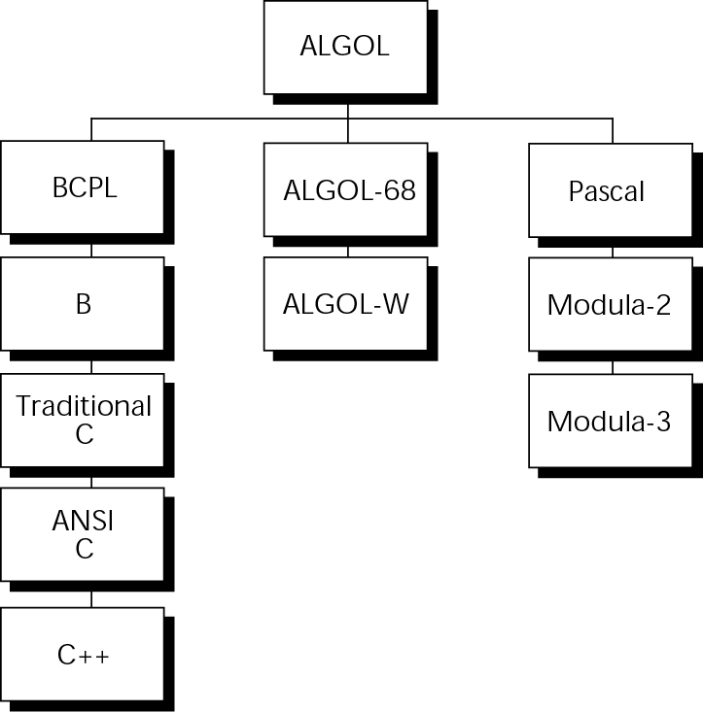
Figure 2-1 Taxonomy of the C++ language

Slide 5
2.2
C++ Programs

Slide 6
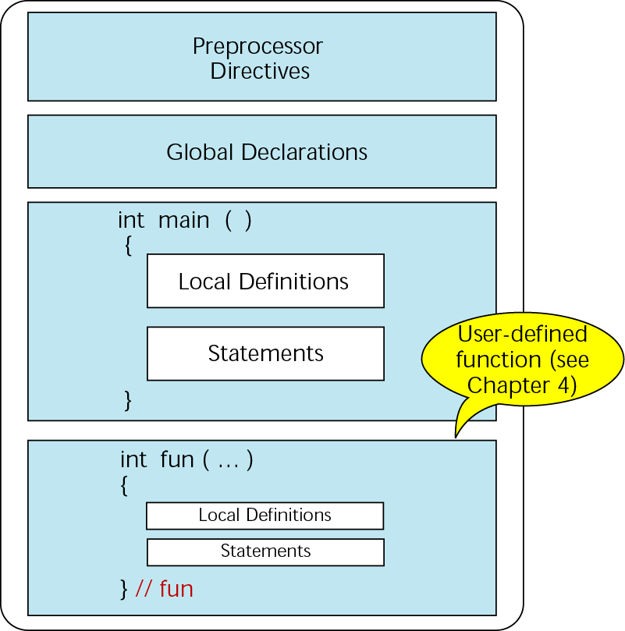
Figure 2-2 Structure of a C++ program

Slide 7
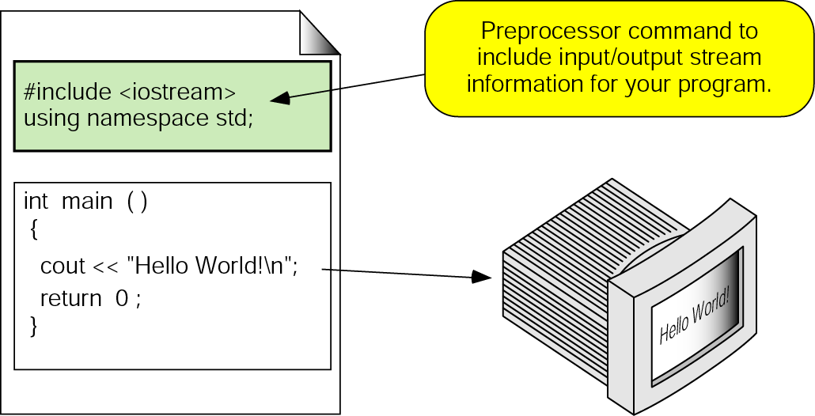
Figure 2-3 The greeting program

Slide 8
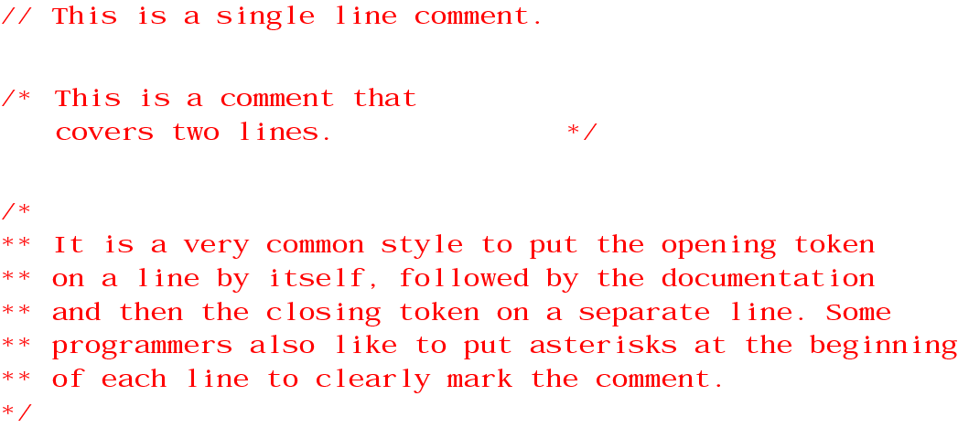
Figure 2-4 Examples of comments

Slide 9
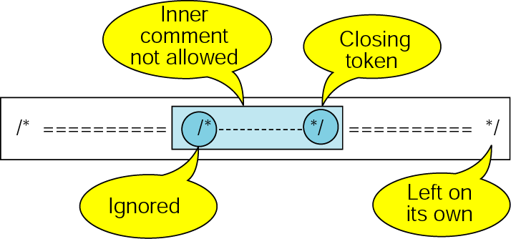
Figure 2-5 Nested block comments are invalid

Slide 10
2.3
Identifiers

Slide 11
2.4
Data Types

Slide 12
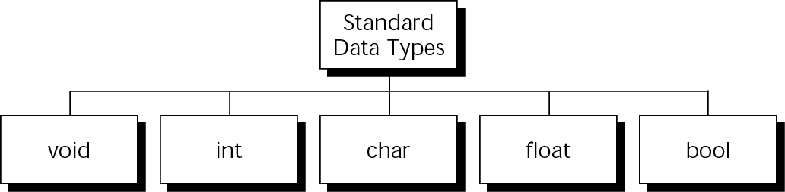
Figure 2-6 Standard data types

Slide 13
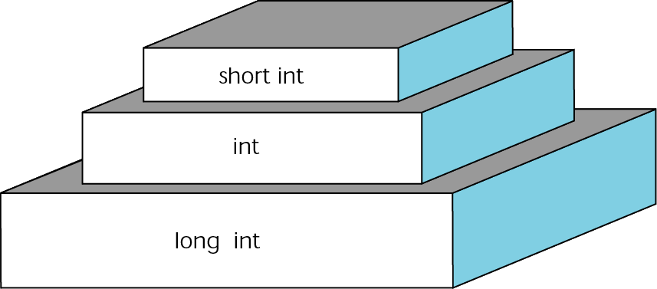
Figure 2-7 Integer types

Slide 14
Note:
A character in C++ can be interpreted as a small integer (between 0 and 255). For this reason, C++ often treats a character like an integer.

Slide 15

Figure 2-8 Floating-point types

Slide 16
Note:
In C++ the Boolean constants are true and false. Additionally, following traditional standards, any nonzero number is considered true, and zero is considered false.

Slide 17
2.5
Variables

Slide 18
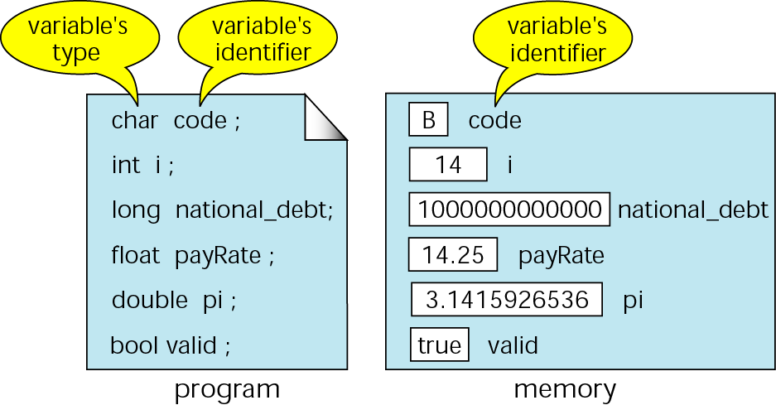
Figure 2-9 Variables in memory

Slide 19
Note:
When a variable is defined, it is not initialized. The programmer must initialize any variable requiring prescribed data when the function starts.

Slide 20
2.6
Constants

Slide 21
Note:
A character constant is enclosed in single quotes.

Slide 22
Note:
Use single quotes for character constants.
Use double quotes for string constants.

Slide 23
Note:
The only bool types constants are true, printed as 1, and false, printed as 0.

Slide 24
Figure 2-10 Some strings
"" // A null string
"h"
"Hello World!\n"
"HOW ARE YOU?"
"Good Morning!"
"'Good' Morning!" // 'Good' Morning
"\"Good\" Morning!" // "Good" Morning

Slide 25
Figure 2-11 Null characters and null strings
'\0' Null character
"" Empty string

Slide 26
2.7
Coding Constants

Slide 27
2.8
Reading and Writing Data

Slide 28
Note:
Keyboards and monitors handle data only as a sequence of characters.

Slide 29
Note:
The standard streams are created automatically and connected to appropriate devices when
a program starts.

Slide 30
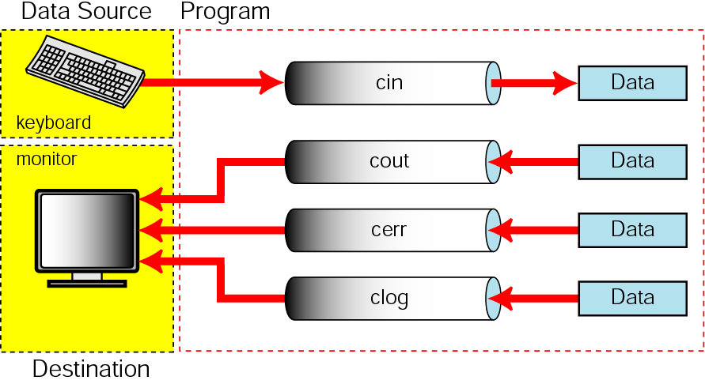
Figure 2-12 Standard streams

Slide 31
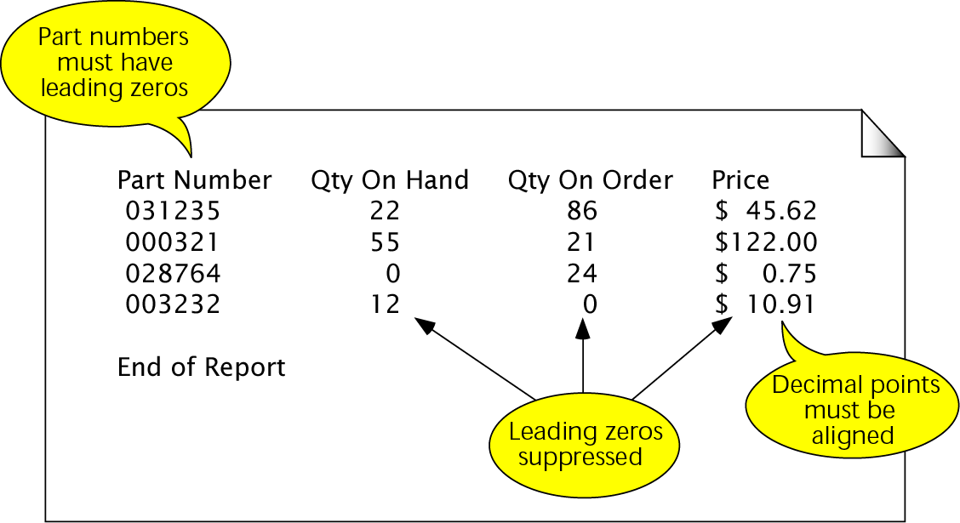
Figure 2-13 Output specifications for inventory report

Slide 32
2.9
Programming Examples

Slide 33
2.10
Software Engineering and Programming Style

Slide 34
Note:
Programming Standard
No variables are to be placed in the global area of a program.

