Slide 1
Chapter 3
Structure
of a
C++ Program

Slide 2
OBJECTIVES
After studying this chapter you will be able to:
 Understand the concept of and use expressions.
 Identify the seven types of C++ expressions.
 Use basic expressions in a program.
 Assign expression values to a variable.
 Evaluate expressions using precedence and associativity.
 Understand and use expression side effects.
 Understand and use compound statements.
 Understand that good functions are simple and short (KISS).
 Use parentheses to clarify code.
 Communicate clearly with the user through well written prompts.

Slide 3

3.1
Expressions

Slide 4
Note:
Expressions always reduce to a single value.

Slide 5
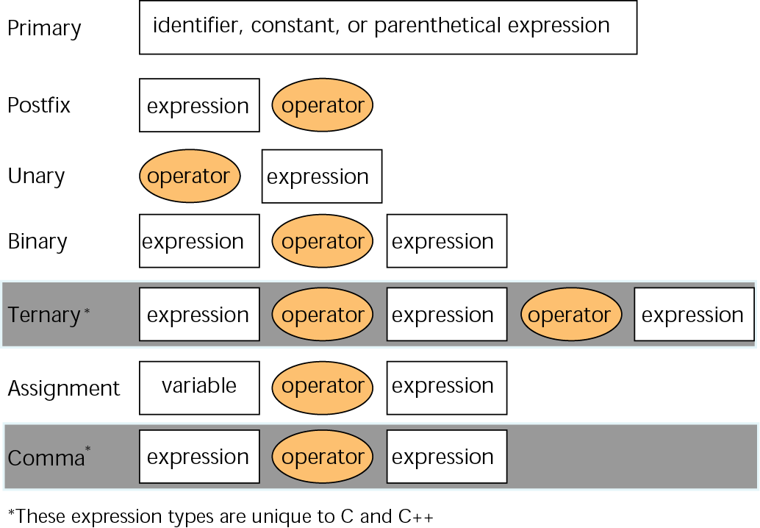
Figure 3-1 C++ expression format

Slide 6
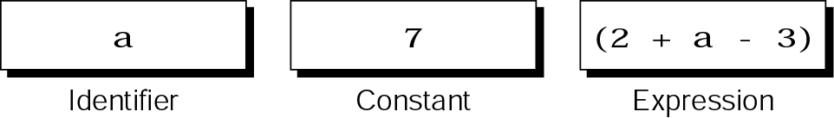
Figure 3-2 Primary expressions

Slide 7
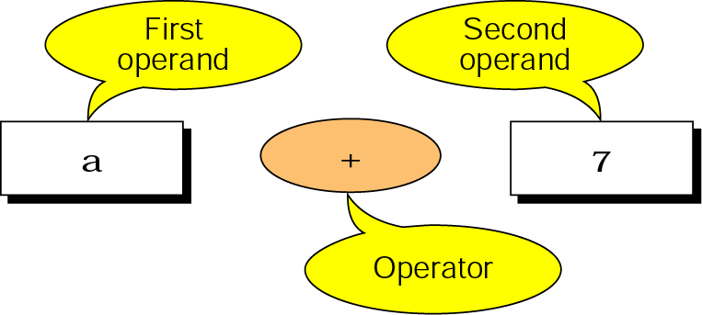
Figure 3-3 Binary expressions

Slide 8
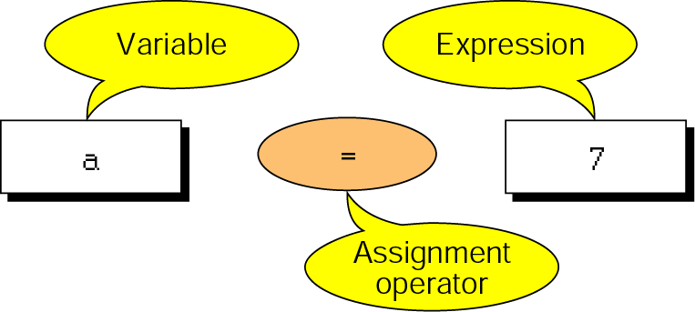
Figure 3-4 Assignment expression

Slide 9
Note:
The left operand in an assignment expression must be a single variable.

Slide 10
Note:
Assignment Expression
The assignment expression has a value and a result.
The value of the total expression is the value of the expression on the right of the assignment operator (=).
The result places the expression value in the operator on the left of the assignment operator.

Slide 11
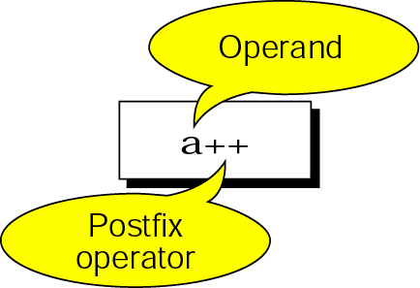
Figure 3-5 Postfix expressions

Slide 12
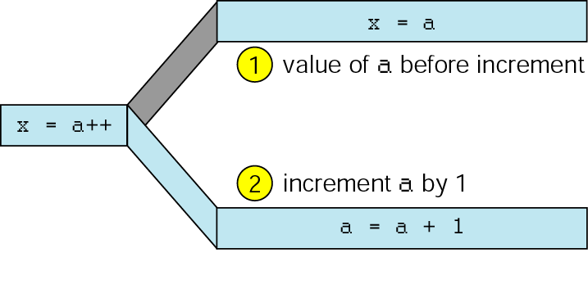
Figure 3-6 Result of postfix a++

Slide 13
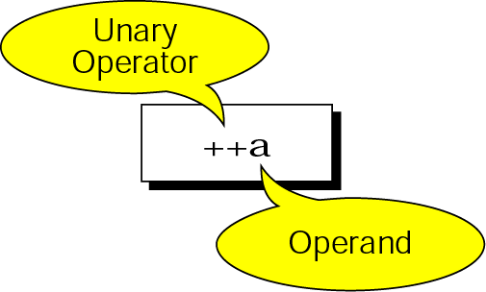
Figure 3-7 Unary expressions

Slide 14
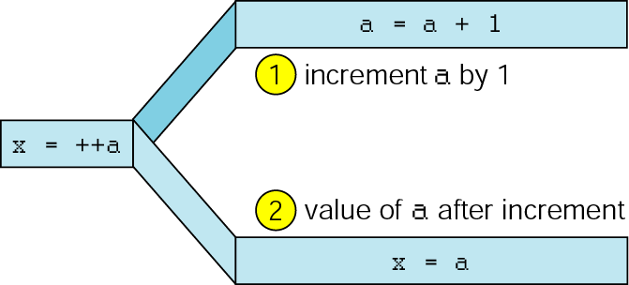
Figure 3-8 Result of prefix ++a

Slide 15
Note:
(++a) has the same effect as
(a = a + 1)

Slide 16
3.2
Precedence and Associativity

Slide 17
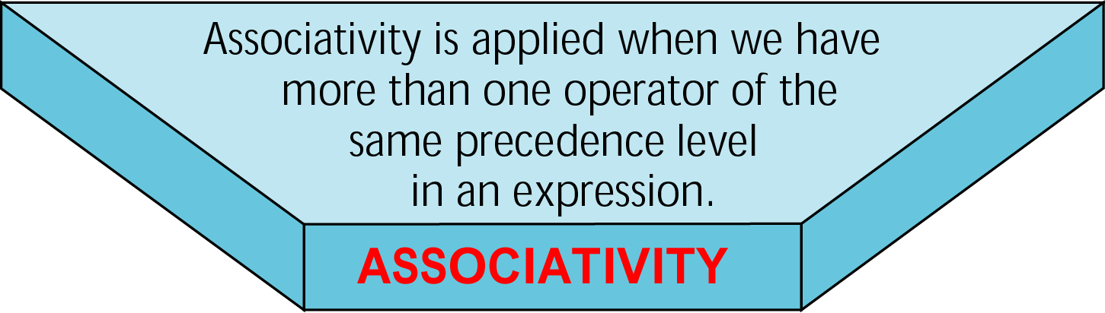
Figure 3-9 Associativity

Slide 18
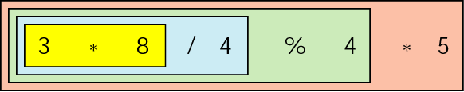
Figure 3-10 Left associativity

Slide 19

Figure 3-11 Right associativity

Slide 20
3.3
Side Effects

Slide 21
3.4
Evaluating Expressions

Slide 22
3.5
Mixed Type Expressions

Slide 23
3.6
Statements

Slide 24
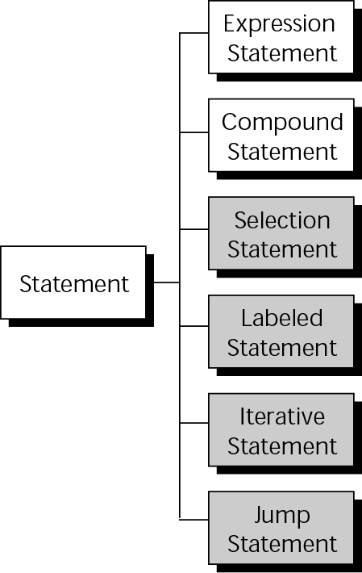
Figure 3-12 Types of statements

Slide 25
Note:
An expression statement is terminated with a semicolon. The semicolon is a terminator, and it tells the compiler that the statement is finished.

Slide 26
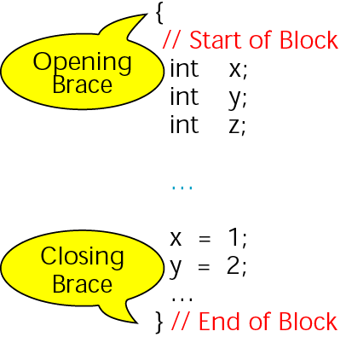
Figure 3-13 Compound statement

Slide 27
3.7
Sample Programs

Slide 28
3.8
Software Engineering and Programming Style

Slide 29
Note:
Blocks of code should be no longer than one screen.

