Slide 1
Chapter 5
Selection--
Making
Decision

Slide 2
OBJECTIVES
After studying this chapter you will be able to:
 Understand and use logical data in a program.
 Understand and use the: not, and, and or logical operators.
 Understand and use the six relational operators.
 Write selection statements using two-way selection and multiway selection.
 Understand and avoid the dangling-else problem.
 Implement multiway selection using the switch statement or the else-if
format.
 Use the standard character functions to test or reformat character data.
 Understand why controlled statements should be indented and use
indentation for program readability.
 Create structure charts that show logic flow in selection paths.

Slide 3

5.1
Logical Data and Operators

Slide 4
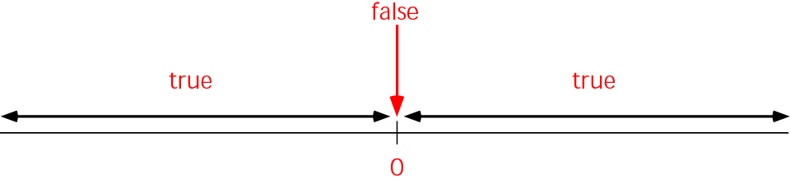
Figure 5-1 Design for print report

Slide 5
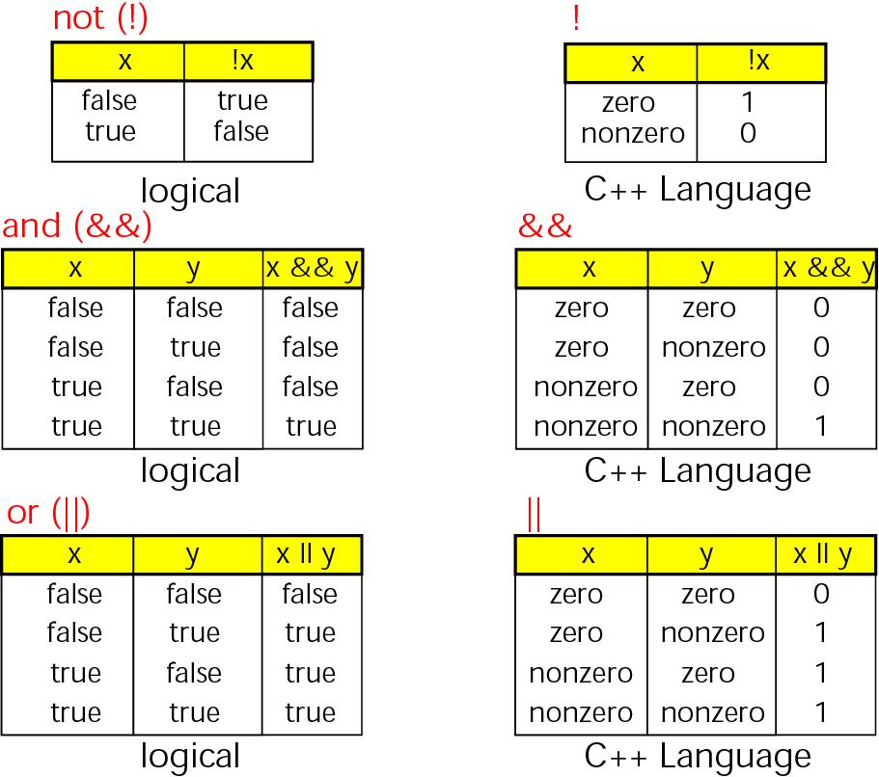
Figure 5-2 Logical operators truth table

Slide 6
Note:
In C++
If a value is zero, it can be used as the logical value false.
If a value is not zero, it can be used as the logical value true.
Zero <===> False
Nonzero <===> True

Slide 7
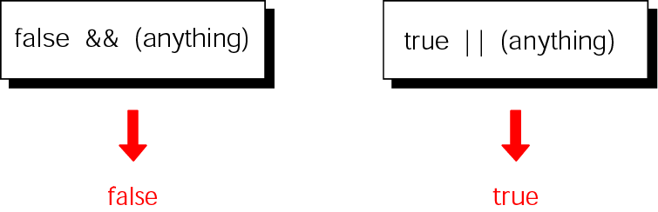
Figure 5-3 Short-circuit methods for and and or

Slide 8
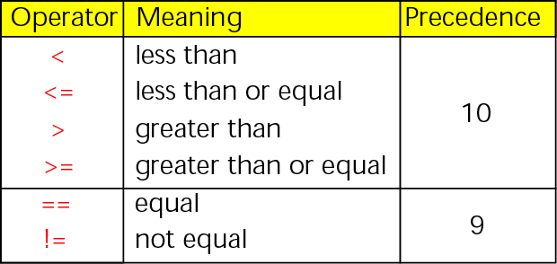
Figure 5-4 Relational operators

Slide 9
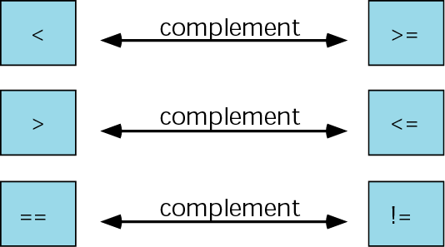
Figure 5-5 Logical operator complements

Slide 10
5.2
Two-Way Selection

Slide 11
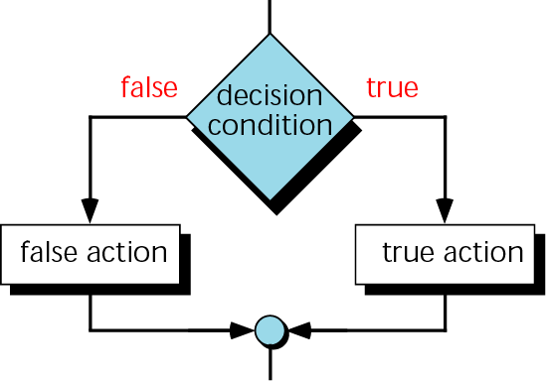
Figure 5-6 Two-way decision logic

Slide 12
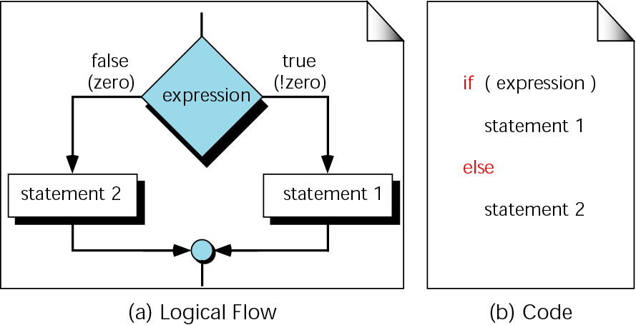
Figure 5-7 if...else logic flow

Slide 13
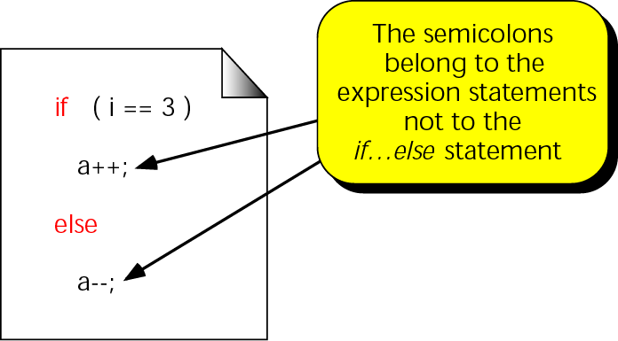
Figure 5-8 A simple if...else statement

Slide 14
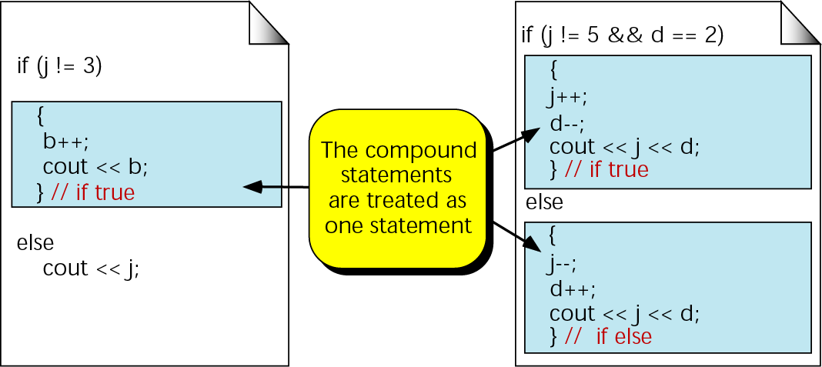
Figure 5-9 Compound statements in an if...else

Slide 15
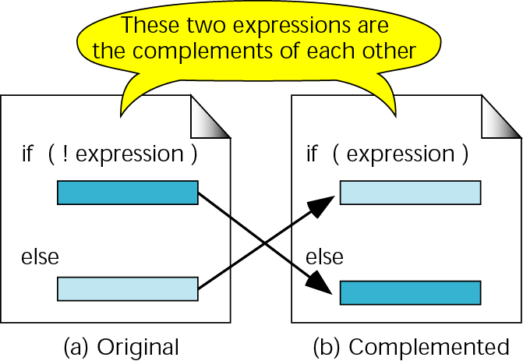
Figure 5-10 Complemented if...then statements

Slide 16
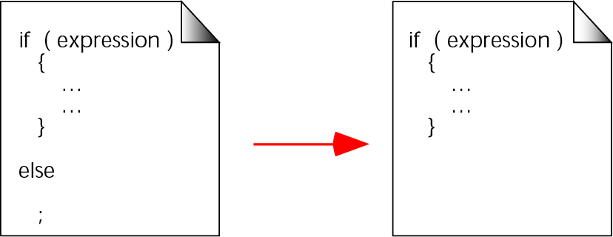
Figure 5-11 A null else statement

Slide 17
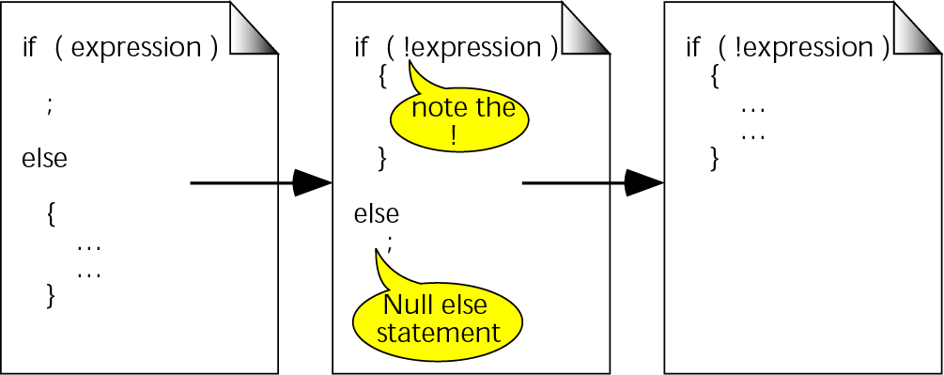
Figure 5-12 A null if statement

Slide 18
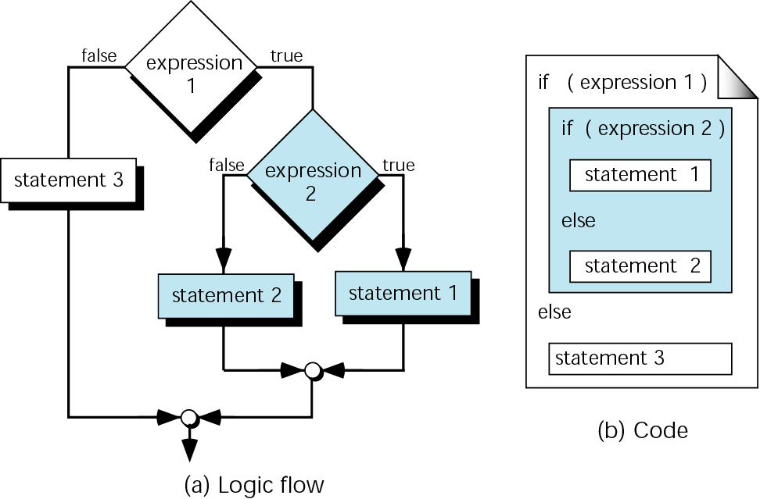
Figure 5-13 Nested if statements

Slide 19
Note:
else is always paired with the most recent, unpaired if

Slide 20
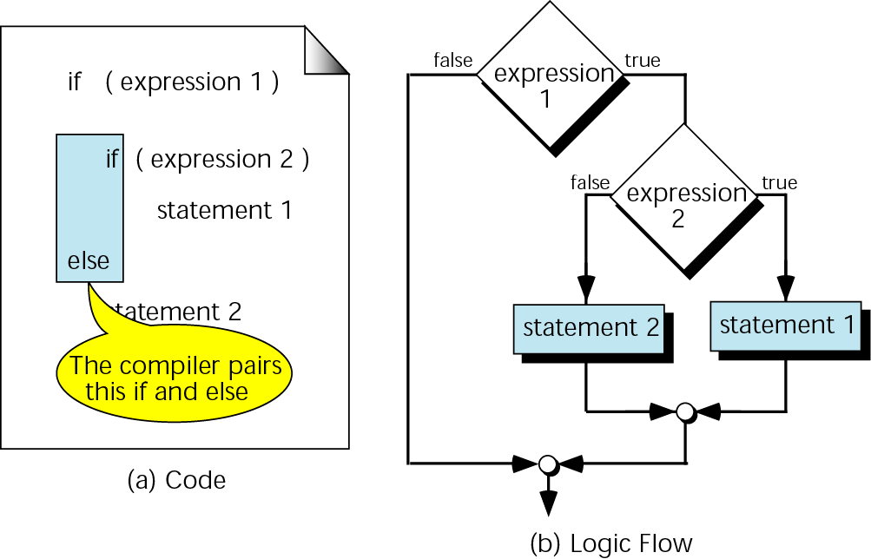
Figure 5-14 Dangling else

Slide 21
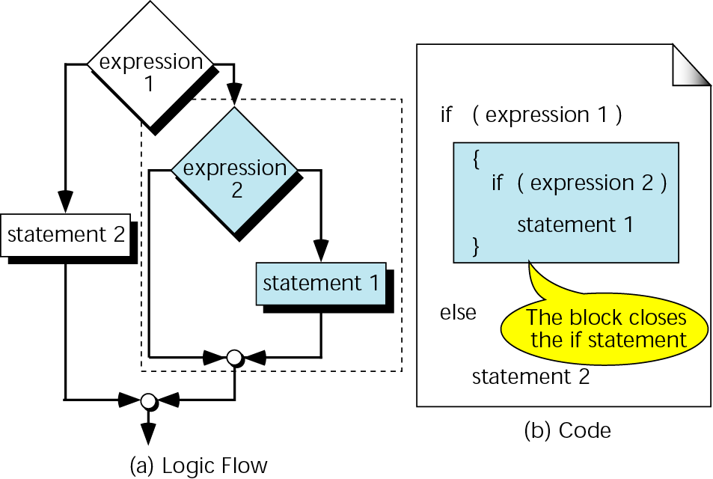
Figure 5-15 Dangling else solution

Slide 22
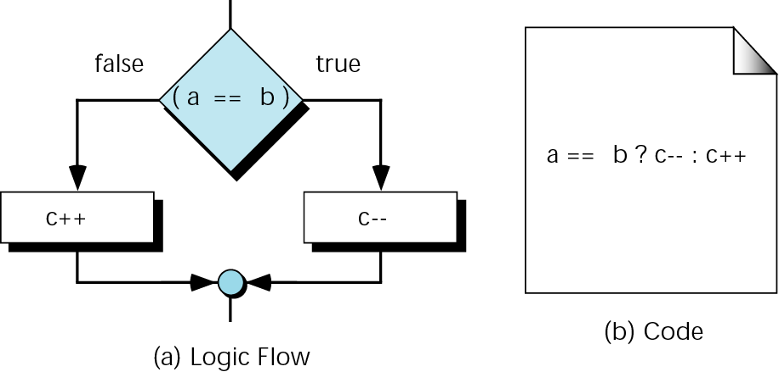
Figure 5-16 Conditional expression

Slide 23
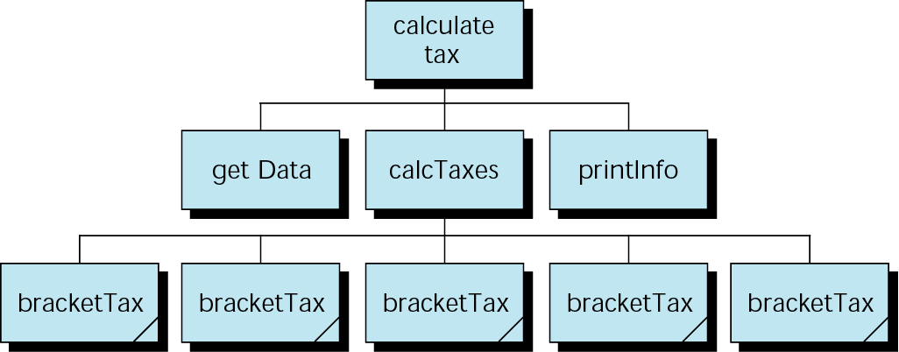
Figure 5-17 Design for calculate taxes

Slide 24
5.3
Multiway Selection

Slide 25
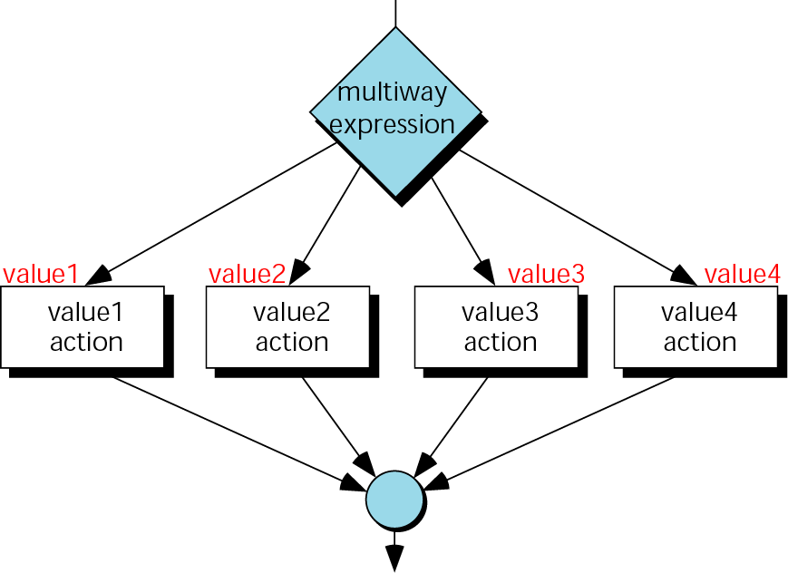
Figure 5-18 switch decision logic

Slide 26
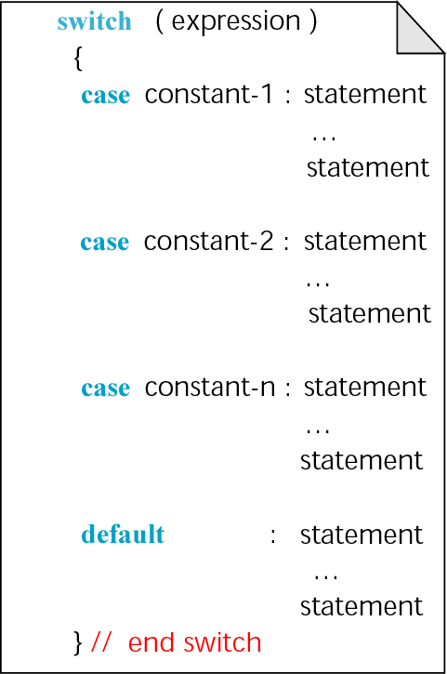
Figure 5-19 switch statement

Slide 27
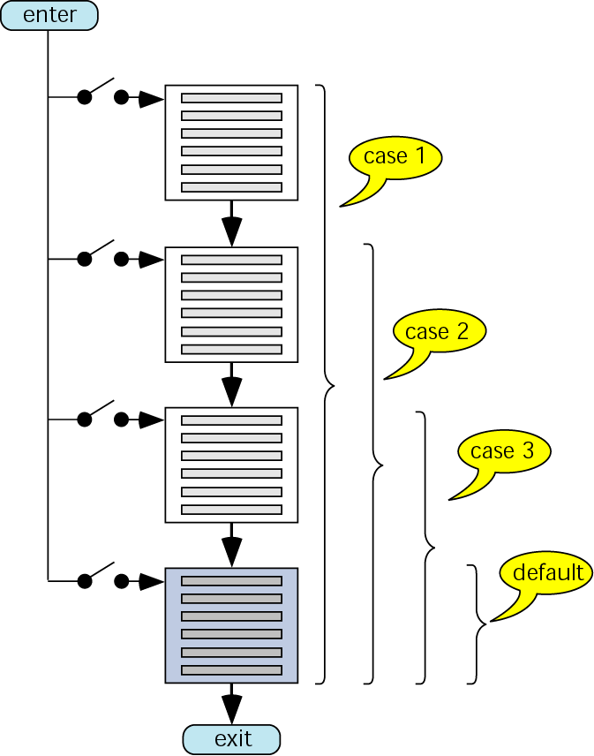
Figure 5-20 switch flow

Slide 28
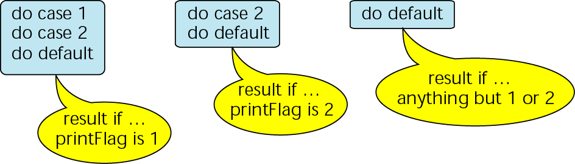
Figure 5-21 switch results

Slide 29
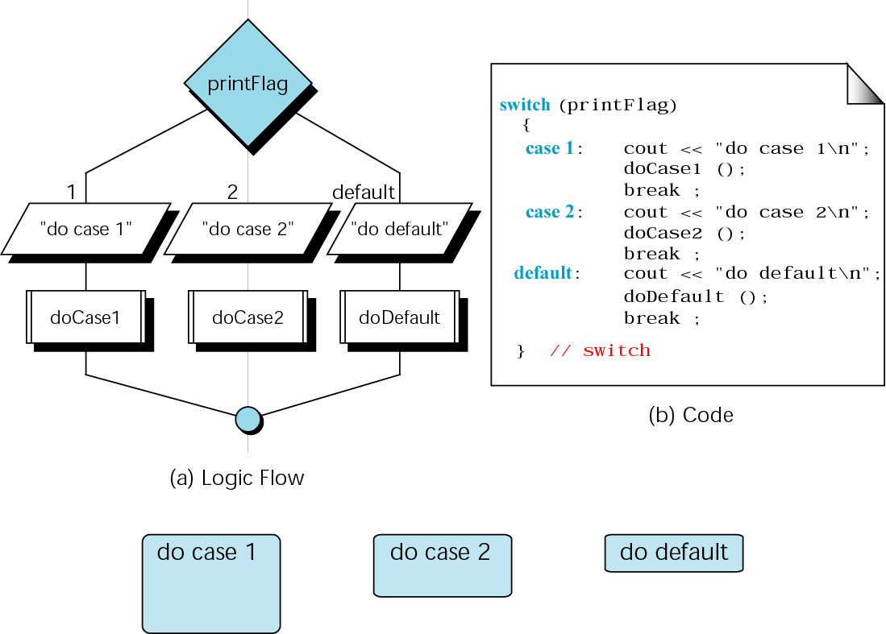
Figure 5-22 A switch with break statements

Slide 30
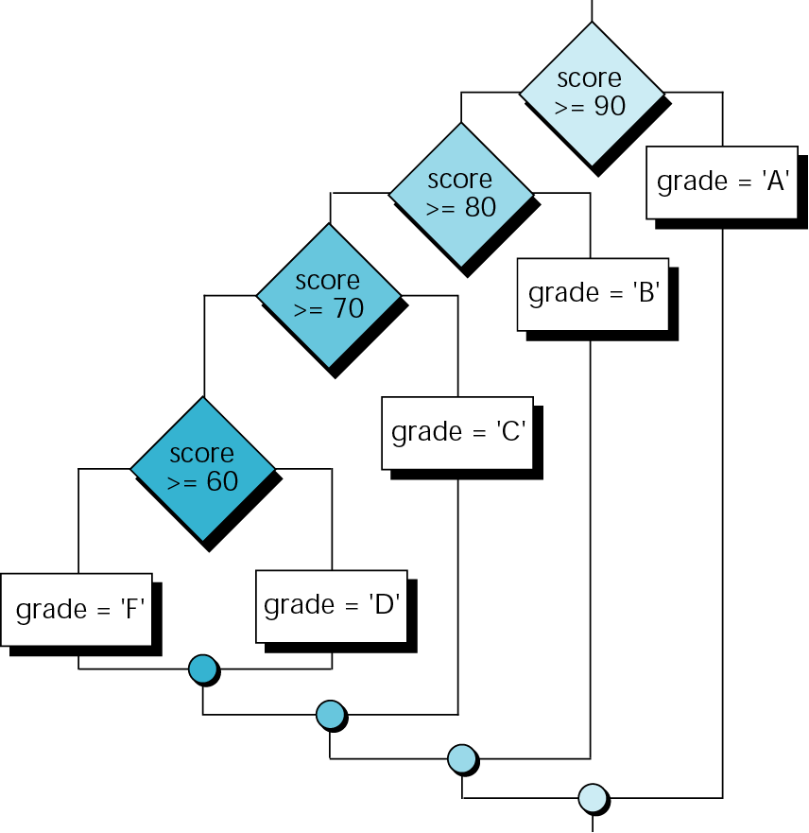
Figure 5-23 The else…if for Program 5-9

Slide 31
Note:
The else-if is an artificial C++ construct that is only used when
1. The selection variable is not an
integral, and
2. The same variable is being tested in
the expressions.

Slide 32
5.4
More Standard Library Functions

Slide 33
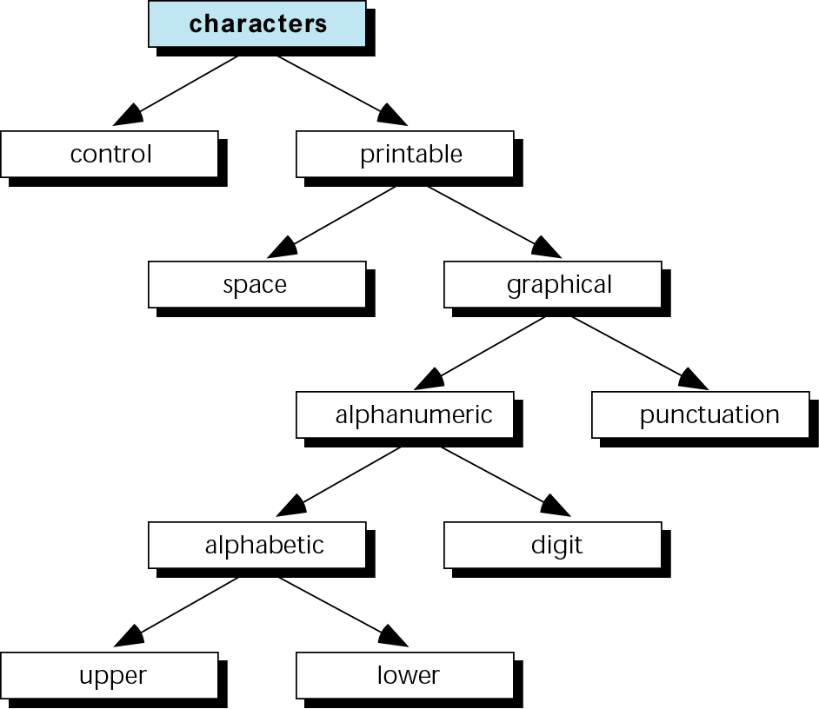
Figure 5-24 Classifications of the character type

Slide 34
5.5
A Menu Program

Slide 35
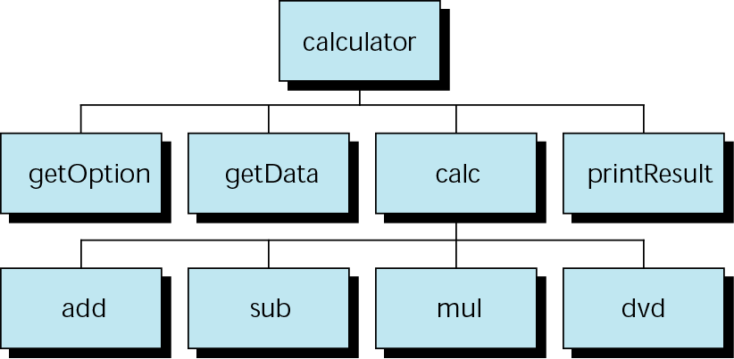
Figure 5-25 Design for menu-driven calculator

Slide 36
5.6
Software Engineering and Programming Style

Slide 37
Note:
Avoid compound negative statements!

Slide 38
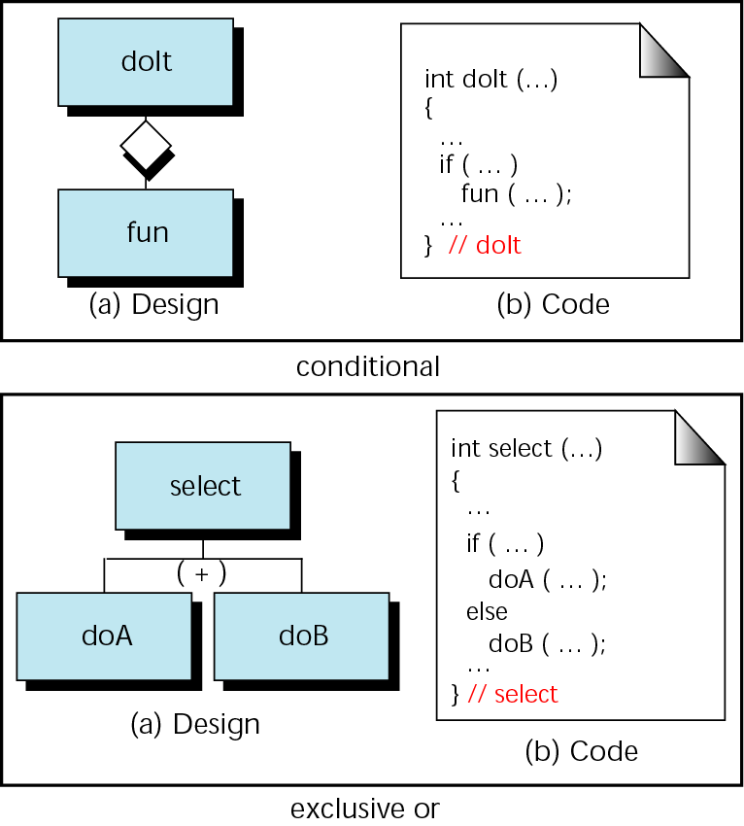
Figure 5-26 Structure chart symbols for selection

Slide 39
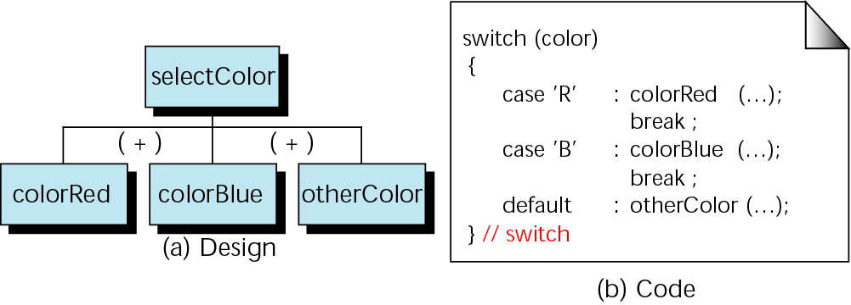
Figure 5-27 Multiway selection in a structure chart

