Slide 1
Chapter 6
Repetition

Slide 2
OBJECTIVES
After studying this chapter you will be able to:
 Understand the basic components of a loop: initialization, control
expression, and update.
 Understand and use pretest, post-test, and count-controlled loops.
 Differentiate between event-controlled and counter-controlled loops.
 Write loops in C++ using while, for, and do...while loops.
 Understand the limitations and use of break and continue statements in
loops.
 Design structure charts for programs using loops.
 Understand how recursion works in a C++ program.
 Analyze the efficiency of algorithms using Big-O theory.

Slide 3

6.1
Concept of a Loop

Slide 4
6.2
Pretest and Post-Test Loops

Slide 5
Note:
Pretest Loop
In each iteration, the loop control expression is tested first. If it is true, the loop action(s) is executed; if it is false, the loop is terminated.
Post-test Loop
In each iteration, the loop action(s) are executed. Next, the loop control expression is tested. If it is true, a new iteration is started; otherwise, the loop terminates.

Slide 6
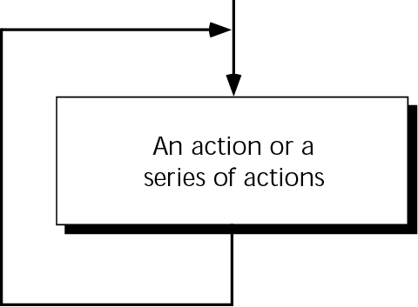
Figure 6-1 The concept of a loop

Slide 7
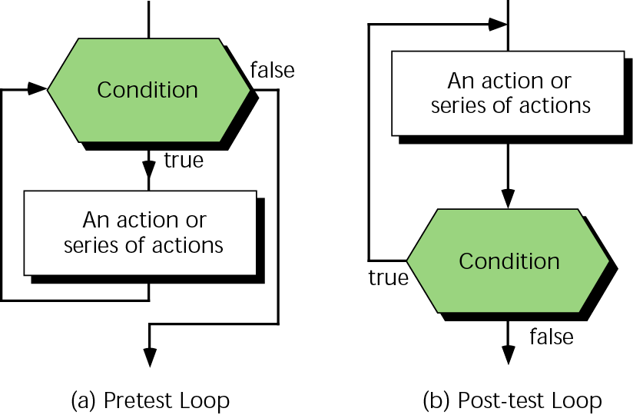
Figure 6-2 Pretest and post-test loops

Slide 8
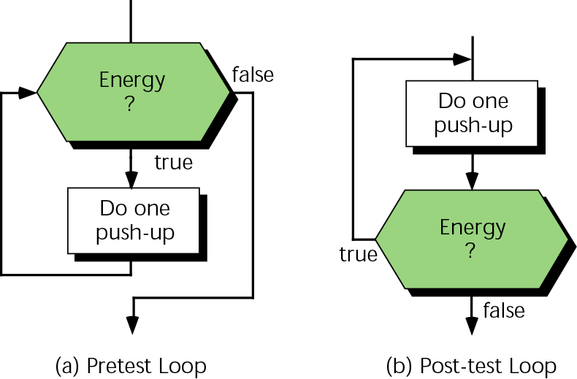
Figure 6-3 Two different strategies for starting exercise

Slide 9
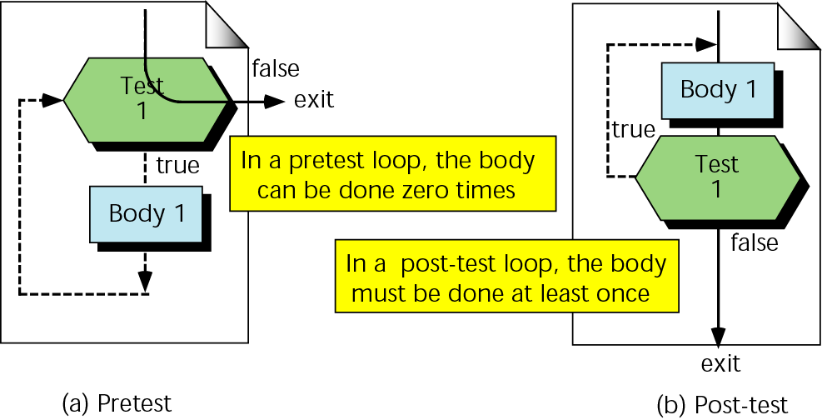
Figure 6-4 Minimum number of iterations in two loops

Slide 10
6.3
Initialization and Updating

Slide 11
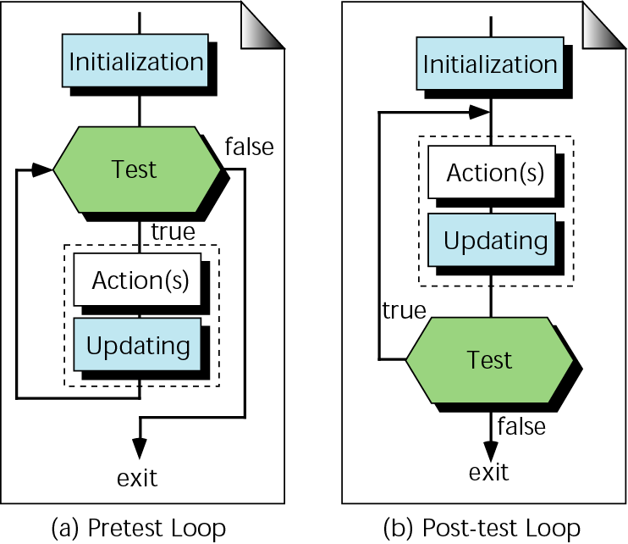
Figure 6-5 Loop initialization and updating

Slide 12
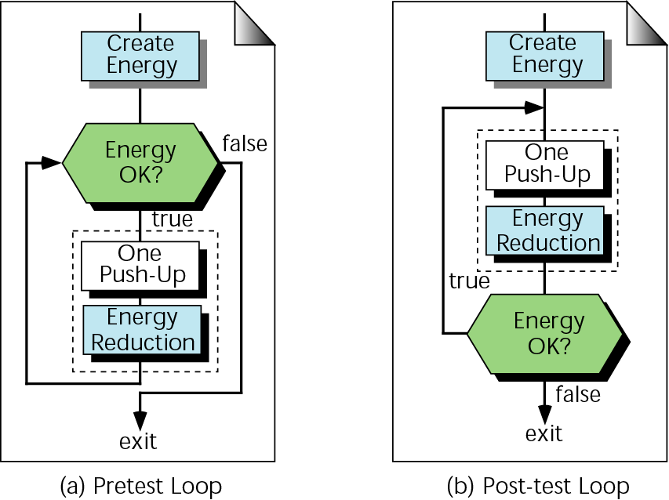
Figure 6-6 Initialization and updating for exercise

Slide 13
6.4
Event-Controlled and
Counter-Controlled
Loops

Slide 14
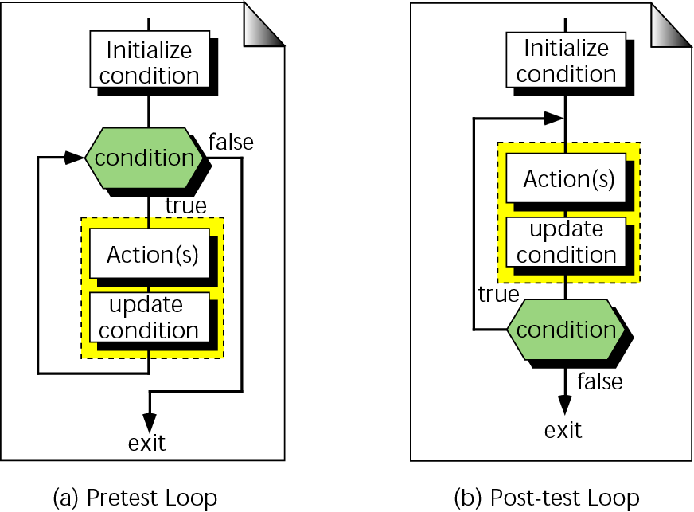
Figure 6-7 Event-controlled loop concept

Slide 15
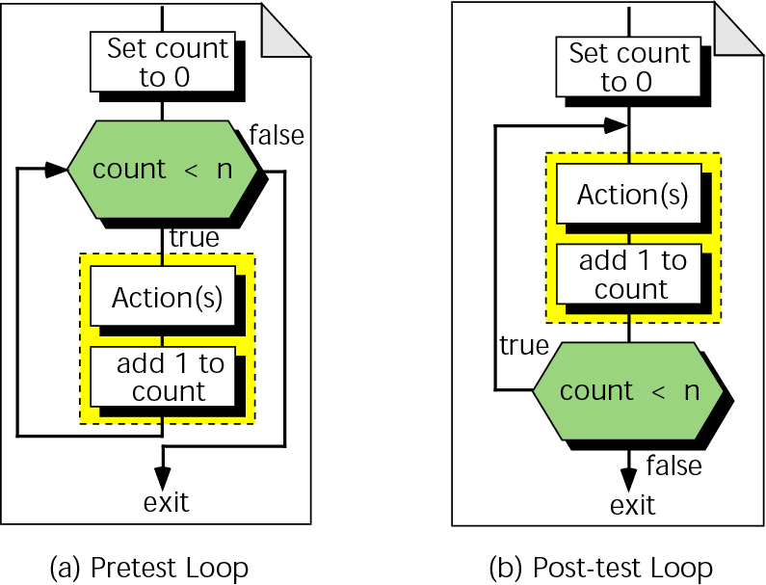
Figure 6-8 Counter-controlled loop concept

Slide 16
6.5
Loops
in C++

Slide 17
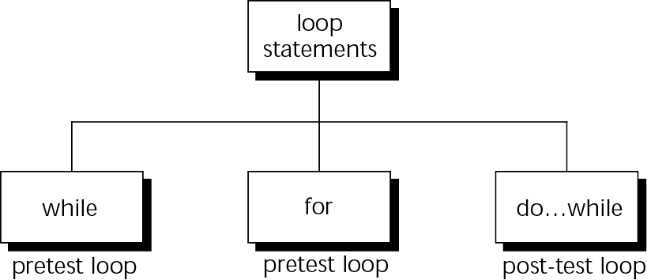
Figure 6-9 C++ loop constructs

Slide 18
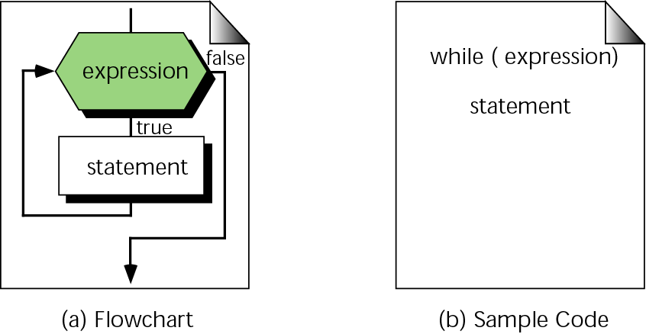
Figure 6-10 The while statement

Slide 19
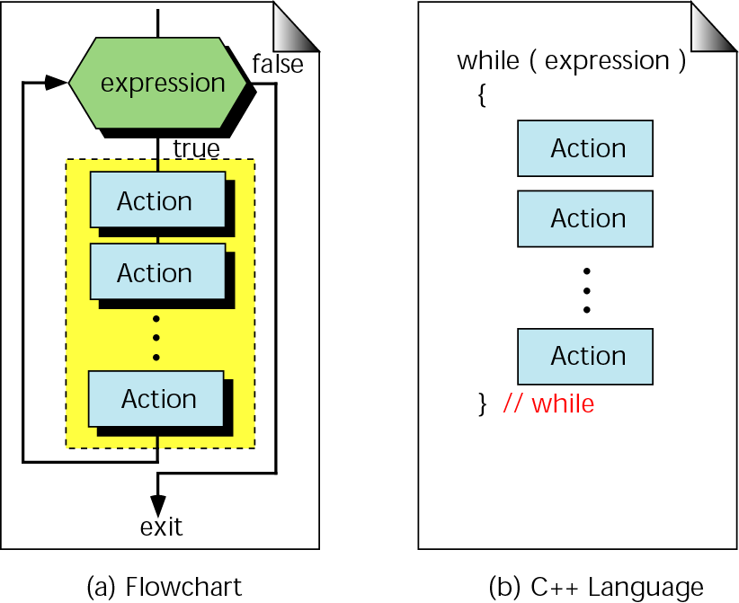
Figure 6-11 Compound while statement

Slide 20
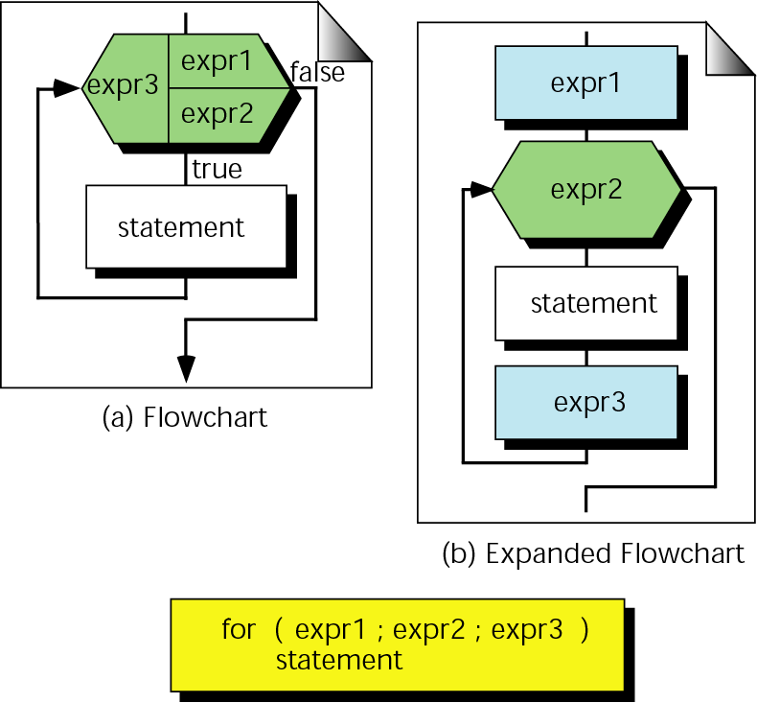
Figure 6-12 for statement

Slide 21
Note:
A for loop is used when your loop is to be executed a known number of times. You can do the same thing with a while loop, but the for loop is easier to read and more natural for counting loops.

Slide 22
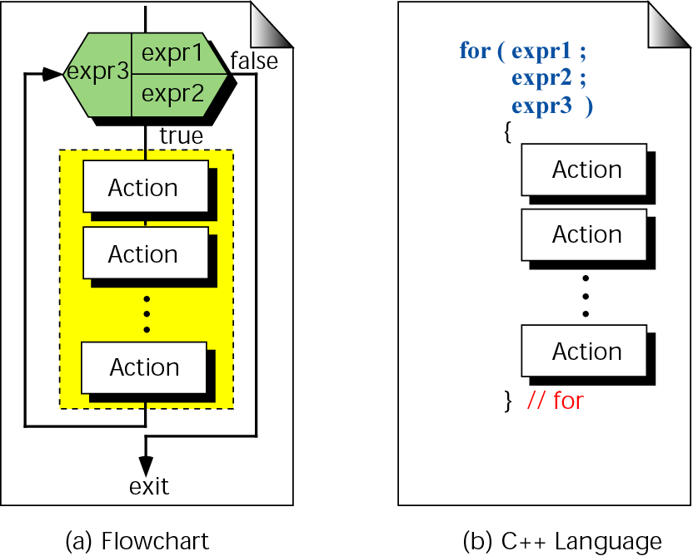
Figure 6-13 Compound for statement

Slide 23
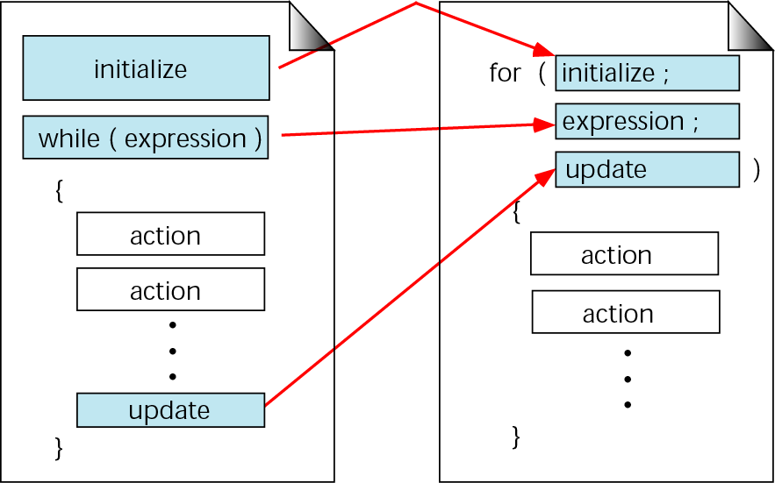
Figure 6-14 Comparing for and while loops

Slide 24
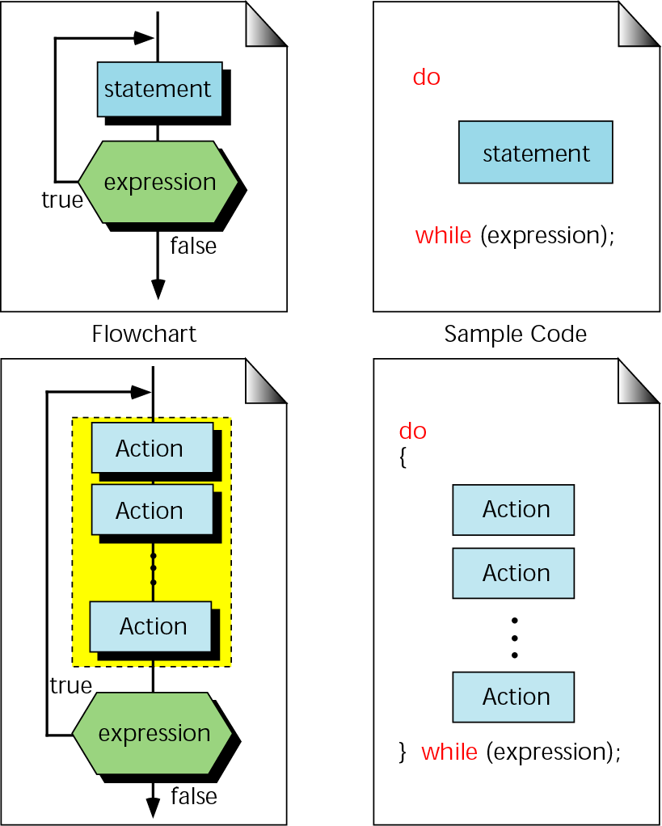
Figure 6-15 Format of the do…while statement

Slide 25
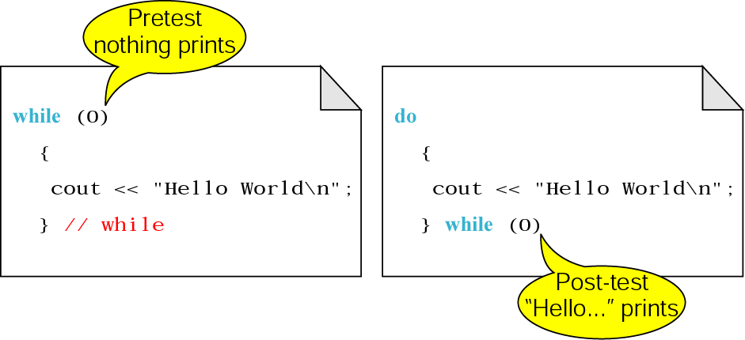
Figure 6-16 Pre- and post-test loops

Slide 26
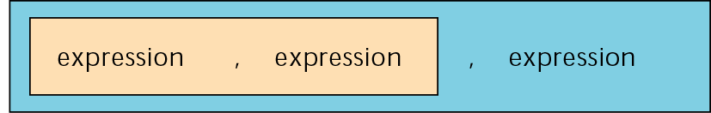
Figure 6-17 Nested comma expression

Slide 27
6.6
Loop
Examples

Slide 28
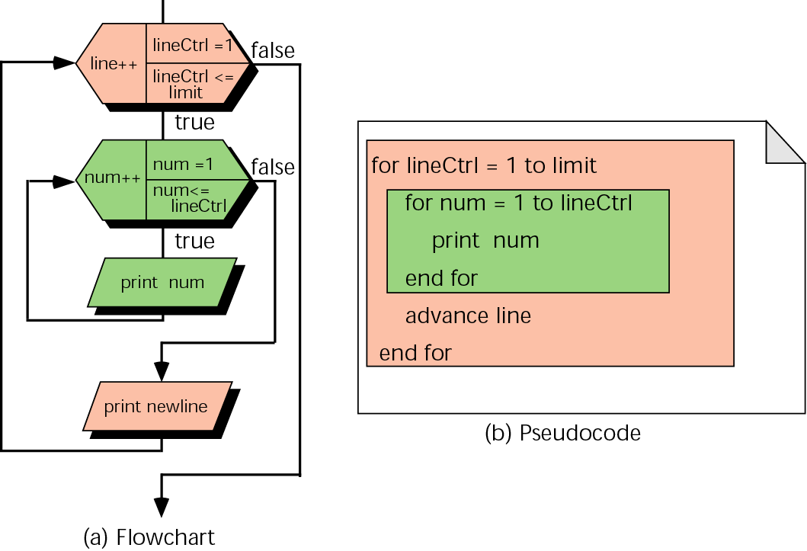
Figure 6-18 Print triangle flowchart and pseudocode

Slide 29
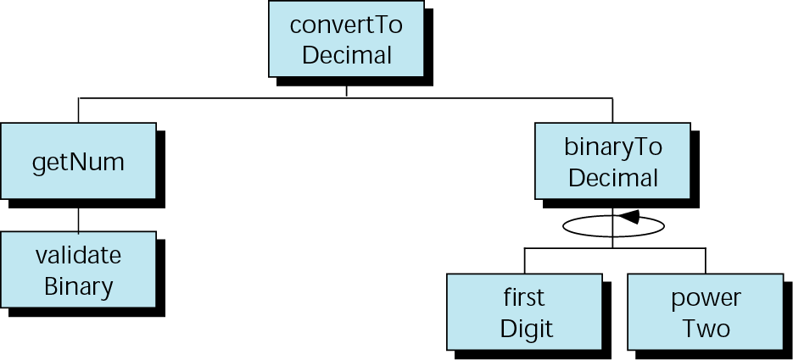
Figure 6-19 Design for binary to decimal

Slide 30
6.7
Other Statements Related to Looping

Slide 31
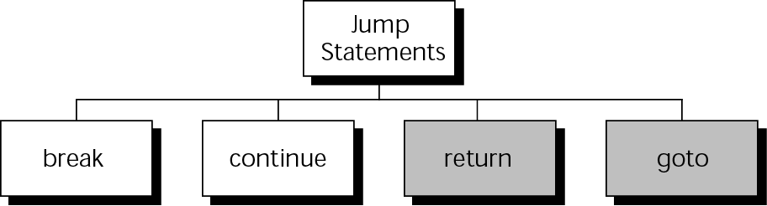
Figure 6-20 Jump statements

Slide 32
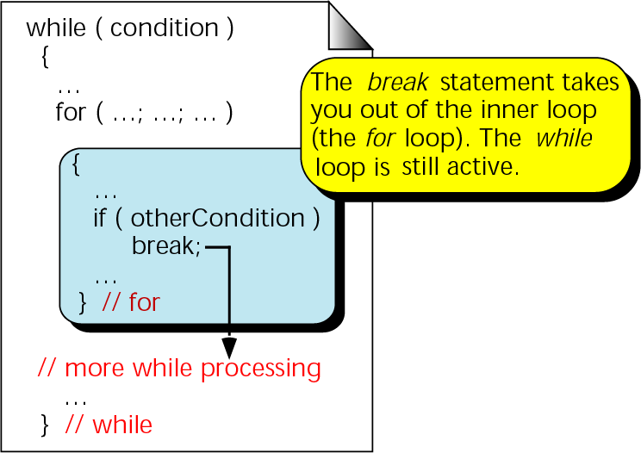
Figure 6-21 break and inner loops

Slide 33
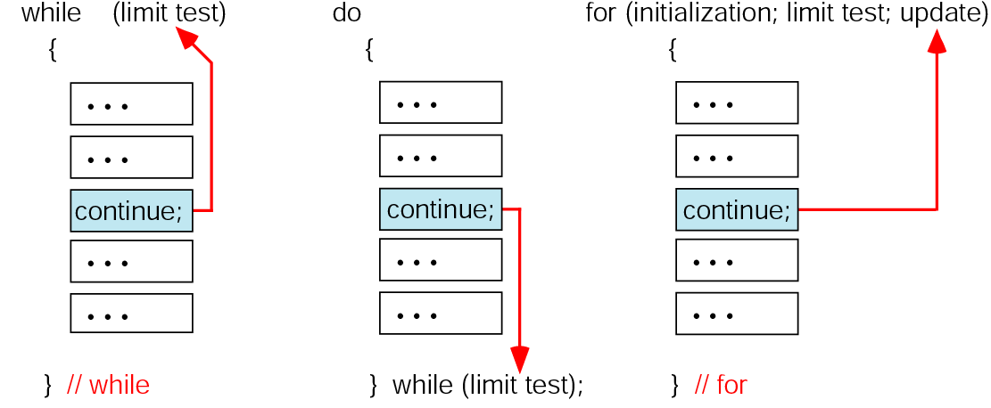
Figure 6-22 The continue statement

Slide 34
6.8
Looping Applications

Slide 35
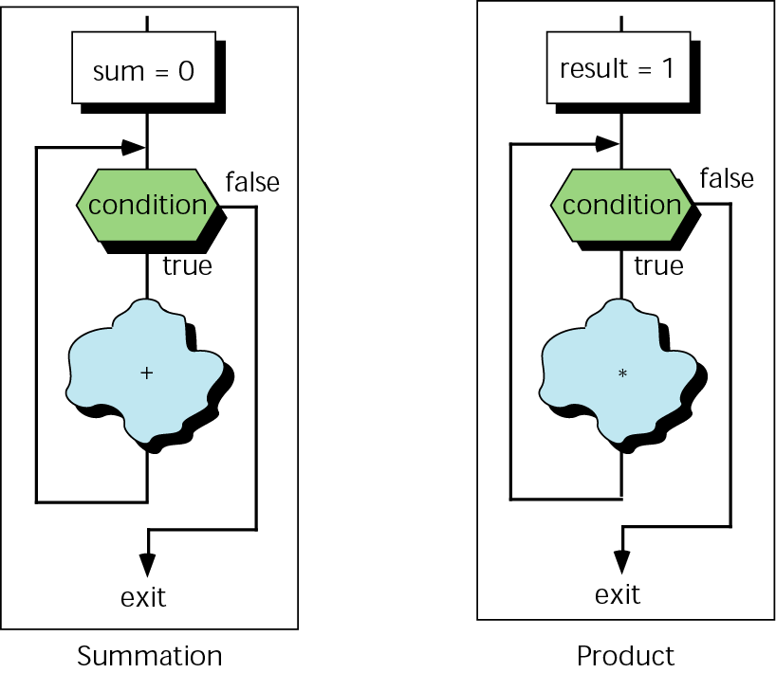
Figure 6-23 Summation and product loops

Slide 36
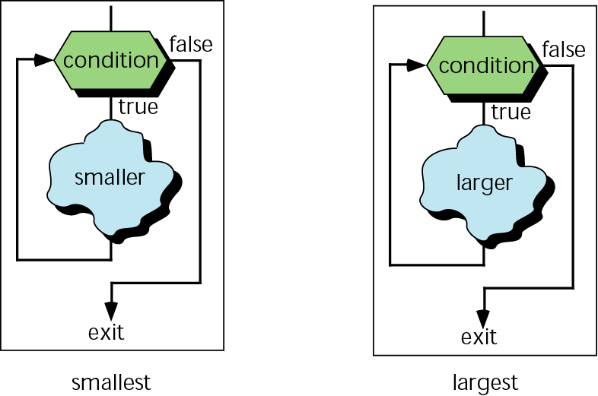
Figure 6-24 Smallest and largest loops

Slide 37
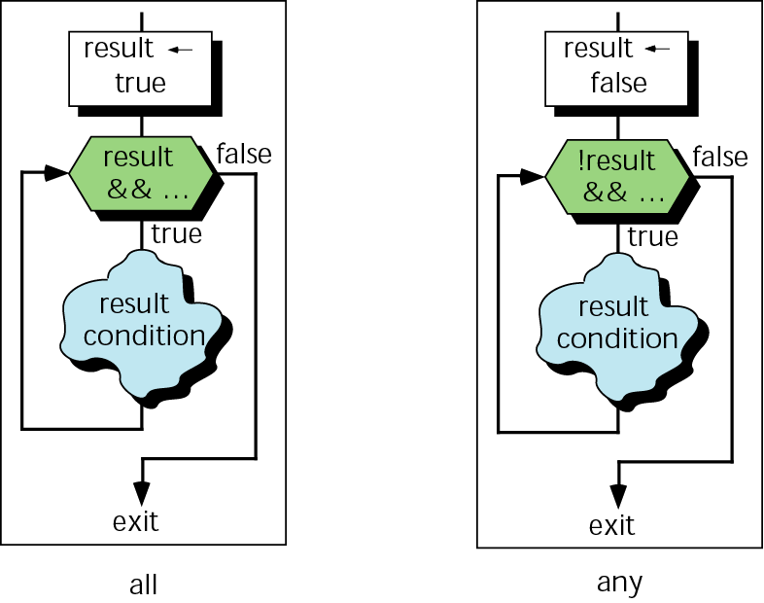
Figure 6-25 any and all inquiries

Slide 38
6.9
Recursion

Slide 39
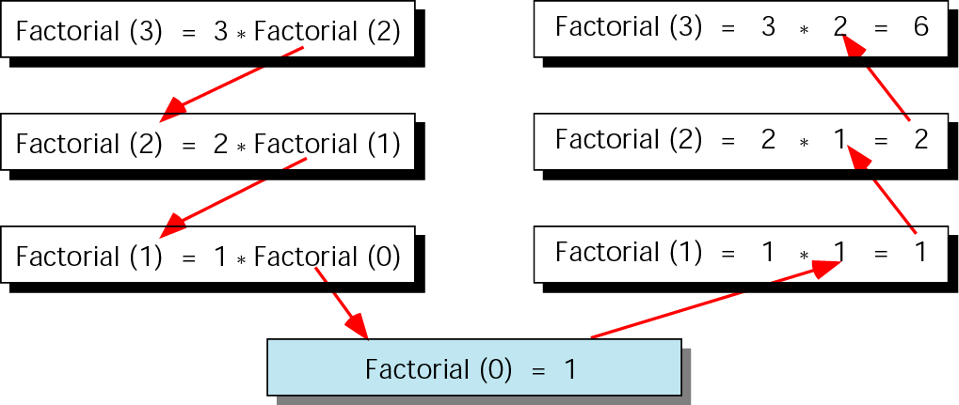
Figure 6-26 Factorial (3) recursively

Slide 40
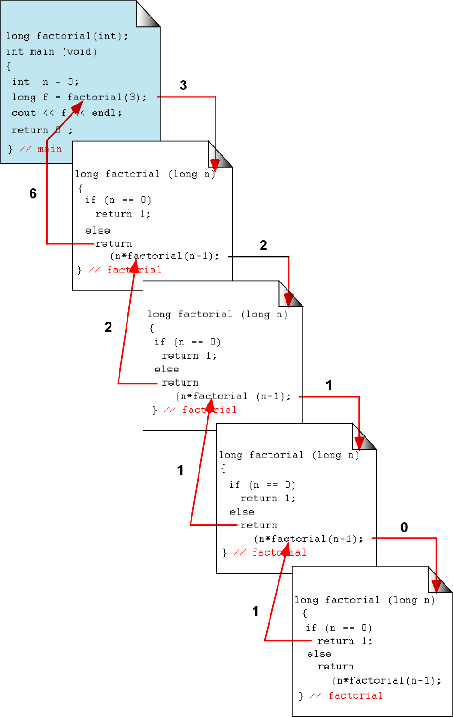
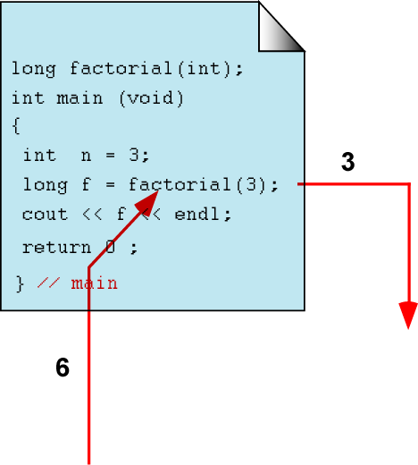
Figure 6-27 Calling a recursive function

Slide 41
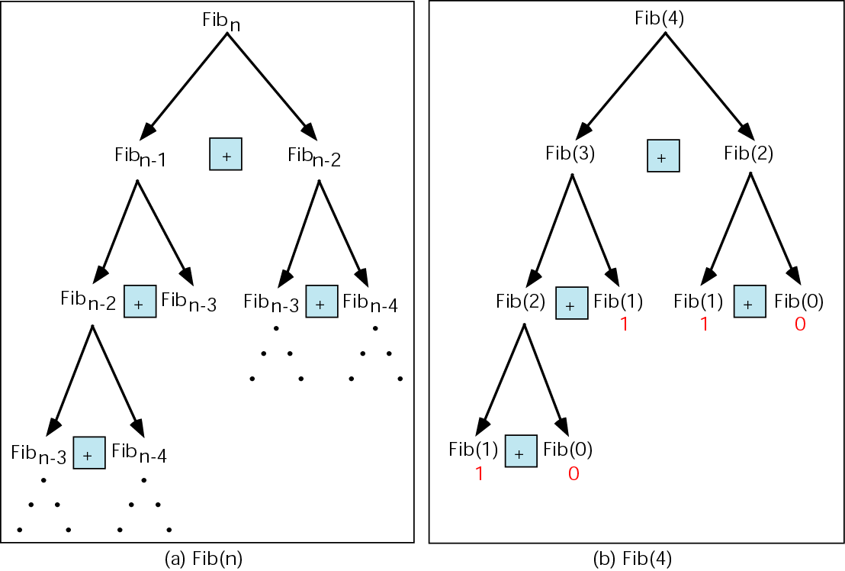
Figure 6-28 Fibonacci numbers

Slide 42
Note:
Every recursive call must either solve part of the problem or reduce the size of the problem.

Slide 43
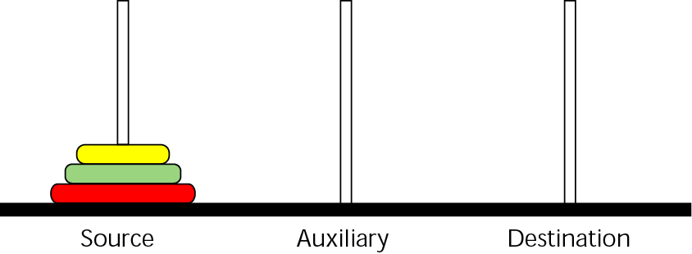
Figure 6-29 Towers of Hanoi—start position

Slide 44
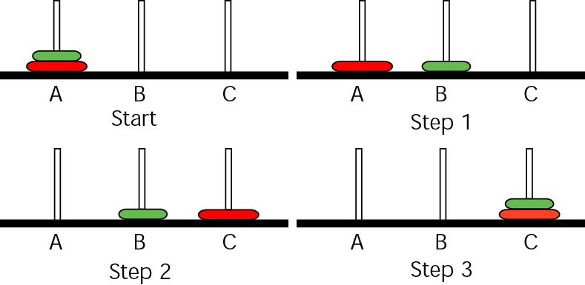
Figure 6-30 Towers solution for two disks

Slide 45
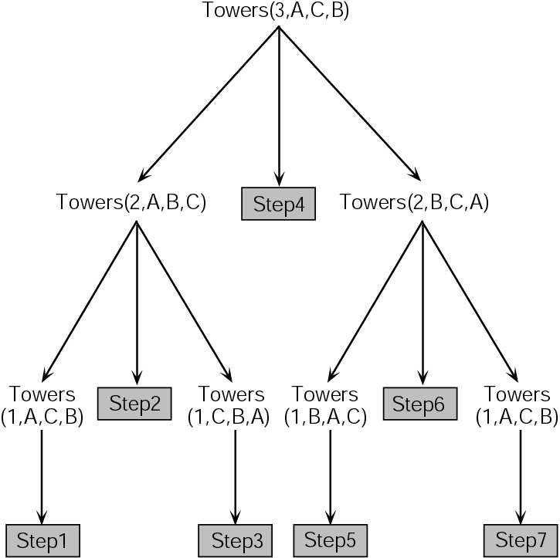
Figure 6-31 Towers solution for three disks

Slide 46
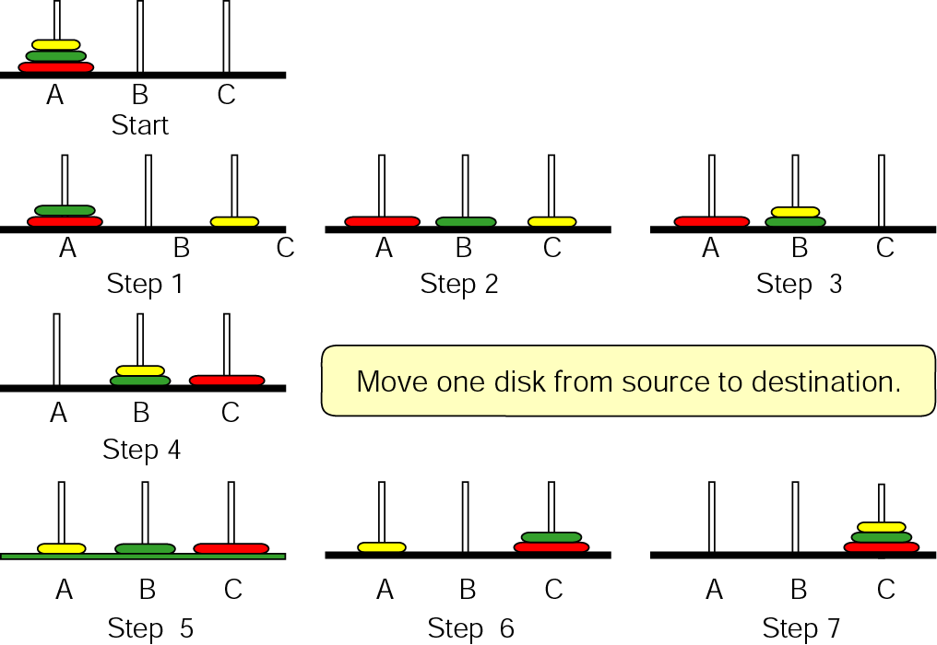
Figure 6-31 Towers solution for three disks (continued)

Slide 47
6.10
A Programming Example—The Calculator
Program

Slide 48
6.11
Software Engineering and Programming Style

Slide 49
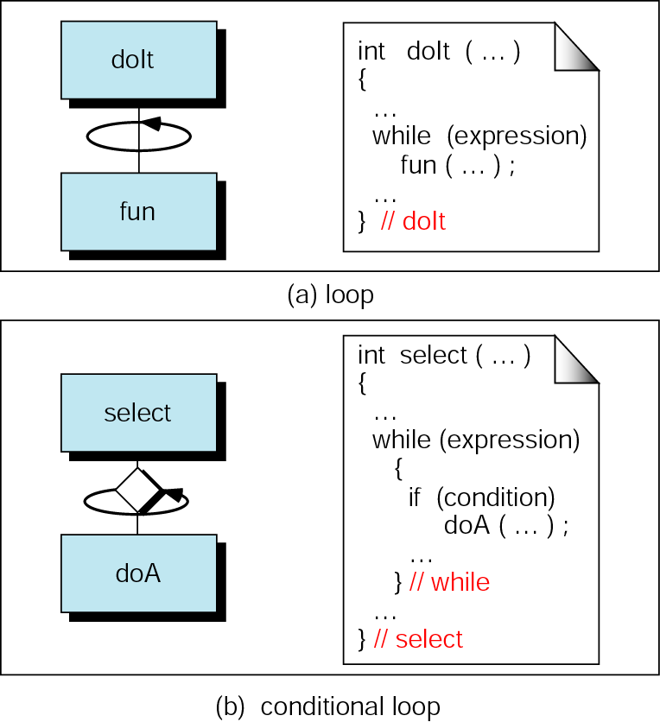
Figure 6-32 Structure chart symbols for loops

Slide 50
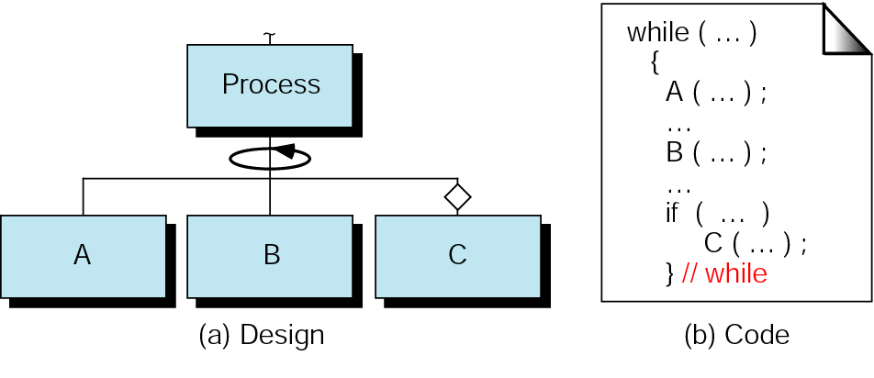
Figure 6-33 Structure chart for process

Slide 51
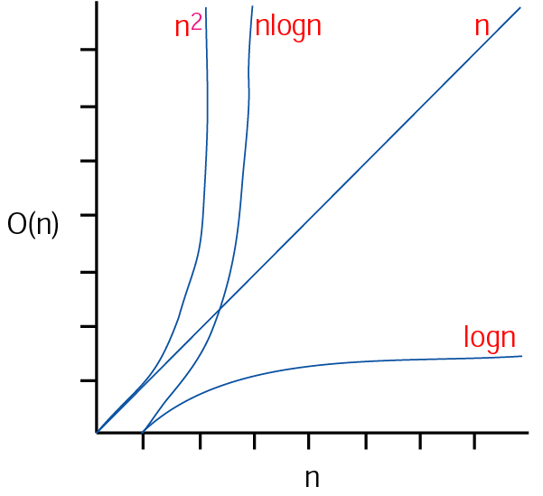
Figure 6-34 Measures of efficiency

