Slide 1
Chapter 11
More Class
Features
and
Other Types

Slide 2
OBJECTIVES
After studying this chapter you will be able to:
 Write explicit and implicit inline functions.
 Use an initialization list to initialize the members of a class.
 Write overloaded functions.
 Overload operators.
 Use static members in a class.
 Use pointers to classes.
 Declare a function as a friend of a class.
 Create an enumerated type.
 Define and use a structure.
 Define and use a union.
 Understand how functions are coupled.

Slide 3
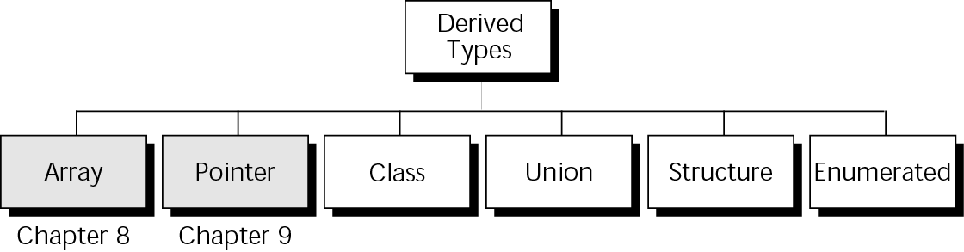
Figure 11-1 Derived types

Slide 4

11.1
Inline Functions

Slide 5
Note:
Inline functions are used to improve the efficiency of a program.

Slide 6
11.2
Initialization List

Slide 7
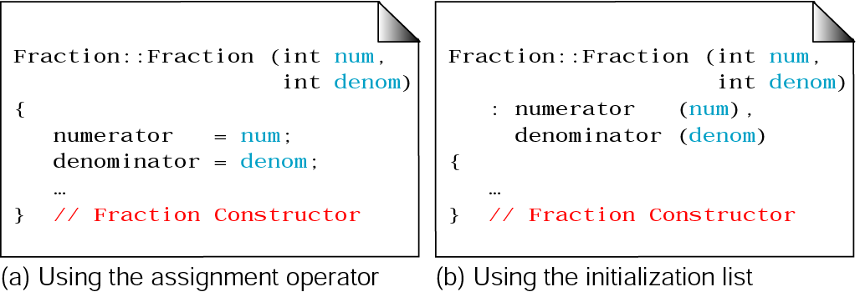
Figure 11-2 Using initialization lists

Slide 8
11.3
Overloading

Slide 9
Note:
C++ provides a bitwise overloaded assignment operator if we don’t overload it ourselves.

Slide 10
Note:
The assignment operator is different from the copy constructor.

Slide 11
Note:
When we need to write a copy constructor, we also need to write an assignment operator and a destructor.

Slide 12
11.4
Static Members

Slide 13
Note:
By default, a class member is an instance member.

Slide 14
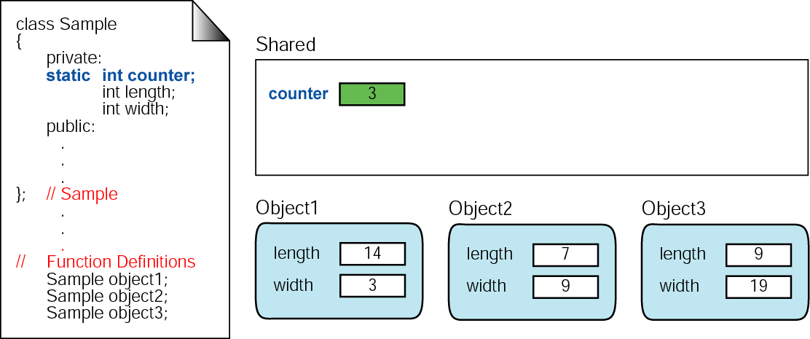
Figure 11-3 Class members

Slide 15
Note:
Static data members are instance independent.

Slide 16
Note:
There are three static data members:
• explicit static data members
• enumerated members
• type defined members

Slide 17
11.5
Friend
Classes

Slide 18
11.6
Classes And Pointers

Slide 19
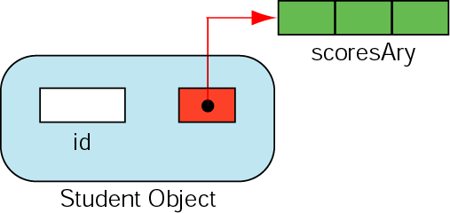
Figure 11-4 Student class object

Slide 20
11.7
Array of Objects

Slide 21
Note:
We are only allowed to call the default constructor when we create an array of objects.

Slide 22
11.8
Structure

Slide 23
Note:
The class and structure constructs are identical with one exception:
Members in a structure are public by default whereas they are private by default in a class

Slide 24
Figure 11-5 Class and structure declarations
class Sample
{
private:
...
private:
...
}; // Sample
struct Sample
{
private:
...
private:
...
}; // Sample

Slide 25
Figure 11-6 Private versus public defaults
class Sample
{
int x;
int y;
...
void print();
}; // Sample
struct Sample
{
int x;
int y;
...
void print();
}; // Sample

Slide 26
Note:
Use structures only for simple constructs that do not require data protection or specialized functions.

Slide 27
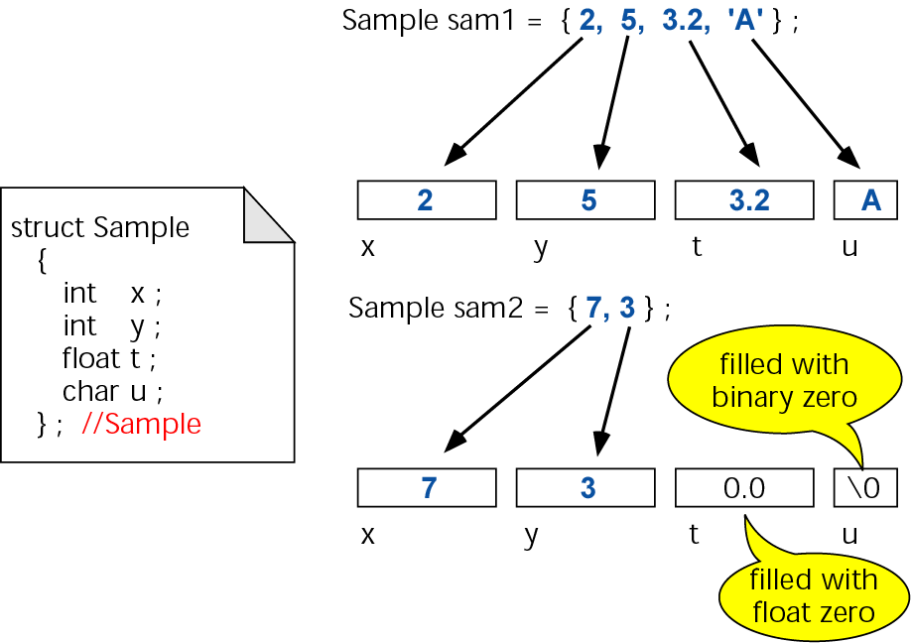
Figure 11-7 Initializing structures

Slide 28
11.9
Unions

Slide 29
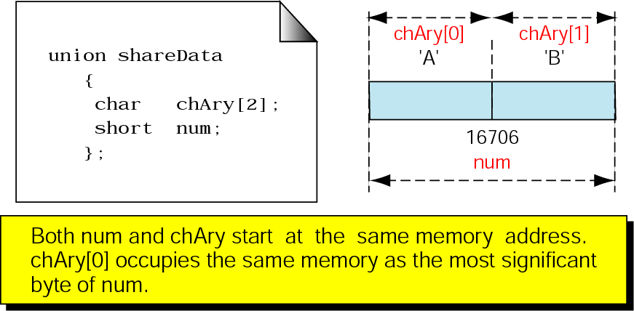
Figure 11-8 Unions

Slide 30
11.10
Enumerated Types

Slide 31
11.11
The Type Definition (typedef)

Slide 32
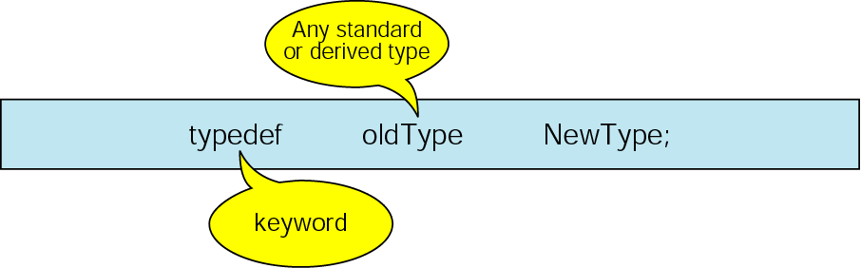
Figure 11-9 Typed definition format

Slide 33
Note:
The typedef command does not create a new type. It just creates an alias, that is, a new name, for an existing type.

Slide 34
11.12
Programming Applications

Slide 35
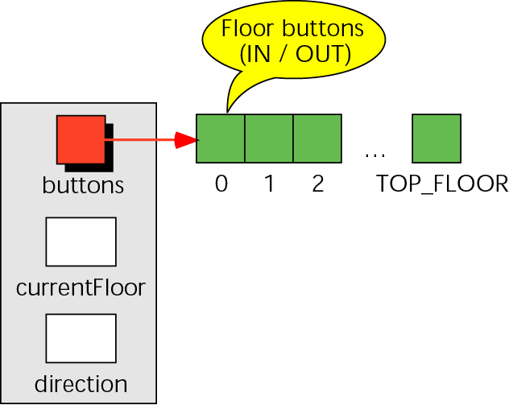
Figure 11-10 Elevator structure

Slide 36
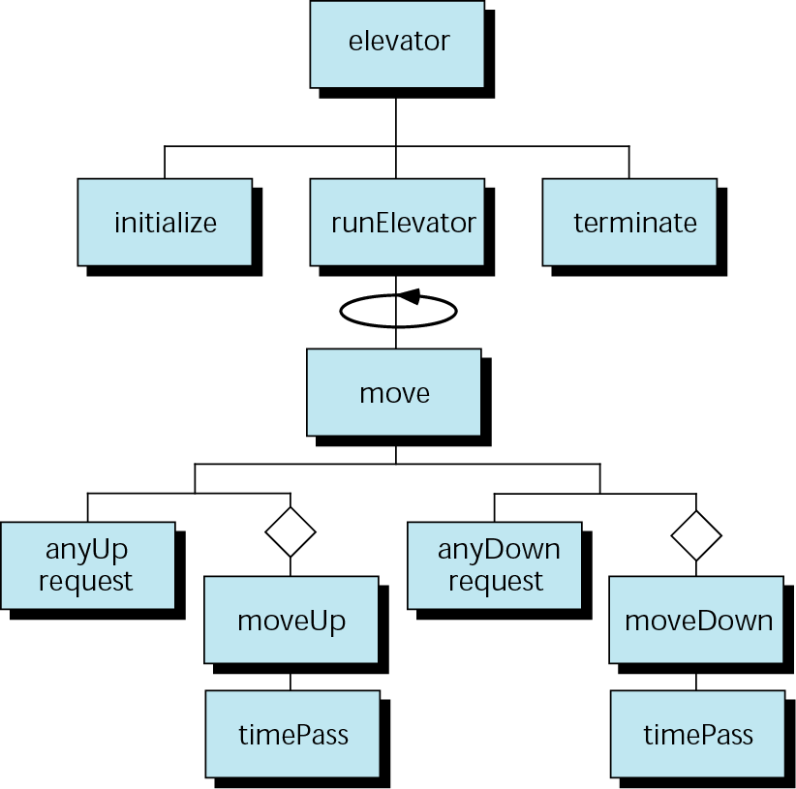
Figure 11-11 Elevator structure chart

Slide 37
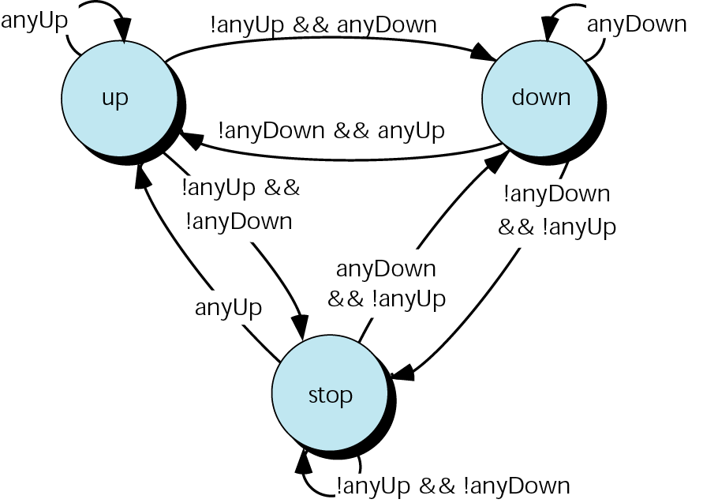
Figure 11-12 Elevator states

Slide 38
11.13
Software Engineering and programming style

Slide 39
Note:
Functions in well-structured programs are highly cohesive and loosely coupled.

Slide 40
Note:
Stamp coupling should pass only the data needed.

Slide 41
Note:
Avoid bundling unrelated data just to reduce the number of parameters being passed between functions.

Slide 42
Note:
Control coupling should be used only to pass status.

Slide 43
Note:
Avoid global coupling within a program.

Slide 44
Note:
Never use content coupling.

Slide 45
Note:
Programming Standard:
Do not place any variables in the global area of a program.

