Slide 1
Chapter 12
Inheritance
and
Aggregation

Slide 2
OBJECTIVES
After studying this chapter you will be able to:
 Create a derived class from a base class.
 Use the private, protected, and public access types.
 Override a member function defined in the base class.
 Use dynamic binding to bind a function to an object during run time.
 Use polymorphism to create different functions with the same name.
 Understand how to use pure virtual functions in an abstract.
 Use upcasting and downcasting to cast base classes and derived classes.
 Use aggregation to create a class object that contains other object(s).
 Understand and describe the seven types of cohesion.

Slide 3

12.1
Inheritance

Slide 4
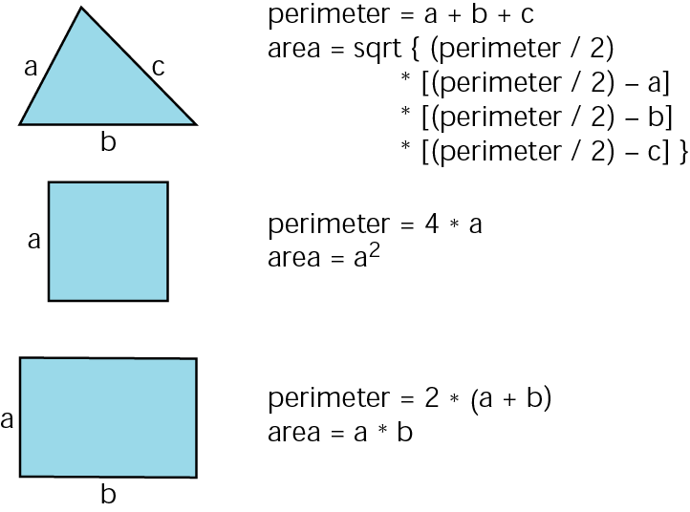
Figure 12-1 Simple polygons

Slide 5
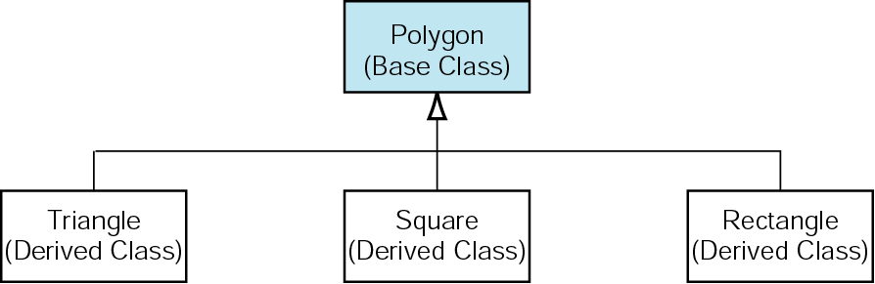
Figure 12-2 Base and derived classes

Slide 6
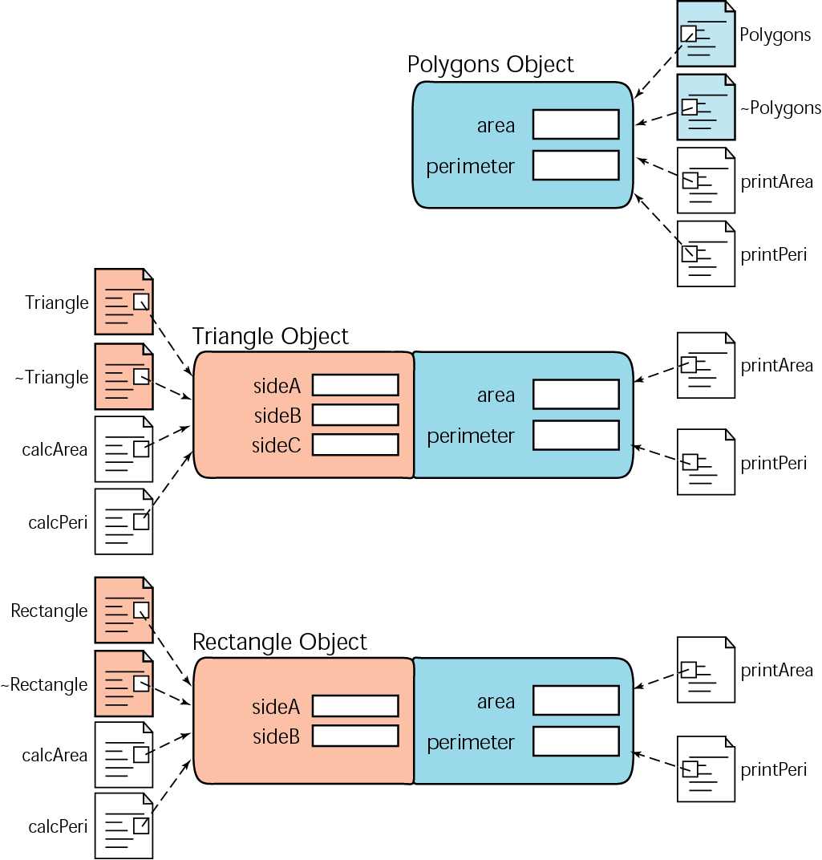
Figure 12-3 Inheritance

Slide 7
Note:
Constructors, destructors, nonmember functions, assignment operators, and virtual methods are not inherited in a derived class. If needed, they must be created.

Slide 8
12.2
Private, Protected, Public

Slide 9
Note:
The combination of the base class access type and the inheritance type determines if and how the base class data and functions can be accessed by the derived class.

Slide 10
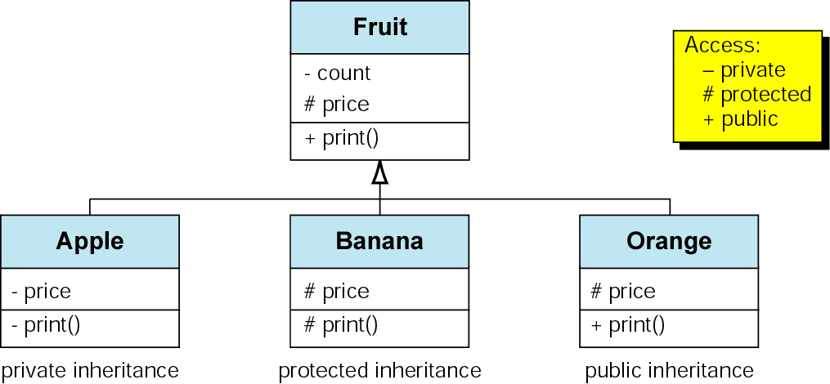
Figure 12-4 Inheritance example

Slide 11
Figure 12-5 Overriding access specifier
class B
{
protected:
int datum;
public:
void print();
...
}; // B
class D : private B
{
protected:
using B :: datum;
...
}; // D
class B
{
protected:
int datum;
public:
void print();
...
}; // B
class D : private B
{
protected:
using B :: datum;
...
}; // D

Slide 12
12.3
Manager Functions Under Inheritance

Slide 13
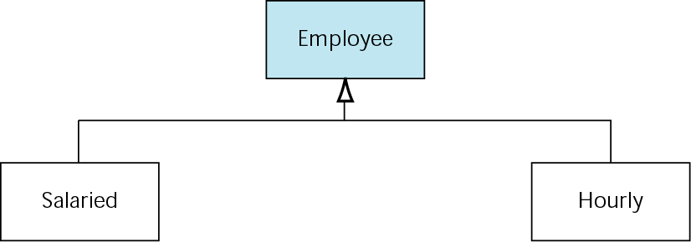
Figure 12-6 Employee class design

Slide 14
12.4
Overriding Member Functions

Slide 15
12.5
Polymorphism

Slide 16
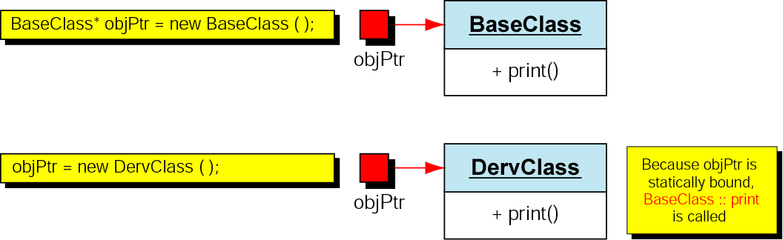
Figure 12-7 Static function binding

Slide 17
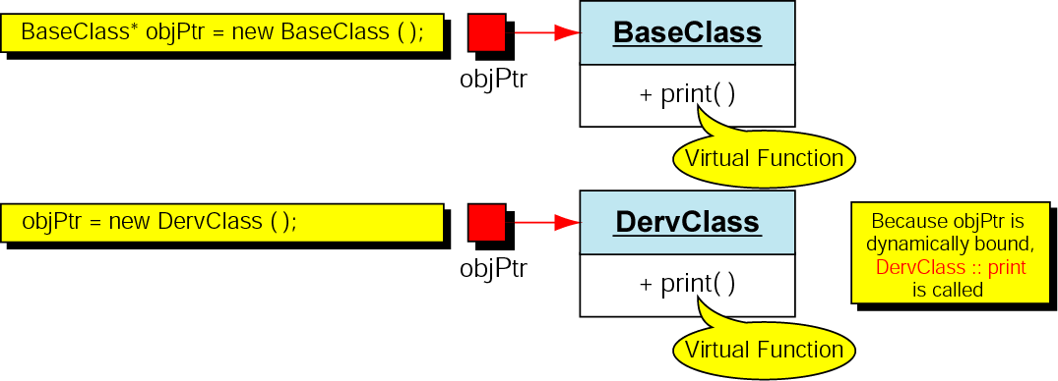
Figure 12-8 Dynamic binding through polymorphism

Slide 18
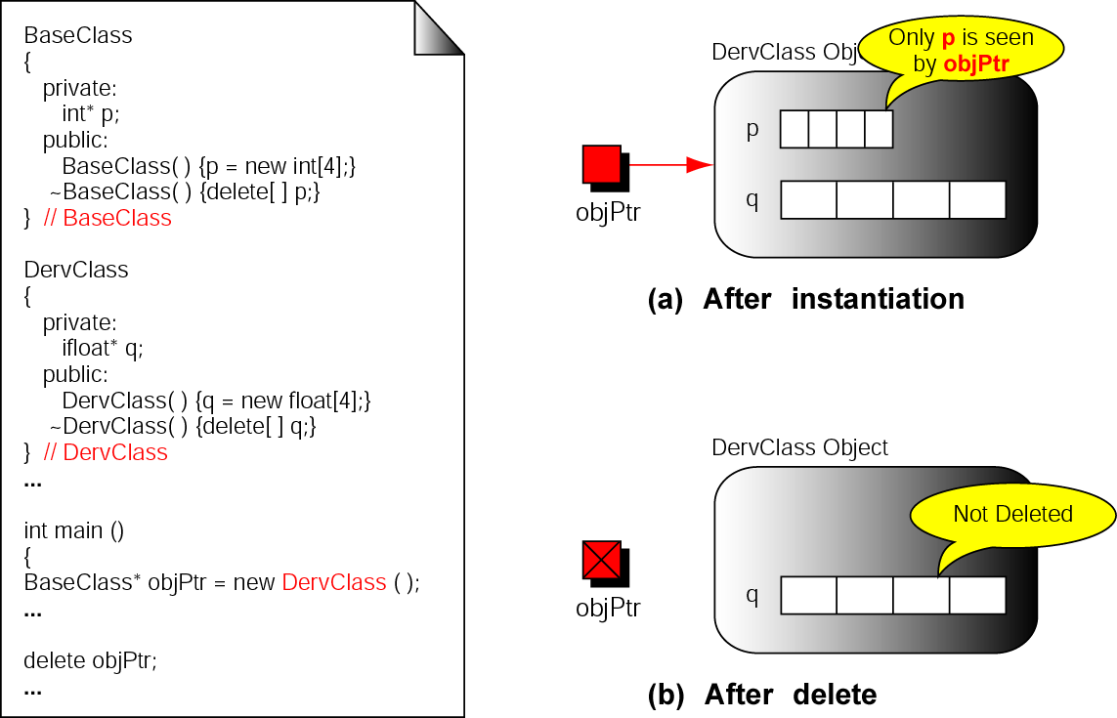
Figure 12-9 Virtual destructors

Slide 19
12.6
Pure Virtual Functions: Abstract Classes

Slide 20
Note:
An abstract class combines the idea of inheritance, polymorphism, and modeling.

Slide 21
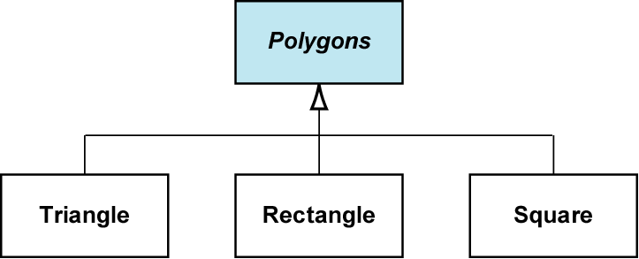
Figure 12-10 Abstract polygon class design

Slide 22
12.7
Type Conversion in Hierarchical Classes

Slide 23
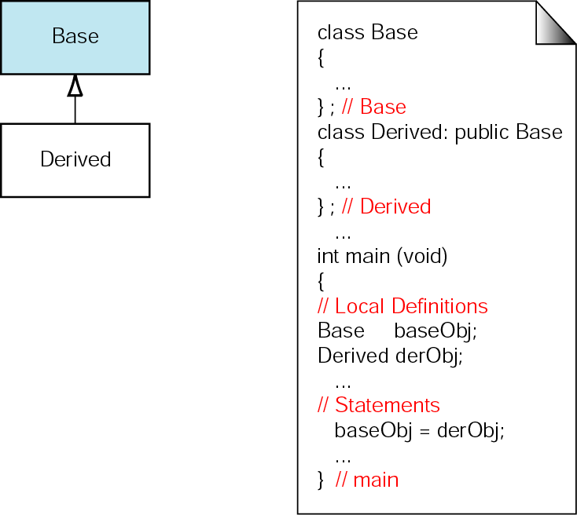
Figure 12-11 Upcasting objects

Slide 24
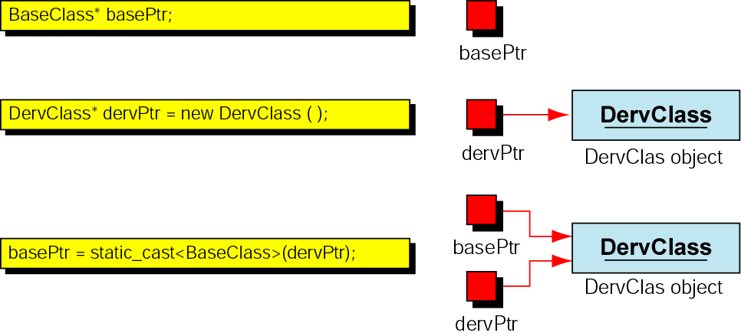
Figure 12-12 Upcasting objects

Slide 25
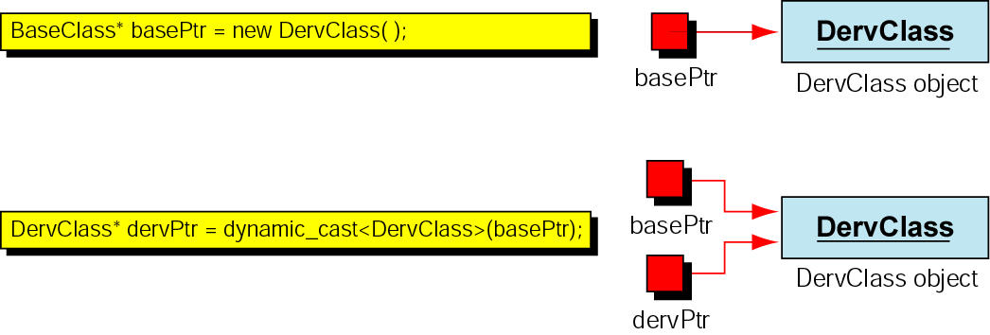
Figure 12-13 Valid downcasting

Slide 26
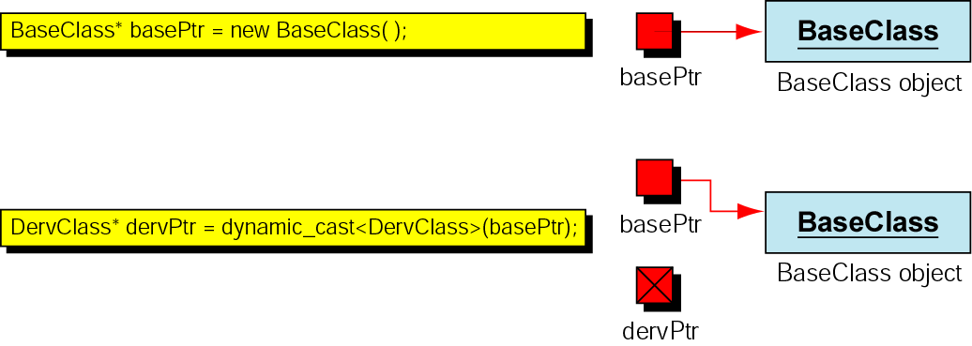
Figure 12-14 Invalid downcasting

Slide 27
12.8
Multiple Inheritance

Slide 28
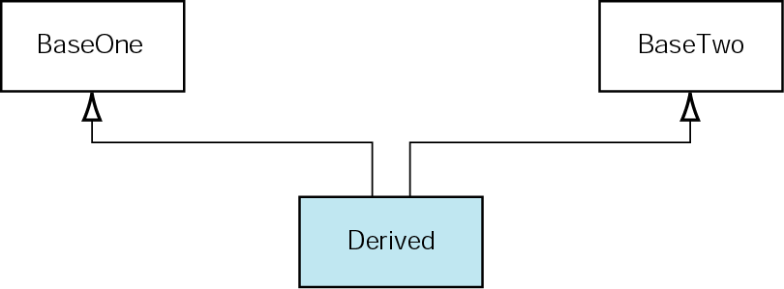
Figure 12-15 Multiple inheritance

Slide 29
12.9
Aggregation

Slide 30
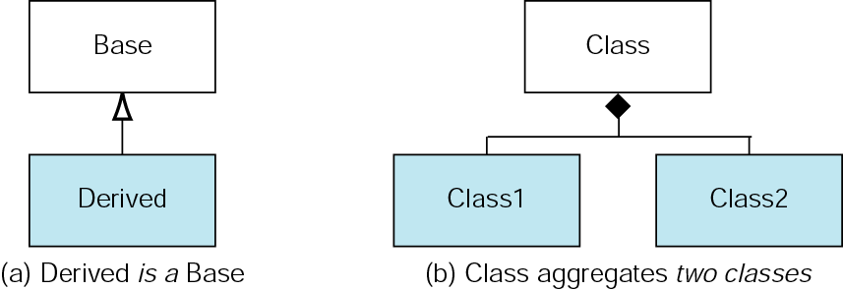
Figure 12-16 Aggregation

Slide 31
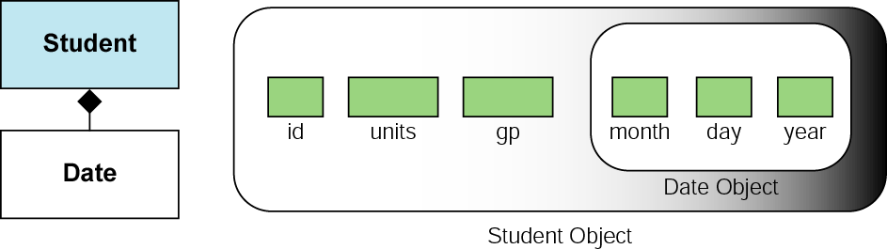
Figure 12-17 Student class

Slide 32
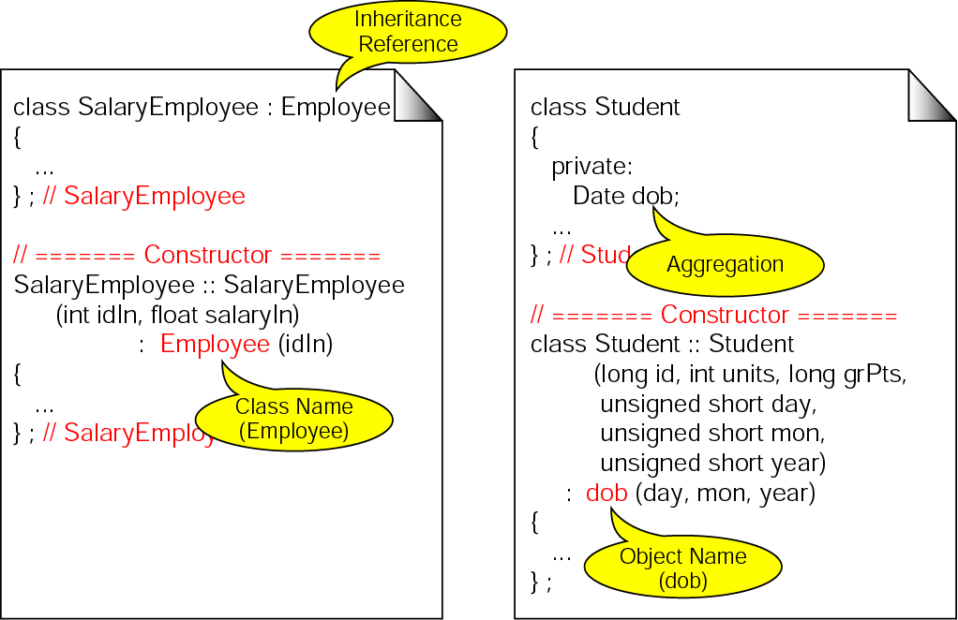
Figure 12-18 Instantiating an object

Slide 33
12.10
Software Engineering and Programming Style

Slide 34
Note:
Hiding implies that effective modularity can be achieved by defining a set of independent modules that communicate with one another only that information necessary to achieve software function. . . . Hiding defines and enforces access constraints to both procedural detail within a module and any local data structure used by the module.

Slide 35
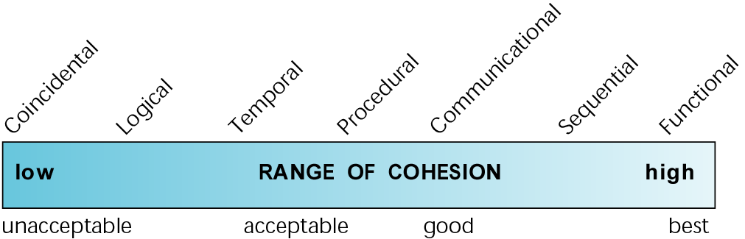
Figure 12-19 Types of cohesion

Slide 36
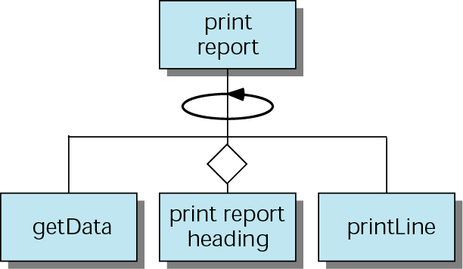
Figure 12-20 Example of functional cohesion

Slide 37
Note:
Well-structured programs are highly cohesive and loosely coupled.

