Slide 1
Chapter 15
Exception
Handling

Slide 2
OBJECTIVES
After studying this chapter you will be able to:
 Use the C++ exception handler.
 Use a throw statement to raise an exception.
 Use the try and catch statements to handle exceptions.
 Use a generic catch statement to catch any type of exception.
 Create an object to throw exceptions.
 Limit the types of exceptions that can be caught.
 Modify the default behavior of unexpected function.
 Modify the behavior of terminate function in a program.
 Use the C++ exception classes.

Slide 3

15.1
Handling Errors

Slide 4
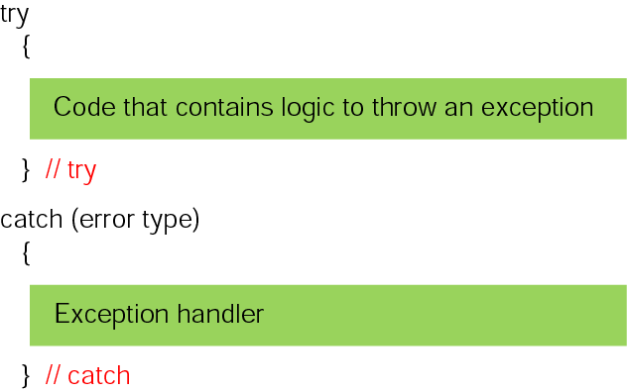
Figure 15-1 The try and catch statements

Slide 5
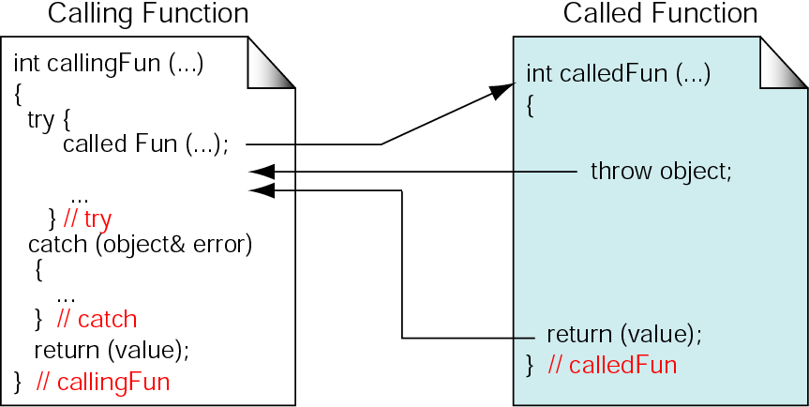
Figure 15-2 Throwing an exception in a separate function

Slide 6
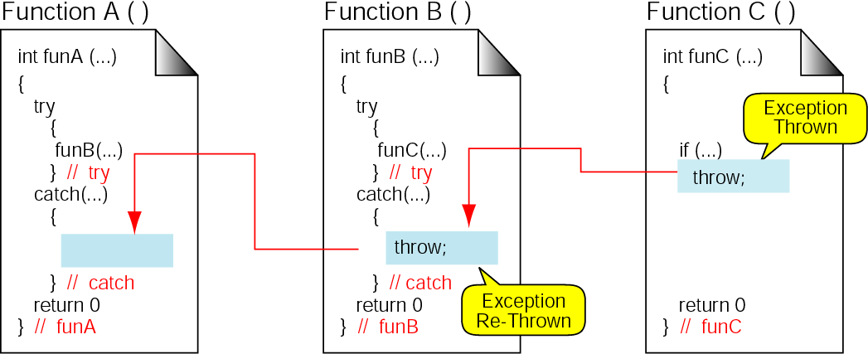
Figure 15-3 Re-throwing an exception

Slide 7
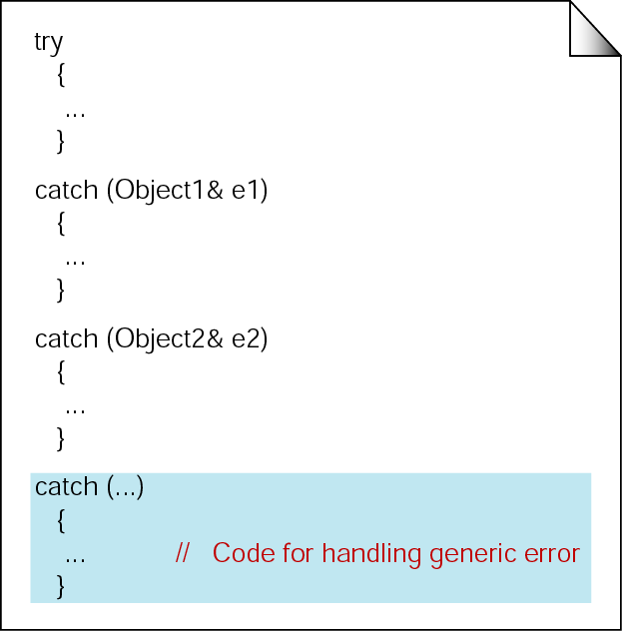
Figure 15-4 Generic exception handler

Slide 8
15.2
Exception Handling Classes

Slide 9
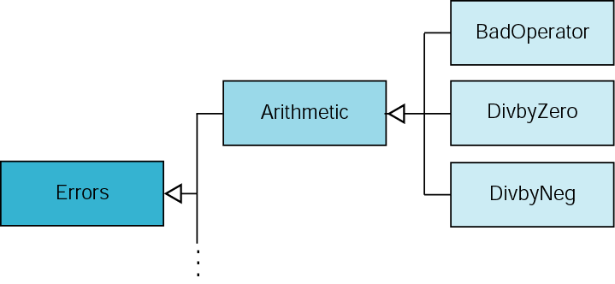
Figure 15-5 Error class design

Slide 10
15.3
Exception Specification

Slide 11
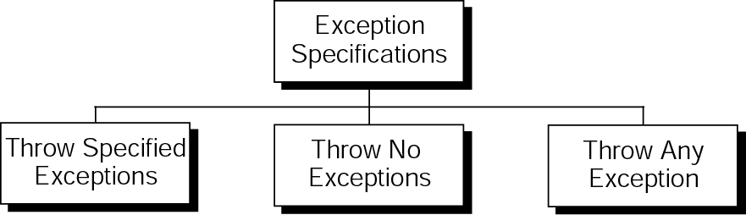
Figure 15-6 Exception specifications

Slide 12
15.4
Exceptions In Classes

Slide 13
15.5
Standard Exceptions

Slide 14
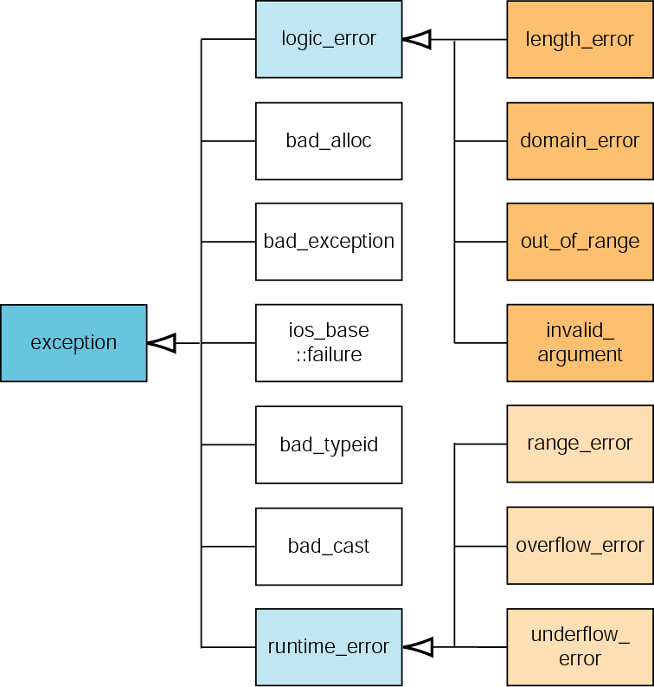
Figure 15-7 Standard exceptions

Slide 15
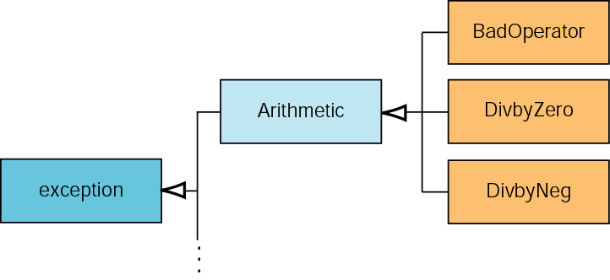
Figure 15-8 Adding errors to standard error class

Slide 16
15.6
Software Engineering and Programming Style

