Slide 1
Chapter 16
Advanced
I/O Concepts

Slide 2
OBJECTIVES
After studying this chapter you will be able to:
 Understand and explain the differences between text and binary files.
 Understand and explain the three file states (read, write, error).
 Read and write binary files.
 Use a seek function to set the file position to a specified location.
 Describe the basic file update concept.
 Write a program to update a sequential file.

Slide 3

16.1
Input/Output Classes

Slide 4
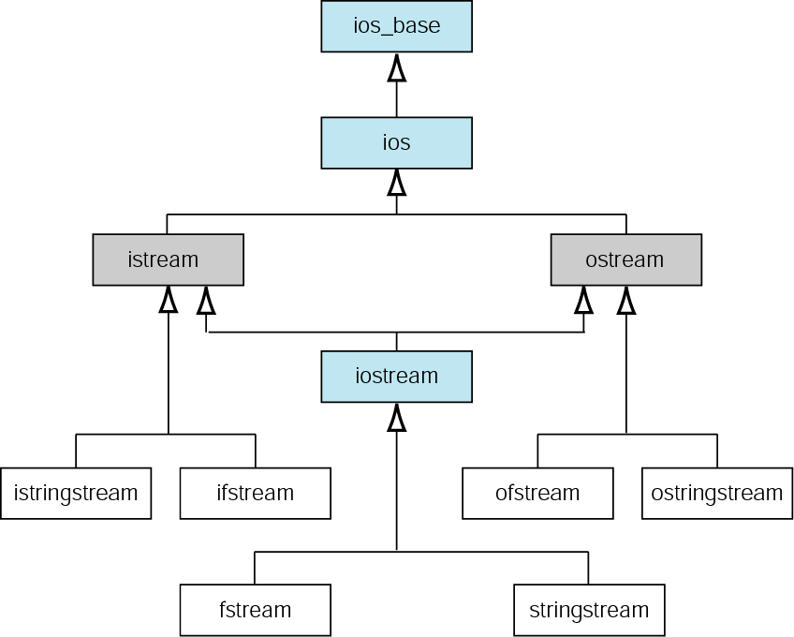
Figure 16-1 Input/output classes

Slide 5
16.2
File States

Slide 6
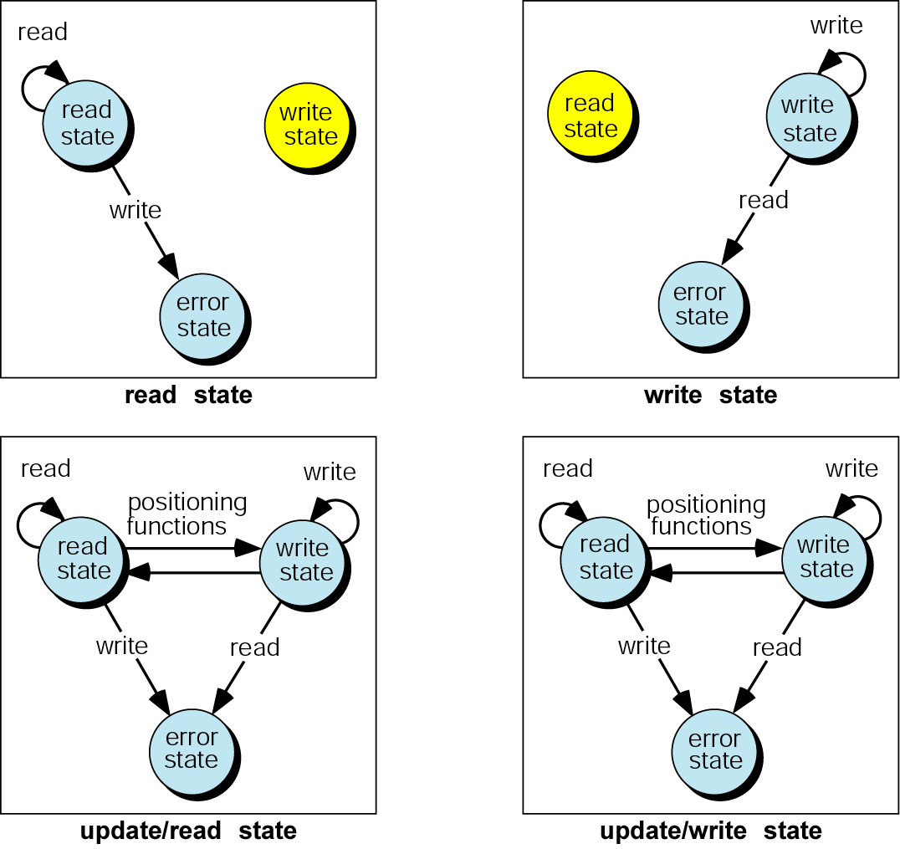
Figure 16-2 File states

Slide 7
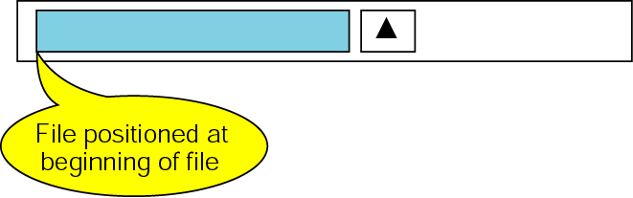
Figure 16-3 Open file in read state

Slide 8
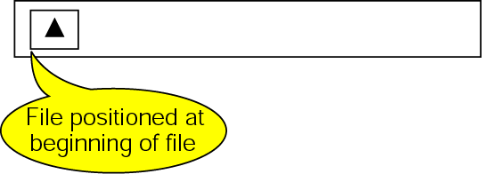
Figure 16-4 File open in write state

Slide 9
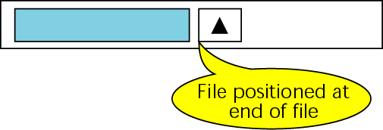
Figure 16-5 File open in write/append state

Slide 10
16.3
Text and Binary Files

Slide 11
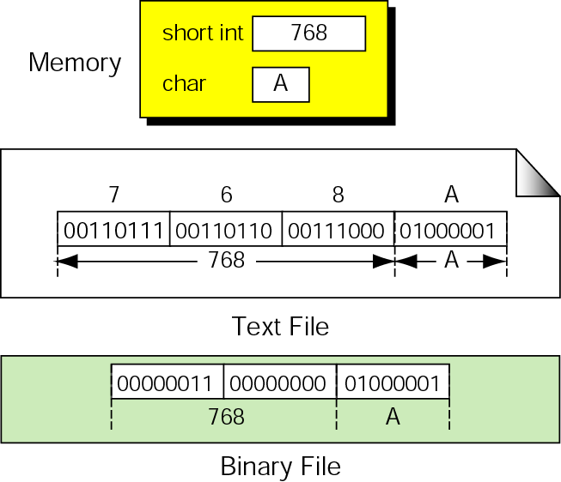
Figure 16-6 Binary and text files

Slide 12
16.4
Standard Library Functions for Files

Slide 13
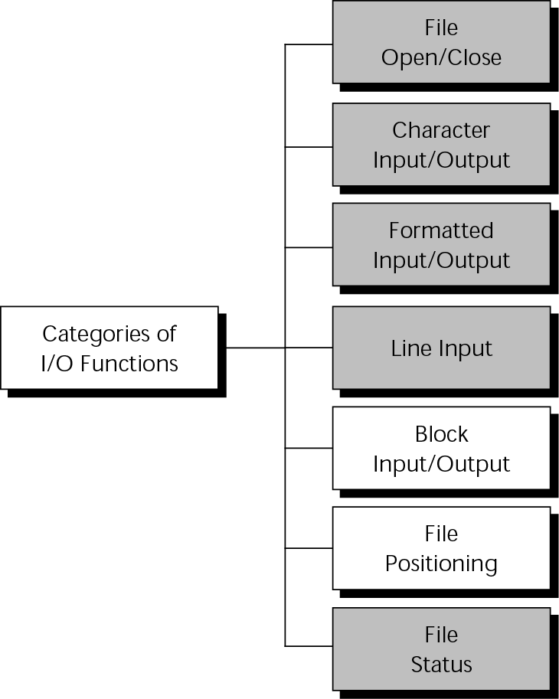
Figure 16-7 Types of standard input/output functions

Slide 14
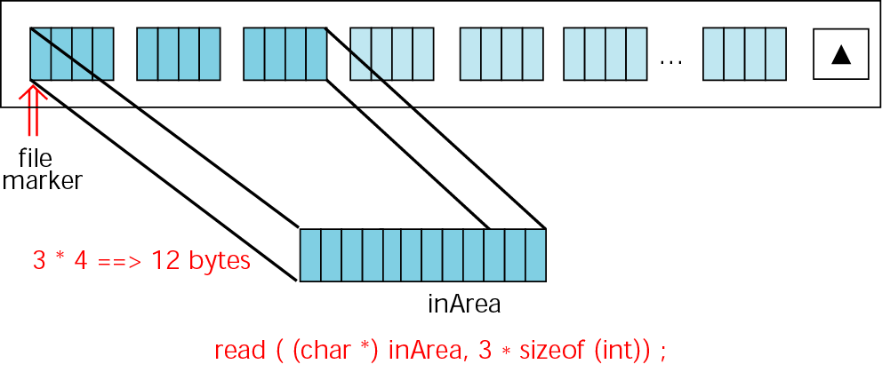
Figure 16-8 read operation

Slide 15
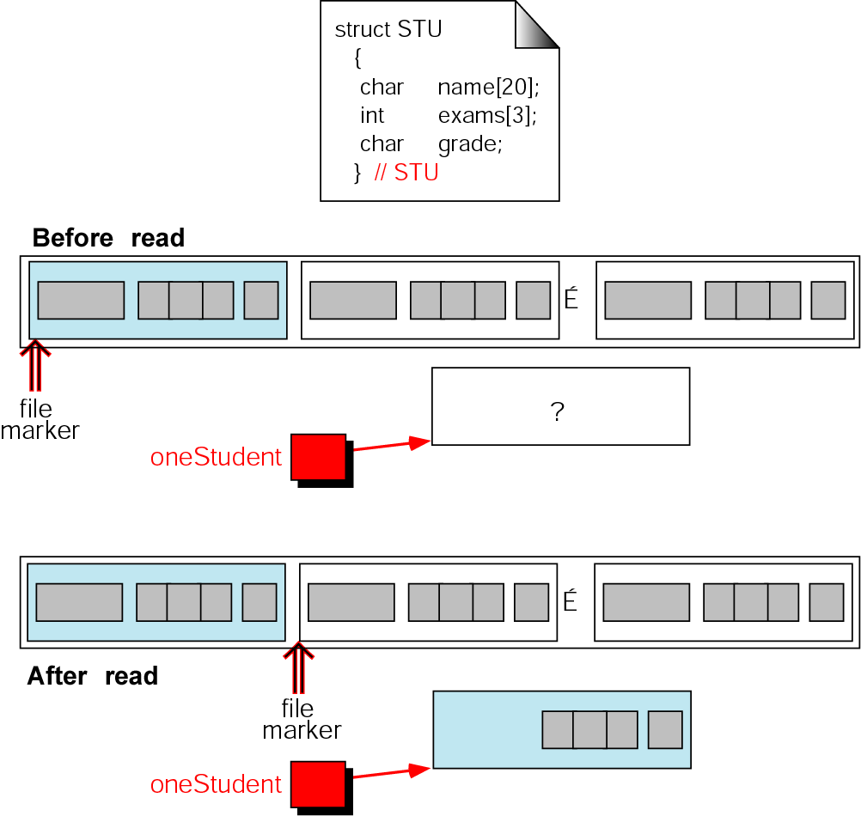
Figure 16-9 Reading a structure

Slide 16
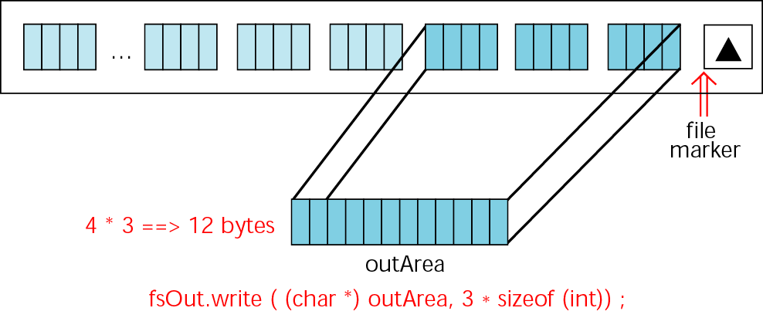
Figure 16-10 write operation

Slide 17
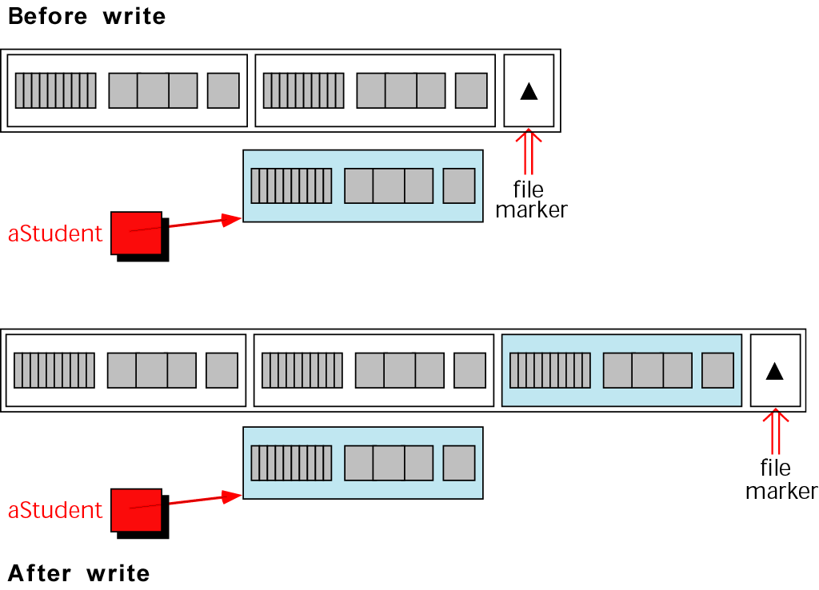
Figure 16-11 Writing a structure

Slide 18
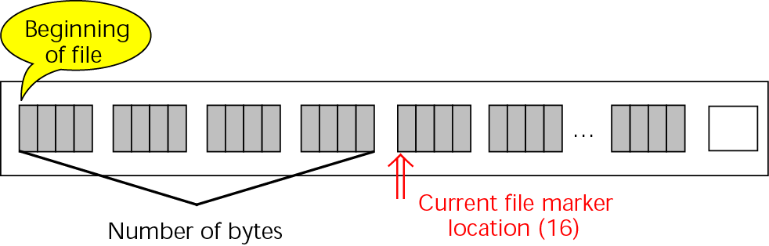
Figure 16-12 tell operation

Slide 19
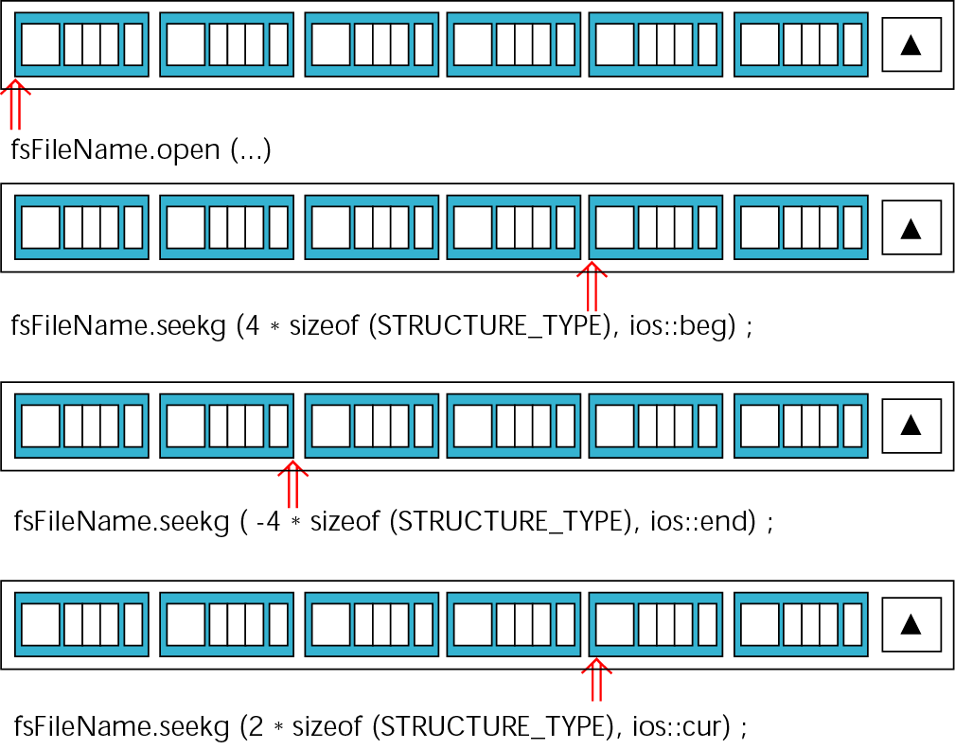
Figure 16-13 seek operation

Slide 20
16.5
Converting File Types

Slide 21
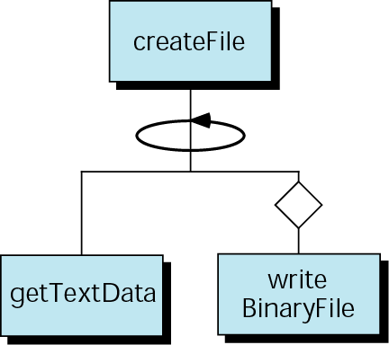
Figure 16-14 Create binary file structure chart

Slide 22
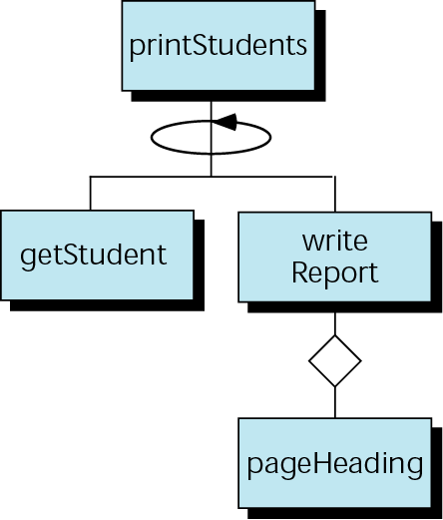
Figure 16-15 Design for print student data

Slide 23
16.6
String Streams

Slide 24
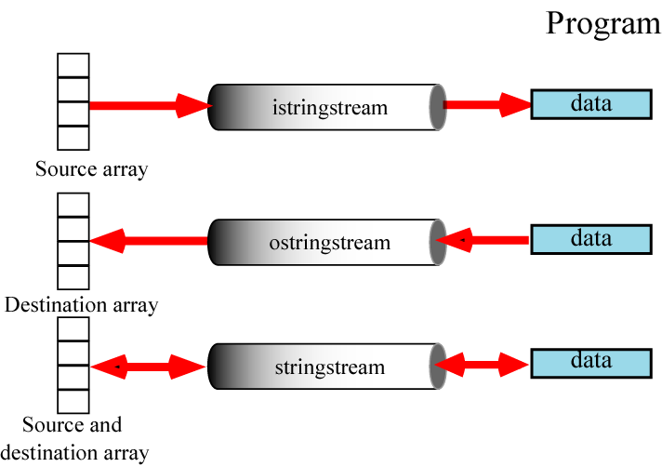
Figure 16-16 Stringstream objects

Slide 25
16.7
File Program Examples

Slide 26
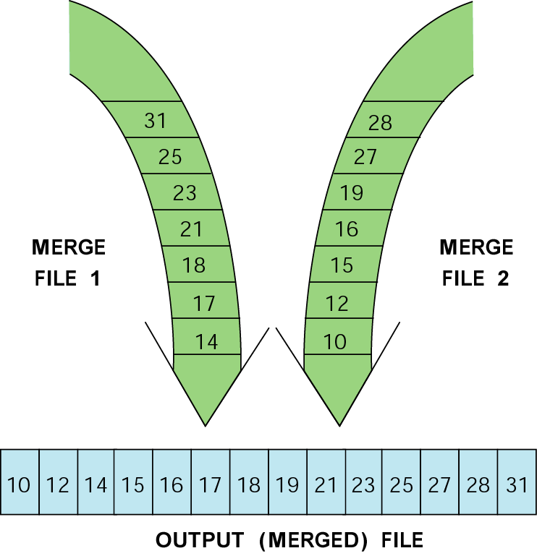
Figure 16-17 File merge concept

Slide 27
16.8
Software Engineering and Programming Style

Slide 28
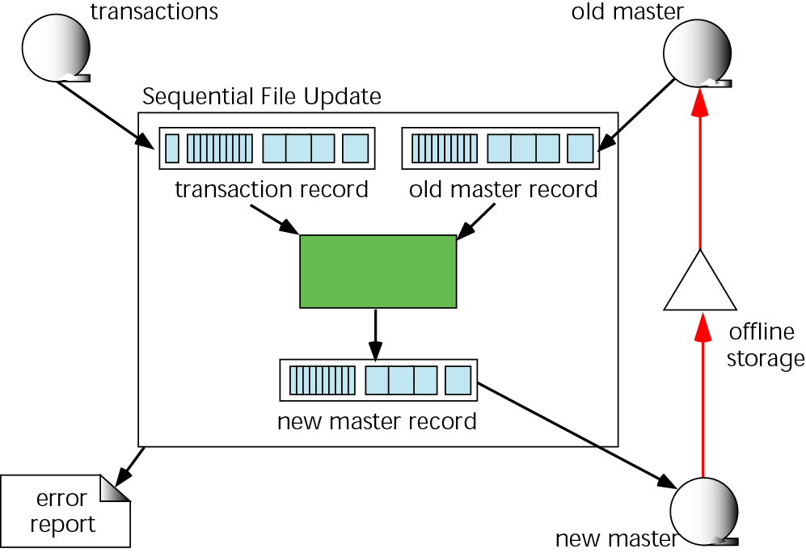
Figure 16-18 Sequential file update environment

Slide 29
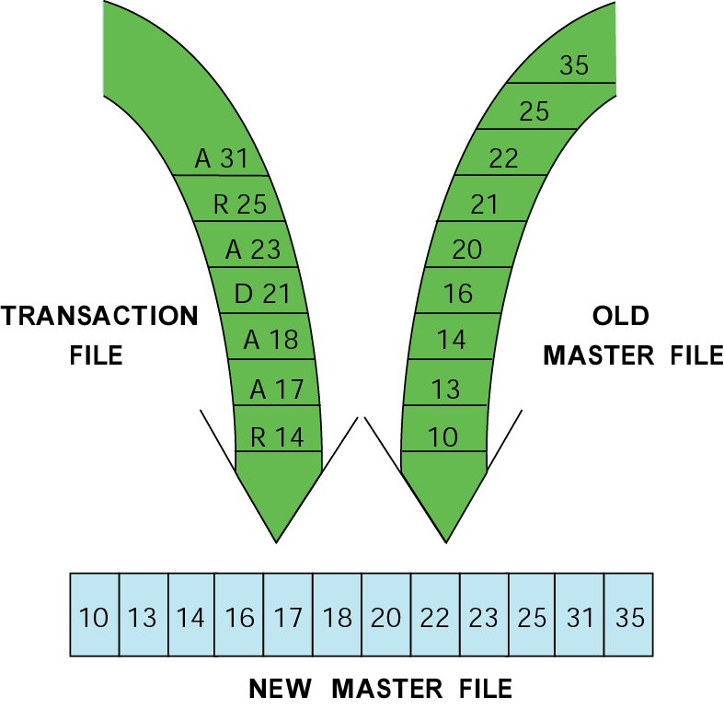
Figure 16-19 File updating example

Slide 30
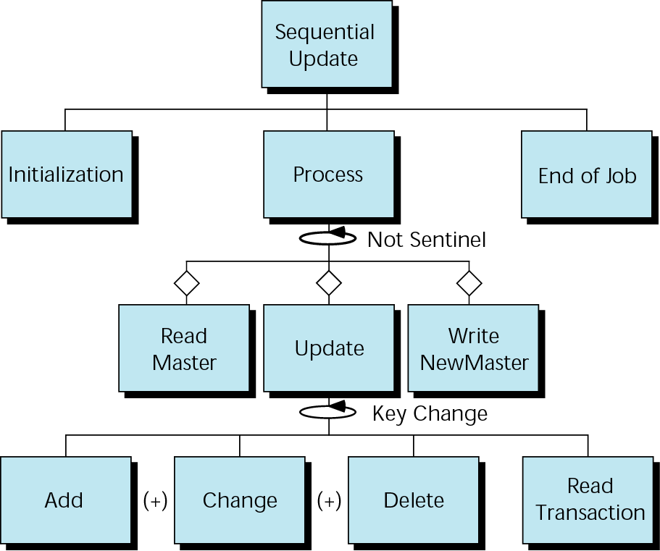
Figure 16-20 Update structure chart

