Slide 1
Chapter 1
Introduction
to
Computers

Slide 2
OBJECTIVES
After studying this chapter you will be able to:
❑ Identify the components of a computer system.
❑ Identify the components of system and application software.
❑ Trace the evolution of programming languages.
❑ Place program development in the system development life cycle.
❑ Differentiate between blackbox and whitebox testing.
❑ Understand the role of software engineering in system development.

Slide 3

1.1
Computer
Systems

Slide 4
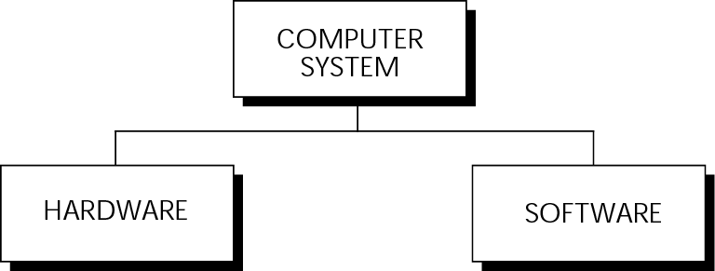
Figure 1-1 A computer system

Slide 5
1.2
Computer Hardware

Slide 6
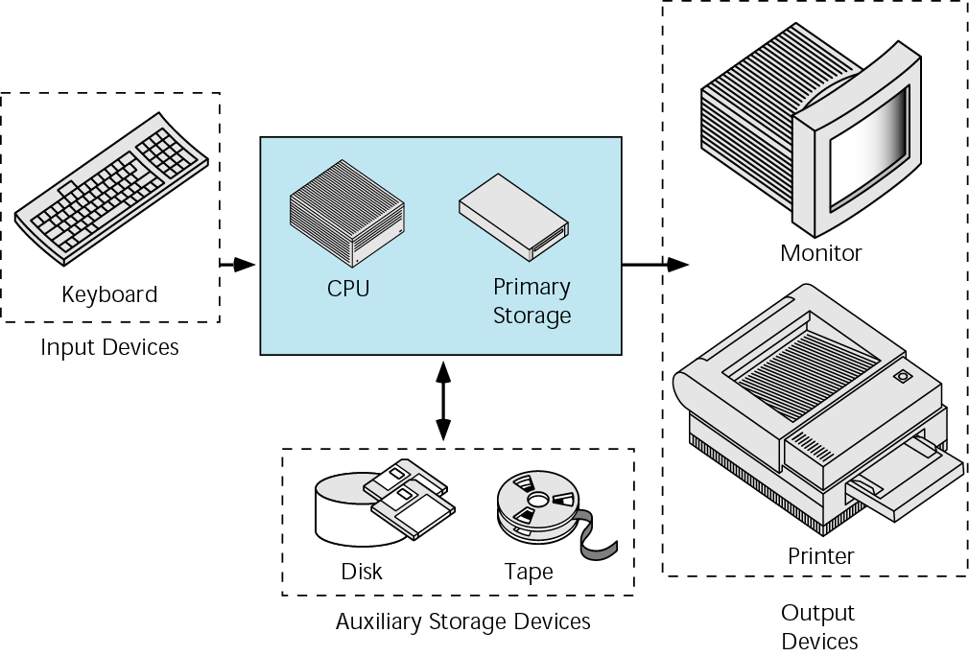
Figure 1-2 Basic hardware components

Slide 7
1.3
Computer Software

Slide 8
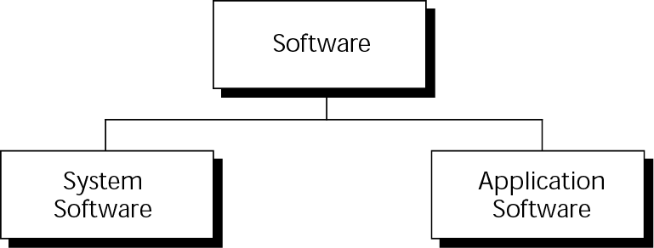
Figure 1-3 Types of software

Slide 9
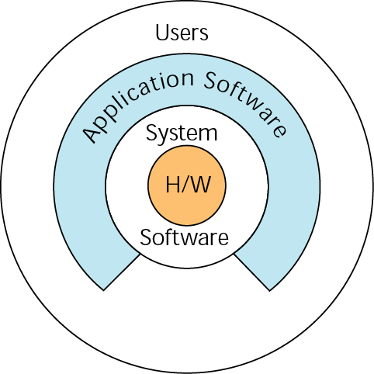
Figure 1-4 Software

Slide 10
1.4
Computing Environments

Slide 11
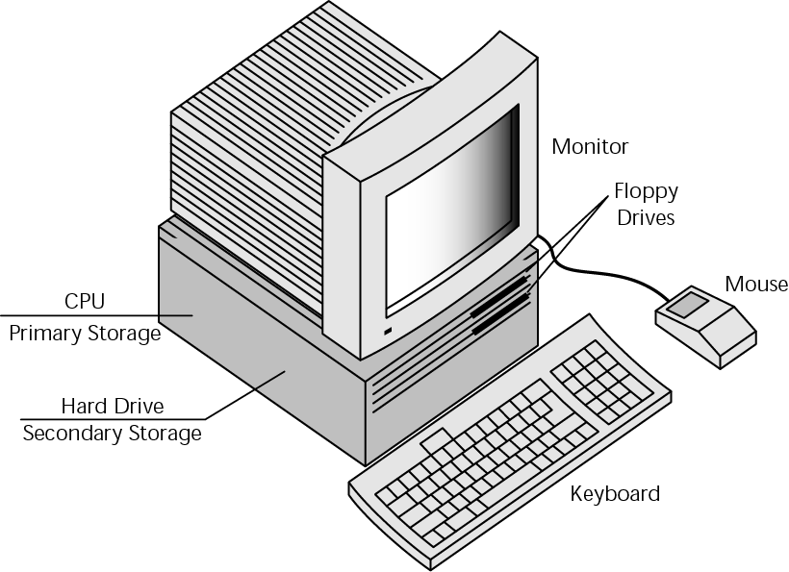
Figure 1-5 Personal computing environment

Slide 12
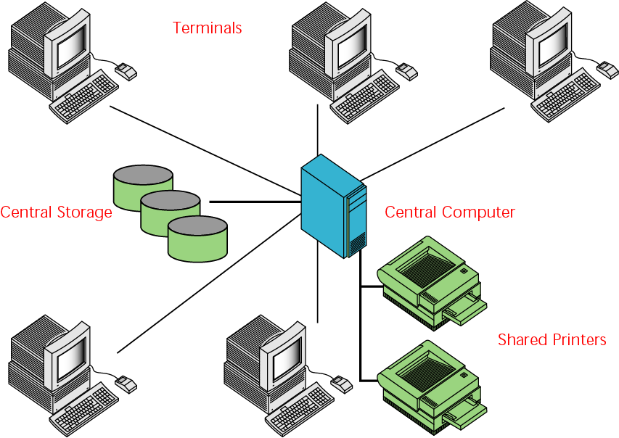
Figure 1-6 Time-sharing environment

Slide 13
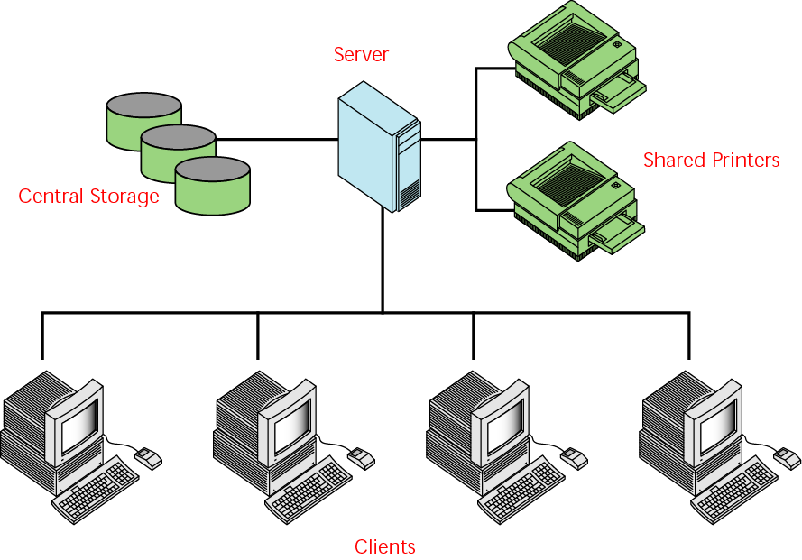
Figure 1-7 Time-sharing environment

Slide 14
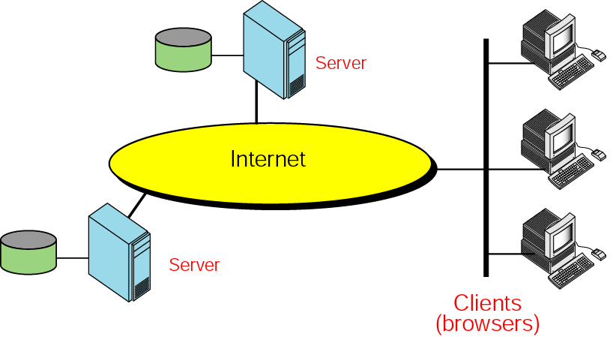
Figure 1-8 Distributed computing

Slide 15
1.5
Computer Languages

Slide 16
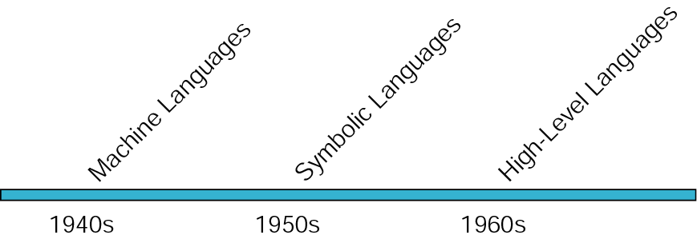
Figure 1-9 Computer language evolution

Slide 17
Note:
The only language understood by a computer is machine language.

Slide 18
1.6
Writing, Editing, Compiling,
and Linking Programs

Slide 19
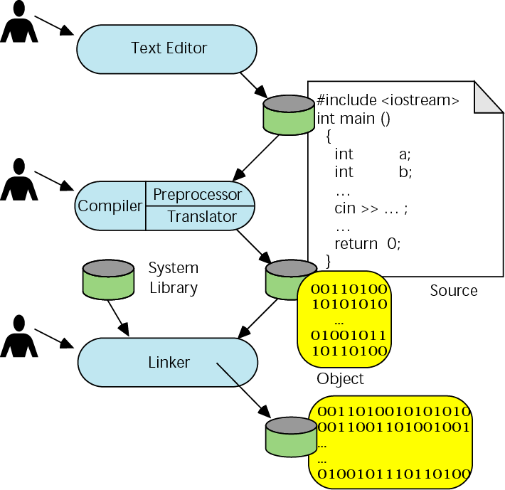
Figure 1-10 Building a C++ program

Slide 20
1.7
Program Execution

Slide 21
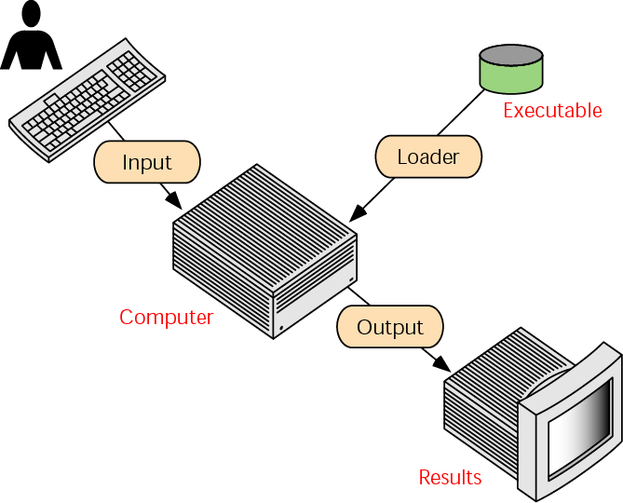
Figure 1-11 Executing programs

Slide 22
1.8
System Development

Slide 23
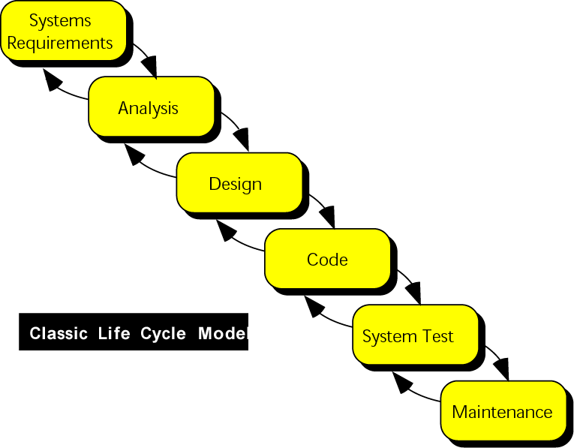
Figure 1-12 System development model

Slide 24
Note:
An old programming proverb:
Resist the temptation to code.

Slide 25
Note:
Pseudocode
A precise algorithmic description of program logic.

Slide 26
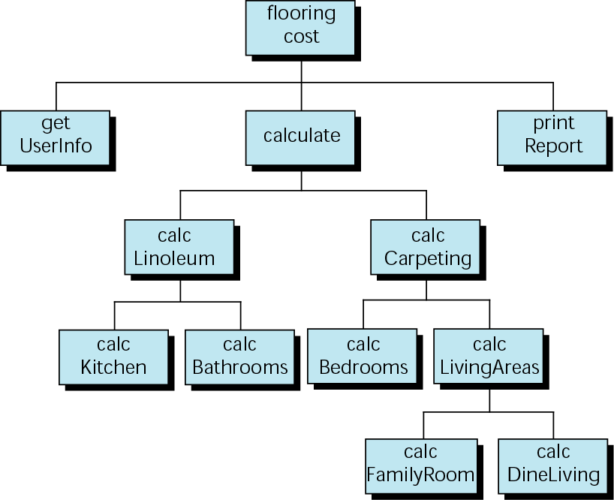
Figure 1-13 Structure chart for calculating footage

Slide 27
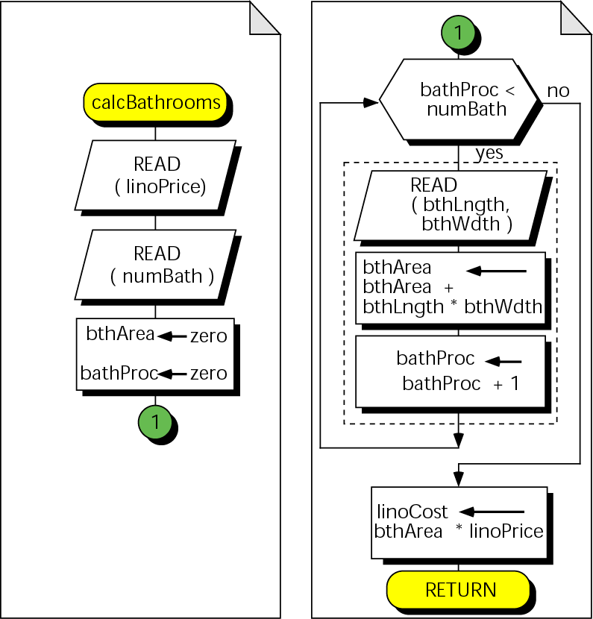
Figure 1-14 Flowchart for calcBathrooms

Slide 28
Note:
One set of test data
will never completely validate a program.

Slide 29
1.9
Software Engineering and Programming Style

