Slide 1
Chapter 4
Functions

Slide 2
OBJECTIVES
After studying this chapter you will be able to:
 Structure a program into functions designed to do a specific task.
 Understand the relationship between parameters and arguments
 Understand the concept of local variables.
 Pass data to a function using pass-by-value or pass-by-reference.
 Use a structure chart to design a program.
 Write function prototype statements.
 Write programs with multiple functions.
 Use mathematical and standard library functions in programs.
 Understand the concept of scope in a C++ program.
 Understand the basic concept of functional cohesion.
 Implement a program using top-down development and stubs.

Slide 3

4.1
Designing Structured
Programs

Slide 4
Note:
In top-down design, a program is divided into a main module and its related modules. Each module is in turn divided into submodules until the resulting modules are intrinsic; that is, until they are implicitly understood without further division.

Slide 5
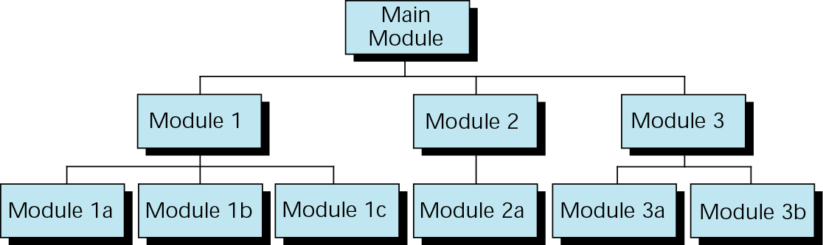
Figure 4-1 Structure chart

Slide 6
Note:
In a structure chart, a module can be called by one and only one higher module.

Slide 7
4.2
Functions
in
C++

Slide 8
Note:
In C++, a program is made of one or more functions, one and only one of which must be named main. The execution of the program always starts with main, but it can call other functions to do some part of the job.

Slide 9
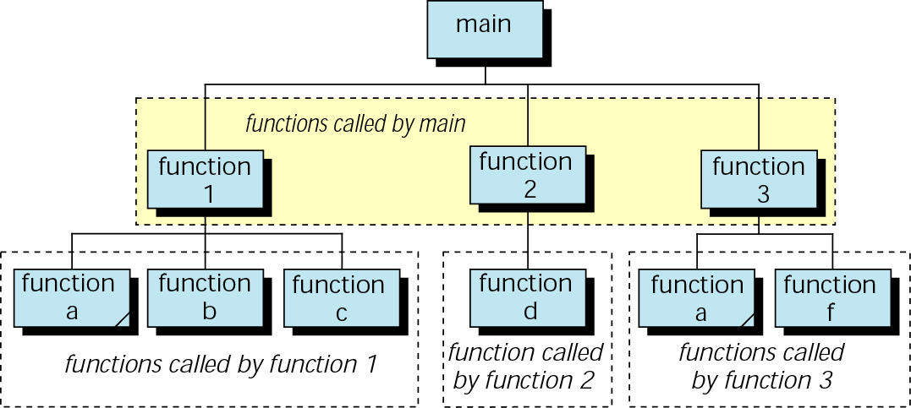
Figure 4-2 Structure chart for a C++ program

Slide 10
Note:
A function in C++ can have a value, a side effect, or both.
The side effect occurs before the value is
returned.
The function’s value is the value of the
expression in the return statement.
A function can be called for its value, its
side effect, or both.

Slide 11
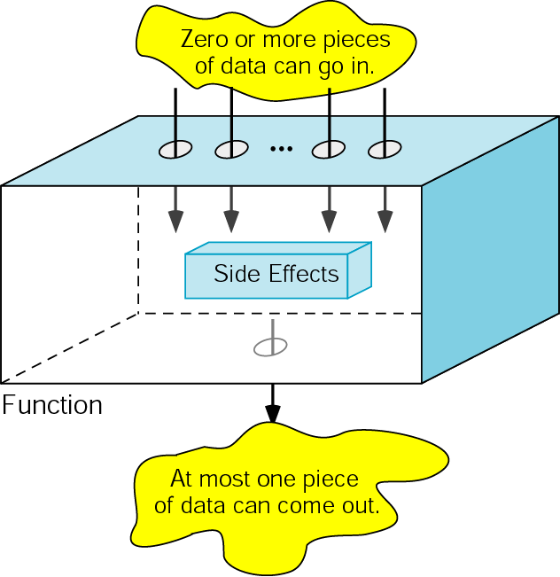
Figure 4-3 Function concept

Slide 12
4.3
User-Defined
Functions

Slide 13
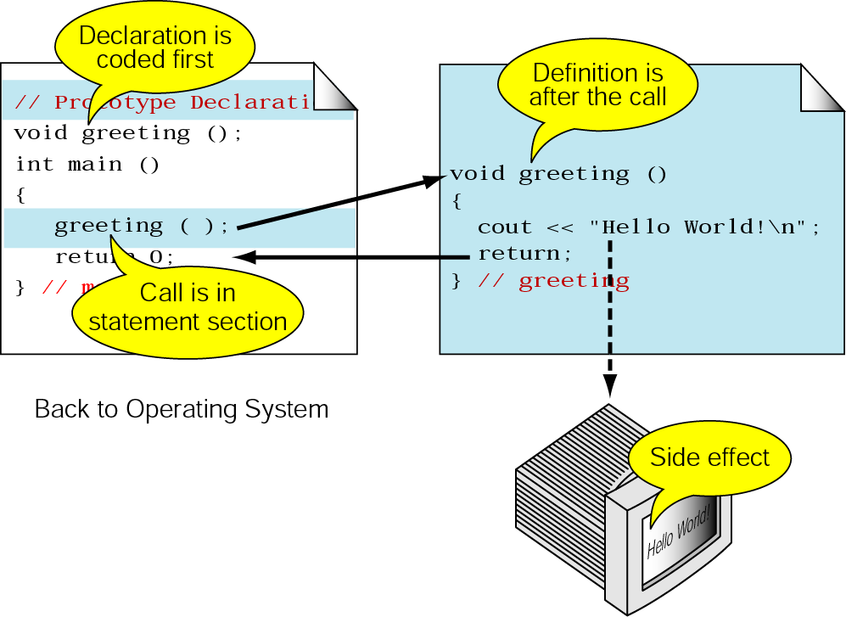
Figure 4-4 Declaring, calling, and defining functions

Slide 14
Note:
The name of a function is used in three ways: for declaration, in a call, and for definition.

Slide 15
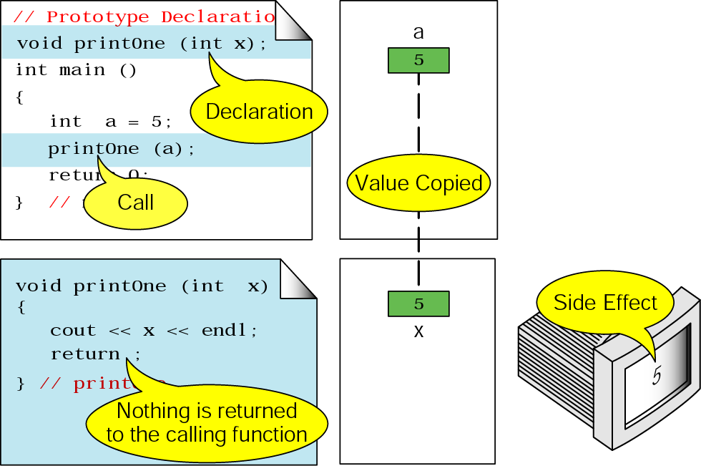
Figure 4-5 void function with parameters

Slide 16
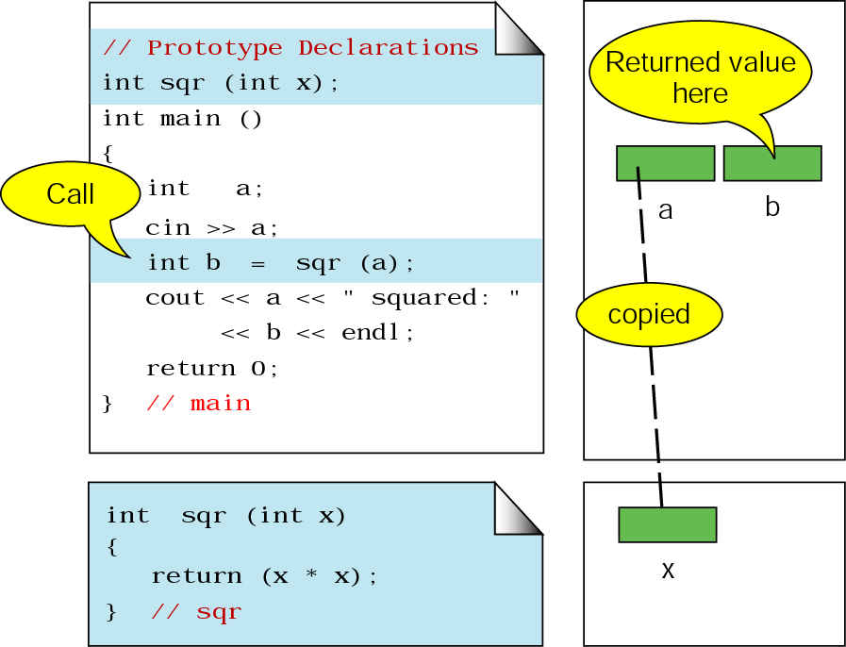
Figure 4-6 Calling a function that returns a value

Slide 17
Note:
void functions cannot be used in an expression; they must be a separate statement.
Functions that return a value may be used in an expression or as a separate statement.

Slide 18
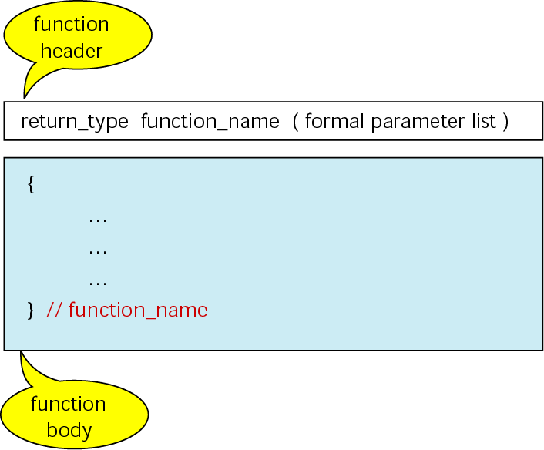
Figure 4-7 Function definition

Slide 19
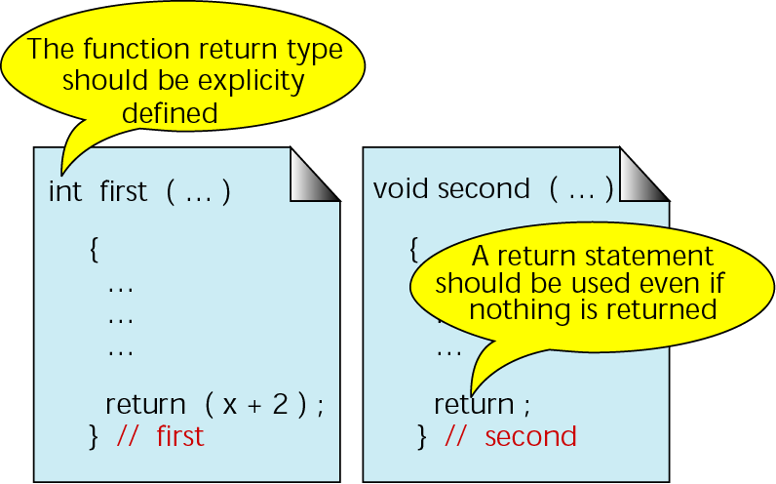
Figure 4-8 Function return statements

Slide 20
Note:
The type of the expression in the return statement must match the return type in the function header.

Slide 21
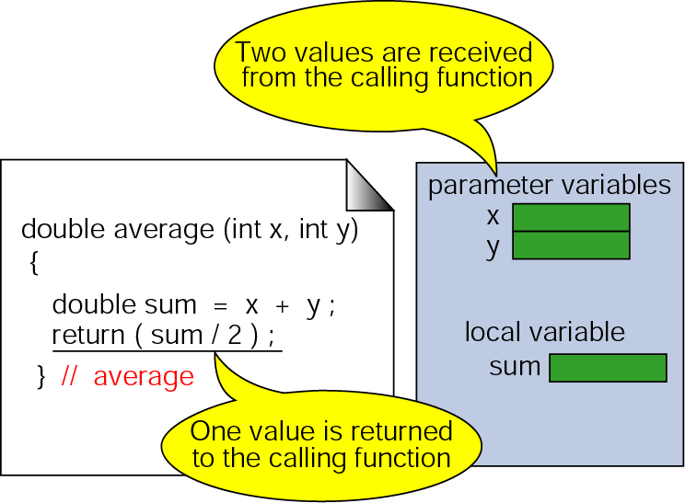
Figure 4-9 Function local variables

Slide 22
Note:
Formal parameters are variables that are
declared in the header of the function
definition.
Actual parameters are the expressions in
the calling statement.
The formal and actual parameters must
match exactly in type, order, and number.
Their names, however, do not need to be
the same.

Slide 23
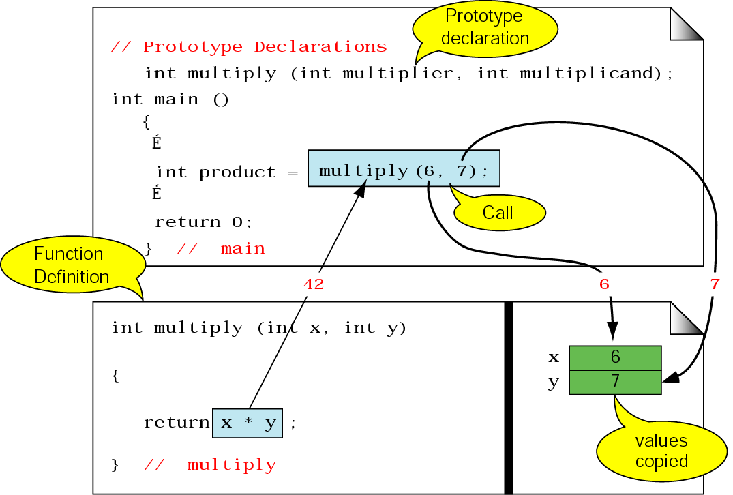
Figure 4-10 Parts of a function call

Slide 24
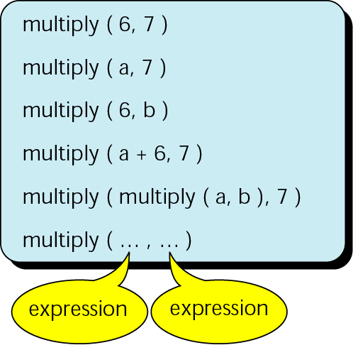
Figure 4-11 Examples of function calls

Slide 25
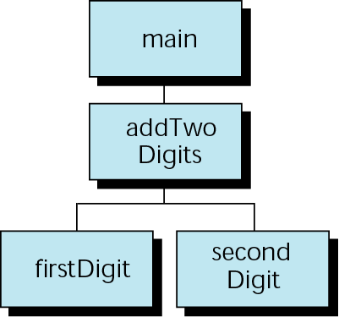
Figure 4-12 Design for addTwoDigits

Slide 26
Note:
It is the nature of the task to be performed, not the amount of code, that determines if a function
should be used.

Slide 27
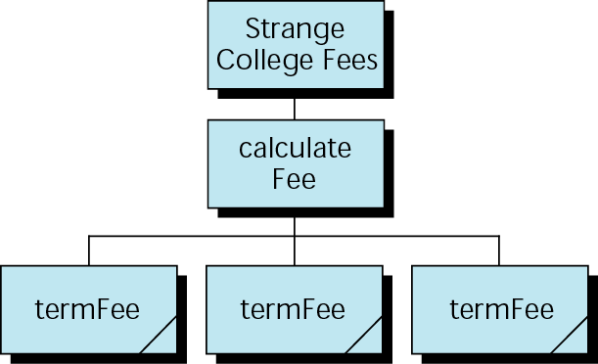
Figure 4-13 Design for Strange College fees

Slide 28
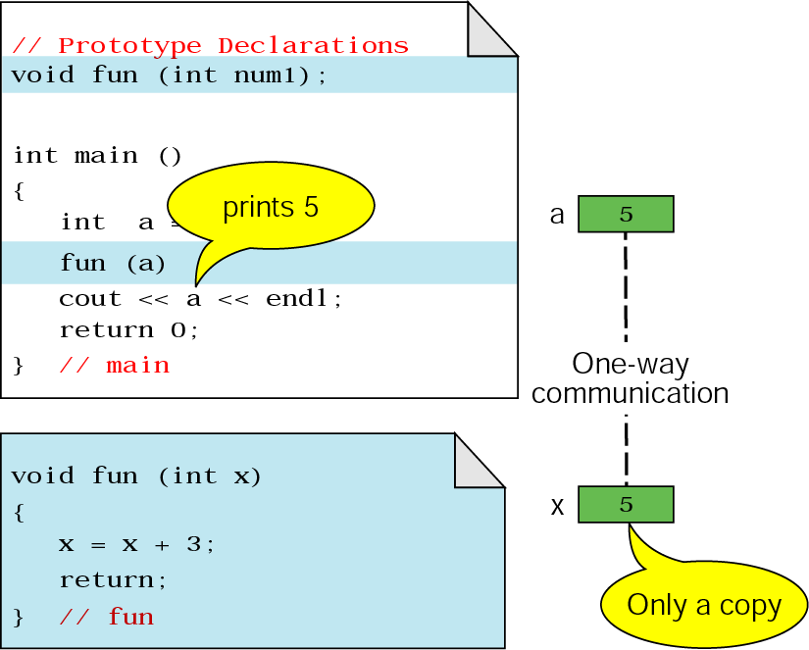
Figure 4-14 Pass by value

Slide 29
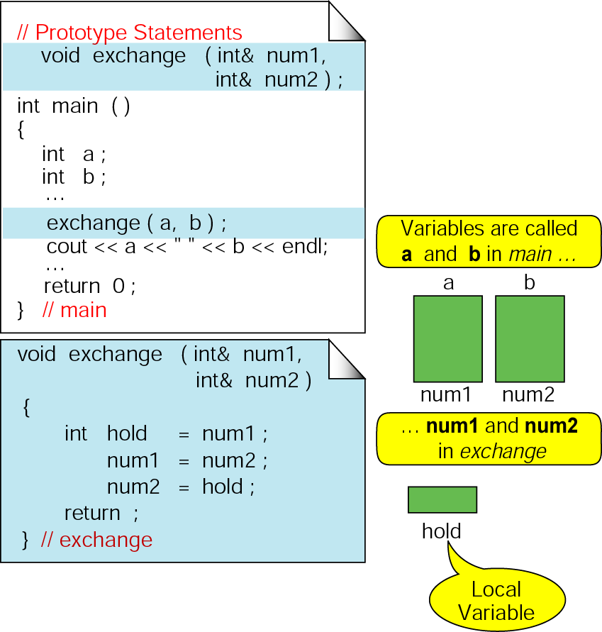
Figure 4-15 Pass by reference

Slide 30
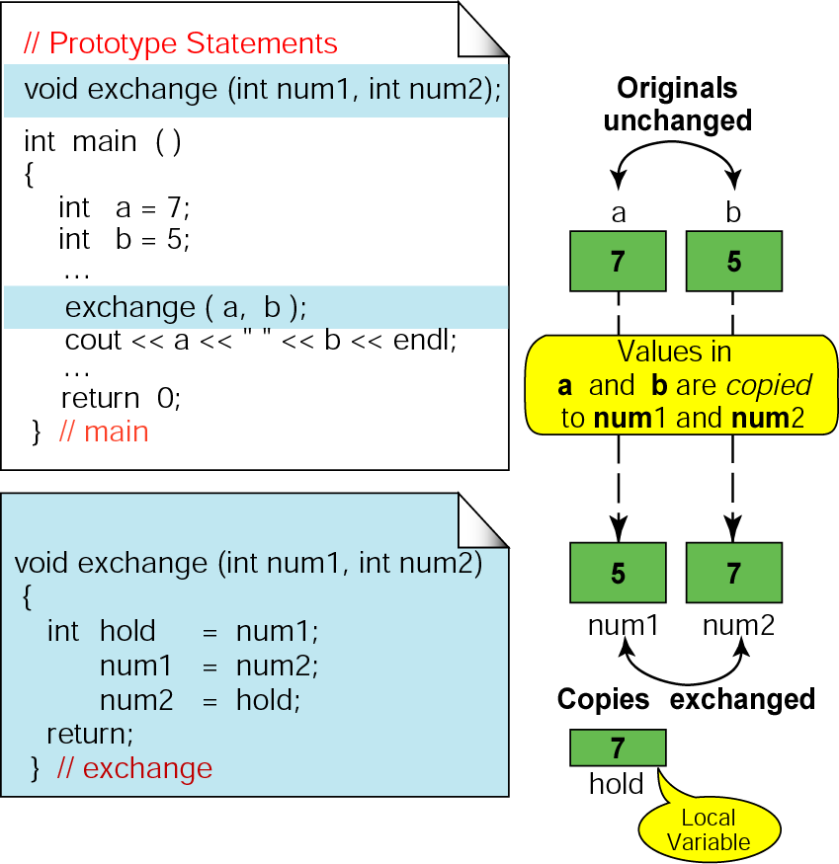
Figure 4-16 A bad exchange

Slide 31
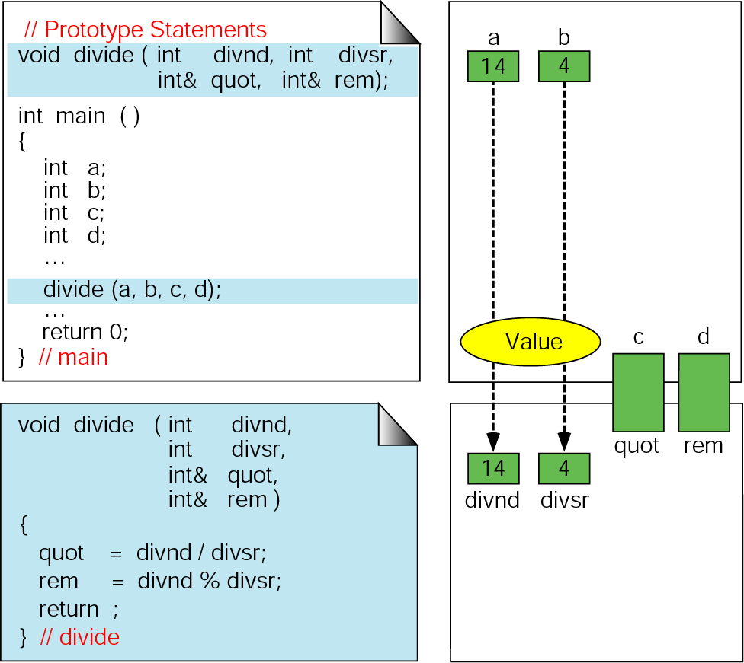
Figure 4-17 Calculate quotient and remainder

Slide 32
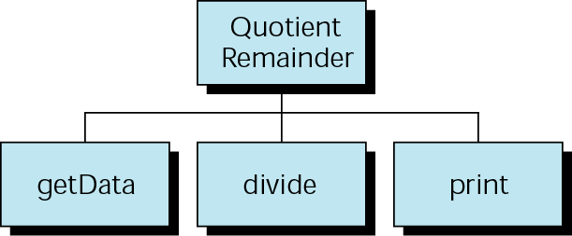
Figure 4-18 Quotient and remainder design

Slide 33
4.4
Default Parameter Arguments

Slide 34
4.5
Standard Library Functions

Slide 35
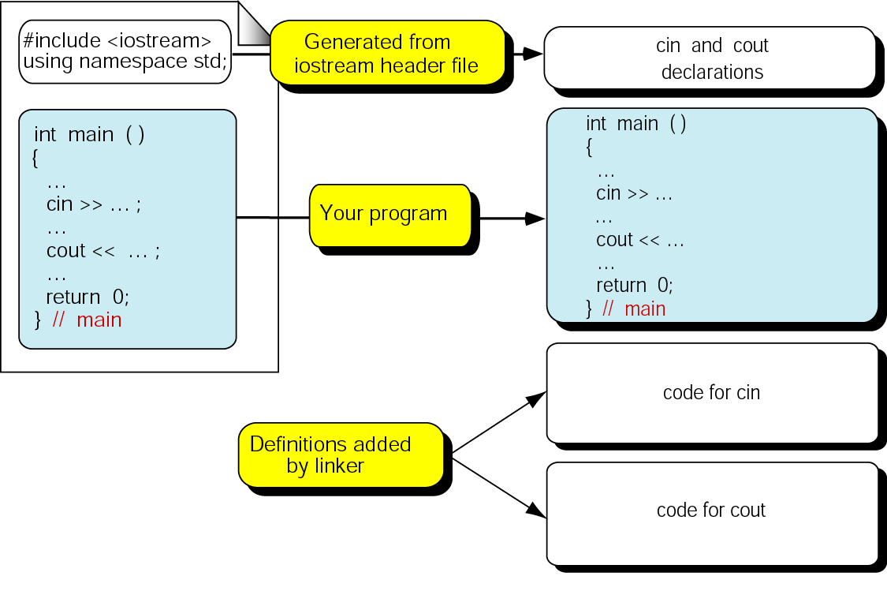
Figure 4-19 Library functions and the linker

Slide 36
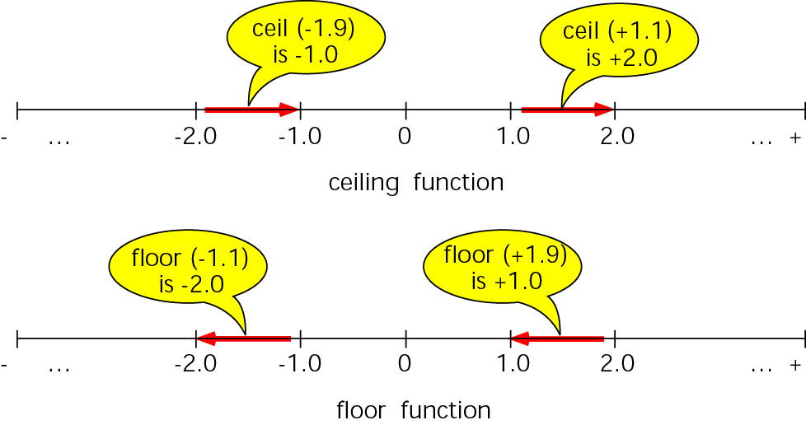
Figure 4-20 Floor and ceiling functions

Slide 37
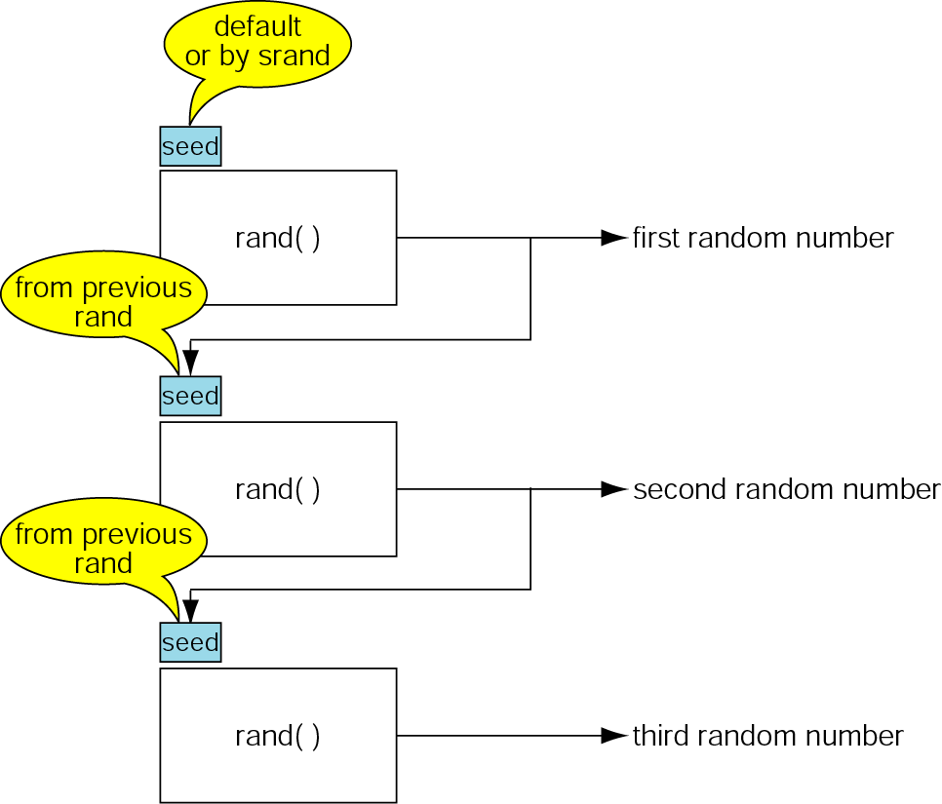
Figure 4-21 The random number seed

Slide 38
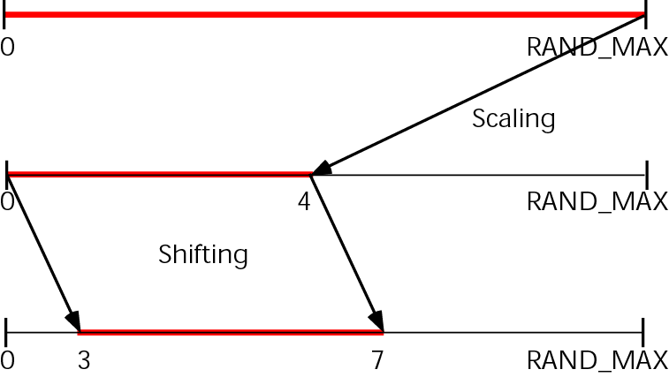
Figure 4-22 Random number scaling for 3-7

Slide 39
4.6
Scope

Slide 40
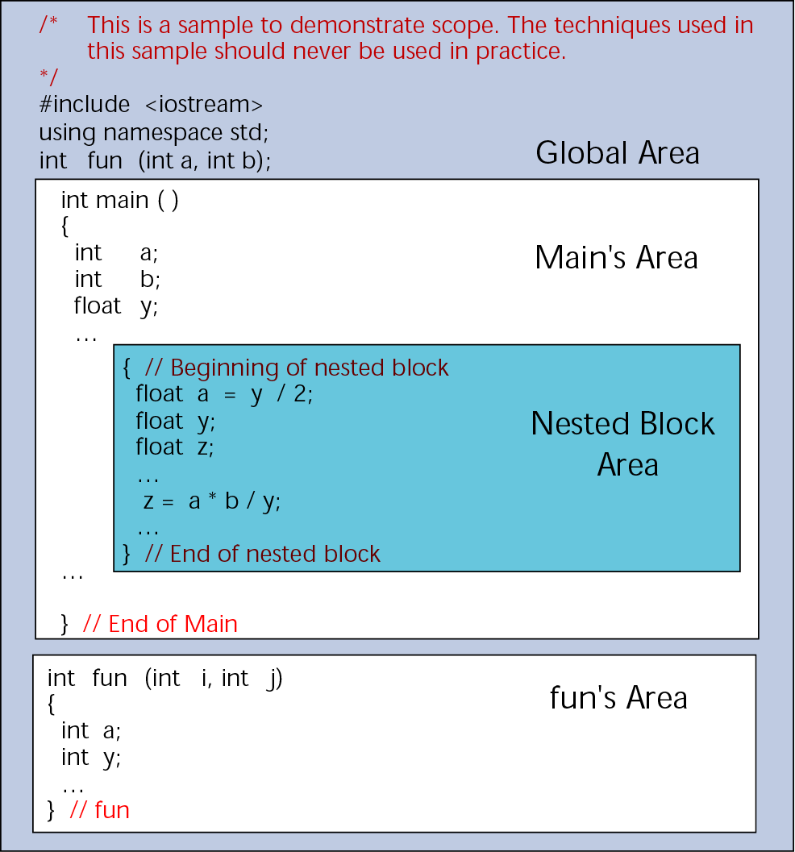
Figure 4-23 Scope for global and block areas

Slide 41
Note:
Variables are in scope from their point of definition until the end of their function or block.

Slide 42
Note:
It is poor programming style to reuse identifiers within the same scope.

Slide 43
4.7
A Programming
Example—Calculator Program

Slide 44
4.8
Software Engineering and Programming Style

Slide 45
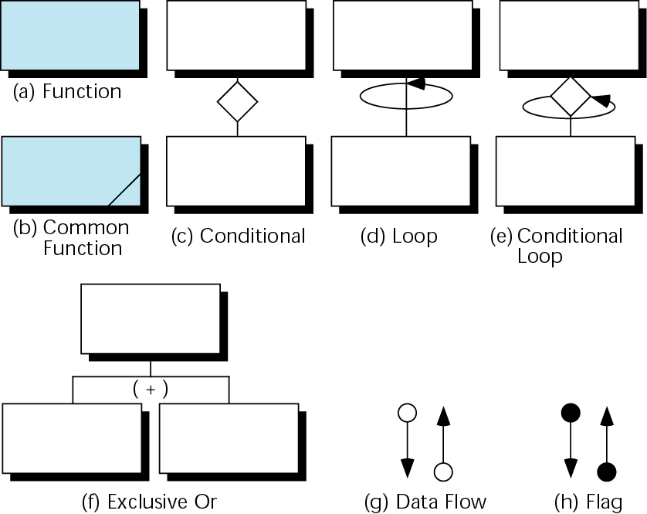
Figure 4-24 Structure chart symbols

Slide 46
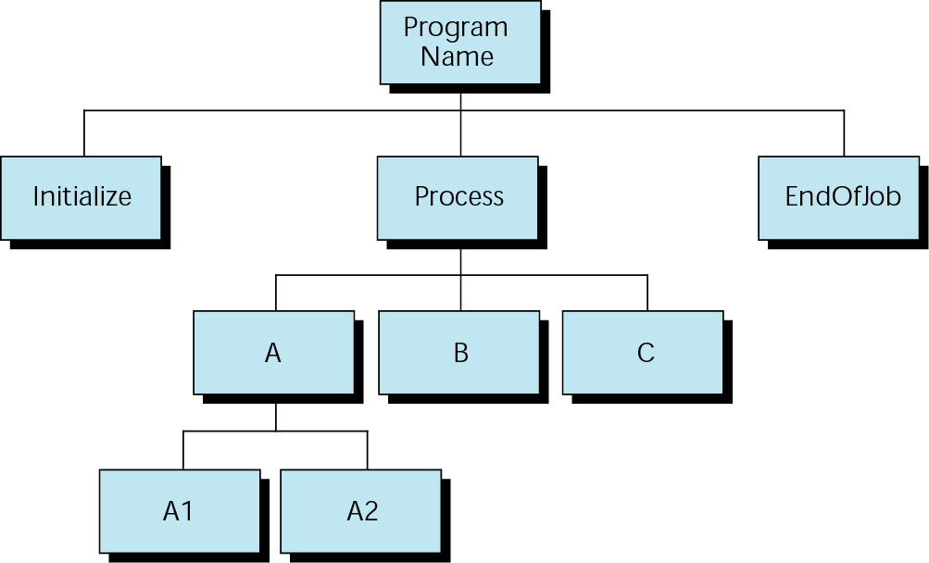
Figure 4-25 Structure chart design

Slide 47
Note:
Structure charts show only function flow; they contain no code.

Slide 48
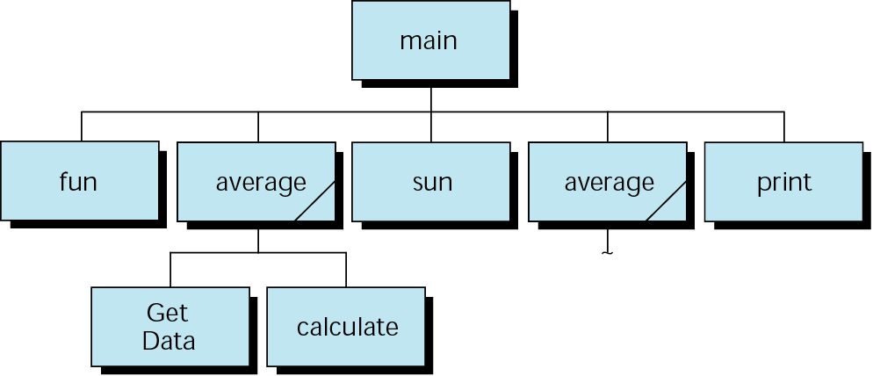
Figure 4-26 Common functions in a structure chart

Slide 49
Note:
Rule of Thumb
When a function has more than four parameters, check its cohesion.

Slide 50
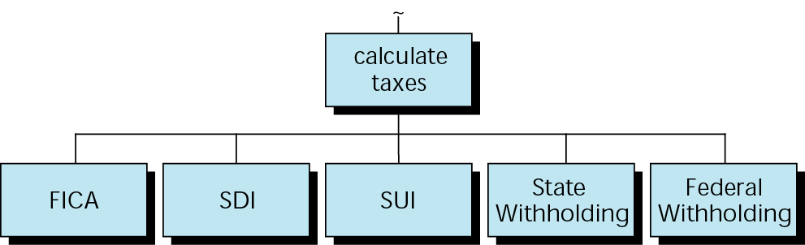
Figure 4-27 Calculate taxes

Slide 51
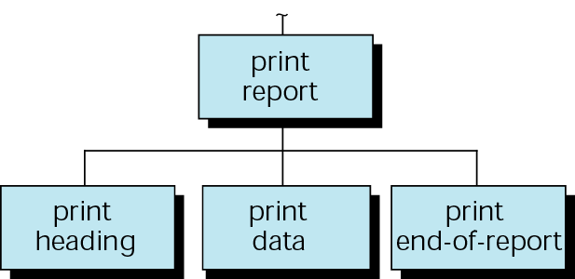
Figure 4-28 Design for print report

