Slide 1
Chapter 7
Text
I/O

Slide 2
OBJECTIVES
After studying this chapter you will be able to:
 Understand the basic design and operation of text files.
 Understand the C++ file implementation (streams).
 Name and use the four C++ standard file streams.
 Open and close application files.
 Read, write, and append text files.
 Format output data for presentation to the user.
 Use character input/output functions to read or write files
 Validate data to ensure accuracy.

Slide 3

7.1
Input and Output entities

Slide 4
Note:
A file on a disk or tape can be a text file or a binary file.

Slide 5
Note:
A file on a disk or tape can be a text file or a binary file.

Slide 6
Note:
The standard input and output behave like text files.

Slide 7
Note:
The standard error behaves like
a text file.

Slide 8
7.2
Streams

Slide 9
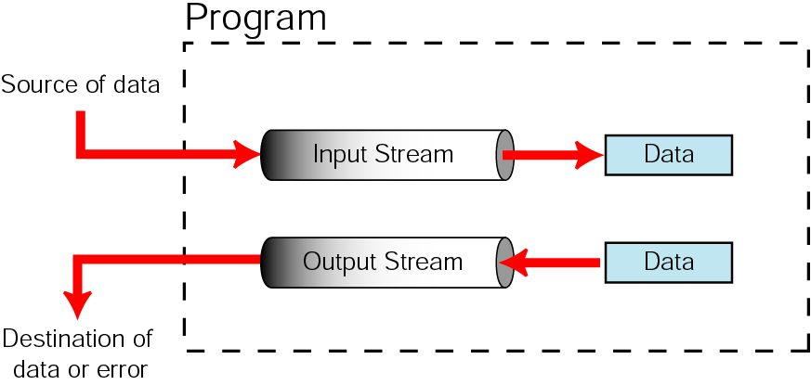
Figure 7-1 The stream concept

Slide 10
Note:
Standard streams are created, connected, and disconnected automatically.

Slide 11
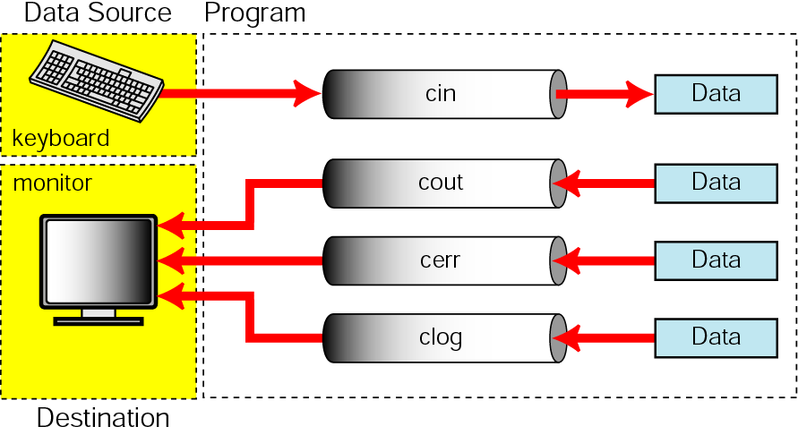
Figure 7-2 Standard streams

Slide 12
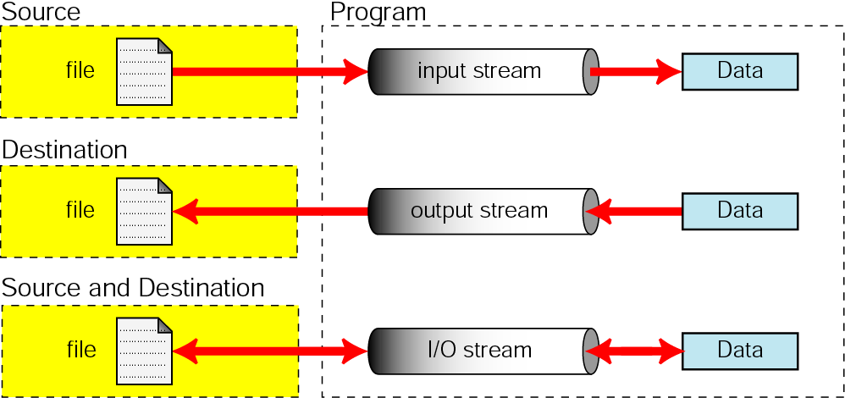
Figure 7-3 Connected file streams

Slide 13
Note:
File streams are created, connected to files, and disconnected from files by the programmer.

Slide 14
7.3
Standard Library Input/Output Functions

Slide 15
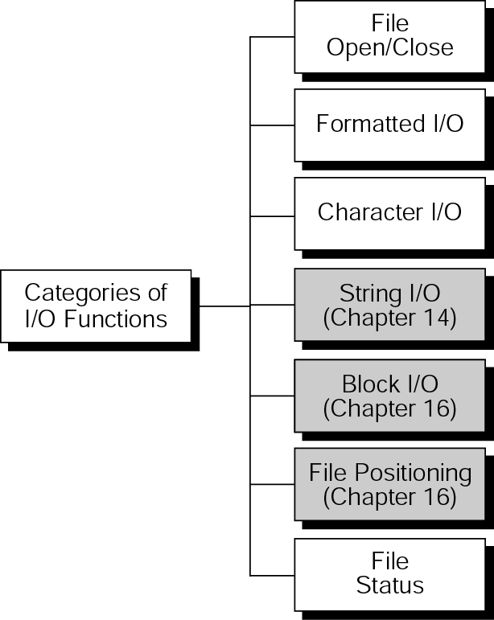
Figure 7-4 Types of standard input/output functions

Slide 16
Note:
File Disposition Warning
The operating system controls what happens when you open an existing file for writing. The one consistent thing is that a new file is created. If you are in a UNIX or an MS/DOS environment, the existing file is deleted when the program completes. In other environments, the existing file still exists, but it is no longer the current file. To read it, you would have to use special job control statements that refer to the older version. Check with the documentation for your operating system to make sure you understand what will happen.

Slide 17
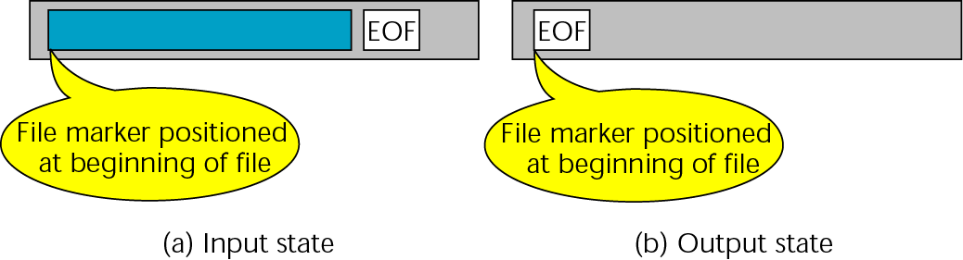
Figure 7-5 File opening states

Slide 18
7.4
Formatting Input and Output

Slide 19
Note:
Always use the adjustfield flag with the left and right flags.

Slide 20
Note:
Always use the basefield flag with the dec, oct, and hex flags.

Slide 21
Note:
Always use the floatfield flag with the fixed and scientific flags.

Slide 22
7.5
File
Example

Slide 23
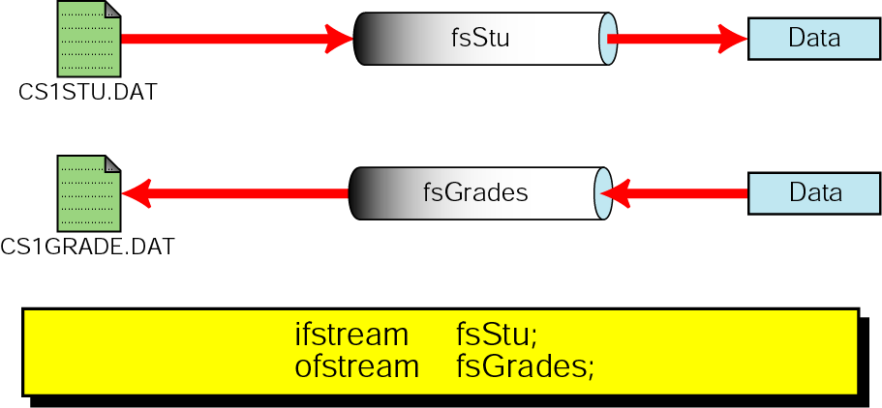
Figure 7-6 Create student grades

Slide 24
7.6
Character Input/Output Functions

Slide 25
7.7
Character Input/Output Examples

Slide 26
7.8
Detecting File Errors

Slide 27
7.9
Software Engineering and Programming Style

