Slide 1
Chapter 8
Arrays

Slide 2
OBJECTIVES
After studying this chapter you will be able to:
 Understand and use one, two, and three dimensional arrays in
C++.
 Understand how to initialize arrays.
 Read data into an array or write data from an array.
 Understand that array range checking is the responsibility of the
programmer.
 Write programs that pass arrays or array elements to functions.
 Sort data in an array using selection, bubble, or insertion sorting.
 Search an array using sequential or binary searches.
 Analyze the efficiency of sorting and searching algorithms.

Slide 3
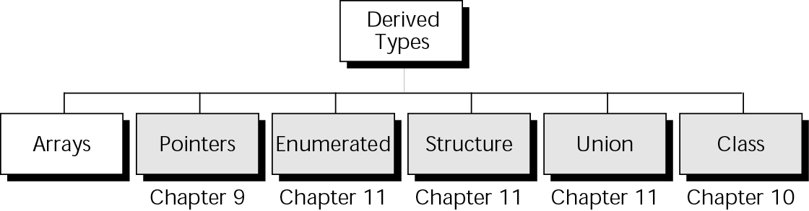
Figure 8-1 Derived types

Slide 4

8.1
Concepts

Slide 5
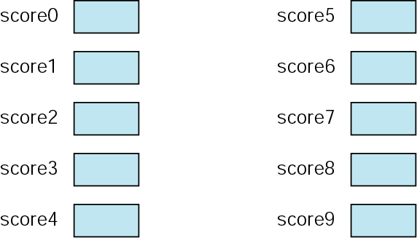
Figure 8-2 Ten variables

Slide 6
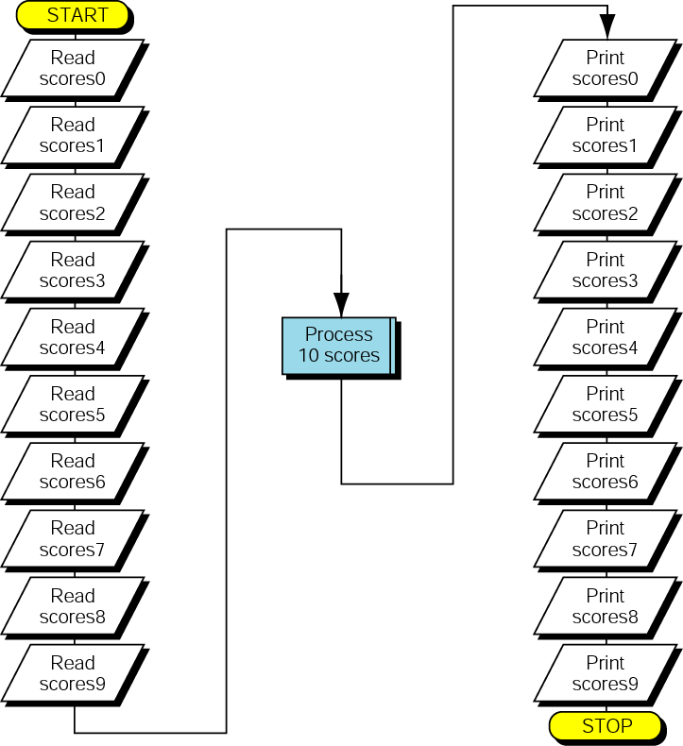
Figure 8-3 Process 10 variables

Slide 7
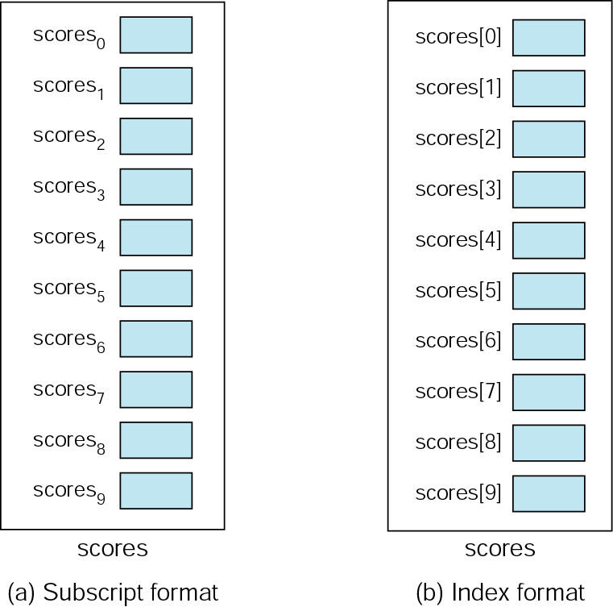
Figure 8-4 An array of scores

Slide 8
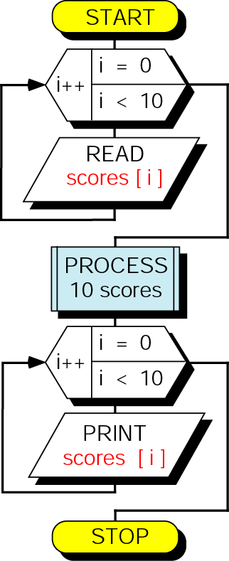
Figure 8-5 Loop for 10 scores

Slide 9
8.2
Using Arrays in C++

Slide 10
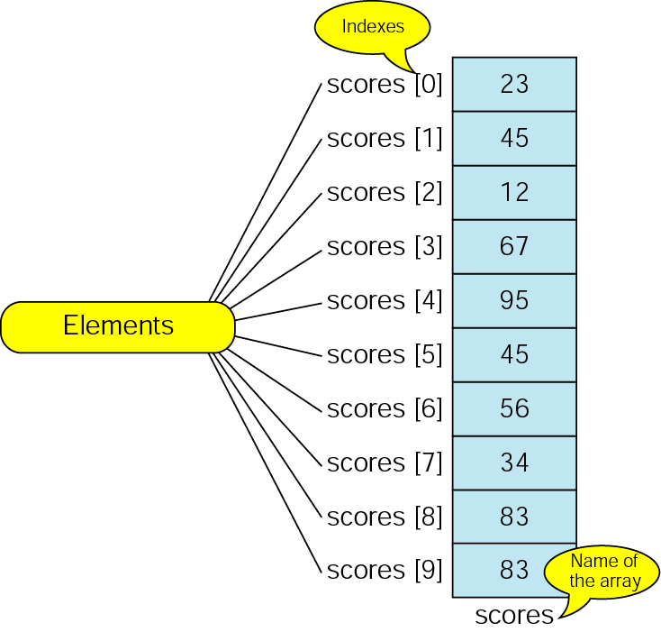
Figure 8-6 The scores array

Slide 11
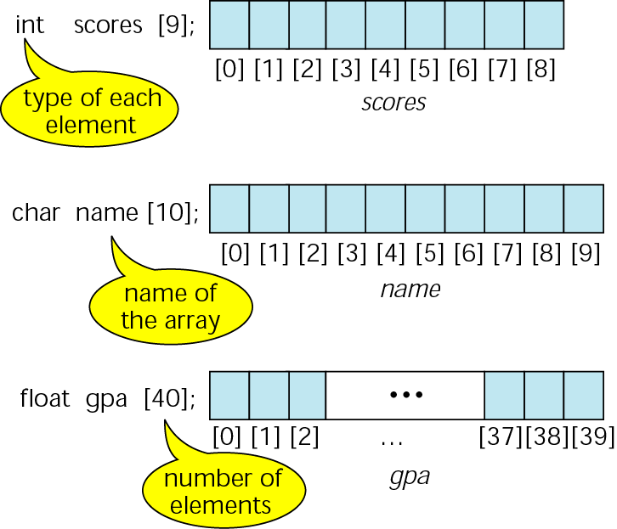
Figure 8-7 Declaring and defining arrays

Slide 12
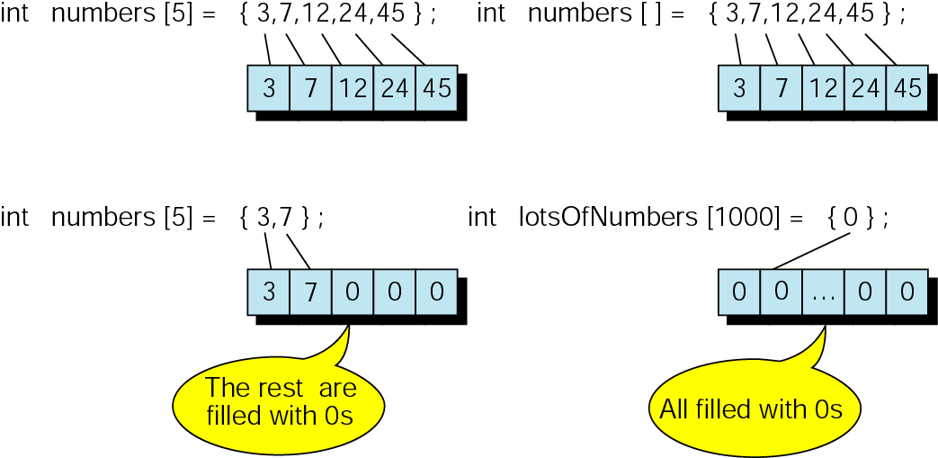
Figure 8-8 Initializing arrays

Slide 13
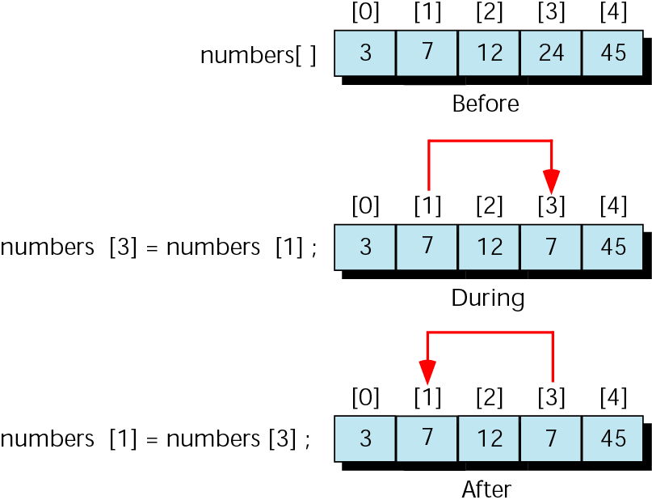
Figure 8-9 Exchanging scores—the wrong way

Slide 14
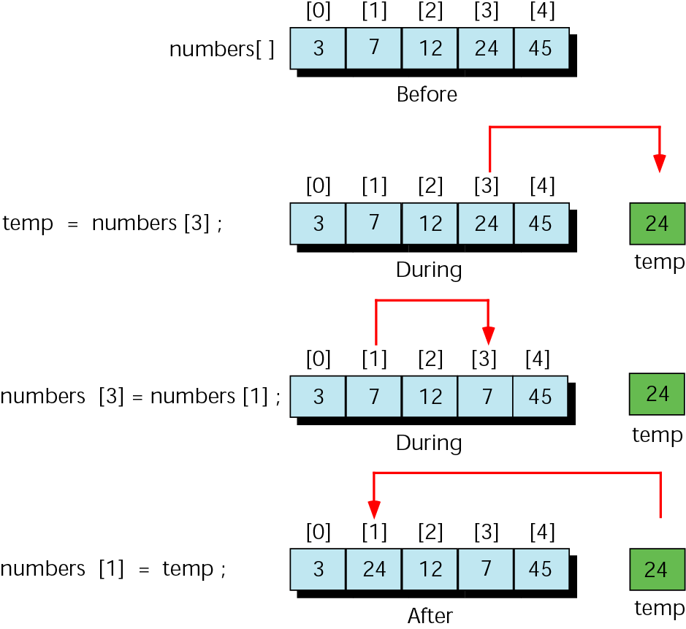
Figure 8-10 Exchanging scores with temporary variable

Slide 15
8.3
Arrays and Functions

Slide 16
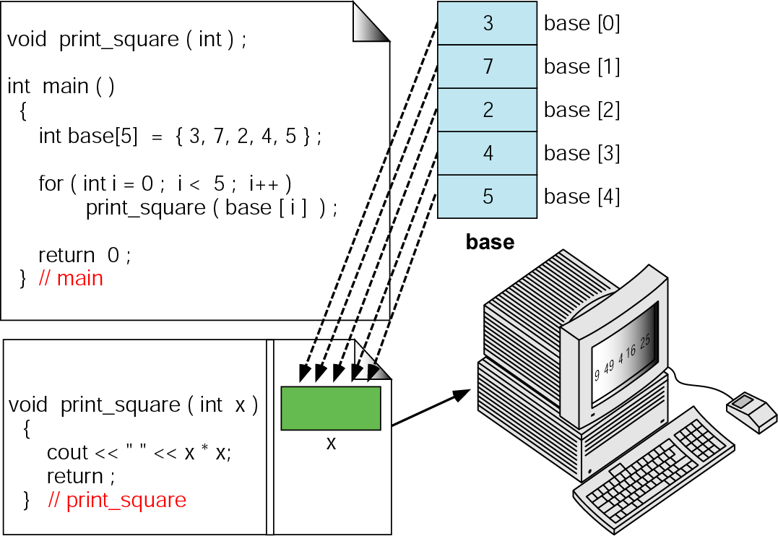
Figure 8-11 Passing individual elements

Slide 17
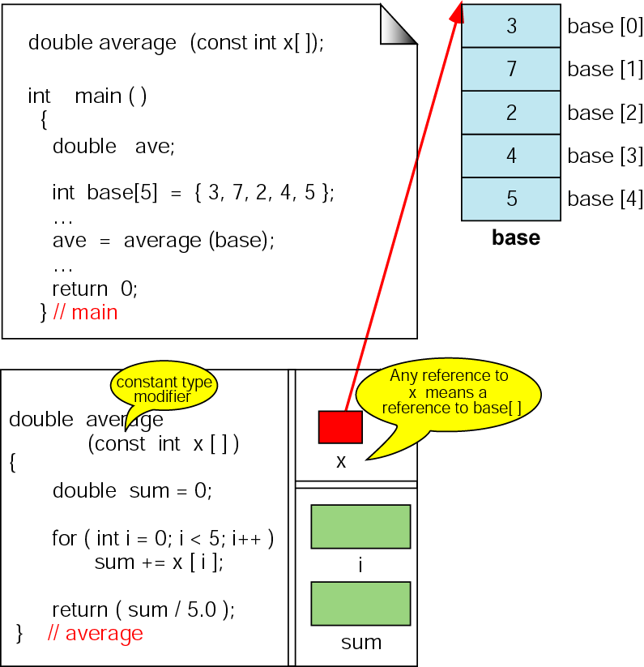
Figure 8-12 Passing arrays—average

Slide 18
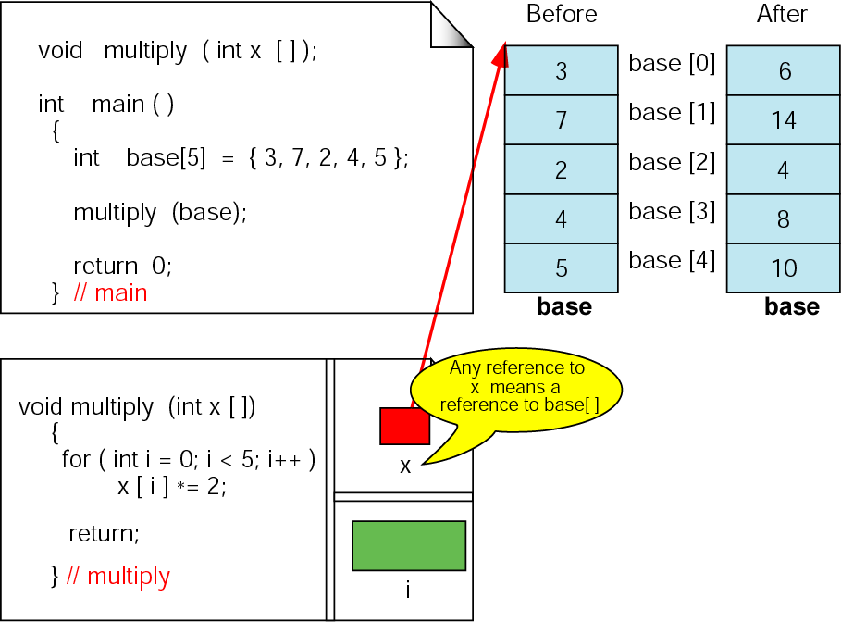
Figure 8-13 Changing values in arrays

Slide 19
8.4
Array Applications

Slide 20
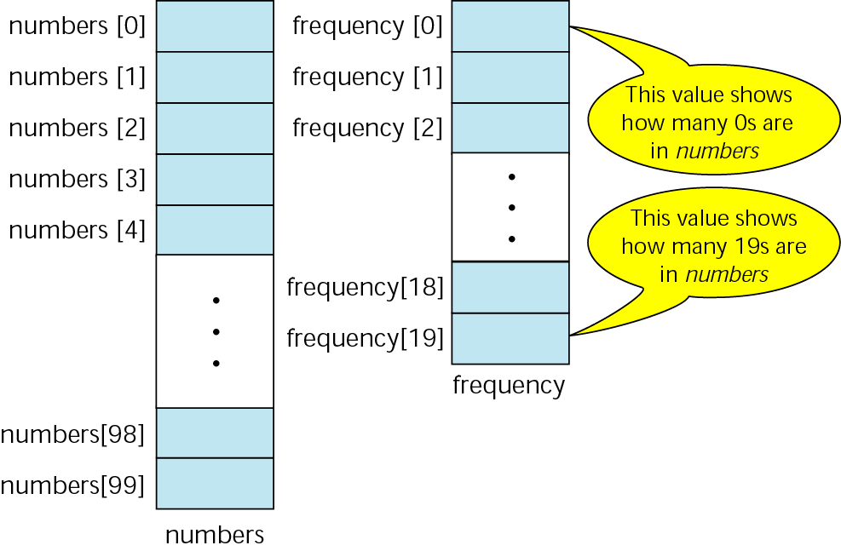
Figure 8-14 Frequency array

Slide 21
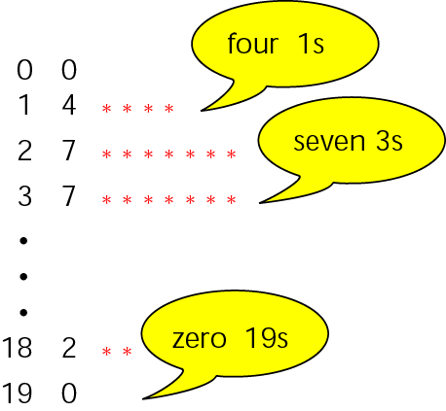
Figure 8-15 Frequency histogram

Slide 22
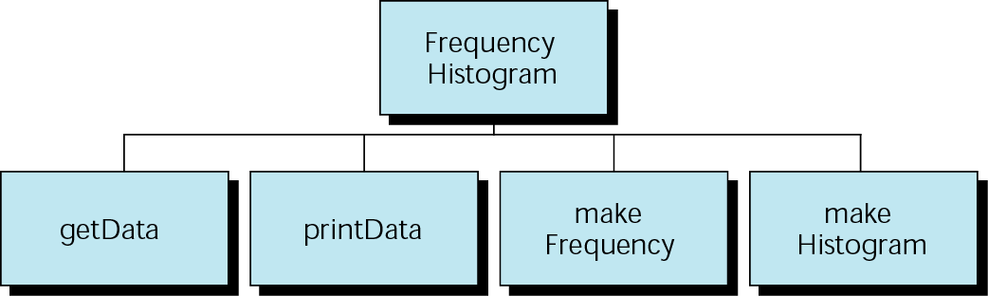
Figure 8-16 Histogram program design

Slide 23
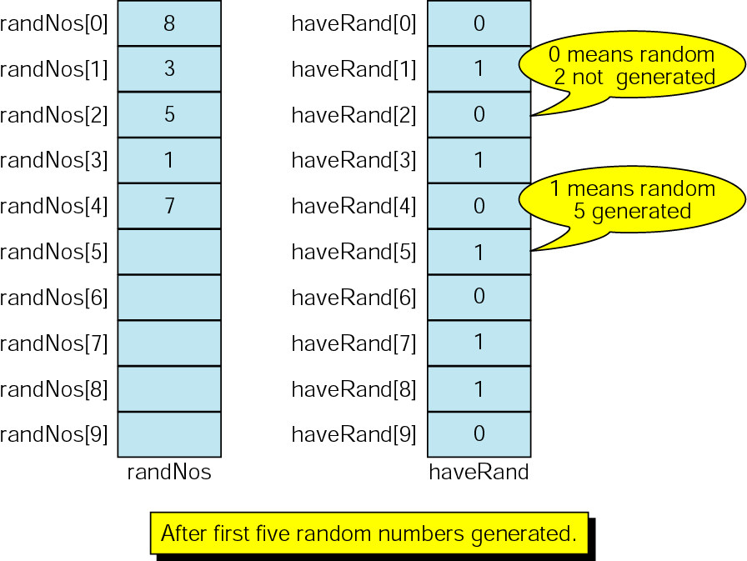
Figure 8-17 Design for random number permutations

Slide 24
8.5
Sorting

Slide 25
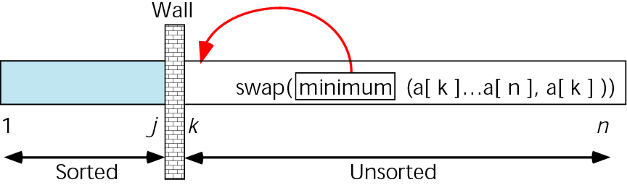
Figure 8-18 Selection sort concept

Slide 26
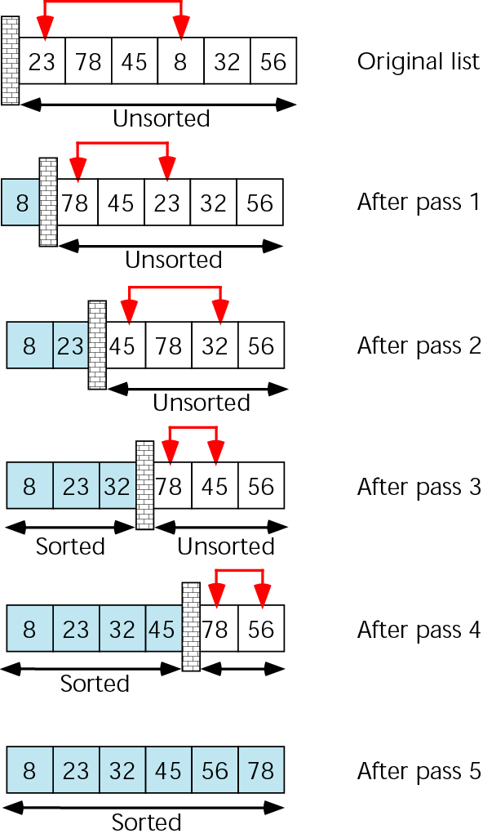
Figure 8-19 Selection sort example

Slide 27
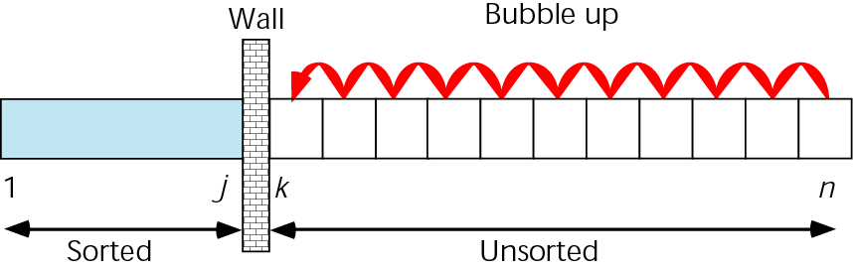
Figure 8-20 Bubble sort concept

Slide 28
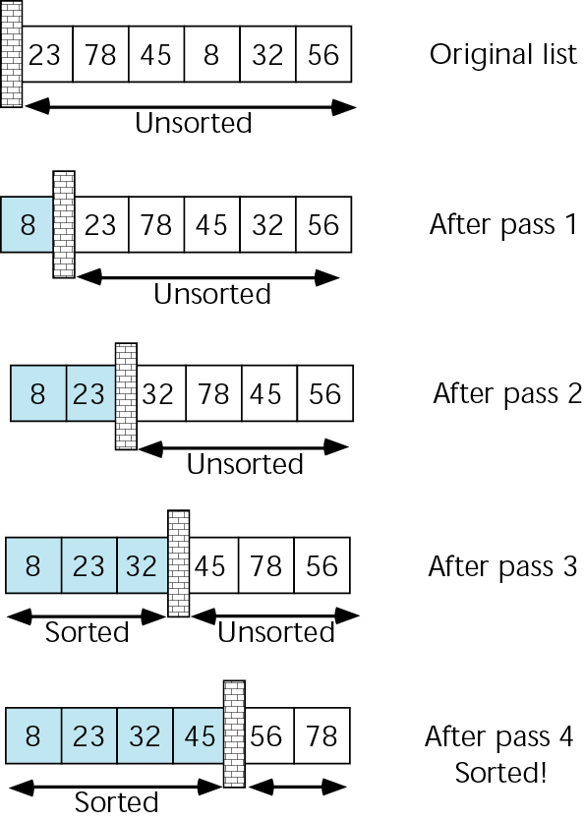
Figure 8-21 Bubble sort example

Slide 29
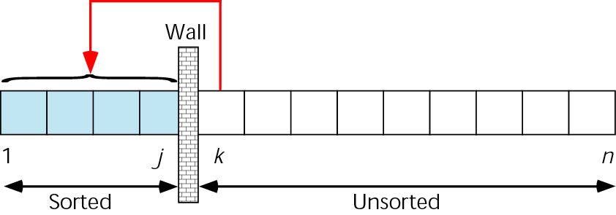
Figure 8-22 Insertion sort concept

Slide 30
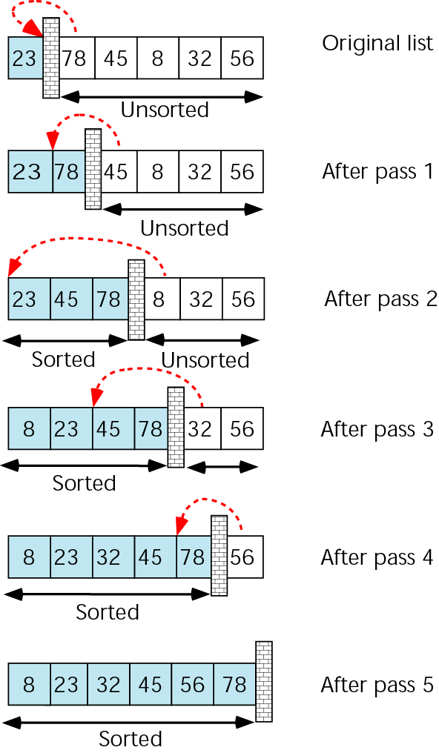
Figure 8-23 Insertion sort example

Slide 31
8.6
Searching

Slide 32
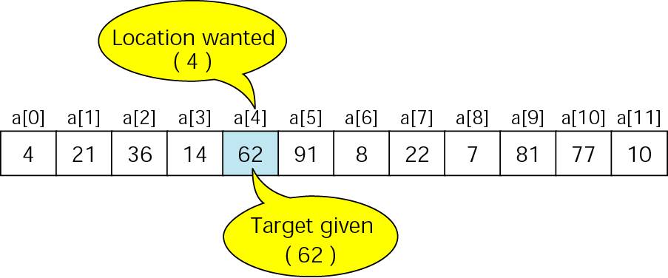
Figure 8-24 Search concept

Slide 33
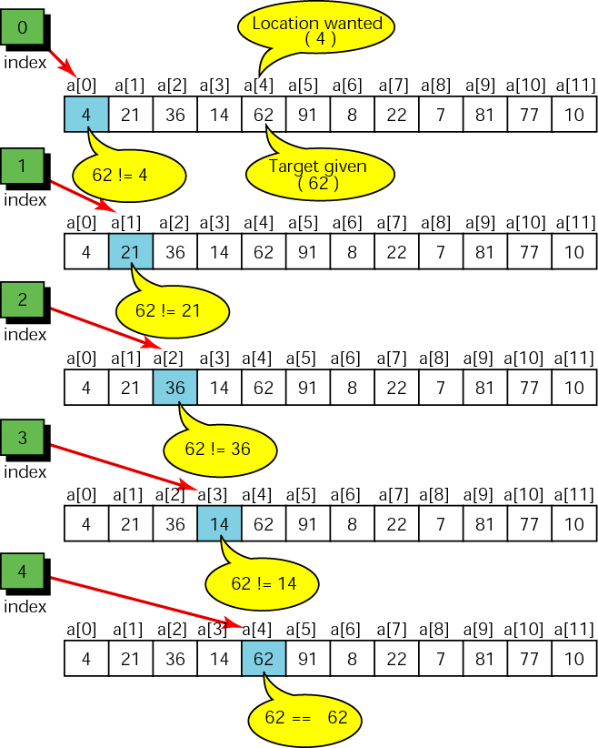
Figure 8-25 Locating data in an unordered list

Slide 34
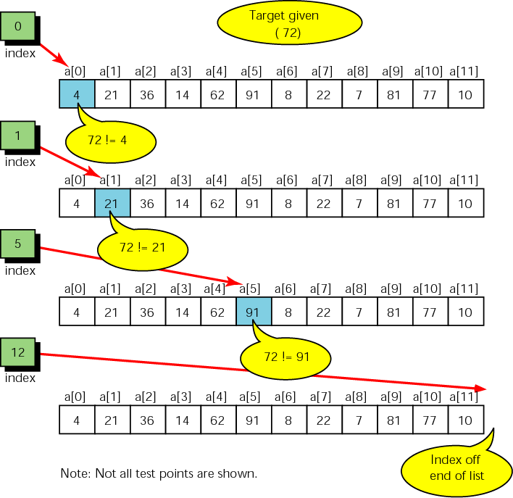
Figure 8-26 Unsuccessful search in an unordered list

Slide 35
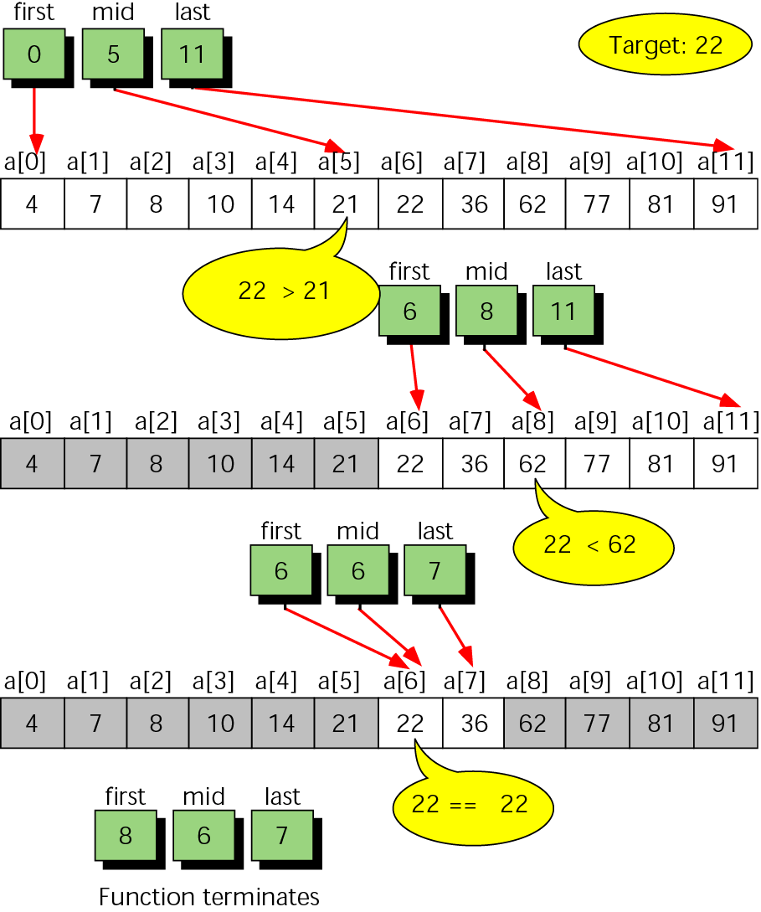
Figure 8-27 Binary search example

Slide 36
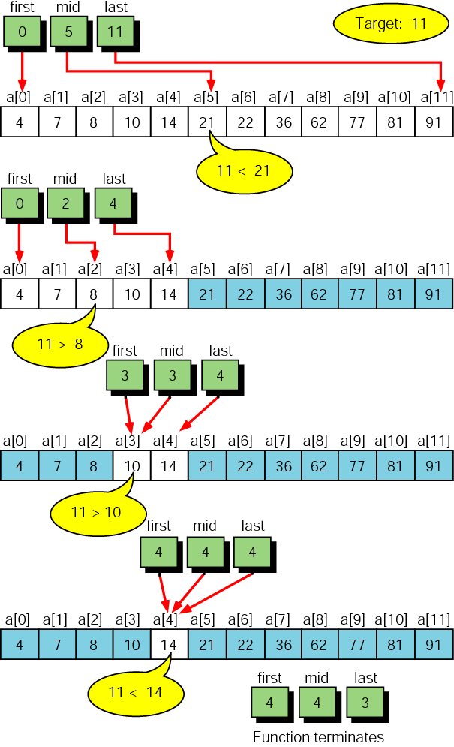
Figure 8-28 Unsuccessful binary search example

Slide 37
8.7
Two-Dimensional Arrays

Slide 38
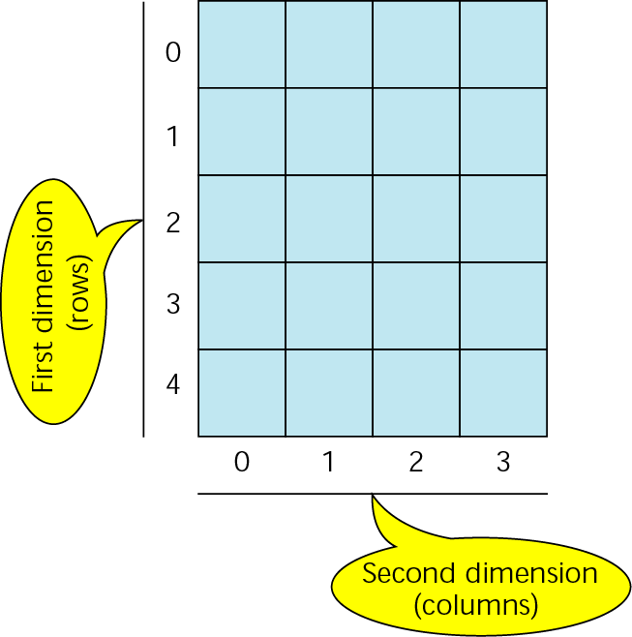
Figure 8-29 Two-dimensional array

Slide 39
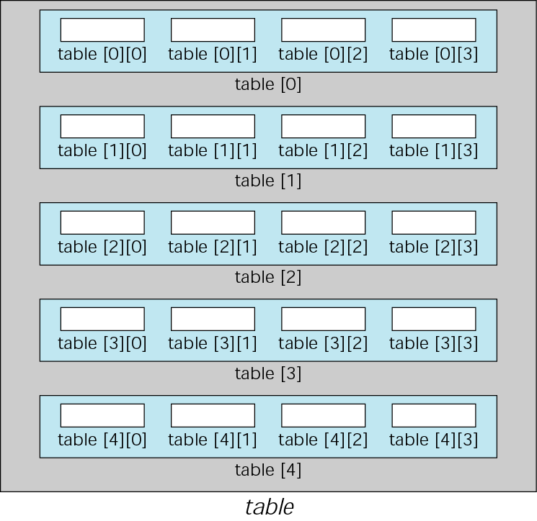
Figure 8-30 Array of arrays

Slide 40
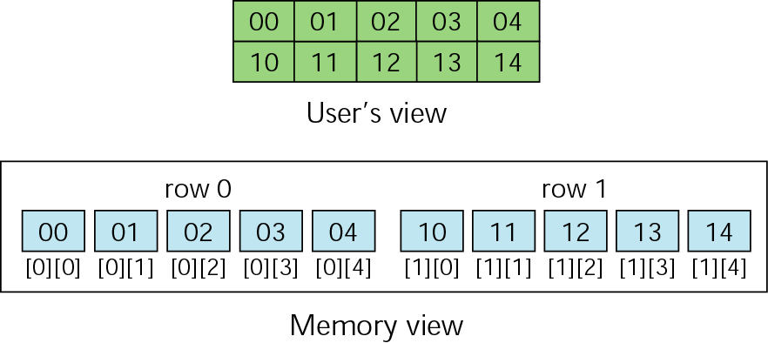
Figure 8-31 Memory layout

Slide 41
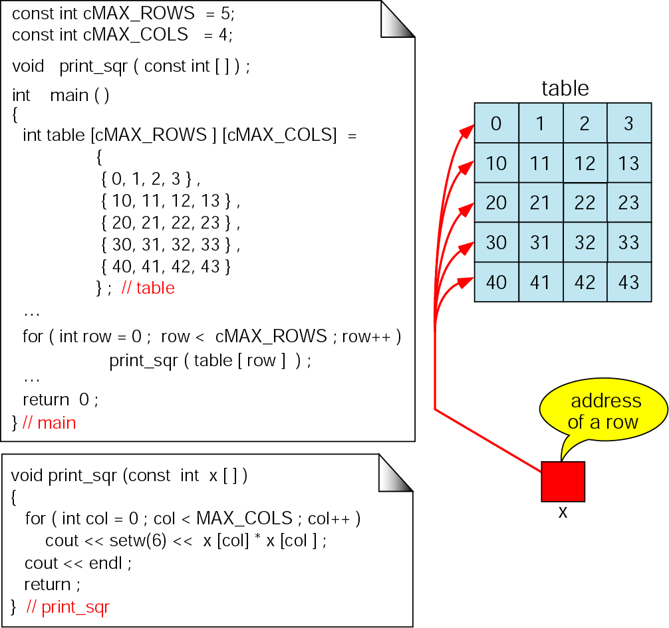
Figure 8-32 Passing a row

Slide 42
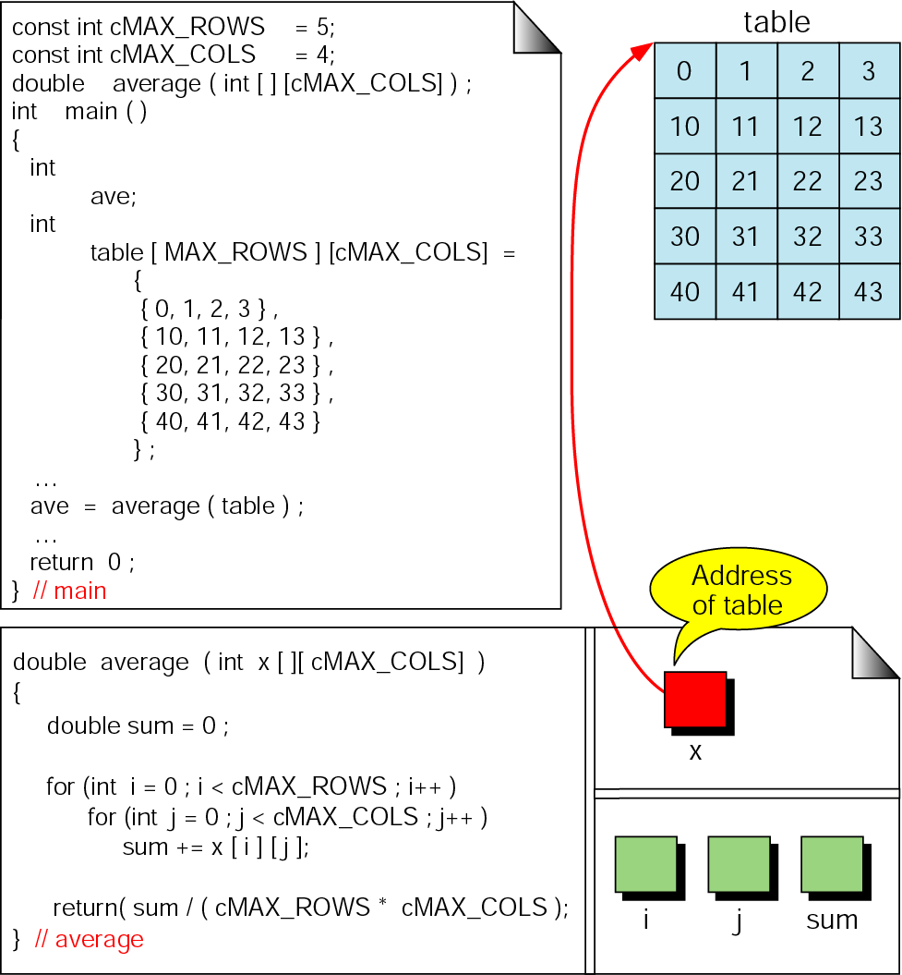
Figure 8-33 Calculate average of integers in array

Slide 43
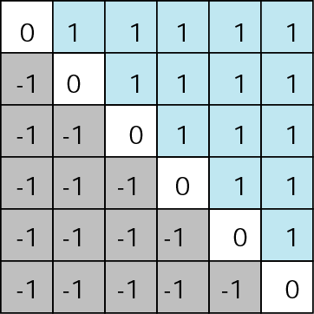
Figure 8-34 Example of filled matrix

Slide 44
8.8
Multidimensional Arrays

Slide 45
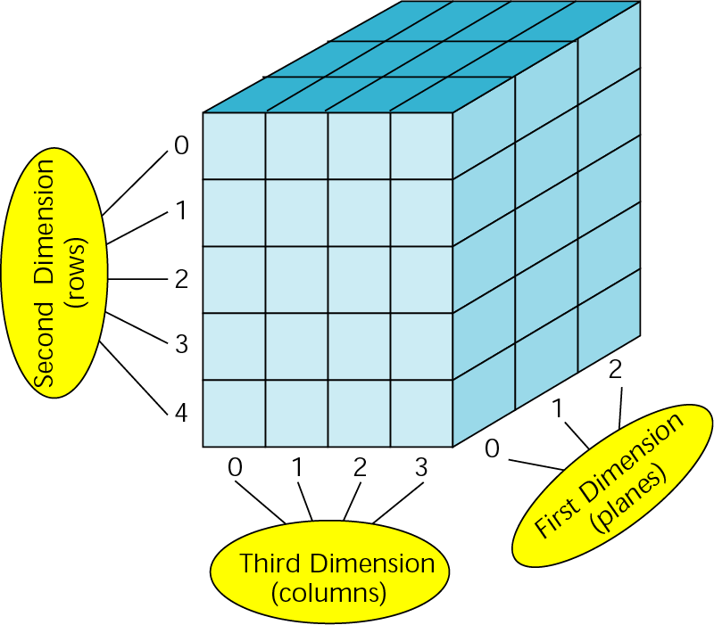
Figure 8-35 A three-dimensional array (3 x 5 x 4)

Slide 46
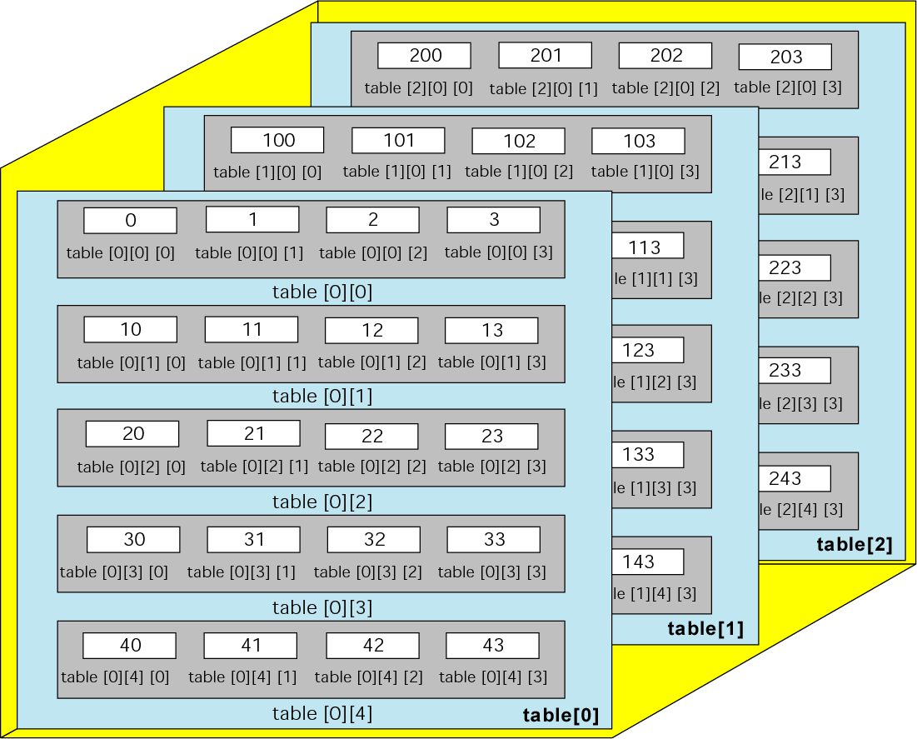
Figure 8-36 C++ view of three-dimensional array

Slide 47
Figure 8-37 Initializing a three-dimensional array
int table[3][5][4] =
{
{ // Plane 0
{0, 1, 2, 3}, // Row 0
...
{40, 41, 42, 43} // Row 4
},
{ // Plane 1
{100, 101, 102, 103}, // Row 0
...
{140, 141, 142, 143} // Row 4
},
{ // Plane 2
{200, 201, 202, 203}, // Row 0
...
{240, 241, 242, 243} // Row 4
}
}; // table

Slide 48
8.9
Programming Example—Calculate Row and Column Averages

Slide 49
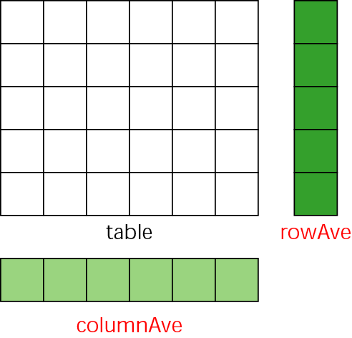
Figure 8-38 Data structures for row-column averages

Slide 50
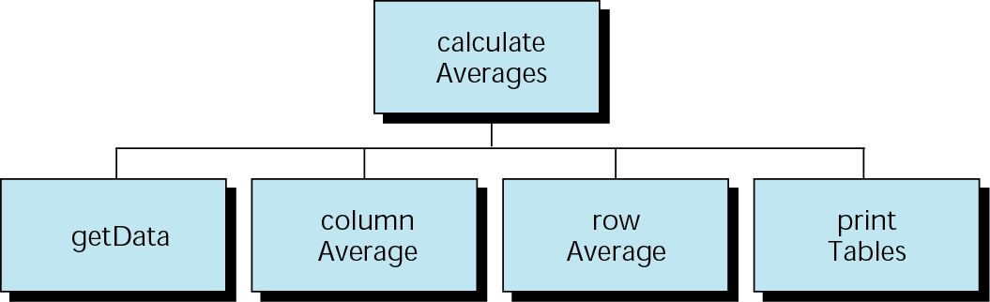
Figure 8-39 Calculate row-column average design

Slide 51
8.10
Software Engineering and Programming Style

Slide 52
Note:
The efficiency of the bubble sort is O(n2).

Slide 53
Note:
The efficiency of the selection sort is O(n2).

Slide 54
Note:
The efficiency of the insertion sort is O(n2).

Slide 55
Note:
The efficiency of the sequential search is O(n).

Slide 56
Note:
The efficiency of the binary search is O(log2n).

