Slide 1
Chapter 9
Pointers

Slide 2
OBJECTIVES
After studying this chapter you will be able to:
 Understand the design and operation of pointers and use the
address and indirection operators.
 Write functions that pass pointers as parameters and that return
pointers.
 Use pointers and pointer arithmetic to process the data in an array.
 Use ragged arrays to save space when some rows of an array are
not full.
 Describe how memory can be divided between program memory
and data memory (global area, heap, and stack).
 Write programs that dynamically allocate memory.

Slide 3
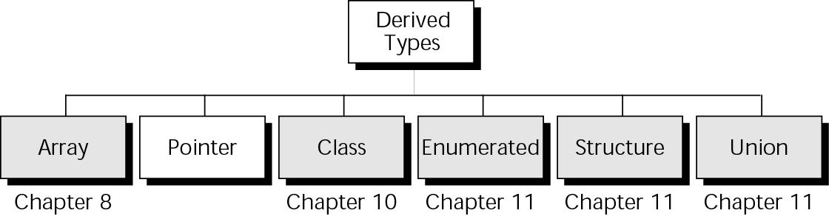
Figure 9-1 Derived types

Slide 4

9.1
Concepts

Slide 5
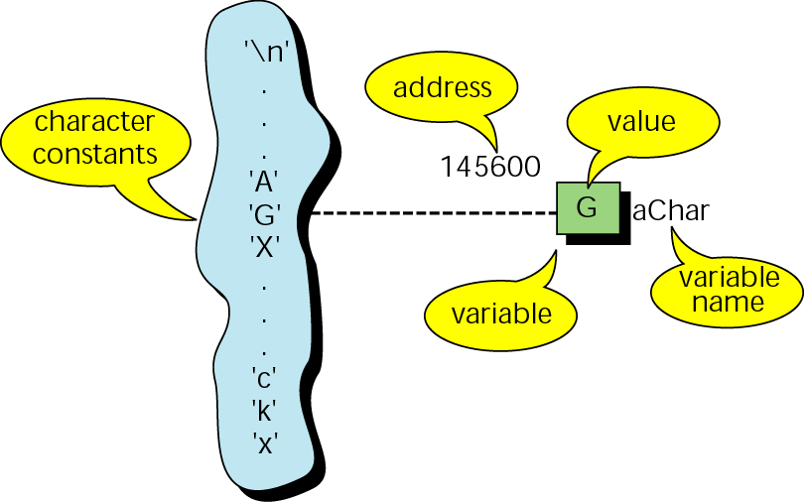
Figure 9-2 Character constants and variables

Slide 6
Note:
Pointer constants, drawn from the set of addresses for a computer, exist by themselves. We cannot change them; we can only use them.

Slide 7
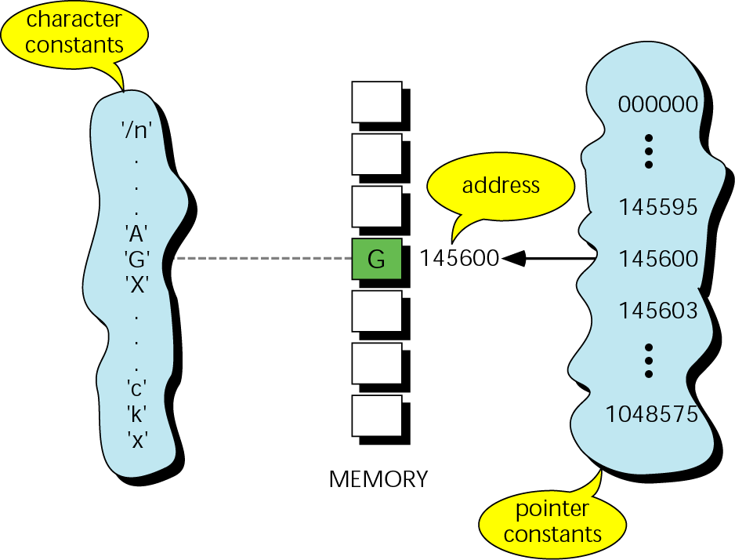
Figure 9-3 Pointer constants

Slide 8
Note:
When the ampersand (&) is used as a prefix to a variable name, it means “address” of variable. When it is used as a suffix to a type, it means reference parameter.

Slide 9
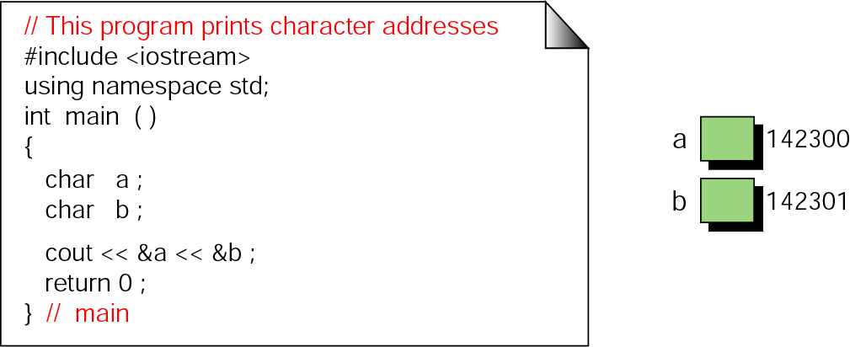
Figure 9-4 Print character addresses

Slide 10
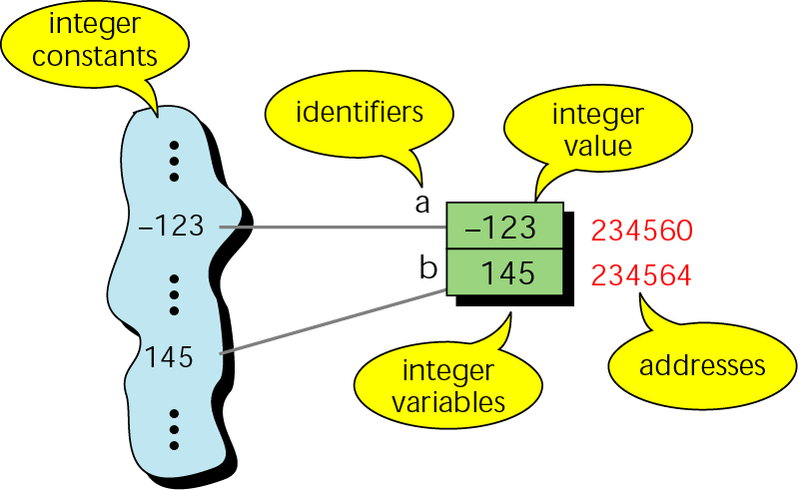
Figure 9-5 Integer constants and variables

Slide 11
Note:
The address of a variable is the address of the first byte occupied by that variable.

Slide 12
9.2
Pointer Variables

Slide 13
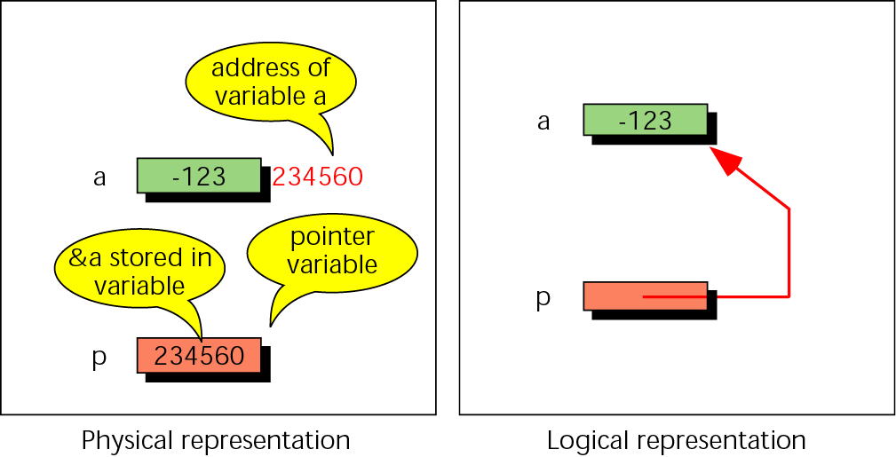
Figure 9-6 Pointer variable

Slide 14
9.3
Accessing Variables Through Pointers

Slide 15
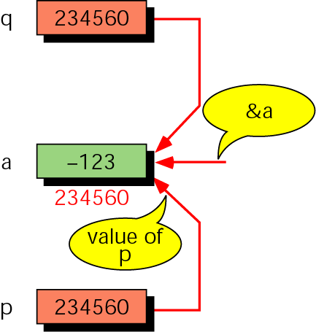
Figure 9-7 Multiple pointers to a variable

Slide 16
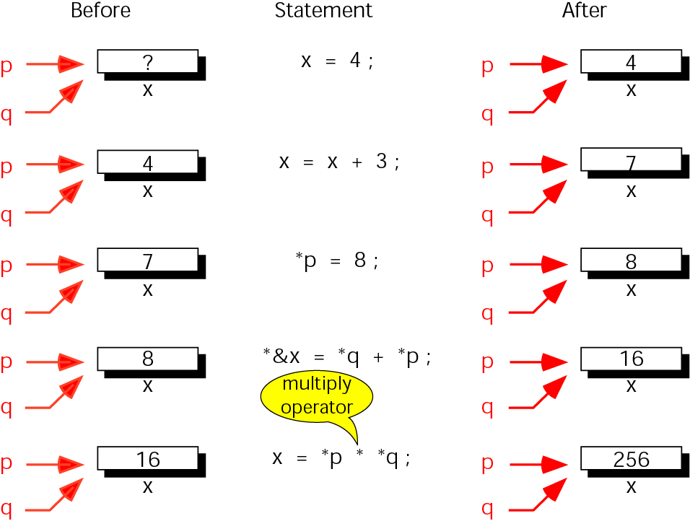
Figure 9-8 Accessing variables through pointers

Slide 17

Figure 9-9 Address and indirection operators

Slide 18
9.4
Pointer Declaration and Definition

Slide 19
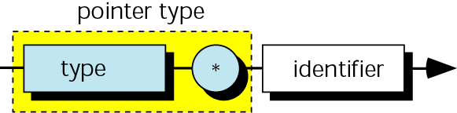
Figure 9-10 Pointer variable declaration

Slide 20
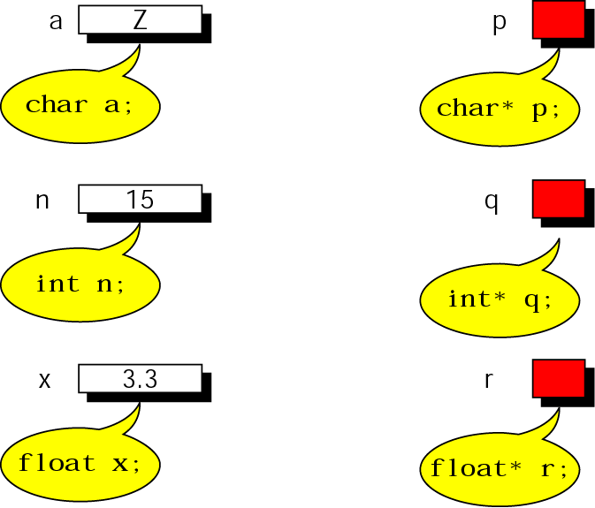
Figure 9-11 Declaring pointer variables

Slide 21
9.5
Initialization of Pointer Variables

Slide 22
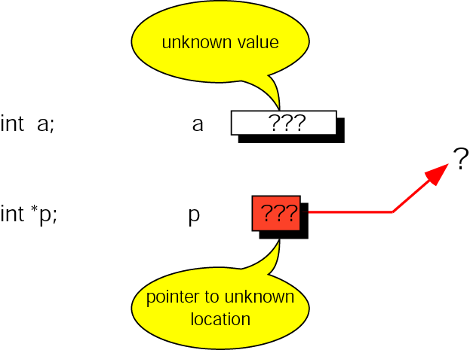
Figure 9-12 Uninitialized pointers

Slide 23
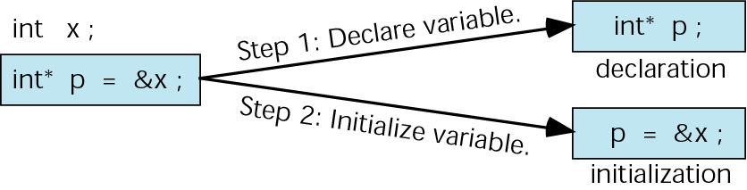
Figure 9-13 Initializing pointer variables

Slide 24
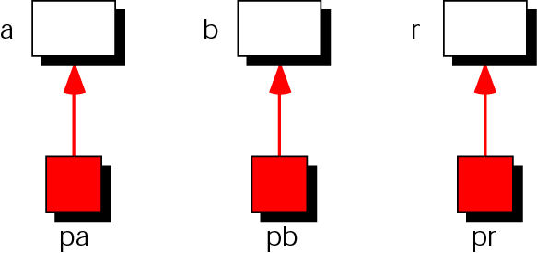
Figure 9-14 Add two numbers using pointers

Slide 25
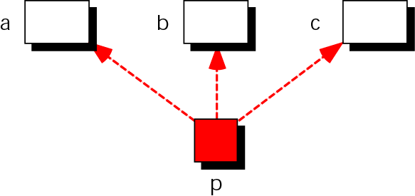
Figure 9-15 Demonstrate pointer flexibility

Slide 26
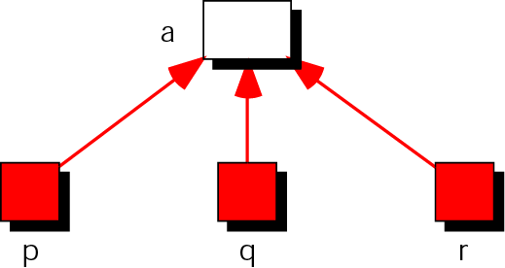
Figure 9-16 Using one variable with many pointers

Slide 27
9.6
Pointers and Functions

Slide 28
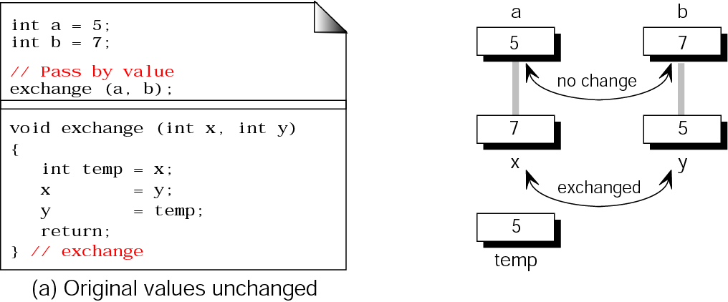
Figure 9-17(a) Exchanging values

Slide 29
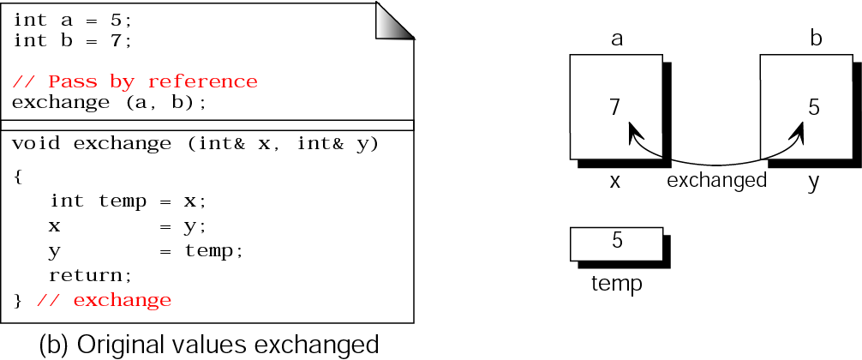
Figure 9-17(b) Exchanging values (continued)

Slide 30
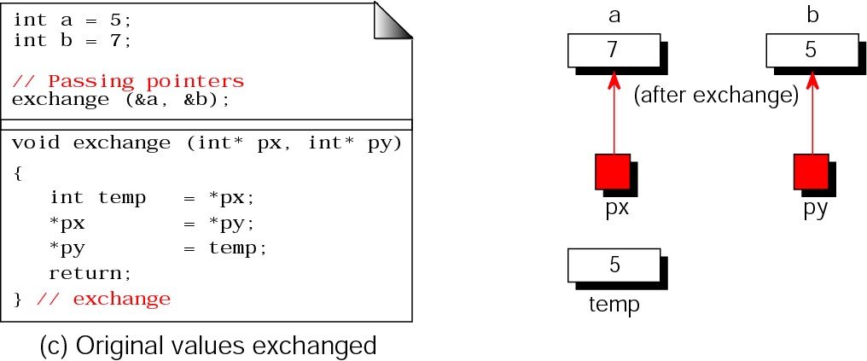
Figure 9-17(c) Exchanging values (continued)

Slide 31
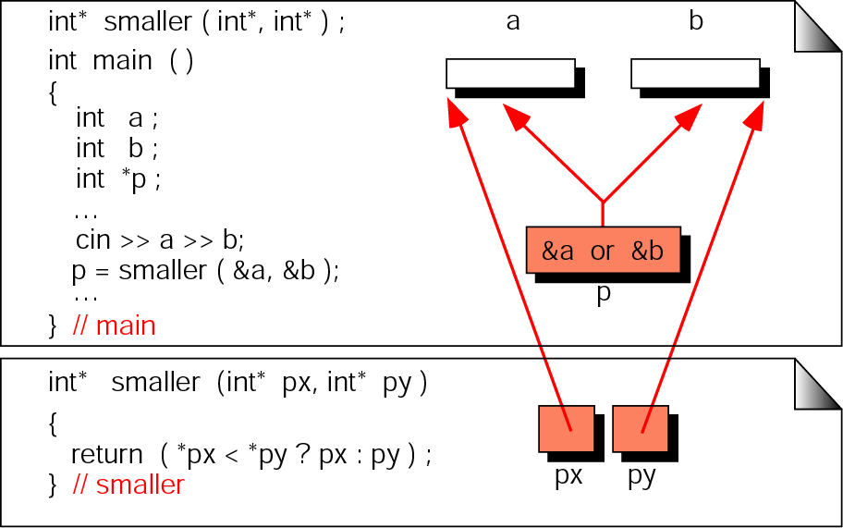
Figure 9-18 Functions returning pointers

Slide 32
Note:
It is a serious error to return a pointer to a local variable.

Slide 33
9.7
Pointers to Pointers

Slide 34
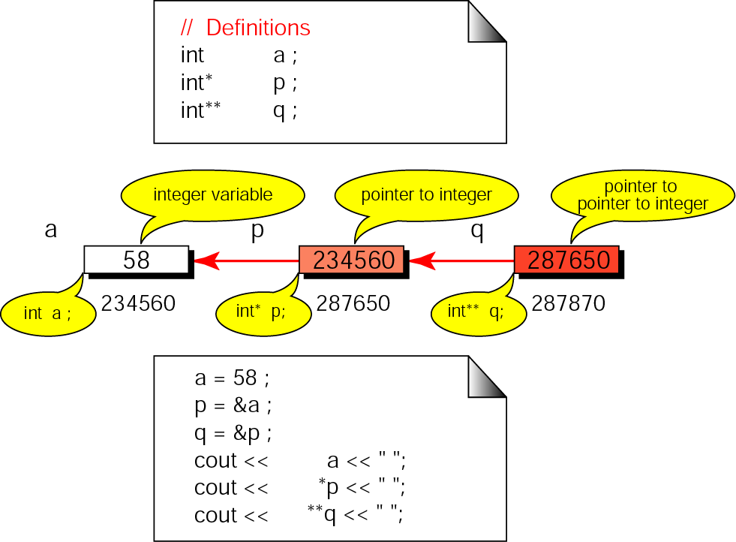
Figure 9-19 Pointers to pointers

Slide 35
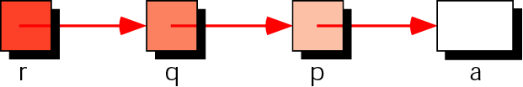
Figure 9-20 Using pointers to pointers

Slide 36
9.8
Compatibility

Slide 37
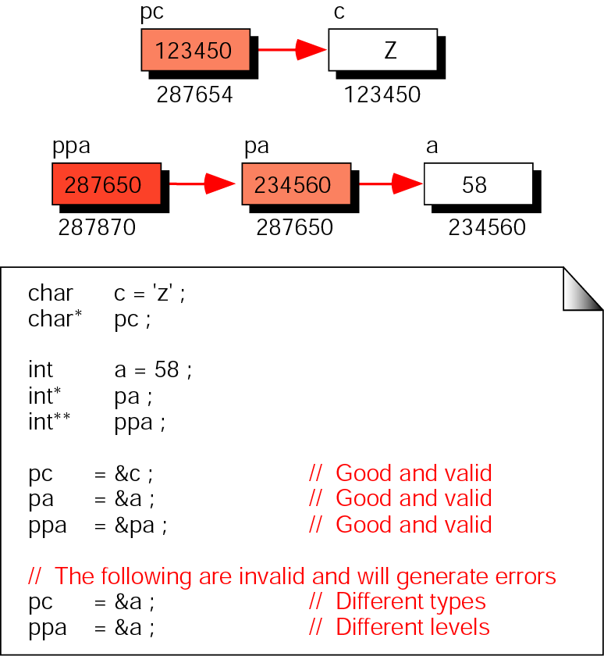
Figure 9-21 Pointer compatibility

Slide 38
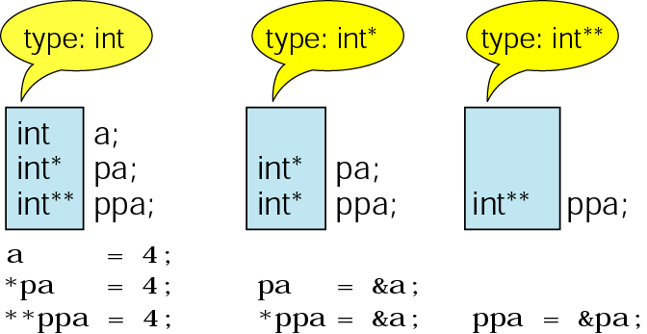
Figure 9-22 Pointer types must match

Slide 39
9.9
Reading and Writing Pointer Values

Slide 40
9.10
lvalue
and
rvalue

Slide 41
9.11
Pointer Applications

Slide 42
Note:
Create local variables when a value parameter will be changed within a function so that the original value will always be available for processing.

Slide 43
Note:
When several values need to be sent back to the calling function, use address parameters for all of them. Do not return one value and use address parameters for the others.

Slide 44
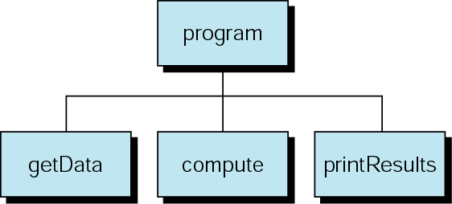
Figure 9-23 A common program design

Slide 45
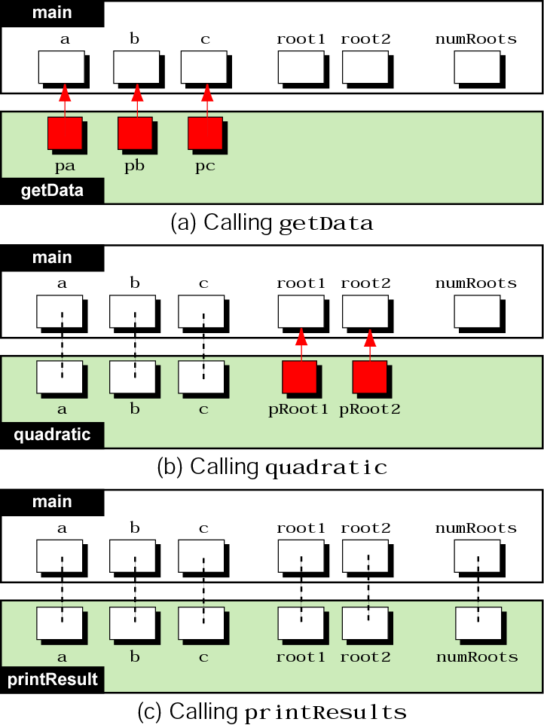
Figure 9-24 Using pointers as parameters

Slide 46
9.12
Arrays
and
Pointers

Slide 47
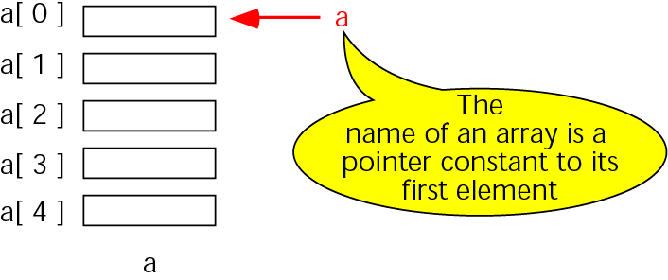
Figure 9-25 Pointers to arrays

Slide 48
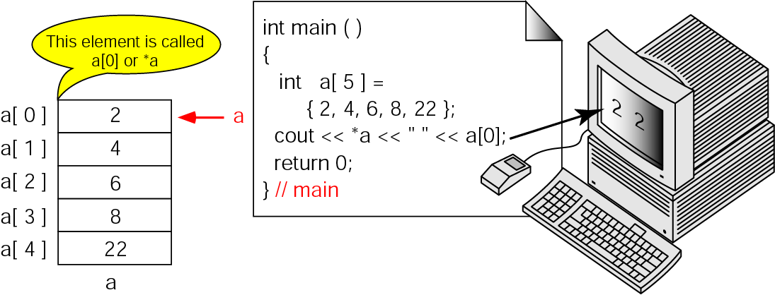
Figure 9-26 Dereference of array name

Slide 49
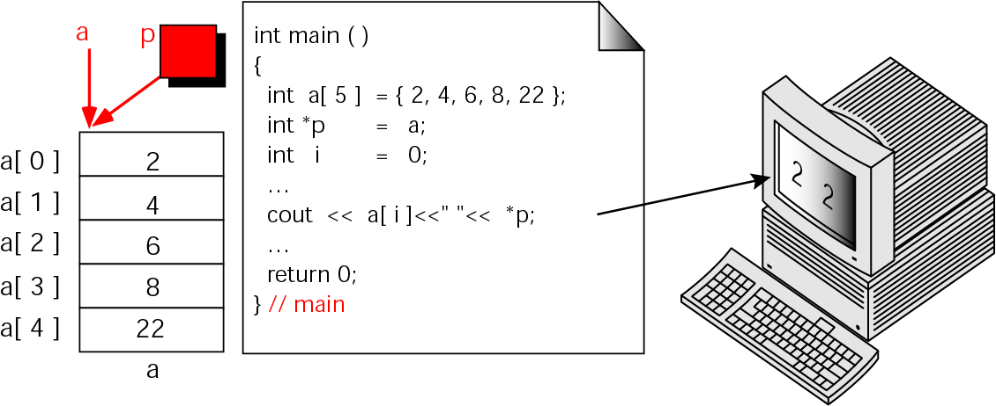
Figure 9-27 Array names as pointers

Slide 50
Note:
To access an array, any pointer to the first element can be used instead of the name of the array.

Slide 51
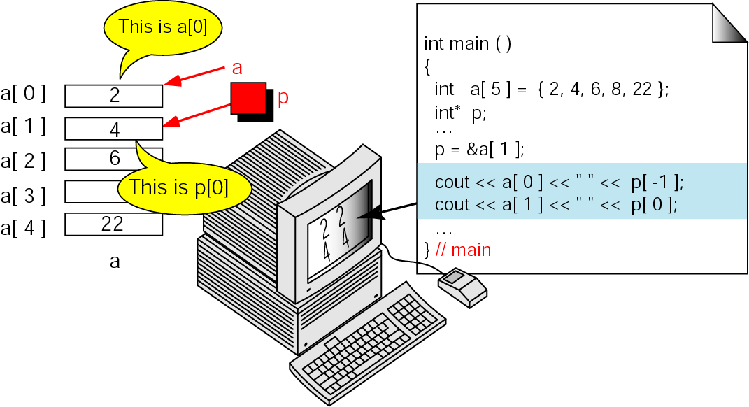
Figure 9-28 Multiple array pointers

Slide 52
9.13
Pointer Arithmetic and Arrays

Slide 53
Note:
Given pointer, p, p ± n is a pointer to the value n elements away.

Slide 54
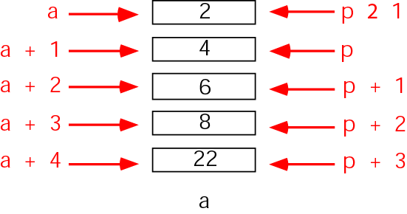
Figure 9-29 Pointer arithmetic
-

Slide 55
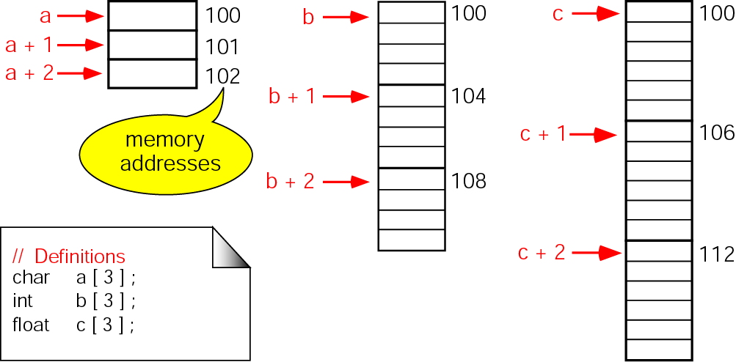
Figure 9-30 Pointer arithmetic and different types

Slide 56
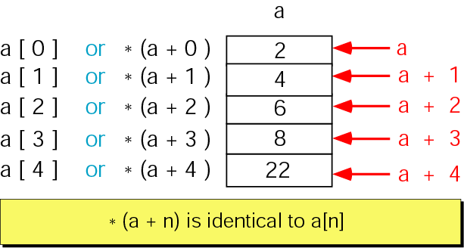
Figure 9-31 Dereferencing array pointers

Slide 57
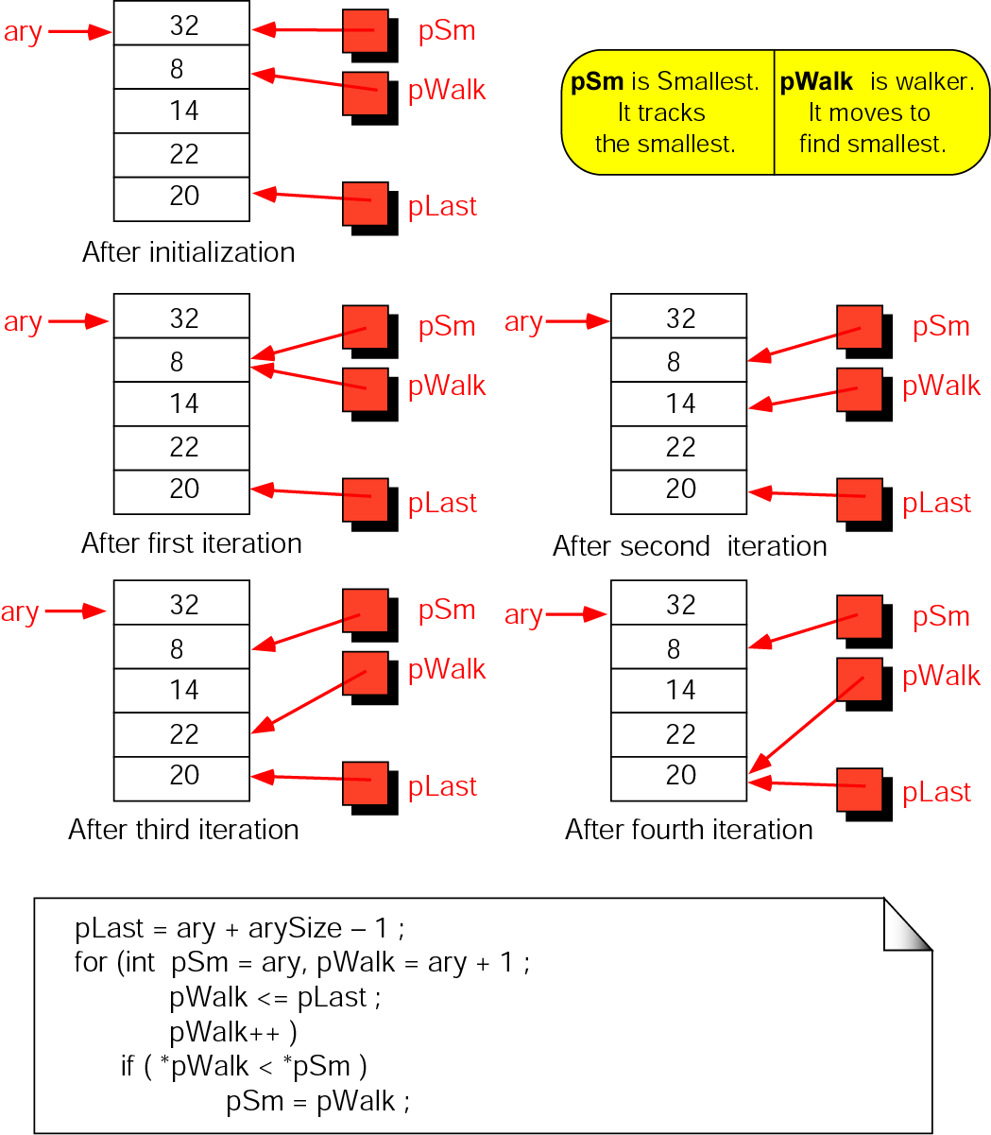
Figure 9-32 Find smallest

Slide 58
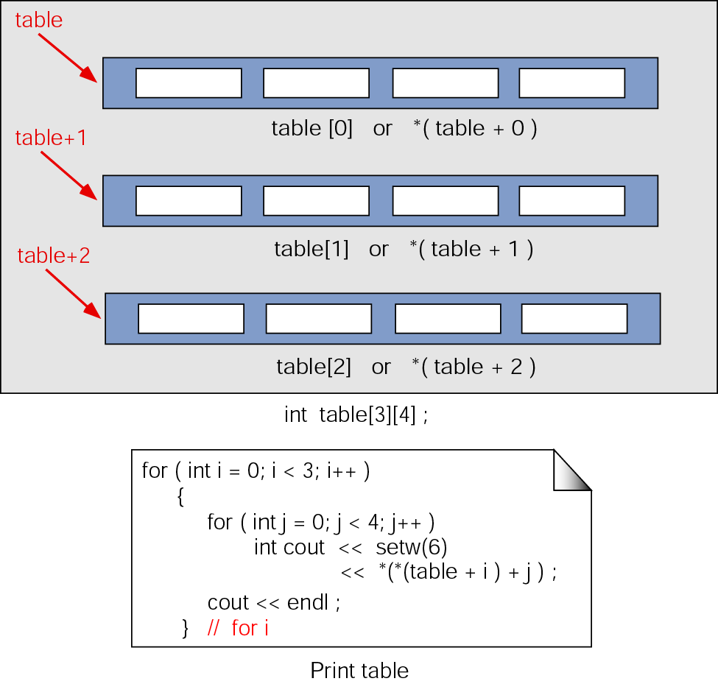
Figure 9-33 Pointers to two-dimensional arrays

Slide 59
9.14
Passing an Array to a Function

Slide 60
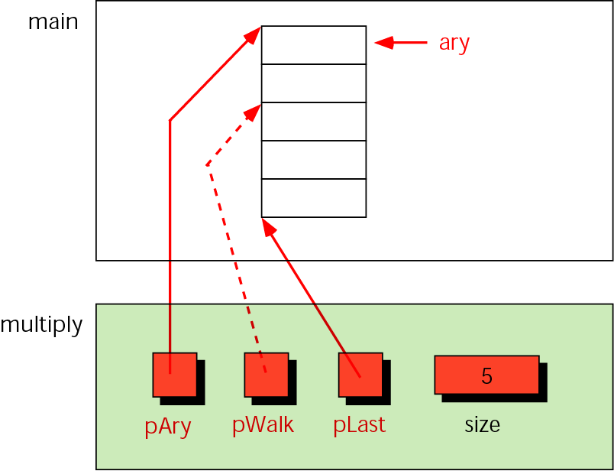
Figure 9-34 Variables for multiplying array elements

Slide 61
9.15
Memory Allocation Functions

Slide 62
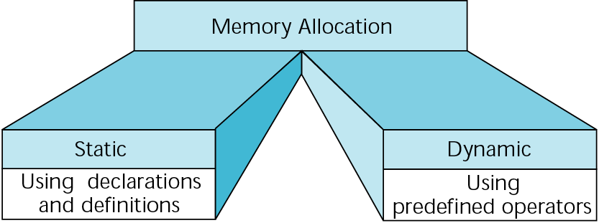
Figure 9-35 Memory allocation

Slide 63
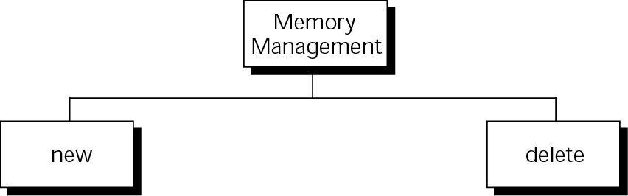
Figure 9-36 Memory management functions

Slide 64
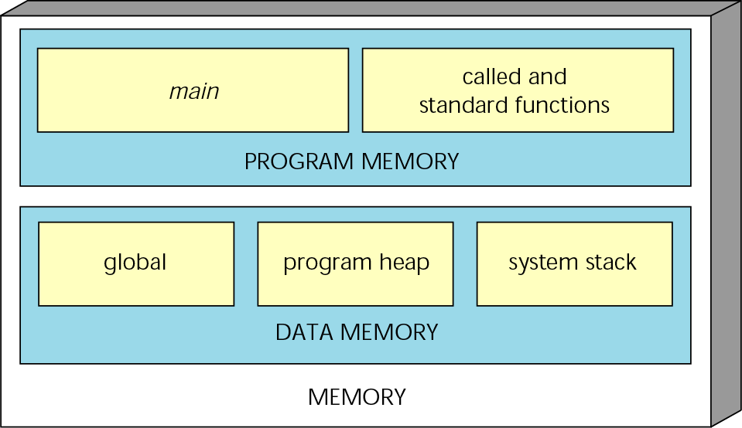
Figure 9-37 A conceptual view of memory

Slide 65
Note:
You can refer to dynamic memory only through a pointer.

Slide 66
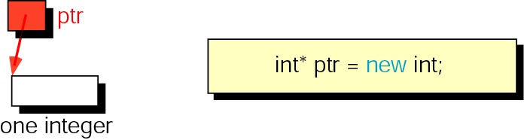
Figure 9-38 new memory allocation for a single data item

Slide 67
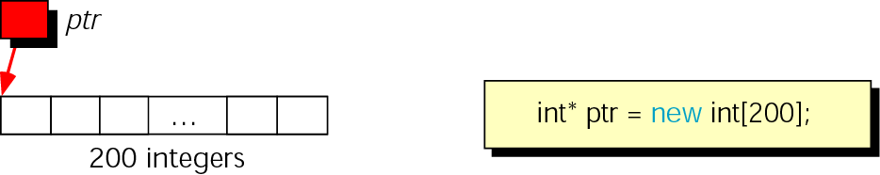
Figure 9-39 Memory allocation for an array

Slide 68
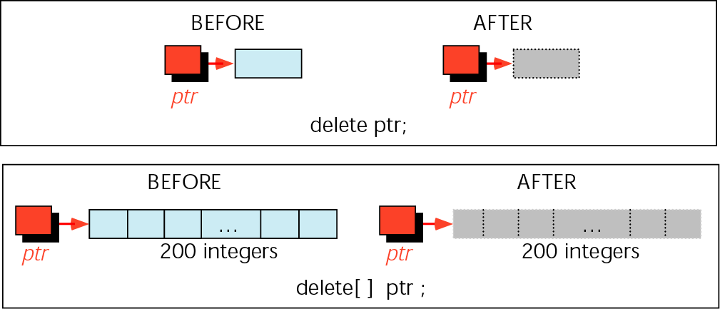
Figure 9-40 Freeing memory

Slide 69
Note:
Memory allocated by new must be released with delete, and memory allocated by new[…] must be released
with delete[ ].

Slide 70
9.16
Array of Pointers

Slide 71
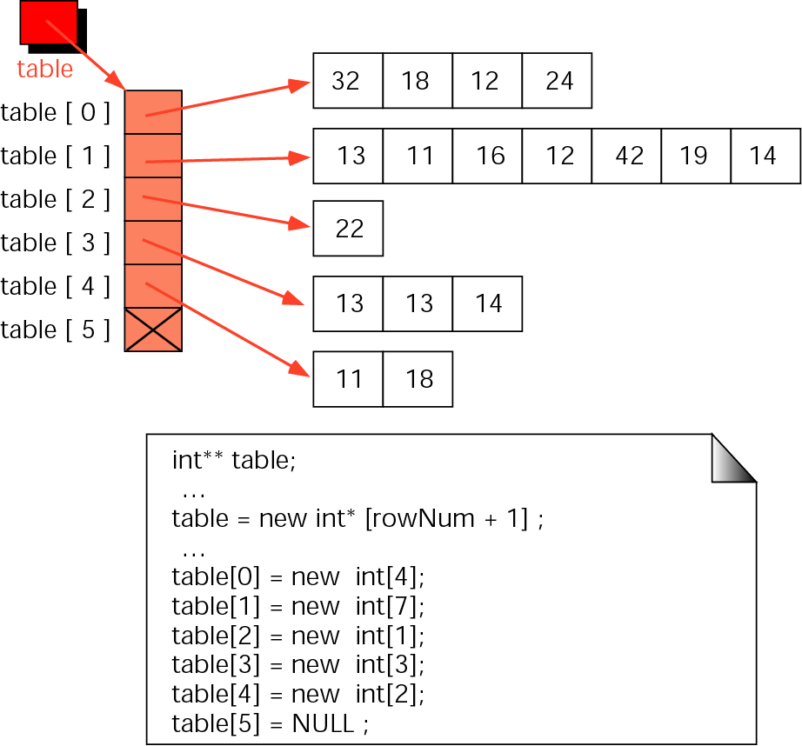
Figure 9-41 A ragged array

Slide 72
9.17
Programming Application

Slide 73
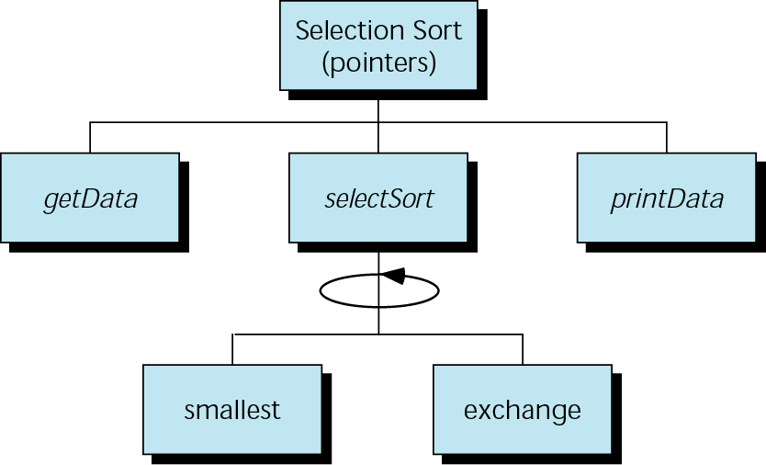
Figure 9-42 Selection sort with pointers

Slide 74
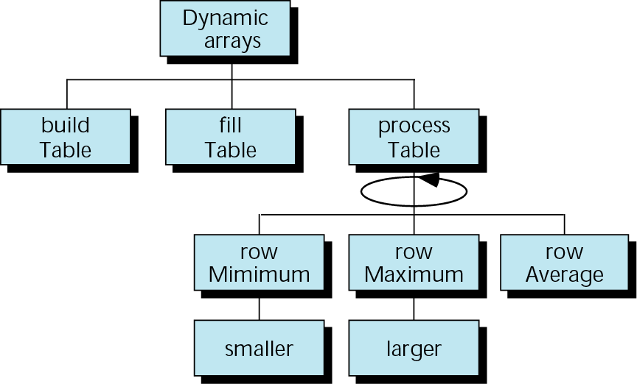
Figure 9-43 Dynamic array structure chart

Slide 75
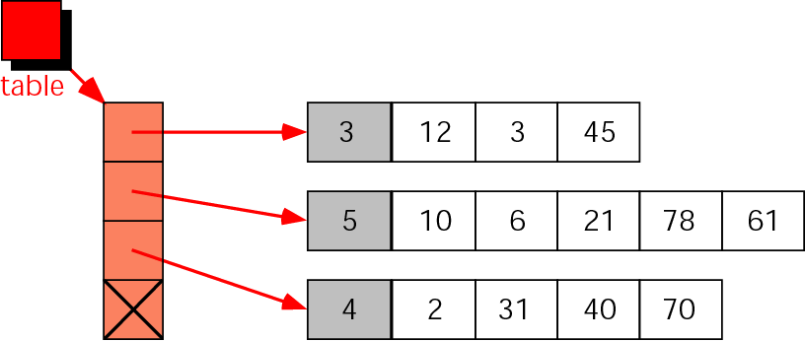
Figure 9-44 Ragged array structure

Slide 76
9.18
Software Engineering and Programming Style

Slide 77
Note:
Use value parameters when possible.

