Slide 1
Chapter 10
Classes

Slide 2
OBJECTIVES
After studying this chapter you will be able to:
 Write programs that use simple class structures.
 Declare class types.
 Understand and use the private, protected, and public access.
 Define a function as a member of a class using the scope resolution
operator.
 Access class members using the member operator.
 Write class constructors and destructors.
 Understand and explain manager, mutator, and accessor functions.
 Use the Unified Modeling Language (UML) to design and document
classes.

Slide 3
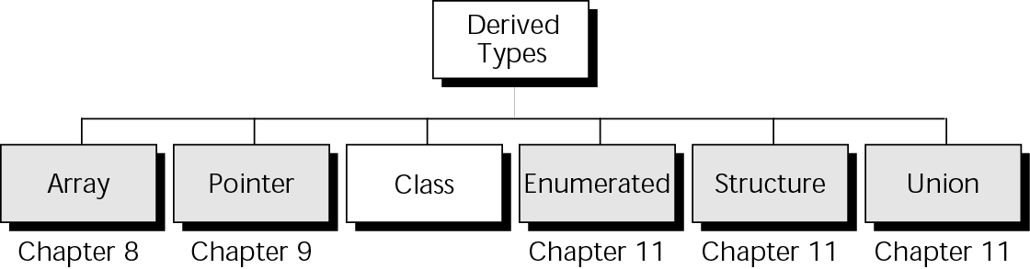
Figure 10-1 Derived types

Slide 4

10.1
Basic Class Concepts

Slide 5
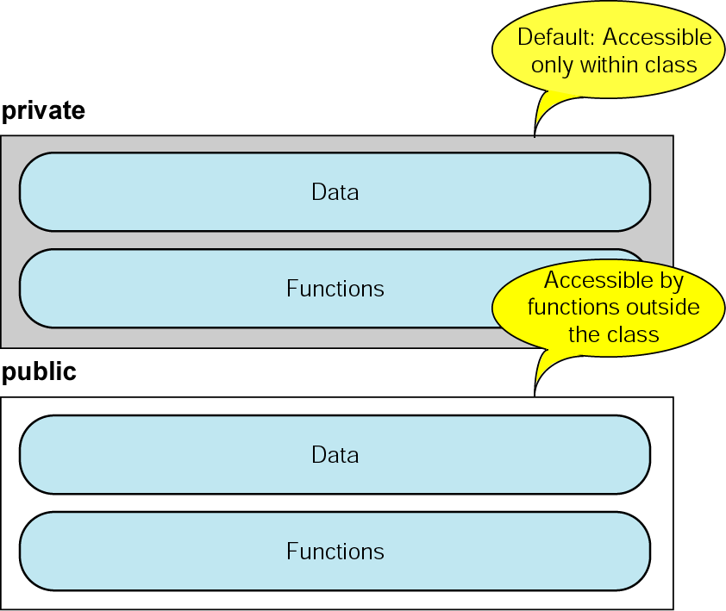
Figure 10-2 Class access specifiers

Slide 6
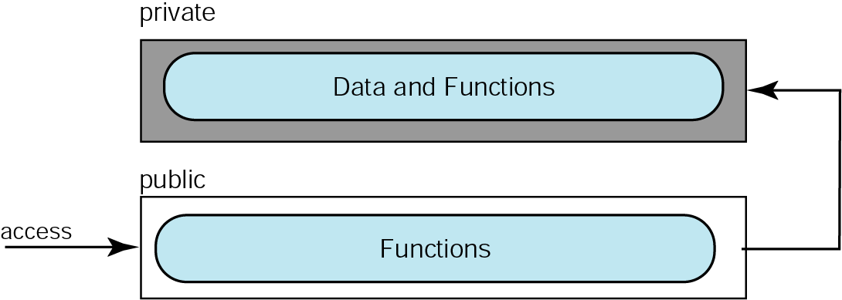
Figure 10-3 Accessing data in a class

Slide 7
Note:
We recommend that class identifiers start with an uppercase letter to ensure uniqueness and to help identify the type as a class.

Slide 8
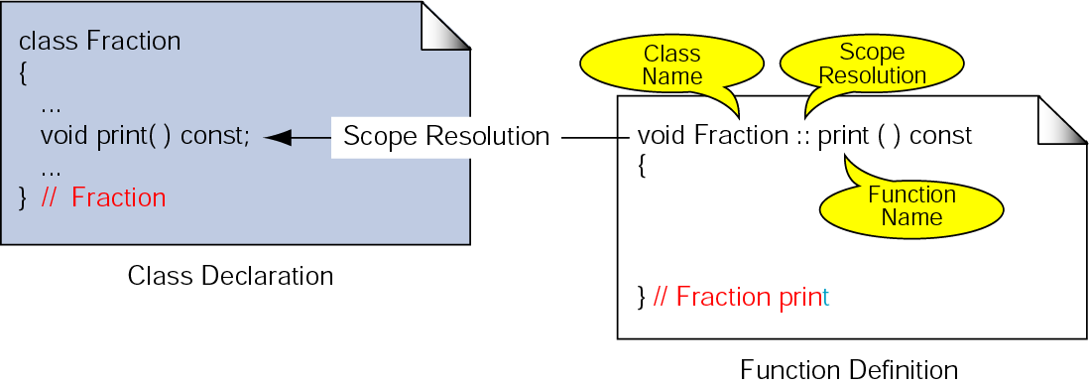
Figure 10-4 Scope resolution operator

Slide 9
10.2
Class
Objects

Slide 10
Note:
Use the scope resolution operator to refer to a specific class type and use the member operator to refer to data or functions within an instantiated class object.

Slide 11
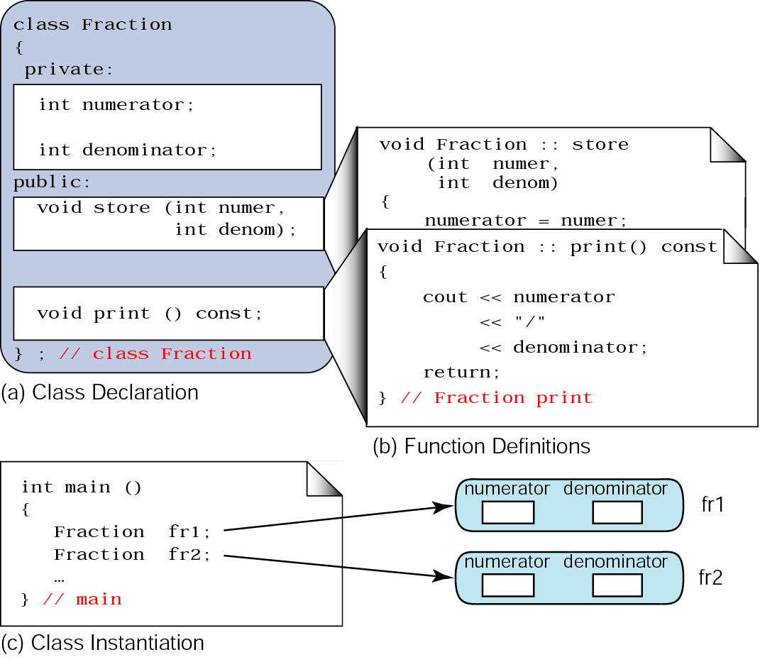
Figure 10-5 Class objects

Slide 12
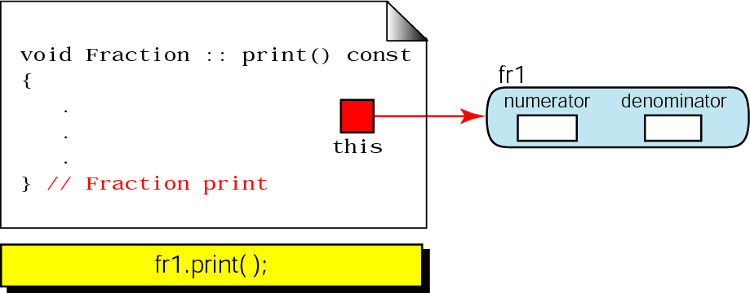
Figure 10-6 The this pointer

Slide 13
10.3
Manager Functions

Slide 14
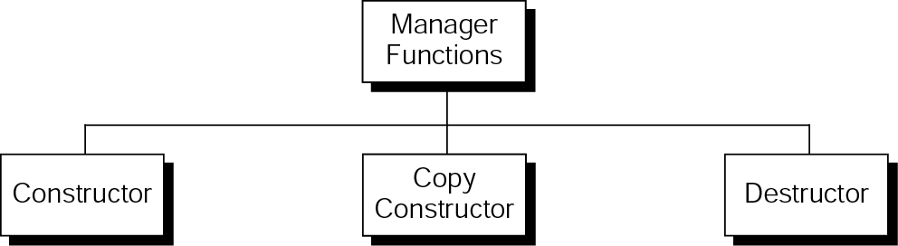
Figure 10-7 Manager Functions

Slide 15
Note:
A constructor is called every time an object is instantiated.

Slide 16
Note:
The name of a constructor is the same as the name of the class and it may not have a return type.

Slide 17
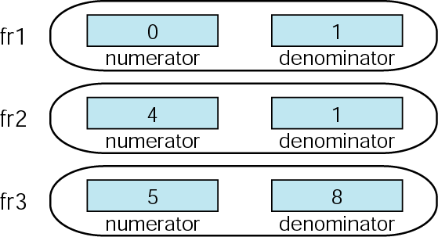
Figure 10-8 Fractions created by Program 10-7

Slide 18
Note:
A class must have at least one constructor, either defined by the program or by the compiler.

Slide 19
Note:
The default constructor is called whenever an object is crated without passing any arguments.

Slide 20
Note:
If we define any type of constructor, we must also define a default constructor if it is needed.

Slide 21
Note:
There is only one default constructor; it cannot be overloaded.

Slide 22
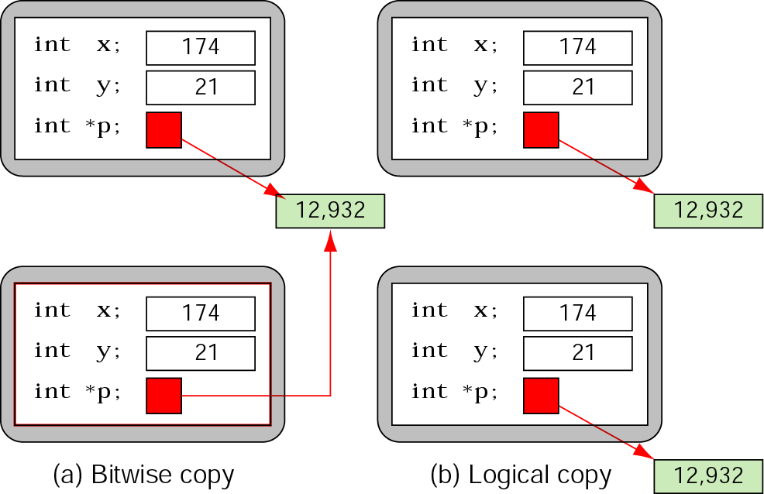
Figure 10-9 Bitwise and logical copies

Slide 23
Note:
There is always one copy constructor available in a class.

Slide 24
Note:
Always pass objects to a function by reference; when the object cannot be changed, pass it as a constant.

Slide 25
Note:
Always return objects by value.

Slide 26
Note:
A class can have one, and only one, destructor.

Slide 27
10.4
Mutators and Accessors

Slide 28
10.5
Class Invariants

Slide 29
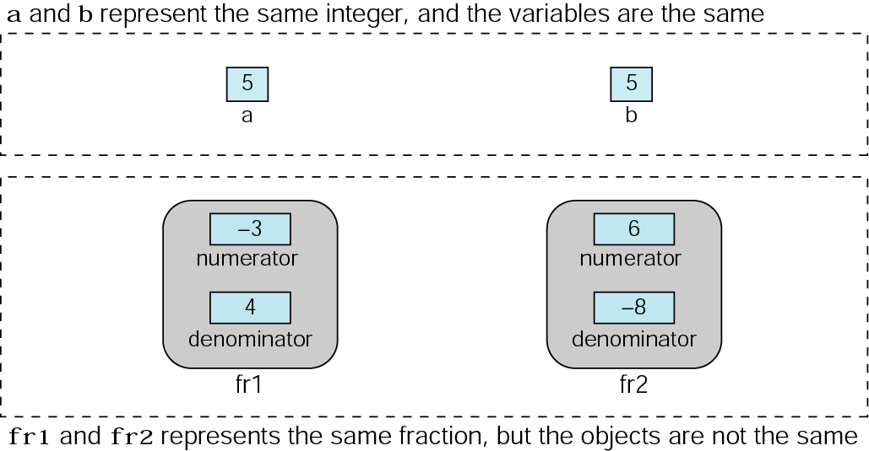
Figure 10-10 Class invariants

Slide 30
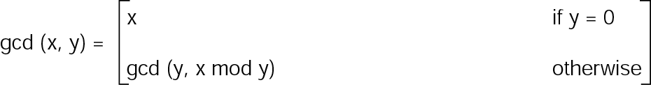
Figure 10-11 Greatest common divisor

Slide 31
10.6
Complex Class Functions

Slide 32
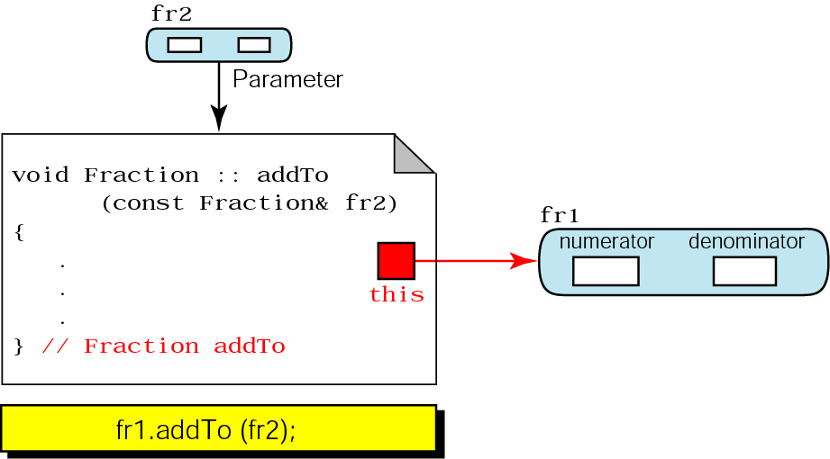
Figure 10-12 Add two fractions

Slide 33
Note:
Functions that are members of a class can only be called through objects of that class. They cannot be called independently.

Slide 34
Note:
Friend functions are not members of a class, but are associated with it.

Slide 35
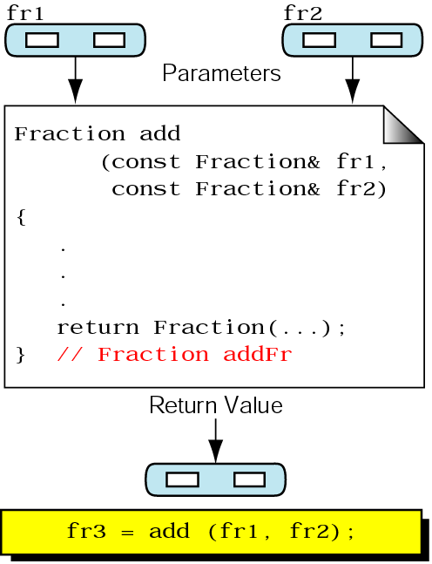
Figure 10-13 Add and return fraction value

Slide 36
10.7
Programming Applications

Slide 37
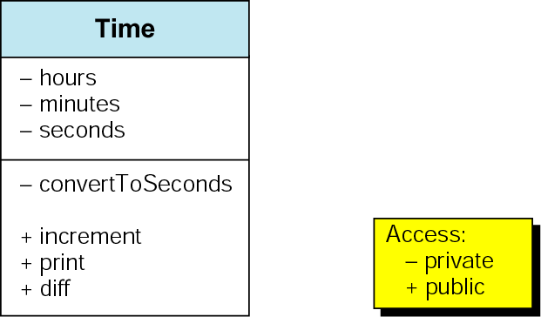
Figure 10-14 Time class design

Slide 38
10.8
Software Engineering and Programming Style

Slide 39
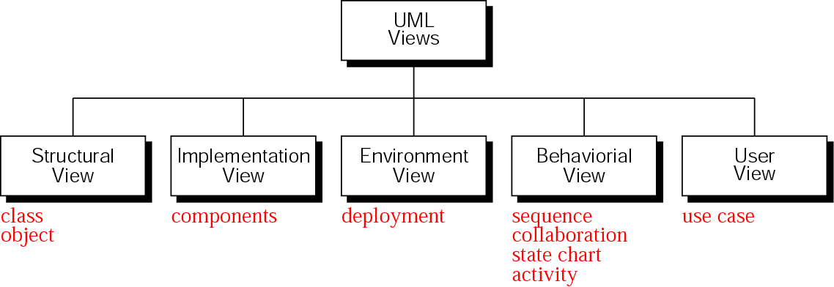
Figure 10-15 UML views

Slide 40
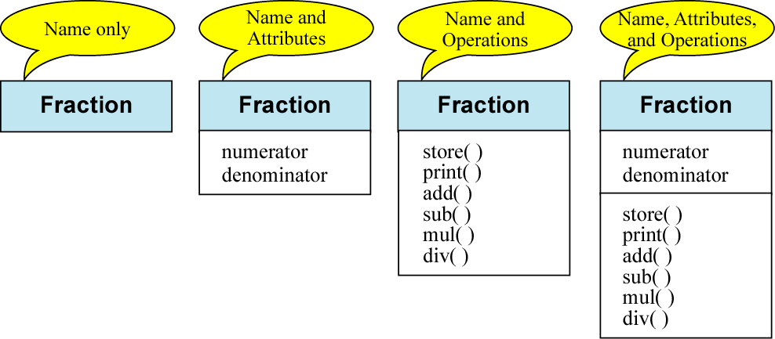
Figure 10-16 Class diagrams

Slide 41
Note:
The name compartment is mandatory in a class diagram.

Slide 42
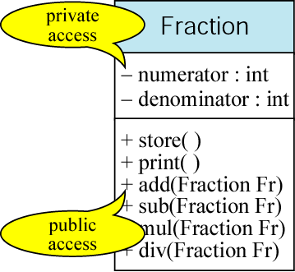
Figure 10-17 Expanded class diagram

Slide 43
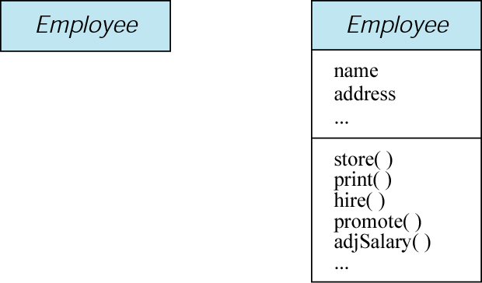
Figure 10-18 An abstract class

Slide 44
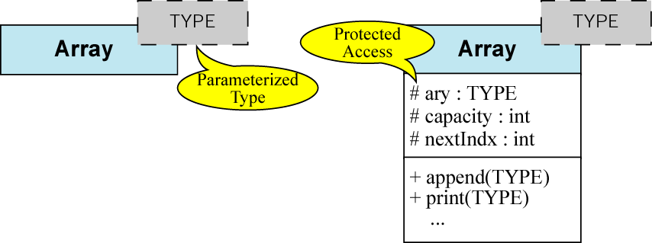
Figure 10-19 Class template diagrams

Slide 45
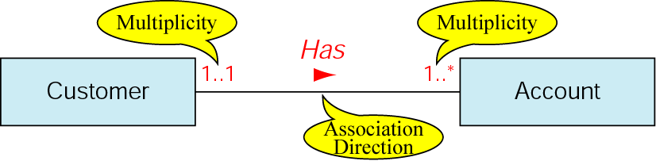
Figure 10-20 Class association

Slide 46
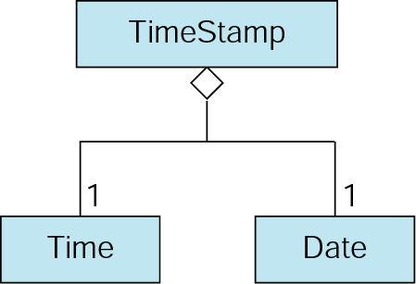
Figure 10-21 Aggregation

Slide 47
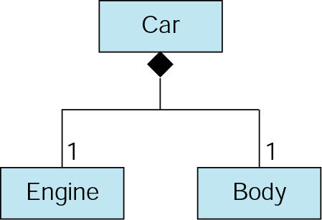
Figure 10-22 Composition

Slide 48
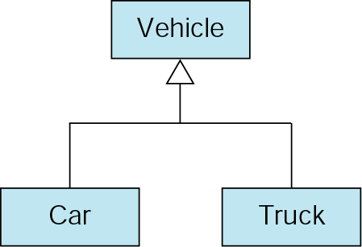
Figure 10-23 Generalization diagram

Slide 49
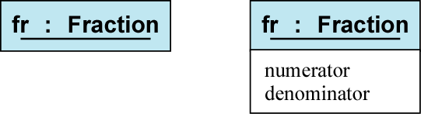
Figure 10-24 Object diagram

