Slide 1
Chapter 13
Templates

Slide 2
OBJECTIVES
After studying this chapter you will be able to:
 Understand and create templates for functions and classes.
 Overload a function template.
 Understand the differences between generic and concrete types.
 Understand the concepts of atomic and composite types.
 Understand the concept of an Abstract Data Type (ADT).

Slide 3
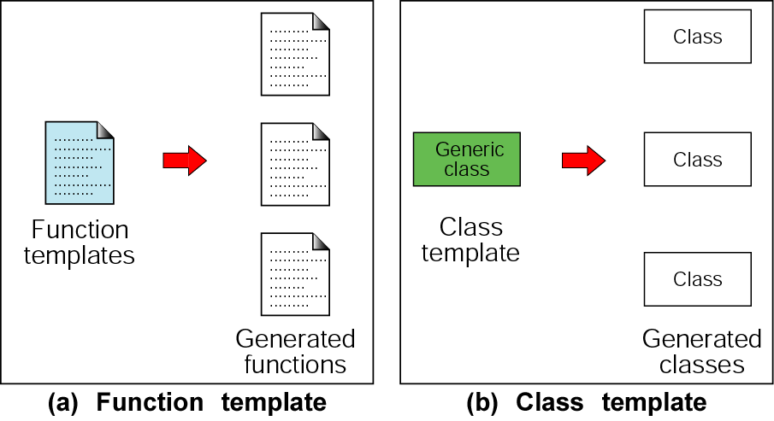
Figure 13-1 Basic template concepts

Slide 4

13.1
Function Templates

Slide 5
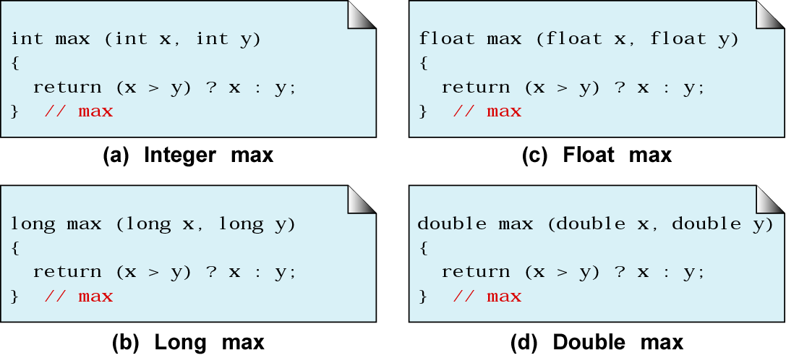
Figure 13-2 Multiple max functions

Slide 6
Note:
A function template can create multiple functions, each with potentially different arguments and return types.

Slide 7
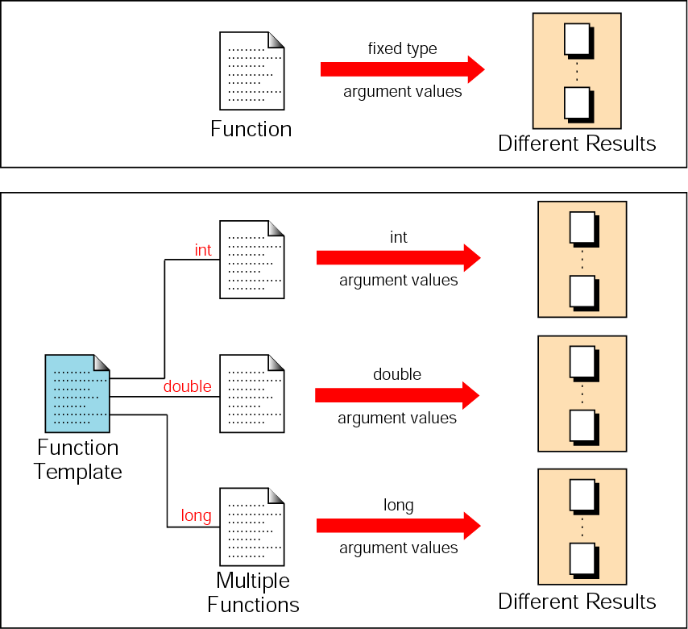
Figure 13-3 Function template operation

Slide 8
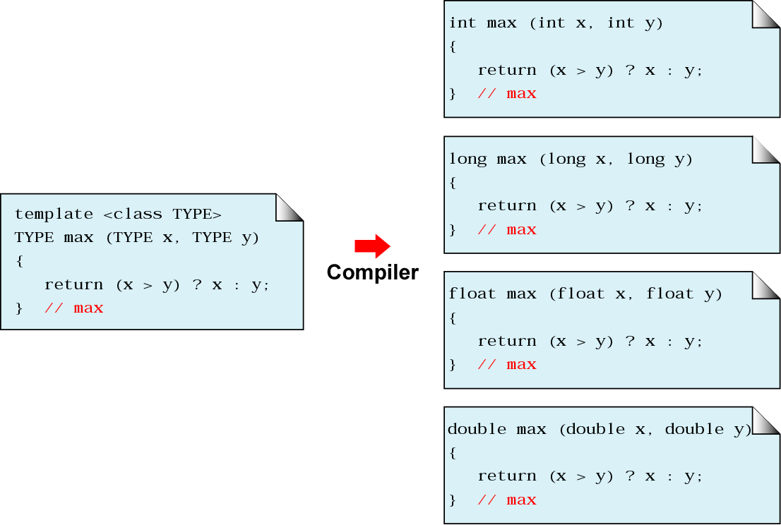
Figure 13-4 Generated functions

Slide 9
Note:
Function templates allow us to write a single function for a whole family of similar functions.

Slide 10
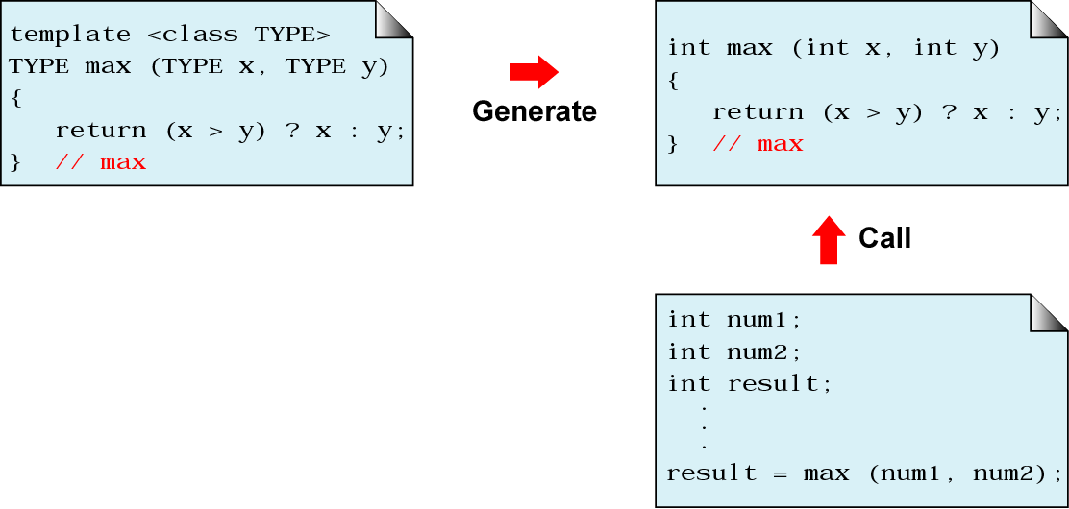
Figure 13-5 Function template generation

Slide 11
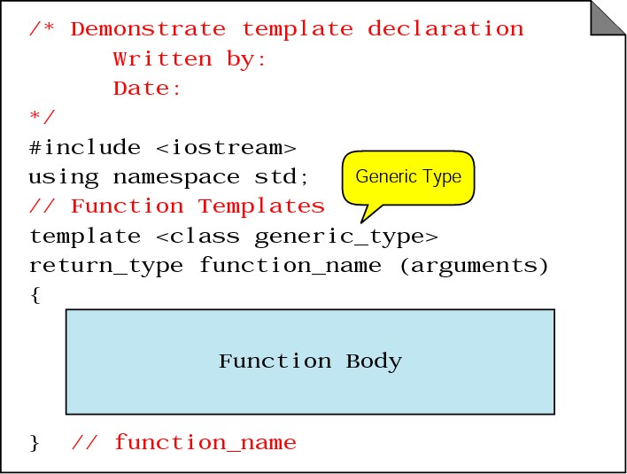
Figure 13-6 Function declaration

Slide 12
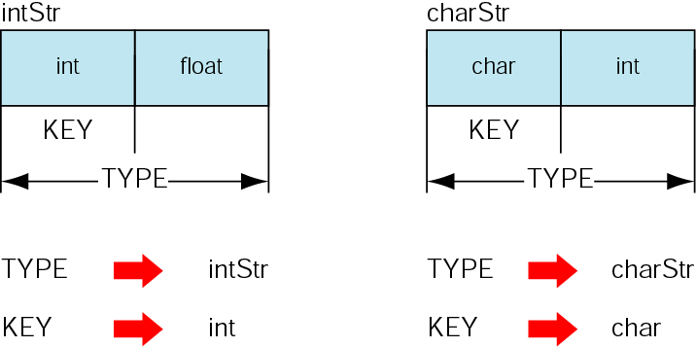
Figure 13-7 Structure design for search template

Slide 13
13.2
Class Templates

Slide 14
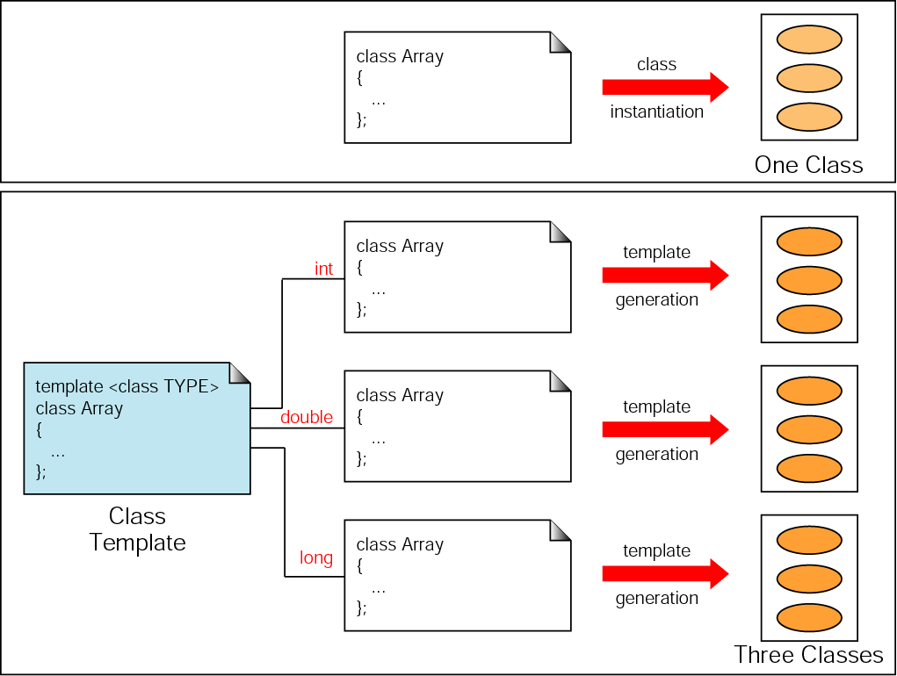
Figure 13-8 Class template operation

Slide 15
13.3
Software Engineering and Programming Style

Slide 16
Note:
Atomic Data Type
1. A set of values
2. A set of operations on values

Slide 17
Note:
Data Structure
1. A combination of elements, each of
which is either an atomic type or
another data structure
2. A set of associations or relationships
(structure) involving the combined
elements

Slide 18
Note:
The concept of abstraction means:
• We know what a data type can do.
• How it is done is hidden.

Slide 19
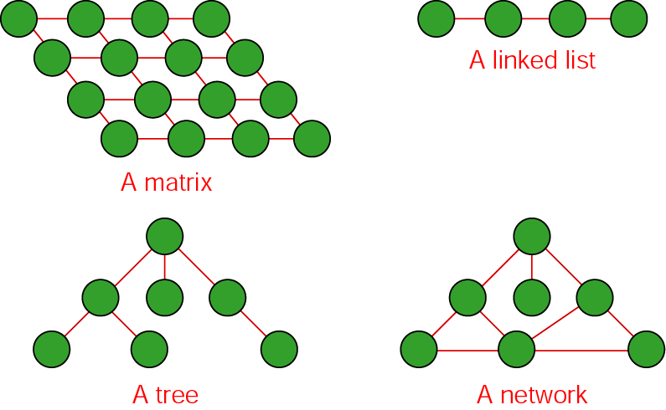
Figure 13-9 Some structures

Slide 20
Note:
Abstract Data Type
1. Declaration of data
2. Declaration of operations

Slide 21
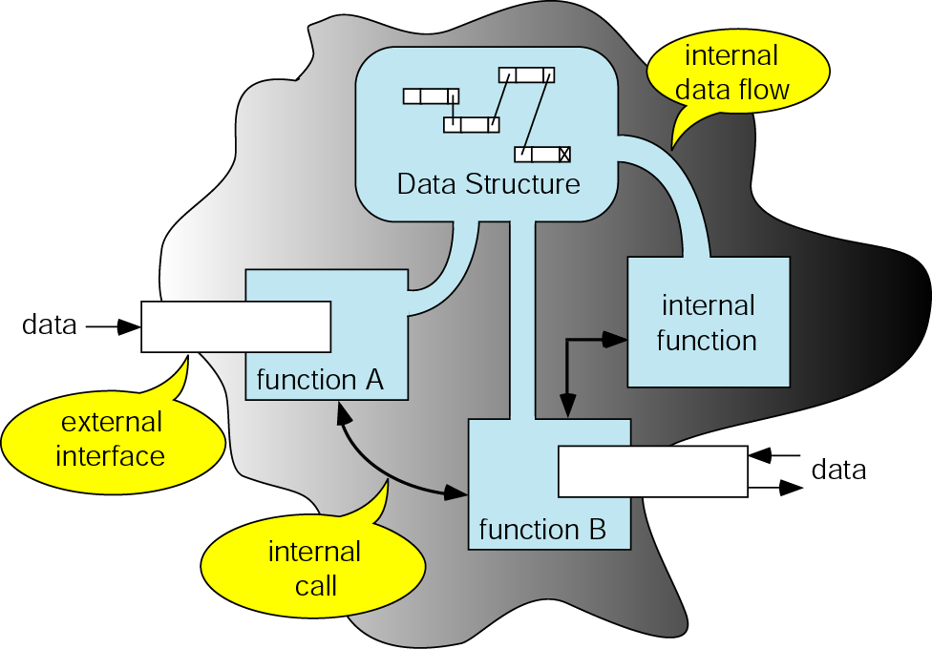
Figure 13-11 Abstract data type model

