Slide 1
Chapter 14
Strings

Slide 2
OBJECTIVES
After studying this chapter you will be able to:
 Understand the basic types of strings.
 Define and use the string class and C-type strings.
 Read and write strings.
 Access and manipulate characters or substrings within a string.
 Concatenate and compare strings.
 Insert, replace, swap, or erase a substring in a string.
 Understand the seven steps in the design of a program:
 Use transform analysis to create a structure chart.

Slide 3

14.1
String Concepts

Slide 4
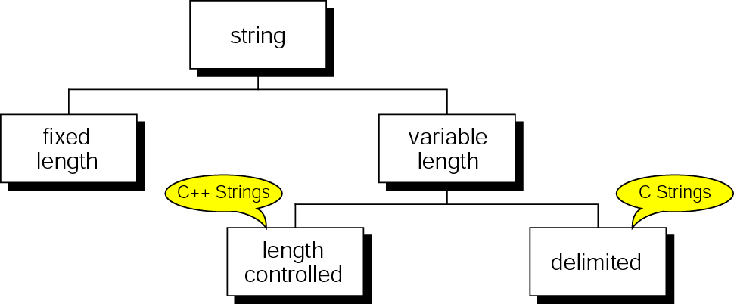
Figure 14-1 String taxonomy

Slide 5
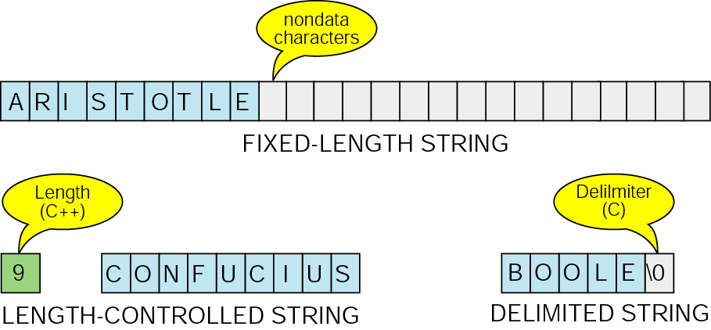
Figure 14-2 String formats

Slide 6
14.2
C++ Strings

Slide 7
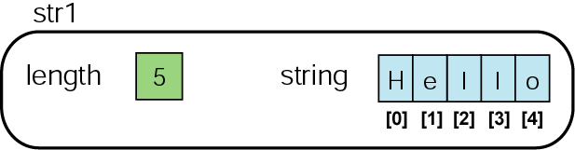
Figure 14-3 A C++ string

Slide 8
14.3
C++ String Input/Output

Slide 9
Note:
The extraction operator stops at whitespace.
To read a string with spaces, we must use getline.

Slide 10
Note:
The string input /output operators and functions are defined
in the string header file,
not the I/O stream header file.

Slide 11
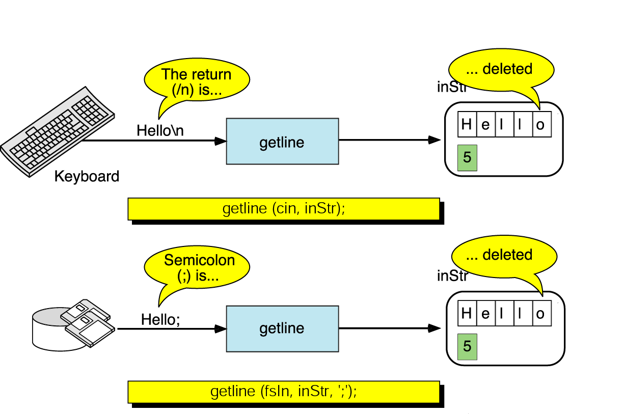
Figure 14-4 getline function

Slide 12
Note:
The getline function is overloaded to work with two or three arguments.

Slide 13
14.4
Arrays of Strings

Slide 14
14.5
String Manipulation Functions

Slide 15
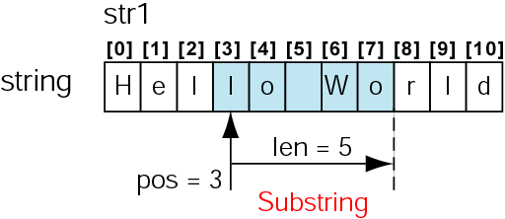
Figure 14-5 Substring concept

Slide 16
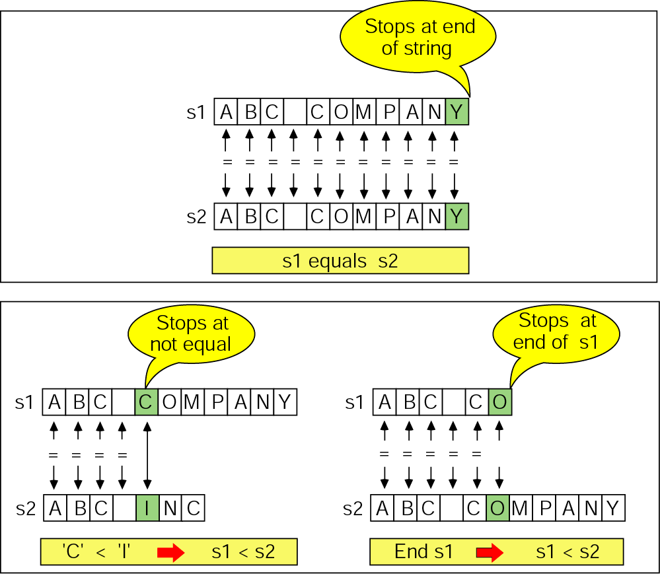
Figure 14-6 String compares

Slide 17
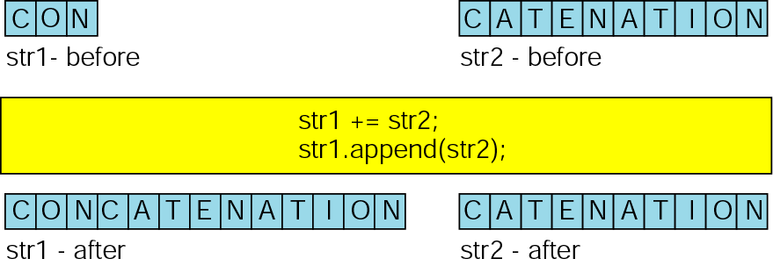
Figure 14-7 String append

Slide 18
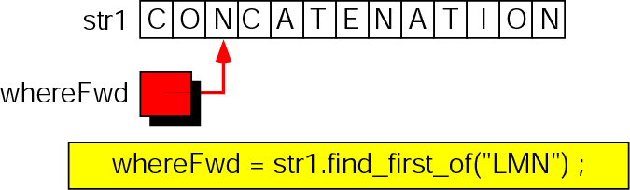
Figure 14-8 Find first

Slide 19
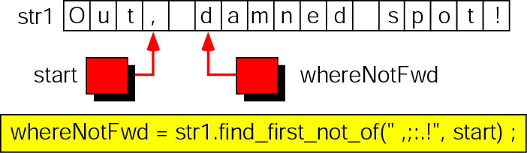
Figure 14-9 Find first not

Slide 20
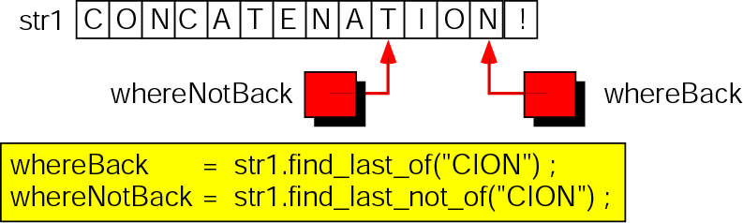
Figure 14-10 Find last

Slide 21
14.6
A Programming Example: Morse Code

Slide 22
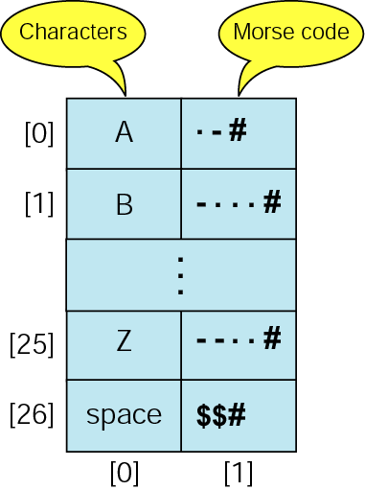
Figure 14-11 Character to Morse code structure

Slide 23
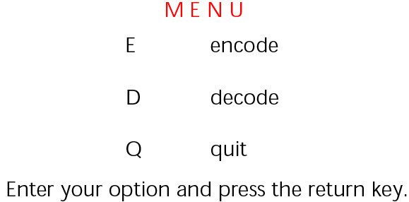
Figure 14-12 Morse code menu

Slide 24
14.7
C Strings

Slide 25
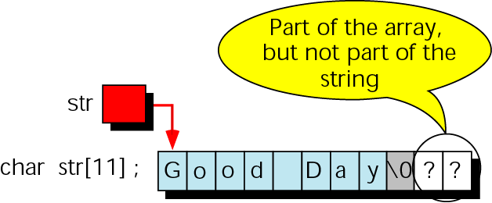
Figure 14-13 Strings in arrays

Slide 26
Note:
We cannot use the assignment operator to copy C strings.
We must use the strcpy function.

Slide 27
Note:
Always use set width when reading C strings.

Slide 28
14.8
Comparison Between C and C++ Strings

Slide 29
14.9
Software Engineering and Programming Style

Slide 30
Figure 14-14 Requirements for case study
Payroll Case Study
1. Requirements:
Given employees and their hours worked, compute net pay and record a
payroll data for subsequent processing, such as W-2 statements. Prepare
paychecks and a payroll ledger.
Maintain data on a sequential payroll file.
2. Provide for the following nonstatutory deductions:
    a. Health plan
    b. United Way
    c. Union dues
3. The payroll data are:
    a. Employee number
    b. Pay rate
    c. Union member flag
    d. United Way contribution

Slide 31
Figure 14-14 Requirements for case study (continued)
4. Maintain the following year-to-date totals:
  a. Earnings
  b. FICA taxes
  c. SDI taxes
  d. Federal withholding
  e. State withholding
  f. Health plan fees
  g. United Way donations
  h. Union dues
5. Algorithms
  a. Gross Pay = (Reg Hours * Rate) + (OT Hours * Rate * 1.5)
  b. FICA Taxes = (Gross Pay * FICA Rate) if less than MaxFICA
  c. SDI Taxes = (Gross Pay * SDI Rate) if less than Max SDI
  d. Taxable Earnings = (Gross Pay – (Exemptions * Exemption Rate))
  e. Federal Taxes = (Taxable Earnings * Federal TaxRate)
  f. State Taxes = (Taxable Earnings * State Tax Rate)
  g. Net Pay = Gross Pay – (FICA Taxes + SDI Taxes + Taxable Earnings +
  Federal Taxes + State Taxes + Health Fee + United Way Donation + Union Dues)

Slide 32
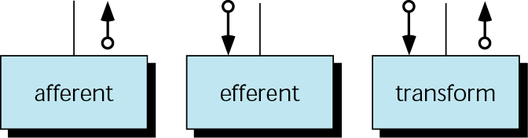
Figure 14-15 Afferent, efferent, and transform modules

Slide 33
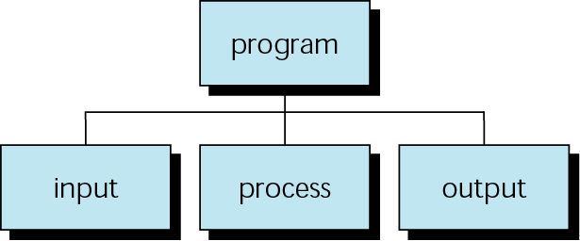
Figure 14-16 Basic structure chart organization

Slide 34
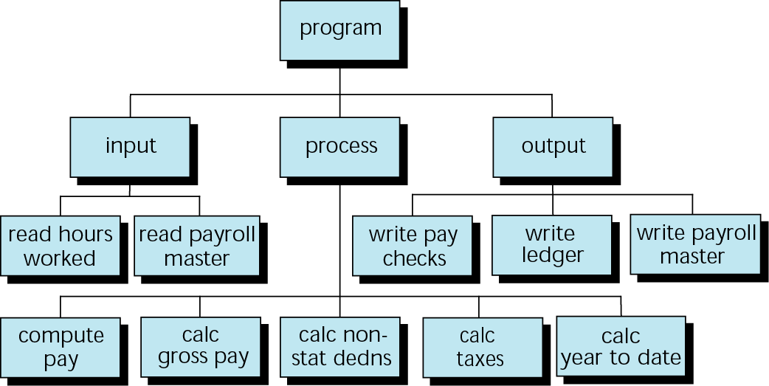
Figure 14-17 First-cut structure chart

Slide 35
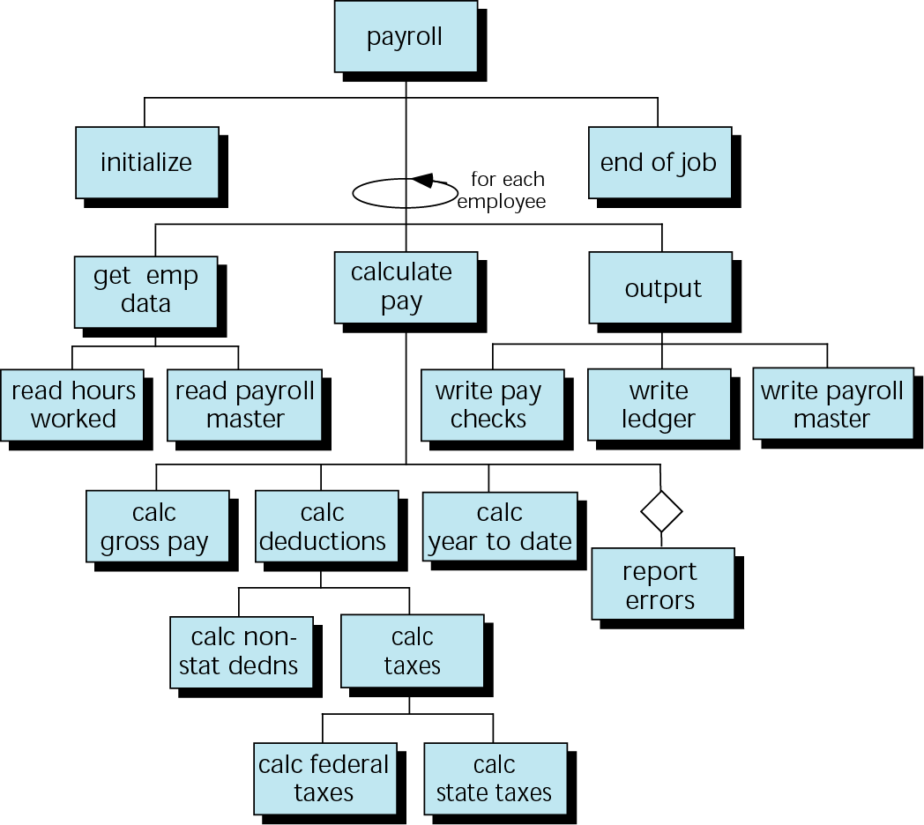
Figure 14-18 Final payroll structure chart

