Slide 1
Chapter 17
Linked
List

Slide 2
OBJECTIVES
After studying this chapter you will be able to:
 Understand and discuss the basic concepts of linked list processing.
 Write functions to insert, delete, search, and traverse a linked list.
 Create a class that maintains and processes data in a linked list.
 Discuss the basic factors involved in developing quality software.

Slide 3

17.1
Linked List Structure

Slide 4
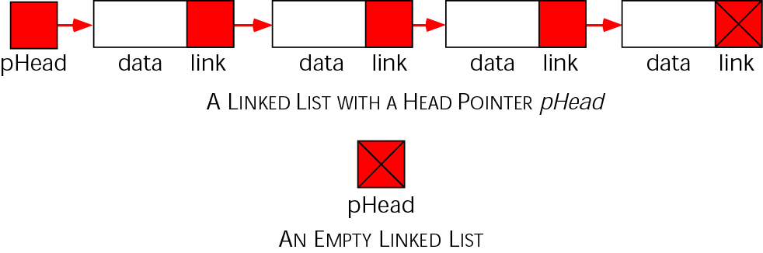
Figure 17-1 A linked list

Slide 5
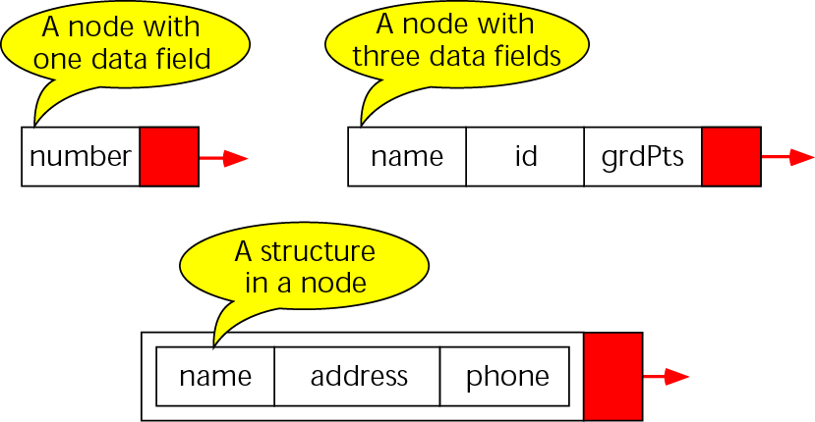
Figure 17-2 Nodes

Slide 6
17.2
Basic Linked List Functions

Slide 7
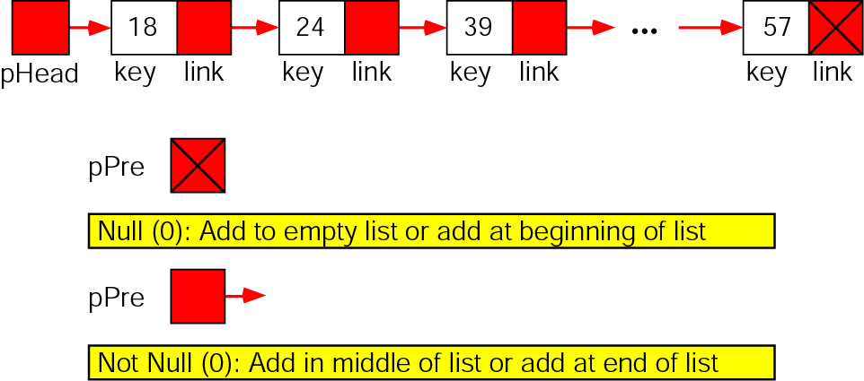
Figure 17-3 Pointer combinations for add

Slide 8
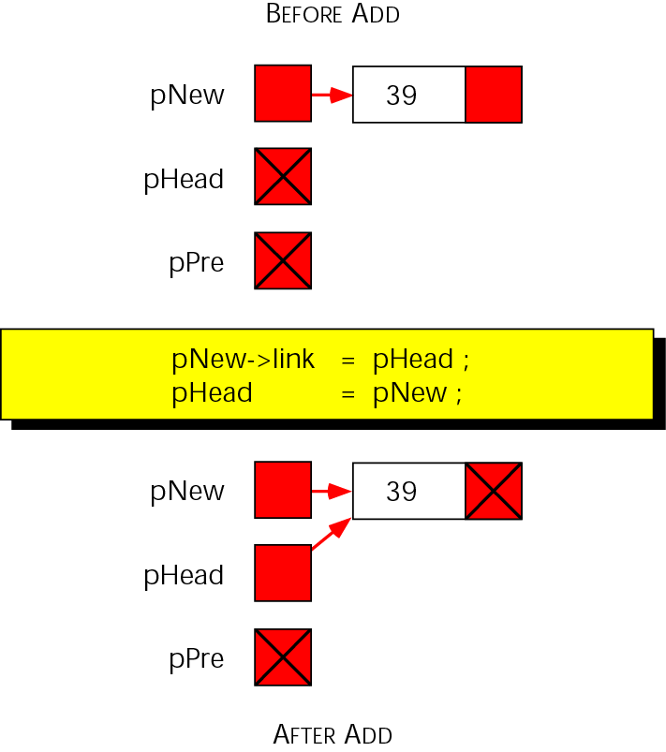
Figure 17-4 Add node to empty list

Slide 9
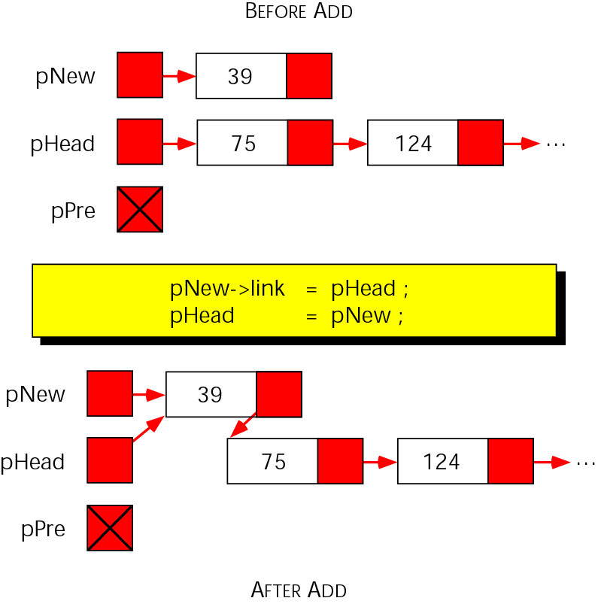
Figure 17-5 Add node at beginning

Slide 10
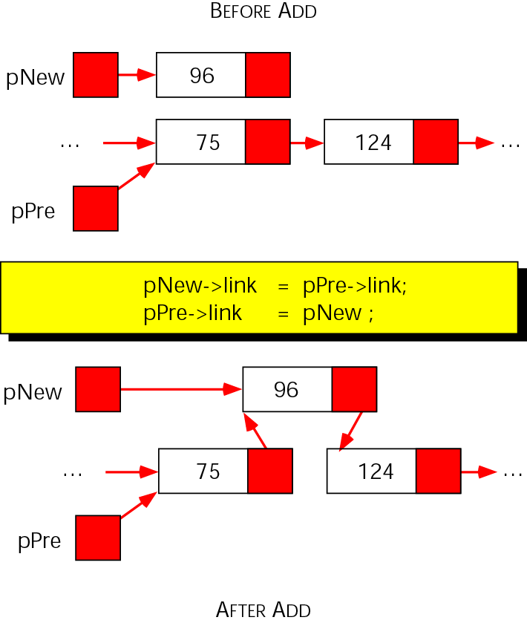
Figure 17-6 Add node in middle

Slide 11
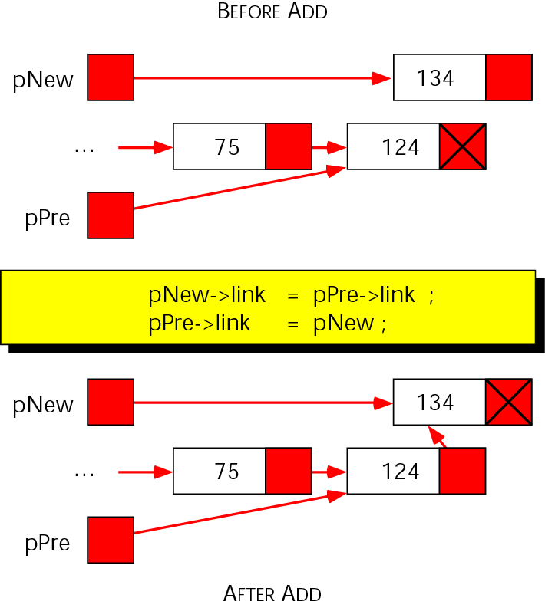
Figure 17-7 Add node at end

Slide 12
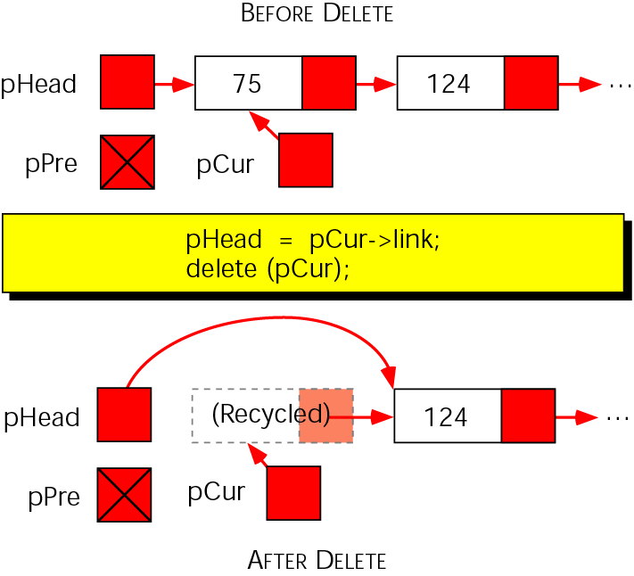
Figure 17-8 Delete first node

Slide 13
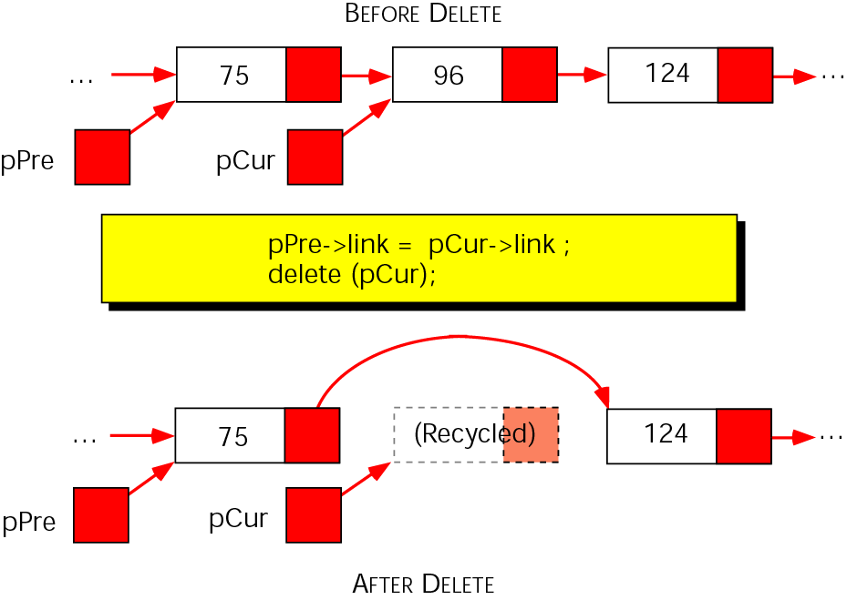
Figure 17-9 Delete—general case

Slide 14
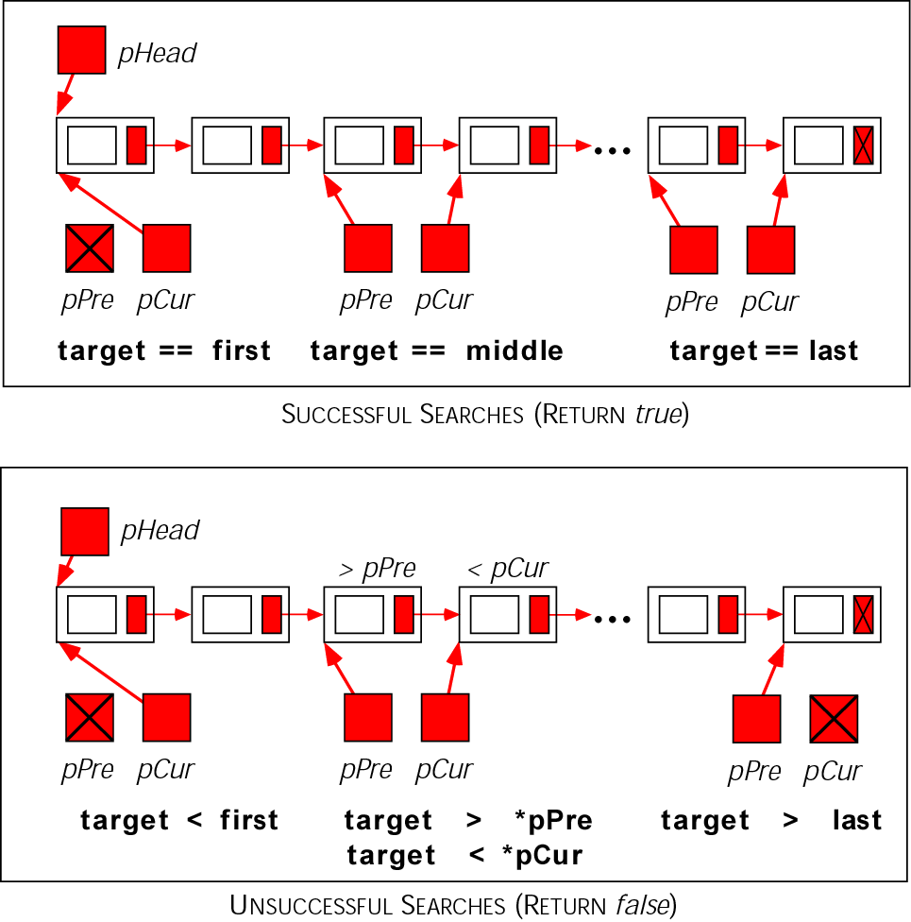
Figure 17-10 Search results

Slide 15
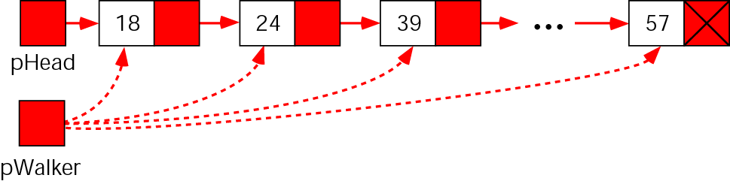
Figure 17-11 Linked list traversal

Slide 16
17.3
Linked List Design

Slide 17
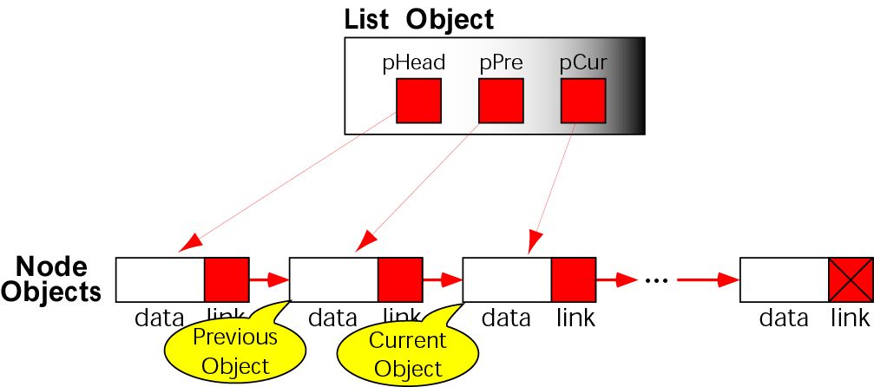
Figure 17-12 List and node interrelationships

Slide 18
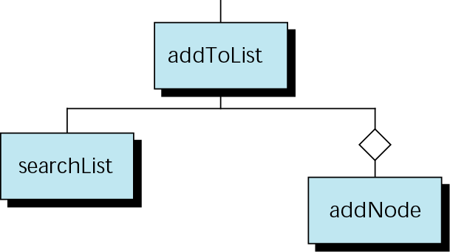
Figure 17-13 Design for addToList

Slide 19
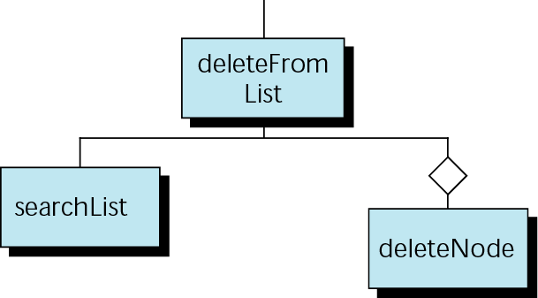
Figure 17-14 Design for deleteFromList

Slide 20
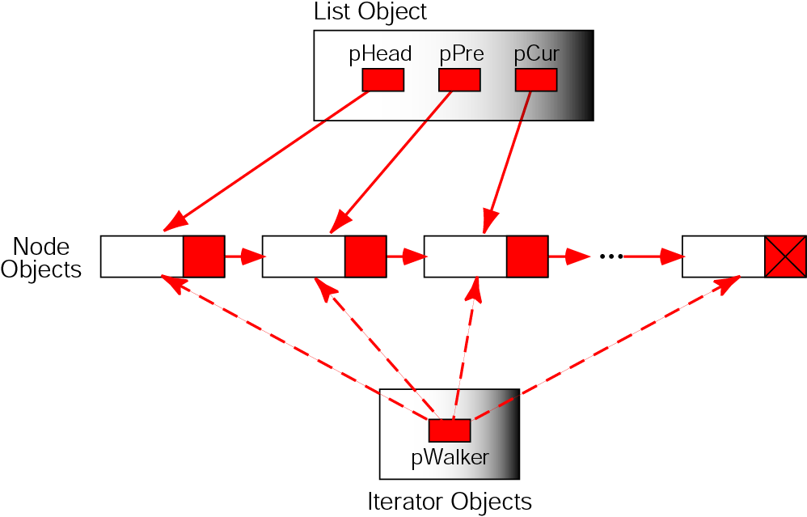
Figure 17-15 Iterator, list, and node objects

Slide 21
17.4
Programming Example—Linked List Average

Slide 22
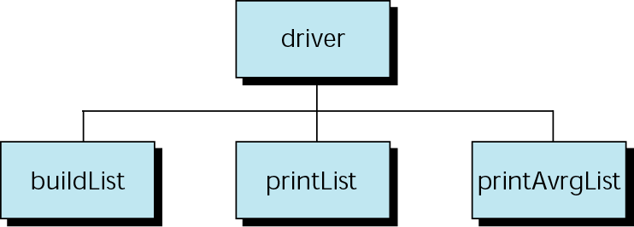
Figure 17-16 Design for linked list average

Slide 23
17.5
Software Engineering and Programming Style

Slide 24
Note:
Software that satisfies the users’ explicit and implicit requirements, is well documented, meets the operating standards of the organization, and runs efficiently on the hardware for which it was developed.

Slide 25
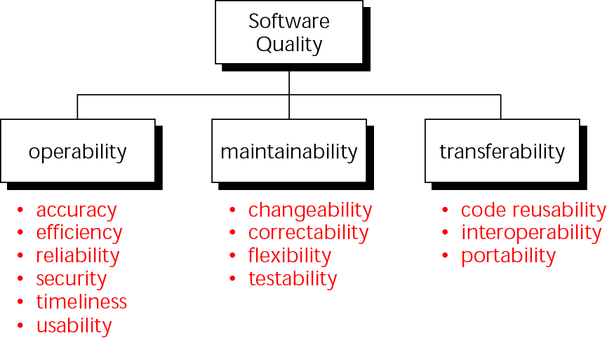
Figure 17-17 Software quality

Slide 26

Figure 17-18 Software quality

