Slide 1
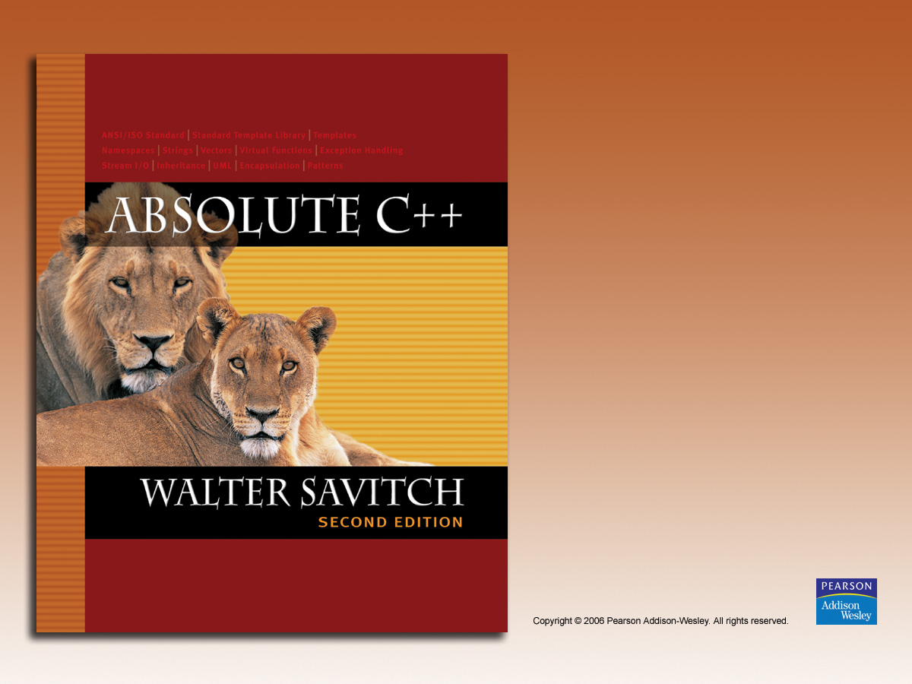
Chapter 4
Parameters
and Overloading

Slide 2

Learning Objectives
Parameters
  Call-by-value
  Call-by-reference
  Mixed parameter-lists
Overloading and Default Arguments
  Examples, Rules
Testing and Debugging Functions
  assert Macro
  Stubs, Drivers

Slide 3
Parameters
Two methods of passing arguments
as parameters
Call-by-value
  "copy" of value is passed
Call-by-reference
  "address of" actual argument is passed

Slide 4
Call-by-Value Parameters
Copy of actual argument passed
Considered "local variable" inside function
If modified, only "local copy" changes
  Function has no access to "actual argument"
  from caller
This is the default method
  Used in all examples thus far

Slide 5
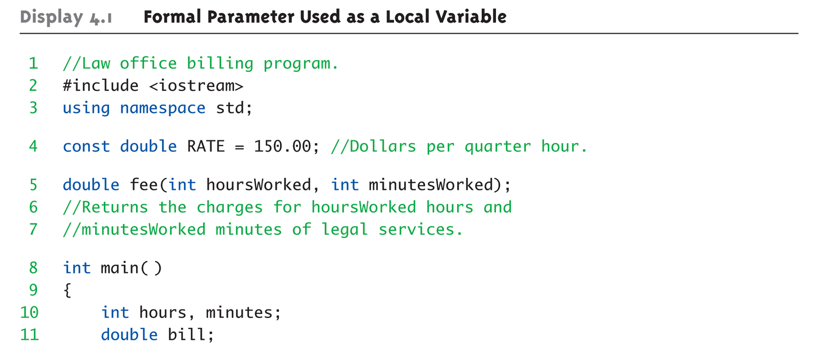
Call-by-Value Example:
Display 4.1 Formal Parameter Used as a Local Variable (1 of 3)

Slide 6
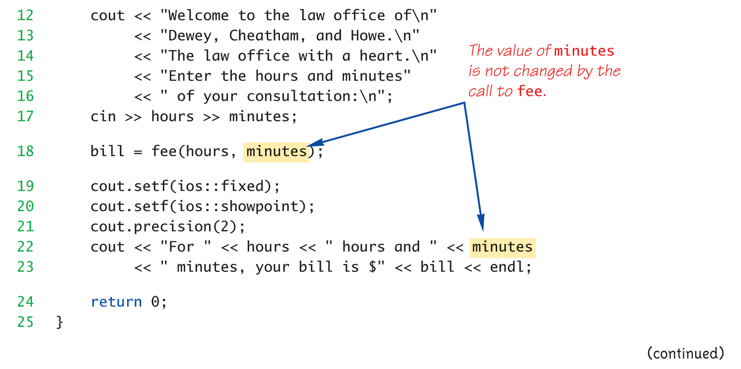
Call-by-Value Example:
Display 4.1 Formal Parameter Used as a Local Variable (2 of 3)

Slide 7
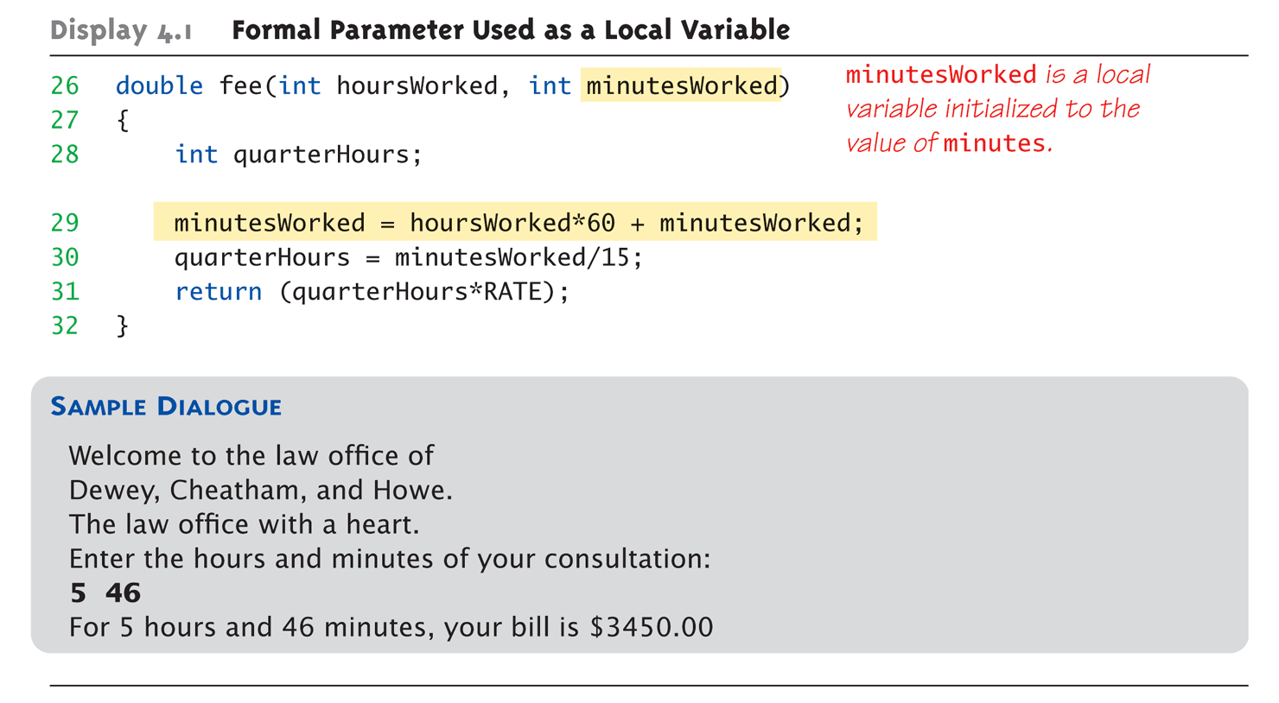
Call-by-Value Example:
Display 4.1 Formal Parameter Used as a Local Variable (3 of 3)

Slide 8
Call-by-Value Pitfall
Common Mistake:
  Declaring parameter "again" inside function:
  double fee(int hoursWorked, int minutesWorked)
  {
  int quarterHours; // local variable
  int minutesWorked // NO!
  }
  Compiler error results
    "Redefinition error…"
Value arguments ARE like "local variables"
  But function gets them "automatically"

Slide 9
Call-By-Reference Parameters
Used to provide access to caller’s
actual argument
Caller’s data can be modified by called function!
Typically used for input function
  To retrieve data for caller
  Data is then "given" to caller
Specified by ampersand, &, after type
in formal parameter list

Slide 10
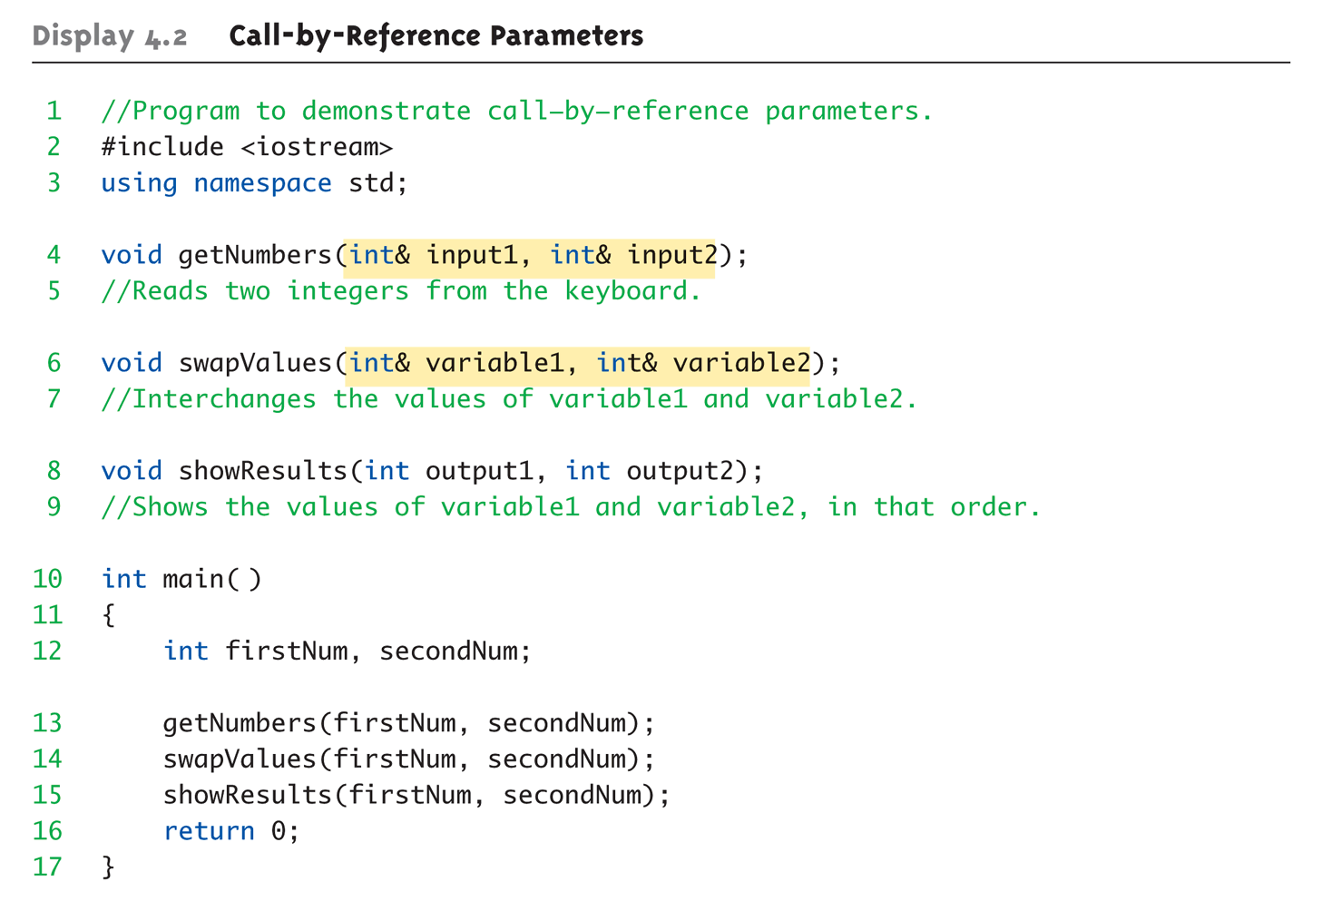
Call-By-Reference Example:
Display 4.1 Call-by-Reference Parameters (1 of 3)

Slide 11
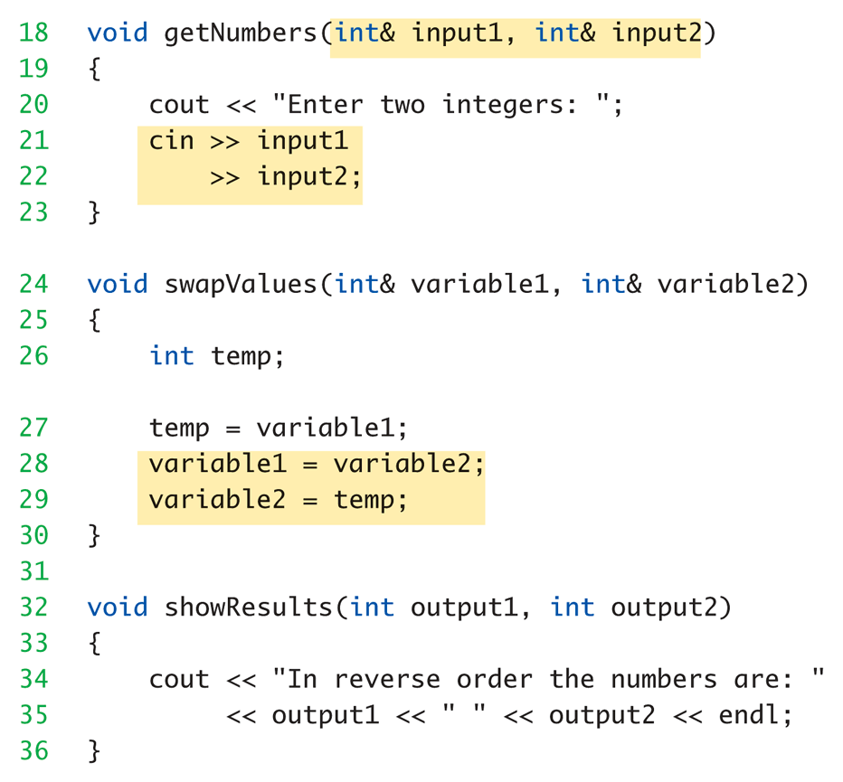
Call-By-Reference Example:
Display 4.1 Call-by-Reference Parameters (2 of 3)

Slide 12
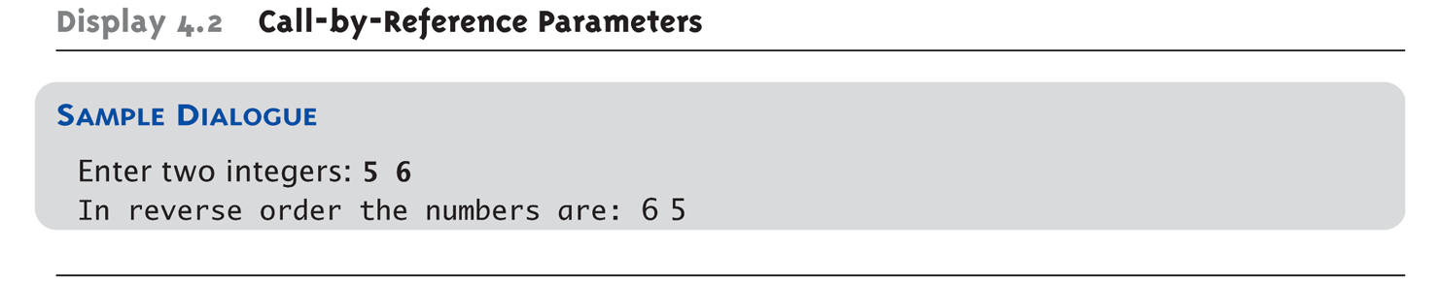
Call-By-Reference Example:
Display 4.1 Call-by-Reference Parameters (3 of 3)

Slide 13
Call-By-Reference Details
What’s really passed in?
A "reference" back to caller’s
actual argument!
  Refers to memory location of
  actual argument
  Called "address", which is a unique number
  referring to distinct place in memory

Slide 14
Constant Reference Parameters
Reference arguments inherently
"dangerous"
  Caller’s data can be changed
  Often this is desired, sometimes not
To "protect" data, & still pass by reference:
  Use const keyword
    void sendConstRef( const int &par1,
    const int &par2);
    Makes arguments "read-only" by function
    No changes allowed inside function body

Slide 15
Parameters and Arguments
Confusing terms, often used interchangeably
True meanings:
  Formal parameters
    In function declaration and function definition
  Arguments
    Used to "fill-in" a formal parameter
    In function call (argument list)
  Call-by-value & Call-by-reference
    Simply the "mechanism" used in plug-in process

Slide 16
Mixed Parameter Lists
Can combine passing mechanisms
Parameter lists can include pass-by-value
and pass-by-reference parameters
Order of arguments in list is critical:
void mixedCall(int & par1, int par2, double & par3);
  Function call:
  mixedCall(arg1, arg2, arg3);
    arg1 must be integer type, is passed by reference
    arg2 must be integer type, is passed by value
    arg3 must be double type, is passed by reference

Slide 17
Choosing Formal Parameter Names
Same rule as naming any identifier:
  Meaningful names!
Functions as "self-contained modules"
  Designed separately from rest of program
  Assigned to teams of programmers
  All must "understand" proper function use
  OK if formal parameter names are same
  as argument names
Choose function names with same rules

Slide 18
Overloading
Same function name
Different parameter lists
Two separate function definitions
Function "signature"
  Function name & parameter list
  Must be "unique" for each function definition
Allows same task performed on different data

Slide 19
Overloading Example: Average
Function computes average of 2 numbers:
double average(double n1, double n2)
{
return ((n1 + n2) / 2.0);
}
Now compute average of 3 numbers:
double average(double n1, double n2, double n3)
{
return ((n1 + n2) / 2.0);
}
Same name, two functions

Slide 20
Overloaded Average() Cont’d
Which function gets called?
Depends on function call itself:
  avg = average(5.2, 6.7);
    Calls "two-parameter average()"
  avg = average(6.5, 8.5, 4.2);
    Calls "three-parameter average()"
Compiler resolves invocation based on
signature of function call
  "Matches" call with appropriate function
  Each considered separate function

Slide 21
Overloading Pitfall
Only overload "same-task" functions
  A mpg() function should always perform
  same task, in all overloads
  Otherwise, unpredictable results
C++ function call resolution:
  1st: looks for exact signature
  2nd: looks for "compatible" signature

Slide 22
Overloading Resolution
1st: Exact Match
  Looks for exact signature
    Where no argument conversion required
2nd: Compatible Match
  Looks for "compatible" signature where
  automatic type conversion is possible:
    1st with promotion (e.g., int→double)
      No loss of data
    2nd with demotion (e.g., double→int)
      Possible loss of data

Slide 23
Overloading Resolution Example
Given following functions:
  1. void f(int n, double m);
  2. void f(double n, int m);
  3. void f(int n, int m);
  These calls:
  f(98, 99); → Calls #3
  f(5.3, 4); → Calls #2
  f(4.3, 5.2); → Calls ???
Avoid such confusing overloading

Slide 24
Automatic Type Conversion and Overloading
Numeric formal parameters typically
made "double" type
Allows for "any" numeric type
  Any "subordinate" data automatically promoted
    int → double
    float → double
    char → double *More on this later!
Avoids overloading for different numeric types

Slide 25
Automatic Type Conversion and Overloading Example
double mpg(double miles, double gallons)
{
return (miles/gallons);
}
Example function calls:
  mpgComputed = mpg(5, 20);
    Converts 5 & 20 to doubles, then passes
  mpgComputed = mpg(5.8, 20.2);
    No conversion necessary
  mpgComputed = mpg(5, 2.4);
    Converts 5 to 5.0, then passes values to function

Slide 26
Default Arguments
Allows omitting some arguments
Specified in function declaration/prototype
  void showVolume( int length,
  int width = 1,
  int height = 1);
    Last 2 arguments are defaulted
  Possible calls:
    showVolume(2, 4, 6); //All arguments supplied
    showVolume(3, 5); //height defaulted to 1
    showVolume(7); //width & height defaulted to 1

Slide 27
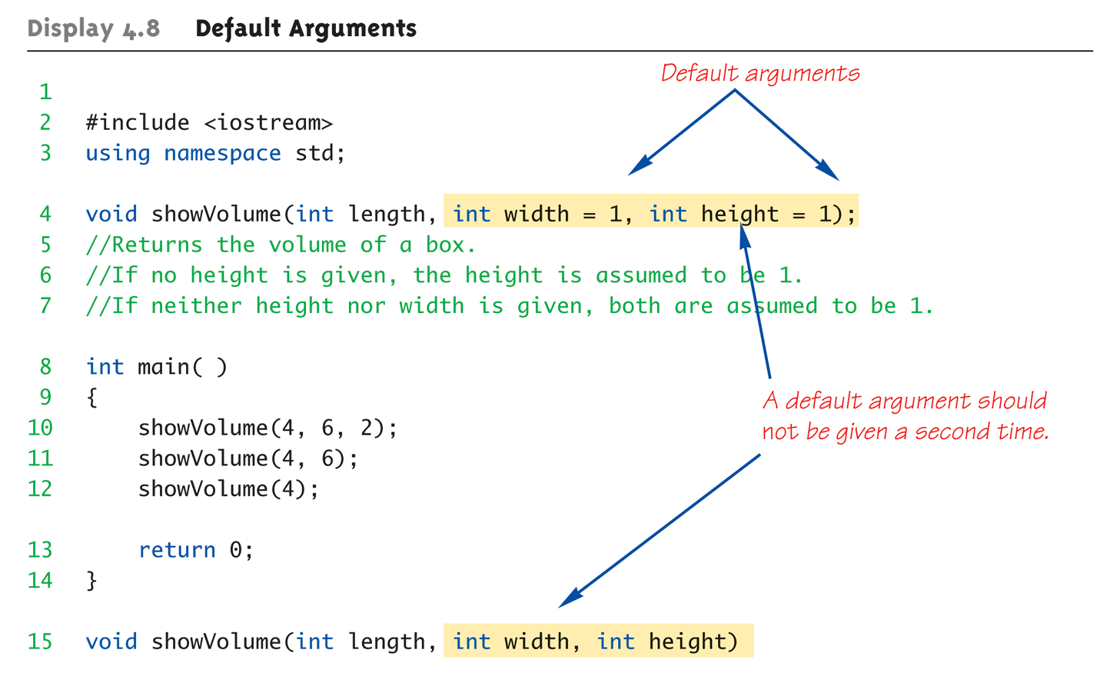
Default Arguments Example:
Display 4.1 Default Arguments (1 of 2)

Slide 28
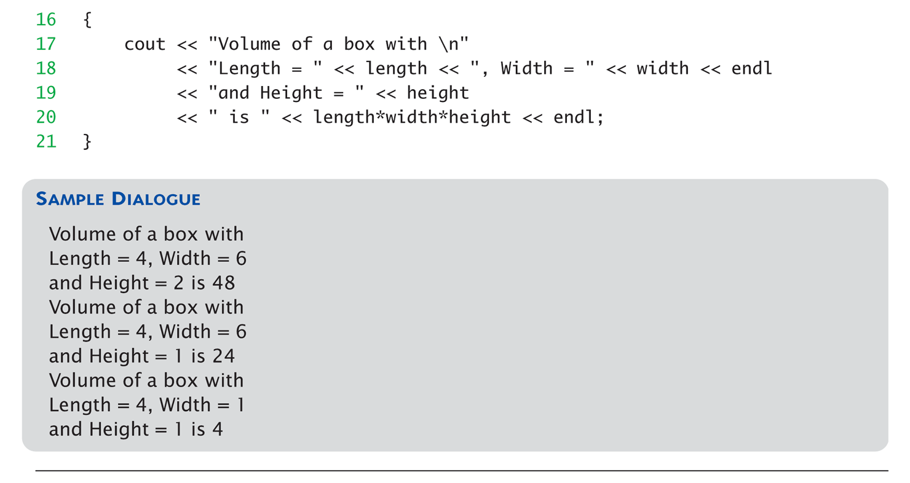
Default Arguments Example:
Display 4.1 Default Arguments (2 of 2)

Slide 29
Testing and Debugging Functions
Many methods:
  Lots of cout statements
    In calls and definitions
    Used to "trace" execution
  Compiler Debugger
    Environment-dependent
  assert Macro
    Early termination as needed
  Stubs and drivers
    Incremental development

Slide 30
The assert Macro
Assertion: a true or false statement
Used to document and check correctness
  Preconditions & Postconditions
    Typical assert use: confirm their validity
  Syntax:
  assert(<assert_condition>);
    No return value
    Evaluates assert_condition
    Terminates if false, continues if true
Predefined in library <cassert>
  Macros used similarly as functions

Slide 31
An assert Macro Example
Given Function Declaration:
void computeCoin( int coinValue,
int& number,
int& amountLeft);
//Precondition: 0 < coinValue < 100
0 <= amountLeft <100
//Postcondition: number set to max. number
of coins
Check precondition:
  assert ((0 < currentCoin) && (currentCoin < 100)
  && (0 <= currentAmountLeft) && (currentAmountLeft < 100));
  If precondition not satisfied → condition is false → program execution terminates!

Slide 32
An assert Macro Example Cont’d
Useful in debugging
Stops execution so problem can
be investigated

Slide 33
assert On/Off
Preprocessor provides means
#define NDEBUG
#include <cassert>
Add "#define" line before #include line
  Turns OFF all assertions throughout
  program
Remove "#define" line (or comment out)
  Turns assertions back on

Slide 34
Stubs and Drivers
Separate compilation units
  Each function designed, coded, tested
  separately
  Ensures validity of each unit
  Divide & Conquer
    Transforms one big task → smaller,
    manageable tasks
But how to test independently?
  Driver programs

Slide 35
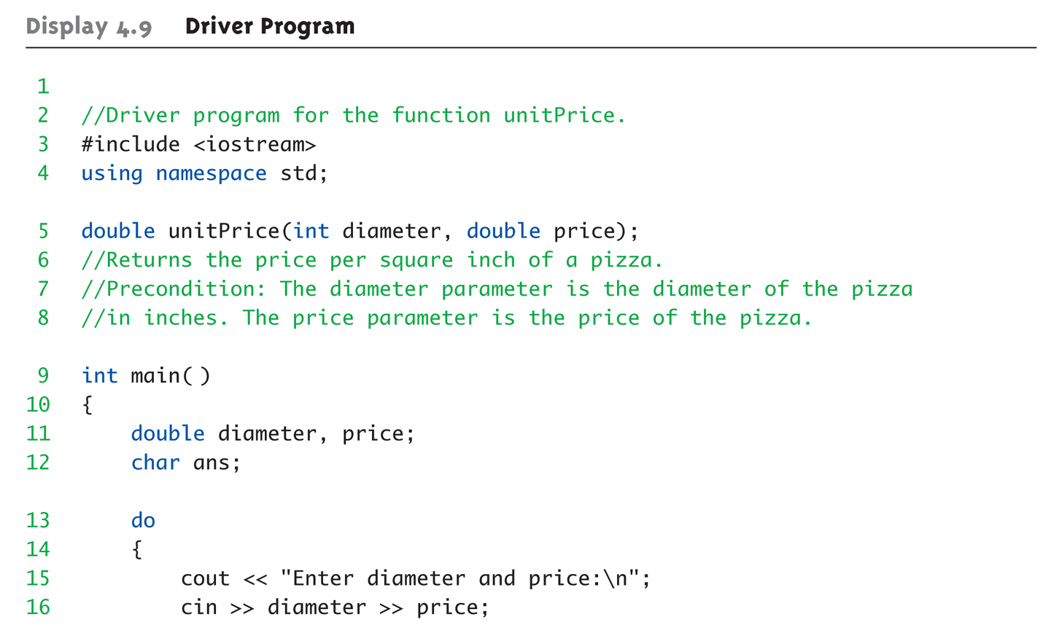
Driver Program Example:
Display 4.9 Driver Program (1 of 3)

Slide 36
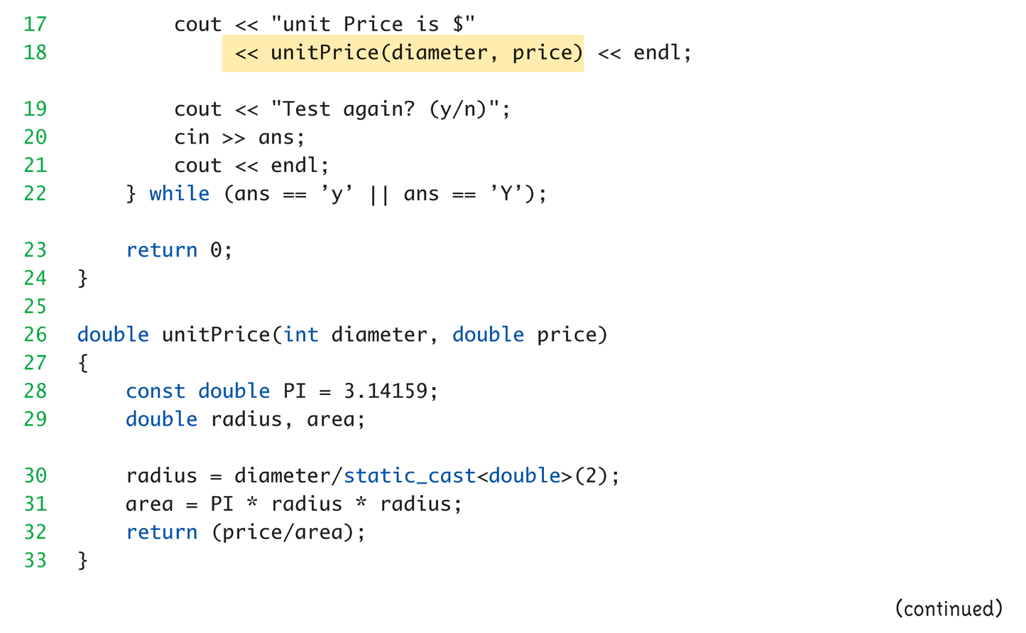
Driver Program Example:
Display 4.9 Driver Program (2 of 3)

Slide 37
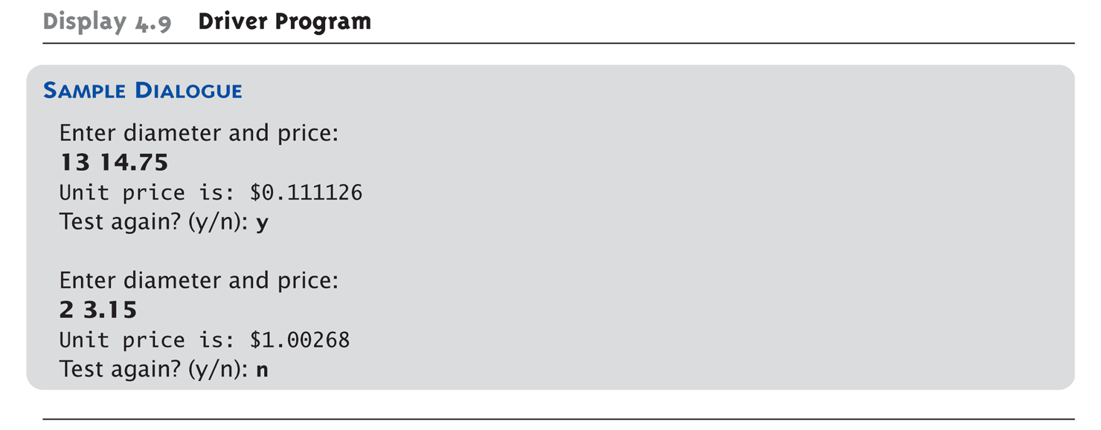
Driver Program Example:
Display 4.9 Driver Program (3 of 3)

Slide 38
Stubs
Develop incrementally
Write "big-picture" functions first
  Low-level functions last
  "Stub-out" functions until implementation
  Example:
  double unitPrice(int diameter, double price)
  {
  return (9.99); // not valid, but noticeably
  // a "temporary" value
  }
  Calls to function will still "work"

Slide 39
Fundamental Testing Rule
To write "correct" programs
Minimize errors, "bugs"
Ensure validity of data
  Test every function in a program where every other function has already been
  fully tested and debugged
  Avoids "error-cascading" &
  conflicting results

Slide 40
Summary 1
Formal parameter is placeholder, filled in with actual argument in function call
Call-by-value parameters are "local copies" in receiving function body
  Actual argument cannot be modified
Call-by-reference passes memory address of actual argument
  Actual argument can be modified
  Argument MUST be variable, not constant

Slide 41
Summary 2
Multiple definitions of same function name
possible: called overloading
Default arguments allow function call to
"omit" some or all arguments in list
  If not provided → default values assigned
assert macro initiates program
termination if assertions fail
Functions should be tested independently
  As separate compilation units, with drivers

