Slide 1
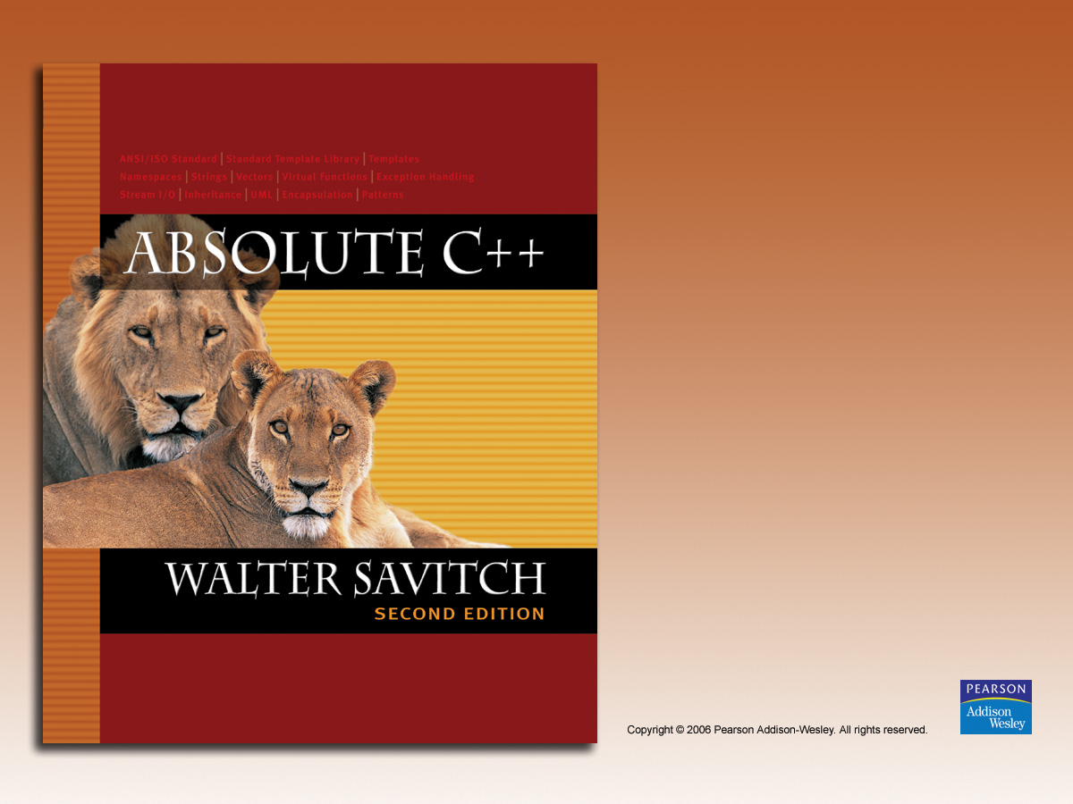
Chapter 8
Operator Overloading, Friends,
and References

Slide 2

Learning Objectives
Basic Operator Overloading
  Unary operators
  As member functions
Friends and Automatic Type Conversion
  Friend functions, friend classes
  Constructors for automatic type conversion
References and More Overloading
  << and >>
  Operators: = , [], ++, --

Slide 3
Operator Overloading Introduction
Operators +, -, %, ==, etc.
  Really just functions!
Simply "called" with different syntax:
x + 7
  "+" is binary operator with x & 7 as operands
  We "like" this notation as humans
Think of it as:
+(x, 7)
  "+" is the function name
  x, 7 are the arguments
  Function "+" returns "sum" of it’s arguments

Slide 4
Operator Overloading Perspective
Built-in operators
  e.g., +, -, = , %, ==, /, *
  Already work for C++ built-in types
  In standard "binary" notation
We can overload them!
  To work with OUR types!
  To add "Chair types", or "Money types"
    As appropriate for our needs
    In "notation" we’re comfortable with
Always overload with similar "actions"!

Slide 5
Overloading Basics
Overloading operators
  VERY similar to overloading functions
  Operator itself is "name" of function
Example Declaration:
const Money operator +( const Money& amount1,
const Money& amount2);
  Overloads + for operands of type Money
  Uses constant reference parameters for efficiency
  Returned value is type Money
    Allows addition of "Money" objects

Slide 6
Overloaded "+"
Given previous example:
  Note: overloaded "+" NOT member function
  Definition is "more involved" than simple "add"
    Requires issues of money type addition
    Must handle negative/positive values
Operator overload definitions generally
very simple
  Just perform "addition" particular to "your" type

Slide 7
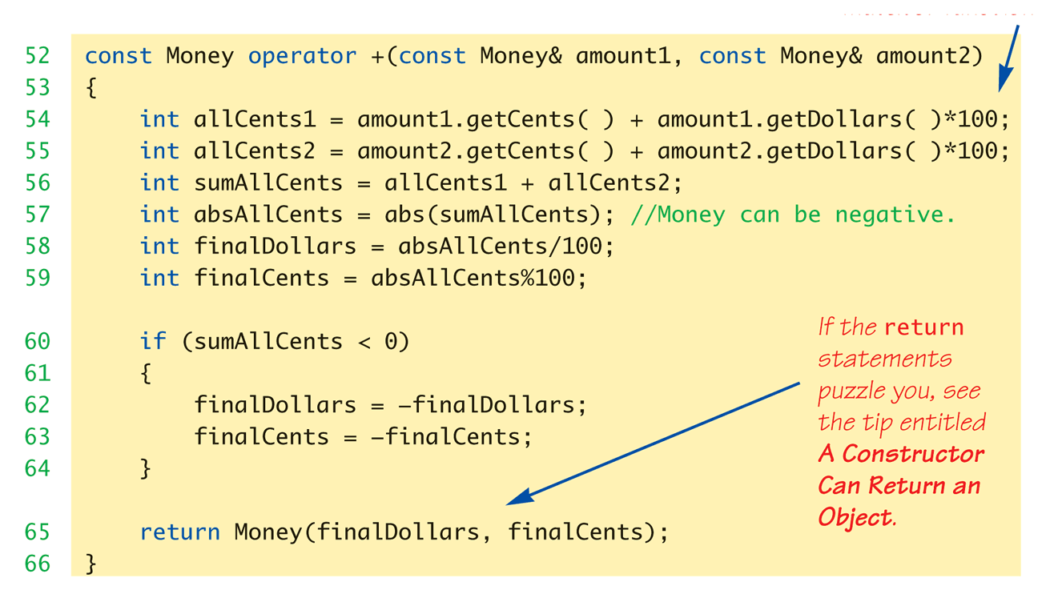
Money "+" Definition:
Display 8.1 Operator Overloading
Definition of "+" operator for Money class:

Slide 8
Overloaded "=="
Equality operator, ==
  Enables comparison of Money objects
  Declaration:
  bool operator ==(const Money& amount1,
  const Money& amount2);
    Returns bool type for true/false equality
  Again, it’s a non-member function
  (like "+" overload)

Slide 9
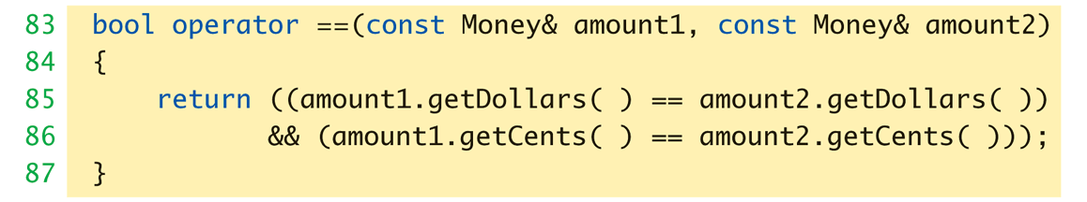
Overloaded "==" for Money:
Display 8.1 Operator Overloading
Definition of "==" operator for Money class:

Slide 10
Constructors Returning Objects
Constructor a "void" function?
  We "think" that way, but no
  A "special" function
    With special properties
    CAN return a value!
Recall return statement in "+" overload
for Money type:
  return Money(finalDollars, finalCents);
    Returns an "invocation" of Money class!
    So constructor actually "returns" an object!
    Called an "anonymous object"

Slide 11
Returning by const Value
Consider "+" operator overload again:
const Money operator +(const Money& amount1,
const Money& amount2);
  Returns a "constant object"?
  Why?
Consider impact of returning "non-const"
object to see…→

Slide 12
Returning by non-const Value
Consider "no const" in declaration:
Money operator +( const Money& amount1,
const Money& amount2);
Consider expression that calls:
m1 + m2
  Where m1 & m2 are Money objects
  Object returned is Money object
  We can "do things" with objects!
    Like call member functions…

Slide 13
What to do with Non-const Object
Can call member functions:
  We could invoke member functions on
  object returned by expression m1+m2:
    (m1+m2).output(); //Legal, right?
      Not a problem: doesn’t change anything
    (m1+m2).input(); //Legal!
      PROBLEM! //Legal, but MODIFIES!
    Allows modification of "anonymous" object!
    Can’t allow that here!
So we define the return object as const

Slide 14
Overloading Unary Operators
C++ has unary operators:
  Defined as taking one operand
  e.g., - (negation)
    x = -y; // Sets x equal to negative of y
  Other unary operators:
    ++, --
Unary operators can also be overloaded

Slide 15
Overload "-" for Money
Overloaded "-" function declaration
  Placed outside class definition:
  const Money operator –(const Money& amount);
  Notice: only one argument
    Since only 1 operand (unary)
"-" operator is overloaded twice!
  For two operands/arguments (binary)
  For one operand/argument (unary)
  Definitions must exist for both

Slide 16
Overloaded "-" Definition
Overloaded "-" function definition:
const Money operator –(const Money& amount)
{
return Money(-amount.getDollars(),
-amount.getCents());
}
Applies "-" unary operator to built-in type
  Operation is "known" for built-in types
Returns anonymous object again

Slide 17
Overloaded "-" Usage
Consider:
Money amount1(10),
amount2(6),
amount3;
amount3 = amount1 – amount2;
    Calls binary "-" overload
amount3.output(); //Displays $4.00
amount3 = -amount1;
    Calls unary "-" overload
amount3.output() //Displays -$10.00

Slide 18
Overloading as Member Functions
Previous examples: standalone functions
  Defined outside a class
Can overload as "member operator"
  Considered "member function" like others
When operator is member function:
  Only ONE parameter, not two!
  Calling object serves as 1st parameter

Slide 19
Member Operator in Action
Money cost(1, 50), tax(0, 15), total;
total = cost + tax;
  If "+" overloaded as member operator:
    Variable/object cost is calling object
    Object tax is single argument
  Think of as: total = cost.+(tax);
Declaration of "+" in class definition:
  const Money operator +(const Money& amount);
  Notice only ONE argument

Slide 20
const Functions
When to make function const?
  Constant functions not allowed to alter class
  member data
  Constant objects can ONLY call constant
  member functions
Good style dictates:
  Any member function that will NOT modify data
  should be made const
Use keyword const after function
declaration and heading

Slide 21
Overloading Operators:
Which Method?
Object-Oriented-Programming
  Principles suggest member operators
  Many agree, to maintain "spirit" of OOP
Member operators more efficient
  No need to call accessor &
  mutator functions
At least one significant disadvantage
  (Later in chapter…)

Slide 22
Overloading Function Application ()
Function call operator, ( )
  Must be overloaded as member function
  Allows use of class object like a function
  Can overload for all possible numbers
  of arguments
Example:
Aclass anObject;
anObject(42);
    If ( ) overloaded → calls overload

Slide 23
Other Overloads
&&, ||, and comma operator
  Predefined versions work for bool types
  Recall: use "short-circuit evaluation"
  When overloaded no longer uses
  short-circuit
    Uses "complete evaluation" instead
    Contrary to expectations
Generally should not overload
these operators

Slide 24
Friend Functions
Nonmember functions
  Recall: operator overloads as nonmembers
    They access data through accessor and mutator
    functions
    Very inefficient (overhead of calls)
Friends can directly access private class data
  No overhead, more efficient
So: best to make nonmember operator
overloads friends!

Slide 25
Friend Functions
Friend function of a class
  Not a member function
  Has direct access to private members
    Just as member functions do
Use keyword friend in front of
function declaration
  Specified IN class definition
  But they’re NOT member functions!

Slide 26
Friend Function Uses
Operator Overloads
  Most common use of friends
  Improves efficiency
  Avoids need to call accessor/mutator
  member functions
  Operator must have access anyway
    Might as well give full access as friend
Friends can be any function

Slide 27
Friend Function Purity
Friends not pure?
  "Spirit" of OOP dictates all operators and functions be member functions
  Many believe friends violate basic OOP principles
Advantageous?
  For operators: very!
  Allows automatic type conversion
  Still encapsulates: friend is in class definition
  Improves efficiency

Slide 28
Friend Classes
Entire classes can be friends
  Similar to function being friend to class
  Example:
  class F is friend of class C
    All class F member functions are friends of C
    NOT reciprocated
    Friendship granted, not taken
Syntax: friend class F
  Goes inside class definition of "authorizing" class

Slide 29
References
Reference defined:
  Name of a storage location
  Similar to "pointer"
Example of stand alone reference:
  int robert;
  int& bob = robert;
    bob is reference to storage location for robert
    Changes made to bob will affect robert
Confusing?

Slide 30
References Usage
Seemingly dangerous
Useful in several cases:
Call-by-reference
  Often used to implement this mechanism
Returning a reference
  Allows operator overload implementations to
  be written more naturally
  Think of as returning an "alias" to a variable

Slide 31
Returning Reference
Syntax:
double& sampleFunction(double& variable);
  double& and double are different
  Must match in function declaration
  and heading
Returned item must "have" a reference
  Like a variable of that type
  Cannot be expression like "x+5"
    Has no place in memory to "refer to"

Slide 32
Returning Reference in Definition
Example function definition:
double& sampleFunction(double& variable)
{
return variable;
}
Trivial, useless example
Shows concept only
Major use:
  Certain overloaded operators

Slide 33
Overloading >> and <<
Enables input and output of our objects
  Similar to other operator overloads
  New subtleties
Improves readability
  Like all operator overloads do
  Enables:
  cout << myObject;
  cin >> myObject;
  Instead of need for:
  myObject.output(); …

Slide 34
Overloading >>
Insertion operator, <<
  Used with cout
  A binary operator
Example:
cout << "Hello";
  Operator is <<
  1st operand is predefined object cout
    From library iostream
  2nd operand is literal string "Hello"

Slide 35
Overloading >>
Operands of >>
  Cout object, of class type ostream
  Our class type
Recall Money class
  Used member function output()
  Nicer if we can use >> operator:
  Money amount(100);
  cout << "I have " << amount << endl;
  instead of:
  cout << "I have ";
  amount.output()

Slide 36
Overloaded >> Return Value
Money amount(100);
cout << amount;
  << should return some value
  To allow cascades:
  cout << "I have " << amount;
  (cout << "I have ") << amount;
    Two are equivalent
What to return?
  cout object!
    Returns it’s first argument type, ostream

Slide 37
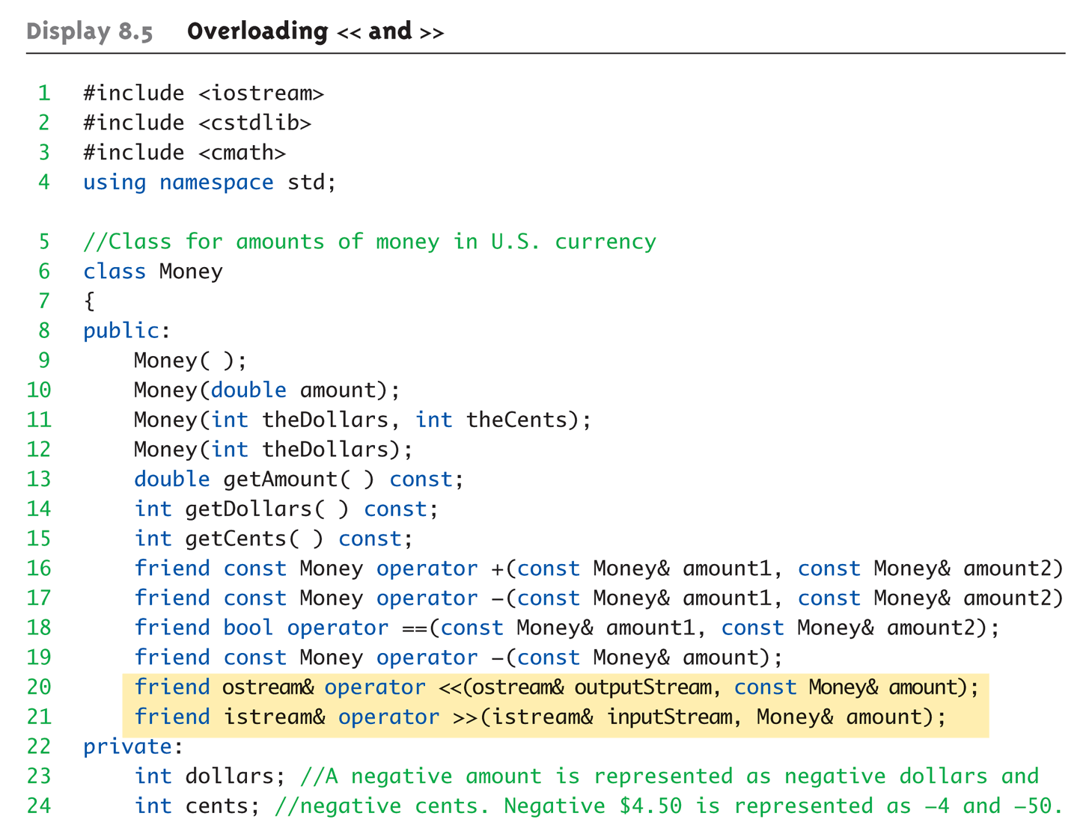
Overloaded >> Example:
Display 8.5 Overloading << and >> (1 of 5)

Slide 38
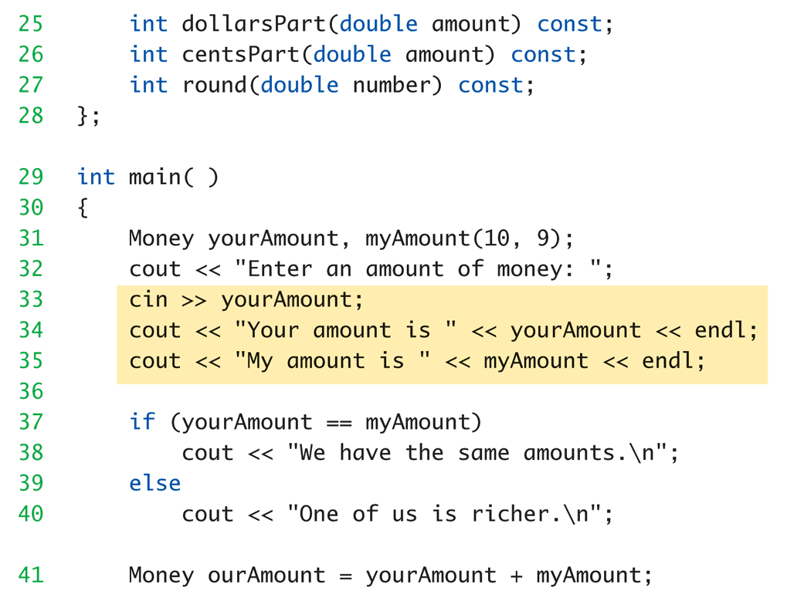
Overloaded >> Example:
Display 8.5 Overloading << and >> (2 of 5)

Slide 39
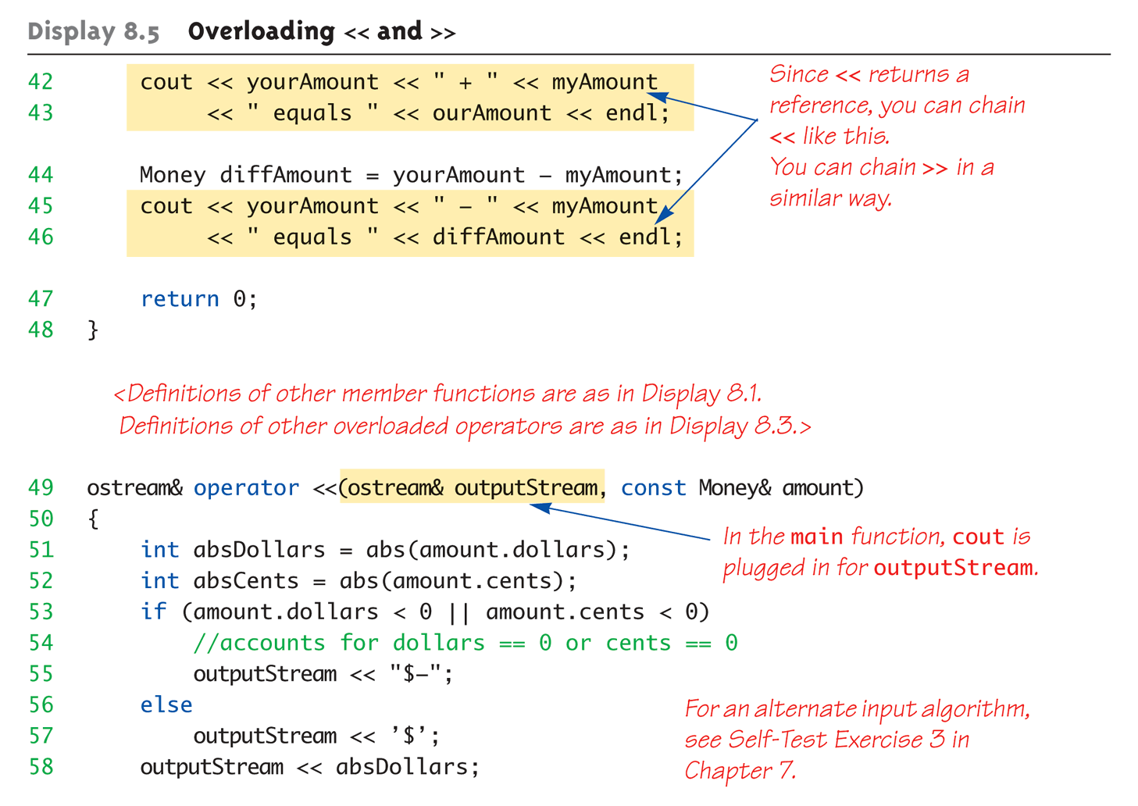
Overloaded >> Example:
Display 8.5 Overloading << and >> (3 of 5)

Slide 40
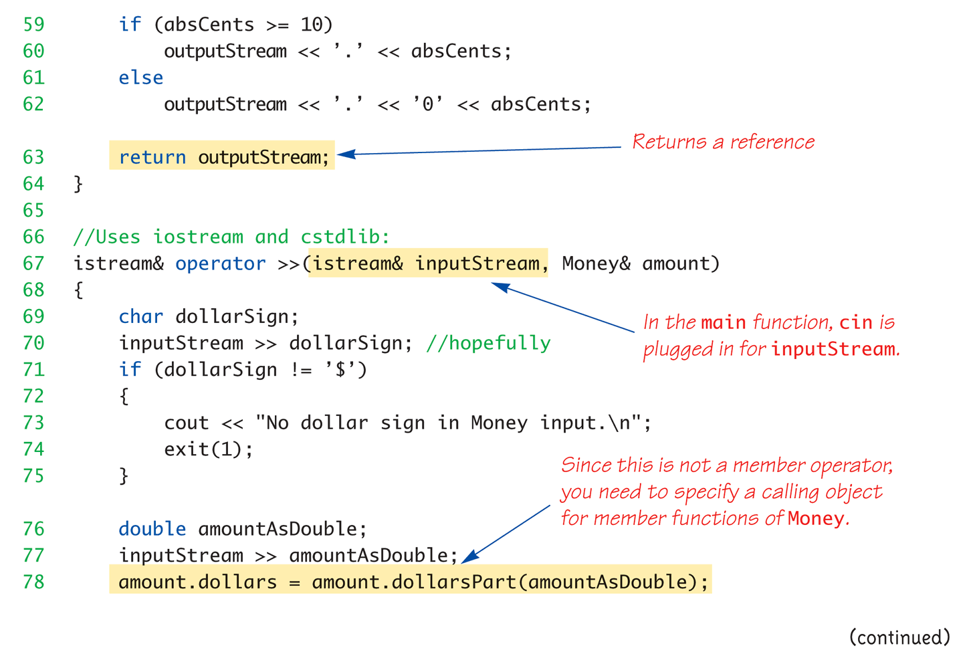
Overloaded >> Example:
Display 8.5 Overloading << and >> (4 of 5)

Slide 41
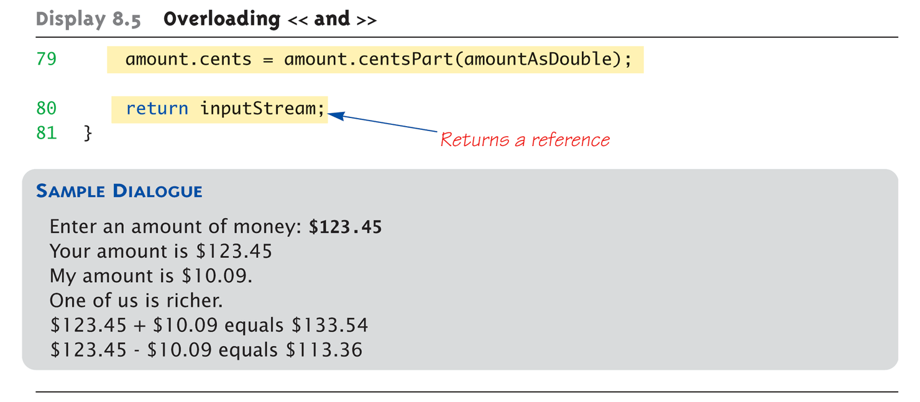
Overloaded >> Example:
Display 8.5 Overloading << and >> (5 of 5)

Slide 42
Assignment Operator, =
Must be overloaded as
member operator
Automatically overloaded
  Default assignment operator:
    Member-wise copy
    Member variables from one object →
    corresponding member variables from other
Default OK for simple classes
  But with pointers → must write our own!

Slide 43
Increment and Decrement
Each operator has two versions
  Prefix notation: ++x;
  Postfix notation: x++;
Must distinguish in overload
  Standard overload method → Prefix
  Add 2d parameter of type int → Postfix
    Just a marker for compiler!
    Specifies postfix is allowed

Slide 44
Overload Array Operator, [ ]
Can overload [ ] for your class
  To be used with objects of your class
  Operator must return a reference!
  Operator [ ] must be a member function!

Slide 45
Summary 1
C++ built-in operators can be overloaded
  To work with objects of your class
Operators are really just functions
Friend functions have direct private
member access
Operators can be overloaded as
member functions
  1st operand is calling object

Slide 46
Summary 2
Friend functions add efficiency only
  Not required if sufficient accessors/mutators
  available
Reference "names" a variable with
an alias
Can overload <<, >>
  Return type is a reference to stream type

