Slide 1
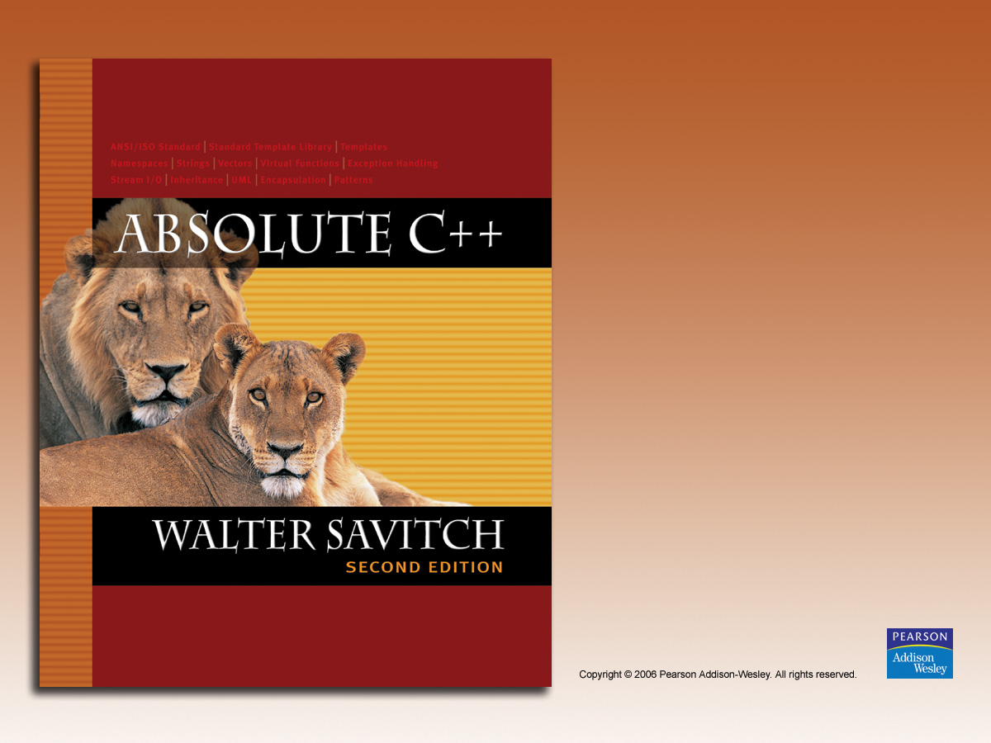
Chapter 10
Pointers and Dynamic Arrays

Slide 2

Learning Objectives
Pointers
  Pointer variables
  Memory management
Dynamic Arrays
  Creating and using
  Pointer arithmetic
Classes, Pointers, Dynamic Arrays
  The this pointer
  Destructors, copy constructors

Slide 3
Pointer Introduction
Pointer definition:
  Memory address of a variable
Recall: memory divided
  Numbered memory locations
  Addresses used as name for variable
You’ve used pointers already!
  Call-by-reference parameters
    Address of actual argument was passed

Slide 4
Pointer Variables
Pointers are "typed"
  Can store pointer in variable
  Not int, double, etc.
    Instead: A POINTER to int, double, etc.!
Example:
double *p;
  p is declared a "pointer to double" variable
  Can hold pointers to variables of type double
    Not other types!

Slide 5
Declaring Pointer Variables
Pointers declared like other types
  Add "*" before variable name
  Produces "pointer to" that type
"*" must be before each variable
int *p1, *p2, v1, v2;
  p1, p2 hold pointers to int variables
  v1, v2 are ordinary int variables

Slide 6
Addresses and Numbers
Pointer is an address
Address is an integer
Pointer is NOT an integer!
  Not crazy → abstraction!
C++ forces pointers be used as
addresses
  Cannot be used as numbers
  Even though it "is a" number

Slide 7
Pointing
Terminology, view
  Talk of "pointing", not "addresses"
  Pointer variable "points to" ordinary variable
  Leave "address" talk out
Makes visualization clearer
  "See" memory references
    Arrows

Slide 8
Pointing to …
int *p1, *p2, v1, v2;
p1 = &v1;
  Sets pointer variable p1 to "point to" int
  variable v1
Operator, &
  Determines "address of" variable
Read like:
  "p1 equals address of v1"
  Or "p1 points to v1"

Slide 9
Pointing to …
Recall:
int *p1, *p2, v1, v2;
p1 = &v1;
Two ways to refer to v1 now:
  Variable v1 itself:
  cout << v1;
  Via pointer p1:
  cout *p1;
Dereference operator, *
  Pointer variable "derereferenced"
  Means: "Get data that p1 points to"

Slide 10
"Pointing to" Example
Consider:
v1 = 0;
p1 = &v1;
*p1 = 42;
cout << v1 << endl;
cout << *p1 << endl;
Produces output:
42
42
p1 and v1 refer to same variable

Slide 11
& Operator
The "address of" operator
Also used to specify call-by-reference
parameter
  No coincidence!
  Recall: call-by-reference parameters pass
  "address of" the actual argument
Operator’s two uses are closely related

Slide 12
Pointer Assignments
Pointer variables can be "assigned":
int *p1, *p2;
p2 = p1;
  Assigns one pointer to another
  "Make p2 point to where p1 points"
Do not confuse with:
*p1 = *p2;
  Assigns "value pointed to" by p1, to "value
  pointed to" by p2

Slide 13
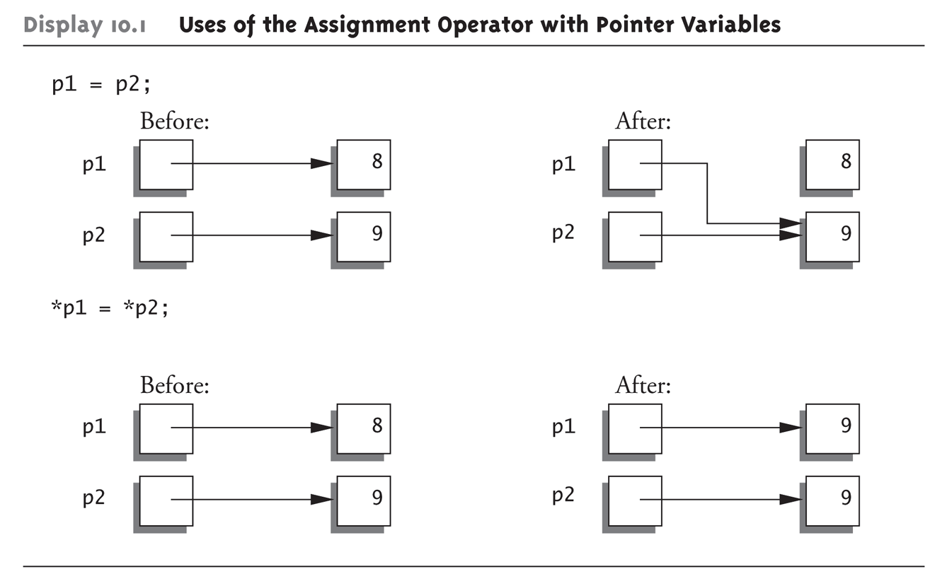
Pointer Assignments Graphic:
Display 10.1 Uses of the Assignment Operator with Pointer Variables

Slide 14
The new Operator
Since pointers can refer to variables…
  No "real" need to have a standard identifier
Can dynamically allocate variables
  Operator new creates variables
    No identifiers to refer to them
    Just a pointer!
p1 = new int;
  Creates new "nameless" variable, and
  assigns p1 to "point to" it
  Can access with *p1
    Use just like ordinary variable

Slide 15
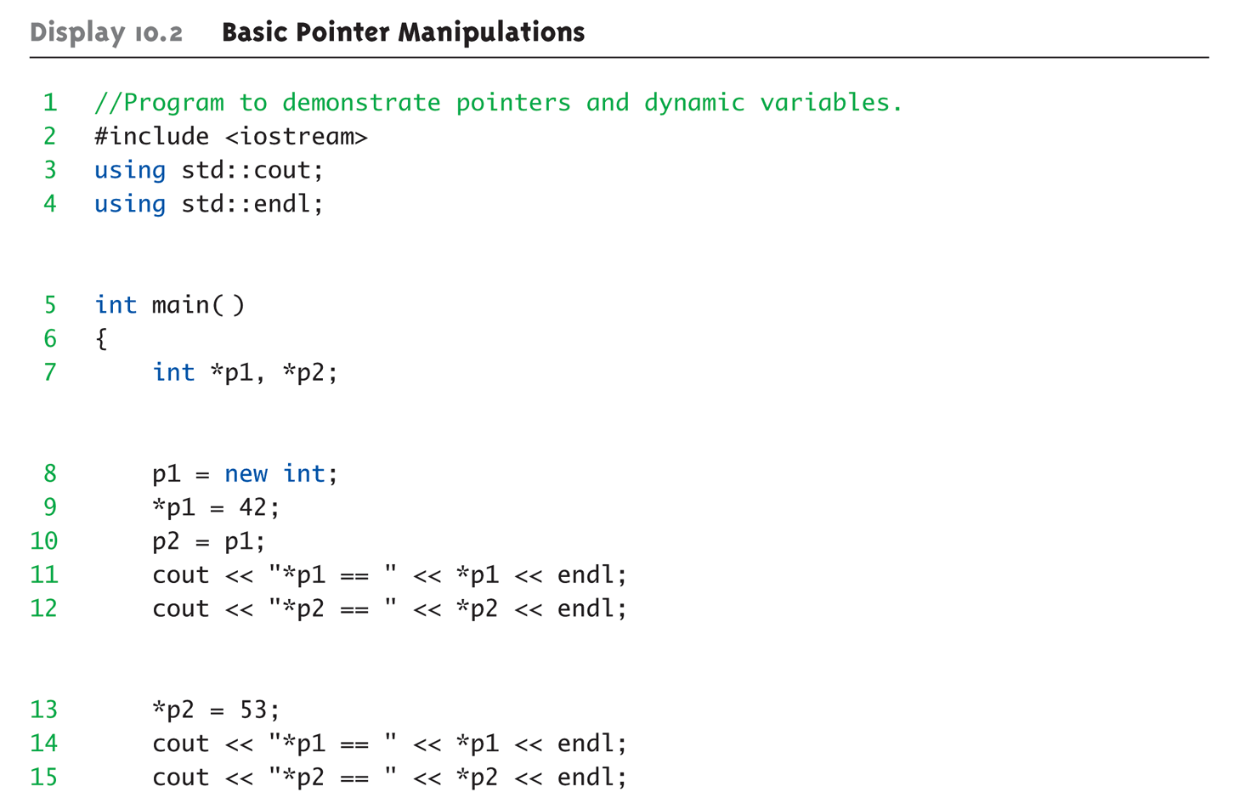
Basic Pointer Manipulations Example:
Display 10.2 Basic Pointer
Manipulations (1 of 2)

Slide 16
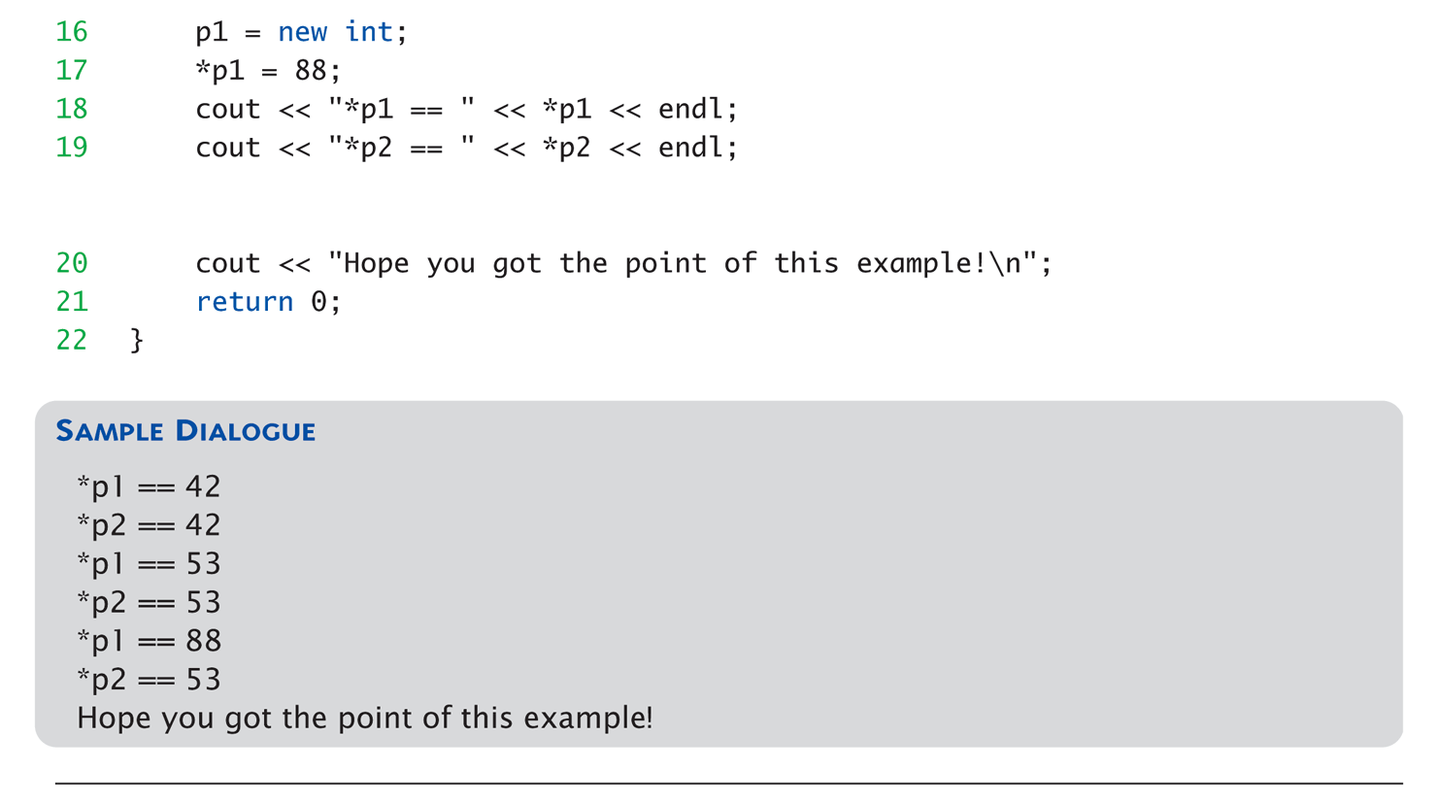
Basic Pointer Manipulations Example:
Display 10.2 Basic Pointer
Manipulations (2 of 2)

Slide 17
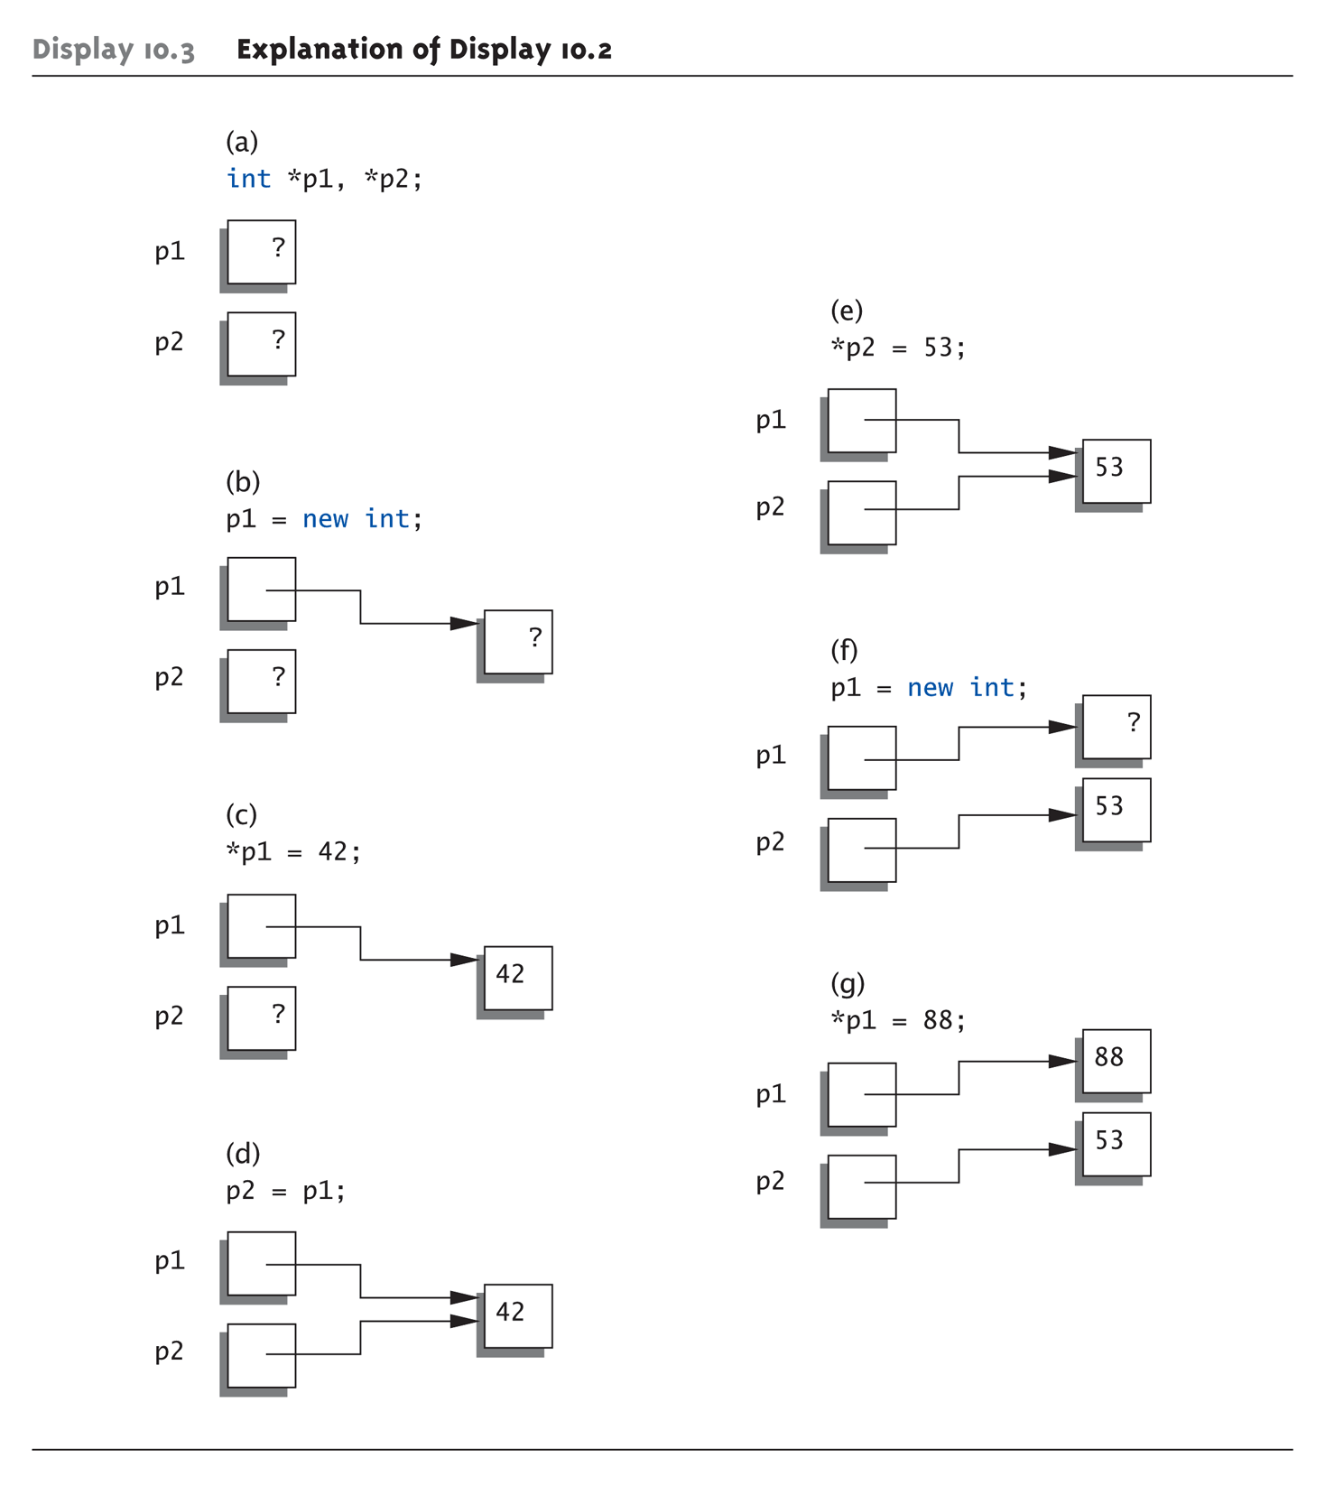
Basic Pointer Manipulations Graphic:
Display 10.3 Explanation of Display 10.2

Slide 18
More on new Operator
Creates new dynamic variable
Returns pointer to the new variable
If type is class type:
  Constructor is called for new object
  Can invoke different constructor with
  initializer arguments:
  MyClass *mcPtr;
  mcPtr = new MyClass(32.0, 17);
Can still initialize non-class types:
int *n;
n = new int(17); //Initializes *n to 17

Slide 19
Pointers and Functions
Pointers are full-fledged types
  Can be used just like other types
Can be function parameters
Can be returned from functions
Example:
int* findOtherPointer(int* p);
  This function declaration:
    Has "pointer to an int" parameter
    Returns "pointer to an int" variable

Slide 20
Memory Management
Heap
  Also called "freestore"
  Reserved for dynamically-allocated variables
  All new dynamic variables consume memory
  in freestore
    If too many → could use all freestore memory
Future "new" operations will fail if freestore
is "full"

Slide 21
Checking new Success
Older compilers:
  Test if null returned by call to new:
  int *p;
  p = new int;
  if (p == NULL)
  {
  cout << "Error: Insufficient memory.\n";
  exit(1);
  }
  If new succeeded, program continues

Slide 22
new Success – New Compiler
Newer compilers:
  If new operation fails:
    Program terminates automatically
    Produces error message
Still good practice to use NULL check

Slide 23
Freestore Size
Varies with implementations
Typically large
  Most programs won’t use all memory
Memory management
  Still good practice
  Solid software engineering principle
  Memory IS finite
    Regardless of how much there is!

Slide 24
delete Operator
De-allocate dynamic memory
  When no longer needed
  Returns memory to freestore
  Example:
  int *p;
  p = new int(5);
  … //Some processing…
  delete p;
  De-allocates dynamic memory "pointed to by
  pointer p"
    Literally "destroys" memory

Slide 25
Dangling Pointers
delete p;
  Destroys dynamic memory
  But p still points there!
    Called "dangling pointer"
  If p is then dereferenced ( *p )
    Unpredicatable results!
    Often disastrous!
Avoid dangling pointers
  Assign pointer to NULL after delete:
  delete p;
  p = NULL;

Slide 26
Dynamic and Automatic Variables
Dynamic variables
  Created with new operator
  Created and destroyed while program runs
Local variables
  Declared within function definition
  Not dynamic
    Created when function is called
    Destroyed when function call completes
  Often called "automatic" variables
    Properties controlled for you

Slide 27
Define Pointer Types
Can "name" pointer types
To be able to declare pointers like other
variables
  Eliminate need for "*" in pointer declaration
typedef int* IntPtr;
  Defines a "new type" alias
  Consider these declarations:
  IntPtr p;
  int *p;
    The two are equivalent

Slide 28
Pitfall: Call-by-value Pointers
Behavior subtle and troublesome
  If function changes pointer parameter
  itself → only change is to local copy
Best illustrated with example…

Slide 29
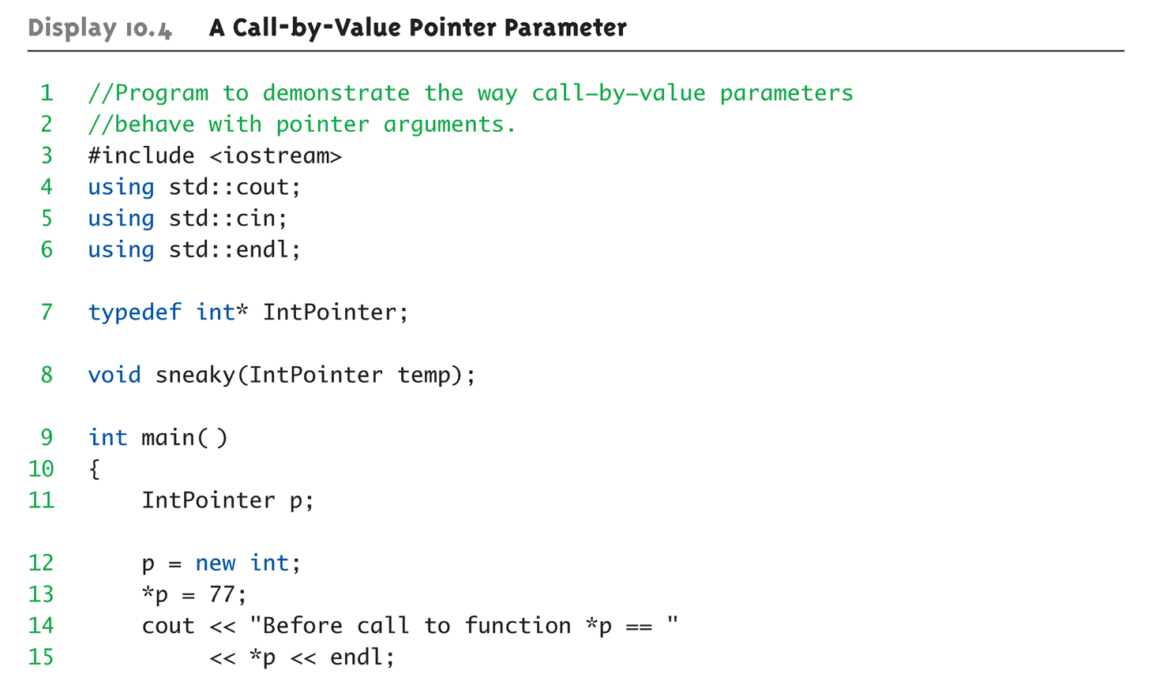
Call-by-value Pointers Example:
Display 10.4 A Call-by-Value Pointer Parameter (1 of 2)

Slide 30
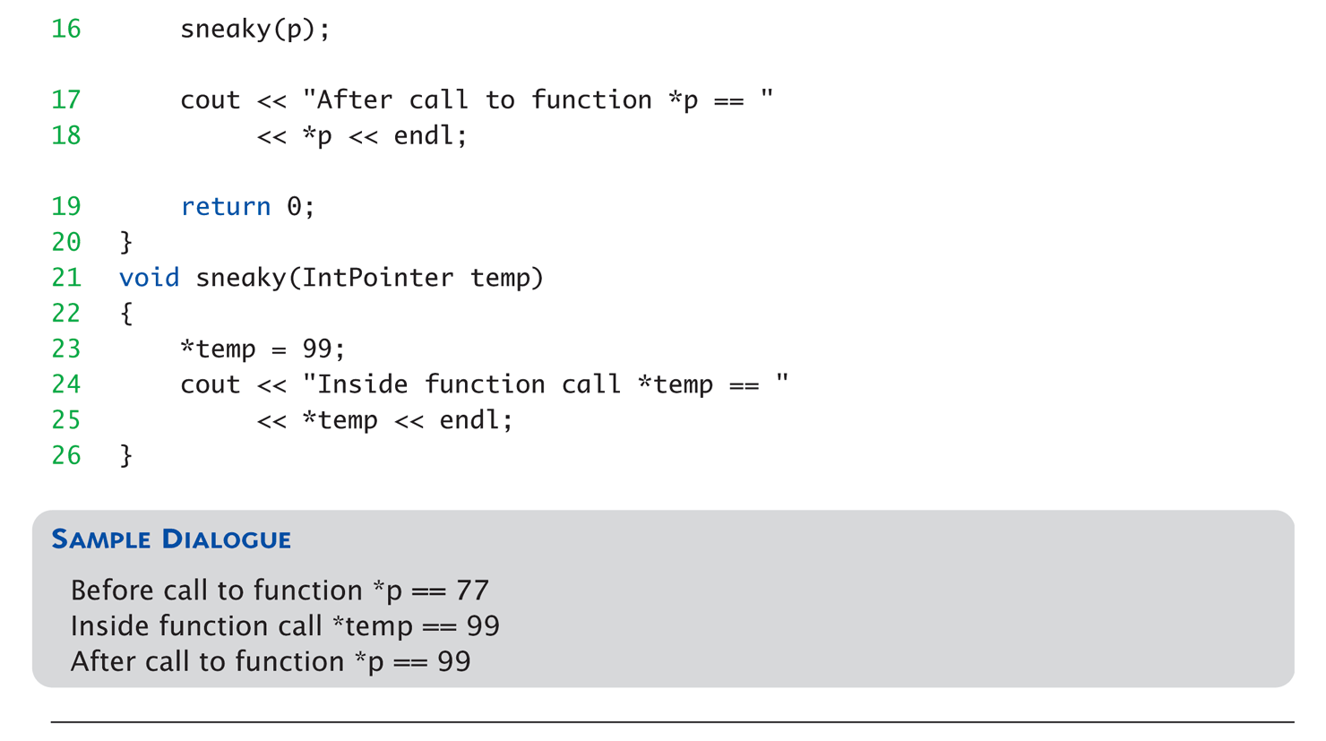
Call-by-value Pointers Example:
Display 10.4 A Call-by-Value Pointer Parameter (2 of 2)

Slide 31
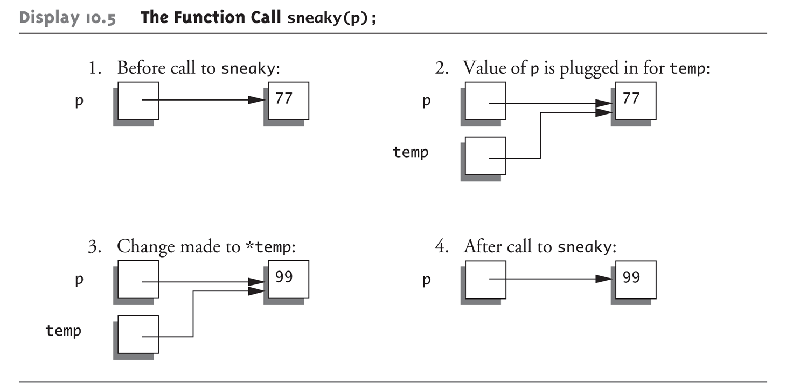
Call-by-value Pointers Graphic:
Display 10.5 The Function Call sneaky(p);

Slide 32
Dynamic Arrays
Array variables
  Really pointer variables!
Standard array
  Fixed size
Dynamic array
  Size not specified at programming time
  Determined while program running

Slide 33
Array Variables
Recall: arrays stored in memory
addresses, sequentially
  Array variable "refers to" first indexed variable
  So array variable is a kind of pointer variable!
Example:
int a[10];
int * p;
  a and p are both pointer variables!

Slide 34
Array Variables → Pointers
Recall previous example:
int a[10];
typedef int* IntPtr;
IntPtr p;
a and p are pointer variables
  Can perform assignments:
  p = a; // Legal.
    p now points where a points
      To first indexed variable of array a
  a = p; // ILLEGAL!
    Array pointer is CONSTANT pointer!

Slide 35
Array Variables → Pointers
Array variable
int a[10];
MORE than a pointer variable
  "const int *" type
  Array was allocated in memory already
  Variable a MUST point there…always!
    Cannot be changed!
In contrast to ordinary pointers
  Which can (& typically do) change

Slide 36
Dynamic Arrays
Array limitations
  Must specify size first
  May not know until program runs!
Must "estimate" maximum size needed
  Sometimes OK, sometimes not
  "Wastes" memory
Dynamic arrays
  Can grow and shrink as needed

Slide 37
Creating Dynamic Arrays
Very simple!
Use new operator
  Dynamically allocate with pointer variable
  Treat like standard arrays
Example:
typedef double * DoublePtr;
DoublePtr d;
d = new double[10]; //Size in brackets
  Creates dynamically allocated array variable d,
  with ten elements, base type double

Slide 38
Deleting Dynamic Arrays
Allocated dynamically at run-time
  So should be destroyed at run-time
Simple again. Recall Example:
d = new double[10];
… //Processing
delete [] d;
  De-allocates all memory for dynamic array
  Brackets indicate "array" is there
  Recall: d still points there!
    Should set d = NULL;

Slide 39
Function that Returns an Array
Array type NOT allowed as return-type
of function
Example:
int [] someFunction(); // ILLEGAL!
Instead return pointer to array base type:
int* someFunction(); // LEGAL!

Slide 40
Pointer Arithmetic
Can perform arithmetic on pointers
  "Address" arithmetic
Example:
typedef double* DoublePtr;
DoublePtr d;
d = new double[10];
  d contains address of d[0]
  d + 1 evaluates to address of d[1]
  d + 2 evaluates to address of d[2]
    Equates to "address" at these locations

Slide 41
Alternative Array Manipulation
Use pointer arithmetic!
"Step thru" array without indexing:
for (int i = 0; i < arraySize; i++)
cout << *(d + I) << " " ;
Equivalent to:
for (int i = 0; i < arraySize; i++)
cout << d[I] << " " ;
Only addition/subtraction on pointers
  No multiplication, division
Can use ++ and -- on pointers

Slide 42
Multidimensional Dynamic Arrays
Yes we can!
Recall: "arrays of arrays"
Type definitions help "see it":
typedef int* IntArrayPtr;
IntArrayPtr *m = new IntArrayPtr[3];
  Creates array of three pointers
  Make each allocate array of 4 ints
for (int i = 0; i < 3; i++)
m[i] = new int[4];
  Results in three-by-four dynamic array!

Slide 43
Back to Classes
The -> operator
  Shorthand notation
Combines dereference operator, *, and
dot operator
Specifies member of class "pointed to"
by given pointer
Example:
MyClass *p;
p = new MyClass;
p->grade = "A"; Equivalent to:
(*p).grade = "A";

Slide 44
The this Pointer
Member function definitions might need to refer to calling object
Use predefined this pointer
  Automatically points to calling object:
  Class Simple
  {
  public:
  void showStuff() const;
  private:
  int stuff;
  };
Two ways for member functions to access:
cout << stuff;
cout << this->stuff;

Slide 45
Overloading Assignment Operator
Assignment operator returns reference
  So assignment "chains" are possible
  e.g., a = b = c;
    Sets a and b equal to c
Operator must return "same type" as it’s
left-hand side
  To allow chains to work
  The this pointer will help with this!

Slide 46
Overloading Assignment Operator
Recall: Assignment operator must be
member of the class
  It has one parameter
  Left-operand is calling object
  s1 = s2;
    Think of like: s1.=(s2);
s1 = s2 = s3;
  Requires (s1 = s2) = s3;
  So (s1 = s2) must return object of s1"s type
    And pass to " = s3";

Slide 47
Overloaded = Operator Definition
Uses string Class example:
StringClass& StringClass::operator=(const StringClass& rtSide)
{
if (this == &rtSide) // if right side same as left side
return *this;
else
{
capacity = rtSide.length;
length
length = rtSide.length;
delete [] a;
a = new char[capacity];
for (int I = 0; I < length; I++)
a[I] = rtSide.a[I];
return *this;
}
}

Slide 48
Shallow and Deep Copies
Shallow copy
  Assignment copies only member variable
  contents over
  Default assignment and copy constructors
Deep copy
  Pointers, dynamic memory involved
  Must dereference pointer variables to
  "get to" data for copying
  Write your own assignment overload and
  copy constructor in this case!

Slide 49
Destructor Need
Dynamically-allocated variables
  Do not go away until "deleted"
If pointers are only private member data
  They dynamically allocate "real" data
    In constructor
  Must have means to "deallocate" when
  object is destroyed
Answer: destructor!

Slide 50
Destructors
Opposite of constructor
  Automatically called when object is out-of-scope
  Default version only removes ordinary
  variables, not dynamic variables
Defined like constructor, just add ~
  MyClass::~MyClass()
  {
  //Perform delete clean-up duties
  }

Slide 51
Copy Constructors
Automatically called when:
  Class object declared and initialized to other object
  When function returns class type object
  When argument of class type is "plugged in"
  as actual argument to call-by-value parameter
Requires "temporary copy" of object
  Copy constructor creates it
Default copy constructor
  Like default "=", performs member-wise copy
Pointers → write own copy constructor!

Slide 52
Summary 1
Pointer is memory address
  Provides indirect reference to variable
Dynamic variables
  Created and destroyed while program runs
Freestore
  Memory storage for dynamic variables
Dynamically allocated arrays
  Size determined as program runs

Slide 53
Summary 2
Class destructor
  Special member function
  Automatically destroys objects
Copy constructor
  Single argument member function
  Called automatically when temp copy needed
Assignment operator
  Must be overloaded as member function
  Returns reference for chaining

