Slide 1

Chapter 11
Separate Compilation
and Namespaces

Slide 2

Learning Objectives
Separate Compilation
  Encapsulation reviewed
  Header and implementation files
Namespaces
  using directives
  Qualifying names
  Unnamed namespaces
  Hiding helping functions
  Nested namespaces

Slide 3
Separate Compilation
Program Parts
  Kept in separate files
  Compiled separately
  Linked together before program runs
Class definitions
  Separate from "using" programs
  Build library of classes
    Re-used by many different programs
    Just like predefined libraries

Slide 4
Class Separation
Class Independence
  Separate class definition/specification
    Called "interface"
  Separate class implementation
  Place in two files
If implementation changes → only that
file need be changed
    Class specification need not change
    "User" programs need not change

Slide 5
Encapsulation Reviewed
Encapsulation principle:
  Separate how class is used by programmer
  from details of class’s implementation
"Complete" separation
  Change to implementation → NO impact on
  any other programs
Basic OOP principle

Slide 6
Encapsulation Rules
Rules to ensure separation:
  All member variables should be private
  Basic class operations should be:
    Public member functions
    Friend or ordinary functions
    Overloaded operators
  Group class definition and prototypes together
    Called "interface" for class
  Make class implementation unavailable to
  users of class

Slide 7
More Class Separation
Interface File
  Contains class definition with function and
  operator declarations/prototypes
  Users "see" this
  Separate compilation unit
Implementation File
  Contains member function definitions
  Separate compilation unit

Slide 8
Class Header Files
Class interface always in header file
  Use .h naming convention
Programs that use class will "include" it
  #include "myclass.h"
  Quotes indicate you wrote header
    Find it in "your" working directory
  Recall library includes, e.g., <iostream>
    < > indicate predefined library header file
    Find it in library directory

Slide 9
Class Implementation Files
Class implementation in .cpp file
  Typically give interface file and implementation file same name
    myclass.h and myclass.cpp
  All class’s member function defined here
  Implementation file must #include class’s
  header file
.cpp files in general, typically contain
executable code
  e.g., Function definitions, including main()

Slide 10
Class Files
Class header file #included by:
  Implementation file
  Program file
    Often called "application file" or "driver file"
Organization of files is system dependent
  Typical IDE has "project" or "workspace"
    Implementation files "combined" here
    Header files still "#included"

Slide 11
Multiple Compiles of Header Files
Header files
  Typically included multiple times
    e.g., class interface included by class implementation and program file
  Must only be compiled once!
  No guarantee "which #include" in which file,
  compiler might see first
Use preprocessor
  Tell compiler to include header only once

Slide 12
Using #ifndef
Header file structure:
  #ifndef FNAME_H
  #define FNAME_H
  … //Contents of header file
  …
  #endif
FNAME typically name of file for
consistency, readability
This syntax avoids multiple definitions
of header file

Slide 13
Other Library Files
Libraries not just for classes
Related functions
  Prototypes → header file
  Definitions → implementation file
Other type definitions
  structs, simple typedefs → header file
  Constant declarations → header file

Slide 14
Namespaces
Namespace defined:
A collection of name definitions
  Class definitions
  Variable declarations
Programs use many classes, functions
  Commonly have same names
  Namespaces deal with this
  Can be "on" or "off"
    If names might conflict → turn off

Slide 15
using Directive
using namespace std;
  Makes all definitions in std namespace
  available
Why might you NOT want this?
  Can make cout, cin have non-standard
  meaning
    Perhaps a need to redefine cout, cin
  Can redefine any others

Slide 16
Namespace std
We’ve used namespace std
Contains all names defined in many standard library files
Example:
#include <iostream>
  Places all name definitions (cin, cout, etc.)
  into std namespace
  Program doesn’t know names
  Must specify this namespace for program
  to access names

Slide 17
Global Namespace
All code goes in some namespace
Unless specified → global namespace
  No need for using directive
  Global namespace always available
  Implied "automatic" using directive

Slide 18
Multiple Names
Multiple namespaces
  e.g., global, and std typically used
What if name defined in both?
  Error
  Can still use both namespaces
  Must specify which namespace used at
  what time

Slide 19
Specifying Namespaces
Given namespaces NS1, NS2
  Both have void function myFunction()
  defined differently
  {
  using namespace NS1;
  myFunction();
  }
  {
  using namespace NS2;
  myFunction();
  }
  using directive has block-scope

Slide 20
Creating a Namespace
Use namespace grouping:
namespace Name_Space_Name
{
Some_Code
}
Places all names defined in Some_Code
into namespace Name_Space_Name
Can then be made available:
using namespace Name_Space_Name

Slide 21
Creating a Namespace Example
Function declaration:
namespace Space1
{
void greeting();
}
Function definition:
namespace Space1
{
void greeting()
{
cout << "Hello from namespace Space1.\n";
}
}

Slide 22
using Declarations
Can specify individual names
from namespace
Consider:
Namespaces NS1, NS2 exist
Each have functions fun1(), fun(2)
  Declaration syntax:
  using Name_Space::One_Name;
  Specify which name from each:
  using NS1::fun1;
  using NS2::fun2;

Slide 23
using Definitions and Declarations
Differences:
  using declaration
    Makes ONE name in namespace available
    Introduces names so no other uses of name
    are allowed
  using directive
    Makes ALL names in namespace available
    Only "potentially" introduces names

Slide 24
Qualifying Names
Can specify where name comes from
  Use "qualifier" and scope-resolution operator
  Used if only intend one use (or few)
NS1::fun1();
  Specifies that fun() comes from namespace
  NS1
Especially useful for parameters:
int getInput(std::istream inputStream);
  Parameter found in istream’s std namespace
  Eliminates need for using directive or declaration

Slide 25
Naming Namespaces
Include unique string
  Like last name
Reduces chance of other namespaces
with same name
Often multiple programmers write
namespaces for same program
  Must have distinct names
  Without → multiple definitions of same name
  in same scope
    Results in error

Slide 26
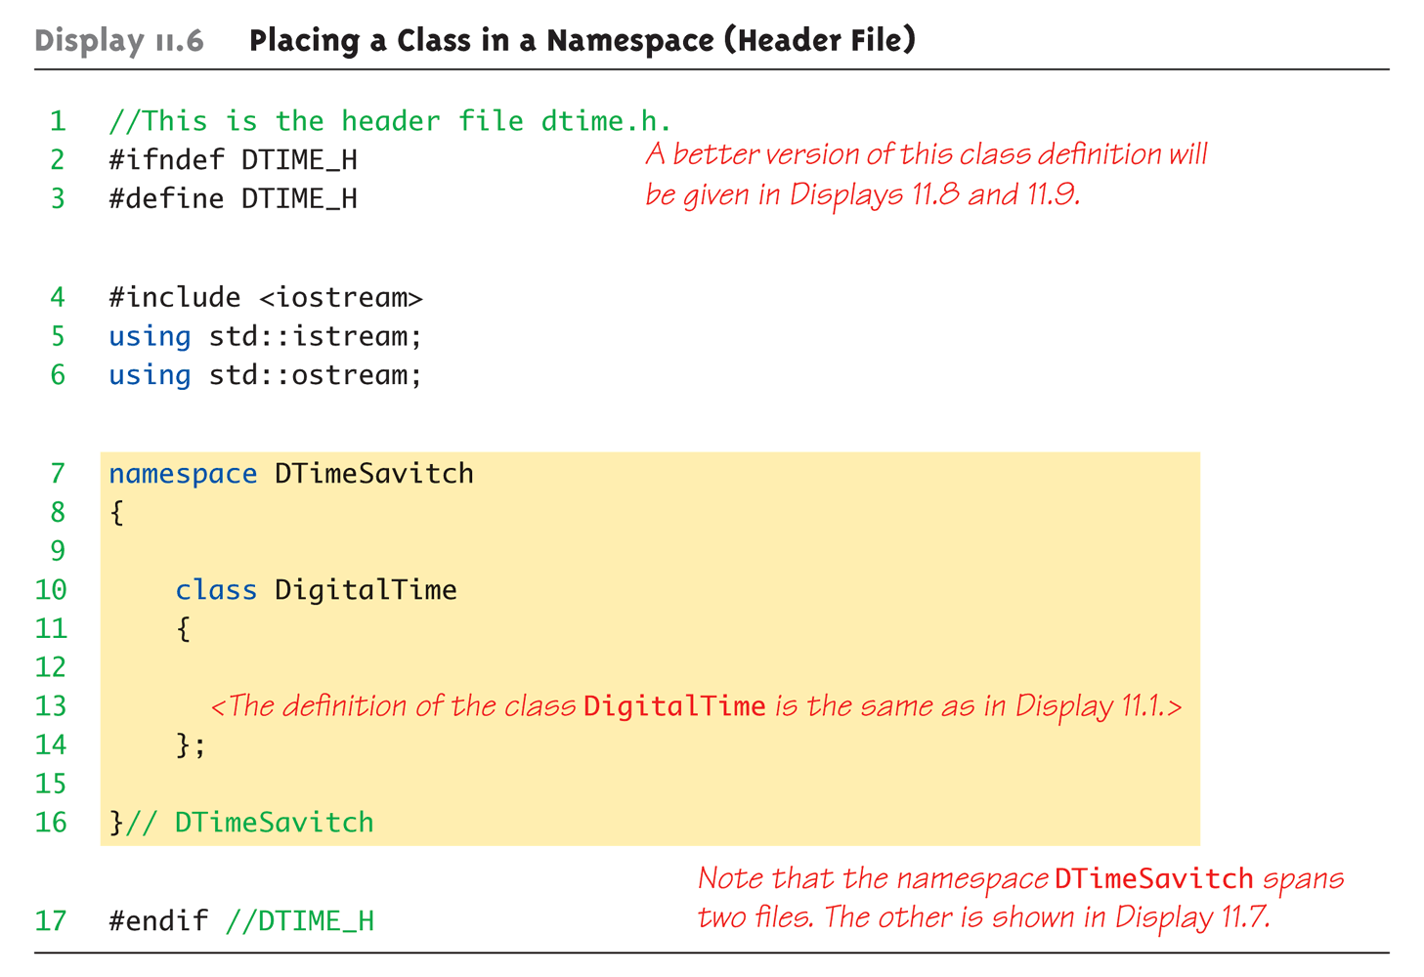
Class Namespace Example:
Display 11.6 Placing a Class in a Namespace (Header File)

Slide 27
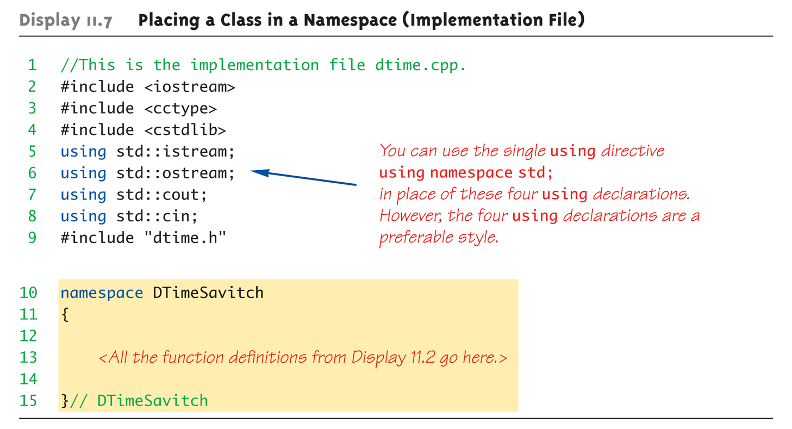
Class Namespace Example:
Display 11.7 Placing a Class in a Namespace (Implementation File)

Slide 28
Unnamed Namespaces
Compilation unit defined:
  A file, along with all files #included in file
Every compilation unit has unnamed namespace
  Written same way, but with no name
  All names are then local to compilation unit
Use unnamed namespace to keep
things "local"
Scope of unnamed namespace is
compilation unit

Slide 29
Global vs. Unnamed Namespaces
Not same
Global namespace:
  No namespace grouping at all
  Global scope
Unnamed namespace:
  Has namespace grouping, just no name
  Local scope

Slide 30
Nested Namespaces
Legal to nest namespaces
namespace S1
{
namespace S2
{
void sample()
{
…
}
}
Qualify names twice:
  S1::S2::sample();

Slide 31
Hiding Helping Functions
Recall helping function:
  Low-level utility
  Not for public use
Two ways to hide:
  Make private member function
    If function naturally takes calling object
  Place in class implementation’s unnamed namespace!
    If function needs no calling object
    Makes cleaner code (no qualifiers)

Slide 32
Summary 1
Can separate class definition and implementation → separate files
  Separate compilation units
Namespace is a collection of name definitions
Three ways to use name from namespace:
  Using directive
  Using declaration
  Qualifying

Slide 33
Summary 2
Namespace definitions are placed
inside namespace groupings
Unnamed namespace
  Used for local name definitions
  Scope is compilation unit
Global namespace
  Items not in a namespace grouping at all
  Global scope

