Slide 1
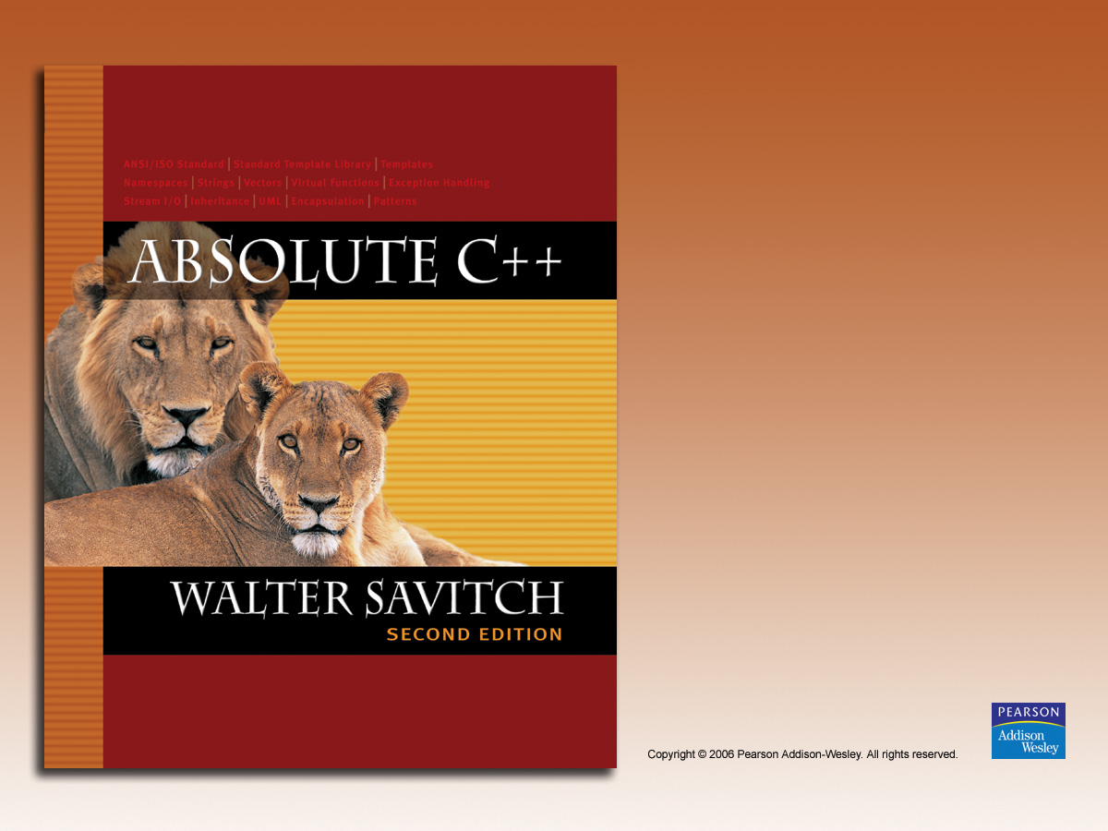
Chapter 13
Recursion

Slide 2

Learning Objectives
Recursive void Functions
  Tracing recursive calls
  Infinite recursion, overflows
Recursive Functions that Return a Value
  Powers function
Thinking Recursively
  Recursive design techniques
  Binary search

Slide 3
Introduction to Recursion
A function that "calls itself"
  Said to be recursive
  In function definition, call to same function
C++ allows recursion
  As do most high-level languages
  Can be useful programming technique
  Has limitations

Slide 4
Recursive void Functions
Divide and Conquer
  Basic design technique
  Break large task into subtasks
Subtasks could be smaller versions of
the original task!
  When they are → recursion

Slide 5
Recursive void Function Example
Consider task:
Search list for a value
  Subtask 1: search 1st half of list
  Subtask 2: search 2nd half of list
Subtasks are smaller versions of original task!
When this occurs, recursive function can
be used.
  Usually results in "elegant" solution

Slide 6
Recursive void Function:
Vertical Numbers
Task: display digits of number vertically,
one per line
Example call:
writeVertical(1234);
Produces output:
1
2
3
4

Slide 7
Vertical Numbers:
Recursive Definition
Break problem into two cases
Simple/base case: if n<10
  Simply write number n to screen
Recursive case: if n>=10, two subtasks:
  1- Output all digits except last digit
  2- Output last digit
Example: argument 1234:
  1st subtask displays 1, 2, 3 vertically
  2nd subtask displays 4

Slide 8
writeVertical Function Definition
Given previous cases:
void writeVertical(int n)
{
if (n < 10) //Base case
cout << n << endl;
else
{ //Recursive step
writeVertical(n/10);
cout << (n%10) << endl;
}
}

Slide 9
writeVertical Trace
Example call:
writeVertical(123);
→ writeVertical(12); (123/10)
→ writeVertical(1); (12/10)
→ cout << 1 << endl;
cout << 2 << endl;
cout << 3 << endl;
Arrows indicate task function performs
Notice 1st two calls call again (recursive)
Last call (1) displays and "ends"

Slide 10
Recursion—A Closer Look
Computer tracks recursive calls
  Stops current function
  Must know results of new recursive call
  before proceeding
  Saves all information needed for current call
    To be used later
  Proceeds with evaluation of new recursive call
  When THAT call is complete, returns to
  "outer" computation

Slide 11
Recursion Big Picture
Outline of successful recursive function:
  One or more cases where function
  accomplishes it’s task by:
    Making one or more recursive calls to solve
    smaller versions of original task
    Called "recursive case(s)"
  One or more cases where function
  accomplishes it’s task without recursive calls
    Called "base case(s)" or stopping case(s)

Slide 12
Infinite Recursion
Base case MUST eventually be entered
If it doesn’t → infinite recursion
  Recursive calls never end!
Recall writeVertical example:
  Base case happened when down to
  1-digit number
  That’s when recursion stopped

Slide 13
Infinite Recursion Example
Consider alternate function definition:
void newWriteVertical(int n)
{
newWriteVertical(n/10);
cout << (n%10) << endl;
}
Seems "reasonable" enough
Missing "base case"!
Recursion never stops

Slide 14
Stacks for Recursion
A stack
  Specialized memory structure
  Like stack of paper
    Place new on top
    Remove when needed from top
  Called "last-in/first-out" memory structure
Recursion uses stacks
  Each recursive call placed on stack
  When one completes, last call is removed
  from stack

Slide 15
Stack Overflow
Size of stack limited
  Memory is finite
Long chain of recursive calls continually
adds to stack
  All are added before base case causes removals
If stack attempts to grow beyond limit:
  Stack overflow error
Infinite recursion always causes this

Slide 16
Recursion Versus Iteration
Recursion not always "necessary"
Not even allowed in some languages
Any task accomplished with recursion can
also be done without it
  Nonrecursive: called iterative, using loops
Recursive:
  Runs slower, uses more storage
  Elegant solution; less coding

Slide 17
Recursive Functions that Return a Value
Recursion not limited to void functions
Can return value of any type
Same technique, outline:
  One+ cases where value returned is
  computed by recursive calls
    Should be "smaller" sub-problems
  One+ cases where value returned
  computed without recursive calls
    Base case

Slide 18
Return a Value
Recursion Example: Powers
Recall predefined function pow():
result = pow(2.0,3.0);
  Returns 2 raised to power 3 (8.0)
  Takes two double arguments
  Returns double value
Let’s write recursively
  For simple example

Slide 19
Function Definition for power()
int power(int x, int n)
{
if (n<0)
{
cout << "Illegal argument";
exit(1);
}
if (n>0)
return (power(x, n-1)*x);
else
return (1);
}

Slide 20
Calling Function power()
Example calls:
power(2, 0);
→ returns 1
power(2, 1);
→ returns (power(2, 0) * 2);
→ returns 1
  Value 1 multiplied by 2 & returned to original call

Slide 21
Calling Function power()
Larger example:
power(2,3);
→ power(2,2)*2
→ power(2,1)*2
→power(2,0)*2
→1
  Reaches base case
  Recursion stops
  Values "returned back" up stack

Slide 22
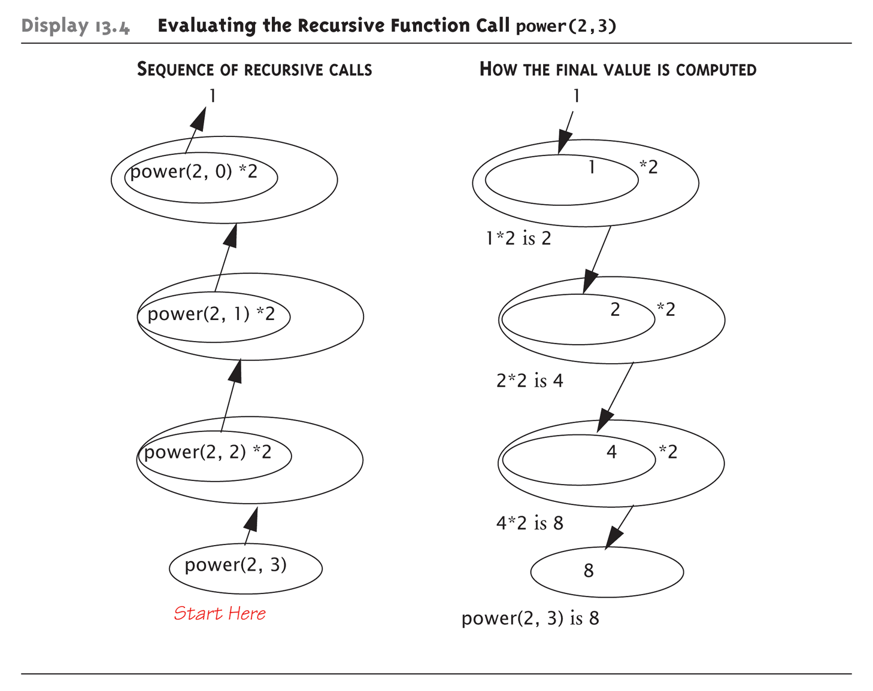
Tracing Function power():
Display 13.4 Evaluating the Recursive Function Call power(2,3)

Slide 23
Thinking Recursively
Ignore details
  Forget how stack works
  Forget the suspended computations
  Yes, this is an "abstraction" principle!
  And encapsulation principle!
Let computer do "bookkeeping"
  Programmer just think "big picture"

Slide 24
Thinking Recursively: power
Consider power() again
Recursive definition of power:
power(x, n)
returns:
power(x, n – 1) * x
  Just ensure "formula" correct
  And ensure base case will be met

Slide 25
Recursive Design Techniques
Don’t trace entire recursive sequence!
Just check 3 properties:
  No infinite recursion
  Stopping cases return correct values
  Recursive cases return correct values

Slide 26
Recursive Design Check: power()
Check power() against 3 properties:
  No infinite recursion:
    2nd argument decreases by 1 each call
    Eventually must get to base case of 1
  Stopping case returns correct value:
    power(x,0) is base case
    Returns 1, which is correct for x⁰
  Recursive calls correct:
    For n>1, power(x,n) returns power(x,n-1)*x
    Plug in values → correct

Slide 27
Binary Search
Recursive function to search array
  Determines IF item is in list, and if so:
  Where in list it is
Assumes array is sorted
Breaks list in half
  Determines if item in 1st or 2nd half
  Then searches again just that half
    Recursively (of course)!

Slide 28
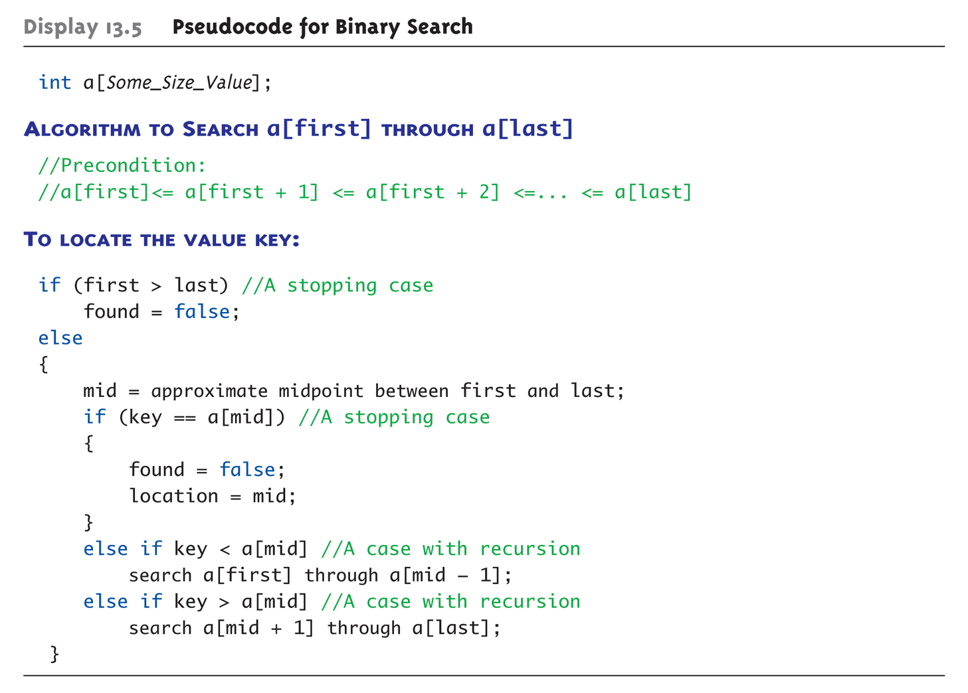
Display 13.5
Pseudocode for Binary Search

Slide 29
Checking the Recursion
Check binary search against criteria:
  No infinite recursion:
    Each call increases first or decreases last
    Eventually first will be greater than last
  Stopping cases perform correct action:
    If first > last → no elements between them, so key
    can’t be there!
    IF key == a[mid] → correctly found!
  Recursive calls perform correct action
    If key < a[mid] → key in 1st half – correct call
    If key > a[mid] → key in 2nd half – correct call

Slide 30
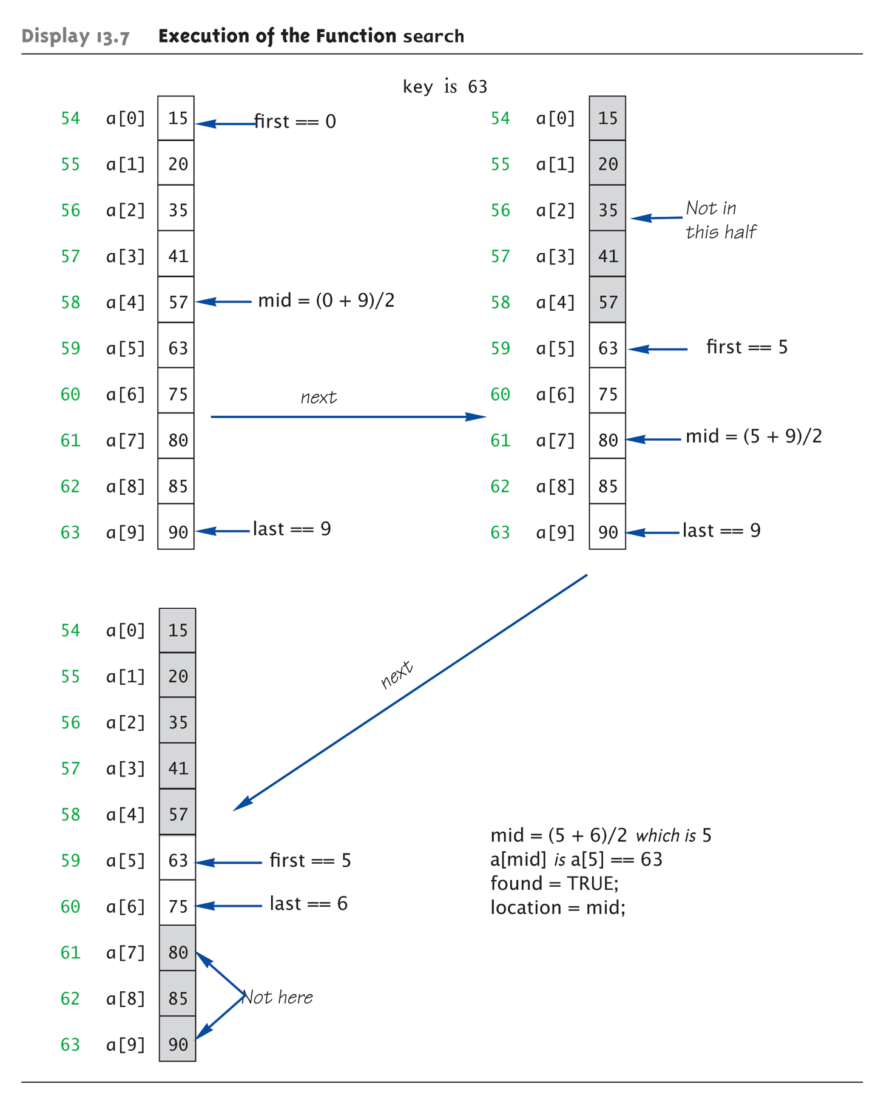
Execution of
Binary Search:
Display 13.7 Execution of the Function search

Slide 31
Efficiency of Binary Search
Extremely fast
  Compared with sequential search
Half of array eliminated at start!
  Then a quarter, then 1/8, etc.
  Essentially eliminate half with each call
Example:
Array of 100 elements:
  Binary search never needs more than 7 compares!
    Logarithmic efficiency (log n)

Slide 32
Recursive Solutions
Notice binary search algorithm actually
solves "more general" problem
  Original goal: design function to search an
  entire array
  Our function: allows search of any interval of array
    By specifying bounds first and last
Very common when designing
recursive functions

Slide 33
Summary 1
Reduce problem into smaller instances of
same problem -> recursive solution
Recursive algorithm has two cases:
  Base/stopping case
  Recursive case
Ensure no infinite recursion
Use criteria to determine recursion correct
  Three essential properties
Typically solves "more general" problem

