Slide 1
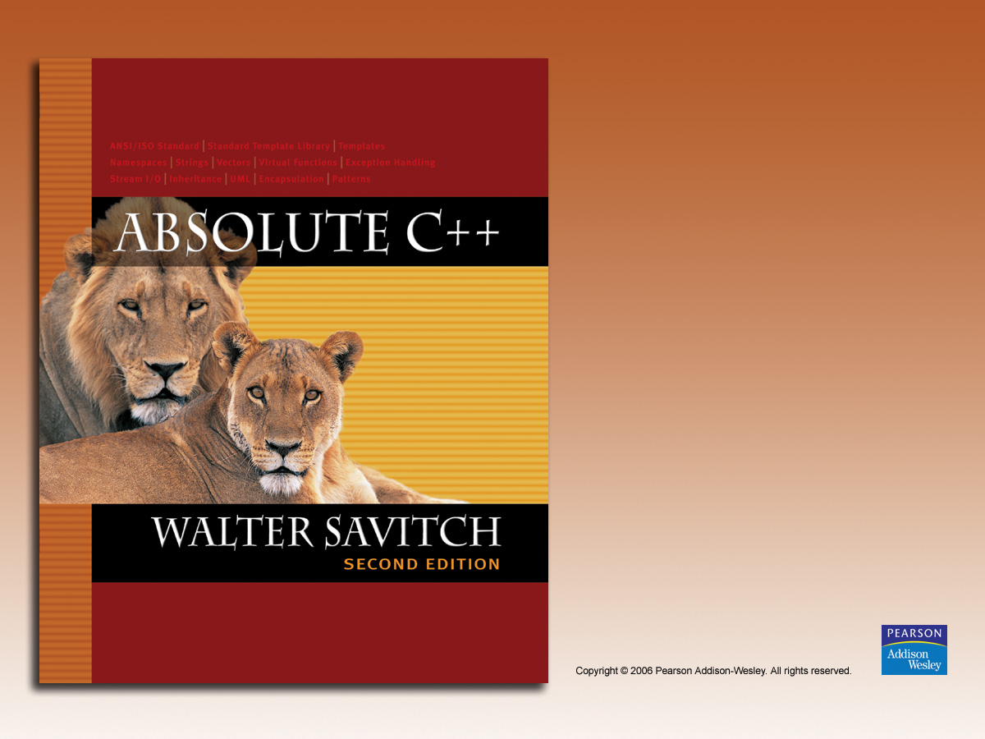
Chapter 17
Linked Data Structures

Slide 2

Learning Objectives
Nodes and Linked Lists
  Creating, searching
Linked List Applications
  Stacks, queues
  Friend classes, alternatives
Iterators
  Pointers as iterators
Trees

Slide 3
Introduction
Linked list
  Constructed using pointers
  Grows and shrinks during run-time
Trees also use pointers
Pointers backbone of such structures
  Use dynamic variables
Standard Template Library
  Has predefined versions of some structures

Slide 4
Approaches
Three ways to handle such data structures:
  C-style approach: global functions and
  structs with everything public
  Classes with private member variables and
  accessor and mutator functions
  Friend classes
Linked lists will use method 1
Stacks, queues will use method 2
Trees will use method 3

Slide 5
Nodes and Linked Lists
Linked list
  Simple example of "dynamic data structure"
  Composed of nodes
Each "node" is variable of struct or class
type that’s dynamically created with new
  Nodes also contain pointers to other nodes
  Provide "links"

Slide 6
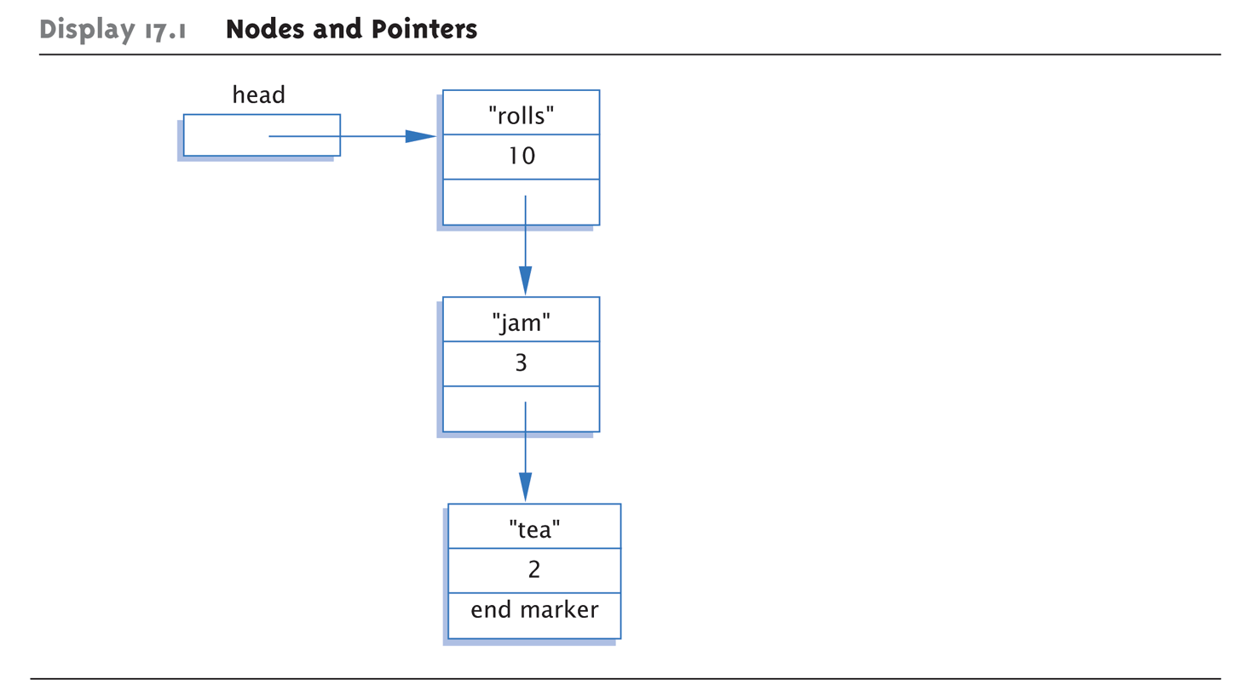
Display 17.1 Nodes and Pointers

Slide 7
Node Definition
struct ListNode
{
string item;
int count;
ListNode *link;
};
typedef ListNode* ListNodePtr;
Order here is important!
  Listnode defined 1st, since used in typedef
Also notice "circularity"

Slide 8
Head Pointer
Box labeled "head" not a node:
ListNodePtr head;
  A simple pointer to a node
  Set to point to 1st node in list
Head used to "maintain" start of list
Also used as argument to functions

Slide 9
Example Node Access
(*head).count = 12;
  Sets count member of node pointed to by
  head equal to 12
Alternate operator, ->
  Called "arrow operator"
  Shorthand notation that combines * and .
  head->count = 12;
    Identical to above
cin >> head->item
  Assigns entered string to item member

Slide 10
End Markers
Use NULL for node pointer
  Considered "sentinel" for nodes
  Indicates no further "links" after this node
Provides end marker similar to how we
use partially-filled arrays

Slide 11
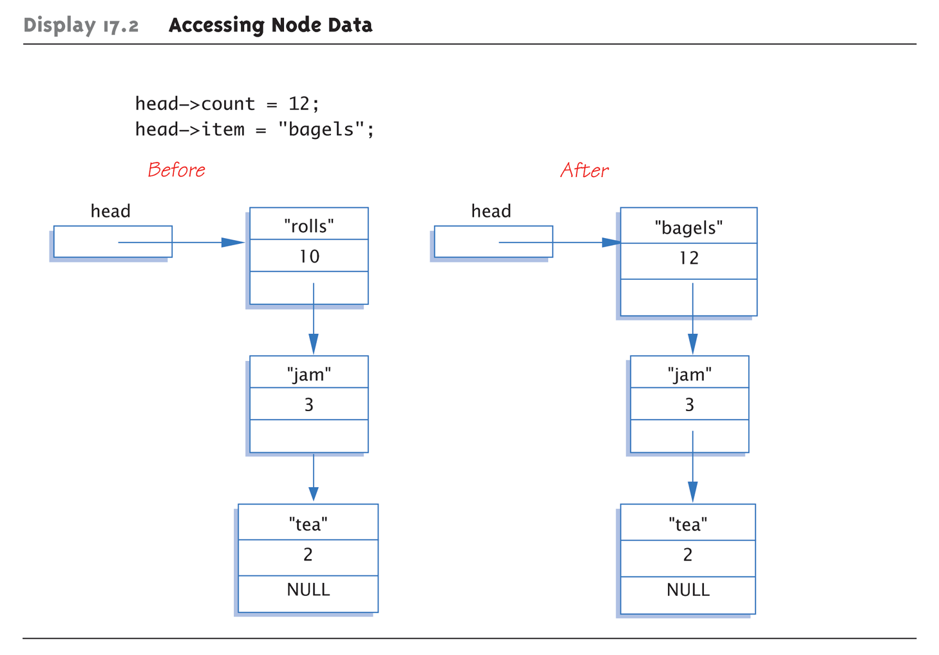
Display 17.2 Accessing Node Data

Slide 12
Linked List
Lists as illustrated called linked lists
First node called head
  Pointed to by pointer named head
Last node special also
  It’s member pointer variable is NULL
  Easy test for "end" of linked list

Slide 13
Linked List Class Definition
class IntNode
{
public:
IntNode() { }
IntNode(int theData, IntNOde* theLink)
: data(theData), link(theLink) { }
IntNode* getLink() const {return link;}
int getData() const {return data;}
void setData(int theData) {data = theData;}
void setLink(IntNode* pointer) {link=pointer;}
private:
int data;
IntNode *link;
};
typedef IntNode* IntNodePtr;

Slide 14
Linked List Class
Notice all member function definitions are inline
  Small and simple enough
Notice two-parameter constructor
  Allows creation of nodes with specific data
  value and specified link member
  Example:
  IntNodePtr p2 = new IntNode(42, p1);

Slide 15
Create 1st Node
IntNodePtr head;
  Declares pointer variable head
head = new IntNode;
  Dynamically allocates new node
  Our 1st node in list, so assigned to head
head->setData(3);
head->setLink(NULL);
  Sets head node data
  Link set to NULL since it’s the only node!

Slide 16
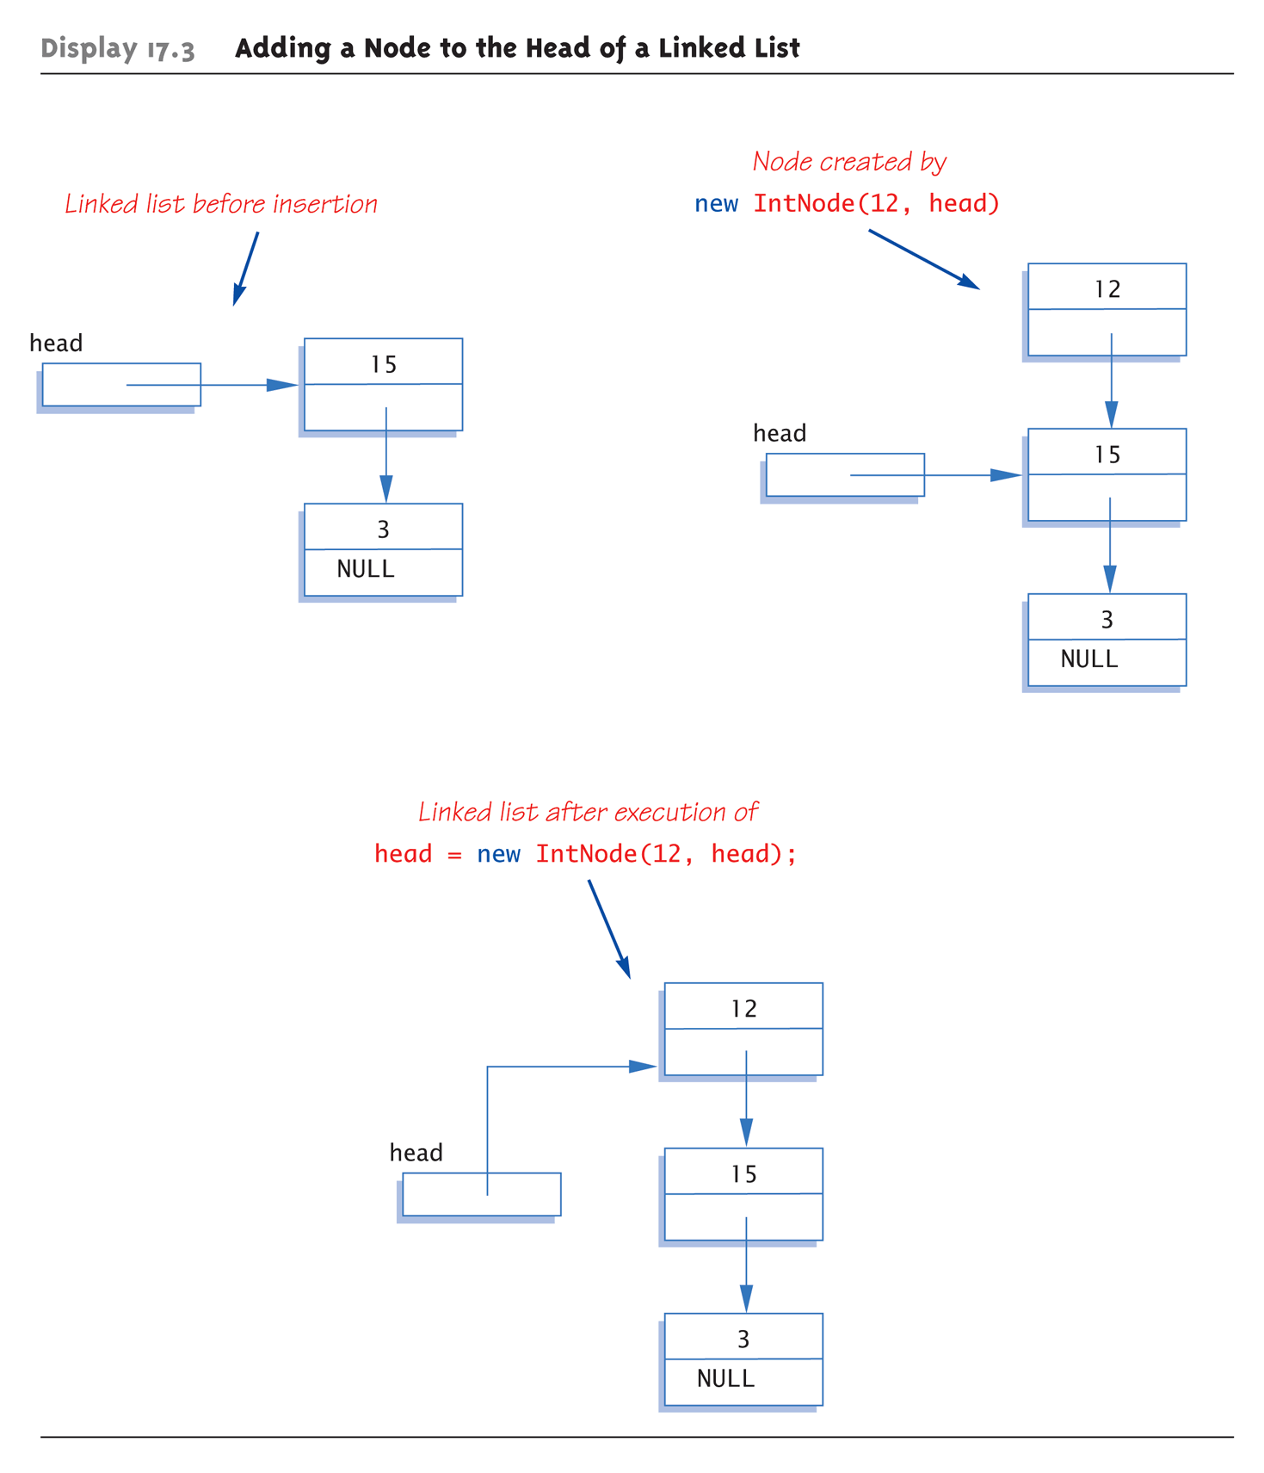
Display 17.3 Adding a Node to the Head of a Linked List

Slide 17
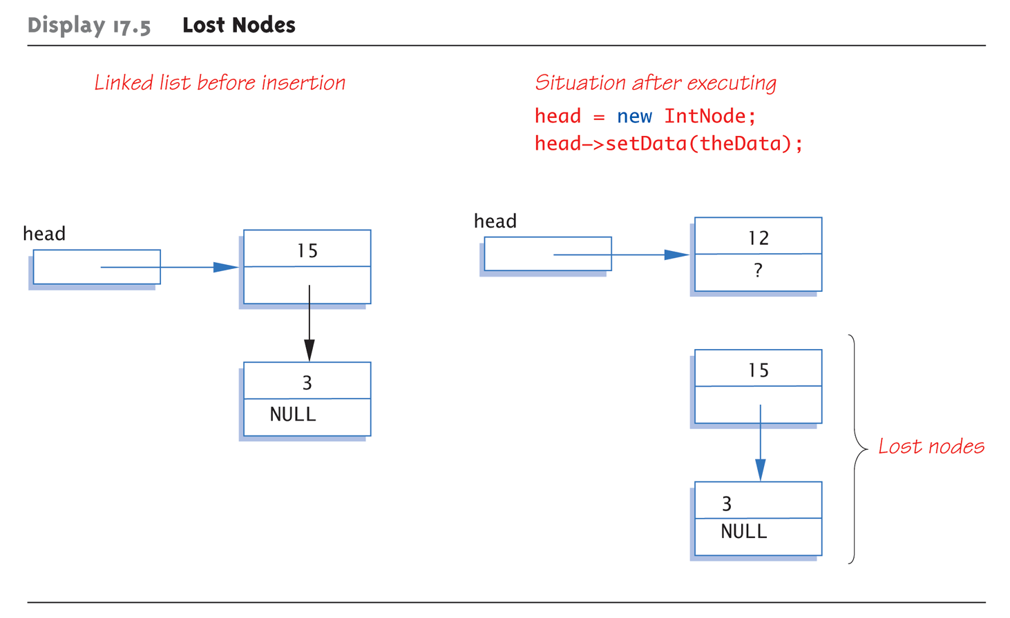
Lost Nodes Pitfall:
Display 17.5 Lost Nodes

Slide 18
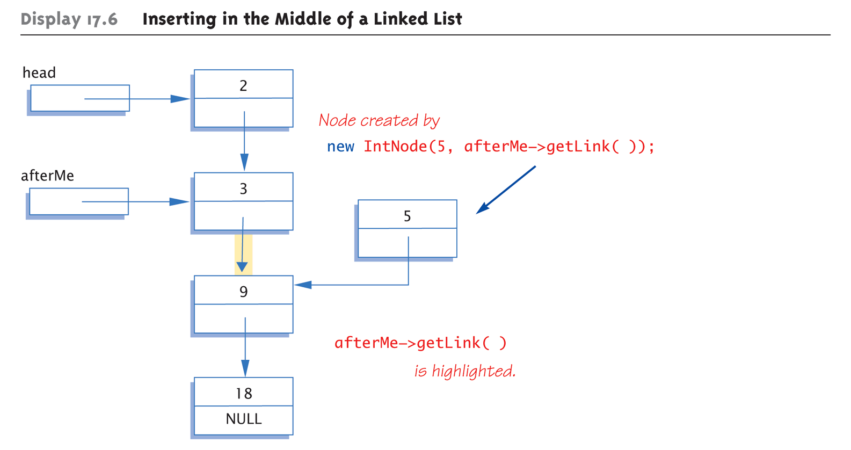
Display 17.6 Inserting in the Middle of a Linked List (1 of 2)

Slide 19
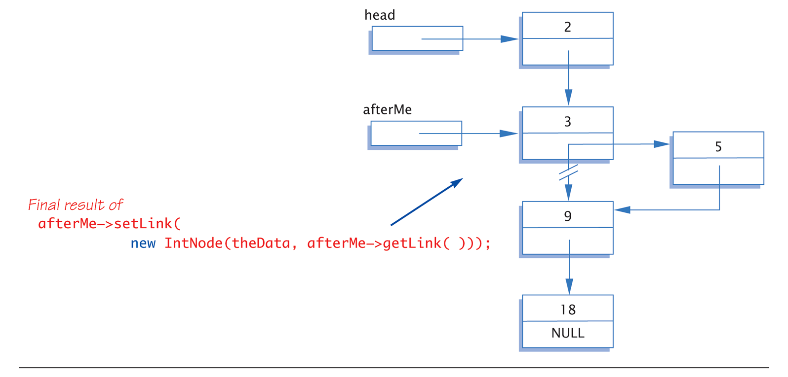
Display 17.6 Inserting in the Middle of a Linked List (2 of 2)

Slide 20
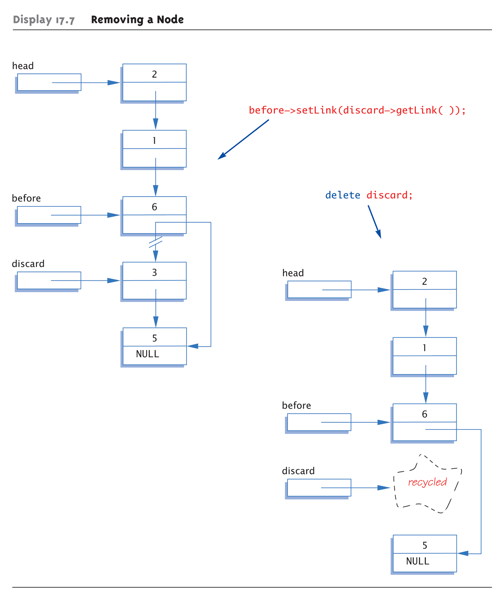
Display 17.7 Removing a Node

Slide 21
Searching a Linked List
Function with two arguments:
IntNodePtr search(IntNodePtr head, int target);
//Precondition: pointer head points to head of
//linked list. Pointer in last node is NULL.
//If list is empty, head is NULL
//Returns pointer to 1st node containing target
//If not found, returns NULL
Simple "traversal" of list
  Similar to array traversal

Slide 22
Pseudocode for search Function
while (here doesn’t point to target node or
last node)
{
Make here point to next node in list
}
if (here node points to target)
return here;
else
return NULL;

Slide 23
Algorithm for search Function
while (here->getData() != target &&
here->getLink() != NULL)
here = here->getLink();
if (here->getData() == target)
return here;
else
return NULL;
Must make "special" case for empty list
  Not done here

Slide 24
Stacks
Stack data structure:
  Retrieves data in reverse order of how stored
  LIFO – last-in/first-out
  Think of like "hole in ground"
Stacks used for many tasks:
  Track C++ function calls
  Memory management
Our use:
  Use linked lists to implement stacks

Slide 25
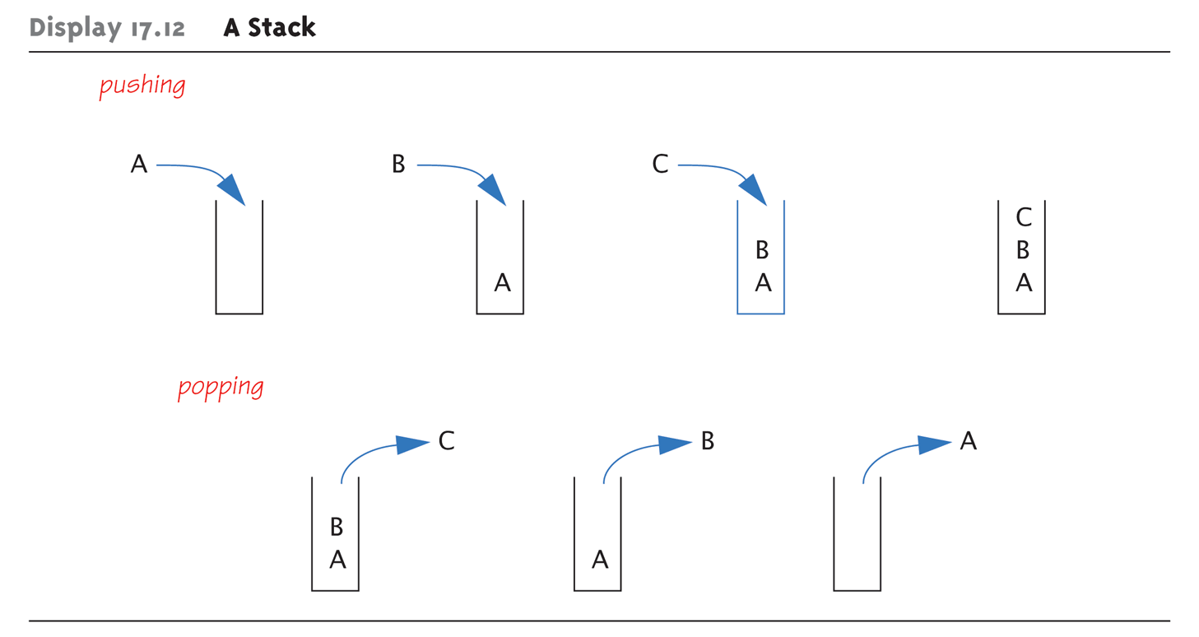
A Stack—Graphic:
Display 17.12 A Stack

Slide 26
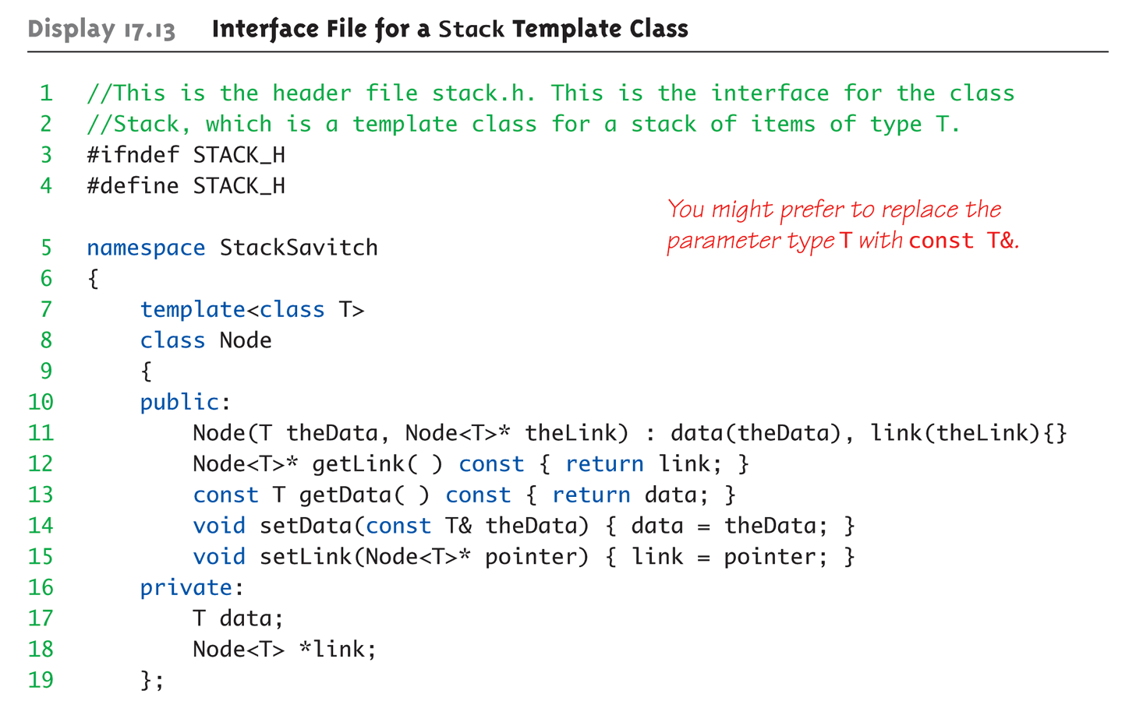
Display 17.13 Interface File for a Stack Template Class (1 of 2)

Slide 27
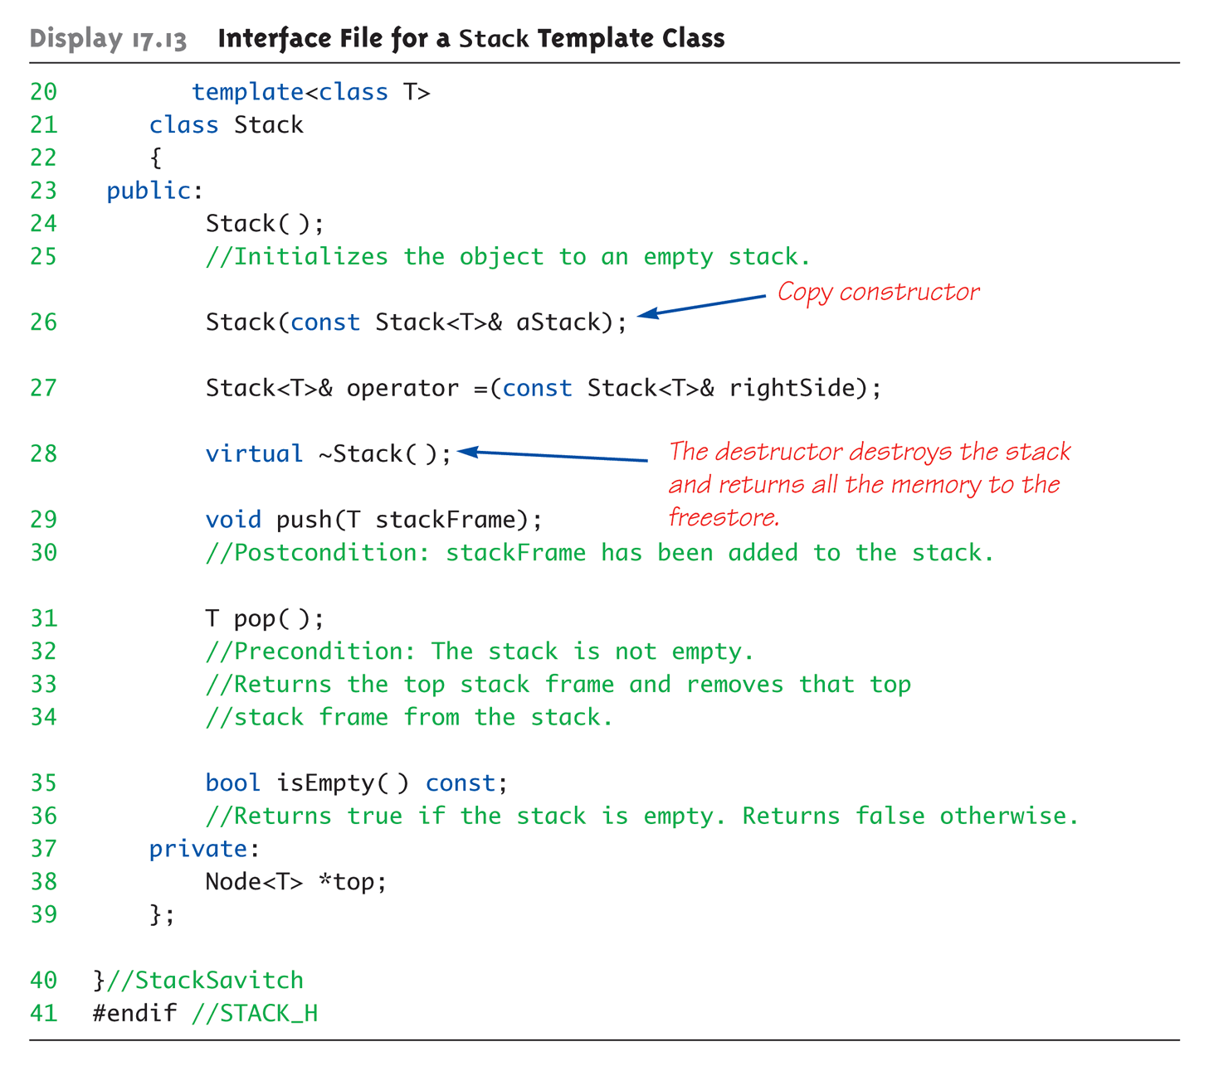
Display 17.13 Interface File for a Stack Template Class (2 of 2)

Slide 28
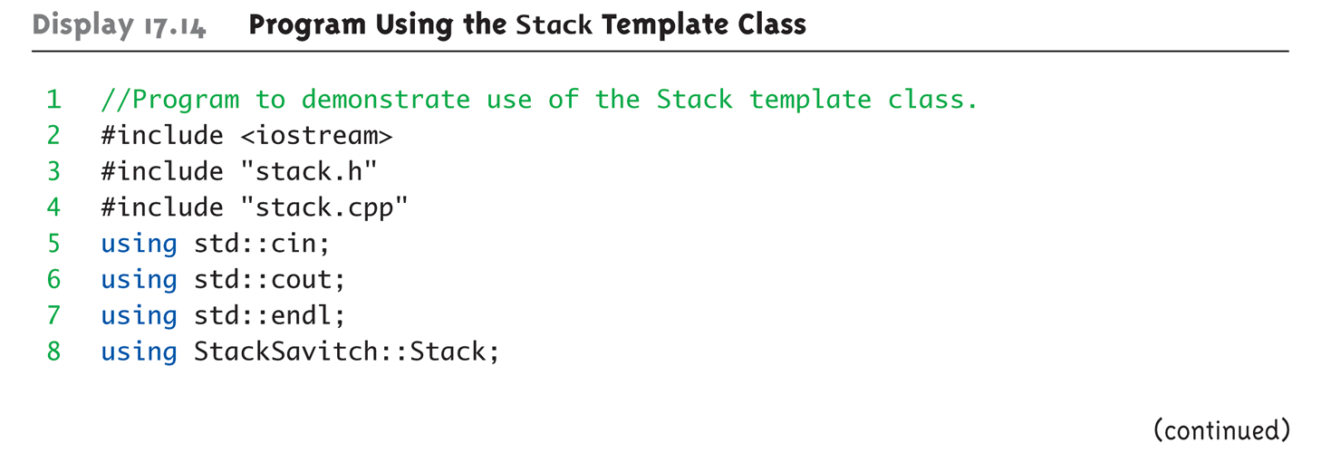
Stack Template Class Driver:
Display 17.14 Program Using the Stack Template Class (1 of 3)

Slide 29
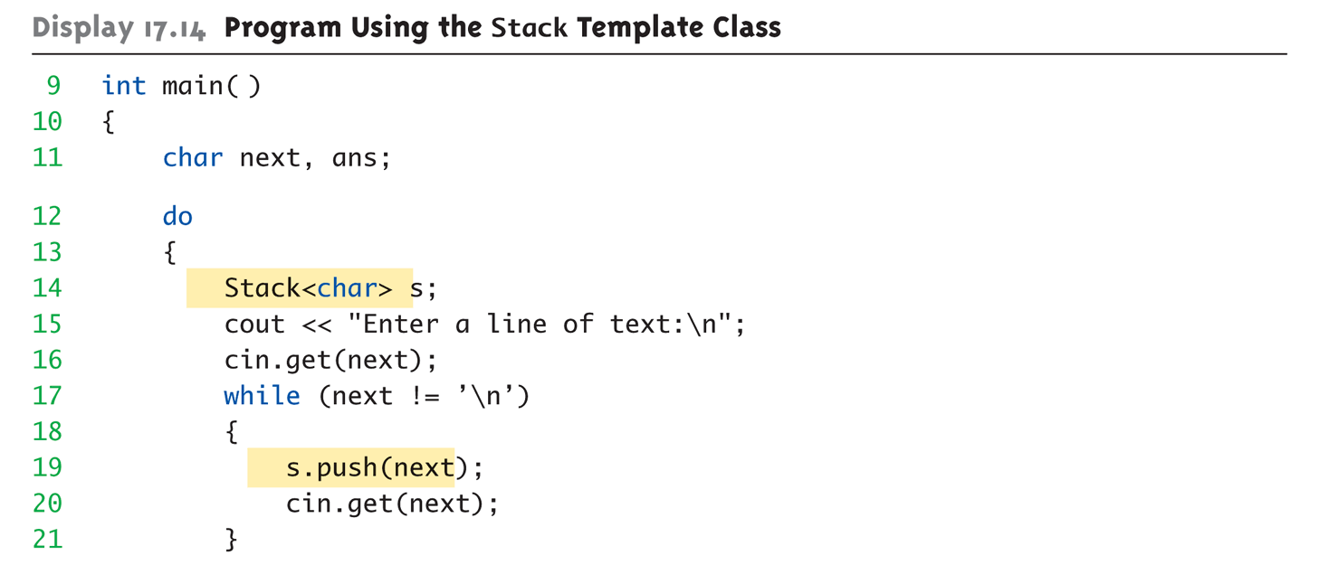
Stack Template Class Driver:
Display 17.14 Program Using the Stack Template Class (2 of 3)

Slide 30
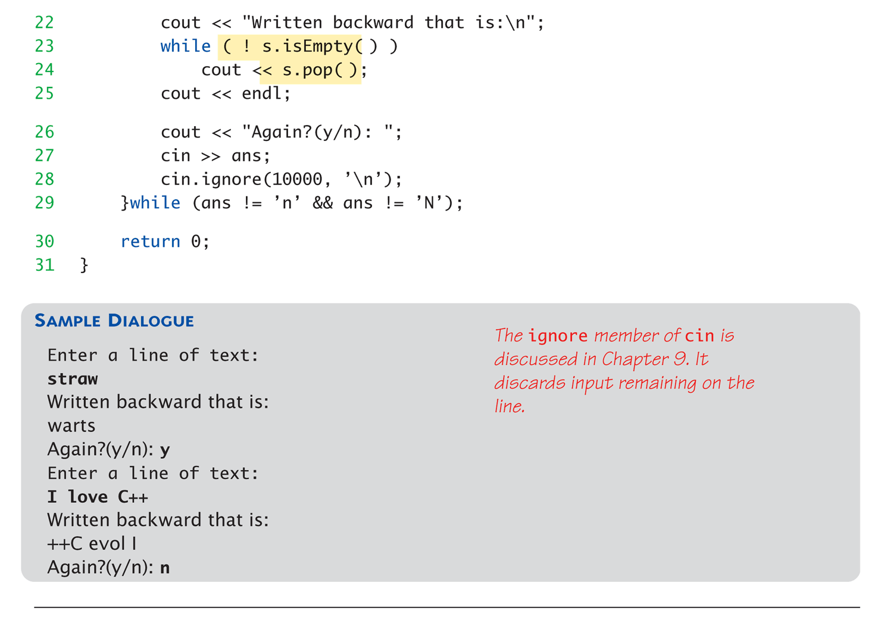
Stack Template Class Driver:
Display 17.14 Program Using the Stack Template Class (3 of 3)

Slide 31
Stack Push and Pop
Adding data item to stack → push
  Considered "pushing" data onto stack
  Recall: goes to "top" of stack
Removing data item from stack → pop
  Considered "popping" item off stack
  Recall: removed from "top" of stack

Slide 32
Queues
Another common data structure:
  Handles data in first-in/first-out manner
  (FIFO)
  Items inserted to end of list
  Items removed from front
Representation of typical "line" forming
  Like bank teller lines, movie theatre
  lines, etc.

Slide 33
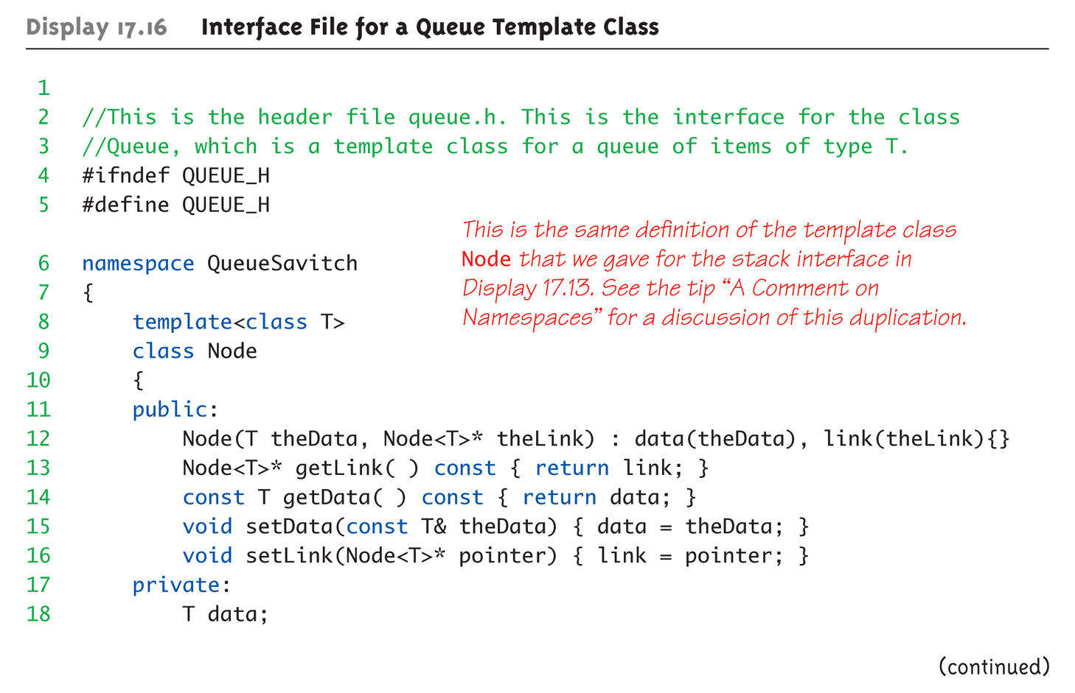
Display 17.16 Interface File for a Queue Template Class (1 of 3)

Slide 34
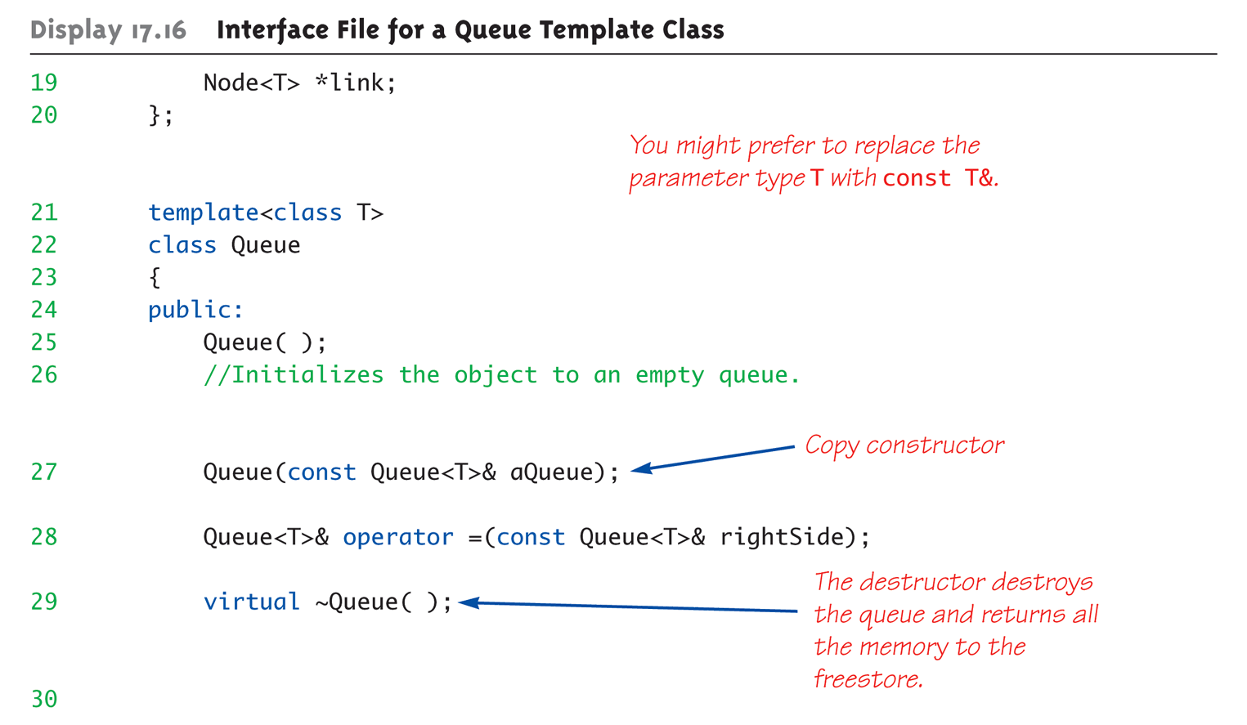
Display 17.16 Interface File for a Queue Template Class (2 of 3)

Slide 35
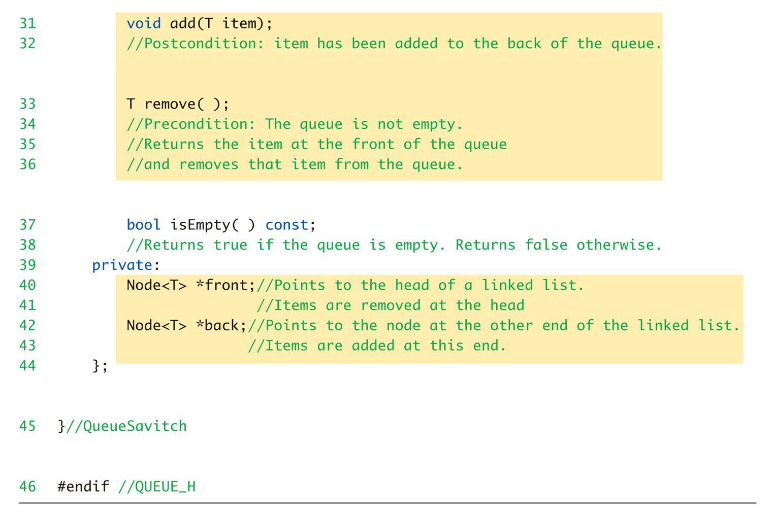
Display 17.16 Interface File for a Queue Template Class (3 of 3)

Slide 36
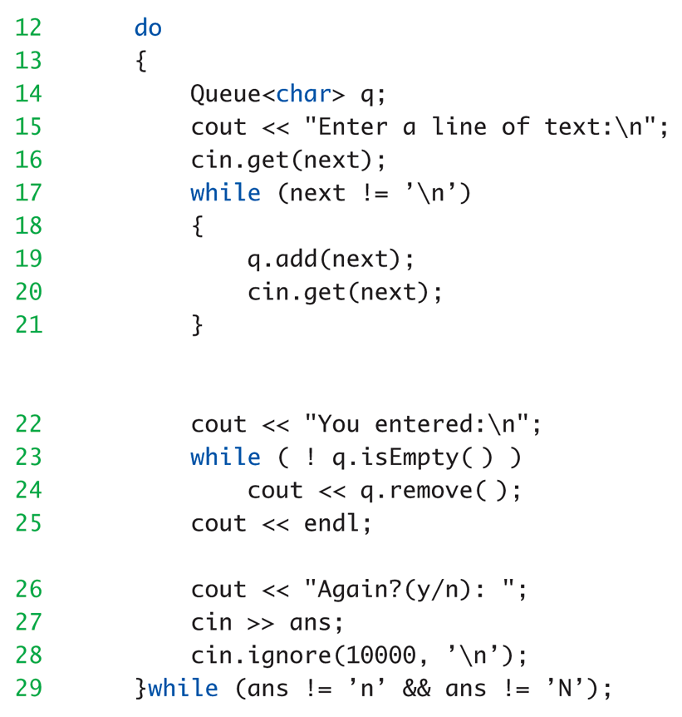
Queue Template Class Driver:
Display 17.17 Program Using the Queue Template Class

Slide 37
Friend Classes
Recall constant use of getLink and
setlink accessor and mutator functions
  Somewhat of a nuisance
  Similar to making data public?!
    Public makes available to ALL!
Use friend class
  Make queue template class "friend" of node
  template class
  All private link members directly available in
  member functions of queue class!

Slide 38
Forward Declaration
Class friendships typically require classes reference each other
  Presents problem
  How can "both" be declared at same time?
Requires forward declaration
  Simple class heading given inside other:
  class Queue; //Forward Dec.
  Announces "class Queue will exist"

Slide 39
Iterators
Construct for cycling through data
  Like a "traversal"
  Allows "whatever" actions required on data
Pointers typically used as iterators
  Seen in linked list implementation

Slide 40
Pointers as Iterators
Recall: linked list: "prototypical" data structure
Pointer: "prototypical" example of iterator
  Pointer used as iterator by moving thru
  linked list node by node starting at head:
  Example:
  Node_Type *iterator;
  for (iterator = Head; iterator != NULL;
  iterator=iterator->Link)
  Do_Action

Slide 41
Iterator Classes
More versatile than pointer
Typical overloaded operators:
++ advances iterator to next item
-- retreats iterator to previous item
== Compares iterators
!= Compare for not equal
* Accesses one item
Data structure class would have members:
begin(): returns iterator to 1st item in structure
end(): returns iterator to test if at end

Slide 42
Iterator Class Example
Cycle through data structure named ds:
for (i=ds.begin();i!=ds.end();i++)
process *i //*i is current data item
i is name of iterator

Slide 43
Trees Introduction
Trees can be complex data structures
Only basics here:
  Constructing, manipulating
  Using nodes and pointers
Recall linked list: nodes have only one
pointer → next node
Trees have two, & sometimes more,
pointers to other nodes

Slide 44
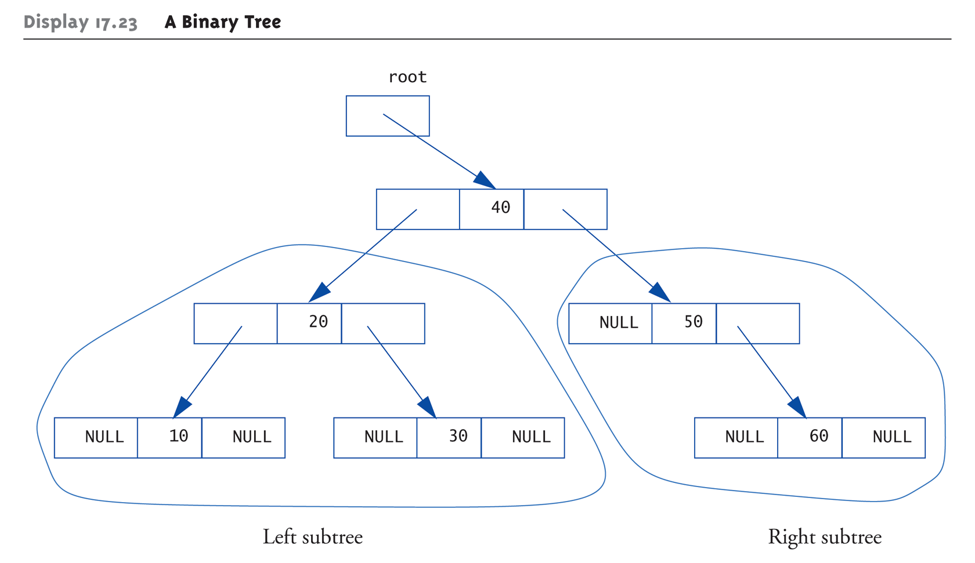
Tree Structure:
Display 17.23 A Binary Tree (1 of 2)

Slide 45
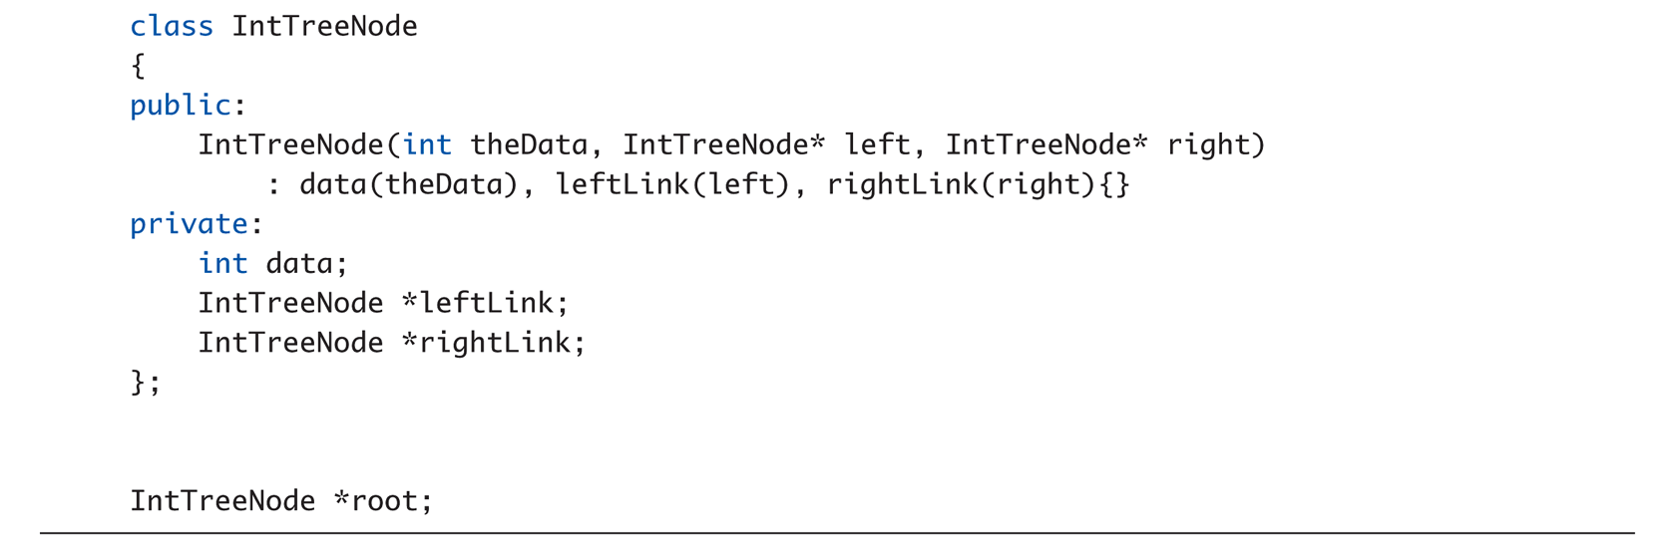
Tree Structure:
Display 17.23 A Binary Tree (2 of 2)

Slide 46
Tree Properties
Notice paths
  From top to any node
  No "cycles" – follow pointers, will reach "end"
Notice here each node has two links
  Called binary tree
  Most common type of tree
Root node
  Similar to linked list’s head
Leaf nodes
  Both link variables are NULL (no subtrees)

Slide 47
Trees and Recursion
Note tree’s "recursive structure"
Each tree has two subtrees
  Each subtree has two subtrees
    Etc., etc.
Makes trees amenable to recursive
algorithms
  For searching especially!

Slide 48
Tree Processing
Preorder Processing:
  Process data in root node
  Process left subtree
  Process right subtree
In-order Processing:
  Process left subtree
  Process data in root
  Process right subtree
Postorder Processing:
  Process left subtree
  Process right subtree
  Process data in root

Slide 49
Tree Storage
Our example stored values in special way:
  Called binary search tree storage rule:
    values in left subtree less than root value
    values in right subtree greater than root
    rule applies recursively to each subtree
Trees using this storage mechanism:
  Called binary search tree (BST)
  Traversals:
  Inorder → values "in order"
  Preorder → "prefix" notation
  Postorder → "postfix" notation

Slide 50
Summary 1
Node is struct or class object
  One or more members is pointer
  Nodes connected by member pointers
    Produce structures that grow and shrink at runtime
Linked list
  List of nodes where each node points to next
End of linked list marked with NULL pointer

Slide 51
Summary 2
Stack is LIFO data structure
Queue is FIFO data structure
Iterator construct allows cycling through
data items in given data structure
Tree data structures
  Nodes have two member pointers
  Each point to other nodes/subtrees
Binary search tree
  Special storage rules allow rapid searches

