Slide 1
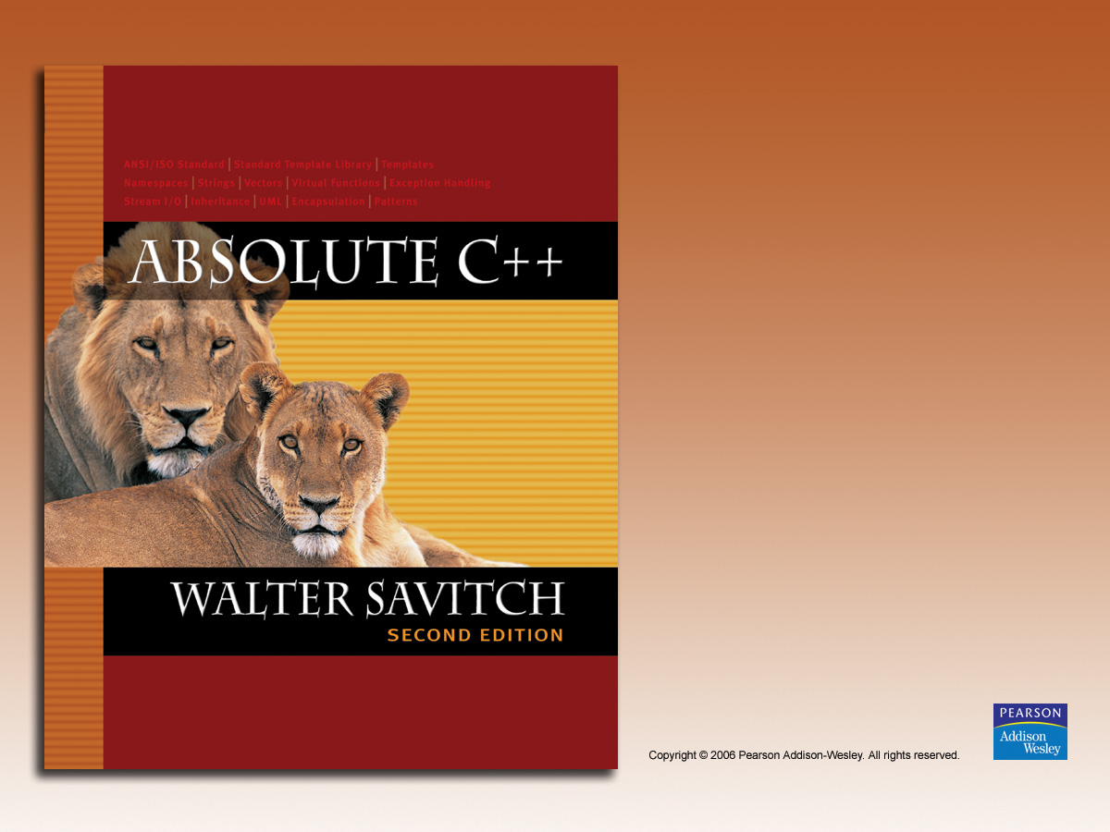
Chapter 18
Exception Handling

Slide 2

Learning Objectives
Exception Handling Basics
  Defining exception classes
  Multiple throws and catches
  Exception specifications
Programming Techniques for
Exception Handling
  When to throw exceptions
  Exception class hierarchies

Slide 3
Introduction
Typical approach to development:
  Write programs assuming things go as planned
  Get "core" working
  Then take care of "exceptional" cases
C++ exception-handling facilities
  Handle "exceptional" situations
  Mechanism "signals" unusual happening
  Another place in code "deals" with exception

Slide 4
Exception-Handling Basics
Meant to be used "sparingly"
  In "involved" situations
Difficult to teach such large examples
Approach:
  Simple "toy" examples, that would not
  normally use exception-handling
  Keep in mind "big picture"

Slide 5
Toy Example
Imagine: people rarely run out of milk:
cout << "Enter number of donuts:";
cin >> donuts;
cout << "Enter number of glasses of milk:";
cin >> milk
dpg = donuts/static_cast<double>(milk);
cout << donuts << "donuts.\n";
<< milk << "glasses of milk.\n";
<< "You have " << dpg
<< "donuts for each glass of milk.\n";
Basic code assumes never run out of milk

Slide 6
Toy Example if-else
Notice: If no milk→divide by zero error!
Program should accommodate unlikely
situation of running out of milk
  Can use simple if-else structure:
  if (milk <= 0)
  cout << "Go buy some milk!\n";
  else
  {…}
Notice: no exception-handling here

Slide 7
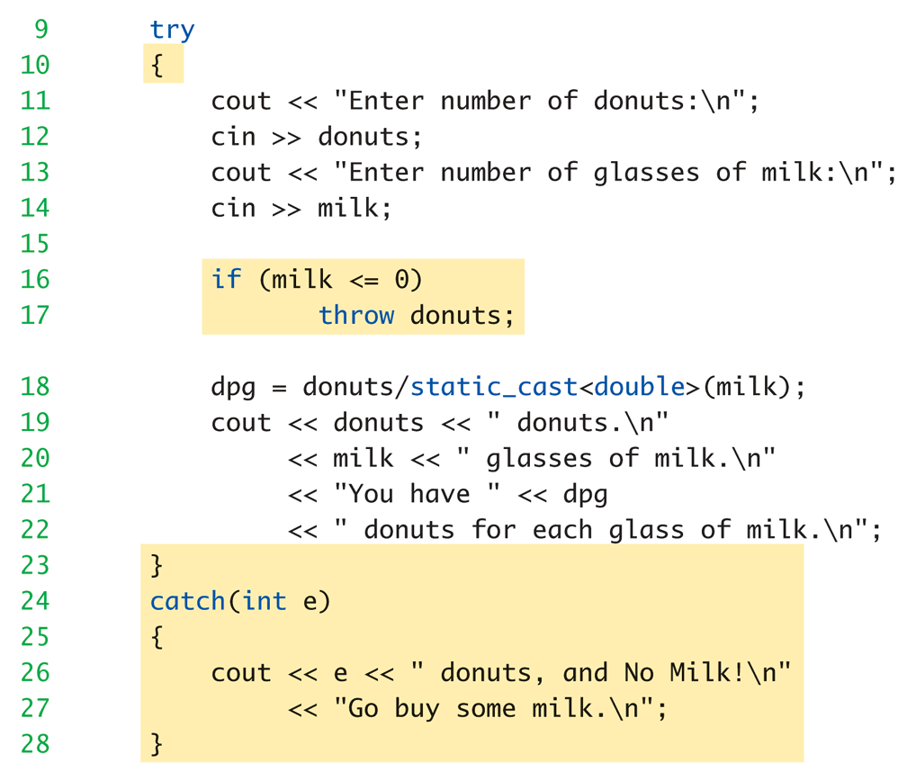
Toy Example with Exception Handling: Display 18.2 Same Thing Using
Exception Handling

Slide 8
Toy Example Discussion
Code between keywords try and catch
  Same code from ordinary version, except
  if statement simpler:
  if (milk <= 0)
  throw donuts;
  Much cleaner code
  If "no milk" → do something exceptional
The "something exceptional" is provided
after keyword catch

Slide 9
Toy Example try-catch
Try block
  Handles "normal" situation
Catch block
  Handles "exceptional" situations
Provides separation of normal
from exceptional
  Not big deal for this simple example, but
  important concept

Slide 10
try block
Basic method of exception-handling is
try-throw-catch
Try block:
try
{
Some_Code;
}
  Contains code for basic algorithm when all
  goes smoothly

Slide 11
throw
Inside try-block, when something
unusual happens:
try
{
Code_To_Try
if (exceptional_happened)
throw donuts;
More_Code
}
  Keyword throw followed by exception type
  Called "throwing an exception"

Slide 12
catch-block
When something thrown → goes somewhere
  In C++, flow of control goes from try-block to
  catch-block
    try-block is "exited" and control passes to catch-block
  Executing catch block called "catching the
  exception"
Exceptions must be "handled" in some
catch block

Slide 13
catch-block More
Recall:
catch(int e)
{
cout << e << " donuts, and no milk!\n";
<< " Go buy some milk.\n";
}
Looks like function definition with
int parameter!
  Not a function, but works similarly
  Throw like "function call"

Slide 14
catch-block Parameter
Recall: catch(int e)
"e" called catch-block parameter
  Each catch block can have at most ONE
  catch-block parameter
Does two things:
  type name specifies what kind of thrown
  value the catch-block can catch
  Provides name for thrown value caught;
  can "do things" with value

Slide 15
Defining Exception Classes
throw statement can throw value of
any type
Exception class
  Contains objects with information to
  be thrown
  Can have different types identifying each
  possible exceptional situation
  Still just a class
    An "exception class" due to how it’s used

Slide 16
Exception Class for Toy Example
Consider:
class NoMilk
{
public:
NoMilk() { }
NoMilk(int howMany) : count(howMany) { }
int getcount() const { return count; }
private:
int count;
};
throw NoMilk(donuts);
  Invokes constructor of NoMilk class

Slide 17
Multiple Throws and Catches
try-block typically throws any number of
exception values, of differing types
Of course only one exception thrown
  Since throw statement ends try-block
But different types can be thrown
  Each catch block only catches "one type"
  Typical to place many catch-blocks after each
  try-block
    To catch "all-possible" exceptions to be thrown

Slide 18
Catching
Order of catch blocks important
Catch-blocks tried "in order" after try-block
  First match handles it!
Consider:
catch (…) { }
  Called "catch-all", "default" exception handler
  Catches any exception
  Ensure catch-all placed AFTER more specific
  exceptions!
    Or others will never be caught!

Slide 19
Trivial Exception Classes
Consider:
class DivideByZero
{ }
No member variables
No member functions (except default
constructor)
Nothing but it’s name, which is enough
  Might be "nothing to do" with exception value
  Used simply to "get to" catch block
  Can omit catch block parameter

Slide 20
Throwing Exception in Function
Function might throw exception
Callers might have different "reactions"
  Some might desire to "end program"
  Some might continue, or do something else
Makes sense to "catch" exception in
calling function’s try-catch-block
  Place call inside try-block
  Handle in catch-block after try-block

Slide 21
Throwing Exception in Function Example
Consider:
try
{
quotient = safeDivide(num, den);
}
catch (DivideByZero)
{ … }
safeDivide() function throws DividebyZero
exception
  Handled back in caller’s catch-block

Slide 22
Exception Specification
Functions that don’t catch exceptions
  Should "warn" users that it could throw
  But it won’t catch!
Should list such exceptions:
double safeDivide(int top, int bottom)
throw (DividebyZero);
  Called "exception specification" or "throw list"
  Should be in declaration and definition
  All types listed handled "normally"
  If no throw list → all types considered there

Slide 23
Throw List
If exception thrown in function NOT in
throw list:
  No errors (compile or run-time)
  Function unexpected() automatically called
    Default behavior is to terminate
    Can modify behavior
Same result if no catch-block found

Slide 24
Throw List Summary
void someFunction()
throw(DividebyZero, OtherException);
//Exception types DividebyZero or OtherException
//treated normally. All others invoke unexpected()
void someFunction() throw ();
//Empty exception list, all exceptions invoke
unexpected()
void someFunction();
//All exceptions of all types treated normally

Slide 25
Derived Classes
Remember: derived class objects also
objects of base class
Consider:
D is derived class of B
If B is in exception specification →
  Class D thrown objects will also be treated
  normally, since it’s also object of class B
Note: does not do automatic type cast:
  double will not account for throwing an int

Slide 26
unexpected()
Default action: terminates program
  No special includes or using directives
Normally no need to redefine
But you can:
  Use set_unexpected
  Consult compiler manual or advanced
  text for details

Slide 27
When to Throw Exceptions
Typical to separate throws and catches
  In separate functions
Throwing function:
  Include throw statements in definition
  List exceptions in throw list
    In both declaration and definition
Catching function:
  Different function, perhaps even in different file

Slide 28
Preferred throw-catch Triad: throw
void functionA() throw (MyException)
{
…
throw MyException(arg);
…
}
Function throws exception as needed

Slide 29
Preferred throw-catch Triad: catch
Then some other function:
void functionB()
{
…
try
{
…
functionA();
…
}
catch (MyException e)
{ // Handle exception
}
…
}

Slide 30
Uncaught Exceptions
Should catch every exception thrown
If not → program terminates
  terminate() is called
Recall for functions
  If exception not in throw list: unexpected()
  is called
    It in turn calls terminate()
So same result

Slide 31
Overuse of Exceptions
Exceptions alter flow of control
  Similar to old "goto" construct
  "Unrestricted" flow of control
Should be used sparingly
Good rule:
  If desire a "throw": consider how to write
  program without throw
  If alternative reasonable → do it

Slide 32
Exception Class Hierarchies
Useful to have; consider:
DivideByZero class derives from:
ArithmeticError exception class
  All catch-blocks for ArithmeticError also
  catch DivideByZero
  If ArithmeticError in throw list, then
  DividebyZero also considered there

Slide 33
Testing Available Memory
new operator throws bad_alloc exception
if insufficient memory:
try
{
NodePtr pointer = new Node;
}
catch (bad_alloc)
{
cout << "Ran out of memory!";
// Can do other things here as well…
}
In library <new>, std namespace

Slide 34
Rethrowing an Exception
Legal to throw exception IN catch-block!
  Typically only in rare cases
Throws to catch-block "farther up chain"
Can re-throw same or new exception
  rethrow;
    Throws same exception again
  throw newExceptionUp;
    Throws new exception to next catch-block

Slide 35
Summary 1
Exception handling allows separation of
"normal" cases and "exceptional" cases
Exceptions thrown in try-block
  Or within a function whose call is in try-block
Exceptions caught in catch-block
try-blocks typically followed by more than
one catch-block
  List more specific exceptions first

Slide 36
Summary 2
Best used with separate functions
  Especially considering callers might
  handle differently
Exceptions thrown in but not caught in
function, should be listed in throw list
Exceptions thrown but never caught →
program terminates
Resist overuse of exceptions
  Unrestricted flow of control

