Slide 1
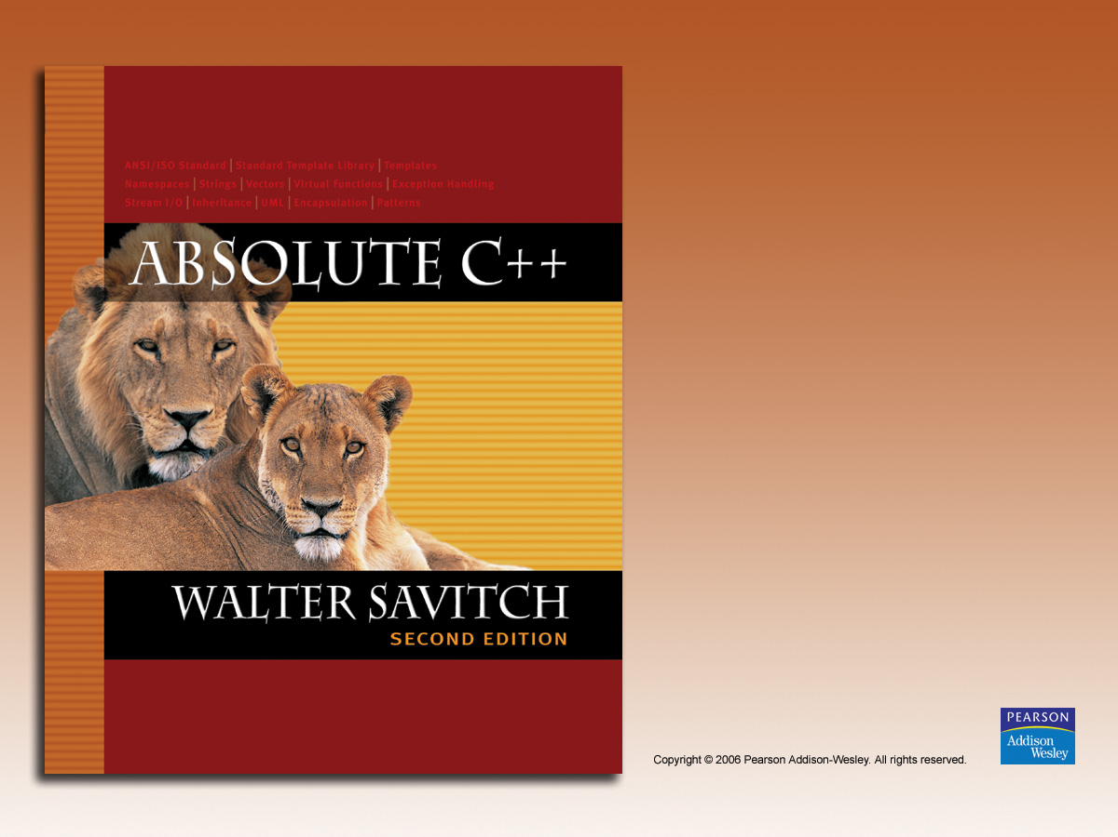
Chapter 19
Standard Template Library

Slide 2
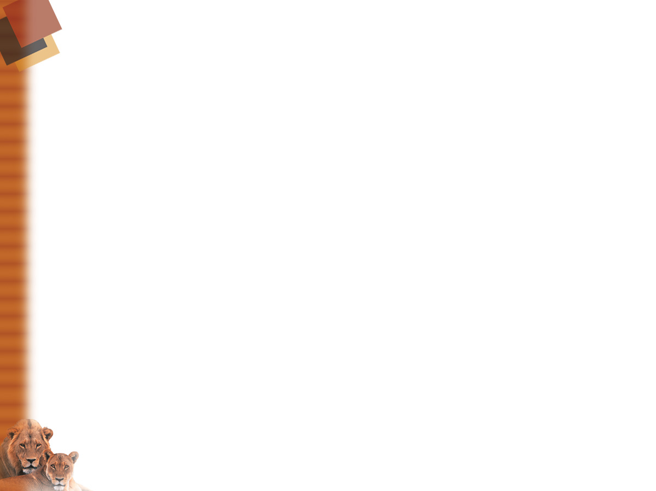
Learning Objectives
Iterators
  Constant and mutable iterators
  Reverse iterators
Containers
  Sequential containers
  Container adapters stack and queue
Generic Algorithms
  Big-O notation
  Sequence, set, and sorting algorithms

Slide 3
Introduction
Recall stack and queue data structures
  We created our own
  Large collection of standard data structures exists
  Make sense to have standard portable
  implementations of them!
Standard Template Library (STL)
  Includes libraries for all such data structures
    Like container classes: stacks and queues

Slide 4
Iterators
Recall: generalization of a pointer
  Typically even implemented with pointer!
"Abstraction" of iterators
  Designed to hide details of implementation
  Provide uniform interface across different
  container classes
Each container class has "own" iterator type
  Similar to how each data type has own
  pointer type

Slide 5
Manipulating Iterators
Recall using overloaded operators:
  ++, --, ==, !=
  *
    So if p is iterator variable, *p gives access to data
    pointed to by p
Vector template class
  Has all above overloads
  Also has members begin() and end()
  c.begin(); //Returns iterator for 1st item in c
  c.end(); //Returns "test" value for end

Slide 6
Cycling with Iterators
Recall cycling ability:
for (p=c.begin();p!=c.end();p++)
process *p //*p is current data item
Big picture so far…
Keep in mind:
  Each container type in STL has own iterator types
    Even though they’re all used similarly

Slide 7
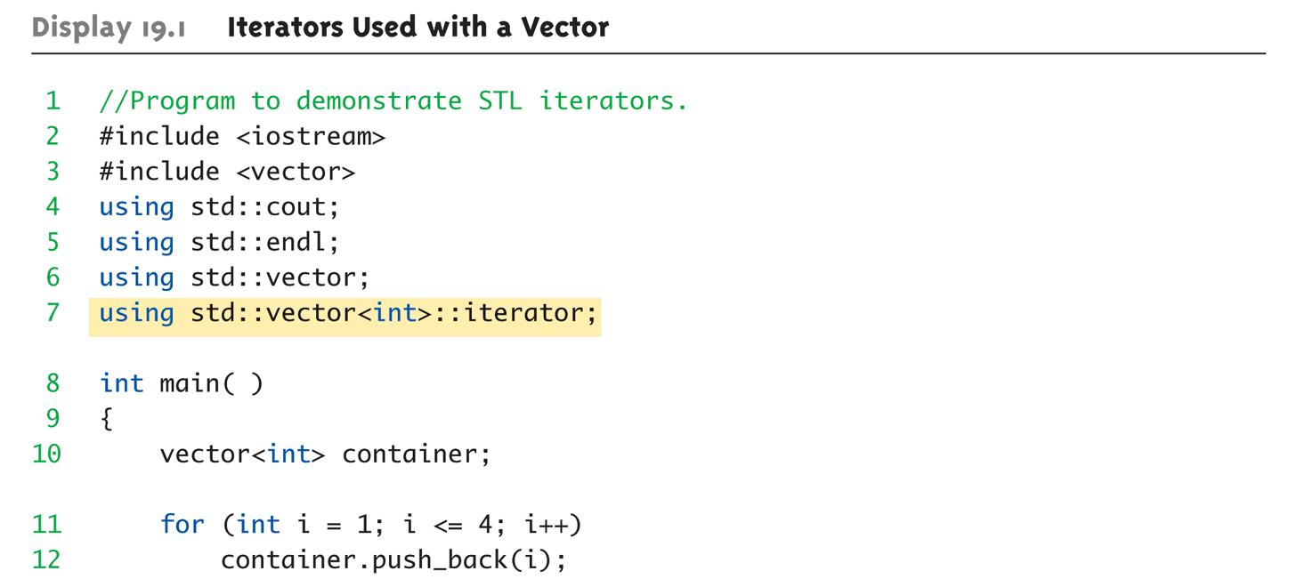
Display 19.1
Iterators Used with a Vector (1 of 2)

Slide 8
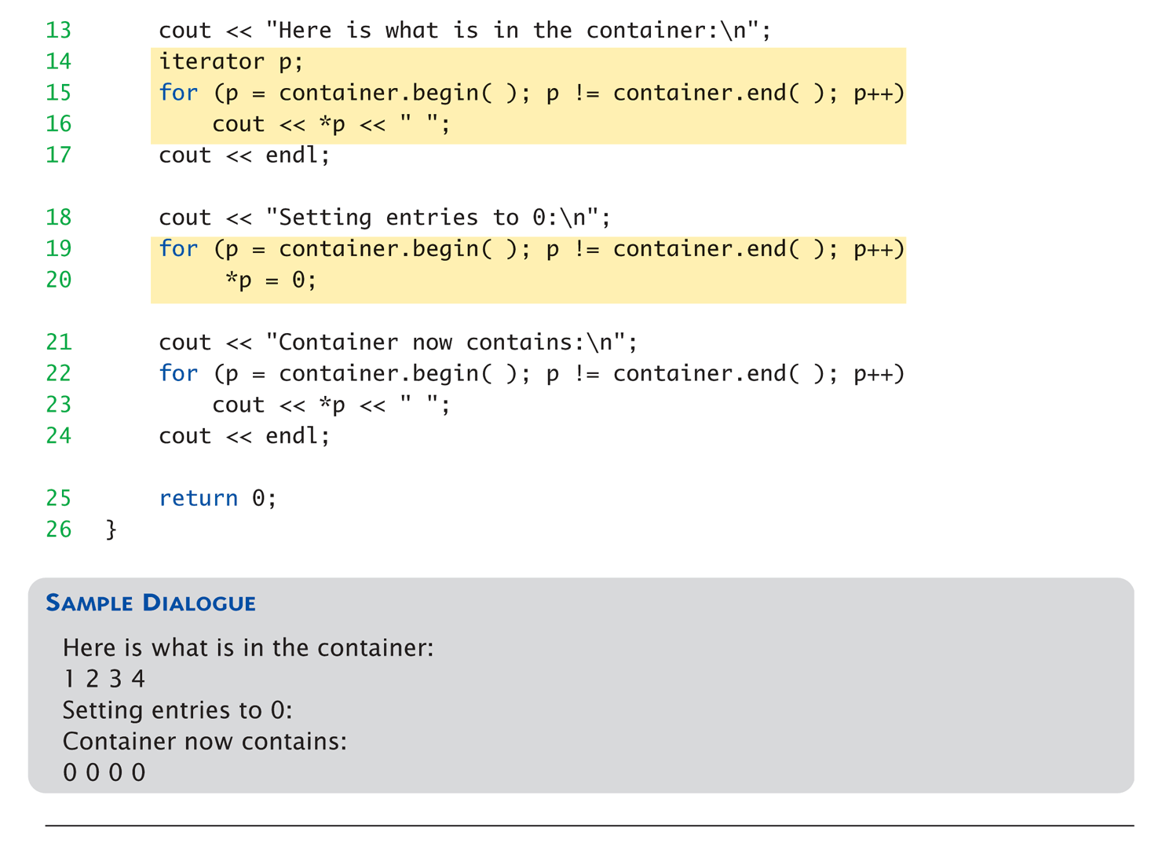
Display 19.1
Iterators Used with a Vector (2 of 2)

Slide 9
Vector Iterator Types
Iterators for vectors of ints are of type:
std::vector<int>::iterator
Iterators for lists of ints are of type:
std::list<int>::iterator
Vector is in std namespace, so need:
using std::vector<int>::iterator;

Slide 10
Kinds of Iterators
Different containers → different iterators
Vector iterators
  Most "general" form
  All operations work with vector iterators
  Vector container great for iterator examples

Slide 11
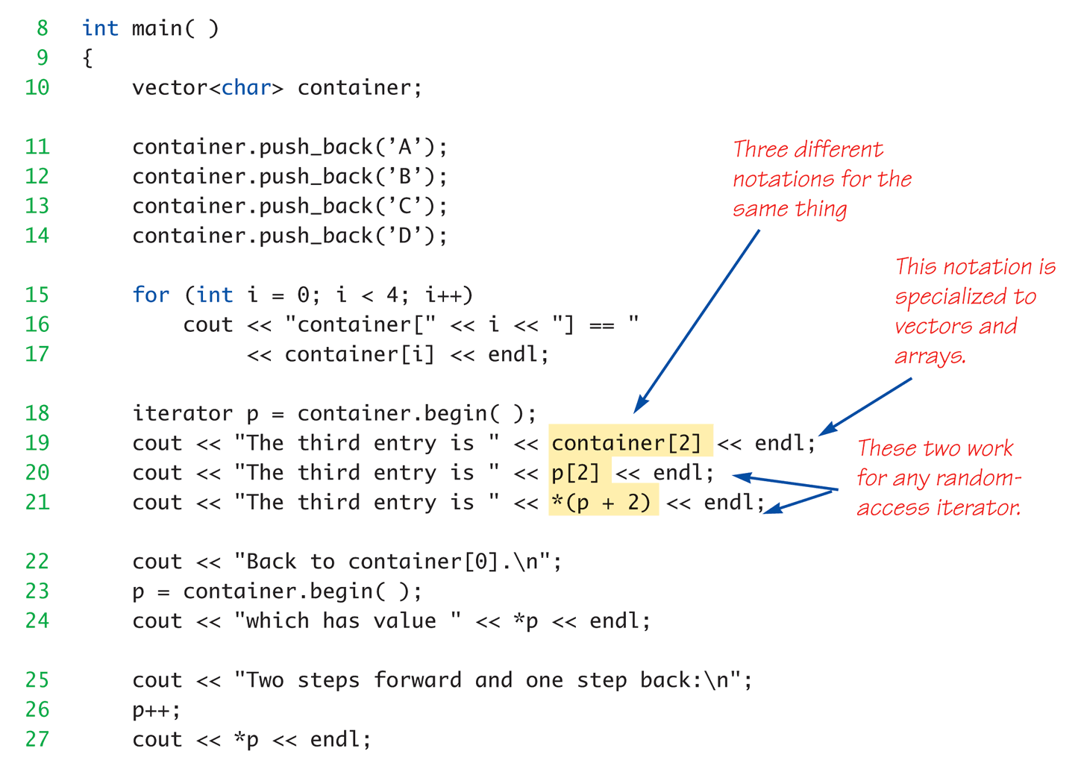
Random Access:
Display 19.2 Bidirectional and
Random-Access Iterator Use

Slide 12
Iterator Classifications
Forward iterators:
  ++ works on iterator
Bidirectional iterators:
  Both ++ and – work on iterator
Random-access iterators:
  ++, --, and random access all work
  with iterator
These are "kinds" of iterators, not types!

Slide 13
Constant and Mutable Iterators
Dereferencing operator’s behavior dictates
Constant iterator:
  * produces read-only version of element
  Can use *p to assign to variable or output,
  but cannot change element in container
    E.g., *p = <anything>; is illegal
Mutable iterator:
  *p can be assigned value
  Changes corresponding element in container
  i.e.: *p returns an lvalue

Slide 14
Reverse Iterators
To cycle elements in reverse order
  Requires container with bidirectional iterators
Might consider:
iterator p;
for (p=container.end();p!=container.begin(); p--)
cout << *p << " " ;
  But recall: end() is just "sentinel", begin() not!
  Might work on some systems, but not most

Slide 15
Reverse Iterators Correct
To correctly cycle elements in reverse
order:
reverse_iterator p;
for (rp=container.rbegin();rp!=container.rend(); rp++)
cout << *rp << " " ;
rbegin()
  Returns iterator at last element
rend()
  Returns sentinel "end" marker

Slide 16
Compiler Problems
Some compilers problematic with iterator
declarations
Consider our usage:
using std::vector<char>::iterator;
…
iterator p;
Alternatively:
std::vector<char>::iterator p;
And others…
  Try various forms if compiler problematic

Slide 17
Containers
Container classes in STL
  Different kinds of data structures
  Like lists, queues, stacks
Each is template class with parameter for particular data type to be stored
  e.g., Lists of ints, doubles or myClass types
Each has own iterators
  One might have bidirectional, another might just have forward iterators
But all operators and members have same meaning

Slide 18
Sequential Containers
Arranges list data
  1st element, next element, … to last element
Linked list is sequential container
  Earlier linked lists were "singly linked lists"
    One link per node
STL has no "singly linked list"
  Only "doubly linked list": template class list

Slide 19
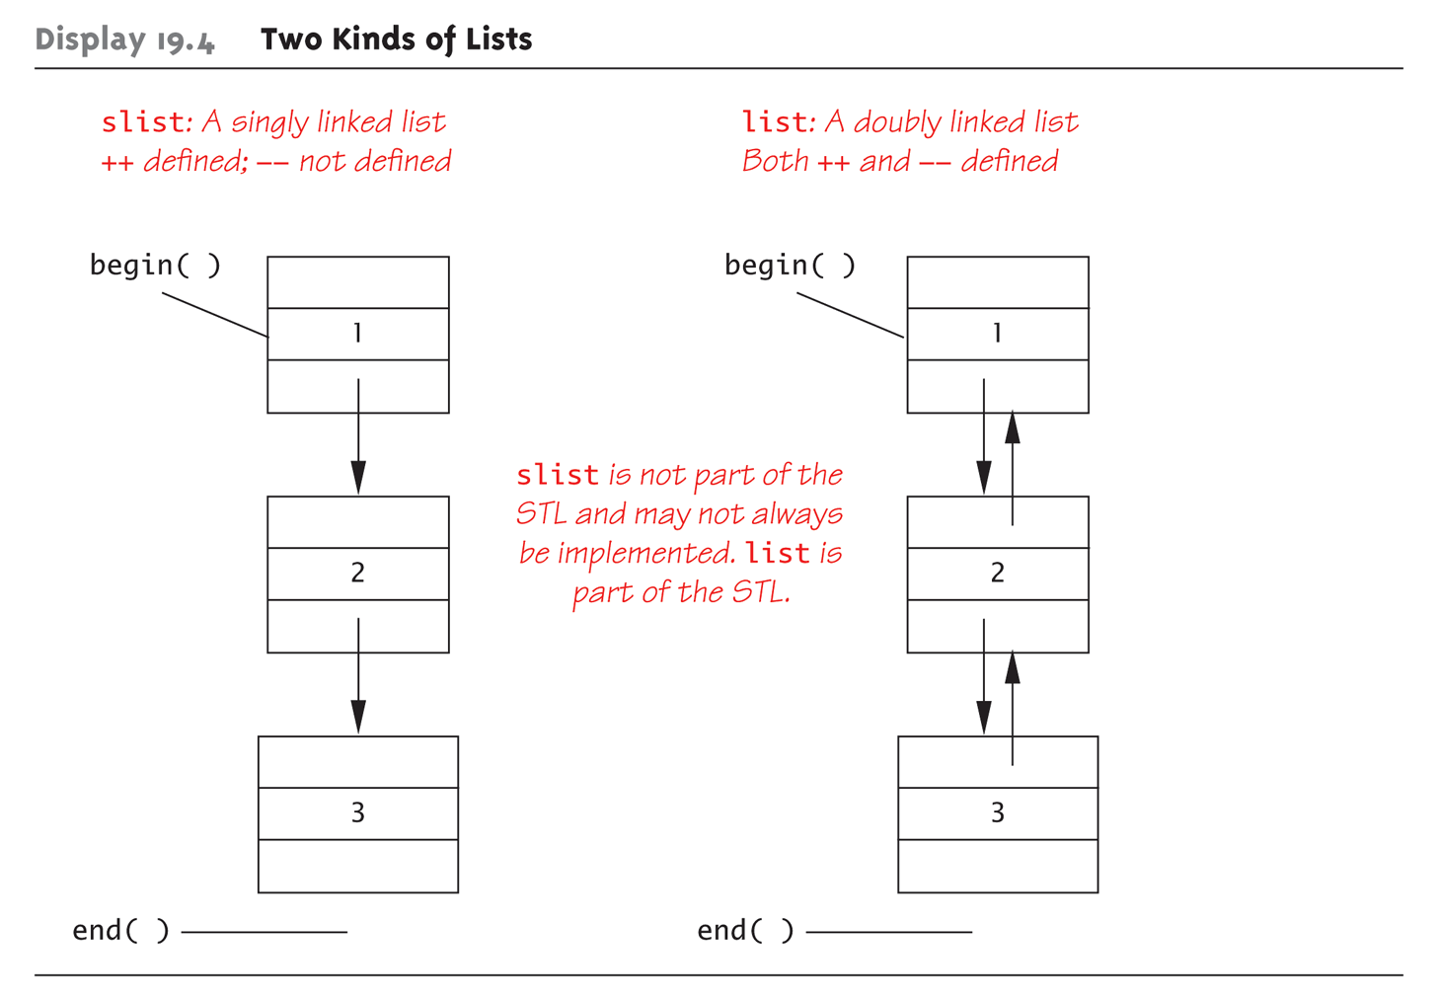
Display 19.4 Two Kinds of Lists

Slide 20
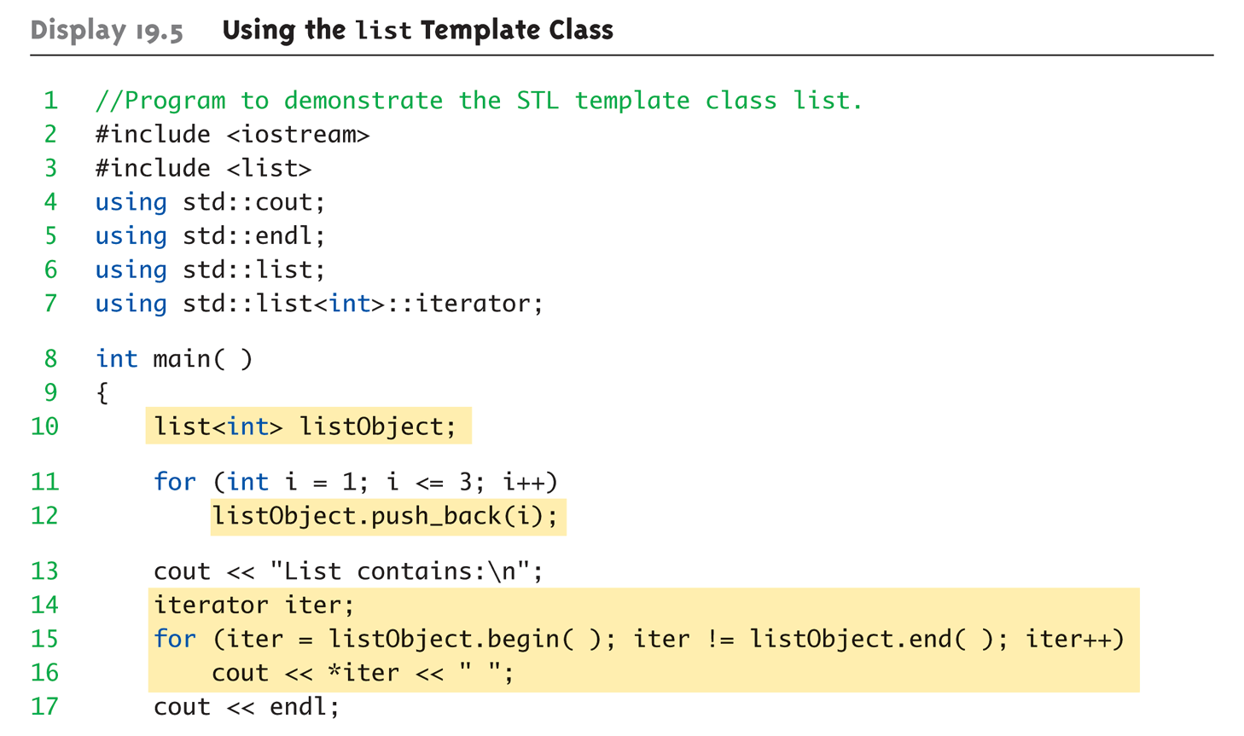
Display 19.5
Using the list Template Class(1 of 2)

Slide 21
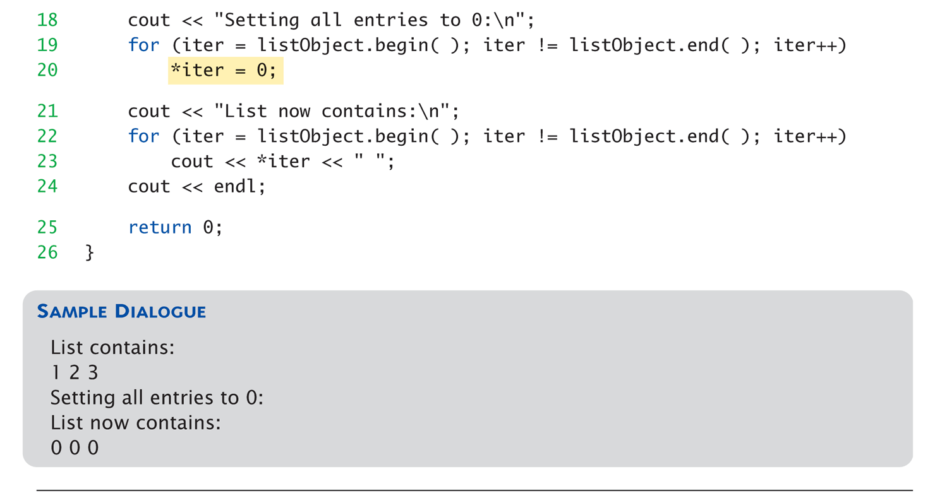
Display 19.5
Using the list Template Class(2 of 2)

Slide 22
Container Adapters stack and queue
Container adapters are template classes
  Implemented "on top of" other classes
Example:
stack template class by default implemented on
top of deque template class
  Buried in stack’s implementation is deque where all data resides
Others:
queue, priority_queue

Slide 23
Specifying Container Adapters
Adapter template classes have "default"
containers underneath
  But can specify different underlying container
  Examples:
  stack template class → any sequence container
  priority_queue → default is vector, could be others
Implementing Example:
stack<int, vector<int>>
  Makes vector underlying container for stack

Slide 24
Associative Containers
Associative container: simple database
Store data
  Each data item has key
Example:
data: employee’s record as struct
key: employee’s SSN
  Items retrieved based on key

Slide 25
set Template Class
Simplest container possible
Stores elements without repetition
1st insertion places element in set
Each element is own key
Capabilities:
  Add elements
  Delete elements
  Ask if element is in set

Slide 26
More set Template Class
Designed to be efficient
  Stores values in sorted order
  Can specify order:
  set<T, Ordering> s;
    Ordering is well-behaved ordering relation that
    returns bool
    None specified: use < relational operator

Slide 27
Map Template Class
A function given as set of ordered pairs
  For each value first, at most one value
  second in map
Example map declaration:
map<string, int> numberMap;
Stores in sorted order, like set
  Second value can have no ordering impact

Slide 28
Efficiency
STL designed with efficiency as
important consideration
  Strives to be optimally efficient
Example: set, map elements stored in
sorted order for fast searches
Template class member functions:
  Guaranteed maximum running time
  Called "Big-O" notation, an "efficiency"-rating

Slide 29
Generic Algorithms
Basic template functions
Recall algorithm definition:
  Set of instructions for performing a task
  Can be represented in any language
  Typically thought of in "pseudocode"
  Considered "abstraction" of code
    Gives important details, but not find code details
STL’s algorithms in template functions:
  Certain details provided only
    Therefore considered "generic algorithms"

Slide 30
Running Times
How fast is program?
  "Seconds"?
  Consider: large input? .. small input?
Produce "table"
  Based on input size
  Table called "function" in math
    With arguments and return values!
  Argument is input size:
  T(10), T(10,000), …
Function T is called "running time"

Slide 31
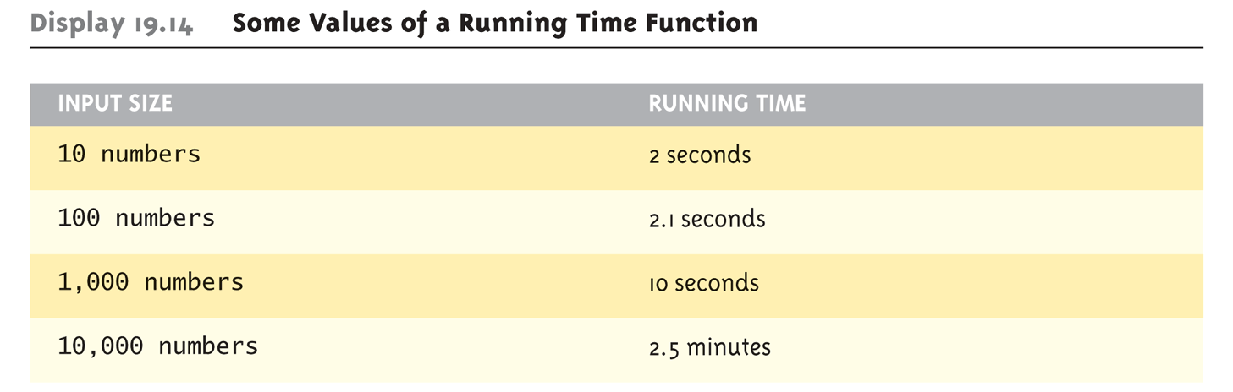
Table for Running Time Function:
Display 19.14 Some Values of a Running Time Function

Slide 32
Consider Sorting Program
Faster on smaller input set?
  Perhaps
  Might depend on "state" of set
    "Mostly" sorted already?
Consider worst-case running time
  T(N) is time taken by "hardest" list
    List that takes longest to sort

Slide 33
Counting Operations
T(N) given by formula, such as:
T(N) = 5N + 5
  "On inputs of size N program runs for
  5N + 5 time units"
Must be "computer-independent"
  Doesn’t matter how "fast" computers are
  Can’t count "time"
  Instead count "operations"

Slide 34
Counting Operations Example
int I = 0;
bool found = false;
while (( I < N) && !found)
if (a[I] == target)
found = true;
else
I++;
5 operations per loop iteration:
<, &&, !, [ ], ==, ++
After N iterations, final three: <, &&, !
So: 6N+5 operations when target not found

Slide 35
Big-O Notation
Recall: 6N+5 operations in "worst-case"
Expressed in "Big-O" notation
  Some constant "c" factor where
  c(6N+5) is actual running time
    c different on different systems
  We say code runs in time O(6N+5)
  But typically only consider "highest term"
    Term with highest exponent
  O(N) here

Slide 36
Big-O Terminology
Linear running time:
  O(N)—directly proportional to input size N
Quadratic running time:
  O(N²)
Logarithmic running time:
  O(log N)
    Typically "log base 2"
    Very fast algorithms!

Slide 37
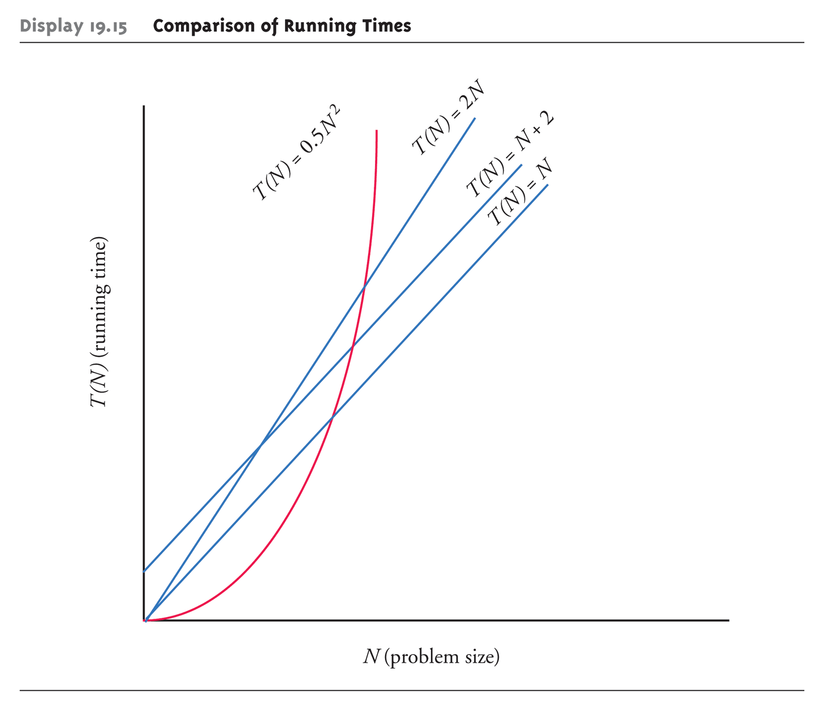
Display 19.15
Comparison of Running Times

Slide 38
Container Access Running Times
O(1) - constant operation always:
  Vector inserts to front or back
  deque inserts
  list inserts
O(N)
  Insert or delete of arbitrary element in vector
  or deque (N is number of elements)
O(log N)
  set or map finding

Slide 39
Nonmodifying Sequence Algorithms
Template functions operating
on containers
  NO modification of container contents
Generic find function
  Typical example
  Can be used with any STL sequence
  container class

Slide 40
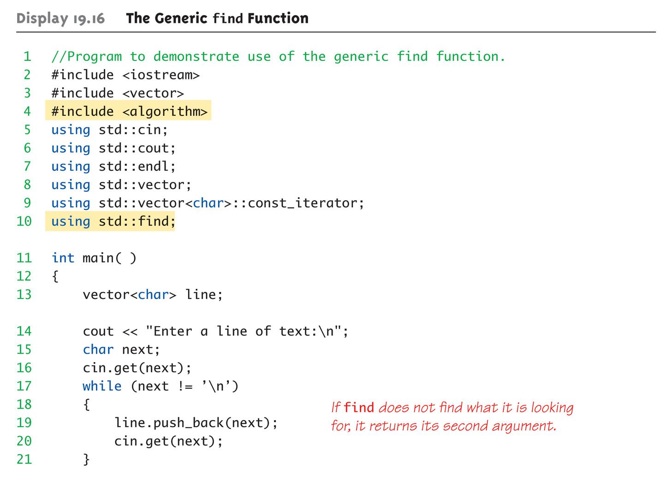
Display 19.16
The Generic find Function (1 of 3)

Slide 41
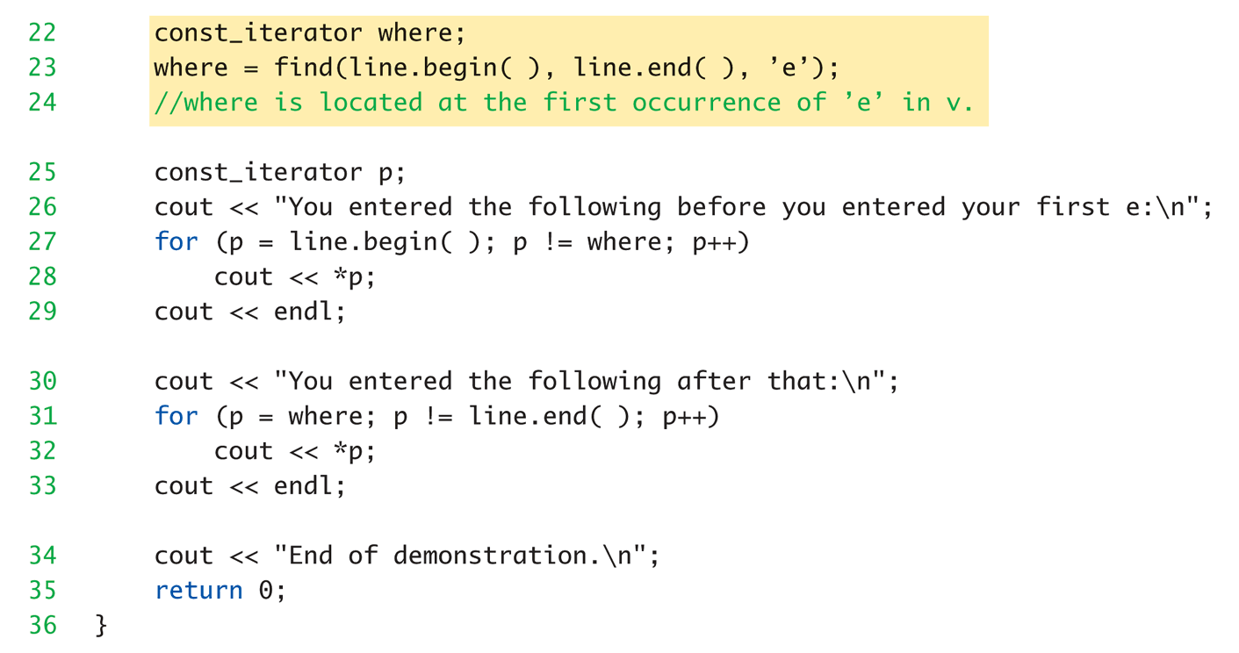
Display 19.16
The Generic find Function (2 of 3)

Slide 42
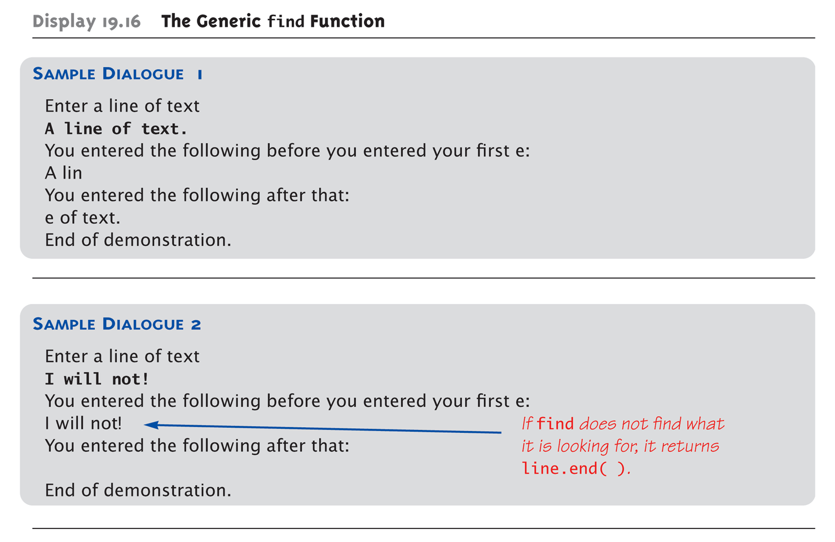
Display 19.16
The Generic find Function (3 of 3)

Slide 43
Modifying Sequence Algorithms
STL functions that change
container contents
Recall: adding/removing elements from
containers can affect other iterators!
  list, slist guarantee no iterator changes
  vector, deque make NO such guarantee
Always watch which iterators are
assured to be changed/unchanged

Slide 44
Set Algorithms
STL generic set operation functions
All assume containers stored in
sorted order
Containers set, map, multiset, multimap
  DO store in sorted order, so all set functions apply
Others, like vector, are not sorted
  Should not use set functions

Slide 45
Sorting Algorithms
STL contains two template functions:
  sort range of elements
  merge two sorted ranges of elements
Guaranteed running time O(N log N)
  No sort can be faster
  Function guarantees fastest possible sort

Slide 46
Summary 1
Iterator is "generalization" of a pointer
  Used to move through elements of container
Container classes with iterators have:
  Member functions end() and begin() to
  assist cycling
Main kinds of iterators:
  Forward, bi-directional, random-access
Given constant iterator p, *p is read-only version of element

Slide 47
Summary 2
Given mutable iterator p → *p can be assigned value
Bidirectional container has reverse iterators allowing reverse cycling
Main STL containers: list, vector, deque
  stack, queue: container adapter classes
set, map, multiset, multimap containers store in sorted order
STL implements generic algorithms
  Provide maximum running time guarantees

